Slide 1
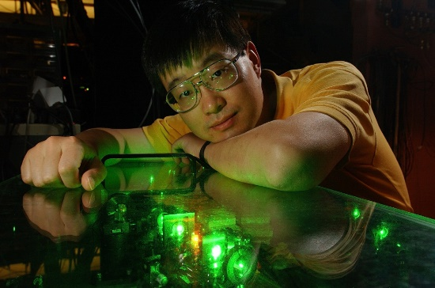
[ Luke Caldwell]
[Kia Boon Ng]
[Tanya Roussy]
[Trevor Wright]
Rohan Kompella
Anzhou Wang
Sun Yool Park
Patricia Hector Hernandez
Addison Hartman
Jun Ye
Eric Cornell
Past Group Members
Laura Sinclair, Will Cairncross
Kang-Kuen Ni, Noah Schlossberger
Kevin Cossel, Tanya Roussy, Trevor Wright
Russ Stutz, Tanner Grogan, Yuval Shagam
Aaron Leanhardt, Kia Boon Ng
Yiqi Ni, Gustavo Santaella, Antonio Vigil
Huanqian Loh, Luke Caldwell
Matt Grau, Ben Hunt, Yan Zhou
Fatemeh Abbasi-Razgaleh, Jeff Meyers, Dan Gresh
Where AMO meets Nuclear meets Particle: quantum state prep and read-out in molecules and the search for CP-violating physics
Local theory: John Bohn
Non local Theory: Bob Field, Lan Cheng
Still Less Local Theory
St. Petersburg quantum chemistry group. Timo Fleig…
Thanks: NSF/PFC, NIST,
and Marsico Foundation
Sloan and Moore
Foundations
AFOSR

Slide 2
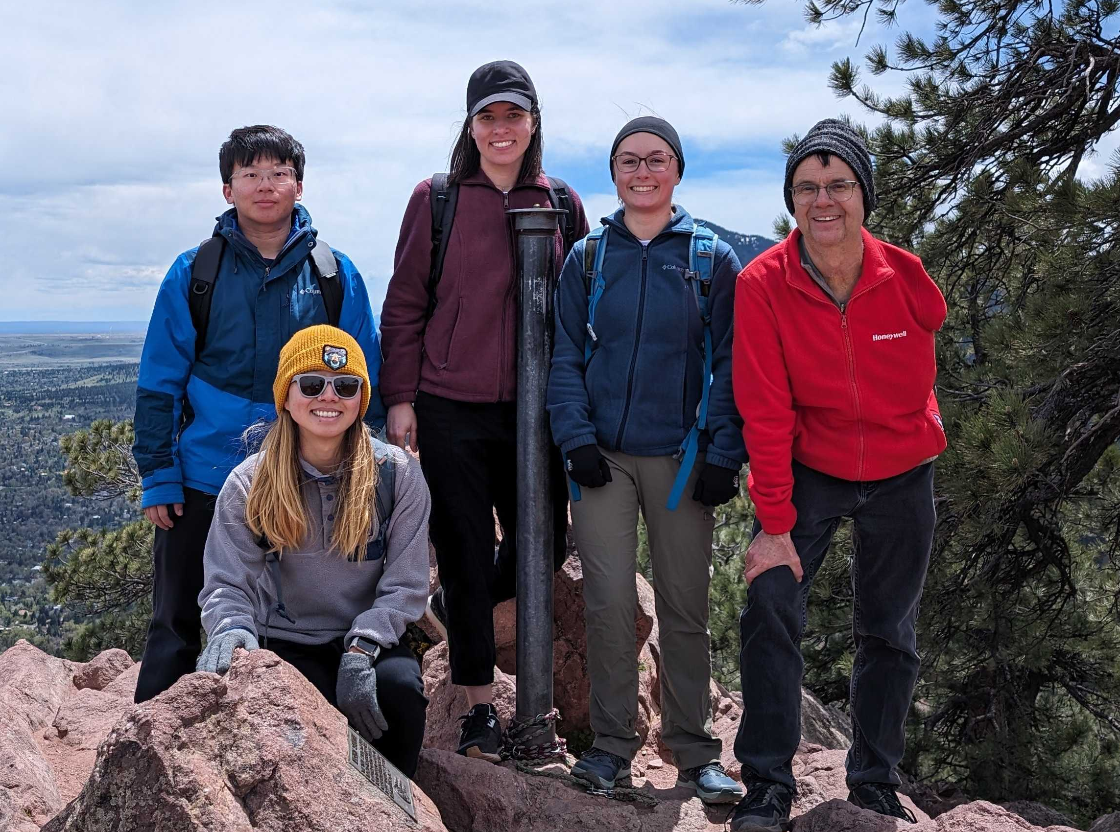
Patricia Hernandez
Addison Hartman
Anzhou Wang
Sunyool Park
Jun Ye
+ Rohan Kompella

Slide 3
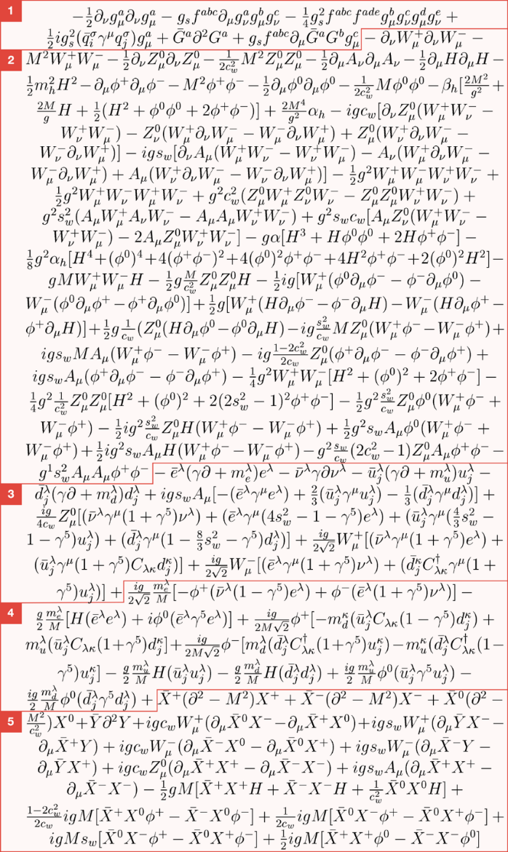
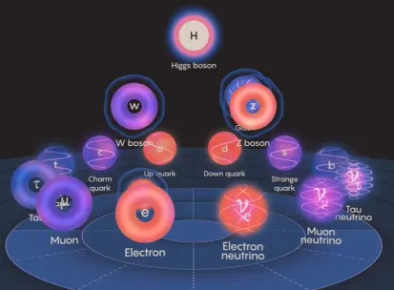
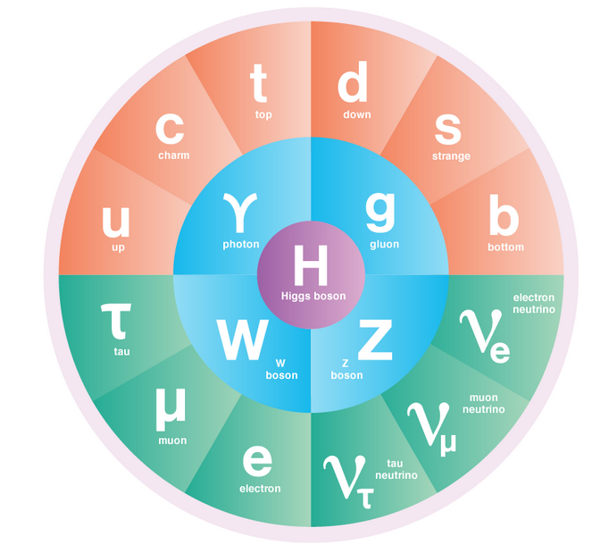
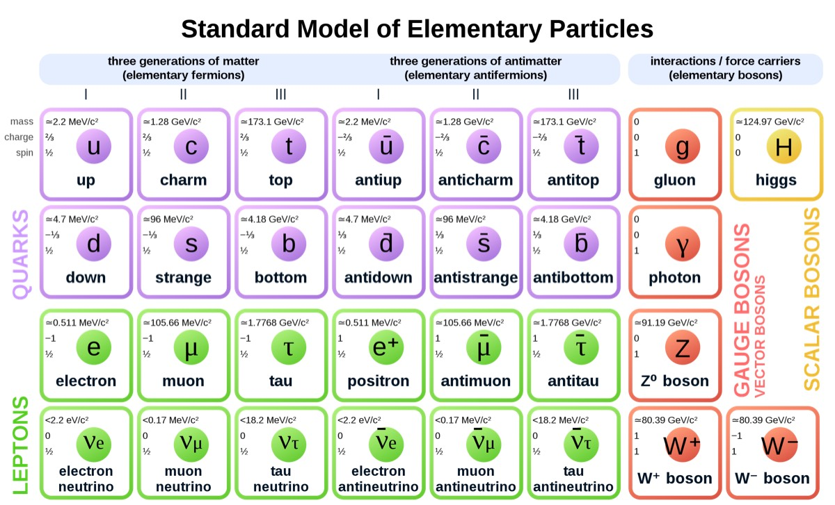
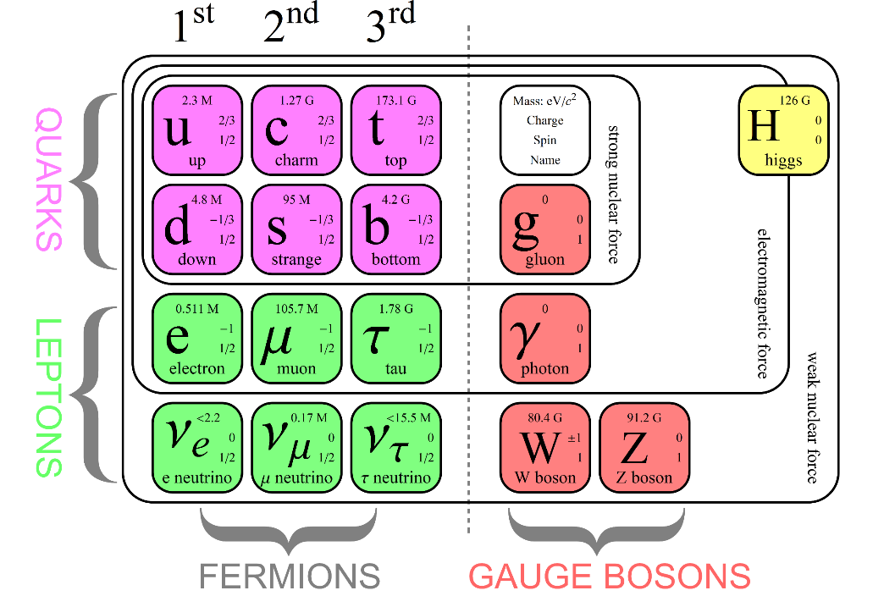
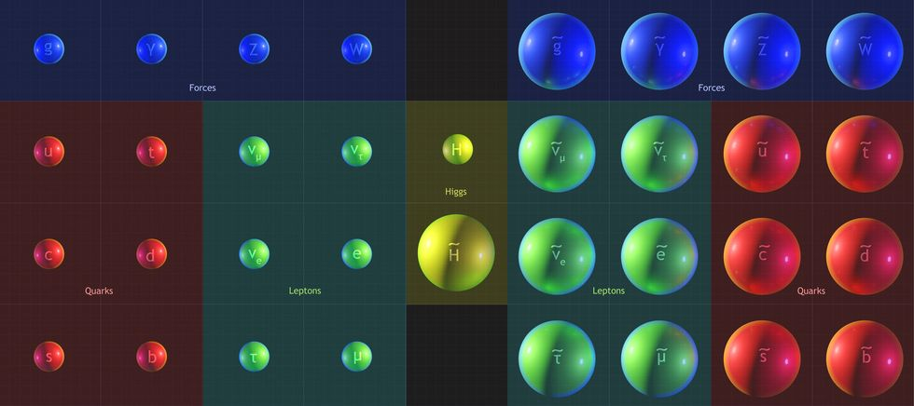
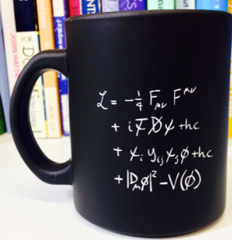

Slide 4
(Some) particles of the Standard Model (plot not to scale)
Particle
Mass
t
c
u
τ
μ
e
ν
γ
g
G
Interactions strength
with SM particles

Slide 5
Particle
Mass
Too phat
Too both
t
Too sly
WHERE are particles beyond the Standard Model (BSM) hiding?
c
u
τ
μ
e
ν
γ
g
G
Interactions strength
with SM particles

Slide 6
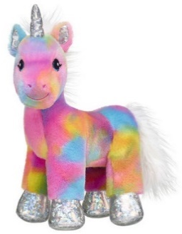
Particle
Mass
Too phat
Too both
WIMP
Searches
t
Too sly
HOW can we find them?
King plots. “Fifth force”. “Weird gravity.” axion cavities, time-varying “constants.” Generically, “Dark Matter searches”.
c
u
τ
μ
e
ν
γ
g
G
Interactions strength
with SM particles

Slide 7
Particle
Mass
Too phat
Too both
xxxxxx Not created in collider xxxx
xxxxxxxxxxxxxxxxxxxxxxxxxxxxxxxx
t
Too sly
This direct approach
“puts constraints on”
M < ~2 TeV*
*Model-dependent
exclusion line
has some slope in this
plot…
c
u
τ
μ
e
ν
γ
g
G
Interactions strength
with SM particles

Slide 8
Particle
Mass
Dipole Moments Searches
Too phat
Too both
What should the next-
generation of collider look like?
A decision that will set the direction of HEP for many decades.
Can we collect data in the short- term to inform these decisions?
xxxxxx Not created in collider xxxx
xxxxxxxxxxxxxxxxxxxxxxxxxxxxxxxx
t
Too sly
c
u
τ
μ
e
ν
γ
g
G
Interactions strength
with SM particles

Slide 9
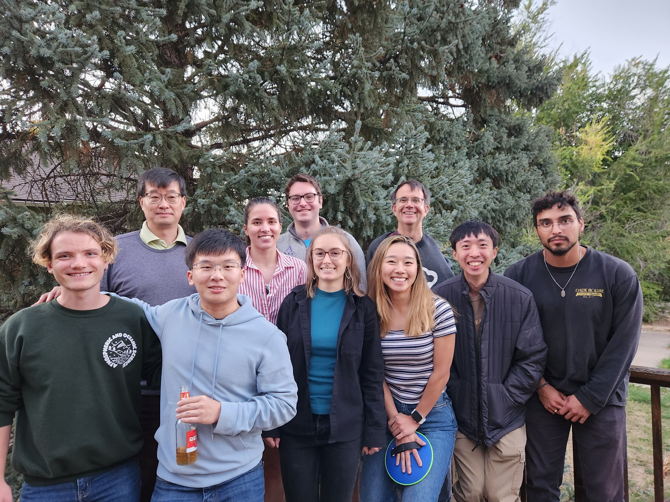
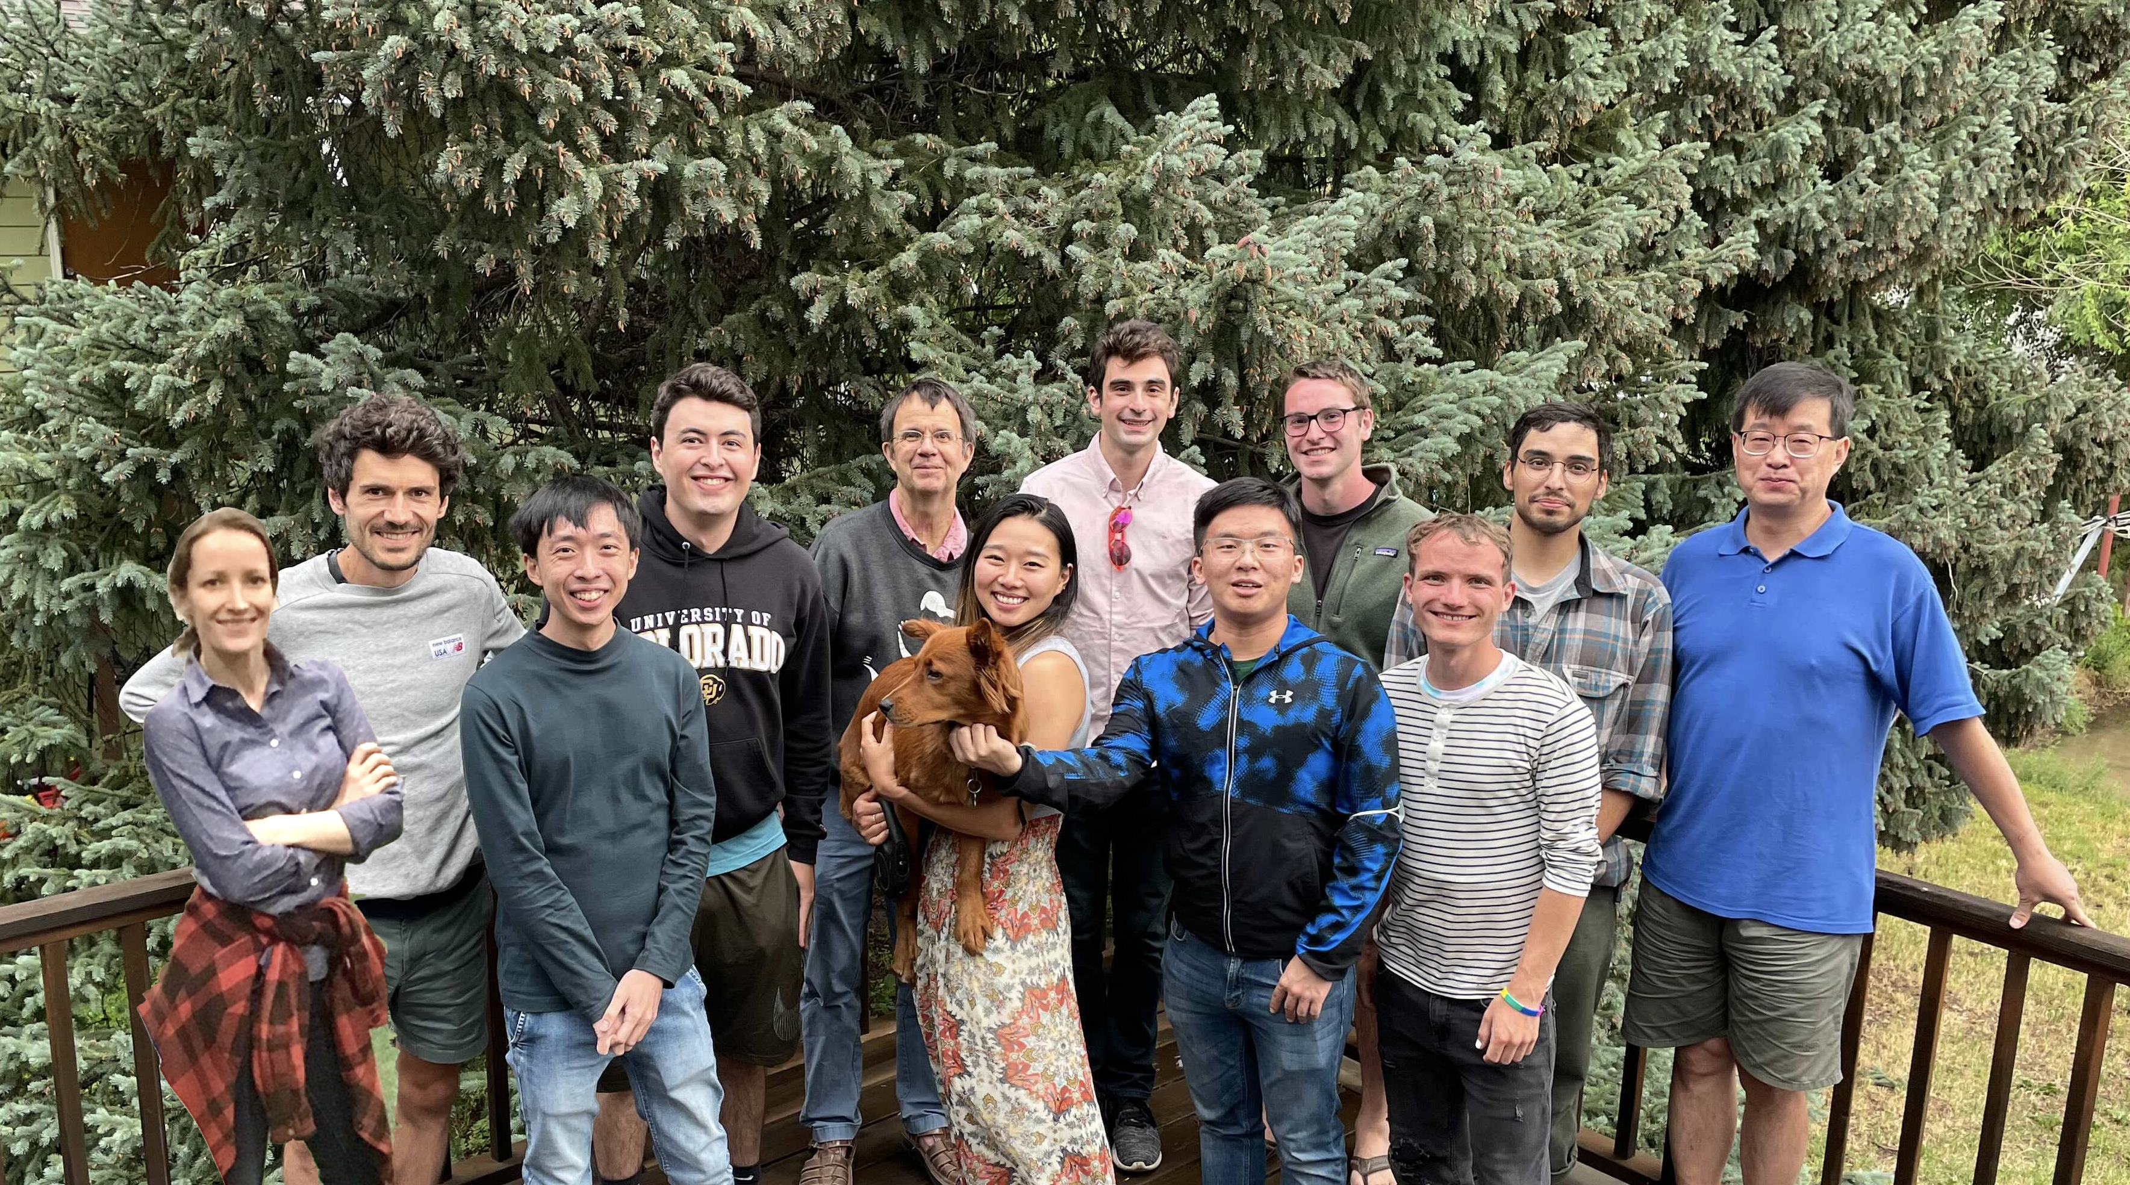
Jun Ye

Slide 10
Particle
Mass
Too phat
Too both
WIMP
Searches
This talk.
Ronald Garcia Ruiz
t
Too sly
IF they exist at all HOW can we find them?
King plots. “Fifth force”. “Weird gravity.” axion cavities, time-varying “constants.” Generically, “Dark Matter searches”.
Piet Schmidt
Claudio Cesar
Tanja Mehlstaubler
Marianna Safronova
Takumi Kobayashi
Yoshiro Takahashi
Johannes Tiedau
Tanya Zelevinsky
c
u
τ
μ
e
ν
γ
g
G
Interactions strength
with SM particles

Slide 11

Q: Why is your talk only about lepton EDMs and MDMs (recall, “g-2” means “MDM”) ? Why not hadrons, nuclei etc?
A:
There have been three new lepton moment experimental results in two years. Leptons are having a moment!
lepton
moment
result
SM value

Slide 12
Q: Why is your talk only about lepton EDMs and MDMs (recall, “g-2” means “MDM”) ? Why not hadrons, nuclei etc?
A:
There have been three new lepton moment experimental results in two years. Leptons are having a moment!
And what would one compare e.g. a precise measurement of proton MDM to?
B
SM=?

Slide 13
Q: Why is your talk only about lepton EDMs and MDMs (recall, “g-2” means “MDM”) ? Why not hadrons, nuclei etc?
A:
There have been three new lepton moment experimental results in two years. Leptons are having a moment!
And what would one compare e.g. a precise measurement of proton MDM to?
But EDM measurements of composite objects (which we compare to “almost zero”) have big promise for discovery.
See Garcia Ruiz talk, next!
E
SM=0!

Slide 14
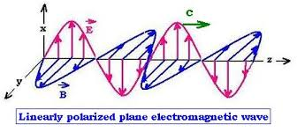
Quick digression on dipole-moment units
The hidden shame of Système International.
E&M wave in a vacuum: |E|=|B|
Dimensions [E] = [B] = [force/charge]
= [(energy/charge)/distance] e.g., volts/cm
Dimensions [ E . d] = [ B . μ ] = [energy] or [frequency]
Dimensions of [d] = [μ] = [charge * distance] e.g. e-cm
So, for instance, 1 μ_{B} = 1.9 x 10⁻¹¹ e-cm
and 1 Tesla = 3 x 10⁶ V-cm

Slide 15
How to measure MDM, or EDM?
s
++
P
2d_{e}E
--
B
E
E
Radio-frequency
photon
s
μB
ν_{rf}
++
--

Slide 16
E
Figure-of-merit:
What makes a good EDM
experiment?
B
E
2d_{e}E
1/t
Big Electric or
Magnetic Field!
Long Coherence
Time (narrow
resonances)!
Large count rate
(split resonance
by )
Combined
Figure-of-merit:
P
2μ_{e}B
(Field) τ
μB
ν_{rf}

Slide 17
N
S
+++++++
If electron EDM exists
at all, it is very small.
We must apply a
VERY large
electric field.
Two problems!
-
-
An electron with,
maybe!
electric dipole
moment (EDM)
+
--------
N
S

Slide 18
N
S
+++++++
If electron EDM exists
at all, it is very small.
We must apply a
VERY large
electric field.
Two problems!
-
-
Problem 1:
Lightning!
Spark!
(If electric field
is too big.)
+
--------
N
S

Slide 19
N
S
+++++++
If electron EDM exists
at all, it is very small.
We must apply a
VERY large
electric field.
Two problems!
Problem 2:
Electron gets
pulled away by
electric field.
-
-
+
--------
N
S

Slide 20
Q: Where in nature can we find a REALLY STRONG electric field?

Slide 21
Q: Where in nature can we find a REALLY STRONG electric field?
A: Inside a molecule!
Example: NaCl (Sodium Chloride). Plain salt.
Na⁺
Cl⁻
e

Slide 22
Q: Where in nature can we find a REALLY STRONG electric field?
A: Inside a molecule!
Example: NaCl (Sodium Chloride). Plain salt.
Hf⁺⁺
Na⁺
Cl⁻
Fl⁻
e
e
Our approach: We use HfF⁺
“Hafnium Fluoride plus”
and more recently ThF⁺

Slide 23
Combined Figure-of-merit:
(Field) τ
recall 1T
= 3x10⁶ V/cm
recall 1 μ_{B} = 2x10¹¹ e-cm
Field
Strength
[10⁷ V/cm]
~2
~2
2000
5000
coherence
time τ
[ms]
5000
0.2
3000
3
count
rate
[s⁻¹]
1/τ * duty cycle = 0.02
1000s ?
200 / τ = 60
many * 10⁶
one-sigma accuracy on
dipole moment,
[10 ⁻³⁰ e-cm ]
2 x 10⁻²⁴
5x10⁻²³
2x 10⁻³⁰
4x10⁻³⁰
Experiment
eMDM
“g_{e} – 2”
μMDM
“g_{μ}-2”
JILA
eEDM
ACME
eEDM
trapped “ion”
“ions” in beam
ion trapped Molecules
neutral Molecules in beam

Slide 24
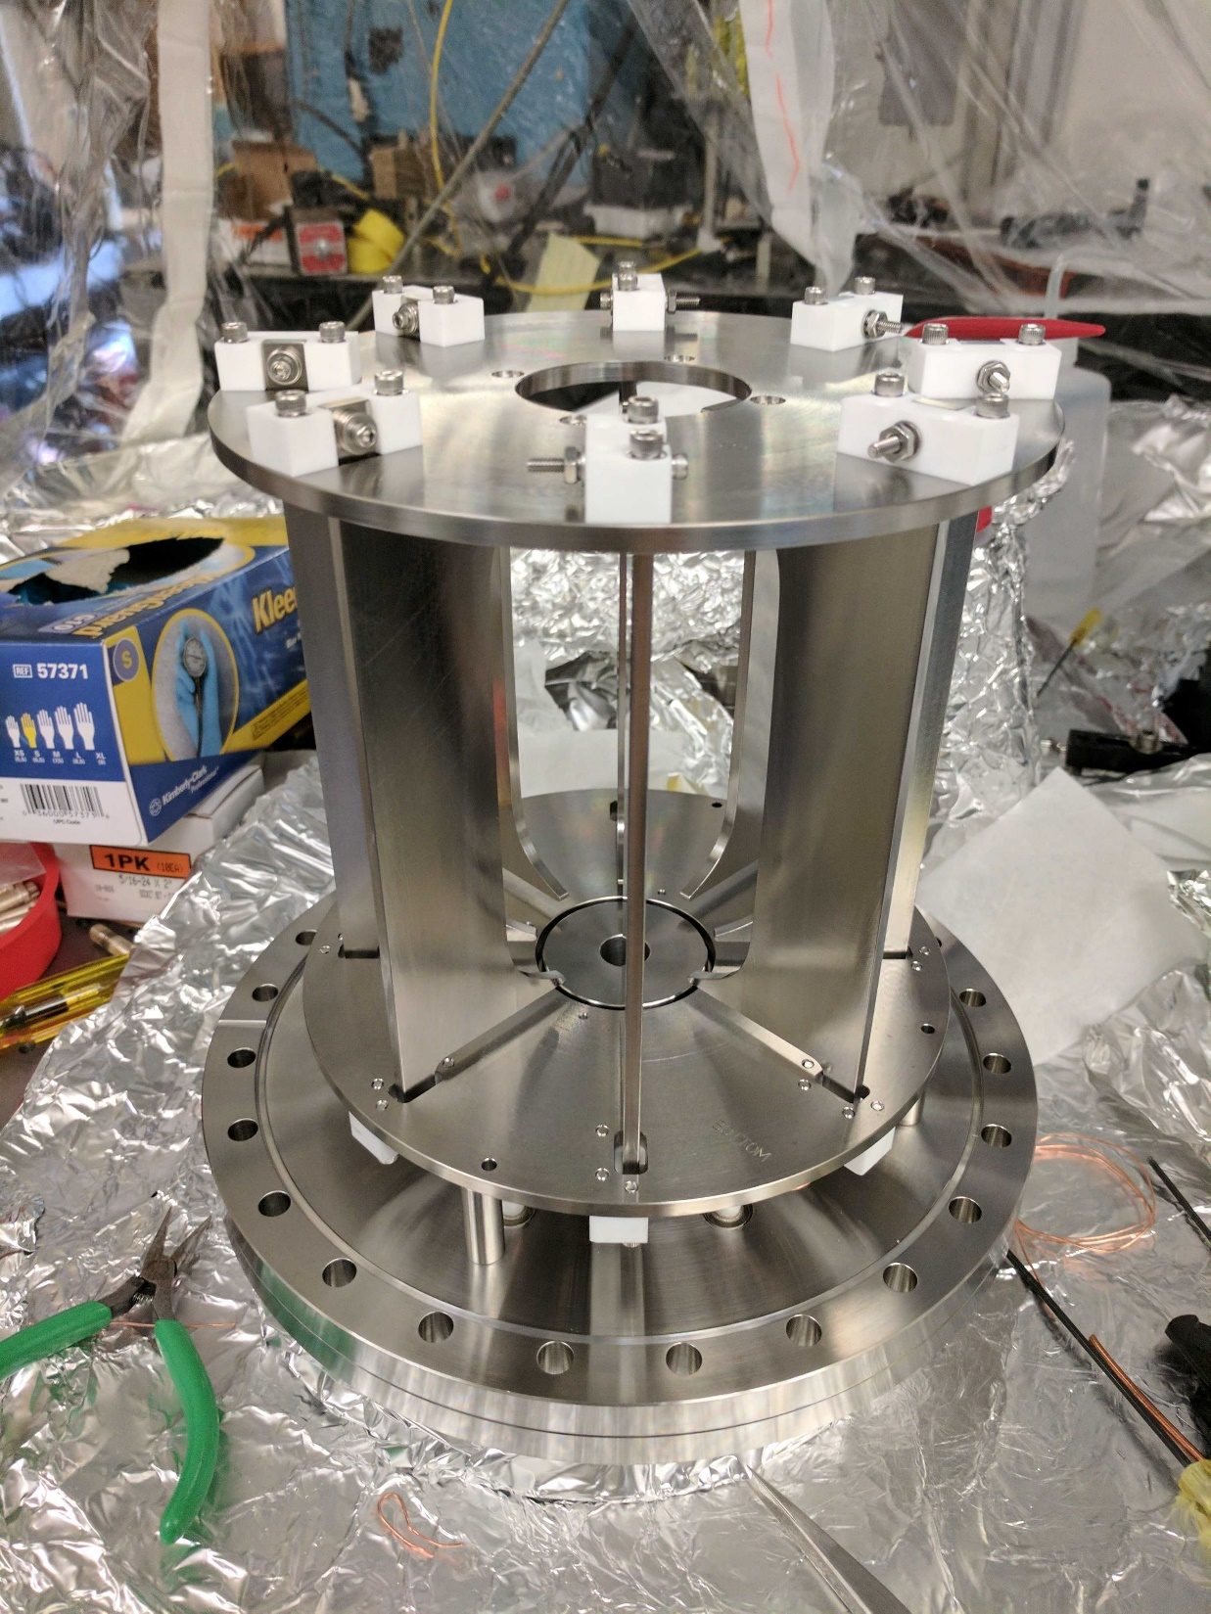
Our approach. 2. Long coherence
time.
Solution: Use a trap!!
Specifically, an ion trap.

Slide 25
Our approach. 3. We want big count
rate (= many ions in the trap!)
Solution: Use a really BIG ion trap!!
(Electrodes spaced by centimeters,
not microns)
In one shot we trap 1000s of ions, and count 100s of ions on the side of a Ramsey fringe.

Slide 26
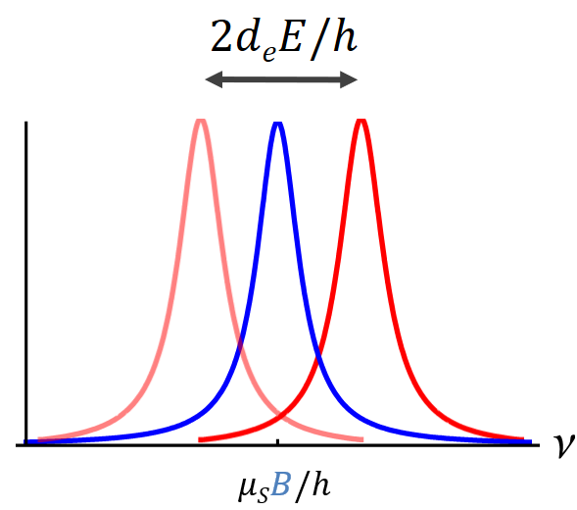
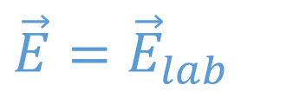

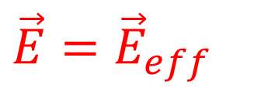
Molecular Alignment
$$\vec{E}={\vec{E}}_{lab}$$
$$\vec{E}={\vec{E}}_{eff}$$
$$\vec{B}={\vec{B}}_{lab}$$

Slide 27
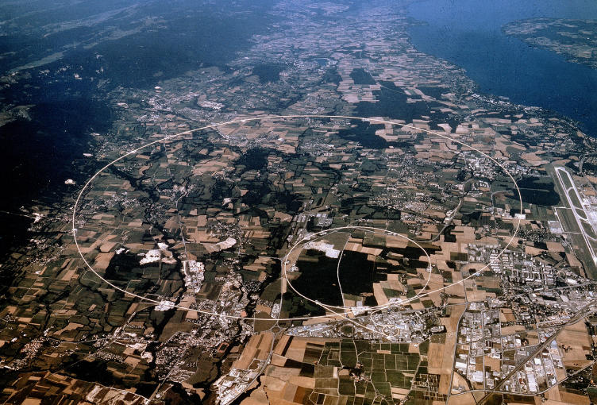
Q: How do you apply
an electric bias field to an ion?
A: In a heavy-ion storage ring!
E
v
E

Slide 28
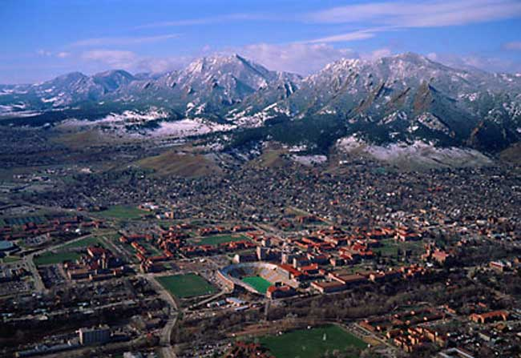

Slide 29
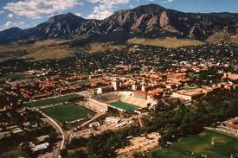

Slide 31
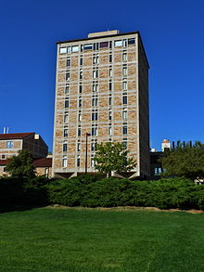

Slide 32
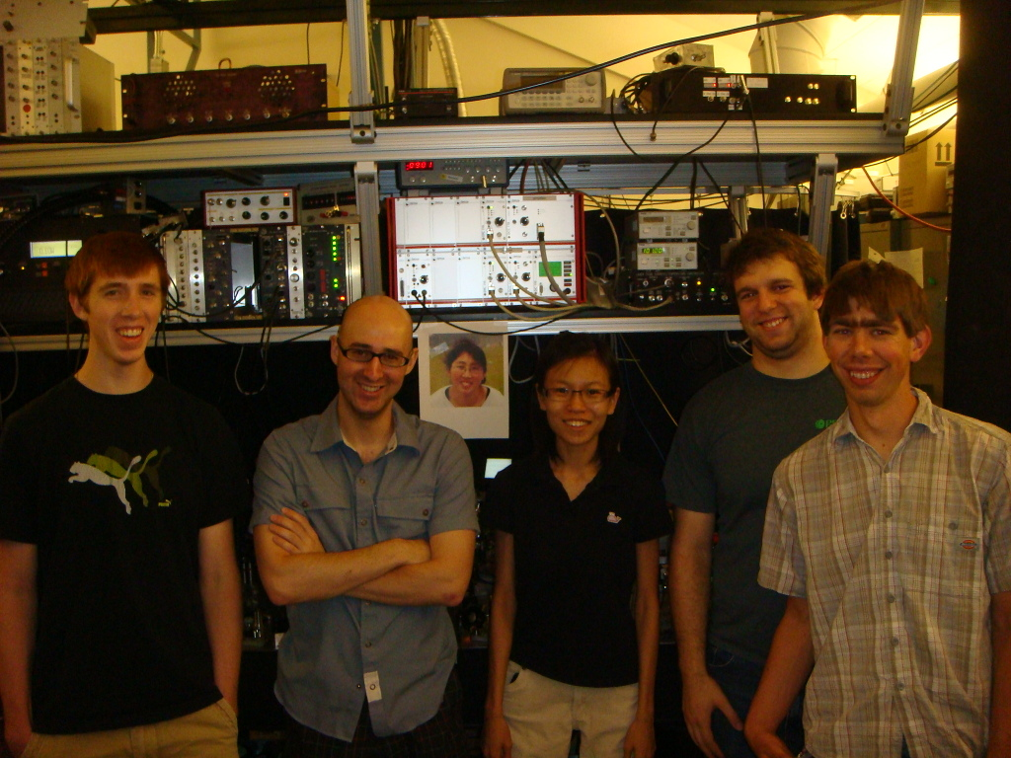

JILA Heavy-Ion Storage Ring, to Scale

Slide 33
JILA Heavy-Ion Storage Ring, to Scale

Slide 34
JILA Heavy-Ion Storage Ring, to Scale

Slide 35
Q: How do you apply
an electric bias field to an ion?

Slide 36

Rotating Electric Field
Solution! Rotate the electric field
Hf⁺
F
$$E$$

Slide 37
!!!!!Use rotating E-field bias!!!!!
-E-field defines quantization axis
-Excellent rejection of lab-frame residual
B-field.
ω_{rot} is:
BIG enough that radius
of “micromotion” circle
is small compared to
trap size.
SMALL enough so that
d_{mol} E >> ω_{rot} and the
molecule axis stays
aligned with E.
+
ω_{rot}t
E
+
+
+
One does Zeeman-level
spectroscopy then
in the rotating frame.
Leanhardt et al, J. Mol. Spec.
(2011) [25 typeset pages]

Slide 39


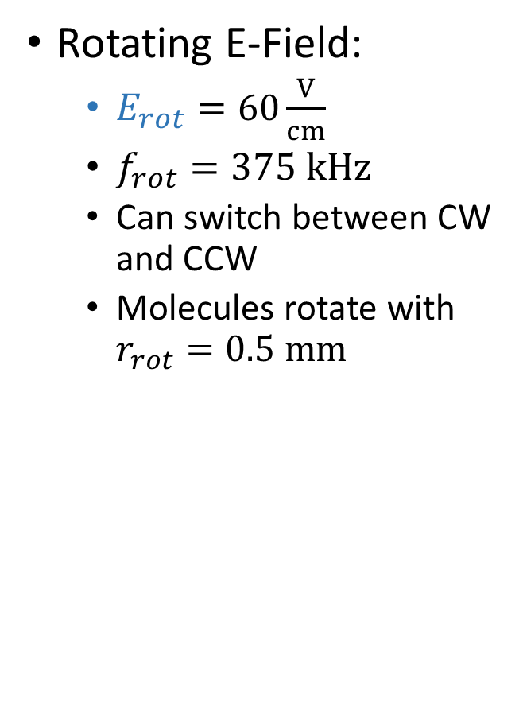
Rotating Fields
y
Rotating E-Field:
  $E_{rot}=60\frac{V}{cm}$
  $f_{rot}=375 kHz$
  Can switch between CW and CCW
  Molecules rotate with $r_{rot}=0.5 mm$
$${\vec{E}}_{rot}$$
x
Notes:
Brot is typically 10 mG

Slide 40
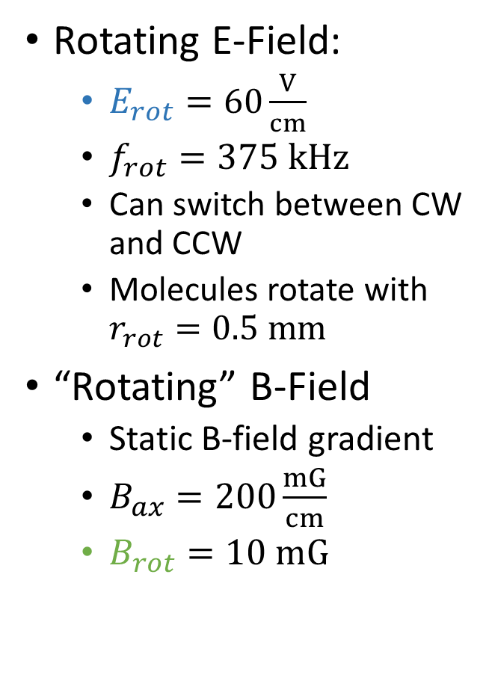

Rotating Fields
y
Rotating E-Field:
  $E_{rot}=60\frac{V}{cm}$
  $f_{rot}=375 kHz$
  Can switch between CW and CCW
  Molecules rotate with $r_{rot}=0.5 mm$
“Rotating” B-Field
  Static B-field gradient
  $B_{ax}=200\frac{mG}{cm}$
  $B_{rot}=10 mG$
$${\vec{E}}_{rot}$$
${\vec{B}}_{rot}$
x
/ SR
Ions travel in 1 mm circle, VVN-RHIC
Notes:
Brot is typically 10 mG

Slide 41
Combined Figure-of-merit:
(Field) τ
recall 1T
= 3x10⁶ V/cm
recall 1 μ_{B} = 2x10¹¹ e-cm
Field
Strength
[10⁷ V/cm]
~2
~2
2000
7000
coherence
time τ
[ms]
5000
0.2
3000
3
count
rate
[s⁻¹]
1/τ * duty cycle = 0.02
1000s ?
200 / τ = 60
many * 10⁶
one-sigma accuracy on
dipole moment,
[10 ⁻³⁰ e-cm ]
2 x 10⁻²⁴
5x10⁻²³
2x 10⁻³⁰
4x10⁻³⁰
Experiment
eMDM
“g_{e} – 2”
μMDM
“g_{μ}-2”
JILA
eEDM
ACME
eEDM
trapped “ion”
“ions” in beam
ion trapped Molecules
neutral Molecules in beam

Slide 42
Combined Figure-of-merit:
(Field) τ
recall 1T
= 3x10⁶ V/cm
recall 1 μ_{B} = 2x10¹¹ e-cm
Field
Strength
[10⁷ V/cm]
~2
~2
2000
7000
coherence
time τ
[ms]
5000
0.2
3000
3
count
rate
[s⁻¹]
1/τ * duty cycle = 0.02
1000s ?
200 / τ = 60
many * 10⁶
one-sigma accuracy on
dipole moment,
[10 ⁻³⁰ e-cm ]
2 x 10⁻²⁴
5x10⁻²³
2x 10⁻³⁰
4x10⁻³⁰
Experiment
eMDM
“g_{e} – 2”
μMDM
“g_{μ}-2”
JILA
eEDM
ACME
eEDM
trapped “ion”
“ions” in beam
ion trapped Molecules
neutral Molecules in beam

Slide 43
Combined Figure-of-merit:
(Field) τ
recall 1T
= 3x10⁶ V/cm
recall 1 μ_{B} = 2x10¹¹ e-cm
Field
Strength
[10⁷ V/cm]
~2
~2
2000
7000
coherence
time τ
[ms]
5000
0.2
3000
3
count
rate
[s⁻¹]
1/τ * duty cycle = 0.02
1000 ?
200 / τ = 60
many * 10⁶
one-sigma accuracy on
dipole moment,
[10 ⁻³⁰ e-cm ]
2 x 10⁻²⁴
5x10⁻²³
2x 10⁻³⁰
4x10⁻³⁰
Experiment
eMDM
“g_{e} – 2”
μMDM
“g_{μ}-2”
JILA
eEDM
ACME
eEDM
trapped “ion”
“ions” in beam
ion trapped Molecules
neutral Molecules in beam

Slide 44
Combined Figure-of-merit:
(Field) τ
recall 1T
= 3x10⁶ V/cm
recall 1 μ_{B} = 2x10¹¹ e-cm
Field
Strength
[10⁷ V/cm]
~2
~2
2000
7000
coherence
time τ
[ms]
5000
0.2
3000
3
count
rate
[s⁻¹]
1/τ * duty cycle = 0.02
1000 ?
200 / τ = 60
many * 10⁶
one-sigma accuracy on
dipole moment,
[10 ⁻³⁰ e-cm ]
2 x 10⁻²⁴
5x10⁻²³
2x 10⁻³⁰
4x10⁻³⁰
Experiment
eMDM
“g_{e} – 2”
μMDM
“g_{μ}-2”
JILA
eEDM
ACME
eEDM

Slide 45
Combined Figure-of-merit:
(Field) τ
recall 1T
= 3x10⁶ V/cm
recall 1 μ_{B} = 2x10¹¹ e-cm
Field
Strength
[10⁷ V/cm]
~2
~2
2000
7000
coherence
time τ
[ms]
5000
0.2
3000
3
count
rate
[s⁻¹]
1/τ * duty cycle = 0.02
1000 ?
200 / τ = 60
many * 10⁶
one-sigma accuracy on
dipole moment,
[ e-cm ]
2 x 10⁻²⁴
5x10⁻²³
2x 10⁻³⁰
4x10⁻³⁰
Experiment
eMDM
“g_{e} – 2”
μMDM
“g_{μ}-2”
JILA
eEDM
ACME
eEDM

Slide 46
Combined Figure-of-merit:
(Field) τ
recall 1T
= 3x10⁶ V/cm
recall 1 μ_{B} = 2x10¹¹ e-cm
Field
Strength
[10⁷ V/cm]
~2
~2
2000
7000
coherence
time τ
[ms]
5000
0.2
3000
3
count
rate
[s⁻¹]
1/τ * duty cycle = 0.02
1000 ?
200 / τ = 60
many * 10⁶
one-sigma accuracy on
dipole moment,
[10 ⁻³⁰ e-cm ]
2 x 10⁻²⁴
5x10⁻²³
2x 10⁻³⁰
4x10⁻³⁰
Experiment
eMDM
“g_{e} – 2”
μMDM
“g_{μ}-2”
JILA
eEDM
ACME
eEDM
JILA and ACME eEDM experiments both use the famous “Omega = 1” co-magnetometer idea. (Eric first met Dave Demille in 2000 in Florence . Mind….blown!)
JILA and ACME both use the ³D₁ low g-factor states of molecules isoelectronic to ThO. (All of us indebted to John Bohn.)
Other than that, VERY different experiments, very different regimes. Astonishing to me such similar results.

Slide 47
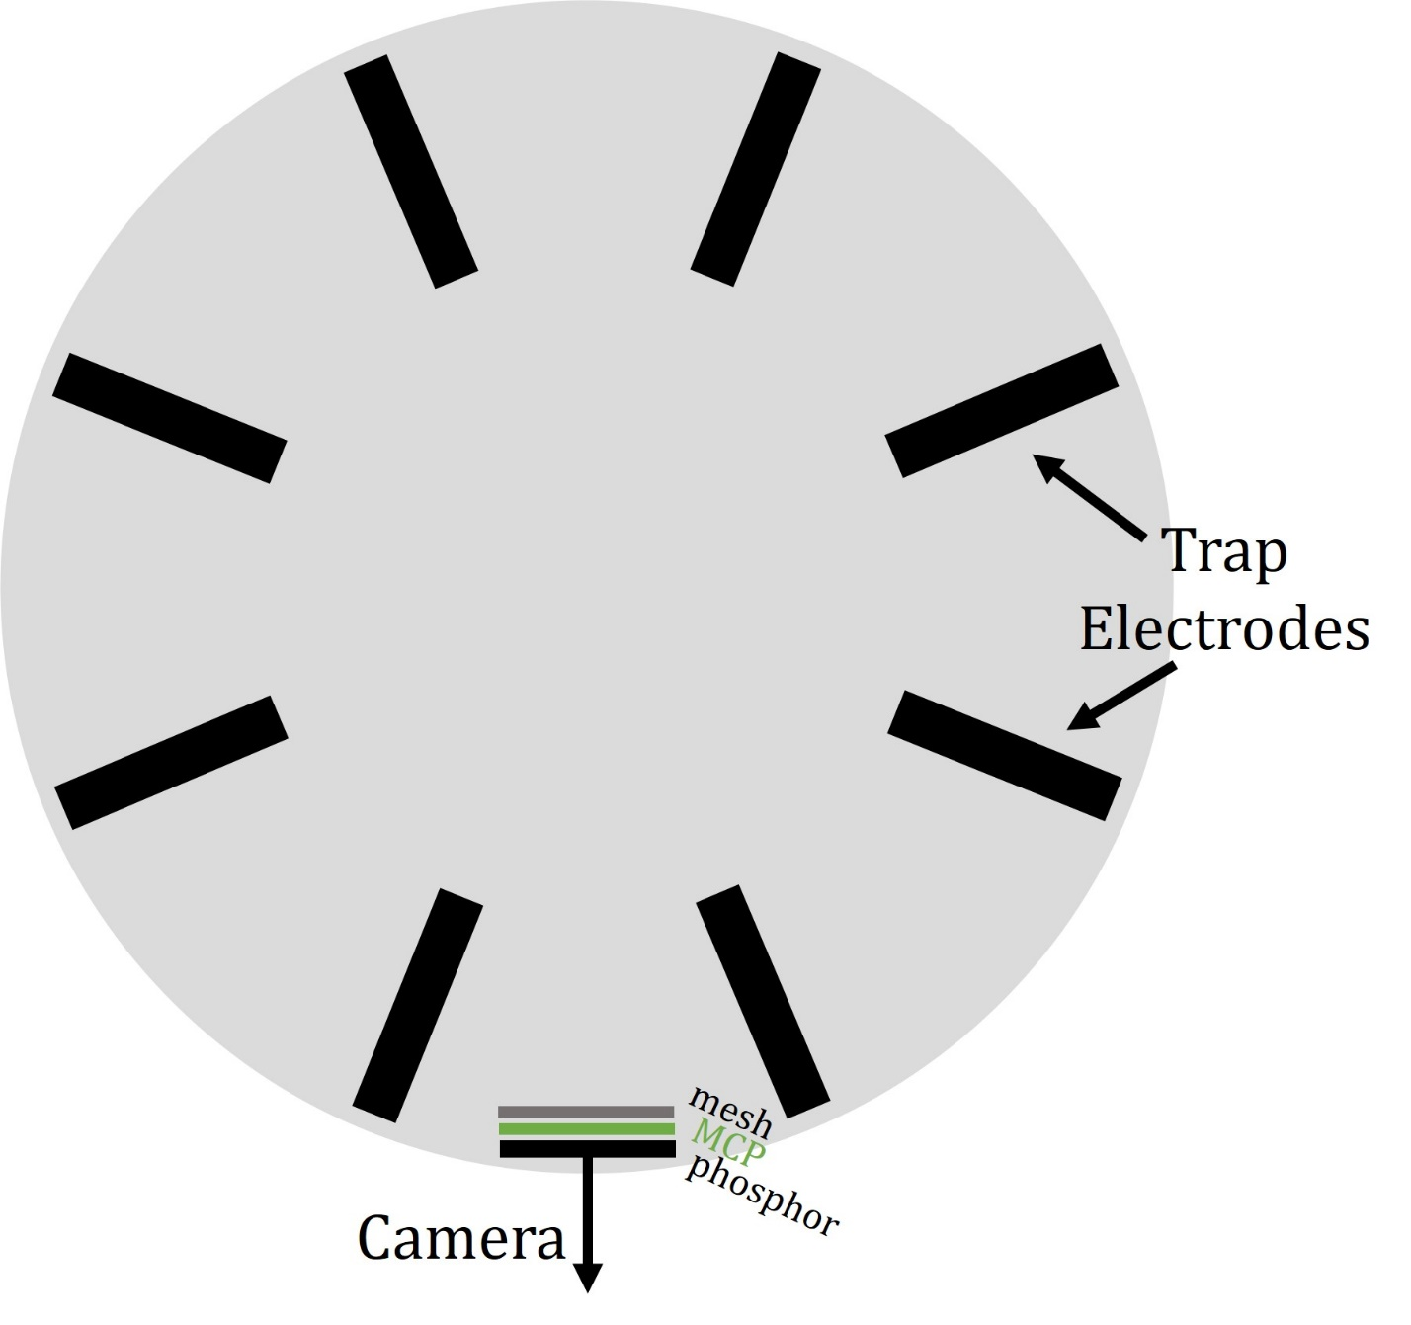
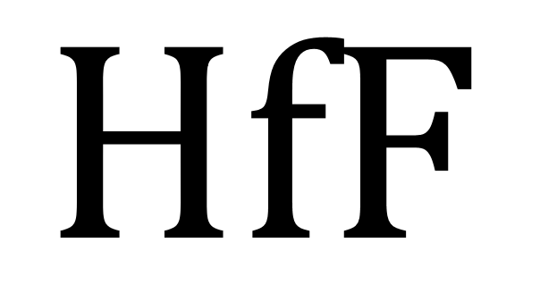
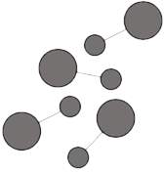
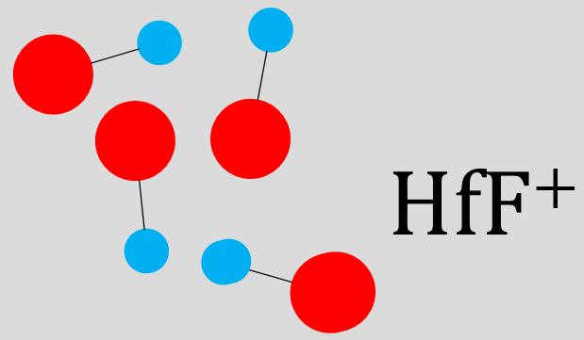
The Ion Trap
Ionization
Lasers

Slide 48

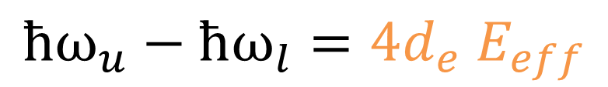

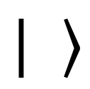


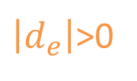


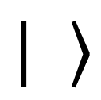




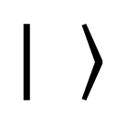




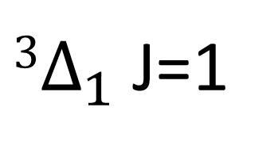
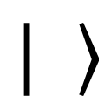

$3Δ_{1}$ J=1
“The Demille scheme”
$$\vec{E}$$
$$\vec{B}$$
$\left|d_{e}\right|$>0
$$ħω_{u}=2µ_{m}B+2 d_{e} E_{eff}$$
$$−$$
$$−$$
$$m=−1$$
$$m=0$$
$$m=1$$
$$+$$
$$+$$
$$ħω_{l}=2µ_{m}B−2 d_{e} E_{eff}$$
$$ħω_{u}−ħω_{l}=4d_{e} E_{eff}$$

Slide 49
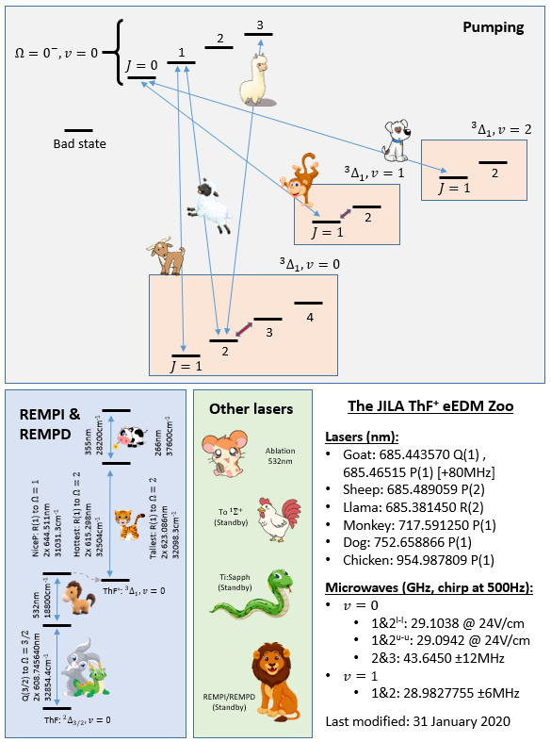

Slide 50
³Δ₁, v = 0, J=1 manifold of molecular states
m_{J}= -1 0 1

Slide 51
³Δ₁, v = 0, J=1 manifold of molecular states
Optically pump to m_{J} =1
m_{J}= -1 0 1

Slide 52
³Δ₁, v = 0, J=1 manifold of molecular states
π/2 pulse
m_{J}= -1 0 1

Slide 53
³Δ₁, v = 0, J=1 manifold of molecular states
coherent evolution
m_{J}= -1 0 1

Slide 54
³Δ₁, v = 0, J=1 manifold of molecular states
π/2 pulse
m_{J}= -1 0 1

Slide 55
³Δ₁, v = 0, J=1 manifold of molecular states
π/2 pulse
m_{J}= -1 0 1

Slide 56
³Δ₁, v = 0, J=1 manifold of molecular states
Deplete all but one state
m_{J}= -1 0 1

Slide 57
³Δ₁, v = 0, J=1 manifold of molecular states
Read-out ion population in J=1 state
m_{J}= -1 0 1

Slide 58
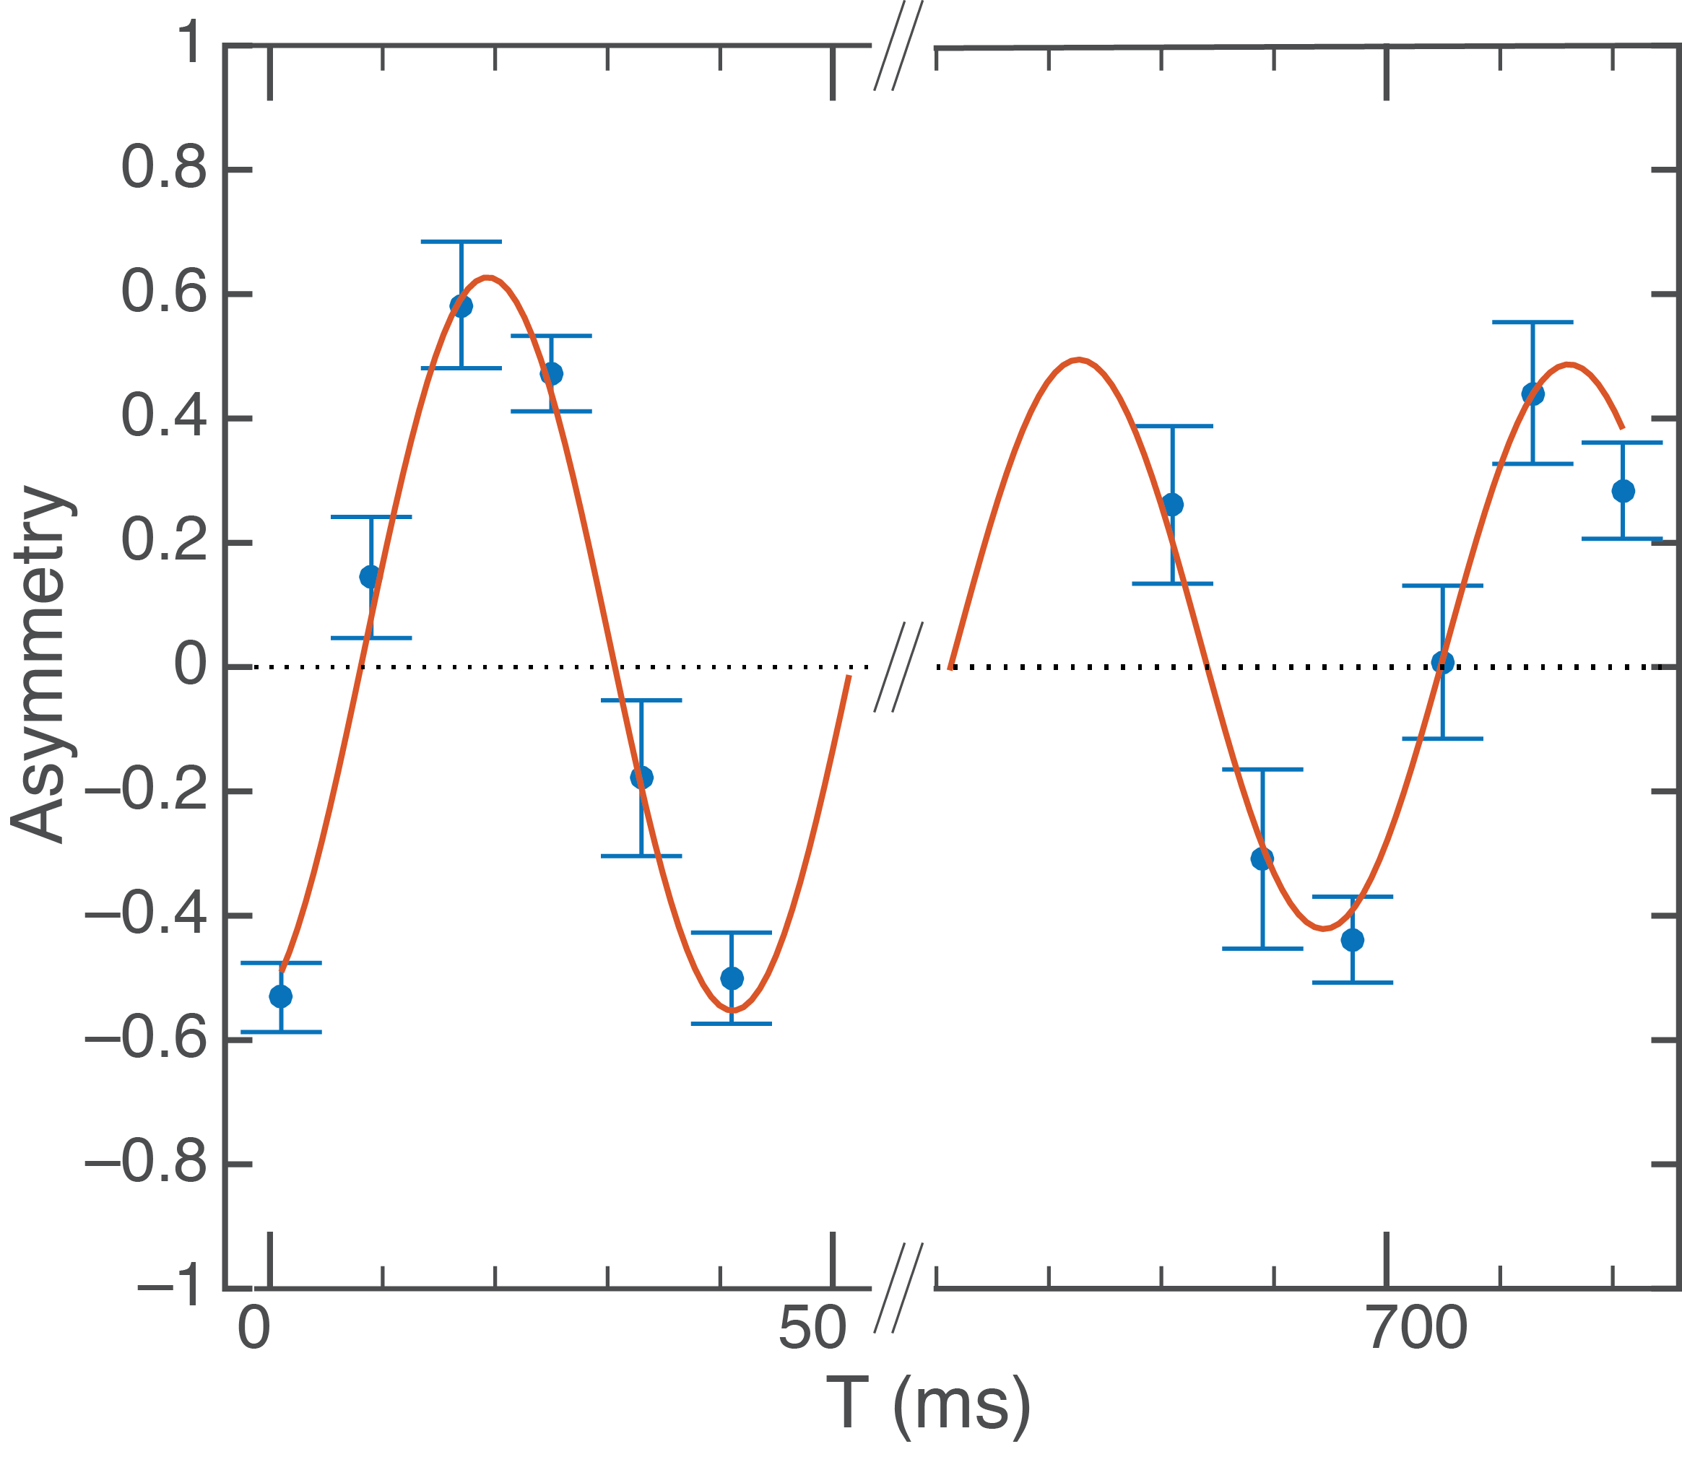
Ramsey Fringe
$$ΔE=3g_{u}μ_{B}B_{r}+2d_{e}E_{eff}$$

Slide 59
³Δ₁, v = 0, J=1 manifold of molecular states
Read-out ion population in J=1 state
m_{J}= -1 0 1

Slide 60
³Δ₁, v = 0, J=1 manifold of molecular states
Read-out ion population in J=1 state
m_{J}= -1 0 1

Slide 61
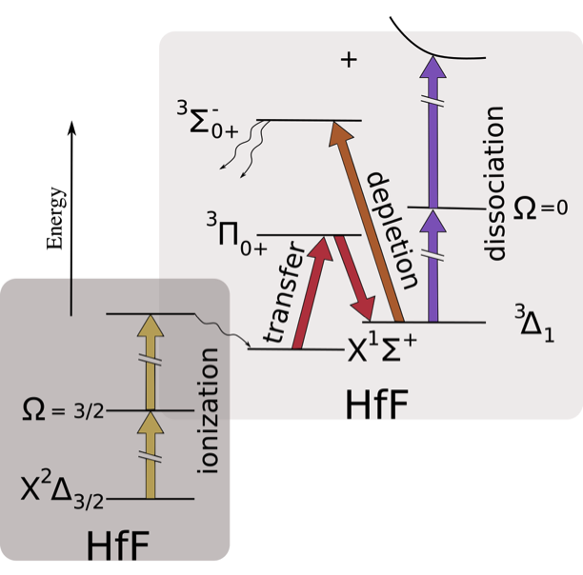
experimental procedure
Notes:
We create HfF by ablating a Hf rod in the presence of Sf6 gas released by a pulsed valve, producing neutral HfF molecules. The neutrals fly into the trapping chamber and are ionized via resonance-enhanced multi-photon ionization. We then transfer those to the 3D1, J=1, F=3/2 state via a raman transition thorugh an intermediate state. To populate only a single stark doublet, transfer is performed with the rotating field on. Transfer leaves us with an incoherent micture of mf = +/- 3/2 states in the upper or lower doublet, so we deplete one of those levels with a circularly polarized laser, then apply a pi/2 pulse to create an equal superposition of mf states. We allow the phase to evolve for some time, then apply a second pi/2 pulse to project the relative phase onto a population difference between mf states. We then deplete all but one mf sublevel, and read out the remaining population by state-selectively dissociating the HfF+ and detecting the Hf+ on an MCP.
[REMPI: first laser at 309.39 nm. The seeding reduces the laser linewidth and thus excites only the correct isotope of Hf. The first photon is on resonance with a P(3/2) transition from the HfF rovibronic ground state (2D3/2, v=0, J=3/2) to an intermediate 2P1/2, v=1, J=1/2 state. Second laser at 367.73nm raises population to a Rydberg state just above the ionization threshold where the population
preferentially autoionizes into the HfF+ 1S+ v = 0, J = 0 state with high efficiency.]
Vrot = 280 Vpp, creating Erot = 24 V/cm,
Vrf = 110 Vpp, Igrad coils = 500 mA, creating rB = Baxgrad = 40 mG/cm. Typical frequencies are
frf = 50 kHz, frot = 250 kHz, and fsecular = 5 kHz.
The transfer lasers, with crossed
linear polarization, traverse the ion trap top-to-bottom, in the axial direction of the trap, to avoid
sampling the large Doppler shifts ( 100's of MHz) induced in the trap radial direction by the
rotating electric bias eld. The axial temperature of about 10 K results in a one-photon doppler of
50 MHz. The two-photon Doppler width from the dierence in frequency of the two trasnfer lasers
is 4 MHz, sucient to resolve the dierent Stark doublets at modest values of Erot.
the cavity is a dichroic cavity with a nesse of 1500 for the 899.67 nm laser and 3000 for the 986.42
nm laser with an FSR of 1.3 GHz
The cavity is built out of a single length of ultra-low expansion
(ULE) glass and is sealed in a vacuum chamber pumped out to the order of 10􀀀7 Torr
The depletion laser is strobed synchronously
with the rotating electric field so that its wave
vector is either parallel or antiparallel to Erot, thus driving a
σ transition to an F0 . 3=2 manifold and leaving one
mF . 3=2 level populated in the 3Δ1 state
This
is accomplished by reducing Erot for a brief interval, which
increases a rotation-induced coupling Δu=l between mF .
3=2 states [Fig. 2(b)] and causes a pure spin state to
evolve into an equal superposition in ∼1 ms
To deplete a particular mF level, in particular either the mF = +3=2 level or the
mF = 􀀀3=2 level, depletion light is strobed on in the radial plane of the trap, either parallel to
or antiparallel to the direction of the rotating quantization axis dened by Erot. This changes the
eective polarization of the light by changing the relative k-vector
The =2 pulses are done
completely in the absence of laser elds by forming =2 pulses solely through a ramp of Erot. This
suppresses a class of systematic errors that can arise from using optical preparation methods

Slide 62
$3Δ_{1}$ J=1
“The Demille scheme”
$$\vec{E}$$
$$\vec{B}$$
$\left|d_{e}\right|$>0
$$ħω_{u}=2µ_{m}B+2 d_{e} E_{eff}$$
$$−$$
$$−$$
$$m=−1$$
$$m=0$$
$$m=1$$
$$+$$
$$+$$
$$ħω_{l}=2µ_{m}B−2 d_{e} E_{eff}$$
$$ħω_{u}−ħω_{l}=4d_{e} E_{eff}$$

Slide 63
Spend 3 years studying systematic errors, then….
spend four months to get 600 hours of high-end data, then….
spend another six month thinking even harder about
systematic errors, then….

Slide 64
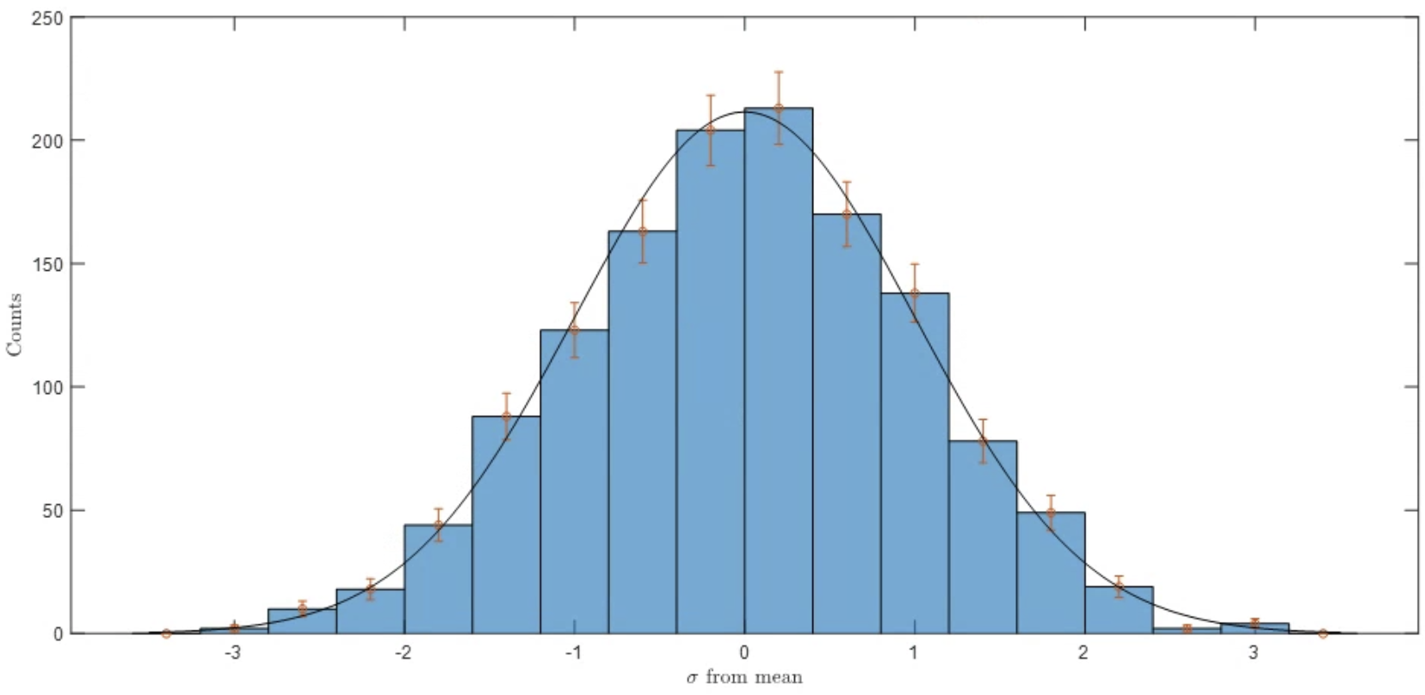

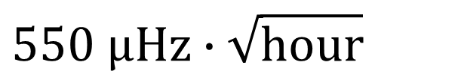

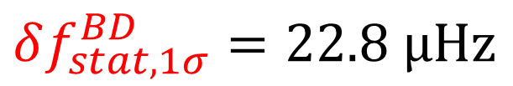
Statistical Result
Data taken blind!
$$600 hours$$
$$χ^{2}=1.078$$
$$550 μHz∙\sqrt{hour}$$
$$δf_{stat, 1σ}^{BD}=22.8 μHz$$
Notes:
Add info about eEDM value, and ACME’s statistical

Slide 65
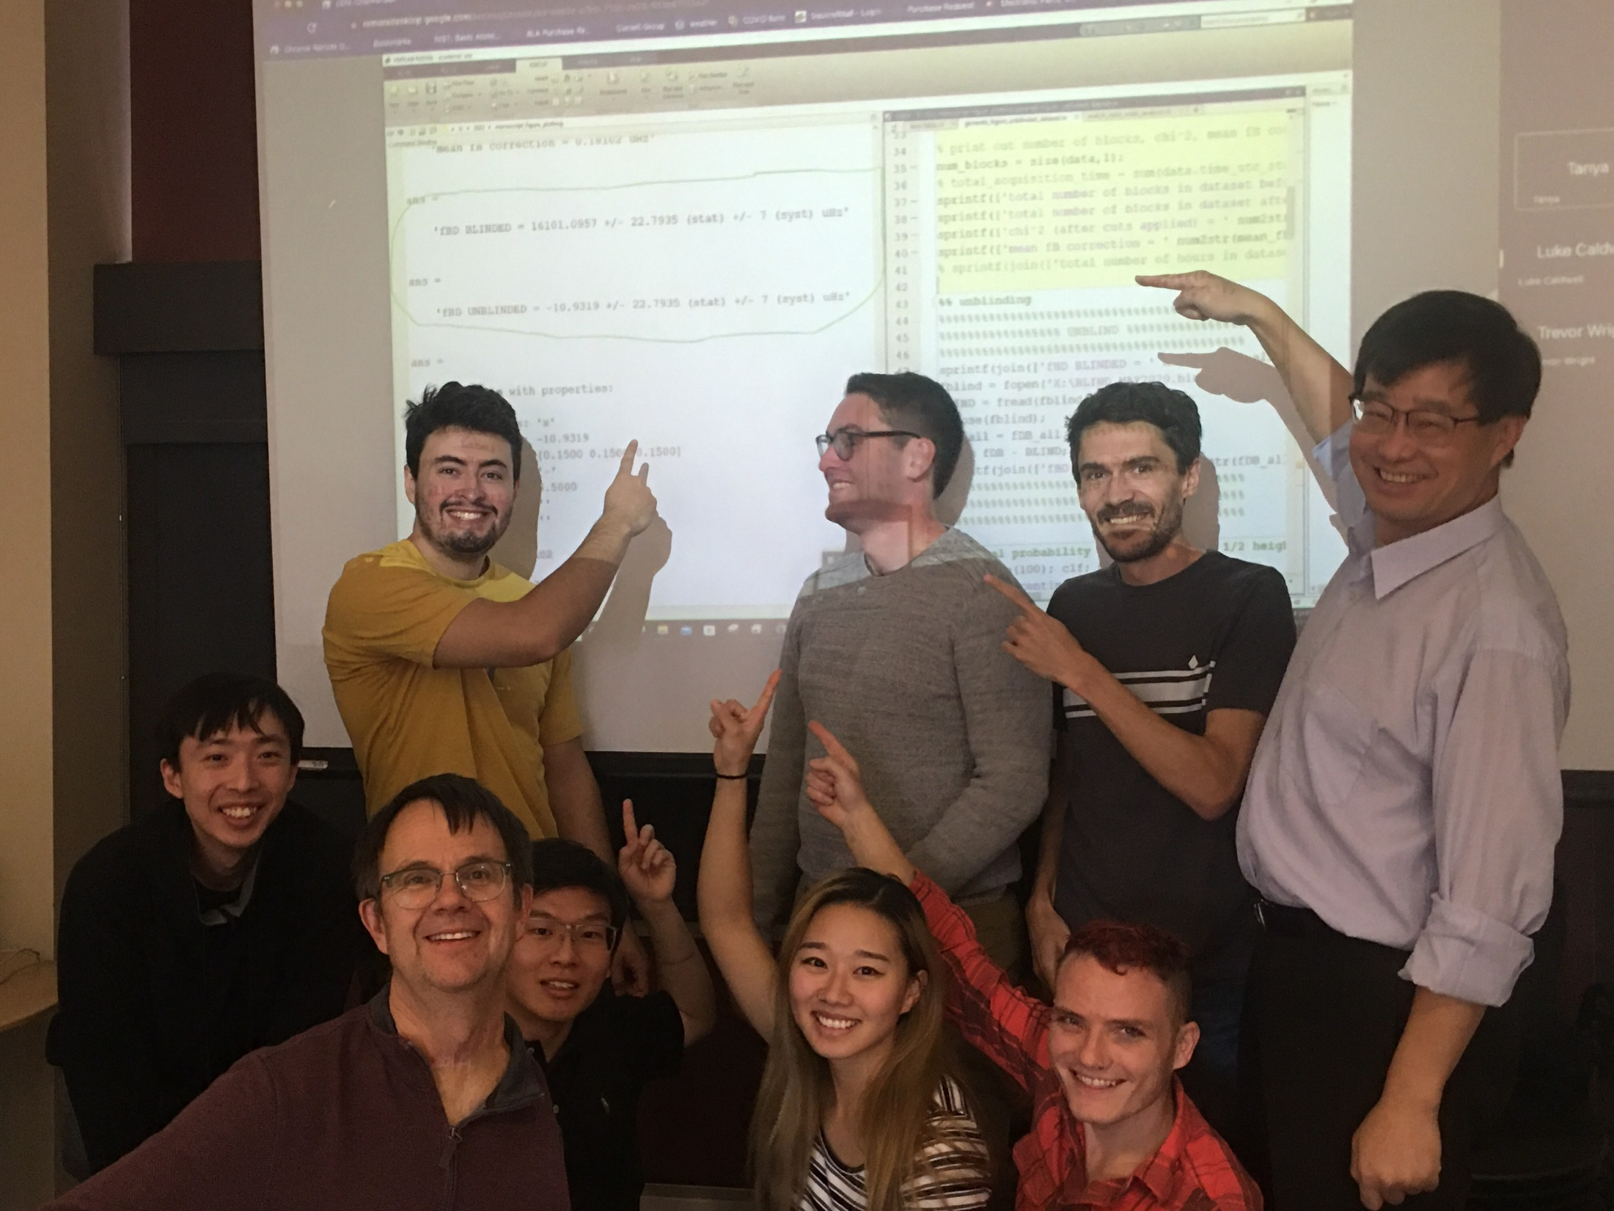
Trevor
Wright
Luke
Caldwell
Jun Ye
Tanya
Roussy

Slide 66
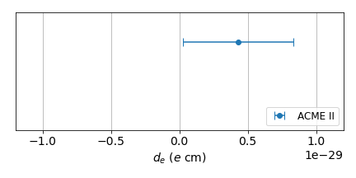
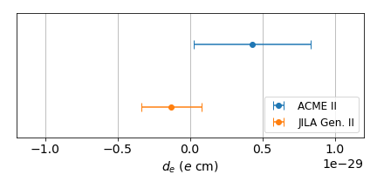
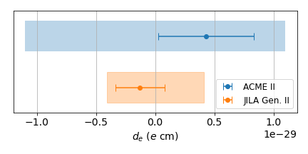
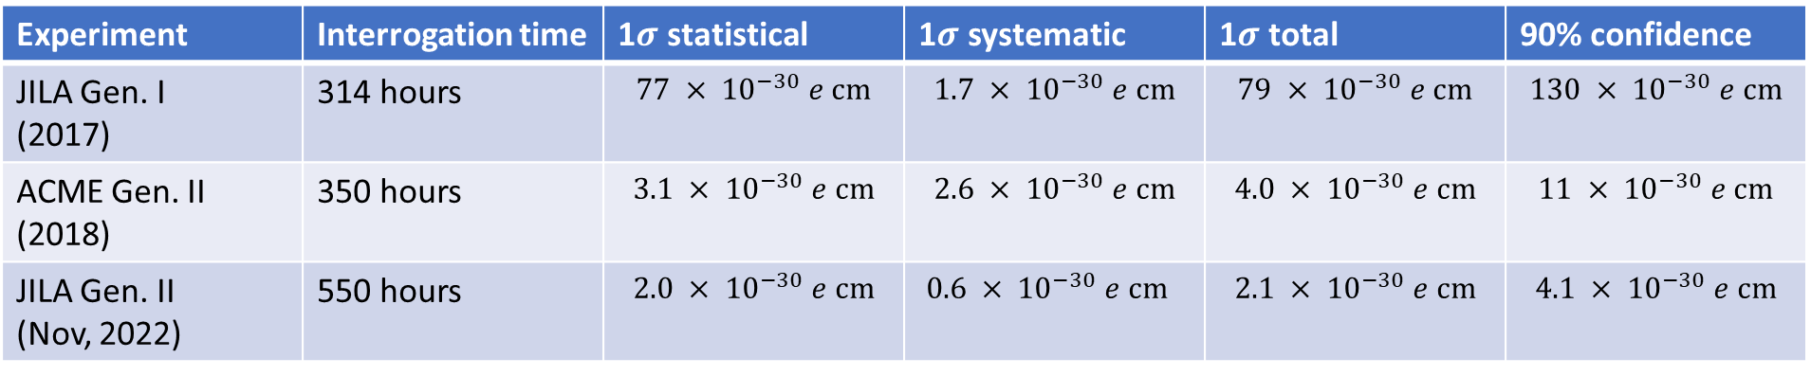
Generation II
Official announcement paper:
arXiv:2212.11841, submitted to Science
Systematics analyses paper:
arXiv:2212.11837, submitted to PRA
Experiment | Interrogation time | 1$σ$ statistical | 1$σ$ systematic | 1$σ$ total | 90% confidence
JILA Gen. I (2017) | 314 hours | $$77 × {10}^{−30} e cm$$ | $$1.7 × {10}^{−30} e cm$$ | $$79 × {10}^{−30} e cm$$ | $$130 × {10}^{−30} e cm$$
ACME Gen. II (2018) | 350 hours | $$3.1 × {10}^{−30} e cm$$ | $$2.6 × {10}^{−30} e cm$$ | $$4.0 × {10}^{−30} e cm$$ | $$11 × {10}^{−30} e cm$$
JILA Gen. II (Nov, 2022) | 550 hours | $$2.0 × {10}^{−30} e cm$$ | $0.6 × {10}^{−30} e cm$ | $$2.1 × {10}^{−30} e cm$$ | $$4.1 × {10}^{−30} e cm$$
Notes:
Let me finish off this part of the talk by turning this table into a more digestible plot.
Here we have the ACME result with their 1sigma error bar. They reported a central value that is slightly larger than 1 sigma. [4.3(3.1)(2.6)e-30 e cm]
*Here we have our Nov 2022 result from JILA, and you can see that it is consistent with zero.
Now it is customary in the field to report our results as a 90% confidence level value assuming that our result is consistent with zero,
And I suppose this practice will continue until we have confirming results that we have measured something non-zero.
*So the colored bars here indicate the 90% confidence level values.
Because our central value lies closer to zero relative to our 1 sigma uncertainty, we can place a tighter bound than the ratio of our 1 sigma uncertainty would naively suggest.

Slide 67


Slide 68
In last two years there have been three
new record-setting measurements of
lepton dipole moments:
muon magnetic dipole (fermi lab)
electron magnetic dipole (northwestern/harvard)
electron electric dipole (JILA)
How do they compare?
μ
B
e
B
e
E

Slide 69
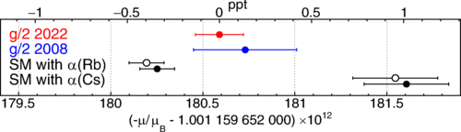
Best electron magnetic moment measurement -- Northwestern
SM:
g-2=1+α/π
α = ?
SM:
quarks?
QCD
background
B
e
μ
B

Slide 70
Best electron magnetic moment measurement -- Northwestern
Discovery potential of electron and muon MDM
currently limited by SM background, not g-2 precision.
BUT, for the next few slides let’s assume SM
background problems are fixed!
FIG. 1. This Northwestern determination (red) and our 2008 Harvard determination (blue) [37]. SM predictions (solid and open black points for slightly differing C10 [40,41]) are functions of discrepant α measurements [38,39]. A ppt is 10⁻¹²
this diagram adds

Slide 71
x
“One-loop” model for discovery.
Hypothetical undiscovered new particles
M_{a} ~ M_{b} ~ M [Ramsey-Musolf; Reece]
coupling strength g at the e-a-b vertex
φ_{CP} is CP-violating angle
ADDS:
μ_{e}= 2 + alpha/pi
x
a
a
e
e
g
g
b
e
e
this diagram adds
δ(d_{e} /e) ~ ( a₀ α g²) / (4 π) sin φ_{CP} (m²/M²)
δ(μ_{e} /e) ~ ( a₀ α g²) / (4 π) cos φ_{CP} (m²/M²)
So, make a good measurement of μ_{e} or d_{e} and have
sensitivity to possible new particles with mass up to M:
M ~ (various constants) * [ (m/δd_{e}) g² sin φ_{CP} ]^{1/2}
M ~ (various constants) * [ (m/δμ_{e}) g² cos φ_{CP} ]^{1/2}
δμ_{e}= alpha/pi
δd_{e} = 0

Slide 72
x
“One-loop” model for discovery.
Hypothetical undiscovered new particles
M_{a} ~ M_{b} ~ M [Ramsey-Musolf; Reece]
coupling strength g at the e-a-b vertex
φ_{CP} is CP-violating angle
ADDS:
g_{e}= 2 + alpha/pi
x
a
a
e
e
b
e
e
this diagram adds
δ(μ_{e} /e) ~ ( a₀ α g²) / (4 π) cos φ_{CP} (m²/M²)
δμ_{e}= μ_{B} α/π
Question: Is this equation some exotic result from supersymmetry? Answer, no.
For “a” and “b”, plug in “electron” and “photon”. M_{a} n.e. M_{b} but take M = (M_{a}+ M_{b})/2 = m_{e}/2
The g = α^{1/2} and this is maximally CP preserving so cos φ_{CP} = 1
We get δ(μ_{e} /e) ~ ( a₀ α α) / π
But recall μ_{B} = α a₀ /2
So δ(μ_{e} ) ~ 2 μ_{Β} α/π
Maybe omit this
slide for
conference talk

Slide 73
Summary of Recent Measurements of Lepton Dipole Moments; Implications
relative
precision
on lab
limit
10⁻¹³
10⁻⁹
~10⁰
“Typical”
detectable
phat BSM,
one-loop*
0.04 TeV
0.12
40 TeV
Detectable
for “weakest*” to strongest
interactions
0.0004~0.4 TeV
0.001~1 TeV
0.4~400 TeV
CP violation!
reduce mass
sensitivity by
(cos α_{cpv})^{1/2}
(cos α_{cpv})^{1/2}
(sin α_{cpv})^{1/2}
absolute
precision
[10⁻³⁰ e-cm]
2 x 10⁶
5 x 10⁷
2
Detectable
M~(m_{l}/δd)^{1/2}
(arb units)
1
3
1000
SM
Background
issues
α = ?
QCD terms
none
SO
MANY
ISSUES!
eMDM
Northwester
μMDM
fermilab
eEDM
JILA/ACME
LHC
LHC
??? <2 TeV ???
For LHC,
α_{cpv}
not a factor

Slide 74
Summary of Recent Measurements of Lepton Dipole Moments; Implications
relative
precision
on lab
limit
10⁻¹³
10⁻⁹
~10⁰
“Typical”
detectable
phat BSM,
one-loop*
0.04 TeV
0.12
40 TeV
Detectable
for “weakest*” to strongest
interactions
0.0004~0.4 TeV
0.001~1 TeV
0.4~400 TeV
CP violation!
reduce mass
sensitivity by
(cos α_{cpv})^{1/2}
(cos α_{cpv})^{1/2}
(sin α_{cpv})^{1/2}
absolute
precision
[10⁻³⁰ e-cm]
2 x 10⁶
5 x 10⁷
2
Detectable
M~(m_{l}/δd)^{1/2}
(arb units)
1
3
1000
SM
Background
issues
α = ?
QCD terms
none
SO
MANY
ISSUES!
eMDM
Northwester
μMDM
fermilab
eEDM
JILA/ACME
LHC
LHC
??? <2 TeV ???
For LHC,
α_{cpv}
not a factor

Slide 75
Summary of Recent Measurements of Lepton Dipole Moments; Implications
relative
precision
on lab
limit
10⁻¹³
10⁻⁹
~10⁰
“Typical”
detectable
phat BSM,
one-loop*
0.04 TeV
0.12
40 TeV
Detectable
for “weakest*” to strongest
interactions
0.0004~0.4 TeV
0.001~1 TeV
0.4~400 TeV
CP violation!
reduce mass
sensitivity by
(cos α_{cpv})^{1/2}
(cos α_{cpv})^{1/2}
(sin α_{cpv})^{1/2}
absolute
precision
[10⁻³⁰ e-cm]
2 x 10⁶
5 x 10⁷
2
Detectable
M~(m_{l}/δd)^{1/2}
(arb units)
1
3
1000
SM
Background
issues
α = ?
QCD terms
none
SO
MANY
ISSUES!
eMDM
Northwester
μMDM
fermilab
eEDM
JILA/ACME
x
a
a
LHC
??? <2 TeV ???
For LHC,
α_{cpv}
not a factor
g
g
b
e
e
M ~ (various constants) * [ (m/δμ_{e}) g² cos φ_{CP} ]^{1/2}

Slide 76
Summary of Recent Measurements of Lepton Dipole Moments; Implications
relative
precision
on lab
limit
10⁻¹³
10⁻⁹
~10⁰
“Typical”
detectable
phat BSM,
one-loop*
0.04 TeV
0.12
40 TeV
Detectable
for “weakest*” to strongest
interactions
0.0004~0.4 TeV
0.001~1 TeV
0.4~400 TeV
CP violation!
reduce mass
sensitivity by
(cos α_{cpv})^{1/2}
(cos α_{cpv})^{1/2}
(sin α_{cpv})^{1/2}
absolute
precision
[10⁻³⁰ e-cm]
2 x 10⁶
5 x 10⁷
2
Detectable
M~(m_{l}/δd)^{1/2}
(arb units)
1
3
1000
SM
Background
issues
α = ?
QCD terms
none
SO
MANY
ISSUES!
eMDM
Northwester
μMDM
fermilab
eEDM
JILA/ACME
x
LHC
a
a
For LHC,
α_{cpv}
not a factor
g
g
b
e
e
M ~ (various constants) * [ (m/δμ_{e}) g² cos φ_{CP} ]^{1/2}

Slide 77
Summary of Recent Measurements of Lepton Dipole Moments; Implications
relative
precision
on lab
limit
10⁻¹³
10⁻⁹
~10⁰
“Typical”
detectable
phat BSM,
one-loop*
0.04 TeV
0.12
40 TeV
Detectable
for “weakest*” to strongest
interactions
0.0004~0.4 TeV
0.001~1 TeV
0.4~400 TeV
CP violation!
reduce mass
sensitivity by
(cos α_{cpv})^{1/2}
(cos α_{cpv})^{1/2}
(sin α_{cpv})^{1/2}
absolute
precision
[10⁻³⁰ e-cm]
2 x 10⁶
5 x 10⁷
2
Detectable
M~(m_{l}/δd)^{1/2}
(arb units)
1
3
1000
SM
Background
issues
α = ?
QCD terms
none
SO
MANY
ISSUES!
10⁻⁶ < g < 1
eMDM
Northwester
μMDM
fermilab
eEDM
JILA/ACME
x
LHC
For LHC,
α_{cpv}
not a factor
a
a
g
g
b
e
e
M ~ (various constants) * [ (m/δμ_{e}) g² cos φ_{CP} ]^{1/2}

Slide 78
Summary of Recent Measurements of Lepton Dipole Moments; Implications
relative
precision
on lab
limit
10⁻¹³
10⁻⁹
~10⁰
“Typical”
detectable
phat BSM,
one-loop*
0.04 TeV
0.12
40 TeV
Detectable
for “weakest*” to strongest
interactions
0.0004~0.4 TeV
0.001~1 TeV
0.4~400 TeV
CP violation!
reduce mass
sensitivity by
(cos α_{cpv})^{1/2}
(cos α_{cpv})^{1/2}
(sin α_{cpv})^{1/2}
absolute
precision
[10⁻³⁰ e-cm]
2 x 10⁶
5 x 10⁷
2
Detectable
M~(m_{l}/δd)^{1/2}
(arb units)
1
3
1000
SM
Background
issues
α = ?
QCD terms
none
SO
MANY
ISSUES!
10⁻⁶ < g < 1
eMDM
Northwester
μMDM
fermilab
eEDM
JILA/ACME
x
LHC
LHC
??? <2 TeV ???
For LHC,
α_{cpv}
not a factor
a
a
g
g
b
e
e
M ~ (various constants) * [ (m/δμ_{e}) g² cos φ_{CP} ]^{1/2}

Slide 79
Summary of Recent Measurements of Lepton Dipole Moments; Implications
relative
precision
on lab
limit
10⁻¹³
10⁻⁹
~10⁰
“Typical”
detectable
phat BSM,
one-loop*
0.04 TeV
0.12
40 TeV
Detectable
for “weakest*” to strongest
interactions
0.0004~0.4 TeV
0.001~1 TeV
0.4~400 TeV
CP violation!
reduce mass
sensitivity by
(cos α_{cpv})^{1/2}
(cos α_{cpv})^{1/2}
(sin α_{cpv})^{1/2}
absolute
precision
[10⁻³⁰ e-cm]
2 x 10⁶
5 x 10⁷
2
Detectable
M~(m_{l}/δd)^{1/2}
(arb units)
1
3
1000
SM
Background
issues
α = ?
QCD terms
none
SO
MANY
ISSUES!
eMDM
Northwester
μMDM
fermilab
eEDM
JILA/ACME
LHC
LHC
??? <2 TeV ???
For LHC,
α_{cpv}
not a factor

Slide 80
Summary of Recent Measurements of Lepton Dipole Moments; Implications
relative
precision
on lab
limit
10⁻¹³
10⁻⁹
~10⁰
“Typical”
detectable
phat BSM,
one-loop*
0.04 TeV
0.12
40 TeV
Detectable
for “weakest*” to strongest
interactions
0.0004~0.4 TeV
0.001~1 TeV
0.4~400 TeV
CP violation!
reduce mass
sensitivity by
(cos α_{cpv})^{1/2}
(cos α_{cpv})^{1/2}
(sin α_{cpv})^{1/2}
absolute
precision
[10⁻³⁰ e-cm]
2 x 10⁶
5 x 10⁷
2
Detectable
M~(m_{l}/δd)^{1/2}
(arb units)
1
3
1000
SM
Background
issues
α = ?
QCD terms
none
eMDM
Northwester
μMDM
fermilab
eEDM
JILA/ACME
LHC
LHC
??? <2 TeV ???
For LHC,
α_{cpv}
not a factor

Slide 81
Summary of Recent Measurements of Lepton Dipole Moments; Implications
relative
precision
on lab
limit
10⁻¹³
10⁻⁹
~10⁰
“Typical”
detectable
phat BSM,
one-loop*
0.04 TeV
0.12
40 TeV
Detectable
for “weakest*” to strongest
interactions
0.0004~0.4 TeV
0.001~1 TeV
0.4~400 TeV
CP violation!
reduce mass
sensitivity by
(cos α_{cpv})^{1/2}
(cos α_{cpv})^{1/2}
(sin α_{cpv})^{1/2}
absolute
precision
[10⁻³⁰ e-cm]
2 x 10⁶
5 x 10⁷
2
Detectable
M~(m_{l}/δd)^{1/2}
(arb units)
1
3
1000
SM
Background
issues
α = ?
QCD terms
none
Q:Does
LHC have
SM
issues?
eMDM
Northwester
μMDM
fermilab
eEDM
JILA/ACME
LHC
LHC
??? <2 TeV ???
For LHC,
α_{cpv}
not a factor

Slide 82
Summary of Recent Measurements of Lepton Dipole Moments; Implications
relative
precision
on lab
limit
10⁻¹³
10⁻⁹
~10⁰
“Typical”
detectable
phat BSM,
one-loop*
0.04 TeV
0.12
40 TeV
Detectable
for “weakest*” to strongest
interactions
0.0004~0.4 TeV
0.001~1 TeV
0.4~400 TeV
CP violation!
reduce mass
sensitivity by
(cos α_{cpv})^{1/2}
(cos α_{cpv})^{1/2}
(sin α_{cpv})^{1/2}
absolute
precision
[10⁻³⁰ e-cm]
2 x 10⁶
5 x 10⁷
2
Detectable
M~(m_{l}/δd)^{1/2}
(arb units)
1
3
1000
SM
Background
issues
α = ?
QCD terms
none
A: SO
MANY
ISSUES!
eMDM
Northwester
μMDM
fermilab
eEDM
JILA/ACME
LHC
LHC
??? <2 TeV ???
For LHC,
α_{cpv}
not a factor

Slide 83
x
“One-loop” model for discovery.
Hypothetical undiscovered new particles
M_{a} ~ M_{b} ~ M [Ramsey-Musolf; Reece]
coupling strength g at the e-a-b vertex
φ_{CP} is CP-violating angle
ADDS:
μ_{e}= 2 + alpha/pi
x
a
a
e
e
g
g
b
e
e
this diagram adds
δ(d_{e} /e) ~ ( a₀ α g²) / (4 π) sin φ_{CP} (m²/M²)
δ(μ_{e} /e) ~ ( a₀ α g²) / (4 π) cos φ_{CP} (m²/M²)
So, make a good measurement of μ_{e} or d_{e} and have
sensitivity to possible new particles with mass up to M:
M ~ (various constants) * [ (m/δd_{e}) g² sin φ_{CP} ]^{1/2}
M ~ (various constants) * [ (m/δμ_{e}) g² cos φ_{CP} ]^{1/2}
One loop vs two-loop
comment
δμ_{e}= alpha/pi
δd_{e} = 0

Slide 84
One loop vs two-loop

Slide 85
Limit on
eEDM
(e-cm)
10⁻²⁴
Amherst
10⁻²⁵
10⁻²⁶
Berkeley
Imperial
College
10⁻²⁷
JILA-NIST
10⁻²⁸
ACME
10⁻²⁹
10⁻³⁰
??
1965
1975
1985
1995
2005
2015
2025
Mass reach goes as square root of EDM precision.
Imagine if LHC upgraded from 14 TeV to 42 TeV! A big deal.

Slide 86
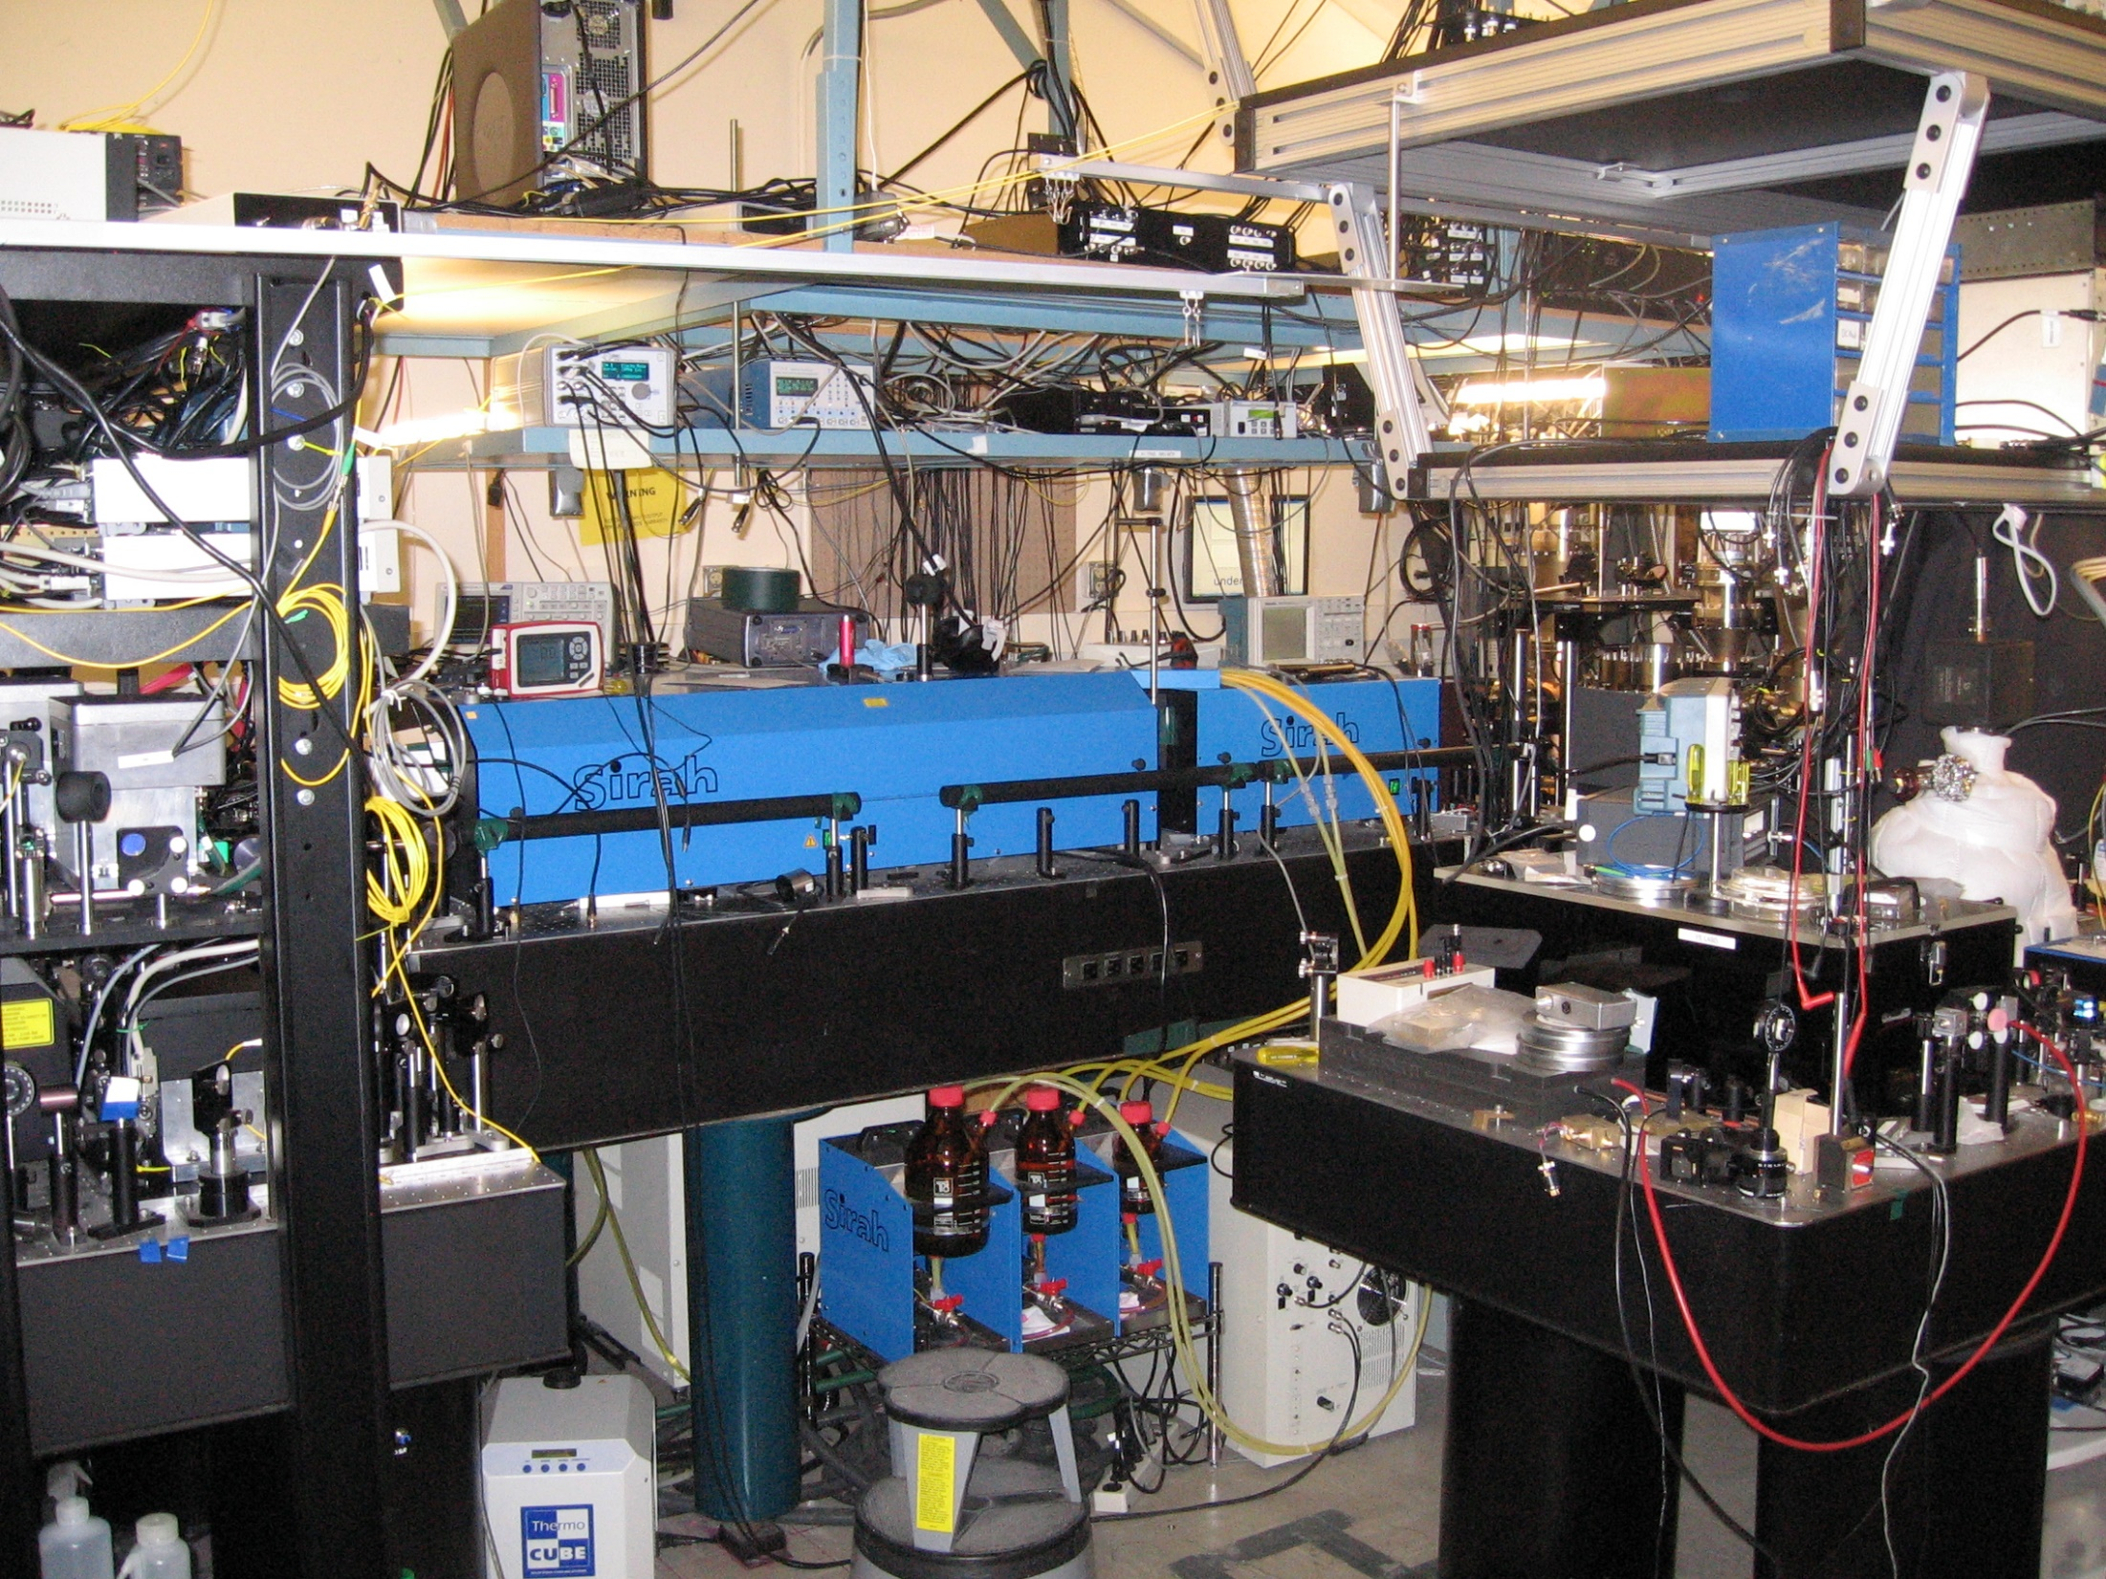
Experiment
Lasers
Lasers
Lasers

Slide 87

Experiment
Experiment
Lasers
Lasers
Lasers
Lasers
Lasers
Lasers
Experiment
Experiment
Lasers
Lasers
Lasers
Lasers
Lasers
Lasers

Slide 88


Lasers
Lasers
Experiment
Experiment
Experiment
Experiment
Lasers
Experiment
Experiment
Lasers
Lasers
Lasers
Lasers
Lasers
Lasers
Lasers
Lasers
Lasers
Lasers
Lasers
Lasers
Lasers
Lasers
Lasers
Experiment
Experiment
Experiment
Experiment
Lasers
Experiment
Lasers
Experiment
Lasers
Lasers
Lasers
Lasers
Lasers
Lasers
Lasers
Lasers
Lasers
Lasers
Lasers
Lasers
Lasers
Lasers
Lasers
Lasers
Lasers
Lasers
Lasers
Experiment
Experiment
Experiment
Experiment
Lasers
Experiment
Experiment
Lasers
Lasers
Lasers
Lasers
Lasers
Lasers
Lasers
Lasers
Lasers
Lasers
Lasers
Lasers
Lasers
Lasers
Experiment
Experiment
Experiment
Experiment
Lasers
Experiment
Lasers
Experiment
Lasers
Lasers
Lasers
Lasers
Lasers
Lasers
Lasers
Lasers
Lasers
Lasers
Lasers
Lasers
Lasers
Lasers
Lasers
Lasers

Slide 89
Experiment
Lasers
Lasers
Lasers

Slide 90
Let’s Play:
“Bug?..... or Feature! Feature? …… or Bug!”
And now, your contrarian host,
heeeeere’s Eric!

Slide 91
Bug?..... or Feature! Feature? …… or Bug!
electron MDM has SM sensitivity to uncertainties in experimental value of alpha. This is a bug.
Maybe. The electron MDM has the best fractional sensitivity of any SM calculable fundamental quantity ever. This means e.g. it can be used to measure alpha better than other methods. This is a feature! More generally, eMDM is the most stringent limit to anything that looks more like a multiplicative correction to SM (ie, not additive) or a limitation to many-loop perturbation theory.
SM:
g-2=1+α/π…
α = ?
B
e

Slide 92
Bug?..... or Feature! Feature? …… or Bug!
muon MDM has sensitivity to uncertainties in SM QCD predictions. This is a bug vis-à-vis electron MDM.
Well, maybe. The μMDM is more troubled by QCD corrections than eMDM, precisely because the muon measurement is more sensitive to corrections from heavy particles -- which after all is something we are looking for!
Feature! When eMDM absolute precision improves to where it is competitive with muon MDM, e MDM too will have to worry about QCD corrections.
SM:
quarks?
QCD
background
μ
B

Slide 93
Bug?..... or Feature! Feature? …… or Bug!
electron eEDM has basically no sensitivity at all to SM background. This is a feature!
Well, sort of. The reason that eEDM doesn’t see any SM background is that eEDM can see only CP violating physics (which SM has very little of.) EDMs in
general are blind to CP-preserving new physics. This is a bug!
E
SM:
eEDM = 0
e

Slide 94
Bug?..... or Feature! Feature? …… or Bug!
electron eEDM can look deeper into “Extra-Phat Exotic Particle Parameter Space” than can the LHC, and much deeper than can the MDM experiments. This is a feature!
Well, ok, actually, yeah. That is pretty rad.

Slide 95
Summary of Recent Measurements of Lepton Dipole Moments; Implications
relative
precision
on lab
limit
10⁻¹³
10⁻⁹
~10⁰
“Typical”
detectable
phat BSM,
one-loop*
0.04 TeV
0.12
40 TeV
Detectable
for “weakest*” to strongest
interactions
0.0004~0.4 TeV
0.001~1 TeV
0.4~400 TeV
CP violation!
reduce mass
sensitivity by
(cos α_{cpv})^{1/2}
(cos α_{cpv})^{1/2}
(sin α_{cpv})^{1/2}
absolute
precision
[10⁻³⁰ e-cm]
2 x 10⁶
5 x 10⁷
2
Detectable
M~(m_{l}/δd)^{1/2}
(arb units)
1
3
1000
SM
Background
issues
α = ?
QCD terms
none
SO
MANY
ISSUES!
eMDM
Northwester
μMDM
fermilab
eEDM
JILA/ACME
LHC
LHC
??? <2 TeV ???
For LHC,
α_{cpv}
not a factor
eEDM already has sensitivity to masses much heavier than LHC limit.
Another factor of 10 is sensitivity is another factor of three in mass reach

Slide 96
Limit on
eEDM
(e-cm)
10⁻²⁴
Amherst
10⁻²⁵
10⁻²⁶
Berkeley
Imperial
College
10⁻²⁷
JILA-NIST
10⁻²⁸
ACME
10⁻²⁹
10⁻³⁰
??
1965
1975
1985
1995
2005
2015
2025
Imagine if LHC upgraded from 14 TeV to 42 TeV! A big deal.

Slide 97
Combined Figure-of-merit:
(Field) τ
recall 1T
= 3x10⁶ V/cm
recall 1 μ_{B} = 2x10¹¹ e-cm
Field
Strength
[10⁷ V/cm]
~2
~2
2000
7000
coherence
time τ
[ms]
5000
0.2
3000
3
count
rate
[s⁻¹]
1/τ * duty cycle = 0.02
1000 ?
200 / τ = 60
many * 10⁶
one-sigma accuracy on
dipole moment,
[10 ⁻³⁰ e-cm ]
2 x 10⁻²⁴
5x10⁻²³
2x 10⁻³⁰
4x10⁻³⁰
Experiment
eMDM
“g_{e} – 2”
μMDM
“g_{μ}-2”
JILA
eEDM
ACME
eEDM

Slide 98
Long coherence: the future! For sensitivity, sure, but also for systematics!
At JILA HfF+ → ThF+ (no spontaneous emission)

Slide 99
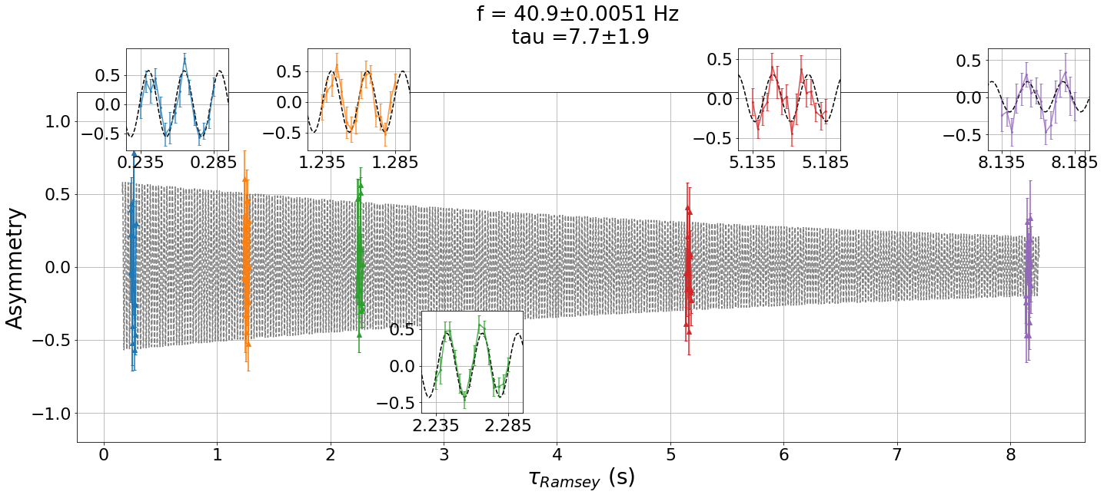
We think this is the longest quantum coherence ever seen in a molecule.
But we also think we are entitled to about another factor of 2.5. We are shooting for 20 s.

Slide 100




Slide 101

Ion Production, state prep →
π/2 pulse #1 →
Coherent evolution….
v_{z} = 10⁻⁹ c →
Anzou Wang
π/2 pulse #2 →
State read-out→
Kiaboon Ng
Sunyool Park

Slide 102




Z (cm)
π/2
π/2
$$τ_{Ramsey}$$
Sci
68.8
Oct
0
300 ms
Time
Z (cm)
π/2
$$τ_{Ramsey}$$
Sci
68.8
π/2
Oct
0
300 ms
Time

Slide 103

Cool vacuum sleeve to 180 K to suppress
black-body decoherence

Slide 104

Coherence in
molecular quantum superposition at
~12 seconds!!

Slide 105
Th⁺ + F
Resonantly Enhanced Multi-Photon
Dissociation (REMPDi) dissociates all
the J=1 ions
ThF⁺
J=1, v=1, ³Δ₁

Slide 106

In collaboration with Tanya Zelevinsky, Columbia U.
Two-state anisotropic detection
Notes:
In experiments, we demonstrate a good contrast in both HfF+ and ThF+ experiments.

Slide 107
Th⁺ + F
Resonantly Enhanced Multi-Photon
Dissociation (REMPDi) dissociates all
the J=1 ions
ThF⁺
J=1, v=1, ³Δ₁

Slide 108
Th⁺ + F
Ramp down E-field to
adiabatically makes
states of good parity.
Selecting parity of
intermediate state,
and polarization of
first photon, will
sequentially ioninze
each of 4 states,
one every 0.1 sec
Resonantly Enhanced Multi-Photon
Dissociation (REMPDi) dissociates all
the J=1 ions
Ω=0⁻
Ω=0⁺
ThF⁺
J=1, v=1, ³Δ₁

Slide 109
Contour lines of trapping potential.
First:
Contour lines of trapping potential.
Then:

Slide 110
Thanks to conversations with our friends, Wes Campbell, Eric Hudson @UCLA
and David Patterson @UCSB. Variations on the theme of trap-loss
spectroscopy.

Slide 111
What difficulties did we have in getting to
8 seconds?
And what new difficulties will we have getting
to 20 seconds?

Slide 112

J=1 lifetime
Relatively deep trap
Erot at 60V/cm
Normalized by ions remaining
one meter
32 48 64 80 96 cm
distance from end of bucket brigade
32 48 64 80 96 cm
distance from end of bucket brigade
Q: What keeps us from getting to 20 seconds coherence time?
A: Various forms of collisions.

Slide 113
Q: What limits us at 8 seconds.
What keeps us from getting to 20 seconds coherence time?
A: Various forms of collisions.
Probably not spatial inhomogeneity.

Slide 114


Slide 115


 | a | b | Ratio of a with High @60V/cm
High ion num @ 60V/cm | 1.6(0.5)*1e-7 | -0.5(0.4) | 1
Low ion num @ 60 V/cm | 4(1)*1e-8 | -0.1(0.1) | 4
High ion num @ 30 V/cm | 3.2(0.8)*1e-7 | -0.5(0.4) | 0.5
*BBR subtracted
y = a*x² + b
From Ramsey fringe
Normalized by ions in J=1
At 300K, but BBR subtracted (4 s)
But BBR effect on J=1 subtracted

Slide 116
+
- +
v
v
ion
neutral

Slide 117
+
- +
v
v
ion
neutral
E ~ 1/r² 1/r³ ~ 1/r⁵
U ~ 1/r⁴

Slide 118

Glancing Collisions between background gas and trapped ions causing ions to heat
in the trap
Hard-core, “Langevin” collisions between background gas and trapped ions causing J-changing
collisions
* Use time < 10 s
50 kHz | ~ 5 K/s
100 kHz | ~ 3 K/s

Slide 119


Slide 120
We are working on collision studies,
Improved UHV,
Bigger rotating bias field.
Also: higher efficiency ThF+ detection
(in collaboration with Xing Fan, Harvard,
Stephan Malbrunot and Kia Boon Ng, TRIUMF,
radioactive ThF+ collaboration.)

Slide 121
Summary of Recent Measurements of Lepton Dipole Moments; Implications
relative
precision
on lab
limit
10⁻¹³
10⁻⁹
~10⁰
“Typical”
detectable
phat BSM,
one-loop*
0.04 TeV
0.12
40 TeV
Detectable
for “weakest*” to strongest
interactions
0.0004~0.4 TeV
0.001~1 TeV
0.4~400 TeV
CP violation!
reduce mass
sensitivity by
(cos α_{cpv})^{1/2}
(cos α_{cpv})^{1/2}
(sin α_{cpv})^{1/2}
absolute
precision
[10⁻³⁰ e-cm]
2 x 10⁶
5 x 10⁷
2
Detectable
M~(m_{l}/δd)^{1/2}
(arb units)
1
3
1000
SM
Background
issues
α = ?
QCD terms
none
SO
MANY
ISSUES!
eMDM
Northwester
μMDM
fermilab
eEDM
JILA/ACME
LHC
LHC
??? <2 TeV ???
For LHC,
α_{cpv}
not a factor
eEDM already has mass reach comparable to the LHC limit.
Another factor of 10 is sensitivity is another factor of three in mass reach

Slide 122
Ion Production, state prep →
π/2 pulse #1 →
The “100 meter” version:
We see our bucket brigade design as a prototype.
Bolt “a few” of these together
and get another factor of 10 in
sensitivity, and a another factor
of three in mass reach.
Coherent evolution….
v_{z} = 10⁻⁹ c →
Anzou Wang
π/2 pulse #2 →
State read-out→
Kiaboon Ng
Sunyool Park

Slide 123
We work with ²³²ThF⁺ , good for eEDM
Can get much enhanced sensitivity looking for CP-violation in hadronic sector
by using an octupole-deformed nuclei,
so,
²²⁷ThF⁺
We are part of a collaboration with Xing Fan at Harvard and
Stephan Malbrunot and Kia Boon Ng at TRIUMF, ot extend EDM
meaurements in ThF+ to radioactive isotopes. Should give an additional
big enhancement factor.

