Slide 1
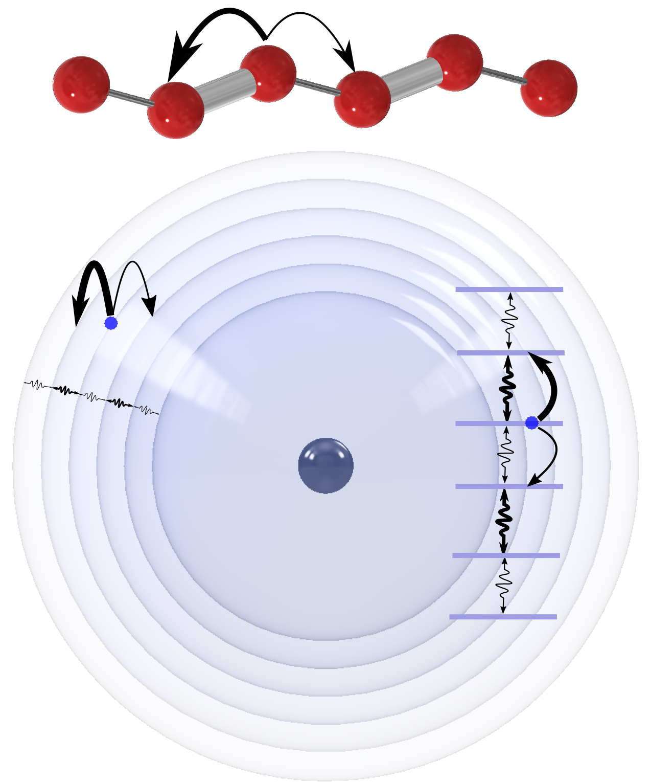
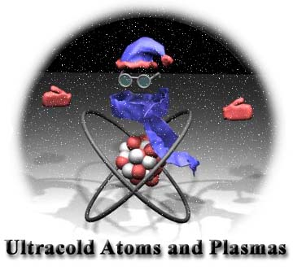
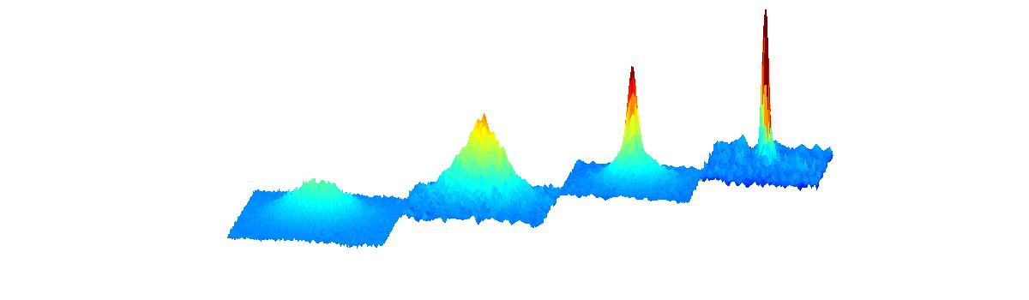



Rydberg Atom Synthetic Dimensions
Thomas C. Killian
F. Barry Dunning
Kaden R. A. Hazzard
Soumya Kanungo
Yi Lu, Chuanyu Wang
Shuhei Yoshida and
Joachim Burgdörfer
Rice University and Rice Center for Quantum Materials
Boston 2025

Slide 2
Outline
Rydberg Atom Synthetic Dimensions
Realizing the Su-Schrieffer-Heeger (SSH) single-particle Hamiltonian
  Measuring the band structure
  Topological edge states
  Extended coherence times and state-selective detection
  Wave-packet dynamics
  Measurement of the chiral displacement
Future Directions

Slide 3
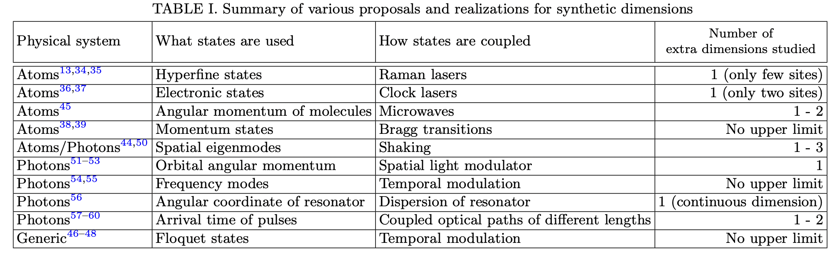
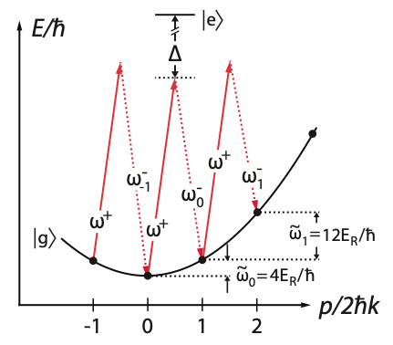
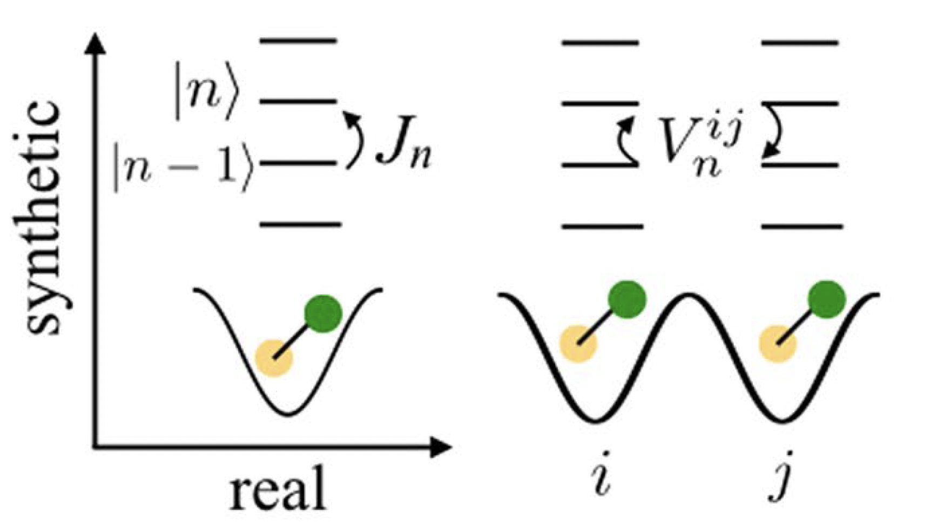
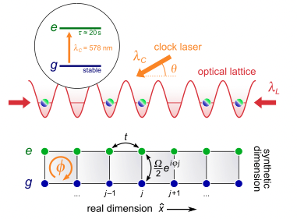
Synthetic Dimensions
Mancini et al. Science 349, 1510 (2015)
Gadway, PRA 92, 043606 (2015)
Sundar et al. Scientific reports 8, 3422 (2018).
Ozawa, T., Price, H.M. Topological quantum matter in synthetic dimensions. Nat Rev Phys1, 349–357 (2019)
Notes:
A synthetic dimension is a degree of freedom can be engineered to match the Hamiltonian of a particle or particles moving in a real-space potential, typically a lattice potentials. Such synthetic dimensions are powerful tools for
quantum simulation because of the control they offer, diagnostics, and the ability to create configurations
difficult to access in real space. Chiral edge states, synthetic fields. Rydberg states – 1st mentioned in Ozawa Nat Rev Phys, inspired by Sundar et al

Slide 4

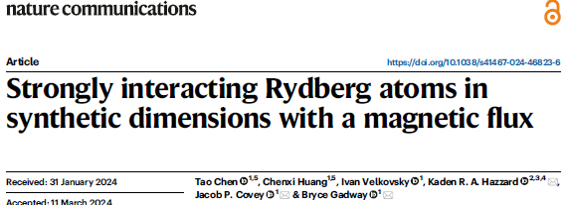
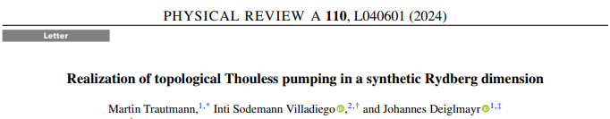
Synthetic Dimensions
Atoms Rydberg atomic states Microwaves/millimeter-waves
Ozawa, T., Price, H.M. Topological quantum matter in synthetic dimensions. Nat Rev Phys1, 349–357 (2019)
Notes:
A synthetic dimension is a degree of freedom can be engineered to match the Hamiltonian of a particle or particles moving in a real-space potential, typically a lattice potentials. Such synthetic dimensions are powerful tools for
quantum simulation because of the control they offer, diagnostics, and the ability to create configurations
difficult to access in real space. Chiral edge states, synthetic fields. Rydberg states – 1st mentioned in Ozawa Nat Rev Phys, inspired by Sundar et al

Slide 5
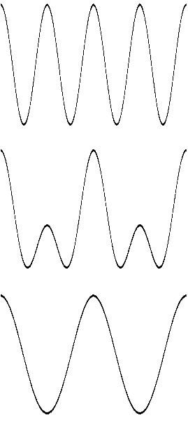
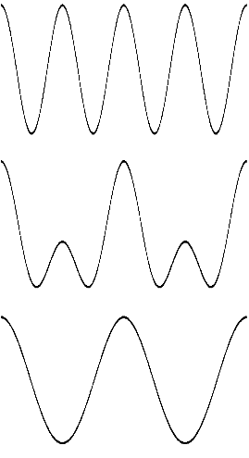
Rydberg Atom Synthetic Dimensions
63
Ω’
Ω
62
63
62
62
61
62
61
61
61
60
60
60
60
59
59
59
59
58
58
Term Energy
Term Energy
58
58
Atom in a Rydberg state corresponds to a particle in a specific site of a synthetic lattice site
Tunneling created by near-resonant microwave fields: rate set by intensities and transition matrix elements
Synthetic space configuration (dimension, topology) set by coupling pattern
On-resonance microwaves create degenerate lattice states; chemical potential set by detuning
57
57
Ω’
Ω’
57
57
Ω
56
Ω
56
56
56
55
55
5sns ¹S₀ 5snp ¹P₁
ns ¹S₀ np ¹P₁
Notes:
A synthetic dimension is a degree of freedom can be engineered to match the Hamiltonian of a particle or particles moving in a real-space potential. I will focus on discrete degrees of freedom, mimicking lattice potentials. Such synthetic dimensions are powerful tools for
quantum simulation because of the control they offer and the ability to create configurations
difficult to access in real space. Chiral edge states, synthetic fields

Slide 6
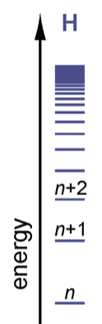
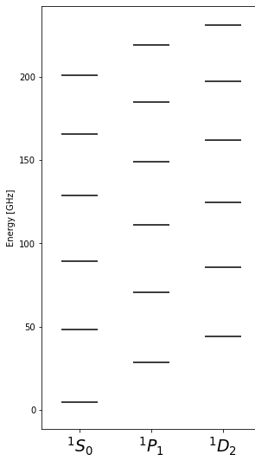
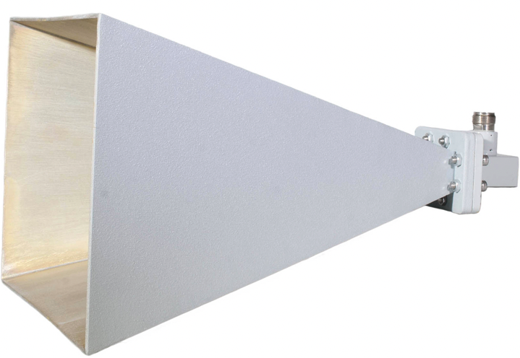
Rydberg Atom Synthetic Dimensions
Many States
Long lifetimes
Flexible state coupling
  ~1-100 GHz frequency difference, 1/n³ scaling
  Advanced commercial microwave components
  Large electronic matrix element
    ~ 1-10 MHz Rabi frequency easily achievable.
Single(or few)-site detection capability with selective field ionization
Notes:
A synthetic dimension is a degree of freedom can be engineered to match the Hamiltonian of a particle or particles moving in a real-space potential. I will focus on discrete degrees of freedom, mimicking lattice potentials. Such synthetic dimensions are powerful tools for
quantum simulation because of the control they offer and the ability to create configurations
difficult to access in real space. Chiral edge states, synthetic fields

Slide 7
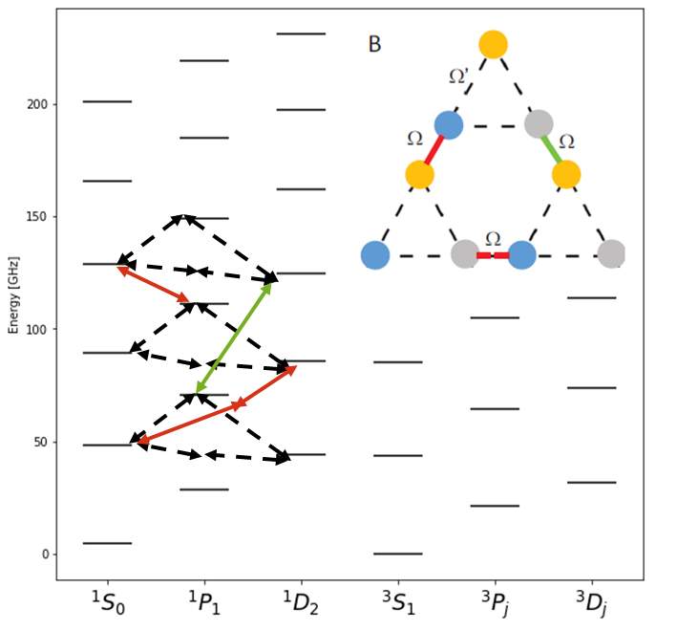
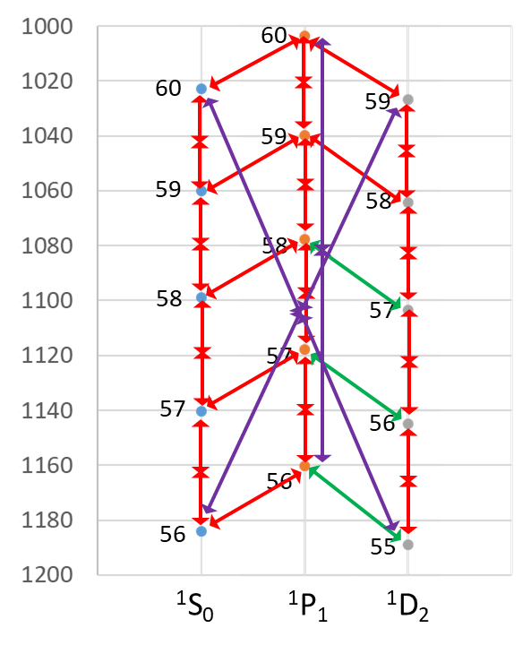
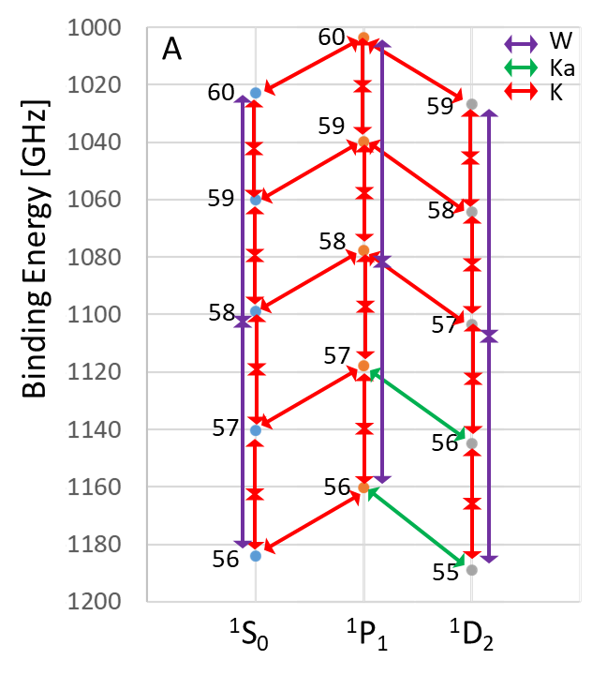
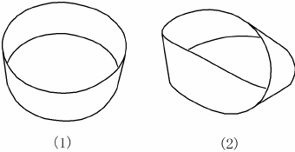
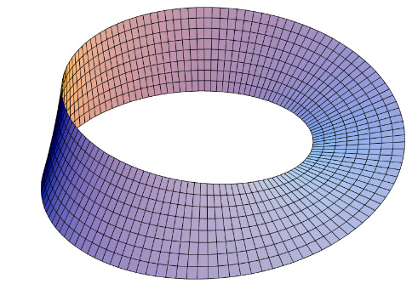
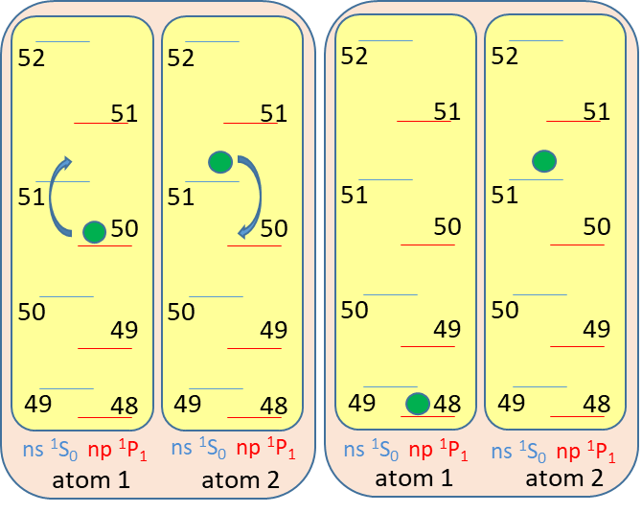
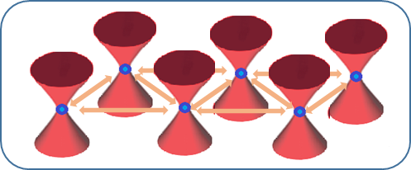
A Few Possibilities
Higher dimensions
Topologies not easily accessible in real space
Potential for Floquet drives, synthetic fields, disorder, dissipation, and many-body interacting states
Localized many-body interacting systems when combined with optical tweezers
Particle dynamics
Notes:
A synthetic dimension is a degree of freedom can be engineered to match the Hamiltonian of a particle or particles moving in a real-space potential. I will focus on discrete degrees of freedom, mimicking lattice potentials. Such synthetic dimensions are powerful tools for
quantum simulation because of the control they offer and the ability to create configurations
difficult to access in real space. Chiral edge states, synthetic fields

Slide 8
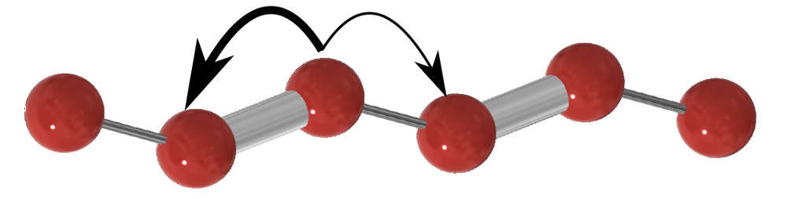
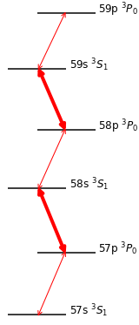
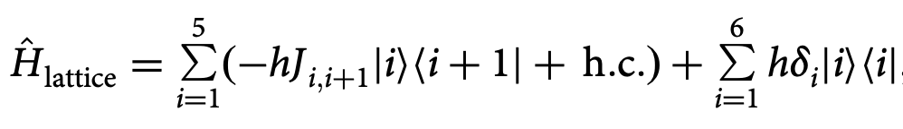
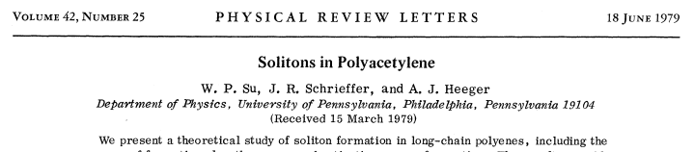
Concrete Example: Su-Schrieffer-Heeger (SSH) Hamiltonian
^{B}
^{A}
^{B}
^{A}
1D lattice (Finite)
N unit cells (2N sites with sublattices A and B)
Alternating strong and weak tunneling
No on-site potential
Simplest model with topological behavior
Chiral symmetry – all Hamiltonian terms are between sublattices
^{B}
^{A}
⁸⁴Sr
Notes:
A synthetic dimension is a degree of freedom can be engineered to match the Hamiltonian of a particle or particles moving in a real-space potential. I will focus on discrete degrees of freedom, mimicking lattice potentials. Such synthetic dimensions are powerful tools for
quantum simulation because of the control they offer and the ability to create configurations
difficult to access in real space. Chiral edge states, synthetic fields

Slide 9
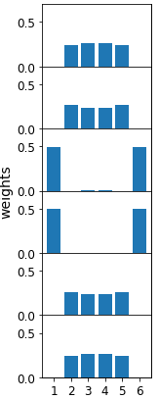
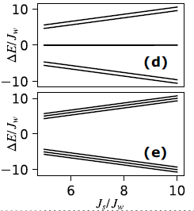
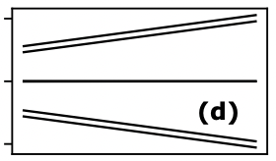
SSH Eigenstates in Topological Configuration: Edge States
^{i=6}
J_{s}
J_{s}/J_{w} = 10
Eigenstate
{| β >} decomposition
J_{w}
Band Structure
J_{s}
Energy
0
^{i=1}
⁸⁴Sr
Edge states with energy=0
Robust to perturbations preserving chiral symmetry
Signature of SSH Hamiltonian in topological configuration
J_{s} / J_{w}
Notes:
A synthetic dimension is a degree of freedom can be engineered to match the Hamiltonian of a particle or particles moving in a real-space potential. I will focus on discrete degrees of freedom, mimicking lattice potentials. Such synthetic dimensions are powerful tools for
quantum simulation because of the control they offer and the ability to create configurations
difficult to access in real space. Chiral edge states, synthetic fields

Slide 10
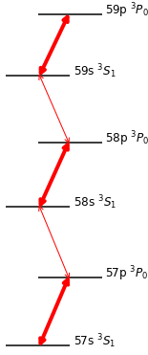
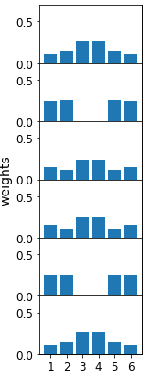
SSH Eigenstates in Trivial Configuration
^{i=6}
J_{w}
J_{s}/J_{w} = 10
Eigenstate
{| β >} decomposition
J_{s}
Band Structure
Energy
0
^{i=1}
⁸⁴Sr
J_{s} / J_{w}
Notes:
A synthetic dimension is a degree of freedom can be engineered to match the Hamiltonian of a particle or particles moving in a real-space potential. I will focus on discrete degrees of freedom, mimicking lattice potentials. Such synthetic dimensions are powerful tools for
quantum simulation because of the control they offer and the ability to create configurations
difficult to access in real space. Chiral edge states, synthetic fields

Slide 11
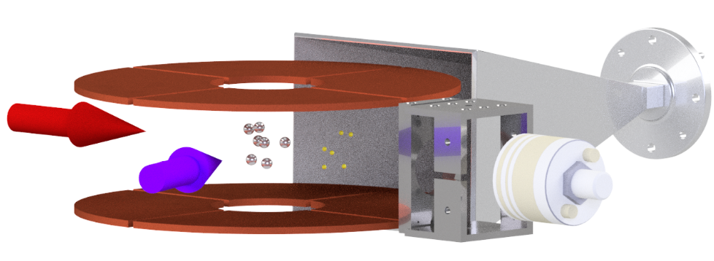
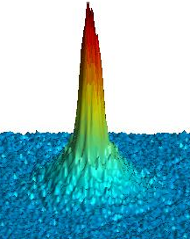
Experimental Details
1064 nm optical dipole trap
⁸⁴Sr thermal Bose gas ≤10¹² cm⁻³
Weak, pulsed (5 μs) two-photon excitation
One or zero Rydberg excitations per pulse for single particle dynamics in synthetic space
5sns ³S1
320 nm
³P2
³P1
³P0
689 nm
7.5 kHz
¹S0
Notes:
I feel incredibly lucky to work in ultracold atomic physics…

Slide 12
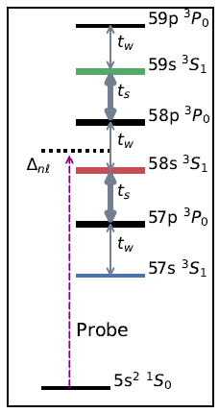

Experimental Details
1064 nm optical dipole trap
⁸⁴Sr thermal Bose gas ≤10¹² cm⁻³
Weak, pulsed (5 μs) two-photon excitation
One or zero Rydberg excitations per pulse for single particle dynamics in synthetic space
4G field lifts degeneracy of 5sns ³S₁ states
Band structure: microwaves applied during the excitation for band
Dynamics: microwaves applied after the excitation
~20GHz
J_{w}
J_{s}
J_{w}
J_{s}
J_{w}
Ω=2J up to 4 MHz
Notes:
I feel incredibly lucky to work in ultracold atomic physics…

Slide 13
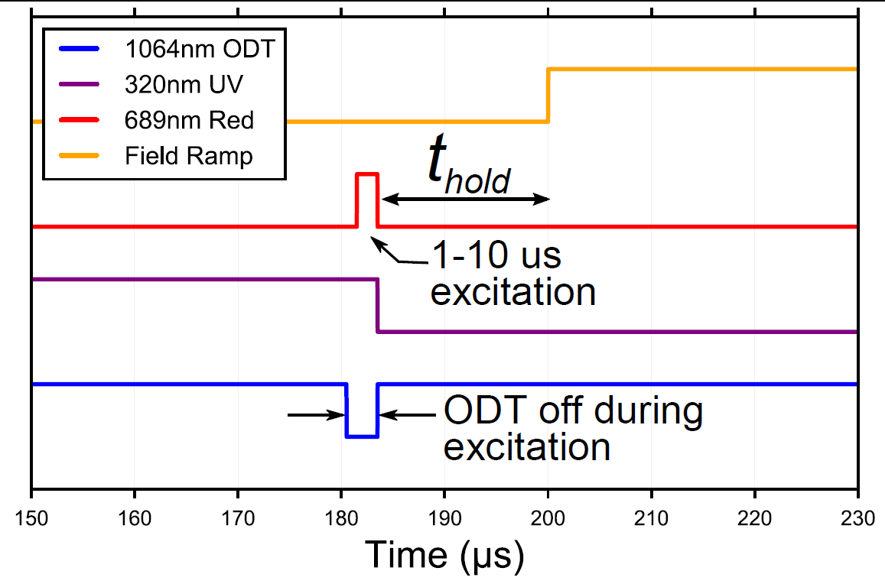
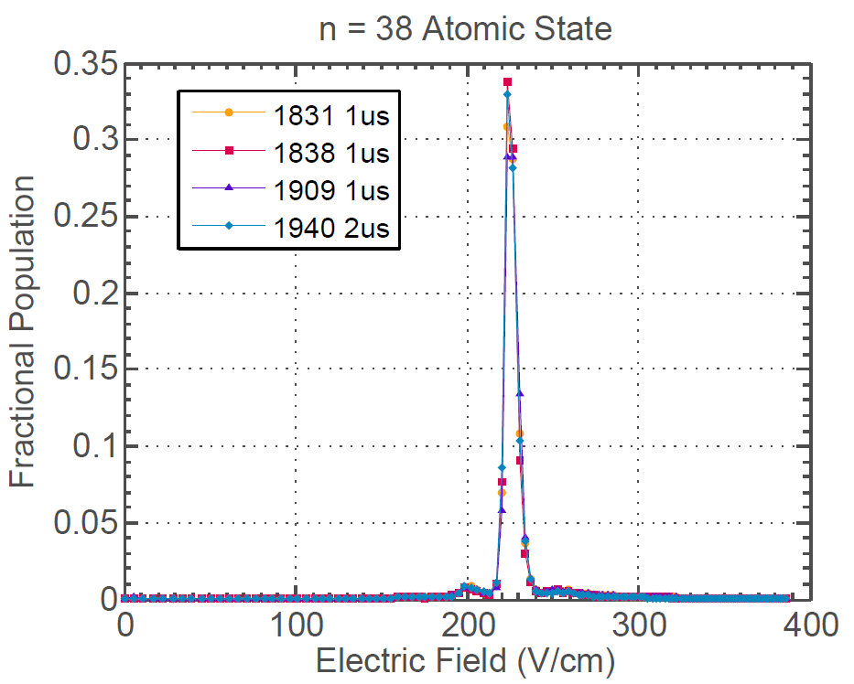
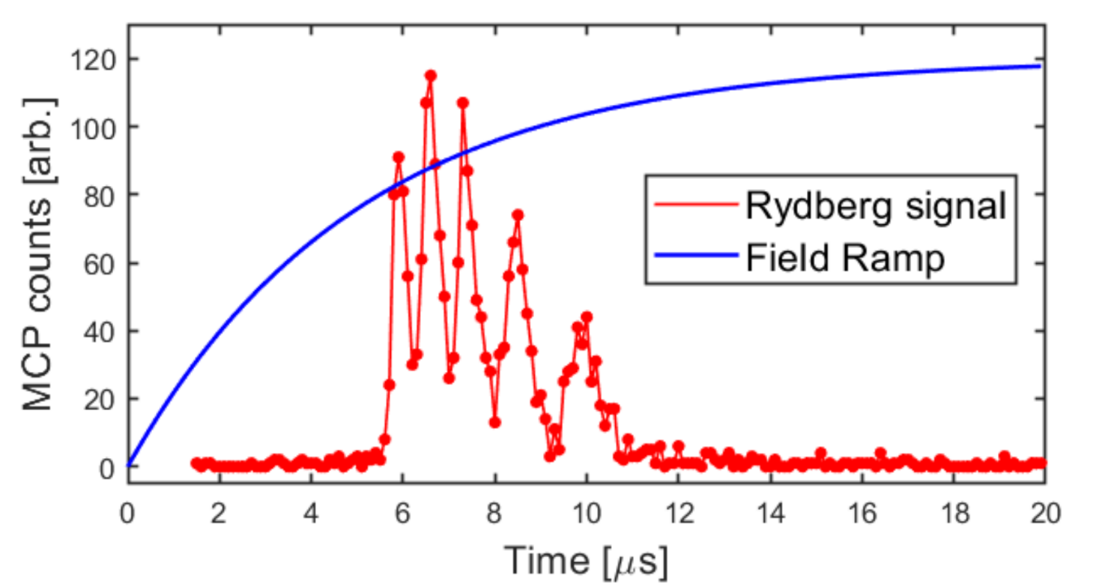

Selective Field Ionization and Charged Particle Diagnostics
5s38s ³S₁
62s
61s
63s
60s
59s
Ionization field decreases as $1/{n^{4}}$
Notes:
I feel incredibly lucky to work in ultracold atomic physics…

Slide 14
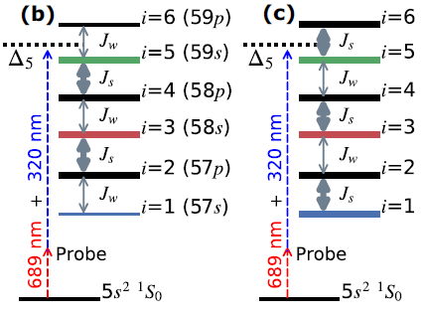
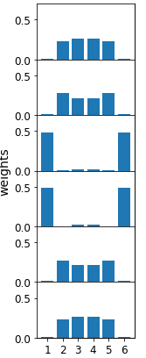
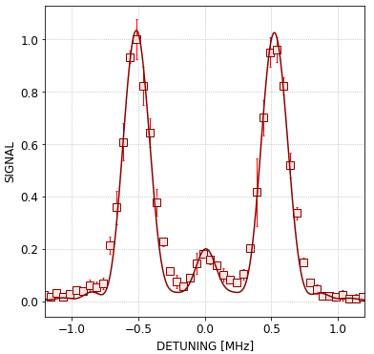
Probe of Synthetic Space Band Structure: Optical Excitation into Rydberg Manifold
Laser tuned near Rydberg state 3 (58s)
Detuning from state 3 sets band energy being probed
Signal intensity measures overlap of the dressed eigenstates with bare state 3
J_{w}
J_{s}
J_{w}
J_{s}
J_{w}

Slide 15
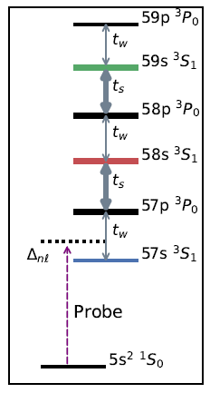
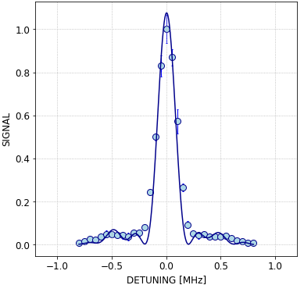
Probe: Optical Excitation into the Rydberg Manifold
Laser tuned near Rydberg state 1 (57s)
Detuning from state 1 sets band energy being probed
Signal intensity measures overlap of the dressed eigenstates with bare state 1
J_{w}
J_{s}
J_{w}
J_{s}
J_{w}

Slide 16
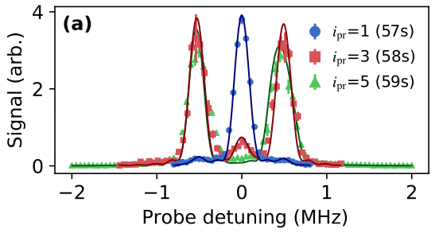
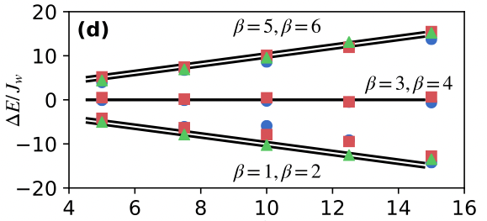
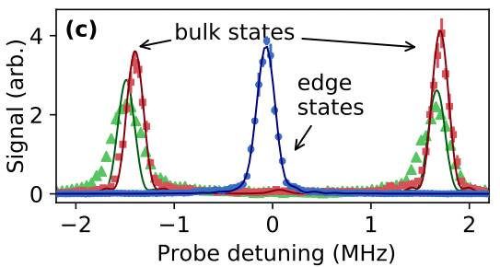
Band Structure
Combining the spectra at 1, 3 and 5.
Bulk and edge states are apparent
Fine structure not resolve
Increase J_{s} / J_{w}
J_{s} / J_{w}

Slide 17
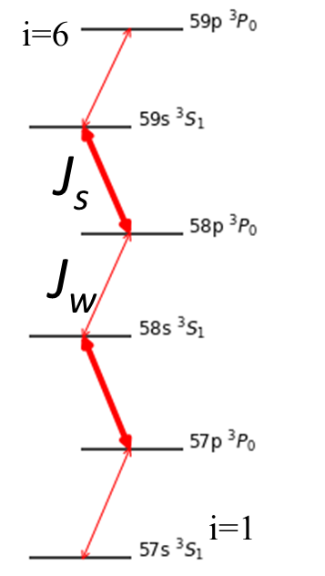
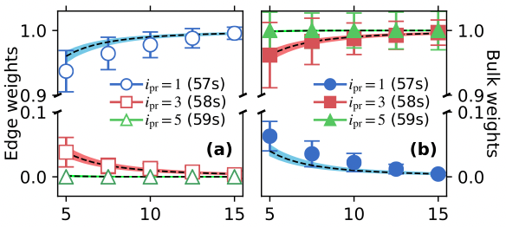
State Decomposition
Increase J_{s} / J_{w}
State with energy=0 is localized on edge (i=1, 57s)
Localization increases with J_{s} / J_{w}
Peak strengths follow expectation of direct diagonalization

Slide 18
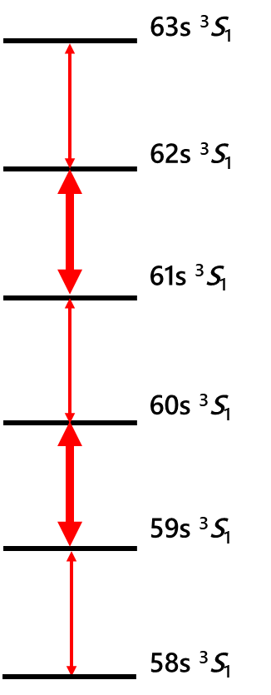
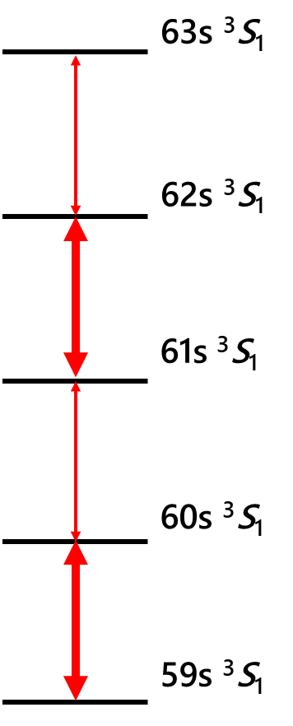
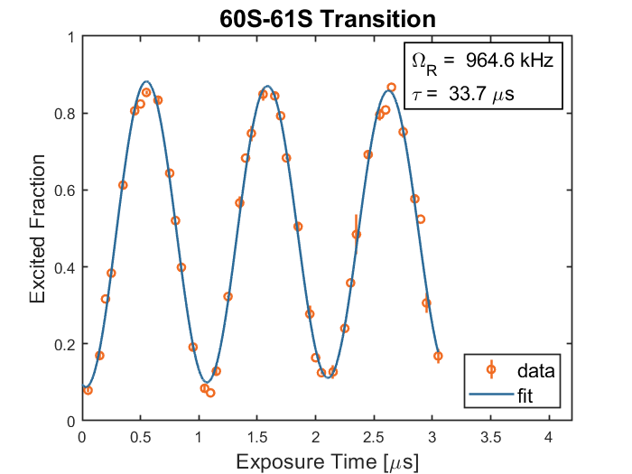
SSH Model with Pure ³S₁ State Ladder
³S₁-³S₁ two-photon transitions
  Resolved state decomposition with SFI
  Improved coherence times
  Lose localized interactions in synthetic space
62s
61s
63s
60s
59s

Slide 19
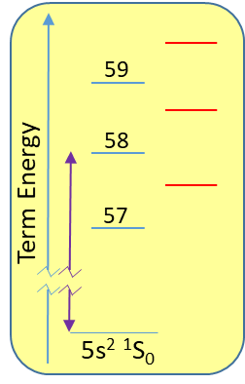







Dynamics in Synthetic Dimension
SFI provides decomposition (site occupancy)
Bulk vs edge state trajectories
Create localized particle
Apply desired Hamiltonian for evolution time
Freeze wave packet

Slide 20

Dynamics: Oscillations in the Bulk
Optically exciting 59s ³S₁ in the bulk
63s ³S₁
62s ³S₁
Ω_{s}
61s ³S₁
Fractional Population
Ω_{w}
60s ³S₁
Ω_{w}
Ω_{s}
59s ³S₁
320nm
58s ³S₁
mm-wave exposure Time [μs]

Slide 21

Dynamics: Oscillations in the Bulk
Optically exciting 59s ³S₁ in the bulk
Calculation assumes exact 800kHz/160kHz strong/weak Rabi frequency and resonant condition for all transitions
63s ³S₁
62s ³S₁
61s ³S₁
60s ³S₁
59s ³S₁
58s ³S₁

Slide 22








Coherence and Atom Loss
Long exposure-time scan suggest a coherence time of ~40μs
Protection of the edge state is more robust than the coherence
Blackbody plus natural decay gives ~75μs lifetime
Fractional Population
62S Fraction
mm-wave exposure Time [μs]
mm-wave Exposure Time [μs]
Notes:
Based on the previous calculation I did when we started the experiment, both the natural and BBR lifetime at this quantum number should be >140us as shown in this plot. This leads to a combined expected lifetime of ~70-80us.

Slide 23



Edge-to-Edge Tunneling
Optically exciting 58s ³S₁ on the edge

Slide 24





Edge States Splitting: Tunneling Rate
4-level
Optically exciting 58s ³S₁ (or 60s ³S₁ for 4-level ladder) on the edge.
Edge-to-edge tunneling rate
  resolves energy splitting between edge states
  varies as ${\left(\frac{Ω_{w}}{Ω_{s}}\right)}^{N}$
6-level
Notes:
In the slides I sent about the 6-level results, for each particular experiment (e.g. 'edge-to-bulk leakage' in this case), my description of the settings span a few pages as I could not fit them into one. For this particular data, the mm-wave exposure time is 2.4us.
In summary, both the 'edge-to-bulk' and 'bulk-to-edge' spectra were taken with 2.4us exposure time.
The 'edge-to-edge' spectrum, however, was taken with 20us exposure time as the edge-to-edge transfer takes longer to build up.
Thanks
Yi

Slide 25
Edge Localization and Bipartite Lattice
Optically exciting 58s ³S₁ on the edge
Short time oscillations between 58s and 60s
  localization of edge state
  bipartite lattice structure

Slide 26







Chiral Displacement: Bulk Measurement
Chiral displacement $\hat{C}\left(t\right)= \hat{Γ}⋅\hat{m}$
  $\hat{Γ}$ : chiral operator
  $\hat{m}$ : unit cell operator
Bulk observable with winding number $Ⱳ$ encoded
  $\left\langle \hat{C}(t)\right\rangle$ averages to $−Ⱳ/2$ at long time ^{[1]}
  $Ⱳ$=1 in SSH non-trivial phase
  $Ⱳ$=0 in SSH trivial phase
$$Ⱳ$$
Xie, D. et al. npj Quantum Inf 5, 55 (2019)
[1] Maria Maffei et al 2018 New J. Phys. 20 013023
https://phyx.readthedocs.io/en/latest/TI/Lecture%20notes/1.html
Notes:
In the slides I sent about the 6-level results, for each particular experiment (e.g. 'edge-to-bulk leakage' in this case), my description of the settings span a few pages as I could not fit them into one. For this particular data, the mm-wave exposure time is 2.4us.
In summary, both the 'edge-to-bulk' and 'bulk-to-edge' spectra were taken with 2.4us exposure time.
The 'edge-to-edge' spectrum, however, was taken with 20us exposure time as the edge-to-edge transfer takes longer to build up.
Thanks
Yi

Slide 27




Chiral Displacement
6-level
63s ³S₁
62s ³S₁
61s ³S₁
60s ³S₁
$\left\langle \hat{C}\left(t\right)\right\rangle$ measured with the bulk oscillations
Cumulative average of $\left\langle \hat{C}\left(t\right)\right\rangle$ converges quickly to near ${−Ⱳ}/2=−0.5$
59s ³S₁
$$\left\langle \hat{C}\left(t\right)\right\rangle =\left\langle \hat{Γ}⋅\hat{m}\right\rangle$$
$$=\left\langle −P_{58}+P_{59}−2P_{60}\right.$$
$\left.+2P_{61}−3P_{62}+3P_{63}\right\rangle$
58s ³S₁
4-level
Notes:
In the slides I sent about the 6-level results, for each particular experiment (e.g. 'edge-to-bulk leakage' in this case), my description of the settings span a few pages as I could not fit them into one. For this particular data, the mm-wave exposure time is 2.4us.
In summary, both the 'edge-to-bulk' and 'bulk-to-edge' spectra were taken with 2.4us exposure time.
The 'edge-to-edge' spectrum, however, was taken with 20us exposure time as the edge-to-edge transfer takes longer to build up.
Thanks
Yi

Slide 28






Interactions in Rydberg Synthetic Dimensions with Optical Tweezers
https://arxiv.org/abs/2306.00883
Sundar et al. Scientific reports 8, 3422 (2018).
Notes:
A synthetic dimension is a degree of freedom can be engineered to match the Hamiltonian of a particle or particles moving in a real-space potential. I will focus on discrete degrees of freedom, mimicking lattice potentials. Such synthetic dimensions are powerful tools for
quantum simulation because of the control they offer and the ability to create configurations
difficult to access in real space. Chiral edge states, synthetic fields

Slide 29









Thanks
Conclusions
Rydberg synthetic dimensions: a new platform for quantum simulation
  Single-particle realization
  SSH model and topological edge states
  Band Structure
  Dynamics
  Explore coherence and robustness of edge state
  Bulk-edge correspondence
  Next:
    Larger spaces
    Multi-particle systems
Post-doc positions open
F. Barry Dunning, Kaden Hazzard
Soumya Kanungo, Yi Lu, Chuanyu Wang, Joe Whalen
Shuhei Yoshida and Joachim Burgdörfer
Notes:
I feel incredibly lucky to work in ultracold atomic physics…

Slide 31

Challenges
General
  AC Stark shifts
  Hardware complexity with increasing number of states/lattice sites
  Decoherence
    80 us lifetime at n=60
³S₁-¹P₀ realization
  Decoherence variation with
  state and microwave power
Increase J_{s} / J_{w}

Slide 32

Challenges
General
  AC Stark shifts
  Hardware complexity with increasing number of states/lattice sites
  Decoherence
    80 us lifetime at n=60
³S₁-¹P₀ realization
  Decoherence variation with
  state and microwave power
  Unresolved state decomposition with SFI

Slide 33


Trivial Configuration
J_{s}
J_{w}
J_{s}
J_{w}
J_{s}
No edge states

Slide 34


Edge-to-Edge Tunneling: Resonance
Optically exciting 58s ³S₁ 0n the edge
Tunneling is very sensitive to edge-to-edge resonance
Fractional Population
20 μs mm-wave exposure
Edge Detuning [MHz]
Notes:
In the slides I sent about the 6-level results, for each particular experiment (e.g. 'edge-to-bulk leakage' in this case), my description of the settings span a few pages as I could not fit them into one. For this particular data, the mm-wave exposure time is 2.4us.
In summary, both the 'edge-to-bulk' and 'bulk-to-edge' spectra were taken with 2.4us exposure time.
The 'edge-to-edge' spectrum, however, was taken with 20us exposure time as the edge-to-edge transfer takes longer to build up.
Thanks
Yi

Slide 35


Breaking Chiral Symmetry
Optically exciting 58s ³S₁ on the edge
Larger detuning breaks the chiral symmetry and destroys the protection of the edge state
Faster time scale an broader resonance than edge-to-edge tunneling
2.4 μs mm-wave exposure
Edge Detuning [MHz]
Notes:
In the slides I sent about the 6-level results, for each particular experiment (e.g. 'edge-to-bulk leakage' in this case), my description of the settings span a few pages as I could not fit them into one. For this particular data, the mm-wave exposure time is 2.4us.
In summary, both the 'edge-to-bulk' and 'bulk-to-edge' spectra were taken with 2.4us exposure time.
The 'edge-to-edge' spectrum, however, was taken with 20us exposure time as the edge-to-edge transfer takes longer to build up.
Thanks
Yi

Slide 36
Topologically Trivial/Non-trivial
Notes:
In the slides I sent about the 6-level results, for each particular experiment (e.g. 'edge-to-bulk leakage' in this case), my description of the settings span a few pages as I could not fit them into one. For this particular data, the mm-wave exposure time is 2.4us.
In summary, both the 'edge-to-bulk' and 'bulk-to-edge' spectra were taken with 2.4us exposure time.
The 'edge-to-edge' spectrum, however, was taken with 20us exposure time as the edge-to-edge transfer takes longer to build up.
Thanks
Yi

Slide 37

Concrete Example: Su-Schrieffer-Heeger (SSH) Hamiltonian
^{i=6}
J_{s}
J_{w}
$$−\left[\begin{matrix}\begin{matrix}0 & J_{w} & 0 \\ J_{w} & 0 & J_{s} \\ 0 & J_{s} & 0\end{matrix} & \begin{matrix}0 & 0 & 0 \\ 0 & 0 & 0 \\ J_{w} & 0 & 0\end{matrix} \\ \begin{matrix}0 & 0 & J_{w} \\ 0 & 0 & 0 \\ 0 & 0 & 0\end{matrix} & \begin{matrix}0 & J_{s} & 0 \\ J_{s} & 0 & J_{w} \\ 0 & J_{w} & 0\end{matrix}\end{matrix}\right]$$
Eigenstates
{| β >}
^{i=1}
⁸⁴Sr
Notes:
A synthetic dimension is a degree of freedom can be engineered to match the Hamiltonian of a particle or particles moving in a real-space potential. I will focus on discrete degrees of freedom, mimicking lattice potentials. Such synthetic dimensions are powerful tools for
quantum simulation because of the control they offer and the ability to create configurations
difficult to access in real space. Chiral edge states, synthetic fields

Slide 38


Probe: Optical Excitation into the Rydberg Manifold
Laser tuned near Rydberg state 5 (59s)
Detuning from state 5 sets band energy being probed
Signal intensity measures overlap of the dressed eigenstates with bare state 5
J_{w}
J_{s}
J_{w}
J_{s}
J_{w}

Slide 39
Protection of the Edge State
Protection of the edge state is more robust than the coherence
Fractional Population
Fractional Population
mm-wave exposure Time [μs]
mm-wave exposure Time [μs]
Notes:
Based on the previous calculation I did when we started the experiment, both the natural and BBR lifetime at this quantum number should be >140us as shown in this plot. This leads to a combined expected lifetime of ~70-80us.

Slide 41
Plaquettes and interactions with optical tweezers
https://arxiv.org/abs/2306.00883
Notes:
A synthetic dimension is a degree of freedom can be engineered to match the Hamiltonian of a particle or particles moving in a real-space potential. I will focus on discrete degrees of freedom, mimicking lattice potentials. Such synthetic dimensions are powerful tools for
quantum simulation because of the control they offer and the ability to create configurations
difficult to access in real space. Chiral edge states, synthetic fields

Slide 42

AC Stark Shifts

Slide 43


Effects of Perturbations on the Edge States
Tunneling amplitude variations
No effect on edge state energy
J_{w}
J_{s}
J_{w}
J_{s}
J_{w}
Introducing on-site potential by varying detuning of microwave field

Slide 44

Challenges
AC Stark shifts
Hardware complexity with increasing number of states/lattice sites
Decoherence
  40 us lifetime at n=60
  Variation with state and
  microwave power
Switching to singlet Rydberg levels
  Lower state density
Increase J_{s} / J_{w}

Slide 45
Outline
Rydberg Atom Synthetic Dimensions
Realizing the Su-Schrieffer-Heeger (SSH) Hamiltonian and topological edge states
Future directions
Measuring three-body spatial correlations Ultralong-range Rydberg molecules (ULRRMs)
  Builds off of work with H. Sadeghpour, and R. Schmidt
ULRRMs in strongly interacting gases
  S. Yoshida, J. Burgdorfer, Vienna University of Technology

Slide 46

Selective Field Ionization:
Unresolved State Decomposition
Ionization field decreases as $1/{n^{4}}$
With Sr quantum defects – two site resolution

Slide 47


Electron-Atom Interaction and Ultralong-Range Rydberg Molecules
$$V_{atom}\left(R\right)≈\frac{2πh^{2}A_{s}}{m_{e}}{\left|Ψ_{ns}\left(R\right)\right|}^{2}$$
Ψ_{ns}(R): Rydberg electron wave function
A_{s}: e-atom s-wave scattering lengths
m_{e}: electron mass
Bendkowsky et al. Nature 458, 1005-1008 (2009)
Greene, Dickinson, and Sadeghpour, Phys. Rev. Lett. 85, 2458 (2000)
Electron probability density in Rydberg atom forms potential wells that can bind ground state atoms
Binding energies of MHz for any element with A_{s}<0
Molecules could be observed with ultracold atoms
Notes:
I feel incredibly lucky to work in ultracold atomic physics…

Slide 48

ULRRM in 84-Sr BEC
5s38s³S₁
Strontium Rydberg-background atom potential
bare atomic excitation
ν₃
75% Sr BEC
ρ_{max}=3x10¹⁴ cm⁻³
ν₂
ν₁
ν=3
?
ν₀
ν=2
ν=1
ν=0
Rydberg + atom in ν₀
Rydberg+ν₁
trimers:
Ryd+2 atoms
D₀
Rydberg+ν₂
D₁
Tr₀₀
Tr₀₁
Tr₀₂
Tr₁₁
D₂
D₄
Tr₂₂
Tr₁₂
D₃
Notes:
I feel incredibly lucky to work in ultracold atomic physics…

Slide 49
Rydberg Molecules of Sr
1064 nm optical dipole trap
⁸⁴Sr thermal Bose gas and BEC
  ≤3x10¹⁴ cm⁻³, 80 nm inter-particle spacing
⁸⁶Sr thermal Bose gas
  ≤1x10¹³ cm⁻³
⁸⁷Sr thermal Fermi gas with I=9/2
  ≤1x10¹³ cm⁻³
Simple structure
  No hyperfine or fine structure
  ¹S₀ ground-state perturber
  No p-wave resonance for electron-atom scattering
5sns ³S1
320 nm
³P2
³P1
³P0
  n=36, r_{ryd}~130 nm
  n=72, r_{ryd}~550 nm
689 nm
7.5 kHz
¹S0
Notes:
I feel incredibly lucky to work in ultracold atomic physics…

Slide 50

Probing Spatial Correlations with Ultralong-Range Rydberg Molecules
Excitation to a molecular state requires the presence in the initial gas of atoms with correct separation
Notes:
I feel incredibly lucky to work in ultracold atomic physics…

Slide 51


Most Deeply Bound Dimer: Mapping the Pair Correlation Function
Deepest-bound Rydberg-dimer state localized at R_{n}~1.8n²a₀
Excitation rate to this state proportional to probability of finding two particles with correct separation
  $Γ {∝g}^{2}\left(R_{n}\right)=\frac{〈Ψ^{\text{†}}\left(\vec{r}\right)Ψ^{\text{†}}\left(\vec{r}+{\vec{R}}_{n}\right)Ψ\left(\vec{r}+{\vec{R}}_{n}\right)Ψ\left(\vec{r}\right)〉}{{〈Ψ^{\text{†}}\left(\vec{r}\right)Ψ\left(\vec{r}\right)〉}^{2}}$
  pair-correlation function
tetrar
5s38s³S₁
  Powerful probe:
    Vary R_{n}
    select isotopes (mixtures), internal states
    in situ
    excellent time resolution
R_{n}
trimer
Pauli blocking
dimer
atomic
  collisional loss
Notes:
I feel incredibly lucky to work in ultracold atomic physics…

Slide 52






Thermal Bosons vs. Fermions
⁸⁴Sr
⁸⁷Sr
Unpolarized fermions in ⁸⁷Sr – 10 ground states
Nearly classical gas
Provides normalization
Notes:
I feel incredibly lucky to work in ultracold atomic physics…

Slide 53



Most Deeply Bound Trimer: Angle-averaged Three-body Correlations
Deepest-bound Rydberg-trimer state localized at R_{n}~2n²a₀
Excitation rate to this state proportional to probability of finding three particles with correct separation from central atom
  $Γ ∝{\left\langle g^{(3)}\left(R_{12}=R_{n},R_{13}=R_{n}, Ω_{12}, Ω_{13}\right)\right\rangle }_{Ω_{12}, Ω_{13}}={\left\langle \frac{〈Ψ^{\text{†}}\left(\vec{r}\right)Ψ^{\text{†}}\left(\vec{r}+{\vec{R}}_{12}\right)Ψ^{\text{†}}\left(\vec{r}+{\vec{R}}_{13}\right)Ψ\left(\vec{r}+{\vec{R}}_{13}\right)Ψ\left(\vec{r}+{\vec{R}}_{12}\right)Ψ\left(\vec{r}\right)〉}{{〈Ψ^{\text{†}}\left(\vec{r}\right)Ψ\left(\vec{r}\right)〉}^{3}}\right\rangle }_{Ω_{12}, Ω_{13}}$
5s38s³S₁
atomic
dimer
trimer
Notes:
I feel incredibly lucky to work in ultracold atomic physics…

Slide 54

Angle-averaged Three-body Correlations
atomic
dimer
trimer
⁸⁴Sr
Ratio of signal to that of unpolarized fermions in ⁸⁷Sr – 10 ground states
Also normalized for density and laser intensity
⁸⁷Sr
Notes:
I feel incredibly lucky to work in ultracold atomic physics…

Slide 55



ULRRM Dimer Spectra:
⁸⁶Sr –Effects of interaction in initial gas
⁸⁴Sr ν=0 dimer
⁸⁶Sr ν=0 dimer
86
84
Sr scattering lengths (a₀)
86
811
32
84
-
123

Slide 56


New Probe of Non-local Spatial Correlations
?
scattering wave functions, non-equilibrium
many-body states
e.g. 1D gases
quantum statistics
Kinoshita et al. Science 305, 1125 (2004)
Notes:
I feel incredibly lucky to work in ultracold atomic physics…

Slide 57







Ultracold Atoms and Plasmas at Rice
ultracold neutral plasmas
quantum degenerate strontium
Ionizing beam
Imaging beam
¹P₁
¹S₀
Grant Gorman
MacKenzie Warrens
ultracold Rydberg gases
James Aman
Josh Hill
Roger Ding
Joe Whalen
Soumya Kanungo
Haad Rathore
Notes:
I feel incredibly lucky to work in ultracold atomic physics…

Slide 58










Rydbergs and Polarons Coming Full Circle
?
+
-
Notes:
I feel incredibly lucky to work in ultracold atomic physics…

