Slide 1

Potential of 2D Dichalcogenides for
Future Electronics
Quantum Information Science on the Intersections of Nuclear and AMO Physics
Goran Karapetrov
Department of Physics
Department of Materials Science and Engineering
Drexel University
Boston, MA
Jan 13-15, 2025

Slide 2

Outline
Motivation for using Ising Superconductors in NP
Ising Superconductivity in 2D Materials
Experimental Setup & Results
Outlook
Supported by DOE – NP DE-SC0023667

Slide 3
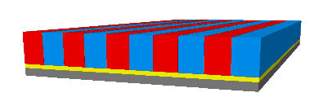
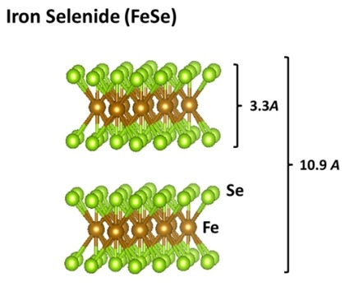
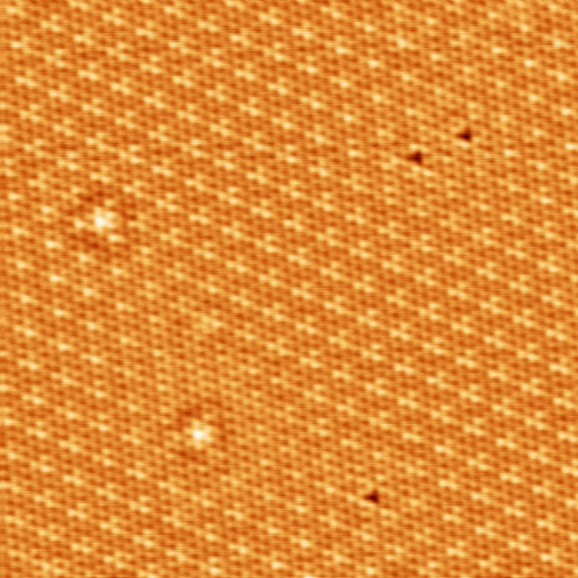

Our Research Group - Current Research Areas
Engineered Correlated Electron Systems
Novel Superconducting Materials
Charge Density Wave Materials

Slide 4
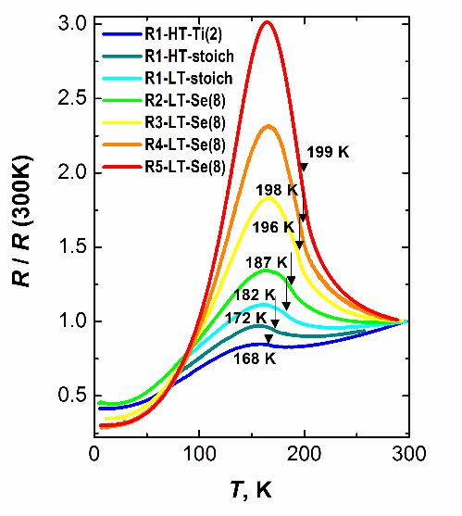
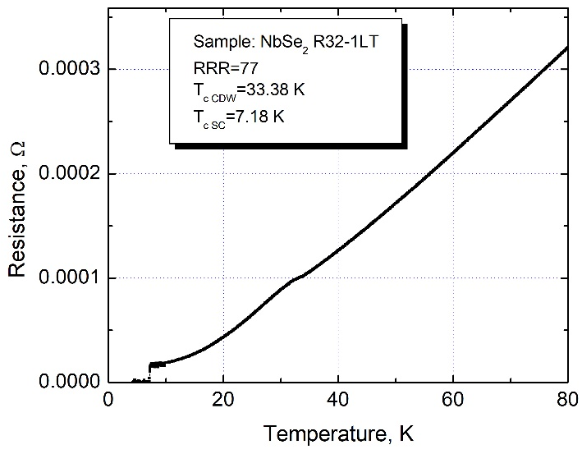
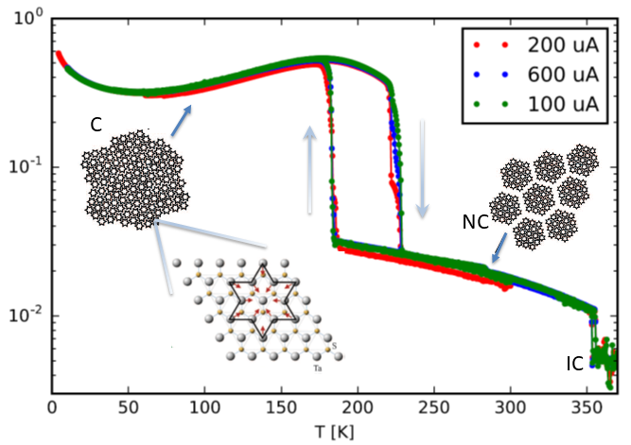
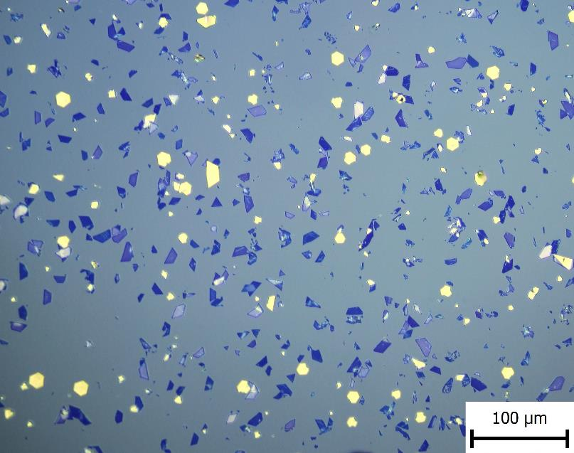
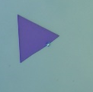
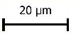
Growth of Single Crystal Dichalcogenides
TiSe₂
NbSe₂
TaS₂
Thin film growth using chemical vapor transport
2I₂(g) + Ti(s) + 2Se(s) → TiI₄(g) + Se₂(g) → TiSe₂(s) + 2I₂(g)

Slide 5
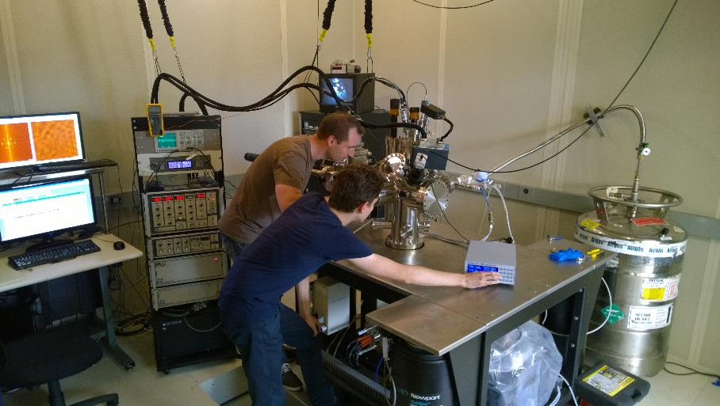
UHV Scanning Probe Microscopy
UHV 10⁻¹¹ Torr
minimum temp. 30K
E-beam evaporators
LEED/Auger, e-beam heating, etc
5

Slide 6
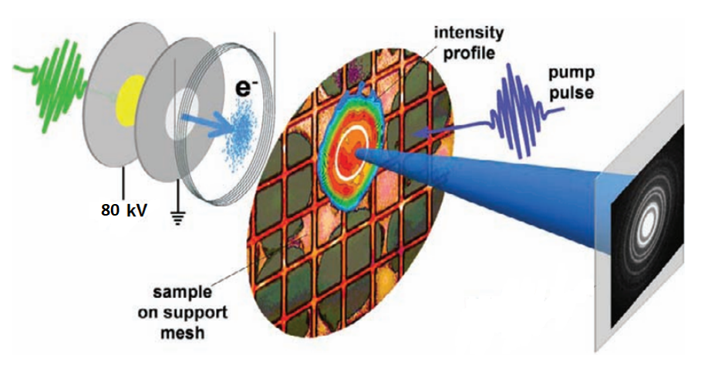
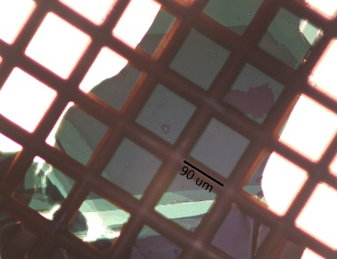
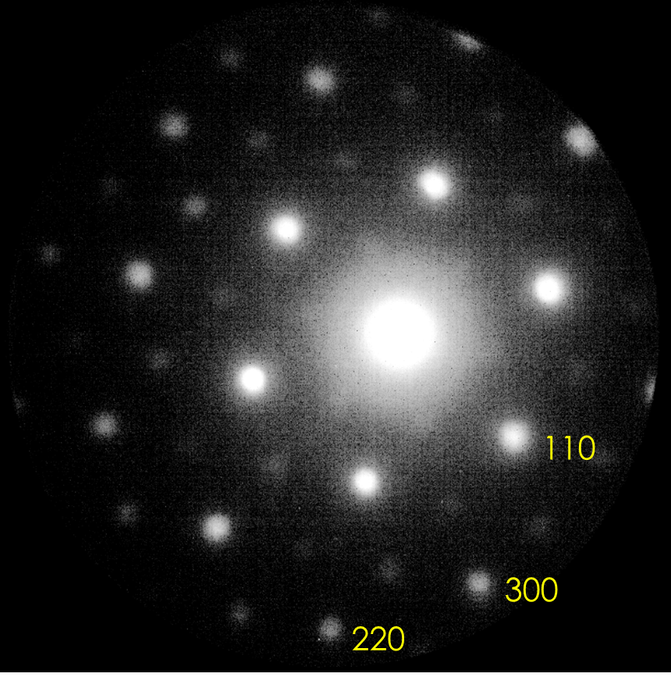
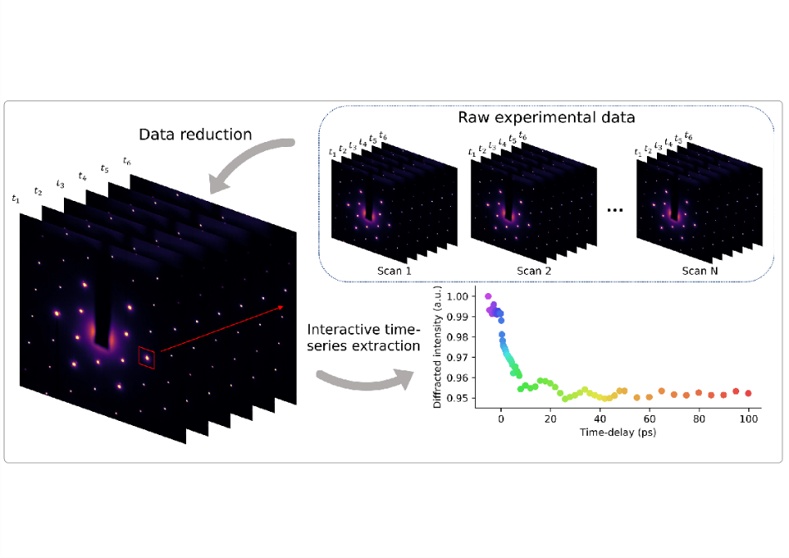
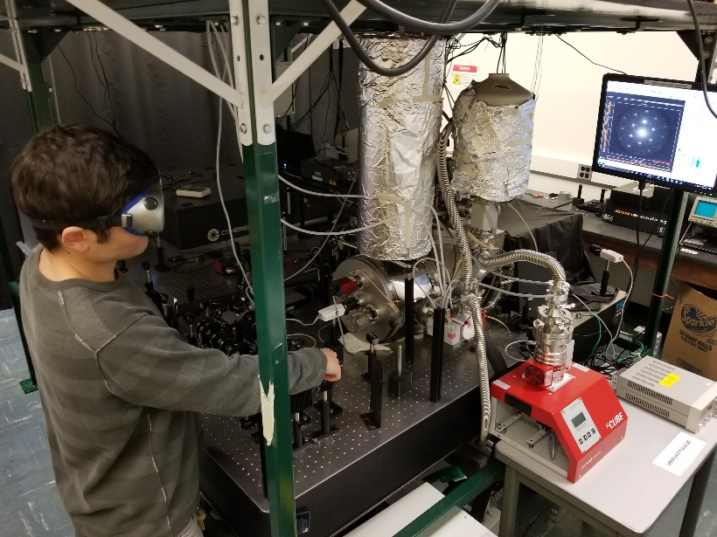
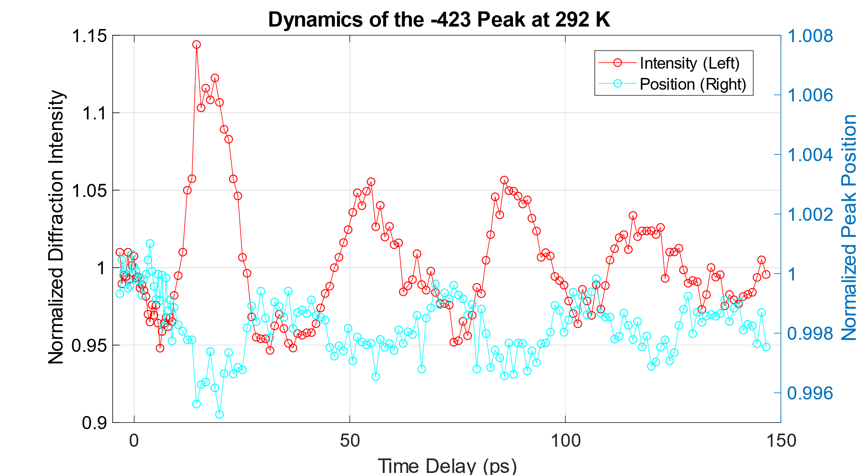
Ultrafast Dynamics: Ultrafast Electron Diffraction
R. Ernstorfer, M. Harb, C. T. Hebeisen, G. Sciaini, T. Dartigalongue and R. J. D. Miller, Science (2009)
L. P. René de Cotret, et al., Advanced Structural and Chemical Imaging 4 (1), 11 (2018)

Slide 7
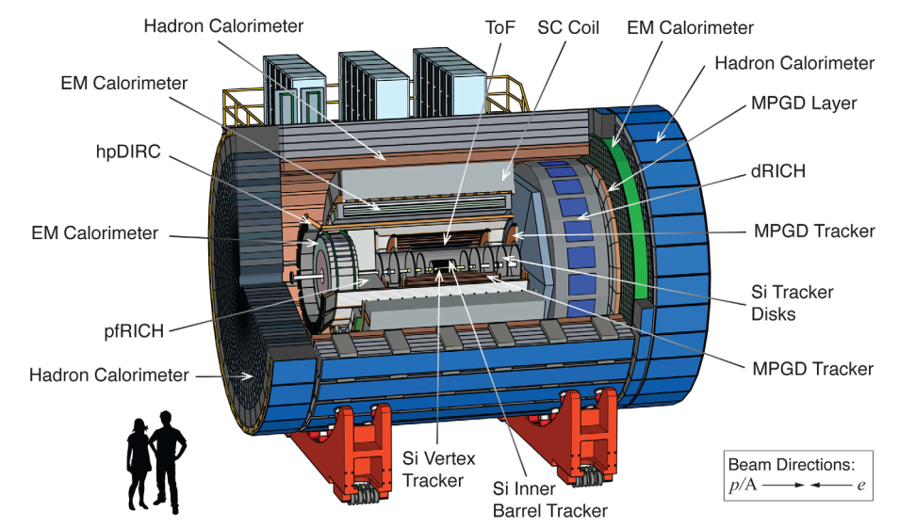
Particle and Single Photon Detectors in
High Magnetic Fields
Precision measurements require large magnetic fields. This demands field-resistance photon detectors for particle identification devices such as RICH detectors

Slide 8
Superconductivity
Normal State
H_{c2}
Upper critical field
Δ R
Vortex State
ΔT
Magnetic Field
SC transition
H_{c1}
Lower critical field
Meissner State
Temperature
T_{c}

Slide 9
Singlet Superconductors in High Magnetic Fields
Orbital effect (Lorentz force)
Paramagnetic effect (singlet pair)
p
B
F_{L}
F_{L}
-p
Kinetic energy of the supercurrent exceeds the superconducting gap energy
μ_{B}H_{c2}~Δ~T_{c}
S_{z}=+1/2
S_{z}=-1/2
Spin paramagnetism exceeds the condensation energy of Cooper pair

Slide 10
Superconductivity Beyond :
Overcoming Pauli Limit
FFLO superconductivity (Fulde-Ferrel-Larkin-Ovchinnikov state)
Spin Triplet superconductivity
Spin-orbit scattering
Spin-orbit coupling (Ising superconductivity)
S_{z}=+1/2
S_{z}=-1/2

Slide 11
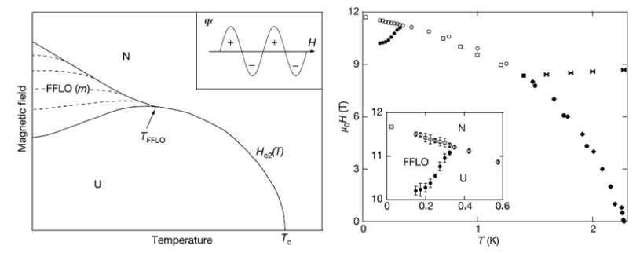
FFLO Superconductivity
Non-zero momentum Cooper pairs giving rise to inhomogeneous superconductivity
Requirement: coherence length << mean free path (clean limit)
H.A. Radovan et al. Nature 425 (2003) 51

Slide 12
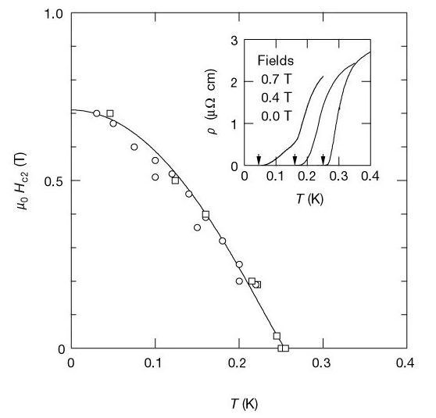
Spin Triplet Superconductivity
S_{z}=+1/2
S_{z}=-1/2
S_{z}=+1/2
S_{z}=+1/2
Singlet Cooper pair (s=0)
Triplet Cooper pair (s=1)
URhGe
Aoki et al. Nature 413 (2001) 613

Slide 13
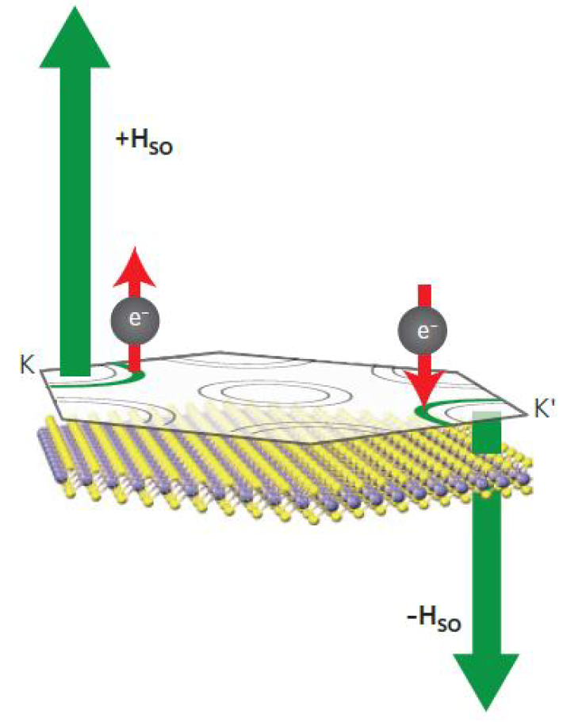
Ising Superconductivity
Intrinsic spin-orbit coupling induced Zeeman field
(locks the spins of Cooper pairs in opposite directions in opposite corners K, -K)
Effective Zeeman field prevents the alignment of the spins in the plane when in-plane magnetic field is applied (protects the superconducting state)
In-plane upper critical field overcomes Pauli limited:

Slide 14
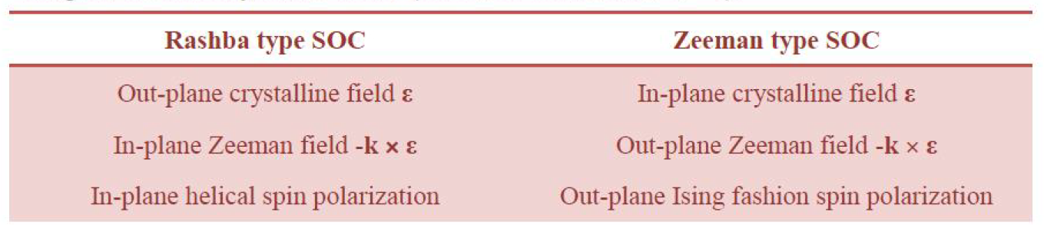
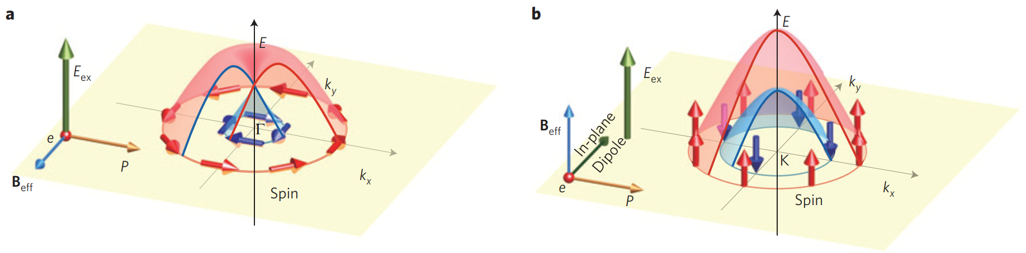
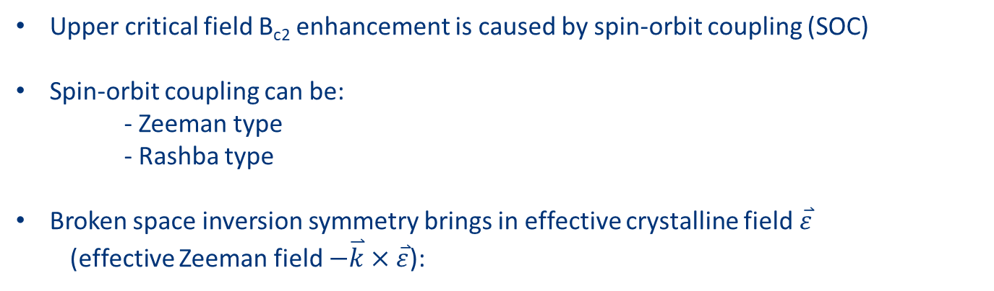
Necessary Ingredients for Ising Superconductivity
Upper critical field B_{c2} enhancement is caused by spin-orbit coupling (SOC)
Spin-orbit coupling can be:
- Zeeman type
- Rashba type
Broken space inversion symmetry brings in effective crystalline field$\overset{⃑}{ε}$
(effective Zeeman field $−\overset{⃑}{k}×\overset{⃑}{ε}$):
Yuan et al. Nature Phys 9 (2013) 563

Slide 15
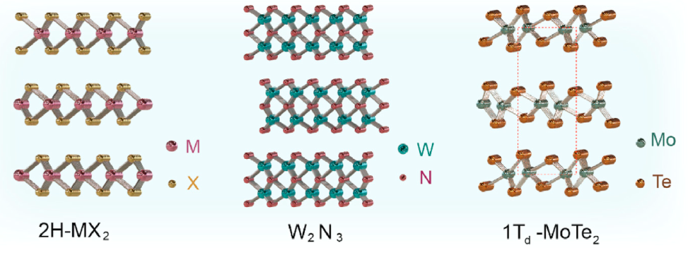
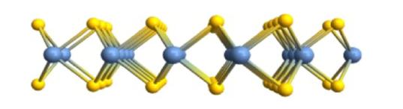
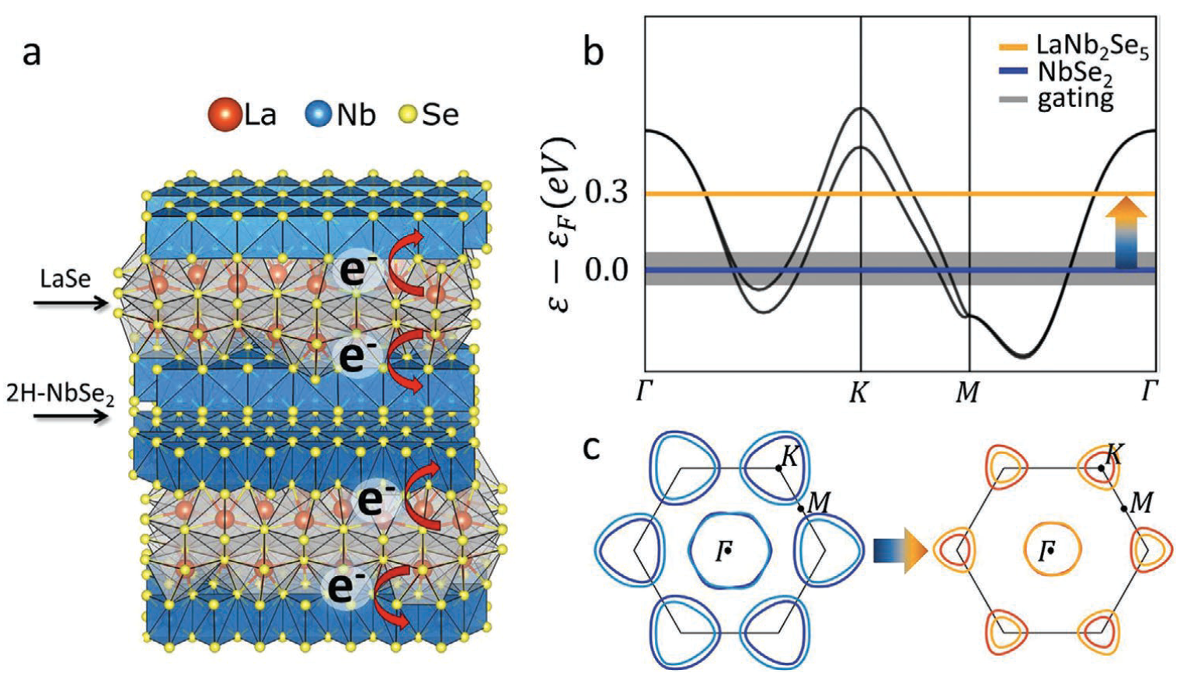

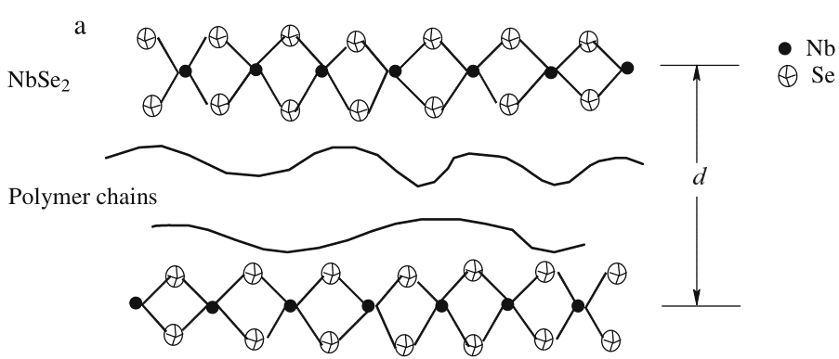
Materials Hosting Ising Superconductivity
Monolayers (with large SOC and broken inversion symmetry)
Bulk quasi-2D crystals with alternating SOC/buffer layers
Bulk 2D crystals intercalated with molecules to decouple individual layers
Non-Ising: amorphous thin films (with large spin-orbit scattering i.e. spin randomization)

Slide 16
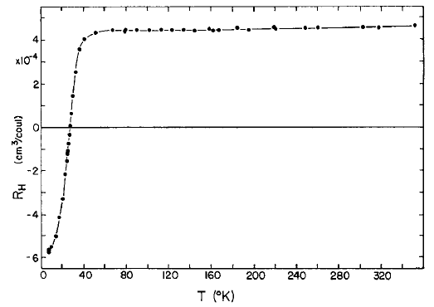
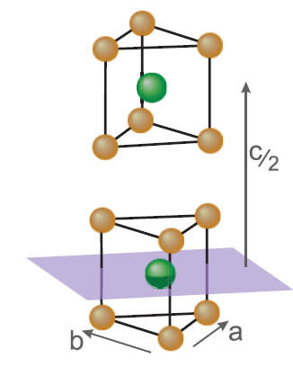
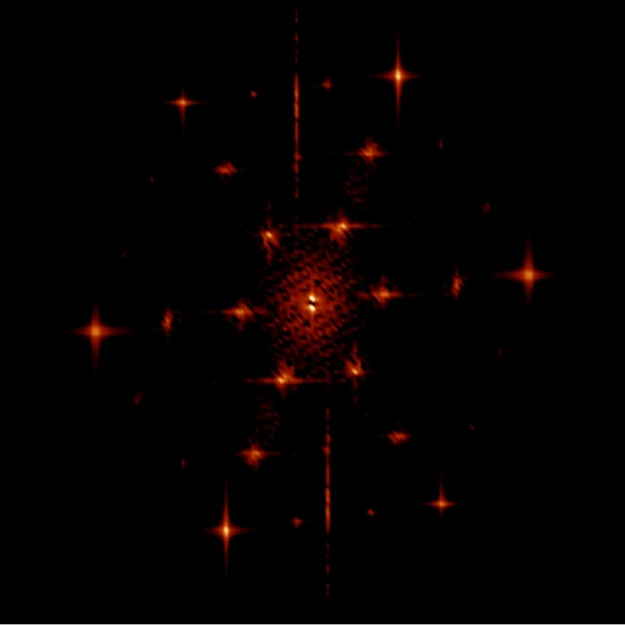
Basic Properties of 2H-NbSe₂
RRR ~ 100
T_{c CDW} = 33.5 K
T_{c SC} = 7.2 K
n-type
p-type
CDW
5% ↑ R
SC
H.N.S. Lee et al., JAP 40 (1969) 602
Incommensurate CDW
17.2 nm x 17.2 nm T=4.2K
M. Iavarone et al., JPCM 22 (2009) 015501

Slide 17
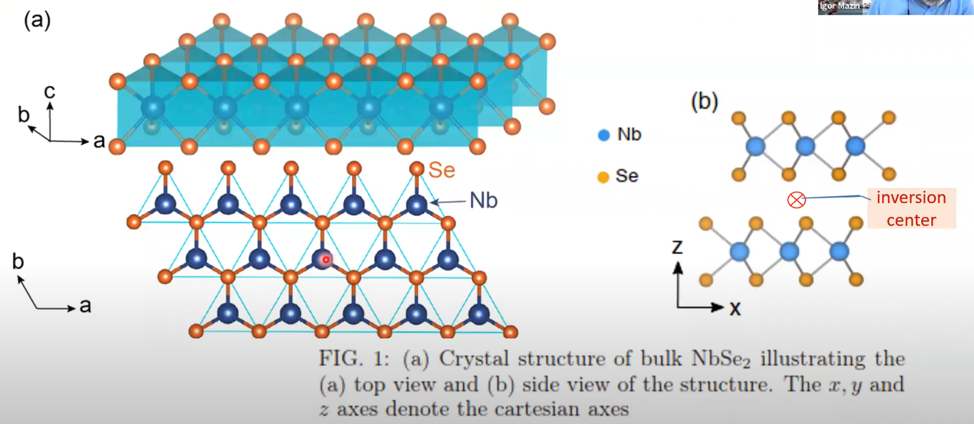
Electronic Structure of NbSe₂ Monolayers
top view
side view
absence of inversion symmetry + spin-orbit coupling = band splitting
D. Wickramaratne et al. PRX 10 (2020) 041003

Slide 18
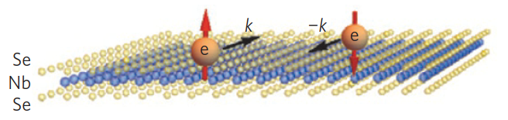
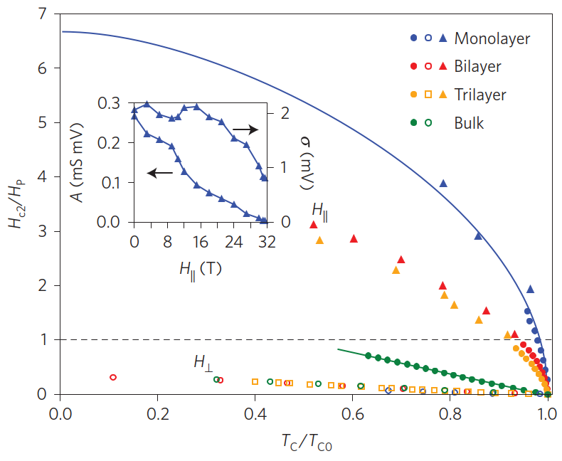
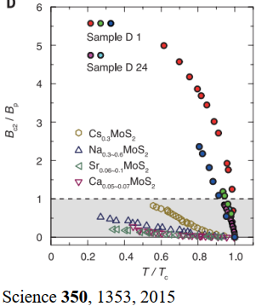
Ising Superconductivity in Monolayers of Transition Metal Dichalcogenides (2H-NbSe₂, 2H-MoS₂…)
Xi et al. Nat Phys 12 (2016) 139

Slide 19
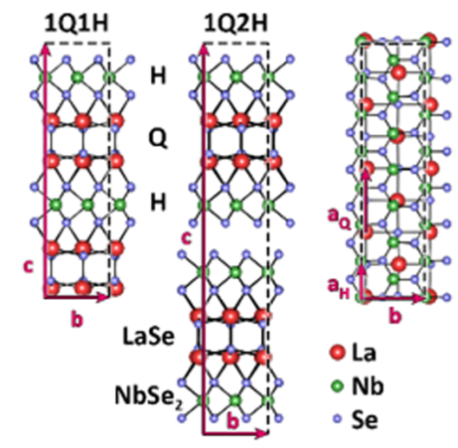
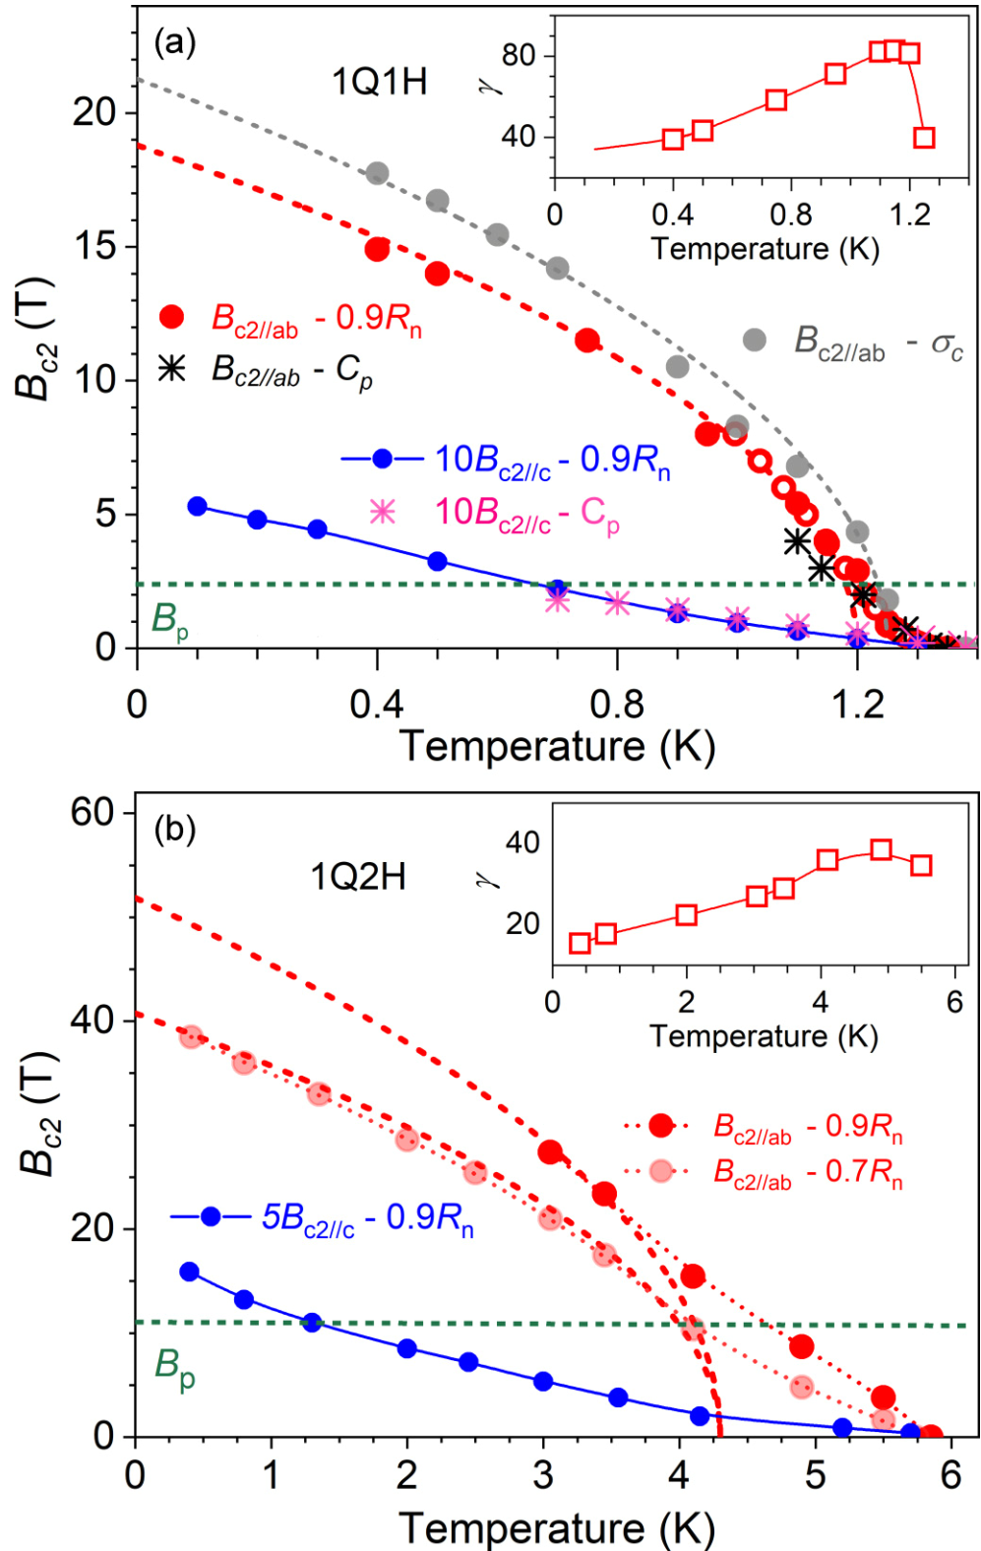
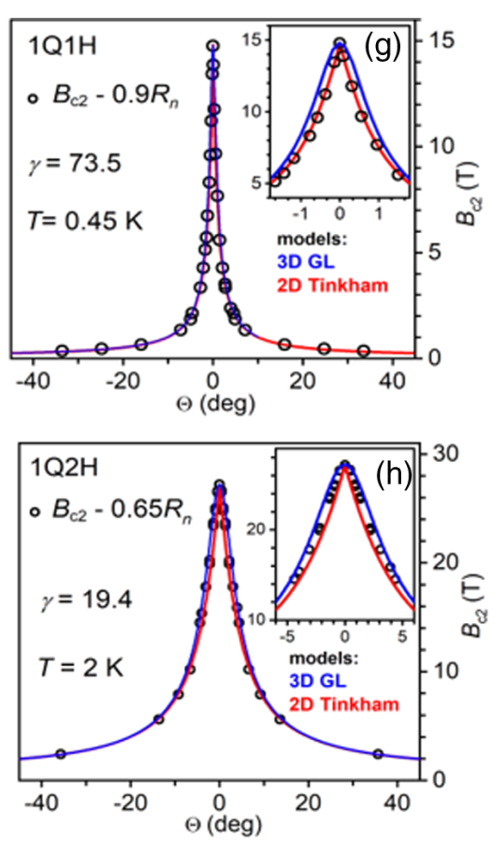

Ising Superconductivity in Intrinsic Bulk Materials
P. Samuely et al. PRB 104 (2021) 224507

Slide 20
Ising Superconductivity in Intrinsic Bulk Materials
LaSe buffer layers provide massive amount of e⁻ to NbSe₂ layers
R.T. Leriche al. Adv. Funct. Mater. 31 (2021) 2007706

Slide 21
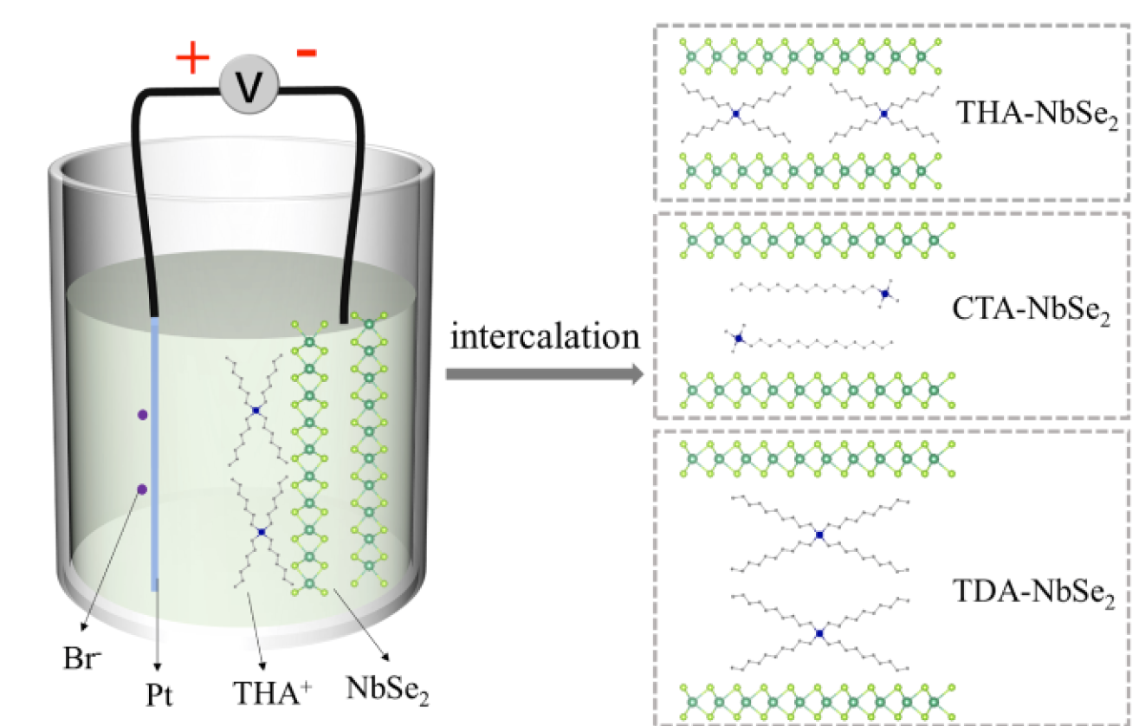
Ising Superconductivity in Artificially Structured Materials
Decoupling the lattice unit layers to achieve: (1) breaking of inversion symmetry
(2) doping
Decoupling of NbSe₂ monolayers through intercalation
Decoupling of NbSe₂ monolayers through MBE growth

Slide 22
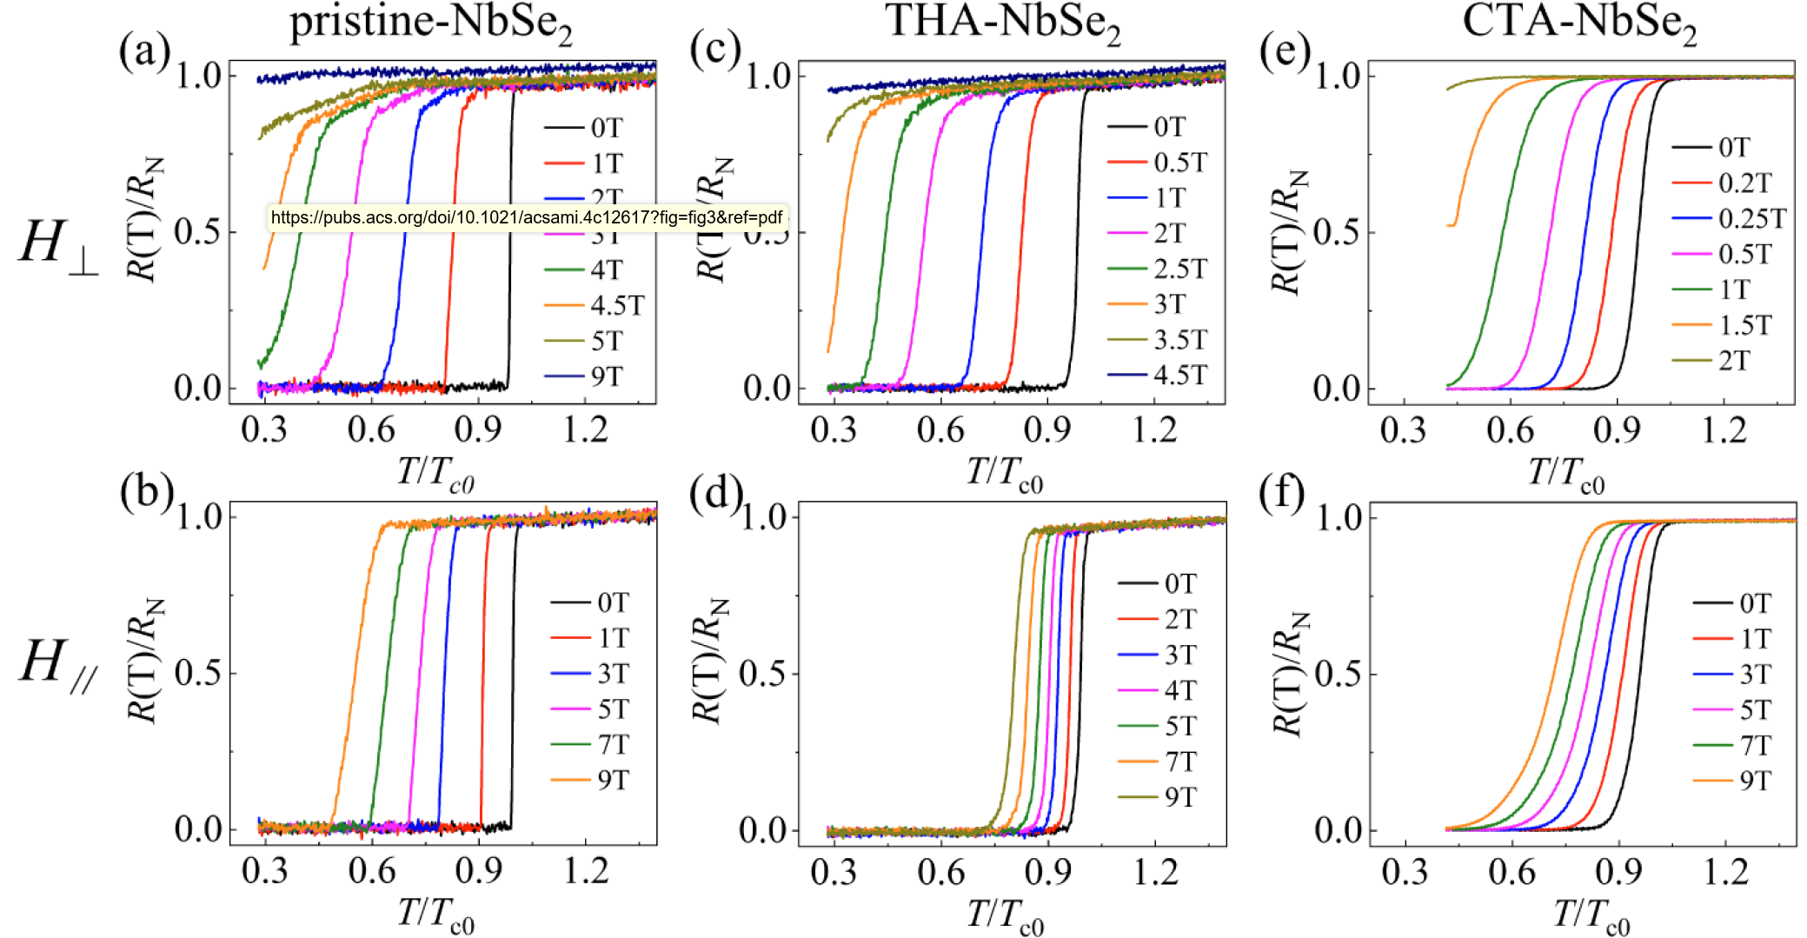
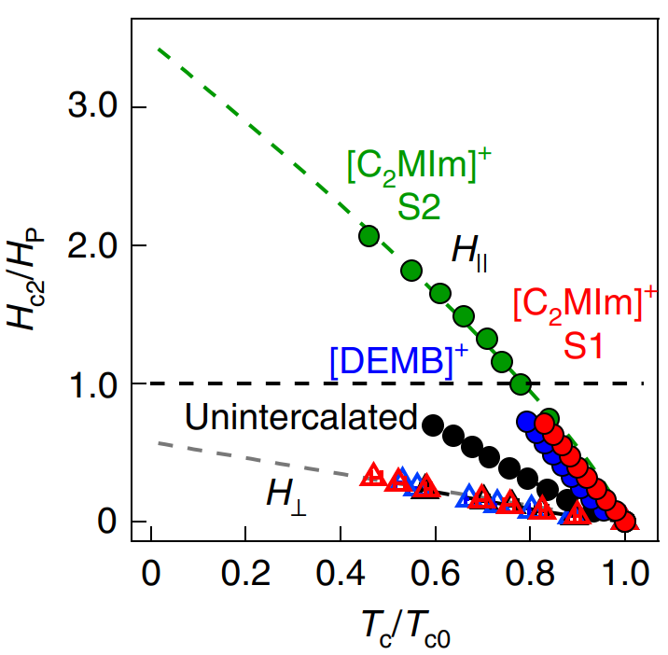
Ising Superconductivity in Fabricated Materials
Decoupling of NbSe₂ monolayers through intercalation
Yu et al. ACS Appl Mat Interf 16 (2024) 5904
Zhang et al. Nat Phys. 18 (2022) 1425

Slide 23
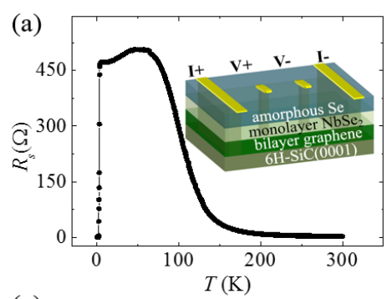
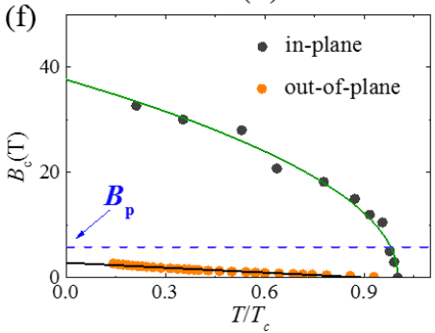
Ising Superconductivity in Artificially Structured Materials
Decoupling the lattice unit layers to achieve: (1) breaking of inversion symmetry
(2) doping
Decoupling of NbSe₂ monolayers through intercalation
Decoupling of NbSe₂ monolayers through MBE growth
Xing et al. Nano Lett. 17 (2017) 6802

Slide 24
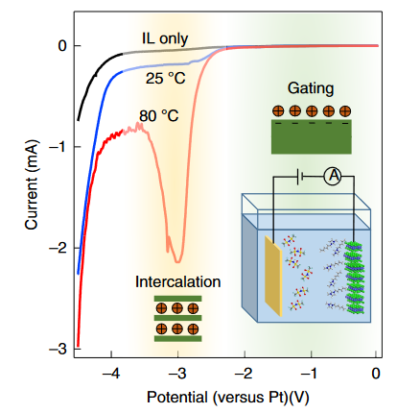
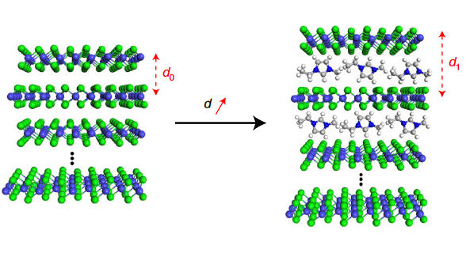
Electrochemical Intercalation of NbSe₂ Single Crystal
NbSe₂ intercalation with organic molecules
Current-Voltage graph of intercalating NbSe₂ and diagram of intercalation process in the ionic liquid
Zhang et al. In: Nat Phys 18 (2022) 1425

Slide 25
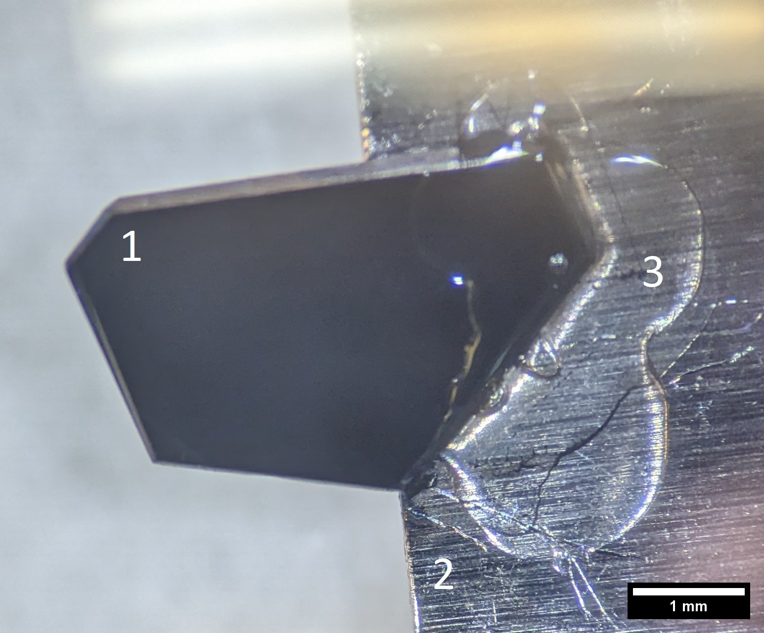
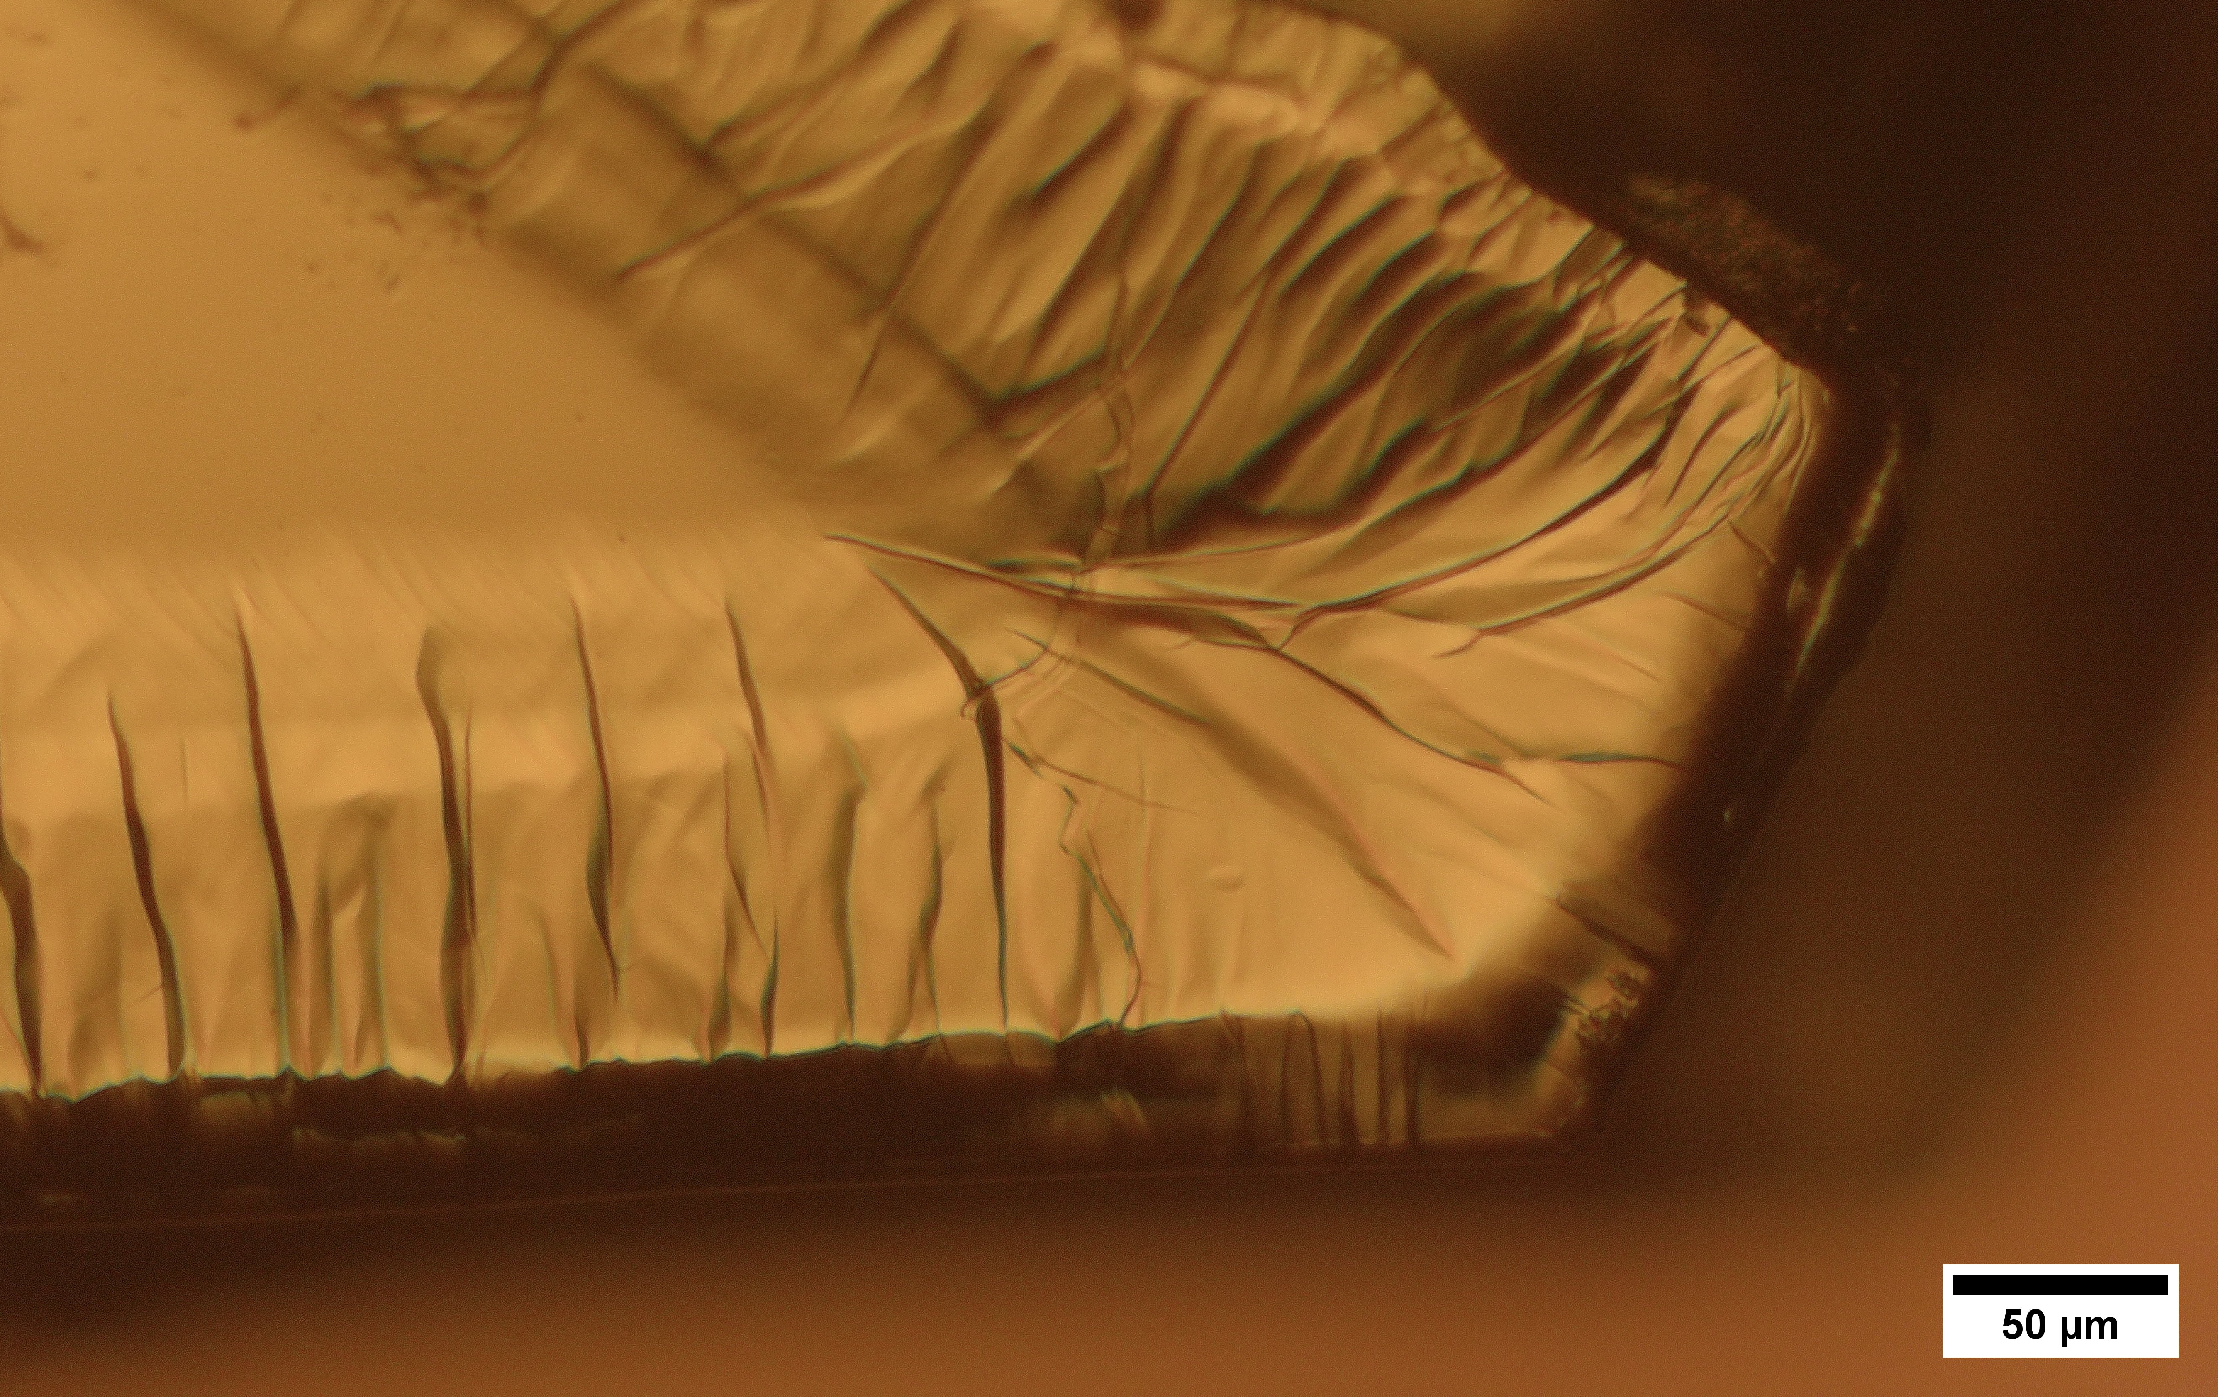
Electrochemical Intercalation of NbSe₂ with [C₂MIm]⁺
NbSe₂ single crystal
Pt electrode
Nail polish
Optical image of the single crystal after 1 hour intercalation

Slide 26
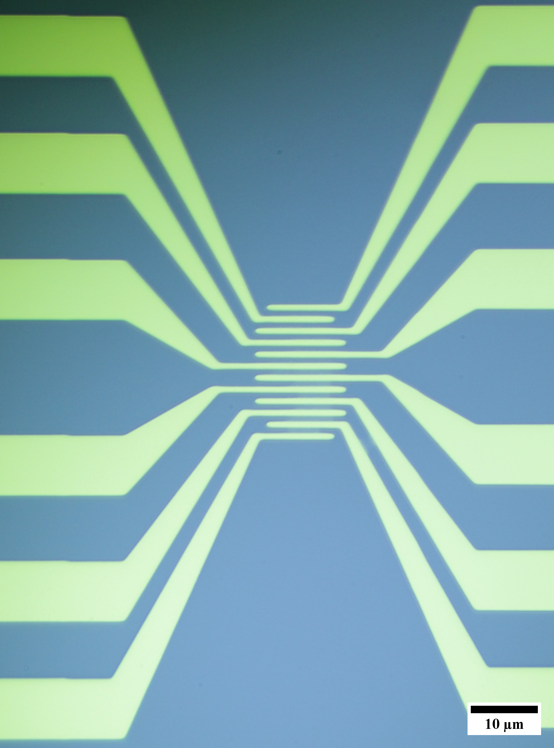
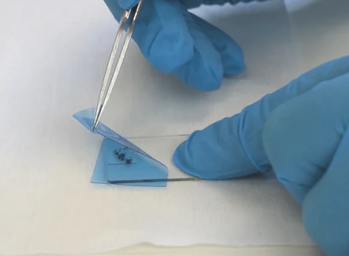
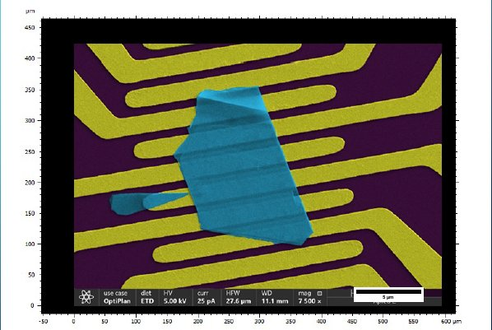
SNSPD Device Fabrication
NbSe₂ flake transfer onto the substrate
Gold electrodes after lift-off​

Slide 27
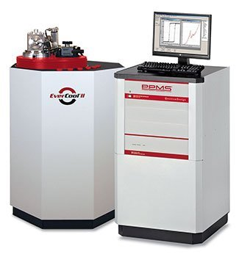




Single-Photon Measurement Probe
Probe coupled with PPMS

Slide 28

Experimental setup for single-photon detection
Experimental setup:
Bias circuit
  Voltage supply w/ R_{LOAD})
  Bias-T
Optical setup
  Repetition modulator
  Laser
  Optical attenuator
Readout circuit
  LNA
  Oscilloscope/counter
SNSPD bias and readout circuit

Slide 29

Preliminary Data
Next step – SNSPD patterning and single photon detection

Slide 30

Future Outlook - Potential Ising Superconductors
Wang et al. Acc. Mater. Res. 2 (2021) 526

Slide 31
Conclusions
Many opportunities (and challenges) in utilizing 2D materials in single photon/particle detection:
High magnetic field applications
Strong light-matter interactions (excitonic)
Intrinsically planar – stacked structures for sensing devices
Potential challenges:
Synthesis on planar substrates
Stability (temperature/radiation)?
Supported by DOE – NP DE-SC0023667

Slide 33

Ising with FFLO

