Slide 1
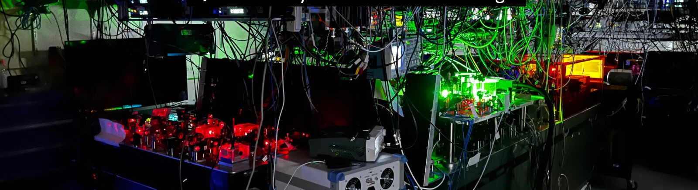









Simulation of quantum models with physical and logical qubits
Mark Saffman

Slide 2
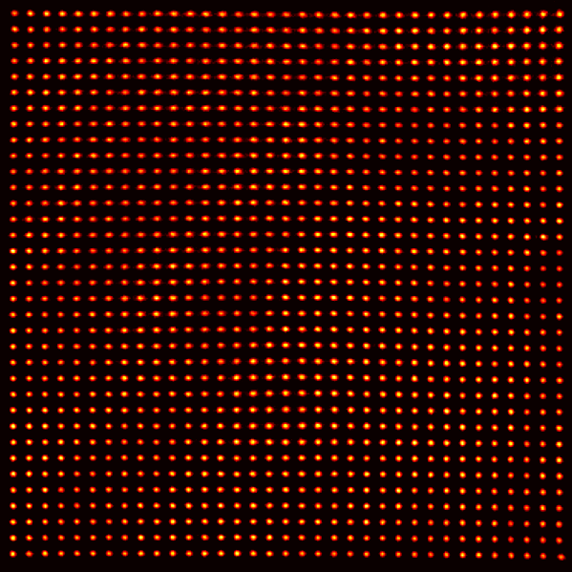
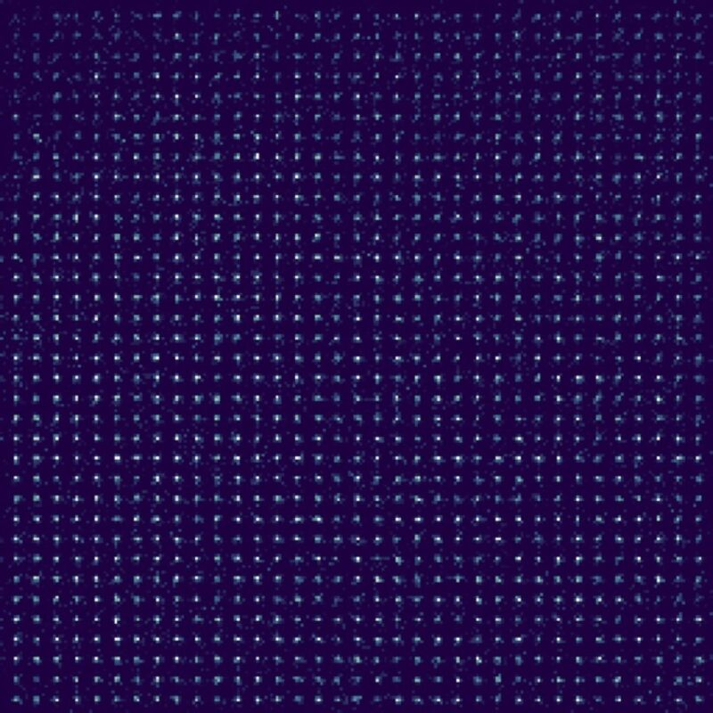
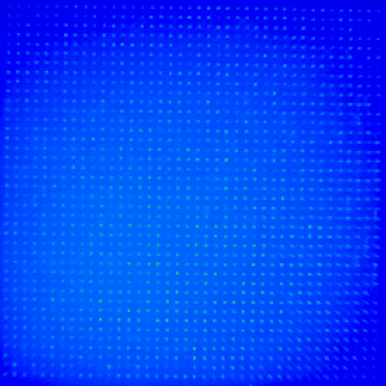
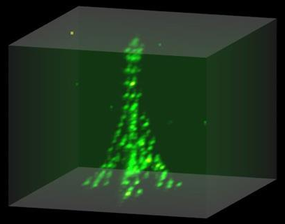
Atom arrays
Slide courtesy of
Christian Gross Tübingen
Darmstadt
Madison
Singapore
AtomComputing
Infleqtion

Slide 3
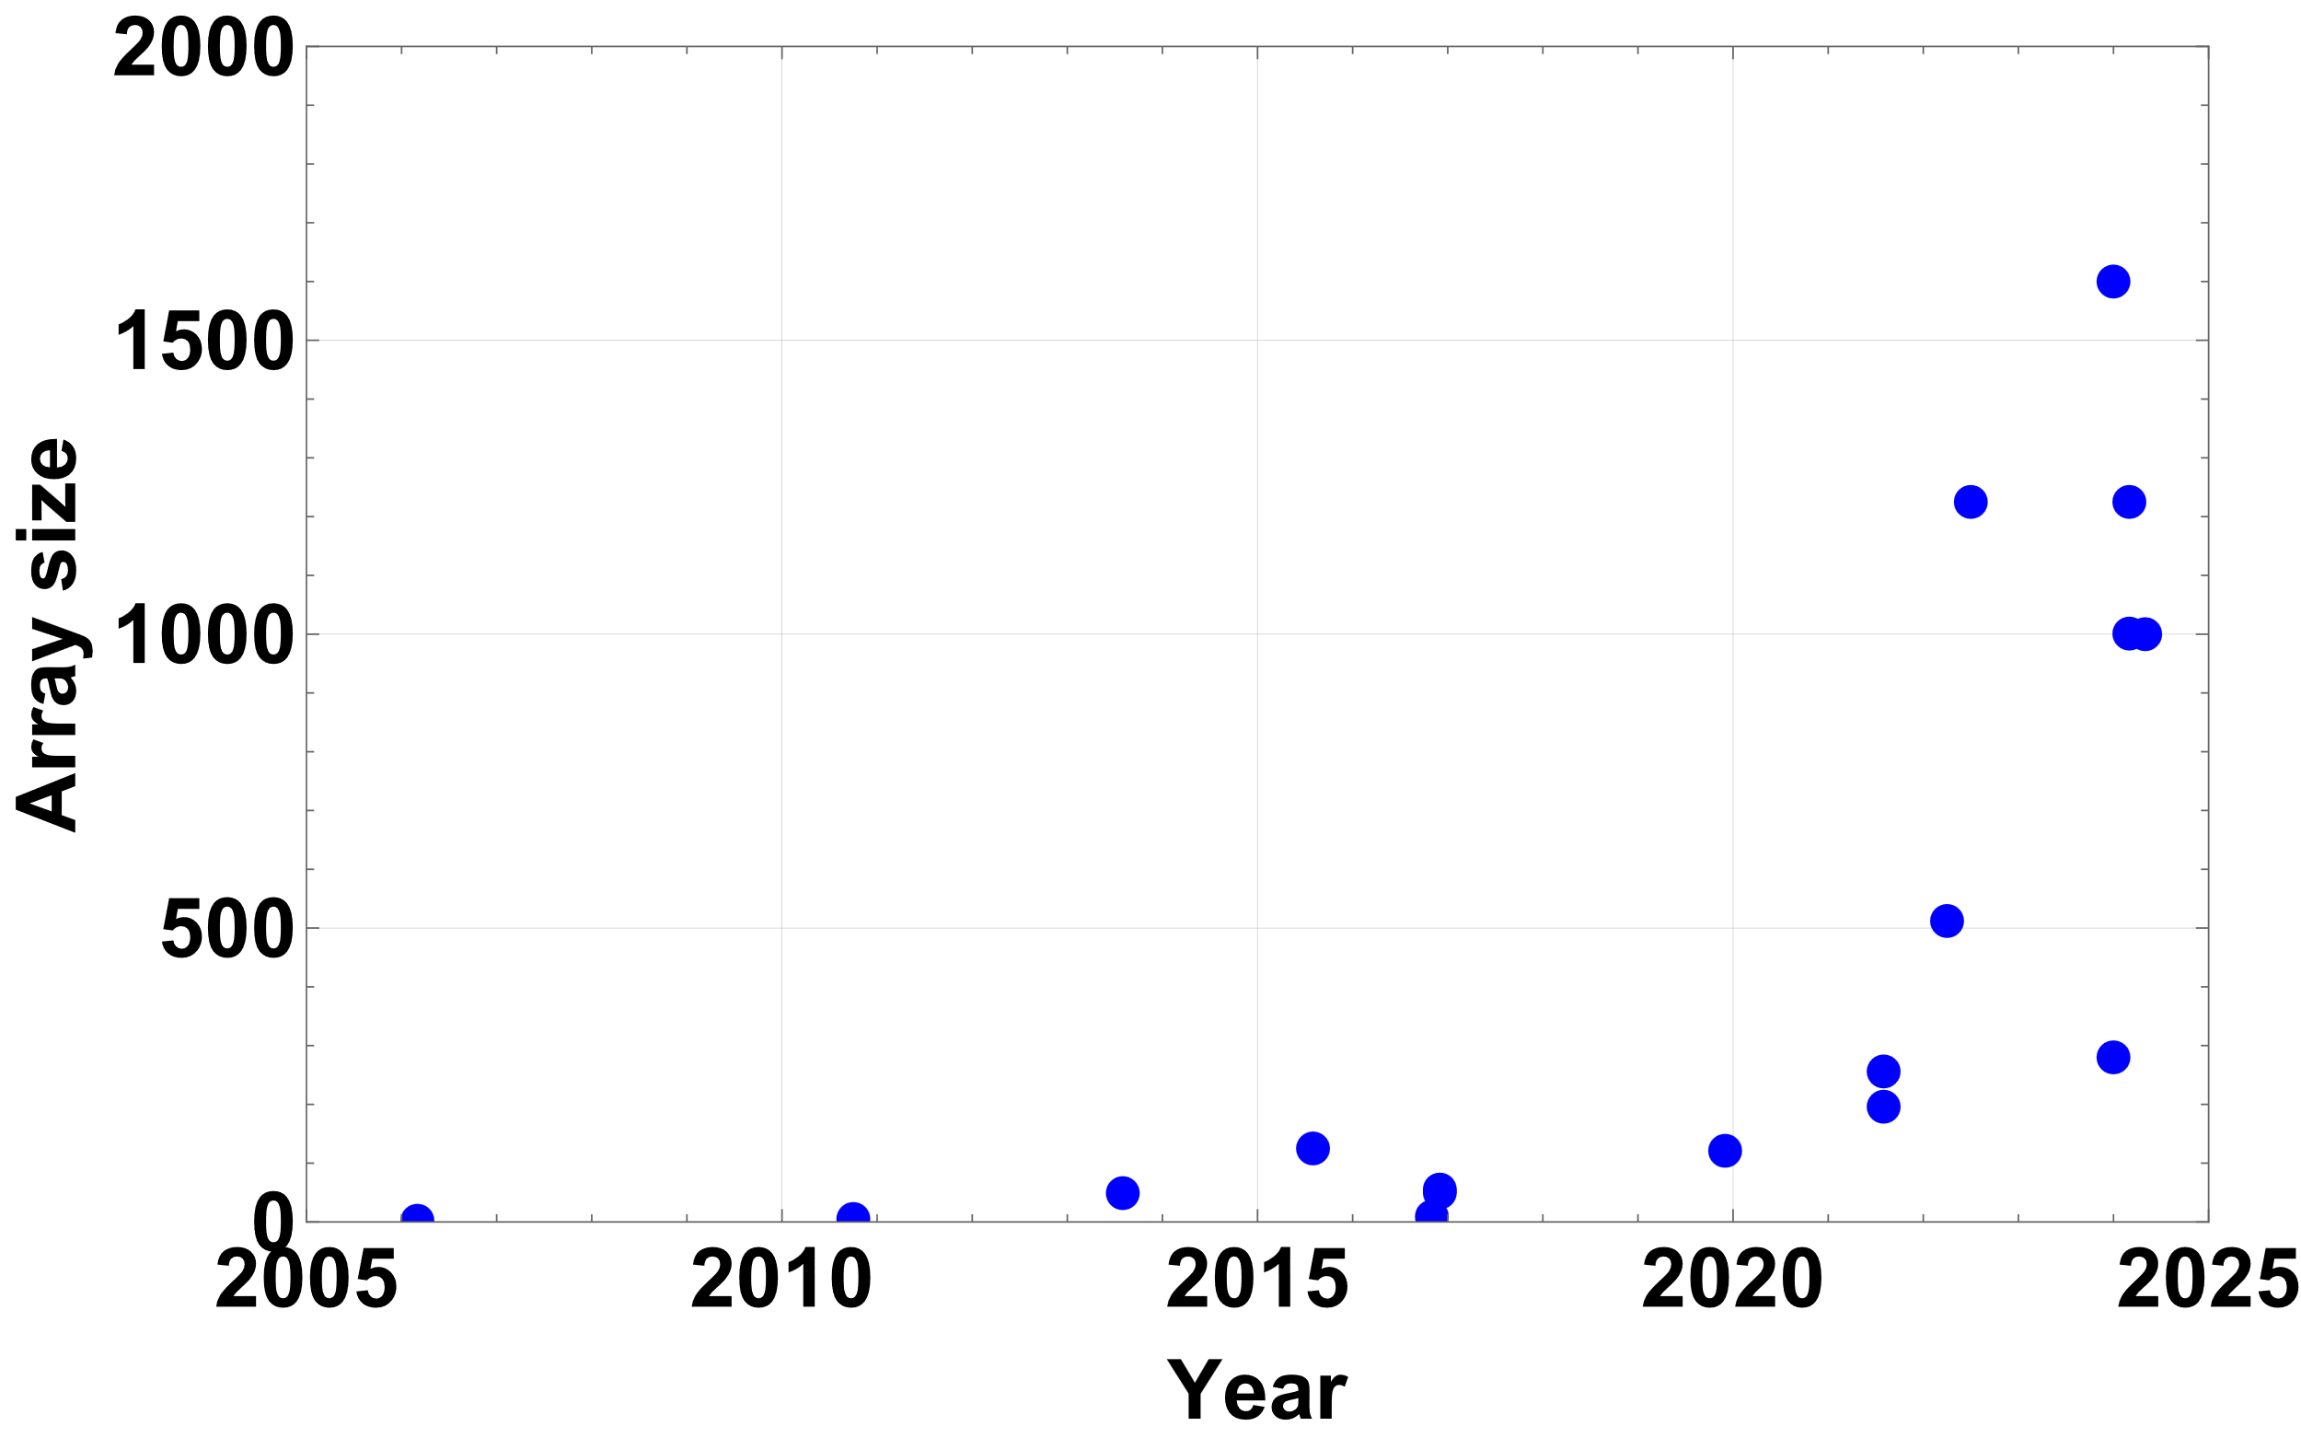
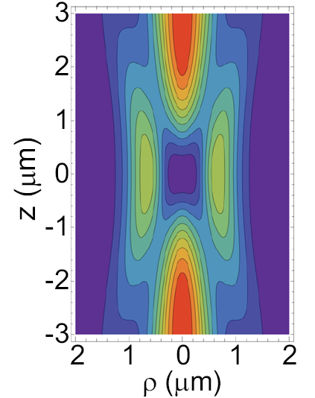

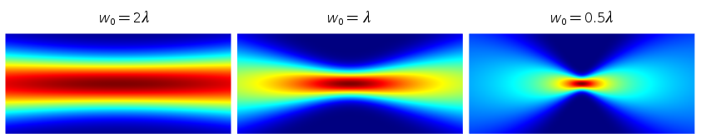
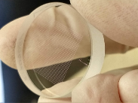

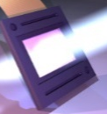
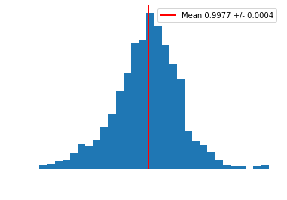
Large arrays
Averaged images
12,000 ! Caltech 2403.12021
1225 atoms
bottles
1600 atoms
tweezers
100 μm
140 μm
PRA 105, 063111 (2022)
Single qubit gates
<F_{RB}>=0.9977
(minimal calibration)

Slide 4
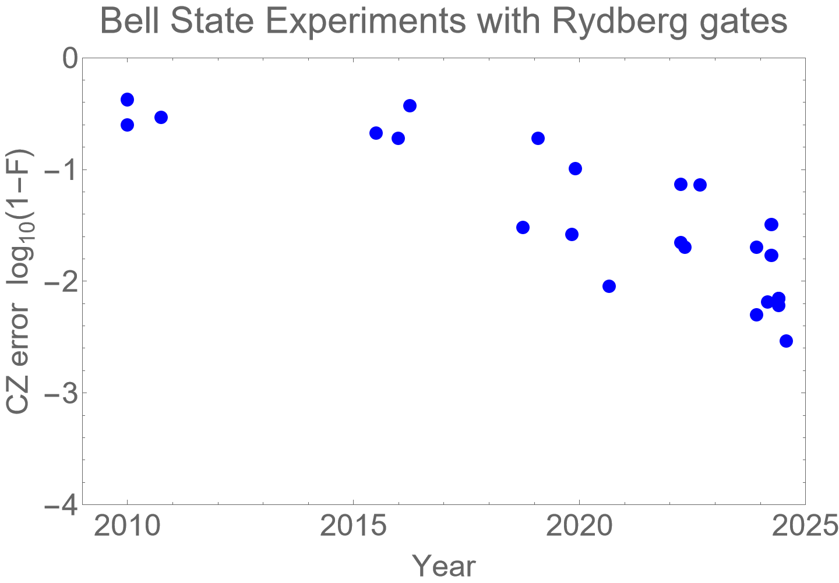
High fidelity entanglement
Fidelity
0.9
0.99 NISQ
0.999 FT
0.9999 Utility
Leading
Results
Sr
F=0.9971
Caltech
arXiv:2407.20184
Rb
F=0.995
Harvard
Nature 622, 268 (2023)
Yb
F=0.994
Princeton arXiv:2406.01482
AtomComputing arXiv:2411.11708
Cs
F=0.9934
Infleqtion
arXiv:2408.08288

Slide 5
Towards useful Quantum computing
Error detection
&
Fault tolerance
Error correction &
Fault tolerance
NISQ
&
Error mitigation
In progress….
NISQ – Noisy Intermediate Scale Quantum
Logical qubits
VQE
arXiv:2412.07670
arXiv:2501.06097
Phase estimation
QAOA
Nature 604, 457 (2022)

Slide 6
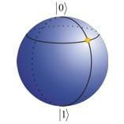
Variational Quantum Eigensolver
Peruzzo, et al. Nat. Commun. 5, 4213 (2014)
ψ₀
^
ψ(θ)
Measure
energy
U(θ)
High dimensional problems have an exponential state space.
Cannot efficiently calculate the state classically.
VQE converges to a
variational optimal
solution.
Quantum
Coprocessor
E(θ)
θ’
Classical Optimizer
θ’ θ

Slide 7
LMG model
Nucl. Phys. 62, 188 (1965)
N fermions distributed among two levels with energy separation ε
Quasispin operators
Quasispin Hamiltonian

Slide 8
LMG model – Quantum simulations
VQE simulation of ground states, error mitigation, N=2 on IBM Q.
VQE for excited states, N=2,3,4 on IBM Q, Gray code encoding
Hamiltonian learning HL-VQE, ground states with N=2 on IBM Q,
qudit representation.
VQE for ground states with N=3,5,7,9,(15), Gray code,
error mitigation, neutral atom
qubits
Madison
Phys. Rev. C 104, 024305 (2021)
Michigan/Saclay
Phys. Rev. C 106, 024319 (2022)
Seattle/Bielefeld
Phys. Rev. C 108, 024313 (2023)
Phys. Rev. C 108, 064306 (2023)
Madison
arXiv:2501.06097

Slide 9
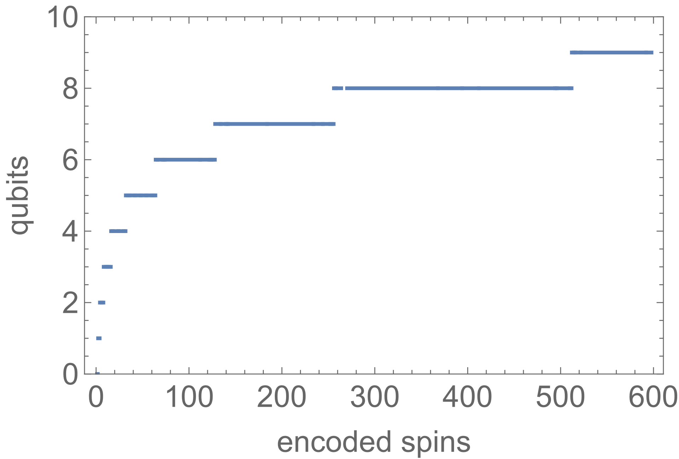
LMG model
In the qubit basis
Ground states are states of maximal J=N/2.
Thus we need only 2J+1 states of M_{J} and symmetry reduces this to J+1.
So we only need qubits to represent the ground state of N spins.
The tradeoff is an increase in the number of measurement bases needed.
Using a Gray code the energy is determined by measuring in O(N) bases.
The ground state of more than 100 spins can be encoded in 6 qubits.

Slide 10

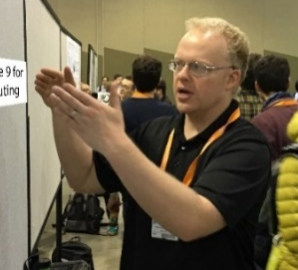
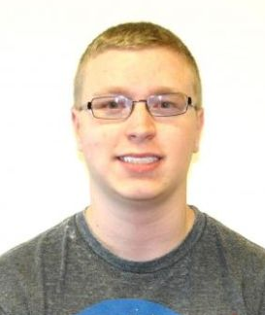
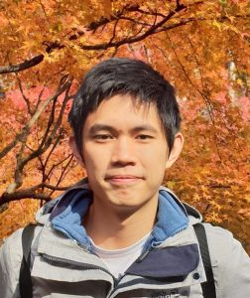
VQE with error mitigation beam scanning & atom motion
Ravi
Chinnarasu
Trent
Graham
Cody
Poole
Linipun Phuttitarn
“senior” collaborators
Baha Balantekin
Susan Coppersmith

Slide 11
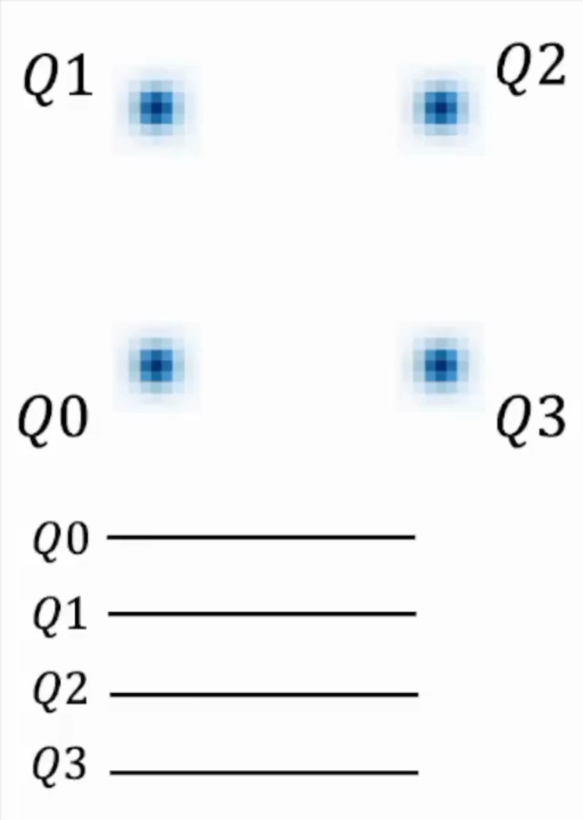
VQE with beam scanning & atom motion

Slide 12
VQE simulation of LMG – 3 spins
3 spins
1 variational parameter
1D parameter scan
Ground state condition:
Standard encoding
3 qubits
Gray code
encoding
1 qubit

Slide 13
Gray code ansatz states
5 spins, 2 qubits, 2 parameters
9 spins, 3 qubits, 4 parameters
7 spins, 2 qubits, 3 parameters
15 spins, 3 qubits, 7 parameters

Slide 14
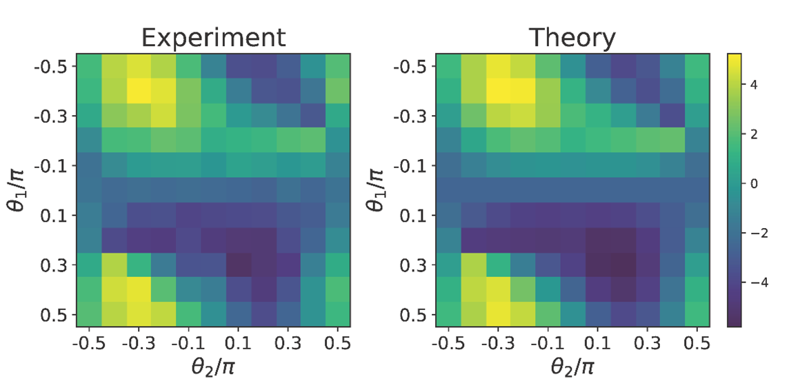
VQE simulation of LMG – 5 spins
5 spins
2 variational parameters
1D parameter scans
Zero noise extrapolation by adding CZ gates Nature 567, 491 (2019)
ZNE result -5.7(2)
Exact ground state energy -5.89
error 3.2%

Slide 15
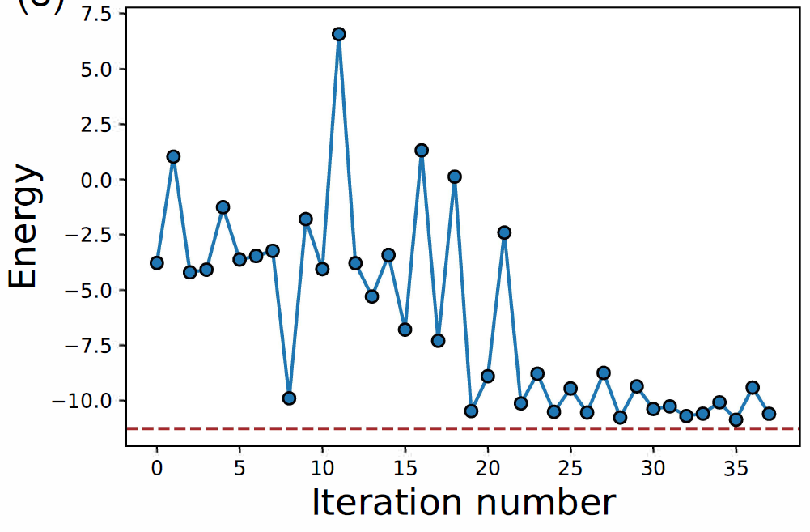
VQE simulation of LMG – 7 spins
7 spins, 3 variational parameters
Nelder Mead optimizer
Zero noise extrapolation
Exact -11.26
ZNE converges to ground state energy

Slide 16
VQE simulation of LMG – 9 spins
9 spins, 4 variational parameters
Does not fully converge

Slide 17
VQE simulation of LMG – 9 spins
9 spins, 4 variational parameters
Can still run ZNE adding more CZ gates to different parts of the circuit and averaging
Exact -18.7
ZNE result -17.6(0.8)
Exact ground state energy -18.7
error 5.9%

Slide 18
VQE results
Also attempted 15 spins with 7 variational parameters, but did not converge.
To realize the full potential of VQE need logical qubits and error correction.

Slide 19
Towards useful Quantum computing
Error detection
&
Fault tolerance
Error correction &
Fault tolerance
NISQ
&
Error mitigation
Logical qubits
NISQ – Noisy Intermediate Scale Quantum
arXiv:2412.07670
VQE
arXiv:2501.06097
Phase estimation
QAOA
Nature 604, 457 (2022)

Slide 20
Error detection & fault tolerance
arXiv:2412.07670
[[4,2,2]] error detecting code
proposed as a testbed for demonstrating fault tolerance.
Gottesman (2016)
With logical qubits we demonstrate relative to physical encoding:
15x reduction in Total variation distance for a set of random circuits.
6x reduction in error of ground state for Anderson Impurity Model
12x reduction in error of Bell state preparation
Recent related work with [[4,2,2]] code:
Harvard, AtomComputing logical entanglement
IBM, magic state distillation
Quantinuum, quantum chemistry ground state

Slide 21
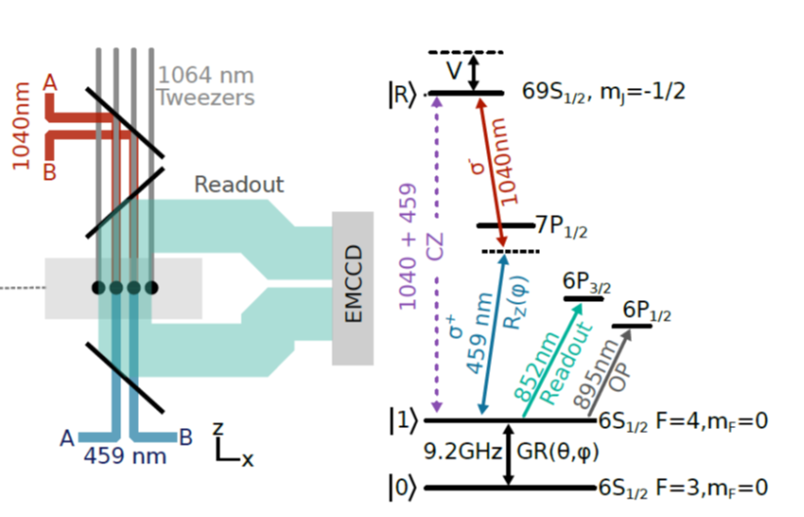
Error detection & fault tolerance
arXiv:2412.07670
arXiv:2408.08288
<CZ>_{post sel.}=99.47
[[4,2,2]] logical states:

Slide 22
Benchmarking fault tolerance
arXiv:2412.07670
For each prepared state run 49 random circuits with depth up to 8.
15x reduction in TVD
For all circuits, except some pathological cases logical encoding gave lower Total Variation Distance

Slide 23
Single Impurity Anderson Model
arXiv:2412.07670
Unencoded circuit
SIAM Hamiltonian (requires 4 qubits)
Encoded (logical) circuit
At half filling this maps to a two qubit Hamiltonian
Ansatz state

Slide 24
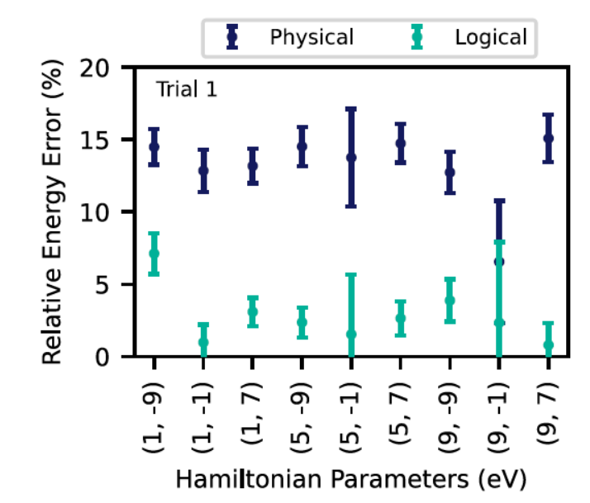
Variational results
arXiv:2412.07670
Energy cost function:
6x reduction in error of ground state
The ansatz parameters were trained classically to minimize the energy and then the quantum circuits were used to
evaluate the energy

Slide 25
Towards useful Quantum computing
Error correction &
Fault tolerance
Error detection
&
Fault tolerance
NISQ
&
Error mitigation
Logical qubits
Challenges:
Qubit count
Gate fidelity
Measurement time
Fast connectivity
at scale
NISQ – Noisy Intermediate Scale Quantum
VQE
arXiv:2412.07670
arXiv:2501.06097
Phase estimation
QAOA
Nature 604, 457 (2022)

Slide 26
Entanglement fidelity
Fidelity
0.9
0.99 NISQ
Error correction &
Fault tolerance
?
0.999 FT
Challenges:
Qubit count
Gate fidelity
Measurement time
Fast connectivity
at scale

Slide 27


Entanglement fidelity
Fidelity
0.9
Rydberg
atoms
0.99 NISQ
Laser
pulse
?
0.999 FT
V=2π x 100 MHz
τ_{R}= 300 μs
Pulse design that reaches ~2x this limit arXiv:2404.18809

Slide 28

Summary
Error correction &
Fault tolerance
Error detection
&
Fault tolerance
NISQ
&
Error mitigation
Logical qubits
NISQ – Noisy Intermediate Scale Quantum
VQE
arXiv:2412.07670
arXiv:2501.06097
Can NISQ + error mitigation & detection
provide quantum utility ?
An optimistic perspective 2501.05694
Phase estimation
QAOA
Nature 604, 457 (2022)

Slide 29
Measurement time
Currently much longer than gate times
Gate times sub-microsecond
Measurement times
~10 μsec (cavity, Harvard)
~ 350 μsec (free space, Sandia)
Atomic amplifier
X
No cloning theorem
Repetition code
(many-body entanglement)

Slide 30
Fast, dual species measurements
PRA 110, 042404 (2024)
Boost signal by mapping ancilla state onto multiple measurement atoms.
Rb-Cs
Rb-Rb
30

Slide 31
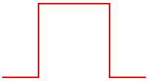
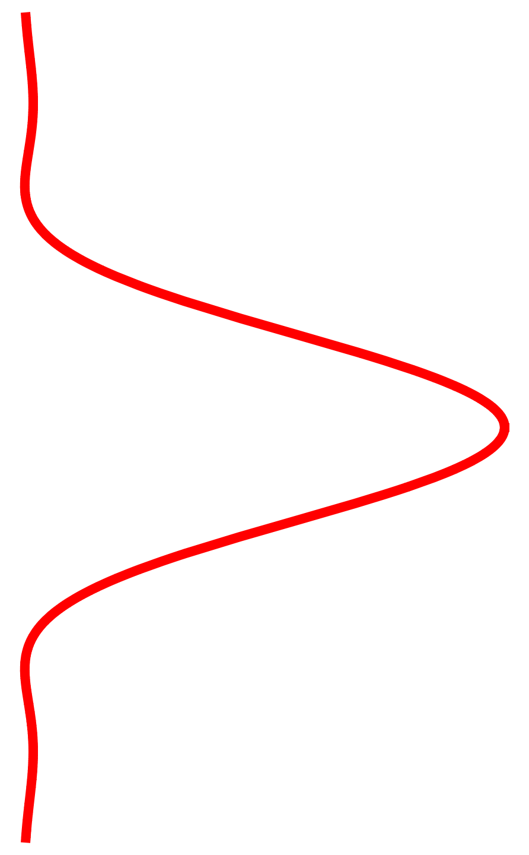
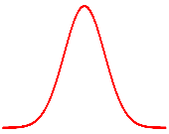

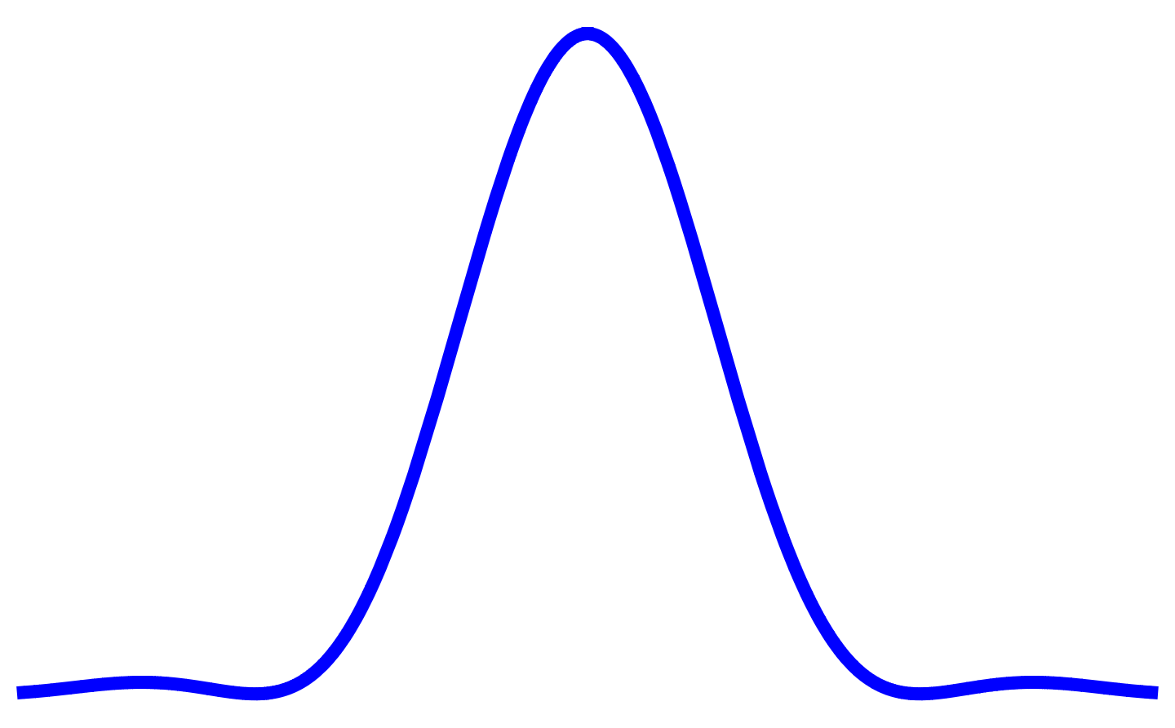
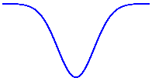
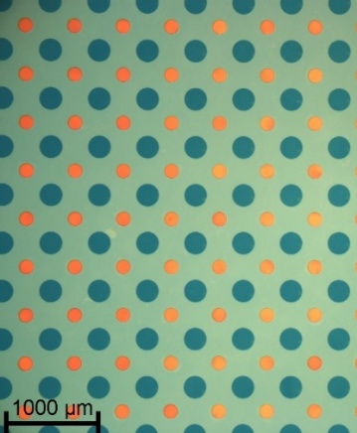
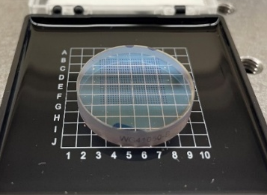
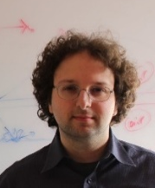








Dual species Rb-Cs arrays
arXiv:2412.20261
Working principle: Fourier filter the Airy pattern
“Airy-Gauss” beam
$${\left|A_{0}\right|}^{2}$$
$${\left|A_{1}\right|}^{2}$$
$${\left|A_{2}\right|}^{2}$$
820 nm
x
x
a
b
Rb
“Bright” traps with red-detuned light
Mask
Iris
0
$$η$$
0
1
1
$$f_{1}$$
$$f_{1}$$
$$f_{2}$$
$$f_{2}$$
x
x
a
b
Cs
“Dark” traps with blue-detuned light
$$t_{a}^{2}$$
0
1
0
1
Transmitting
Partially transmitting
Last week – Rb-Cs entanglement !
Mikhail Kats
Also Bernien group:
PRX (2022), Science (2023), Nat. Phys. (2024)
31

Slide 32
LMG model
Nucl. Phys. 62, 188 (1965)
7 spin ansatz state
J=7/2, M=-7/2,-3/2,1/2, 5/2
2 qubits
3 variational parameters θ₁, θ₂, θ₃

Slide 33
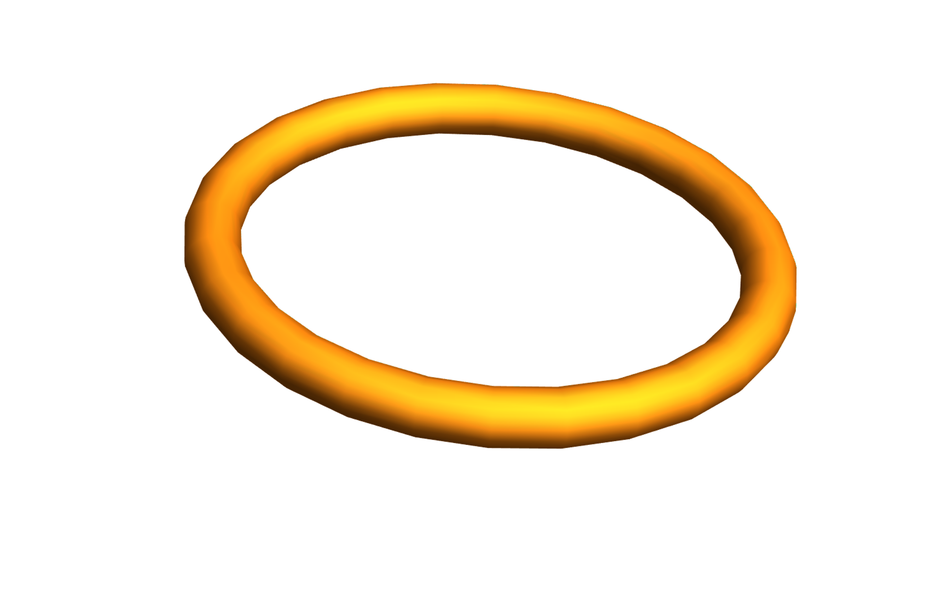
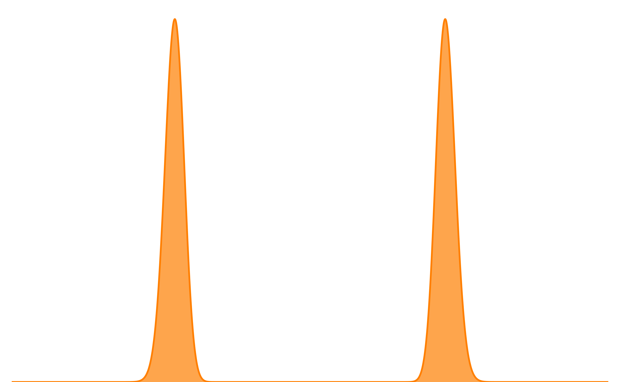
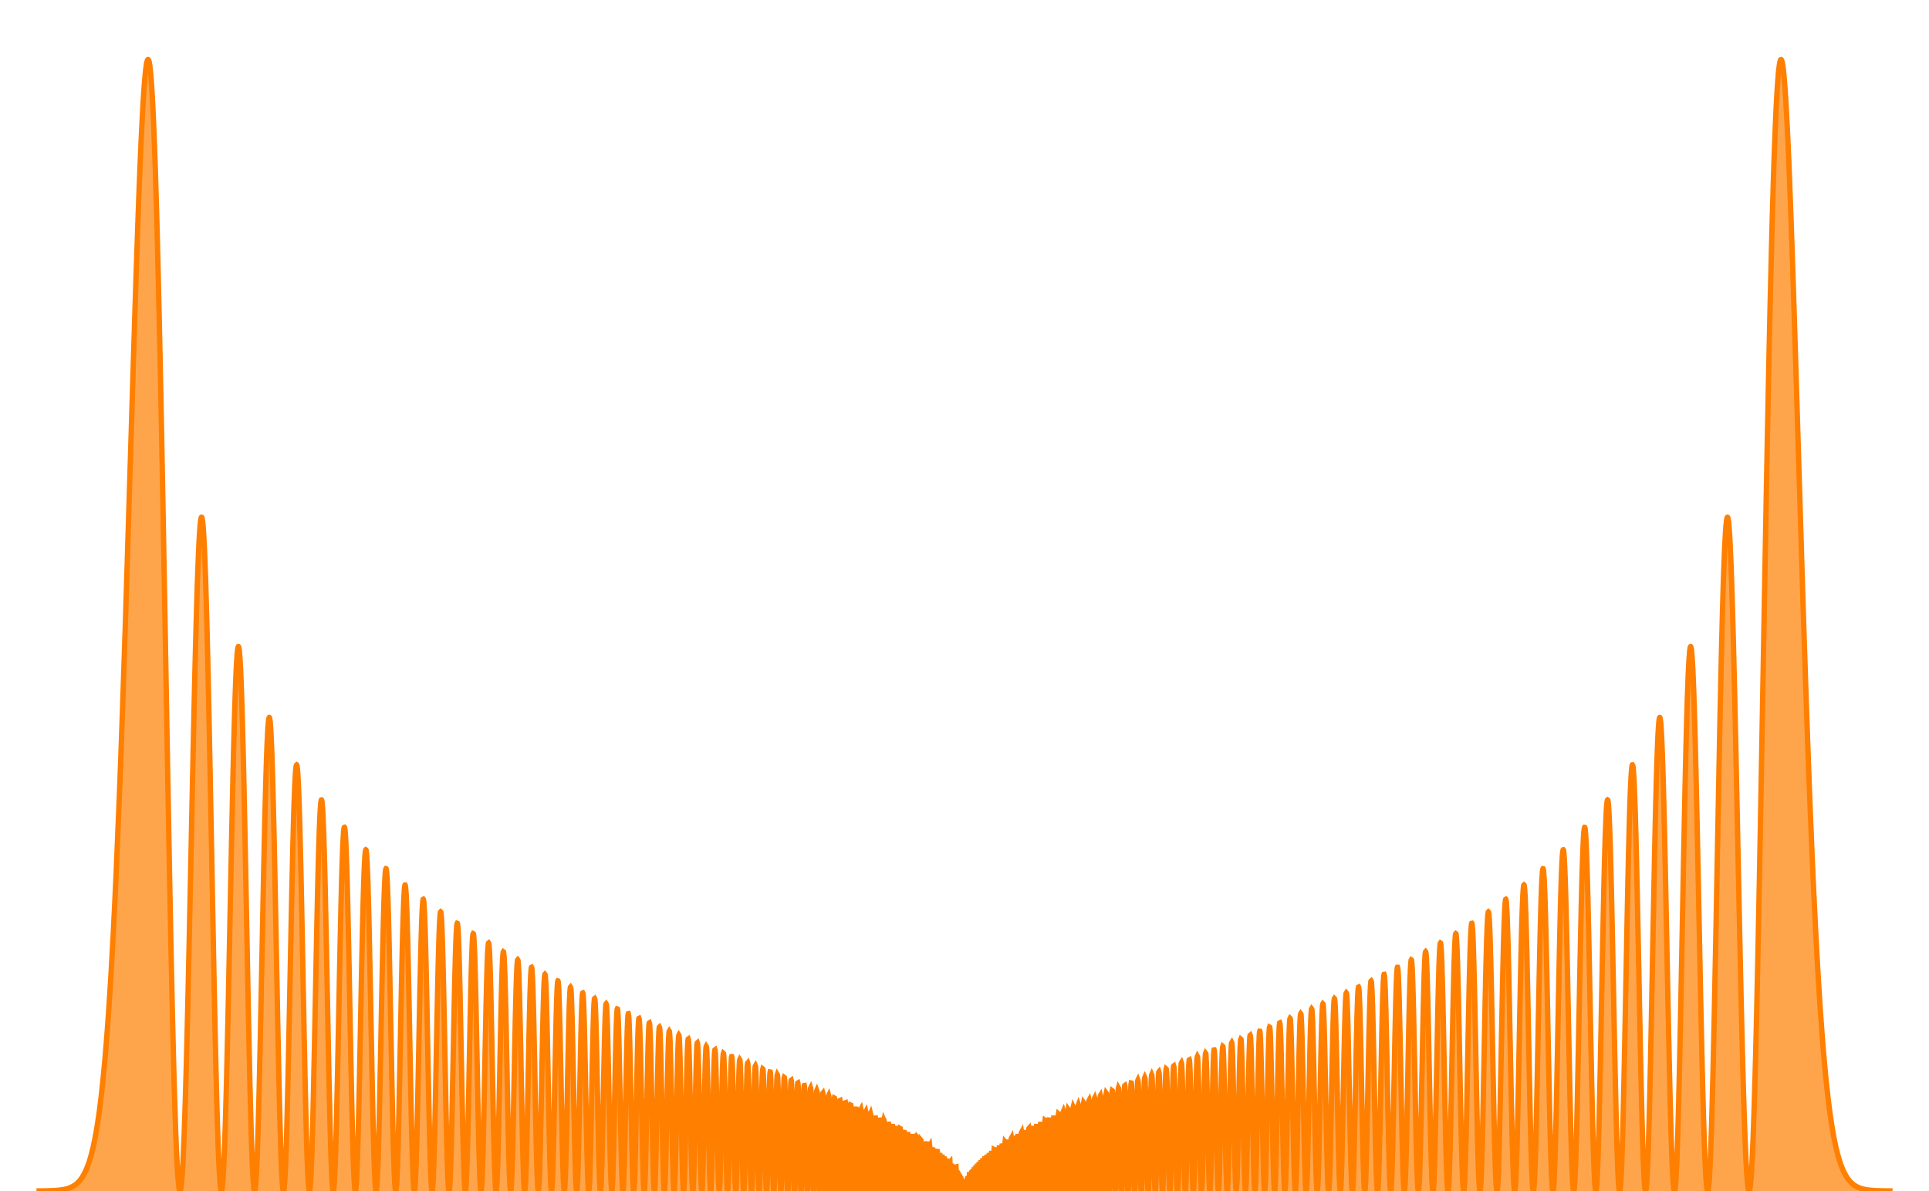
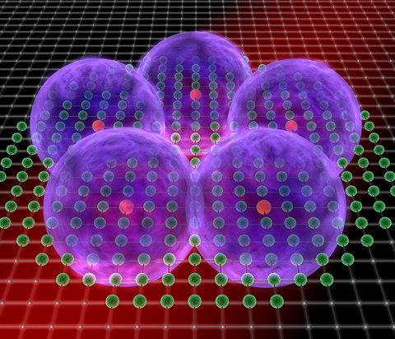
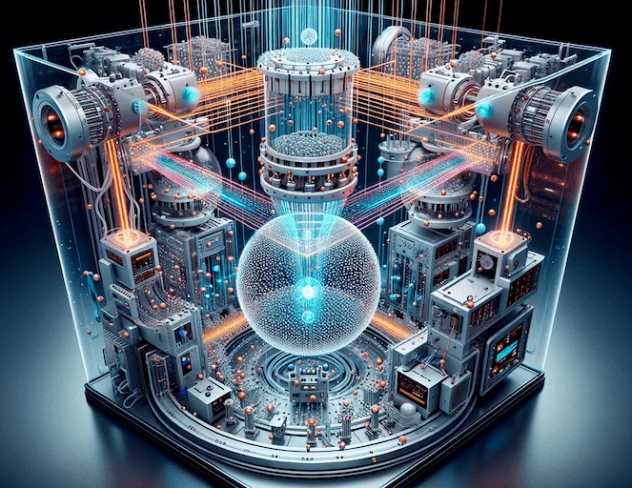
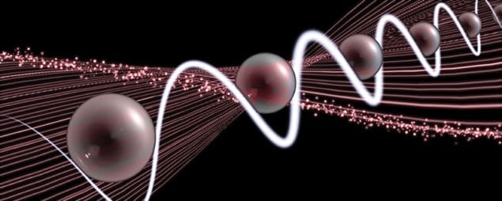

Rydberg enabled quantum science
100s (l=0)
100s, l=99, m=99
τ ~ n³
τ ∼ n⁵
Cs, τ= 0.32 ms
Cs, τ= 1 s
(0.3 K environment)
(300 K environment)
τ= 1.1 ms @ 4K
1.1 μm
2 μm
Quantum sensors & networks
Quantum
simulators
Quantum computers
New atomic physics
JQI
MPQ
QuEra

