Slide 1

Atomically Precise Devices for Analog Quantum Simulation of Lattice Gauge Theories
PIs: Rick Silver, James Owen, Jon Wyrick, Michael Gullans, and Zohreh Davoudi
Ali Rad, Fan Fei, Pradeep Namboodiri, FNU Utsav, Brian Courts, Mark Yves-Gaunin

Slide 2
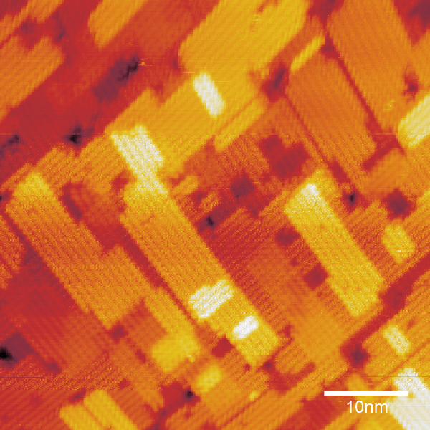
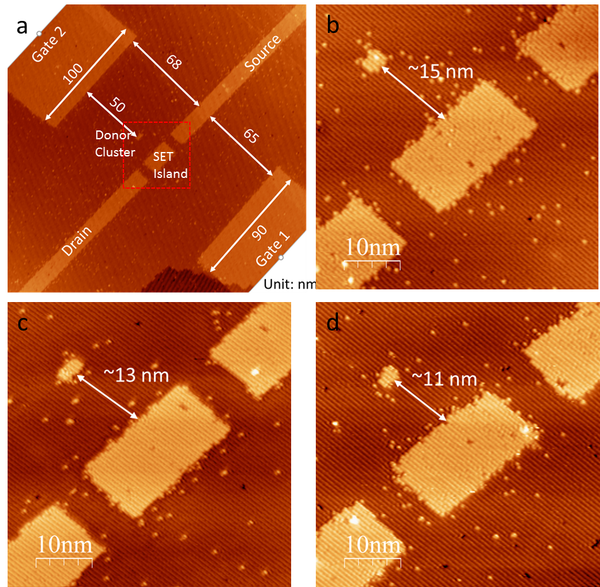
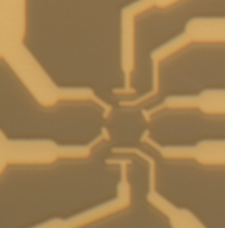
Analog Quantum Simulations of a Lattice Gauge Theory
Intro to STM fabrication
  Hubbard Model AQS
Proposal for Nuclear Physics AQS
  Motivation
Numerical simulations for feasibility
Experimental requirements
  State preparation, measurement and probing
Notes:
2

Slide 3
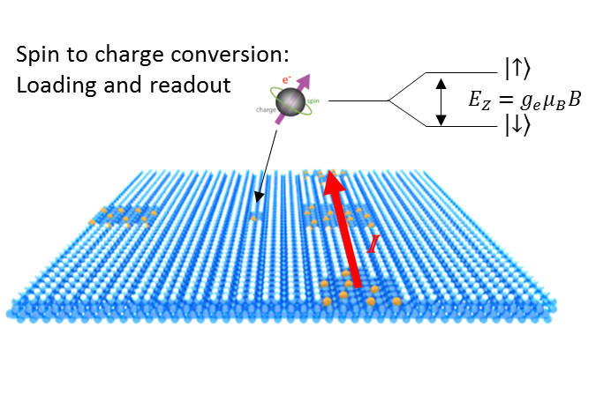
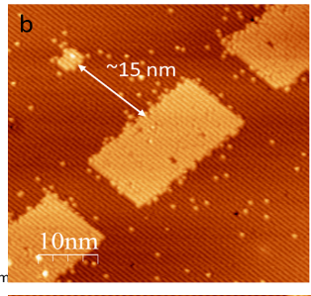
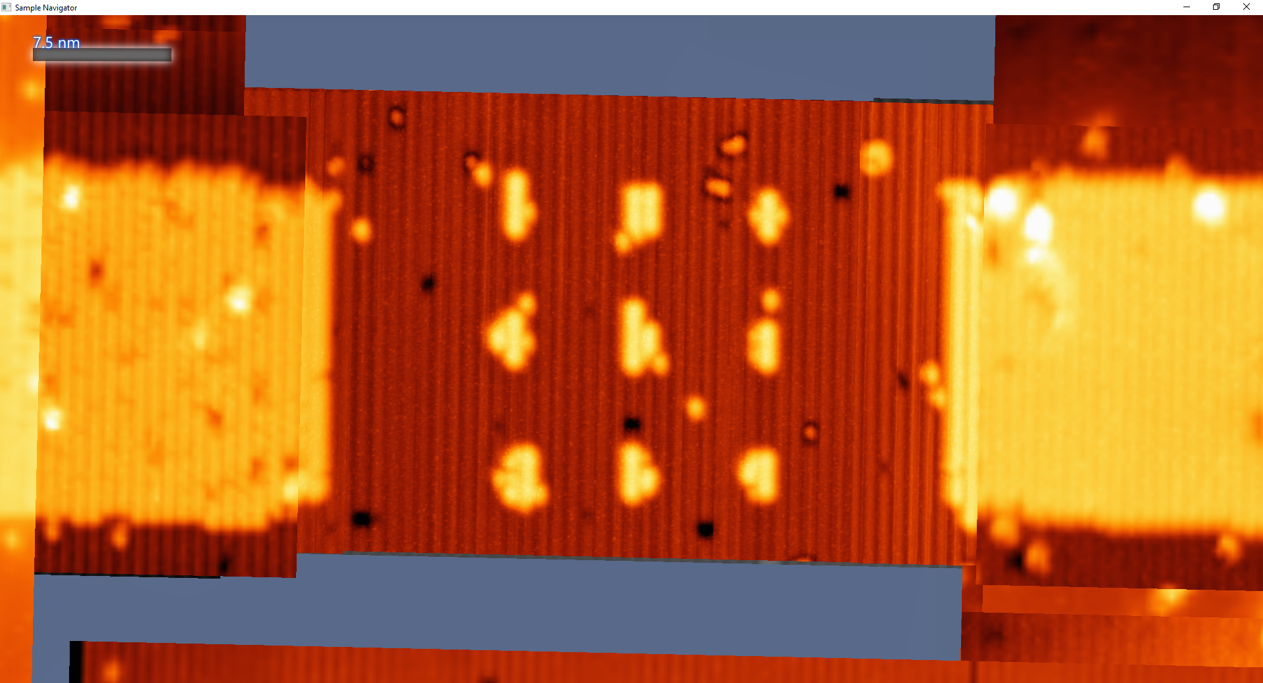
STM-based Fabrication of Single Dopant Atom Quantum Devices
Hydrogen Depassivation Lithography
Gas Phase Dosing and Si Overgrowth
Palladium Silicide Contacts
STM Tip
Hydrogen terminated surface
PH₃ molecules adsorb on patterned regions
Epitaxial Si overgrowth
Single Atom Qubits for Quantum Computing
Arrays of Atoms for Analog Quantum Simulation
X. Wang, J. Wyrick, R. Kashid, P. Namboodiri, S. Schmucker, A. Murphy, M. D. Stewart, Jr., and R. M. Silver, Atomic-scale Control of Tunneling in Donor Based Devices, Comm. Physics, Nature Res. J., 3, 82 (2020).

Slide 4
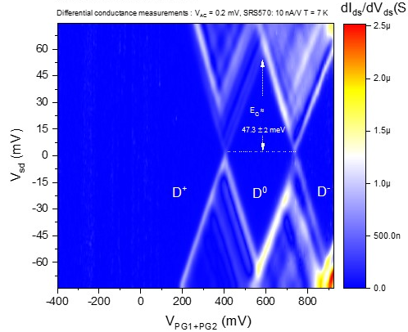
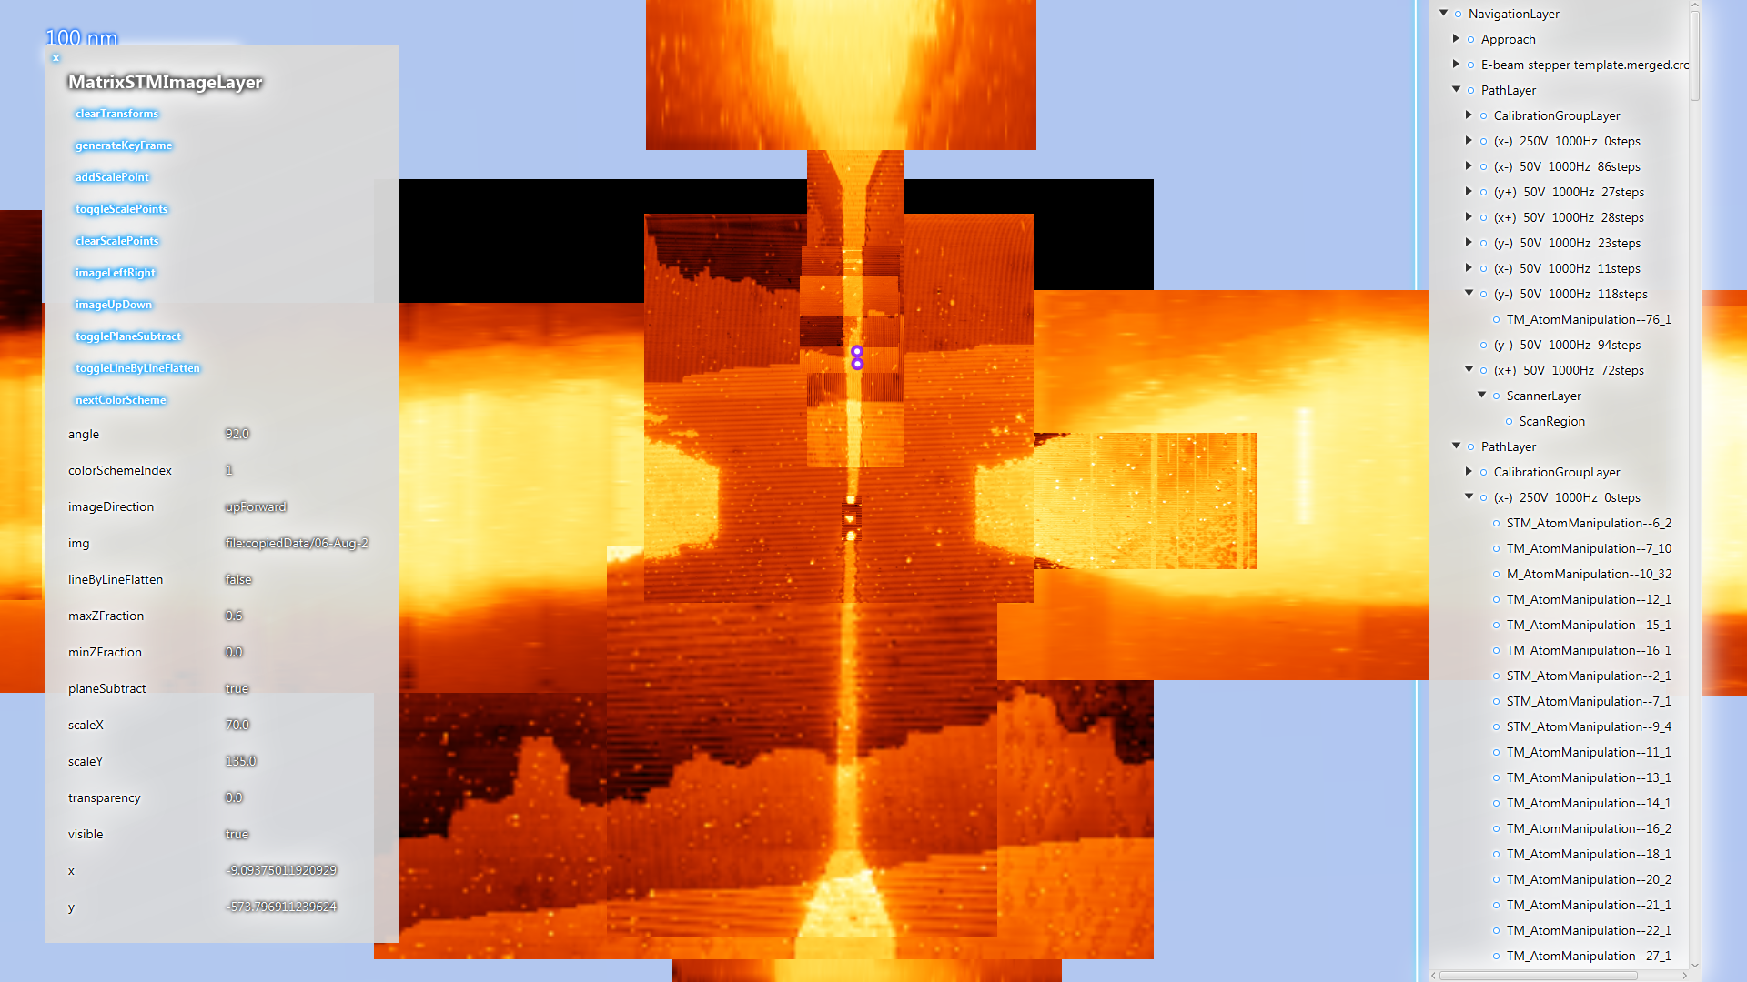
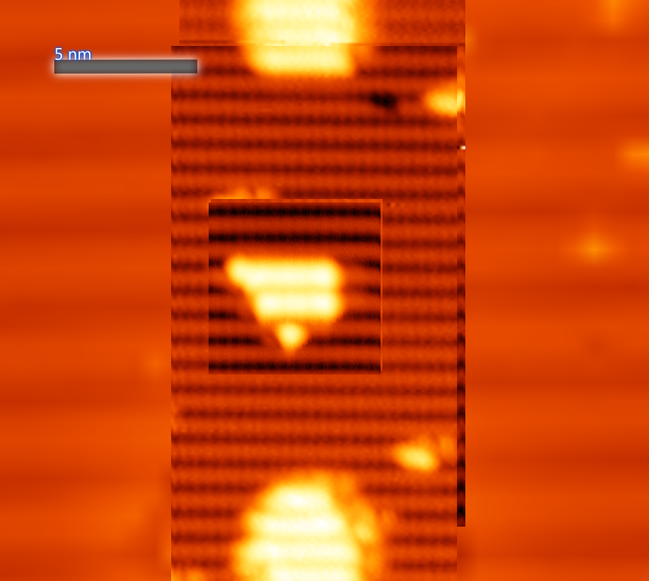
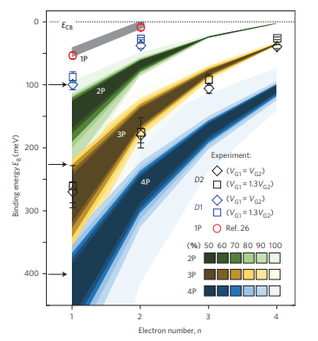
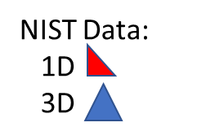
A Single Atom Transistor
2 (dimer rows) x 6 (dimers)
+ 2 isolated dangling bonds
+ possibly one additional dimer on top row
= 1nm x 2nm
Source
8 rows = 6.2nm
Charge stability plot for a single atom transistor.
PG-1
PG-2
~ 64 nm
Drain
7 rows = 5.4nm
Three dopant transistor
Using spectroscopy to determine the number of dopant atoms.
Weber et al., Nature Nano, 9, 2014.
J. Wyrick, X. Wang, R. Kashid, P. Namboodiri, S. Schmucker, J. Hagmann, K. Liu, M.D. Stewart Jr., C. Richter, G. Bryant, and R. M. Silver, Atom by Atom Fabrication of Single and Few Dopant Quantum Devices, Adv. Functional Matls 29 (52) 1903475, May 2019.

Slide 5
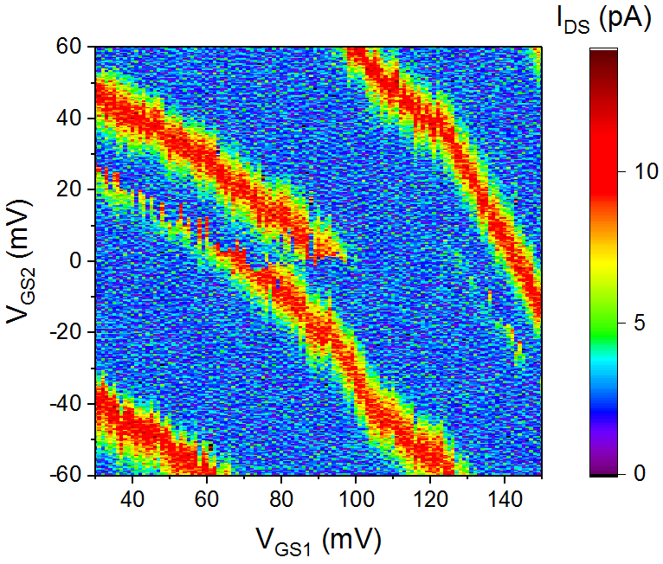
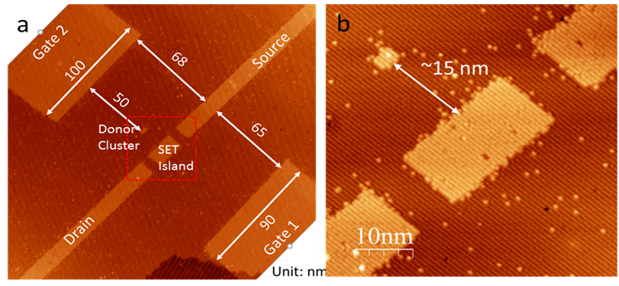
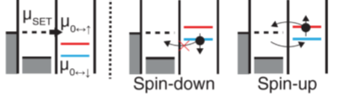
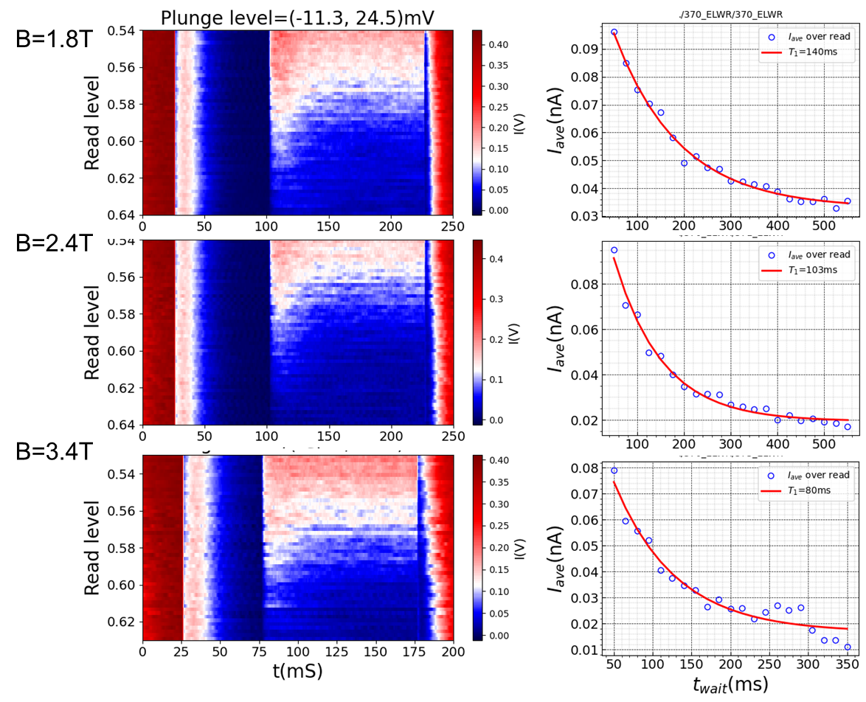
Few Donor/Quantum Dot Spin Selective Readout
Single qubit donor/dot device designs
Load
Read
Unload
Single Shot Spin Readout
load
read
empty
Spin tails as a function of magnetic field
T1 times versus magnetic field: charge noise effects
Empty
Load
Read
Empty

Slide 6

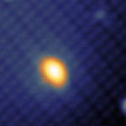
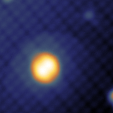
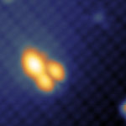
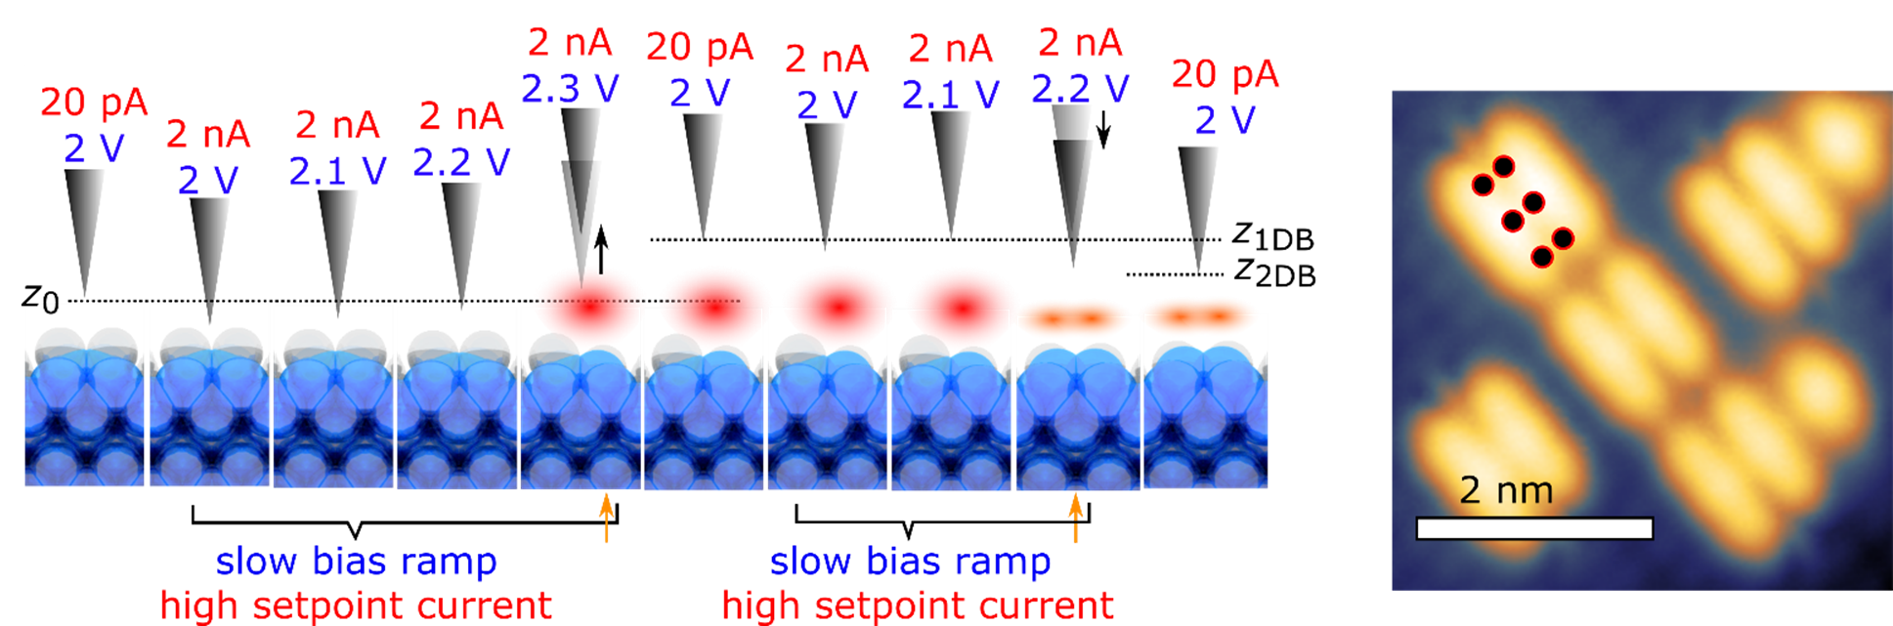
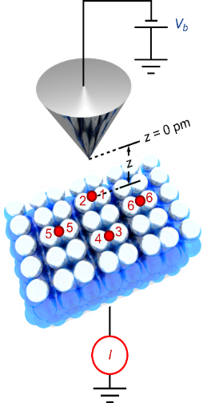
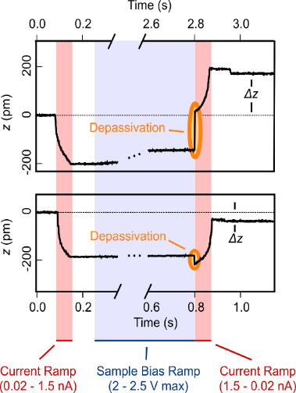
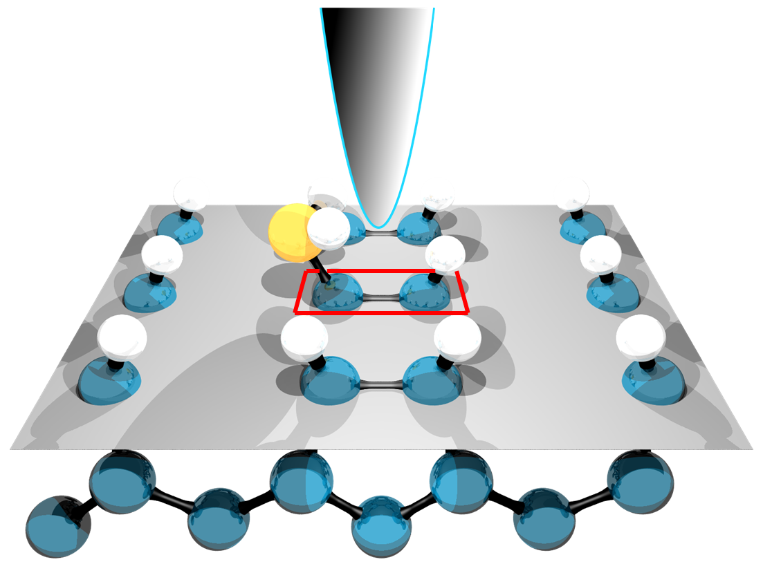
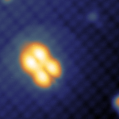
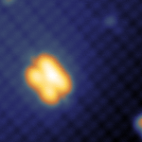
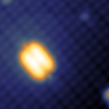
Fabrication of Deterministic Single Dopant Atom Devices
Jon Wyrick
Feedback Controlled Lithography
1
2
3
Atomic precision manipulation of molecules.
4
5
6
Wyrick J, Wang X, Namboodiri P, Schmucker SW, Kashid RV, Silver RM. Atom-by-Atom Construction of a Cyclic Artificial Molecule in Silicon. Nano Letters 2018, 18(12).
Wyrick, J., Wang, X., Namboodiri, P., Kashid, R., Fei, F., Fox, J., Silver, R. M., ACS Nano Nov. 2022.

Slide 7
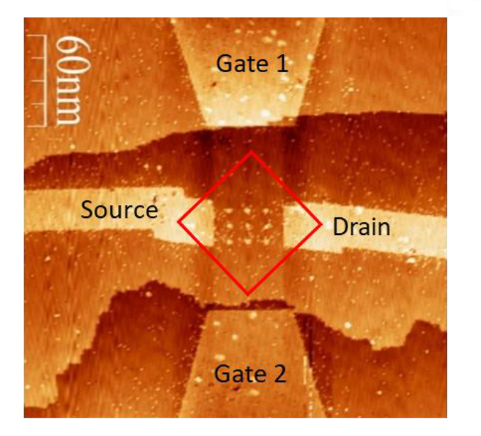
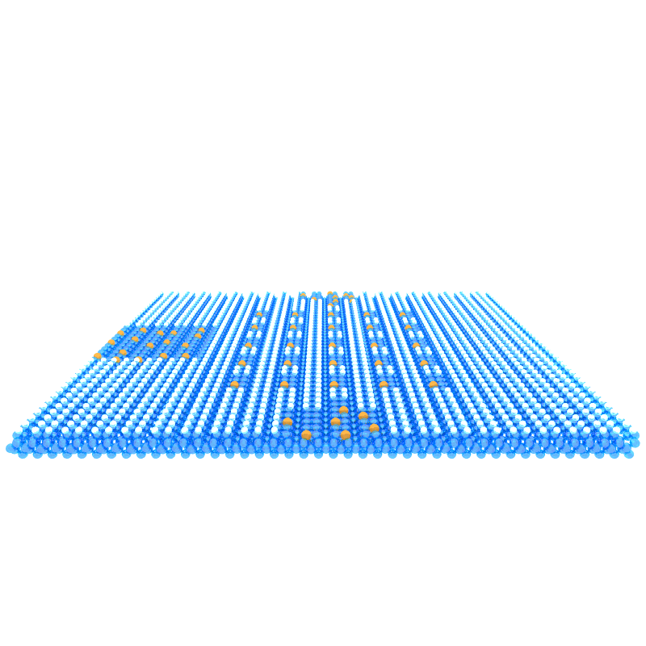
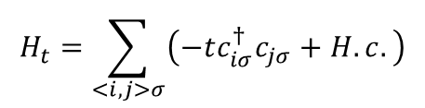
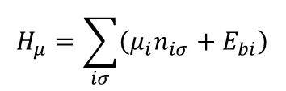

Fabricating Atom Arrays for Analog Quantum Simulation of the Hubbard Model
Tunable Parameters in the Hubbard array:
Tunnel coupling
Coulomb Interactions
Chemical potential/electron occupation
$$H_{array}=H_{t}+H_{μ}+H_{U}+H_{J}$$
Controlled by spacing and
electrostatic gates.
Controlled by adsorbed species, number of atoms per site, and electrostatic gates
Y. Shuo, X. Wang, S. Das Sarma, Generic Hubbard model description of semiconductor quantum-dot spin qubits, Phys. Rev. B 83, 161301(R);
N.H. Le, A.J. Fisher, E. Ginossar, Extended Hubbard model for mesoscopic transport in donor arrays in silicon, Phys. Rev. B 96, 245406;

Slide 8
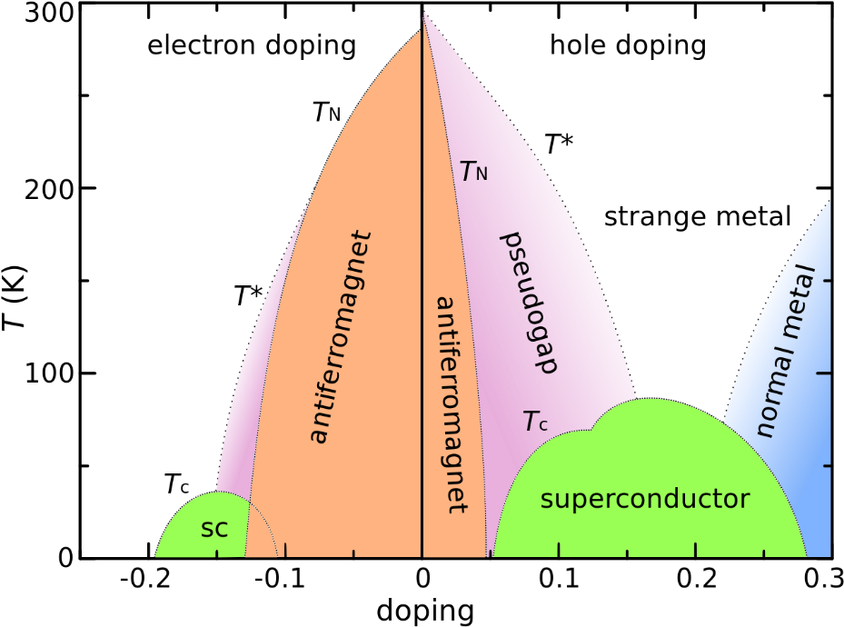
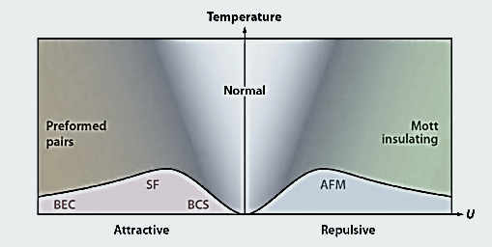
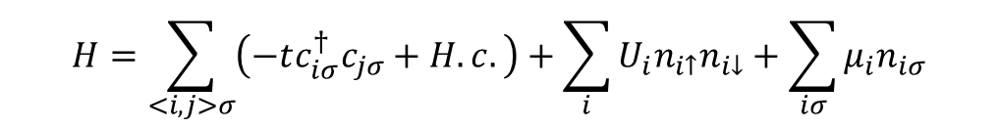
The Hubbard Model Phase Space
$$H=\sum_{<i,j>σ}{\left(−tc_{iσ}^{†}c_{jσ}+H.c.\right)}+\sum_{i}{U_{i}n_{i↑}n_{i↓}}+\sum_{iσ}{μ_{i}n_{iσ}}$$
T
Weak
Interaction
Strong
Interaction
n=0
U/t
n=1 Half-filling
n=2
Doping
Many solid-state materials properties can be explored including superconductivity, spin liquids, Mott insulators, ferromagnetism, strange metals, etc.
Esslinger, Tilman. Annu. Rev. Condens. Matter Phys. 1.1 (2010): 129-152.
Notes:
The hubbard model in the field of quantum manybody physics simplies model that you can think of that retains many of the key phenomenon in condensed matter physics. The Hubbard model in its simplest form contains the kinetic (or hopping) terms that account for electrons tunneling between lattice sites, the interaction terms that account for Coulomb interactions between electrons either at the same sites or at different lattice sites, and finally, the chemical potential terms at each site, which forms the chemical potential landscape within the array. Typically people tune four of the physical parameters in the Hamiltonian, namely, the number of electrons in the lattice, the temperature T, the interaction U, and the hopping t. These parameters span a multi-dimensional parameter space that covers an extremely wide range of phase diagrams in condensed matters. Many of these phases have not been fully understood and new phases are still being discovered. However, because of the exponential growth of the Hilbert space with the number of lattice sites, the largest Hubbard systems that can be solved exactly using classical super computers are limited to about 50 sites so far. So we want to build analog quantum simulators that emulate Hubbard model Hamiltonians with efficient control of the relevant parameters to explore the phase space.

Slide 9
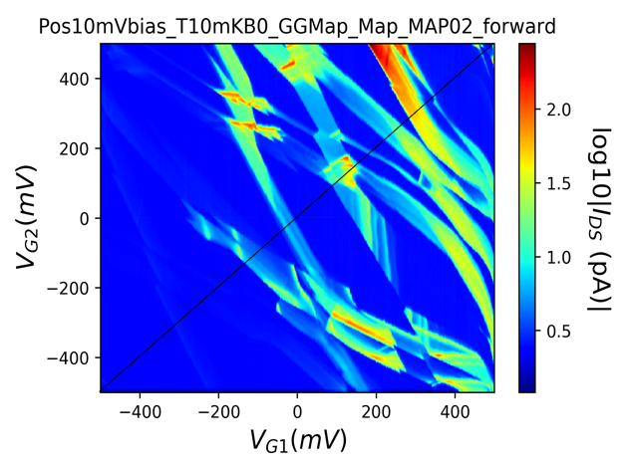
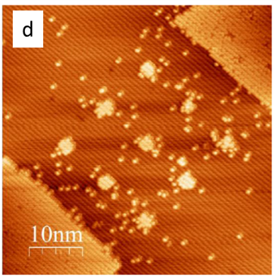

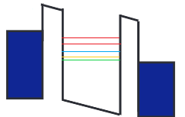
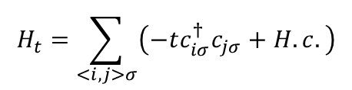
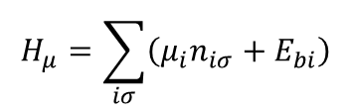

Compare Classical Hubbard Model Simulations to Analog Quantum Simulations
$$H_{array}=H_{μ}+H_{t}+H_{U}+H_{J}$$
Gate-gate map for array #3
Solve Hamiltonian for many body eigenstates and plot charge stability diagrams, charge occupancy, conductance...
Chemical potential:
(Site specific)
Tunnel coupling:
Coulomb interaction:
(Electron-electron and electron-ion)
$$H_{μ}=\sum_{iσ}{\left(μ_{i}n_{iσ}+E_{bi}\right)}$$
$$H_{t}=\sum_{<i,j>σ}{\left(−tc_{iσ}^{†}c_{jσ}+H.c.\right)}$$
$$H_{U}=\sum_{i}{U_{i}n_{i↑}n_{i↓}}+\sum_{i,j}{\left[U_{i,j}\left(n_{i↑}n_{j↓}+n_{i↓}n_{j↑}\right)+\left(U_{ij}−J_{e}\right)\left(n_{i↑}n_{j↑}+n_{i↓}n_{j↓}\right)+V_{i,j}\right]}$$
Typical parameter space:
$$t\sim (0.1, 10)meV, U=45meV, U_{ij}\sim 15meV, V_{ij}\sim −100meV$$
Transport through many body states
Y. Shuo, et al., Generic Hubbard model description of semiconductor quantum-dot spin qubits, Phys. Rev. B 83, 161301(R);
N.H. Le, et al., Extended Hubbard model for mesoscopic transport in donor arrays in silicon, Phys. Rev. B 96, 245406;
Notes:
1 min

Slide 10
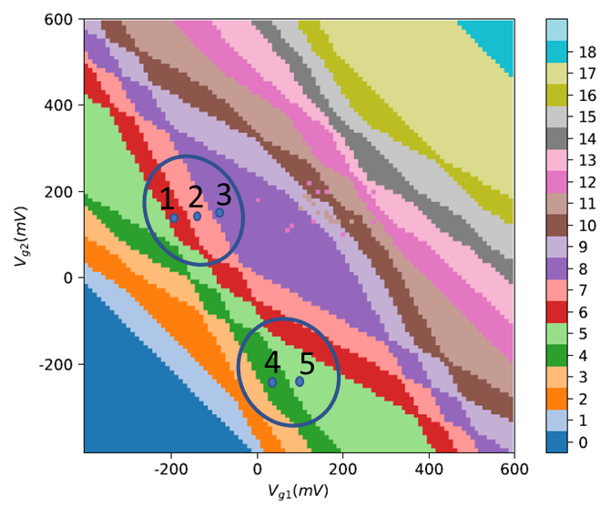
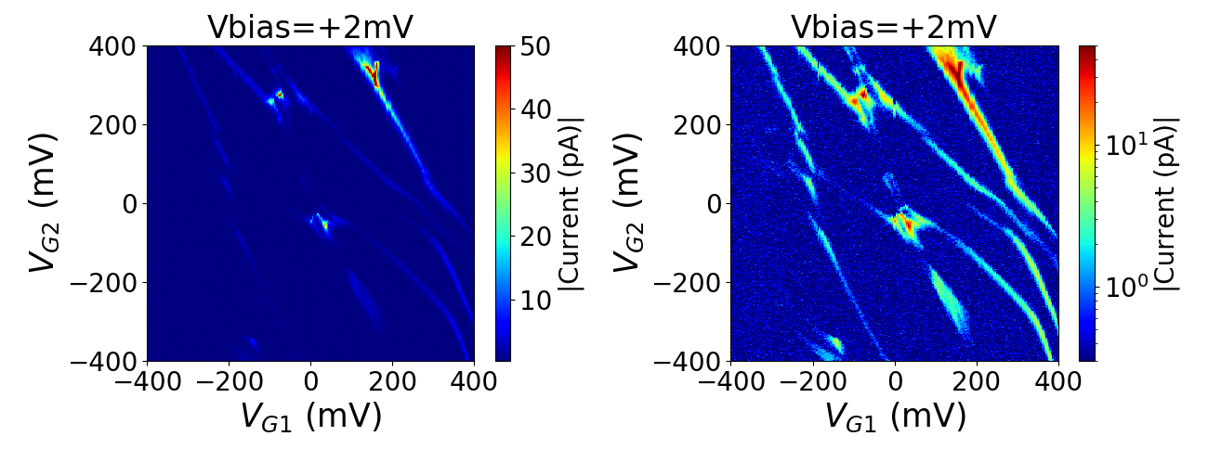

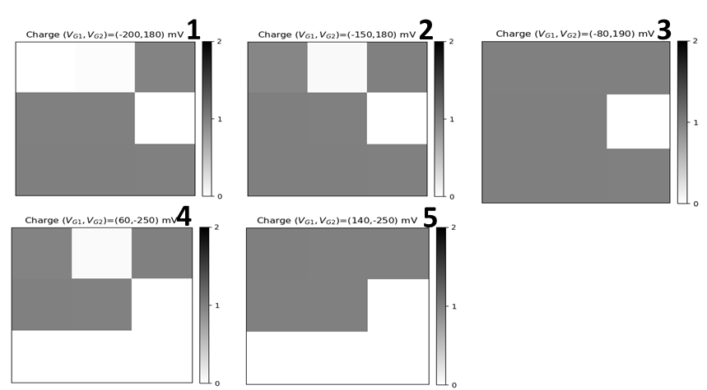
Compare AQS Experiments with Numerical Hubbard Simulations
Transport to study dopant number, tunnel coupling, disorder, gating, charge occupation, etc.
Simulated gate-gate map: charge stability diagram
Experimental conductance gate-gate map
Array 3
Electron addition lines give rise to current - not all transitions support current.
Slopes are due to capacitive coupling of gate to electron addition site.
Electron filling at points 1-5
Transport through many body states
Drain
Source

Slide 11
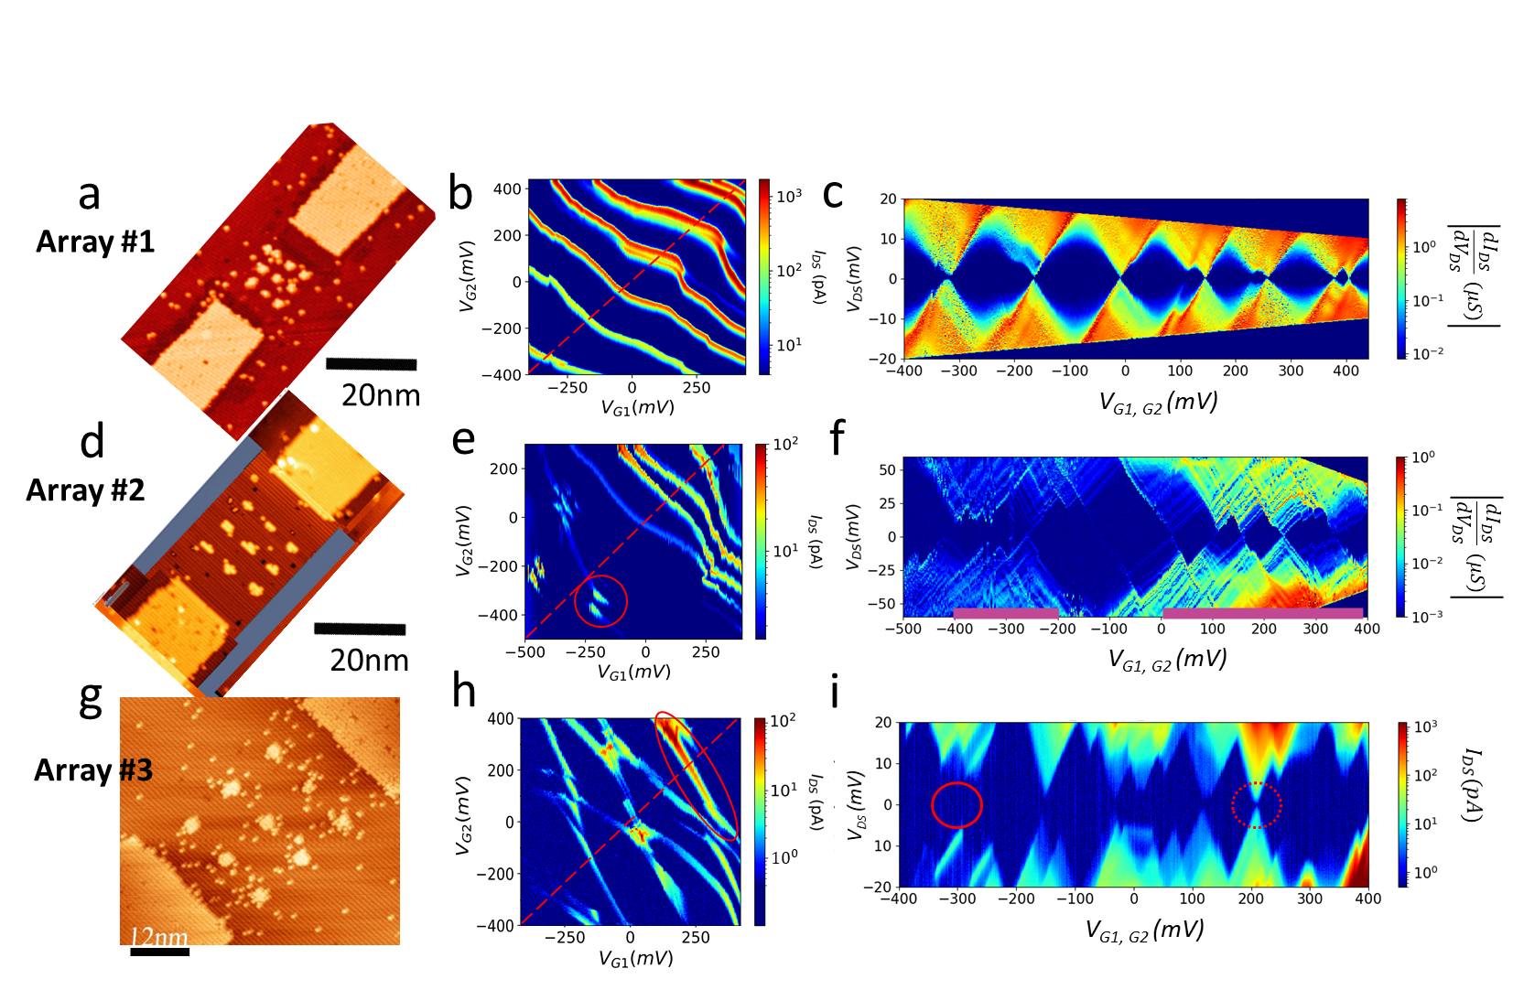

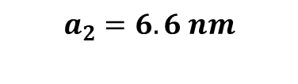

Varying the Tunnel Coupling: Experimental Charge Stability and Coulomb Blockade Diagrams
(Tuning hopping and long-range interactions)
Array lattice constant
$$a_{1}=4.1 nm$$
$$a_{2}=6.6 nm$$
$$a_{3}=10.7 nm$$
X. Wang, E. Khatami, F. Fei, J. Wyrick, P. Namboodiri, R. Kashid, A. Rigosi, G. Bryant, and R. M. Silver, Quantum Simulation of an Extended Fermi-Hubbard Model Using a 2D Lattice of Dopant based Quantum Dots”, Nature Comm. 13, No. 6824 (Nov. 2022).
X. Wang, J. Wyrick, R. Kashid, P. Namboodiri, S. Schmucker, A. Murphy, M. D. Stewart, Jr., and R. M. Silver, Atomic-scale Control of Tunneling in Donor Based Devices, Comm. Physics, Nature Res. J., 3, 82 (2020).

Slide 12
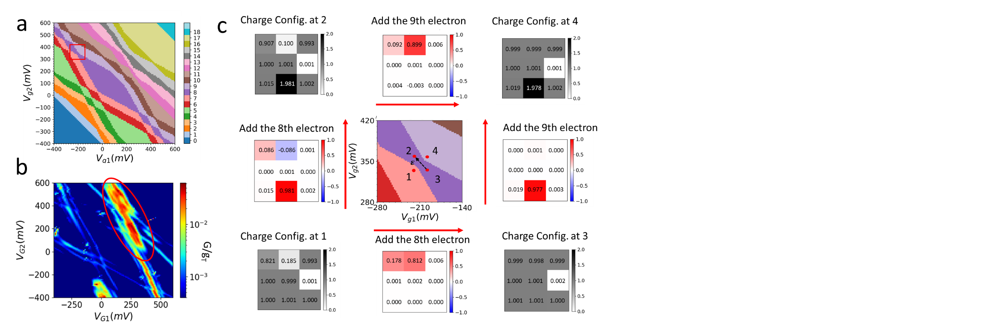
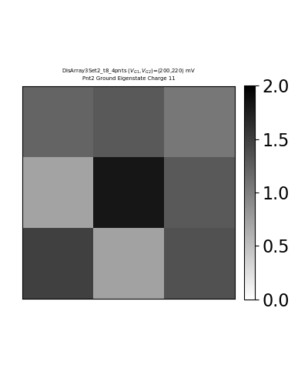
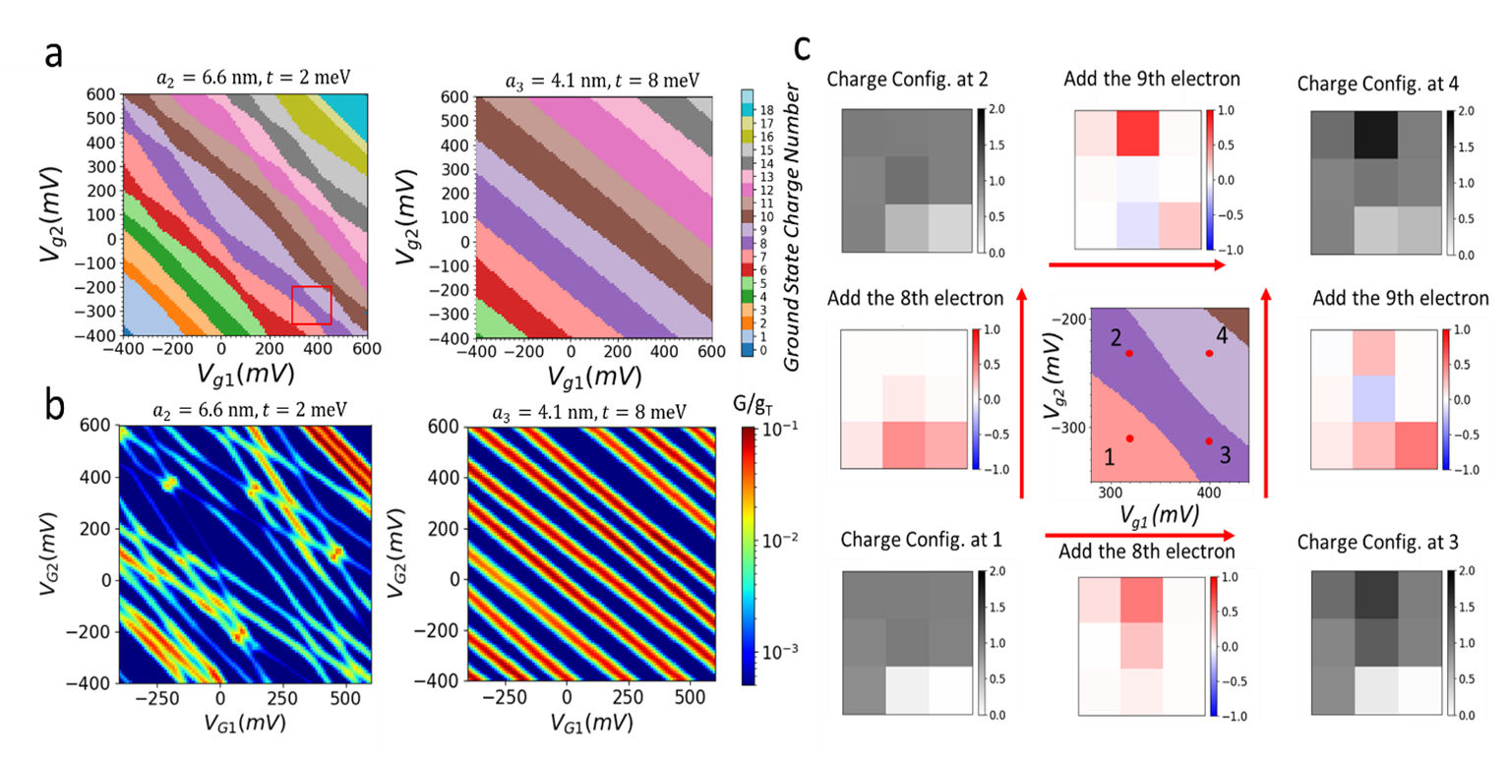
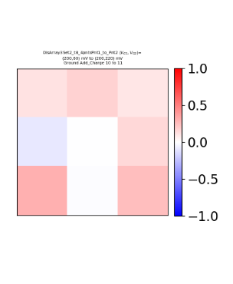
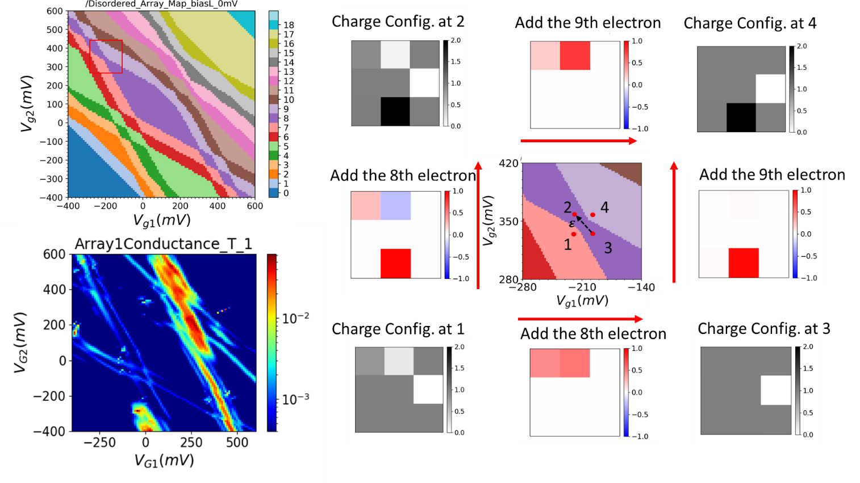
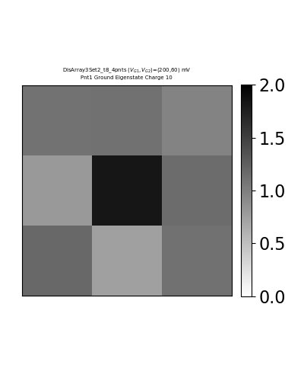


Electron localization as a Function of Tunnel Coupling
Array 1 (a₁ = 4.1 nm)
Array 1
Array 3
Array 3 (a₃ = 10.7 nm)
Add the 11th electron
a₁
Add the 8th electron
Significant change in electron localization from Array 1 (strong coupling) to Array 3 (weak coupling).

Slide 13

DOE NP Proposal: Benchmarking Solid-State Quantum Simulators for Applications in Lattice Gauge Theory
Applicant/Institution: Zyvex Labs LLC
Lead PI James H.G. Owen, 214 384-0723 jowen@zyvexlabs.com
NIST CoPIs Richard Silver, Jon Wyrick, Michael Gullans
Univ. Maryland CoPI Zohreh Davoudi
Simulating fermions coupled to spin degrees of freedom, relevant for a range of quantum field theories, represents a promising application for atom-based quantum simulators.

Slide 14

Simulating a lattice gauge theory
Electrons hop between (dynamical) nuclear spins which are doped near a silicon surface on a regular array…
…the system is then controlled by a set of gates and measured using a set of probes.

Slide 15
Motivation
The origin of the mass of elementary and composite particles is an ongoing challenge in the field of particle and hadronic physics.
A spontaneous symmetry breaking of gauge symmetries gives rise to the mass of elementary particles, while spontaneous breaking of a chiral symmetry greatly influences the spectrum of hadrons in quantum chromodynamics (QCD).
However, a complete picture of dynamical mass generation, and the connection between chiral symmetry breaking and the confinement-deconfinement phase transition, are yet to be developed.
Quantum simulation of quantum field theories provides an avenue to explore nonperturbative, and dynamical phenomena such as quantum phase transitions and mass generation in QCD.
Here we are developing a solid-state analog quantum simulator to explore questions in a quantum field theory.

Slide 16
The Approach
Dynamical mass generation, where mass in the fermion field arises from the spontaneous breakdown of chiral symmetry, may be observed when the confinement-deconfinement phase transition is crossed.
One of the simplest models which has captured the physics of dynamical mass generation and the confinement-deconfinement quantum phase transition is the Jackiw-Rebbi model – fermions interacting with a dynamical lattice.
Here we propose to use a dynamical lattice of coupled nuclear spins and conduction-band electrons to realize an extended rotor Jackiw-Rebbi quantum field theory - fermions coupled to a lattice of quantum rotors.
Numerical simulations are used to demonstrate the feasibility of observing dynamical mass generation and a confinement-deconfinement quantum phase transition in 1+1 dimensions on this platform, even in the presence of strong long-range Coulomb interactions.

Slide 17



The Hamiltonian of Rotor Jackiw-Rebbi model…
…. can be mapped to a lattice Hamiltonian in 1+1 D and in 2+1 D:
Electron hopping
Chemical potential term
Hyperfine coupling
Zeeman coupling for nuclear spin
Coulomb interaction energy
A. Rad, A. Schuckert, E. Crane, G. Nambiar, F. Fei, J. Wyrick, R. M. Silver, M. Hafezi, Z. Davoudi, and M. J. Gullans, Analog Quantum Simulator of a Quantum Field Theory with Fermion-Spin Systems in Silicon, arXiv:2407.03419 [quant-ph] (2024).
D. Gonzalez-Cuadra, A. Dauphin, M. Aidelsburger, M. Lewenstein, and A. Bermudez, Rotor jackiw-rebbi model: a cold-atom approach to chiral symmetry restoration and charge confinement, Prx Quantum 1, 020321 (2020).

Slide 18


Numerical simulation shows that there should be a spontaneous chiral symmetry breaking, hence dynamical mass generation, in the 1+1 D model.
as well as two phases: confined and de-confined.
The phase diagram showing two distinct phases, trivial and nontrivial, versus external magnetic field. The nontrivial N´eel phase, indicated in blue, and the trivial phase, where all spins are polarized, is represented by a white background.

Slide 19

Numerical demonstration that dynamical mass generation occurs in 2+1 D square lattice.
The spin configuration and fermion distributions in a two-dimensional square array, N = 10 × 10 are shown.
The arrows represent the spin, ⟨S_{z}⟩, of the dopants, while the circles denote the fermion density at each site, indicated as ⟨n_{i,j}⟩.
The N´eel-order phase is in blue and the trivial phase in white. The blue color represents the order parameter |n_{z}|, which is ideally one for the N´eel-order phase and zero for the trivial phase.
The features are robust to finite temperature, transverse magnetic field, and Coulomb interactions.
Here t = 7.5 meV, h_{x}S/t = 0.01, and V0/(at) = 1.1

Slide 20




Atomically Precise 2x2 Plaquettes for NP Analog Quantum Simulations
The central (blue) overlayed scan is of 4 bare dimers taken at negative bias.
The same 4 bare dimers taken at positive sample bias.
Lithography and dopant manipulation is performed at low temperature to achieve single atom precision.
Positive bias scan of the 4 sites after PH3 deposition. Each dimer site houses a PH2 + H (PH2 at one top site, H at the other).
Individual white dots are single dangling bonds and don’t react with PH3.

Slide 21
State Preparation
For the magnetic-field range used, and electron and nuclear gyromagnetic ratios γ_{e} B ≫ g > γ_{n} B, the eigenstates of the fermion– nuclear-spin system at each site order as |↓, ⇑⟩, |↓, ⇓⟩, |↑, ⇓⟩, and |↑, ⇑⟩.
To see the nontrivial phase in the rotor Jackiw-Rebbi model, we prepare each site to be |↓, ⇓⟩. The electrons can be polarized to all spin down ↓ state using a strong magnetic field.
Rather than individual site manipulation, a scalable approach is to place a single electron on each site and use dynamical nuclear polarization (DNP) to simultaneously pump the nuclear spins to a polarized state.
For the rotor Jackiw-Rebbi model, we then change the electron occupation to be close to 1/2 electrons at each dopant site.

Slide 22


Measurement: Probing with transport and RF sensing in an array
DC transport through the array to sense changes in the charge configuration.
Green dashed lines: visible in the conductance map
White dashed lines: invisible/weak in the conductance map
Notes:
The result from RF phase response show there are quite a few charge transitions than what’s visible just from dc transport measurement. Green dashed lines mark the transitions that support tunneling current. White dashed lines mark the capacitive responses that’s only visible in the RF measurement. From the similar lever arm ratios between those white lines and the green conductance lines from the array, we deduce that the location of the corresponding charge states should be within the array itself. That is, the localized charge states in the array act as a charge trap.

Slide 23









Charge movement/transitions visible only in the RF response
Drain
c1
Source
Probing a 3x3 array
Charge transition between localized charge states coupling to the same leads.
N+1
c2
N+2
$$C_{q}= \frac{{Δα}^{2}e^{2}t^{2}}{4}[(\frac{ε}{2})^{2}+t^{2}]^{−3/2}$$
N
N+1
Single Lead Quantum Dot Reflectometry on a 2x2 Array
G1
GM
Extract effective tunnel coupling between two localized charge states:
G2
G3
$$ε$$
G4
Notes:
We also observe a charge transition between a localized charge state and a barely extended state. The schematic on the right shows a possible configuration. From the width of the transition line, we can extract the effective tunnel coupling between these two charge states with a value of 35ueV.

Slide 24

Simulations to demonstrate that phases are feasible with realistic experimental parameters.
|n_{z}| illustrated for a 2 × 2 dopant array
Variation of gS/t is challenging so we keep gS/t fixed and vary the external magnetic field.
a) The system transitions through different phases (trivial phase (|n_{z}| = 0) to the N´eel ordered phase) corresponding to varying levels of the magnetic field for three different values of tunneling coupling.
b) The phase diagram of the 2 × 2 dopant array, with the region gS/t coupling feasible in an experimental setup (simulated using the ED method).
Varying the external magnetic field as an experimental control.

Slide 25

Summary
Hubbard simulations using few-dopant 2x2 and 3x3 arrays. Map out charge transitions, tune the occupation, tunnel coupling etc.
Can prepare, manipulate and read individual electron spins. ESR and NMR for coherent manipulation.
High bandwidth RF reflectometry to track individual electron dynamics.
Demonstrate atomic precision for position and dopant number in larger arrays.
Create near perfect host silicon lattice.
Outlook
Supported by DOE QIS Research
and Innovation for Nuclear Science (DE-SC002371)

