Slide 1
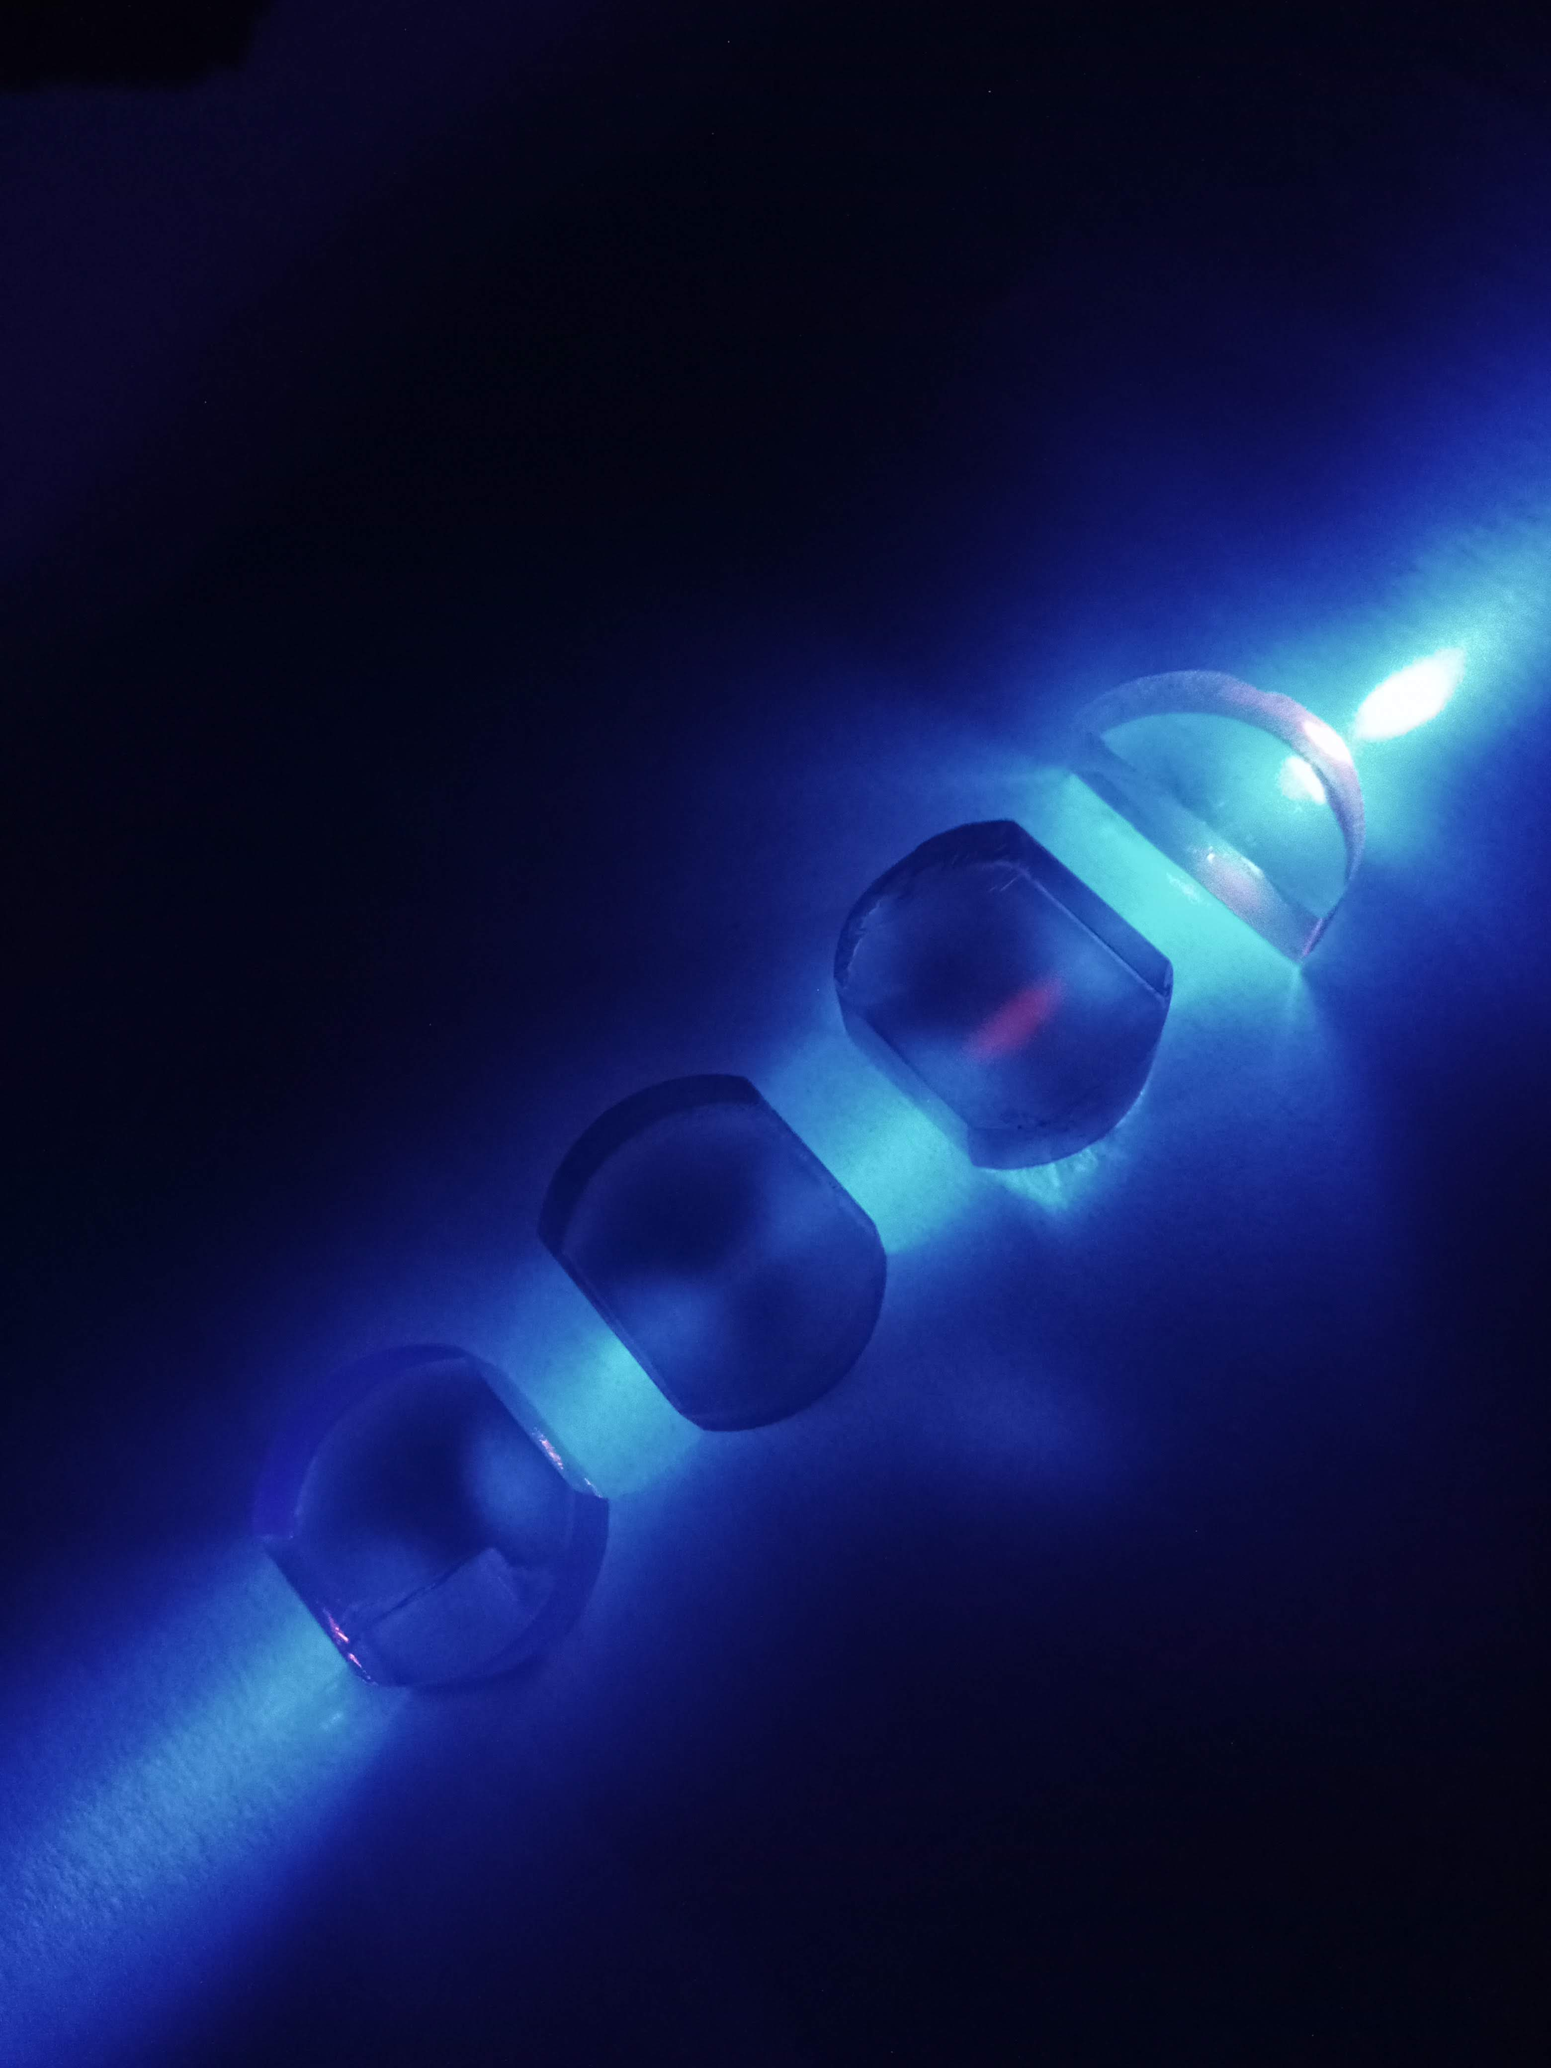
Making a solid-state nuclear optical clock
²³²Th:CaF₂ high doping
2 F⁻ vacancy fluorescence
²²⁹Th:CaF₂ low doping
²³²Th:CaF₂ low doping
Undoped CaF₂
Kjeld beeks, EPFL/TU Wien
Notes:
Add V center things

Slide 2
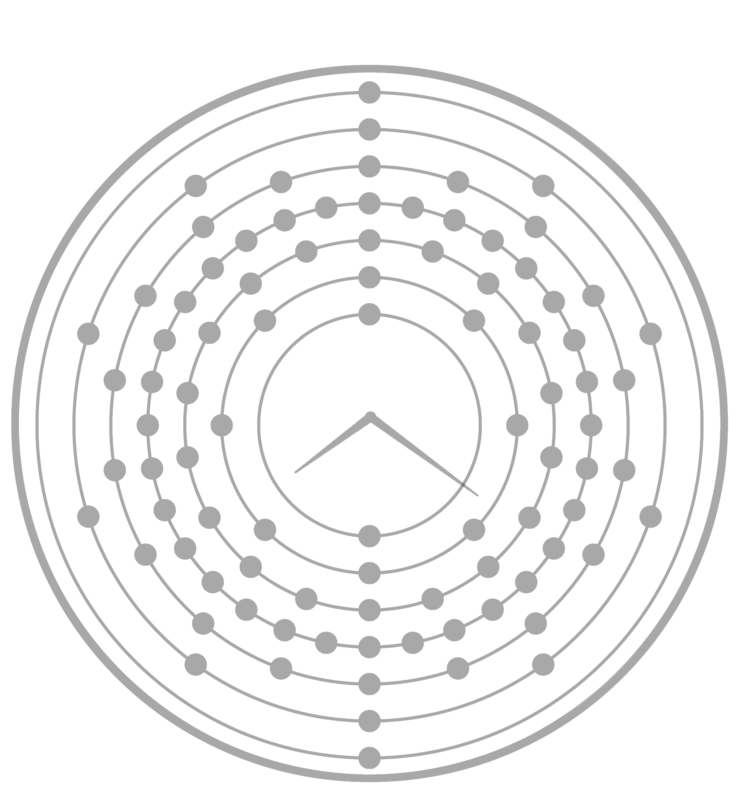
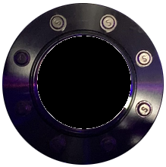
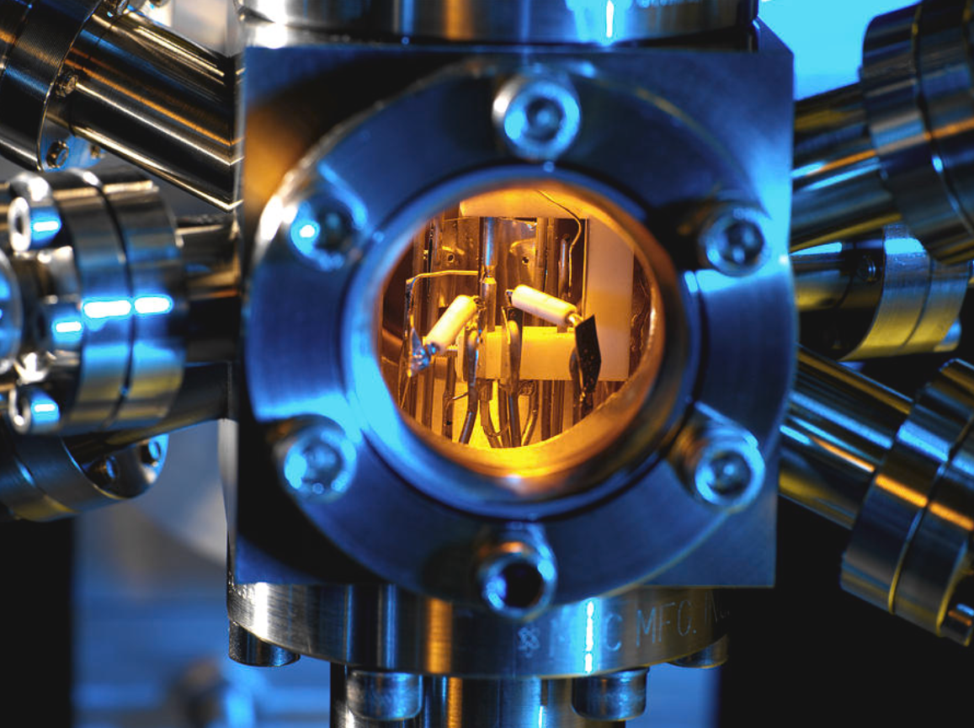
QM: Optical ion clocks
Measures time by monitoring the resonant frequency of atoms
Is the same for every atom in the universe
VACUUM
Kjeld Beeks| Slide 1
Notes:
Atomic clocks use the oscillation frequency of an electron between two orbits around a nucleus to measure time. Many of these atomic clocks together define the second. We can compare different clocks because this resonance is the same for every single atom in the universe. Because we can compare clocks, they can be used to measure position such as in GPS, and are used to precisely measure time differences which is used in astronomy and the internet. The currently best clocks are ultracold atoms held in a large vacuum system, and are probed using lasers with 689 nm photons. So, how can we improve these even further?

Slide 3
QM: Optical ion clocks
Kjeld Beeks| Slide 1

Slide 4
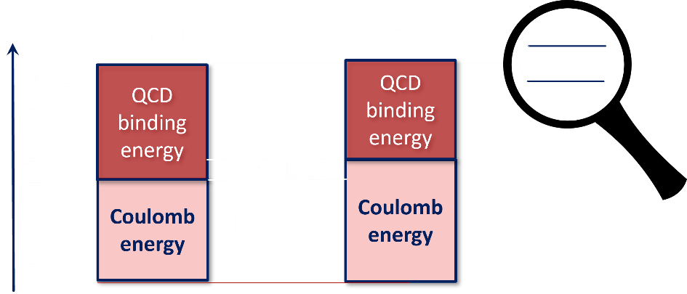
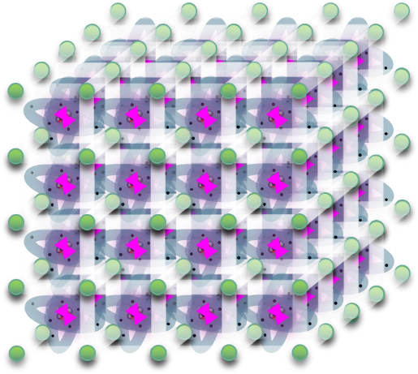
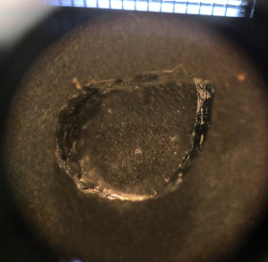
QM techniques for a nucleus
Thorium-229
Narrow (mHz/10³ s) nuclear excitation at “optical” wavelength
Nuclear “unaffected” by environment
Nuclear resonance extra sensitive to new physics?*
Density in solid-state: 10¹⁵ vs 1 ion
Allows us to make a more precise, stable, faster and smaller clock!
F⁻
CaF₂ 122 nm transparent
Th⁴⁺
148 nm
Is internal conversion suppressed?
Does CaF₂ stay transparent after doping?
Can we grow such a crystal?
* Beeks, Kjeld, et al. "Fine-structure constant sensitivity of the Th-229 nuclear clock transition." arXiv preprint arXiv:2407.17300 (2024).
Kjeld Beeks| Slide 2
Notes:
We can improve on many fronts simultaneously by using a nuclear excitation instead of an electronic one. As the outer electrons of an atom are involved in collisions and chemical bonds, they are highly sensitive to their surroundings. The nucleus however is not involved in these interactions and is thus unaffected by the environment. Thorium-229, a radioactive element, has an extremely low energy excitation that we can also probe with lasers, at 150 nm. By using this nucleus, we can directly transfer the developed clock techniques to a nuclear system. This has many benefits: The nucleus is sensitive to new physics compared to atomic clocks, and can be used to uncover more about the universe. Because the nucleus is insensitive to its environment, we can hold it in a crystal instead of a vacuum, which reduces the size of the setup and increases the amount of nuclei that are interrogated. This results in a more precise, stable, fast and smaller clock! The only requirement for the material is that it needs to be transparent to the probing wavelength, 150 nm. For this reason we chose CaF2 as a host material, which is a natural crystal that is transparent up to 122 nm. The main questions that then remain are, does CaF2 remain transparent after doping this nucleus in it, and are we technically able to produce these crystals?

Slide 5
QM techniques for a nucleus
Kjeld Beeks| Slide 2

Slide 6
Internal Conversion
Internal Conversion (IC) is the preferred decay mechanism
Lifetime of $μs$
Stronger for orbitals with nuclear overlap
Only allowed if $E_{S}>E_{B}$
$$E_{kin}=E_{s}−E_{B}$$
$$M_{1}/E_{2}$$
Kjeld Beeks| Slide 3
Notes:
Talk about what internal conversion means to us, and what is important in our case. Compare to lanthanide case? Quenching, non-radiative decay etc.
Talk also about quenching, and EB excitation. What it means for the clock.

Slide 7
Bound Internal Conversion (Quenching)
Lifetime of ??
Stronger for orbitals with nuclear overlap
Electronic states around dopant can allow “bound” IC
Quenching would broaden line
Kjeld Beeks| Slide 4
Notes:
Talk about what internal conversion means to us, and what is important in our case. Compare to lanthanide case? Quenching, non-radiative decay etc.
Talk also about quenching, and EB excitation. What it means for the clock.

Slide 8
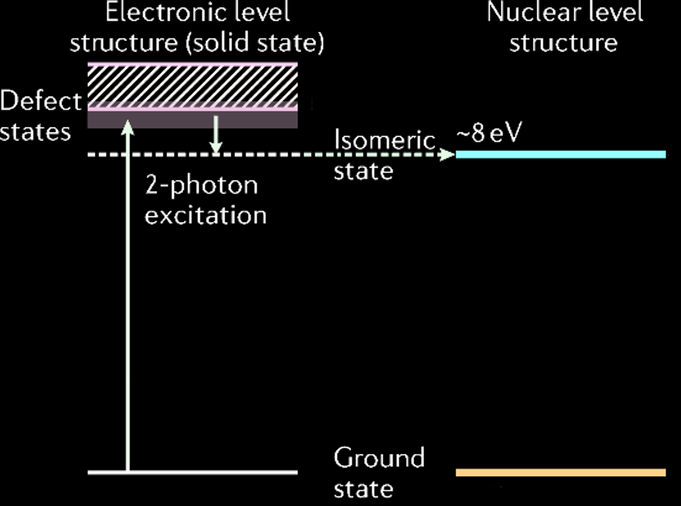
CaF₂ remains transparent?
Density Functional Theory (DFT) simulations on Th:CaF₂ using the Vienna Ab initio Simulation Package for many different geometries.
Transparency window
148 nm ~8 eV
Transparent for photons ~10 eV
Kjeld Beeks| Slide 5
Notes:
To answer the first question, simulations were performed to assess the feasibility of doping. For this, the unique expertises of Vienna was exploited: Density functional theory simulations using the VASP code developed in Vienna. In collaboration with the IFP and VSC we calculated the effect of doping. We predicted that this would only create some extra electronic excitations, or defects, close to the conduction band of this crystal, effectively leaving this crystal transparent for photons up to 10 eV. This is 2 eV larger than the probe photon, and thus the doping should not affect our goal.

Slide 9
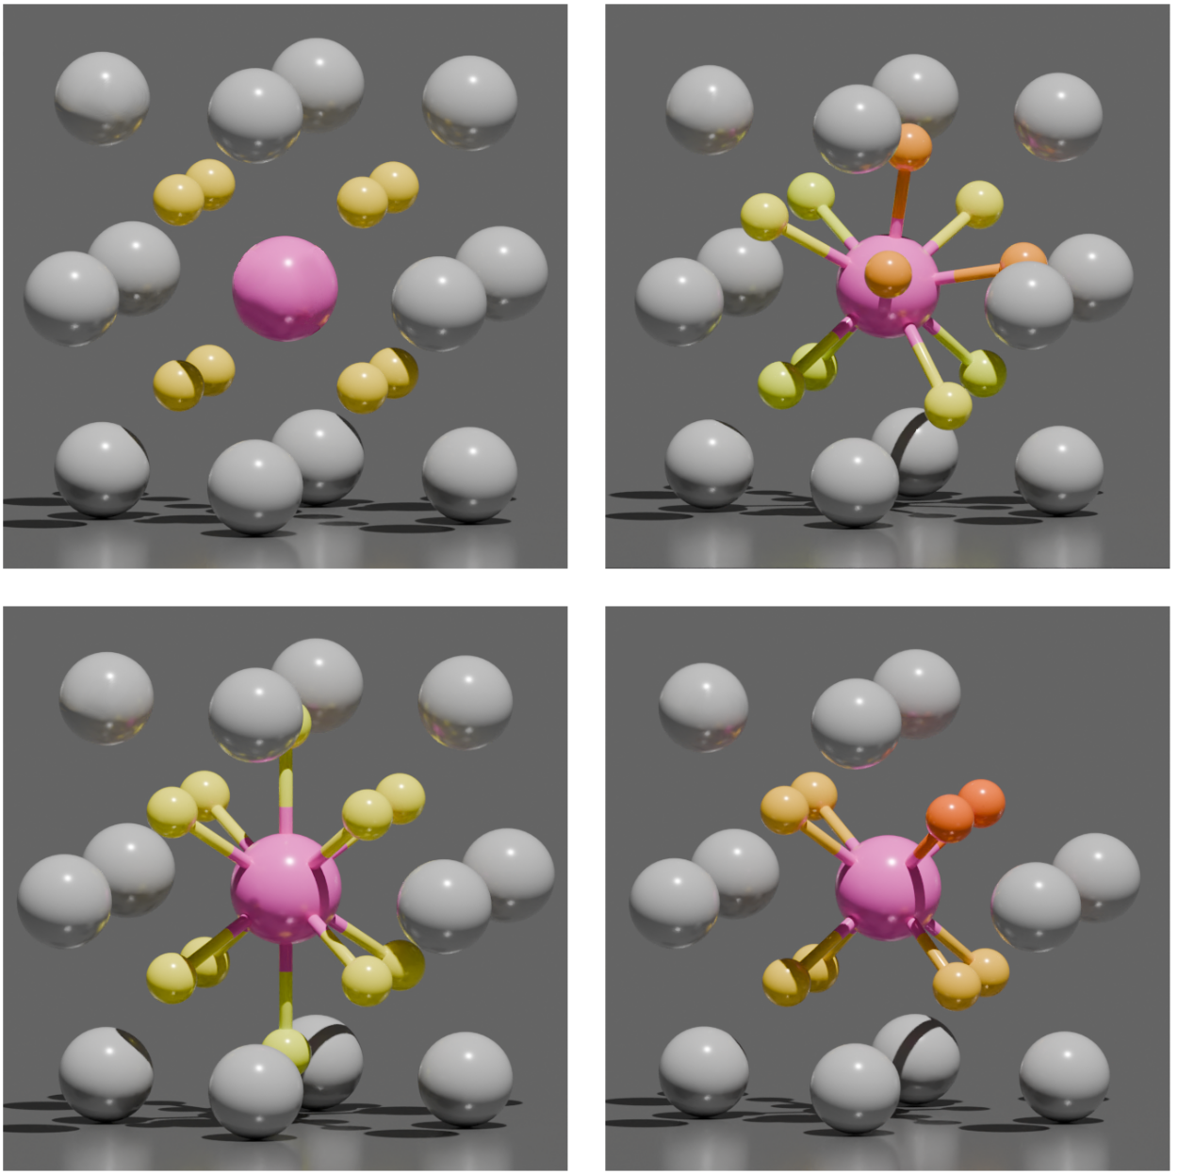
Different Thorium Geometries
2 interstitial F, 71 degrees “Angled”
Uncompensated
2 interstitial F, 180 degrees “Linear”
Ca vacancy
Kjeld Beeks| Slide 6
Pimon, Martin, et al. "Ab-Initio Study of Calcium Fluoride Doped with Heavy Isotopes." Crystals 12.8 (2022): 1128.
Notes:
Go through the different options we are considering, just to have some frame of reference to talk about. Why is it important? All should be transparent.
Add EFGs

Slide 10
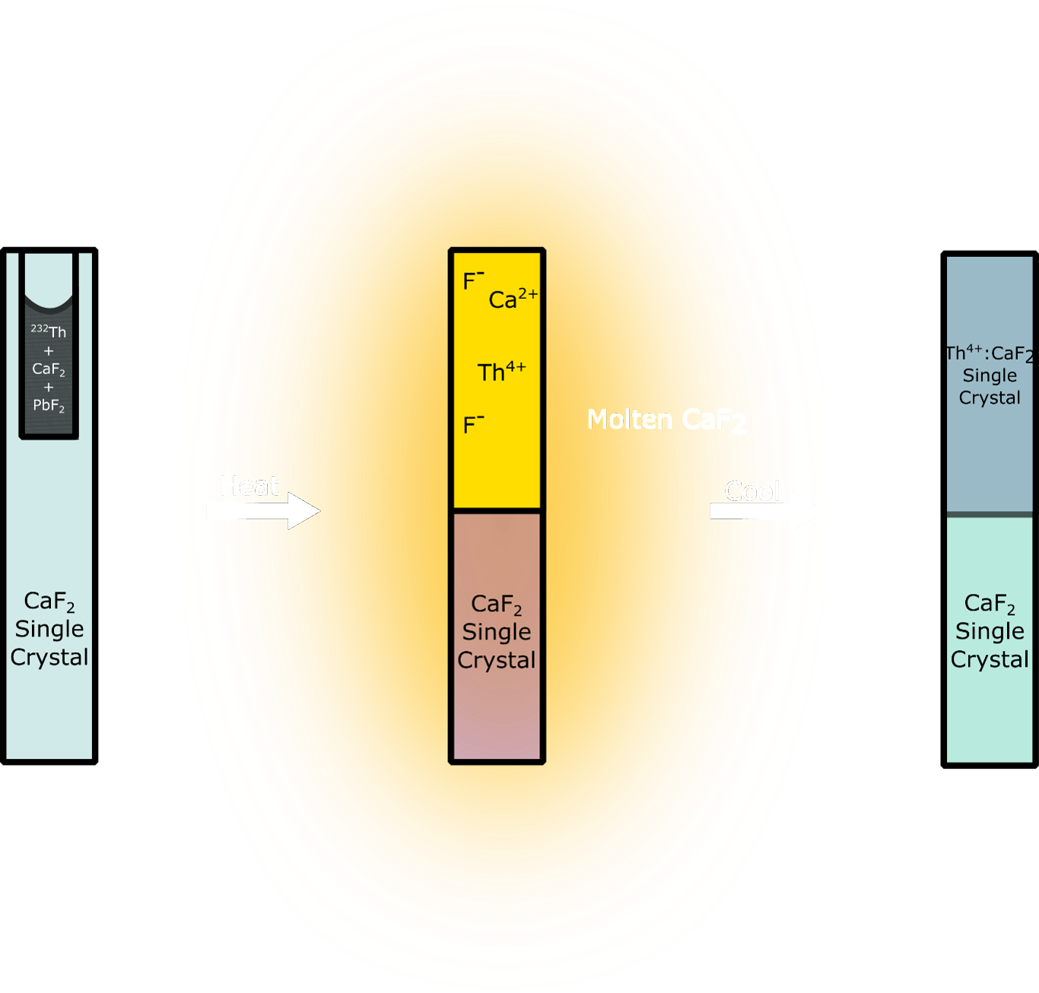
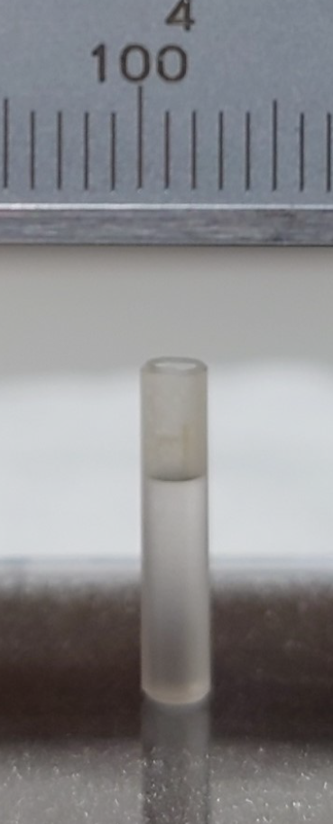
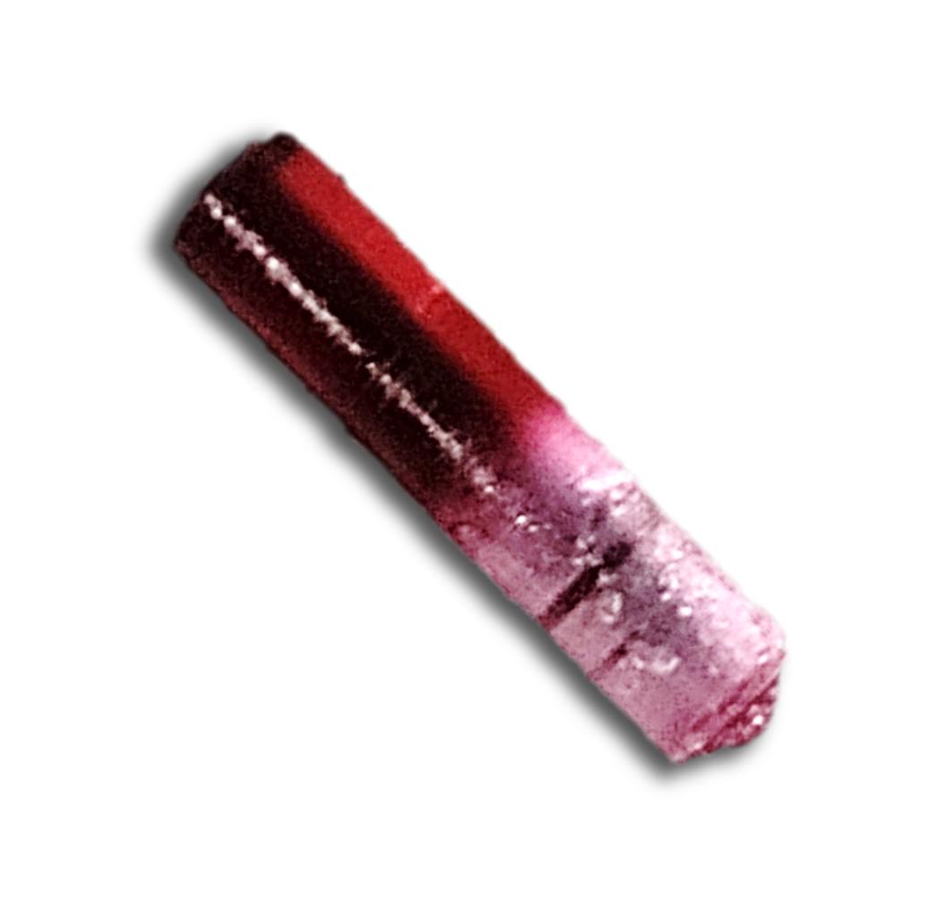
Growing doped CaF₂ Crystals
Vertical Gradient Freeze
Kjeld Beeks| Slide 7
Notes:
To answer the second question, we looked towards crystal growing methods that produced as little residu as possible. As thorium-229 is scarce, we do not want to waste anything and we want to get to the highest doping concentrations possible. For this we used the vertical gradient freeze method: We put some powder containing CaF2, ThF4 and PbF2 (as oxygen scavenger, to reduce contaminations), on top of a single crystal CaF2. We then proceed to apply a steep temperature gradient which melts half the crystal, and thus mixes the separate molecules. By carefully moving this steep temperature gradient, upward, thereby cooling the crystal from bottom to top, it crystallizes on top of the single crystal. This way we can grow a single crystal CaF2 doped with Thorium with the same structure as the bottom seed crystal. The crystallinity ensures the transparency up to 122 nm. Tests with the non-radioactive and widely available isotope of thorium, 232, produced 122 nm transparent crystals using this method.

Slide 11
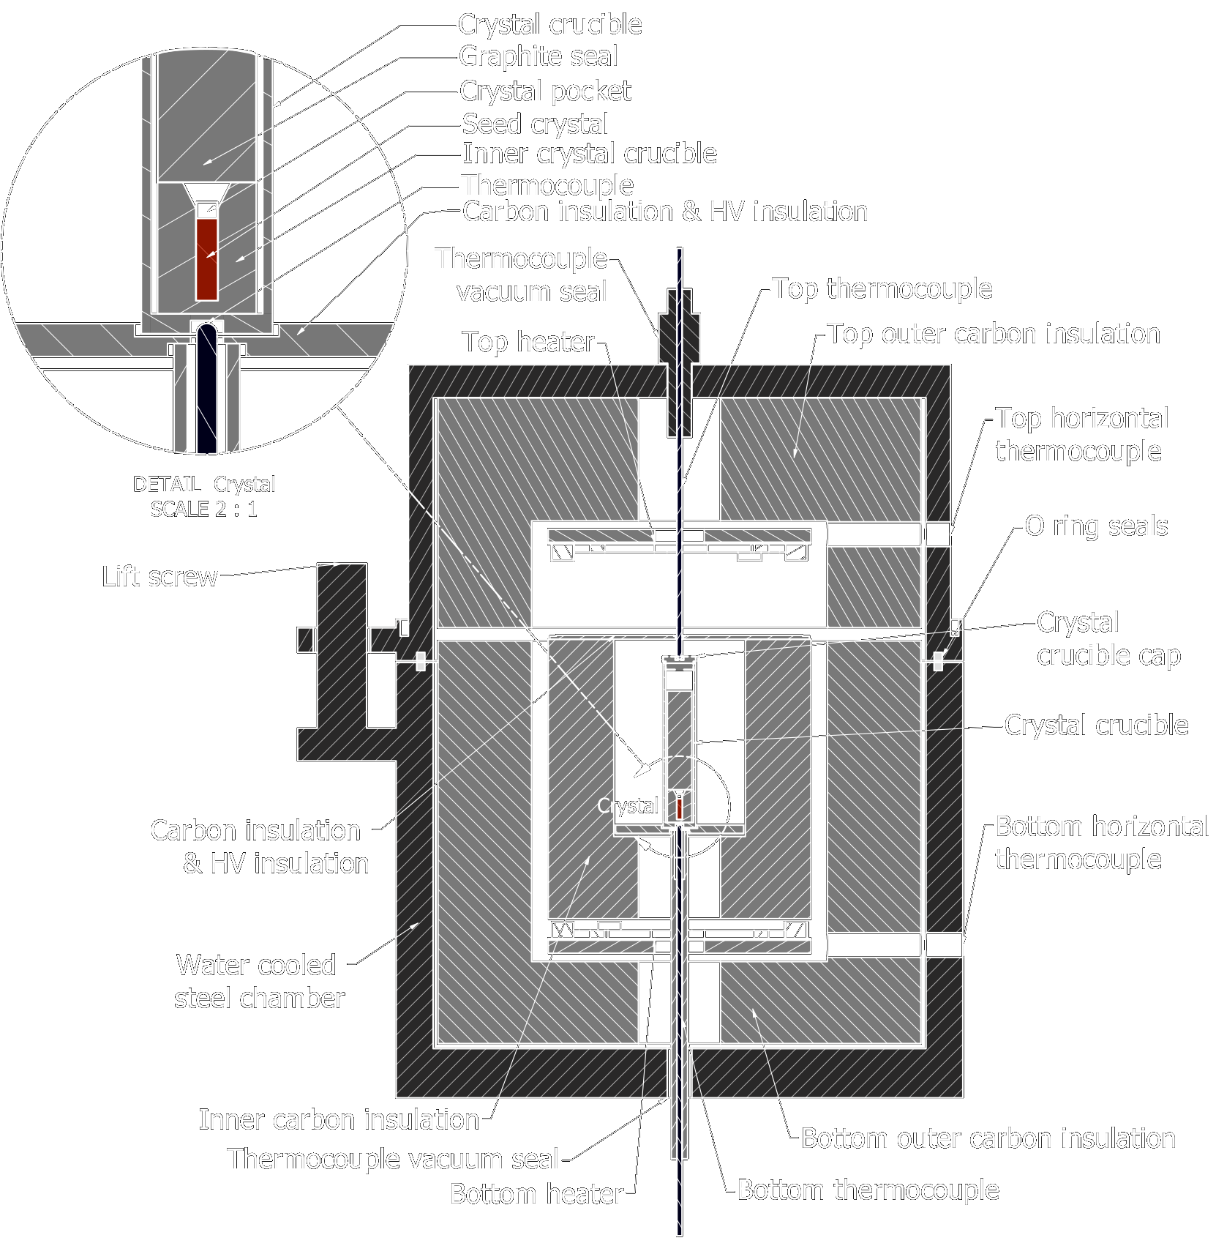
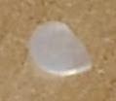
Growing doped CaF₂ Crystals
Through engineering we:
Reduced crystal size from 17 mm to 3.2 mm
Increased precision and steepness of temperature gradient
Implemented higher temperature and fluoride vacuum materials
Removed crystal impurities
Reduced CaF₂ carrier amount through coprecipitation
Beeks, Kjeld, et al. "Growth and characterization of thorium-doped calcium fluoride single crystals." Scientific Reports 13.1 (2023): 3897.
Kjeld Beeks| Slide 8
Notes:
To grow these crystals we again looked to the unique situation of Vienna, where the Atominstitut is allowed to handle radioactive material and grow macroscopic crystals with it. We only know of 2 other places in the world that do this. Together with the German IISB Fraunhofer institute a prototype crystal grower was designed and manufactured to grow 17 mm crystals, the smallest possible then. Throughout my PhD many engineering challenges arose: We reduced the size of the crystal to 3.2 mm to achieve the highest doping concentration with the mg available amounts of thorium-229. Because of the size of the crystal we had to increase precision and steepness of the temperature gradient. Because of this, we needed to implement materials with higher resistance to temperatures and fluorinating atmospheres. By experimenting with scavengers and starting materials we effectively reduced impurities to non-measureable quantities. Finally we reduced the amount of CaF2 that was used as a carrier for thorium-229 through coprecipitating the materials. After many years of experimentation and calibration we finally produced a radioactively doped CaF2 crystal, which was sadly opaque.

Slide 12
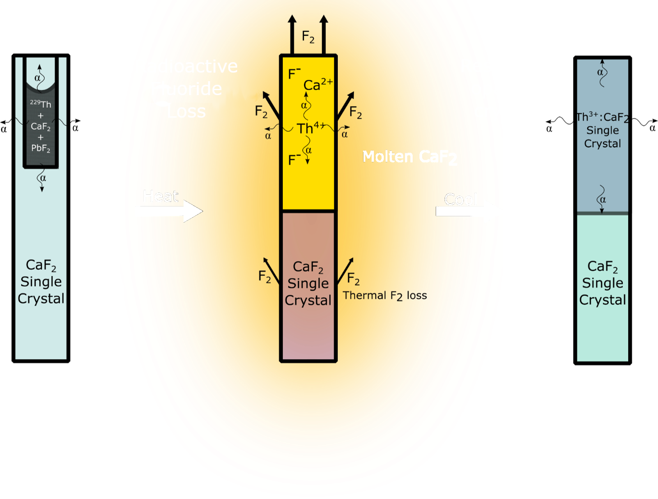
Making Radioactive Crystals Transparent
Solution: Annealing in CF₄ at superionic temperatures to add fluoride after growth (Using a new machine!)
Kjeld Beeks and Thorsten Schumm. The Nuclear Excitation of Thorium-229 in the CaF2 Environment. Diss. Wien, 2022.
Beeks, Kjeld, et al. "Optical transmission enhancement of ionic crystals via superionic fluoride transfer: Growing VUV-transparent radioactive crystals." Physical Review B 109.9 (2024): 094111.
Kjeld Beeks| Slide 9
Notes:
Through optical absorption measurements, and consulting experts at the IFP and the Marburg university we figured out what made the radioactive crystals opaque, and the non-radioactive ones transparent: Large amounts of fluoride were lost during the growth process due to radioactivity induced dissociation: radiolysis. This imbalance between Ca and F produced highly opaque crystals. Our last engineering challenge was to put back the fluoride for which we developed a new technique: annealing the crystals in CF4 to disperse fluoride quickly through the crystal. For this a new type of induction crystal growing oven with control of the ambient gas was installed in the Atominstitut, which can also be used to develop new crystal growing methods. This technique is now used by other crystal growing groups around the world. The effect is even visible, where one can see the opaqueness receding as a function of annealing time. Finally, this produced crystals transparent up to 122 nm containing thorium-229. Only 3 crystals were produced this way, with only one, X2, containing the highest density of Thorium-229.

Slide 13
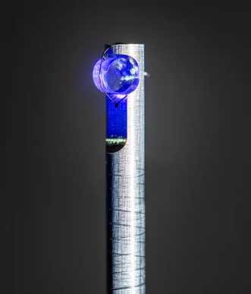
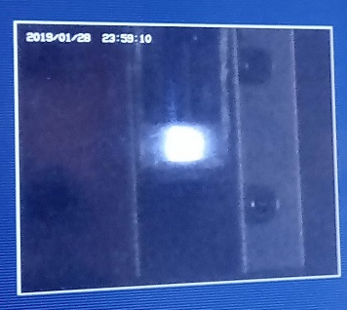
More questions than answers
Why is the transparency controlled by F content? Hypothesis: arXiv preprint arXiv:2410.00230 (2024).
But we see x-ray intensity dependent quenching? More characterization: Nature communications 15.1 (2024): 5536.
But we see laser intensity/crystal temperature dependent quenching? arXiv preprint arXiv:2412.12339 (2024).
But the EFG does not match expectations? arXiv preprint arXiv:2409.11590 (2024). (See Chuankun‘s Talk)
Kjeld Beeks| Slide 10
Notes:
After finally producing a suitable CaF2 crystal containing thorium-229, collaborations around the world were sought to put X2 to the test. First the crystal was sent to the Spring-8 synchrotron in Japan where in collaboration with Okayama U and Riken the thorium nucleus was excited using extremely narrowband x-rays. We were successful in exciting and manipulating a population of excited nuclei in the crystal, but lacked the precise spectroscopy needed for a clock. In the image one can see the fluorescence the x-rays generate in the CaF2. Next, we sent X2 to the German metrology institute PTB to perform narrowband laser spectroscopy. Cryogenic cooling of the crystal was necessary to reduce damage to the crystal, but we managed to be the first to ever excite a nucleus with a laser. The exact frequency of the nuclear oscillation was now known precisely, and using this information X2 was sent to JILA in Boulder to do a proper clock comparison using a laser frequency comb between the currently best atomic clock using Sr-87 and the nuclear clock. Now, the nuclear clock is a reality and is taking its first steps towards competing with the world’s best clocks.

Slide 14
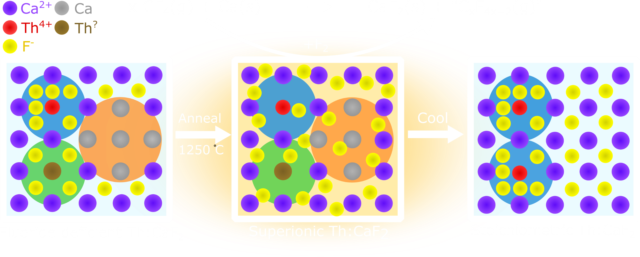
Why is the transparency controlled by F?
Kjeld Beeks| Slide 11
Notes:
Mention EPR?

Slide 15
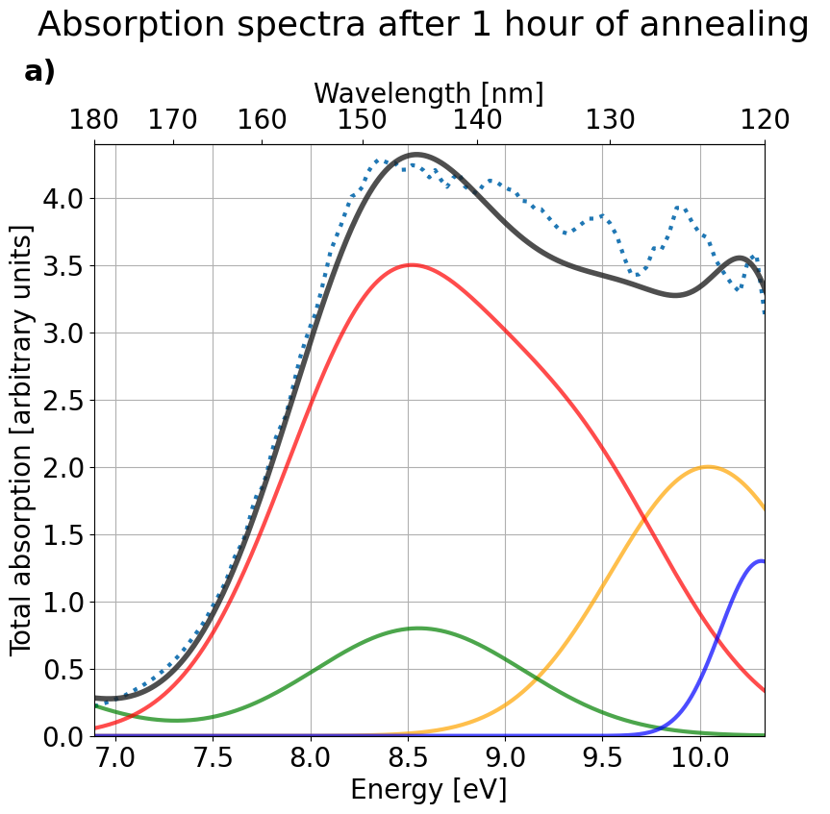
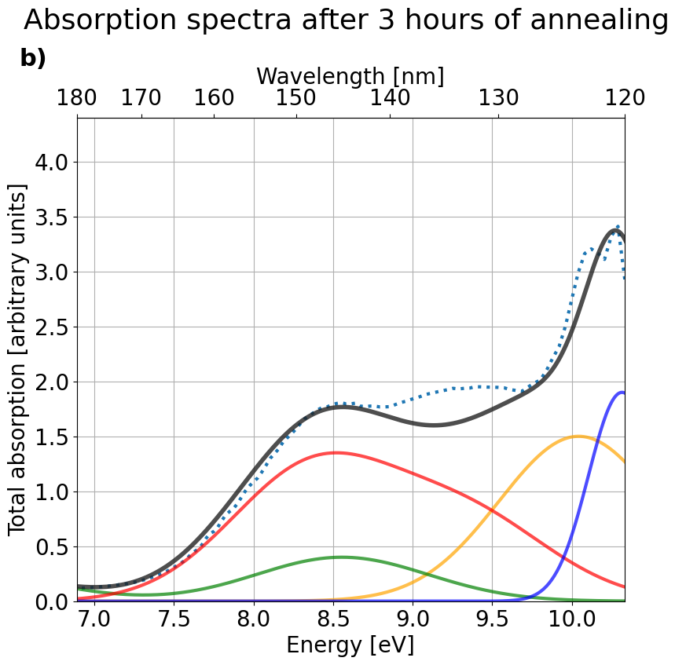
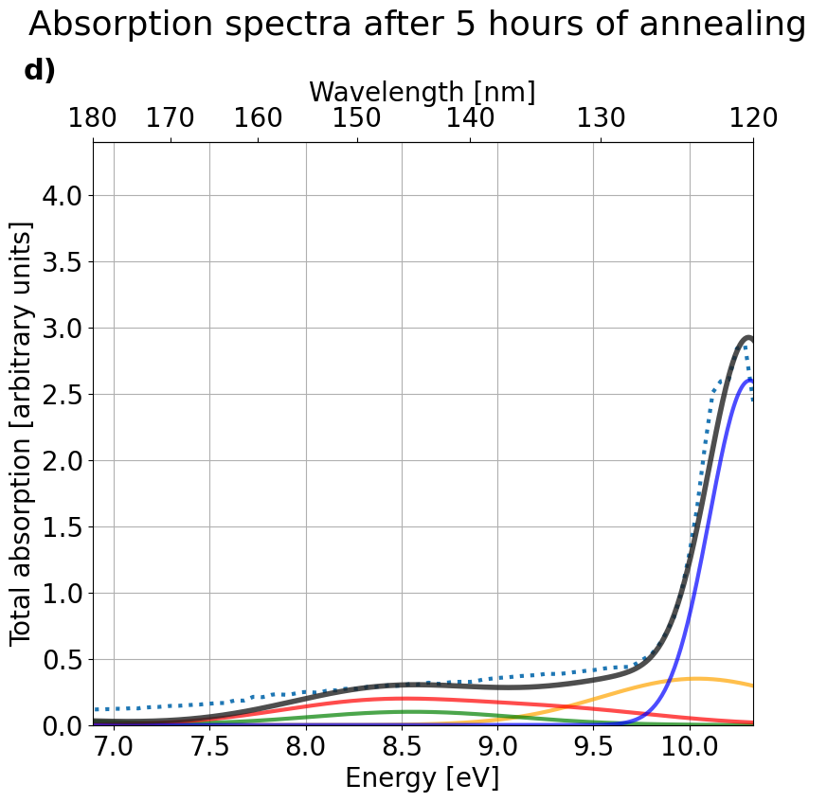
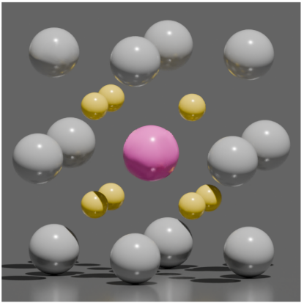
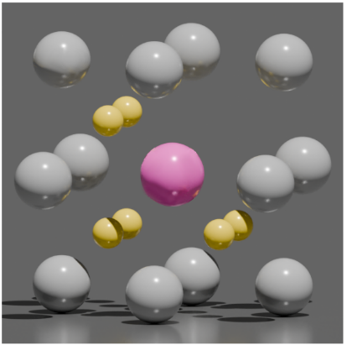
Why is the transparency controlled by F?
Kjeld Beeks| Slide 12
Notes:
Talk about 4+ charge and 4 valency

Slide 16
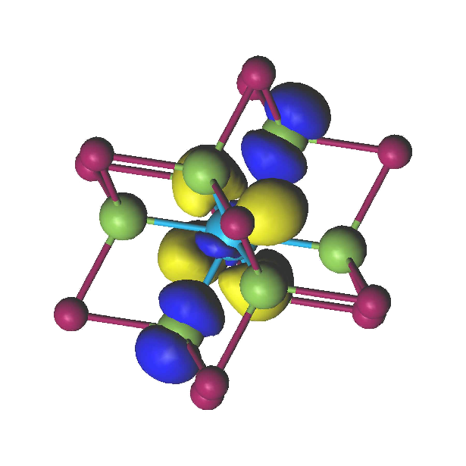
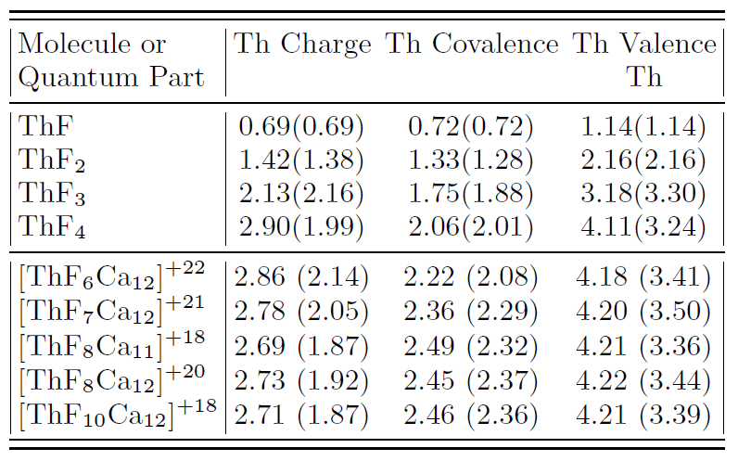
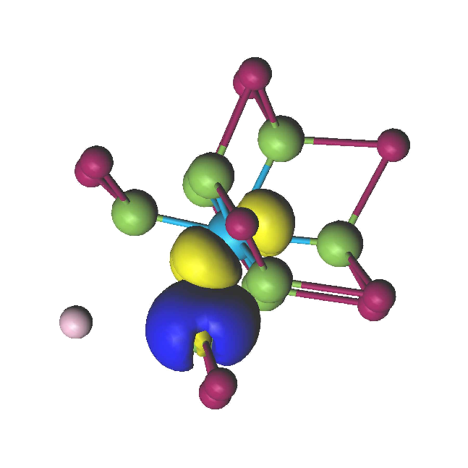
How many F vacancies do you need to quench a nucleus?
F⁻
e⁻
Kjeld Beeks| Slide 13
Notes:
Add the wavefunctions calculated by the polish

Slide 17
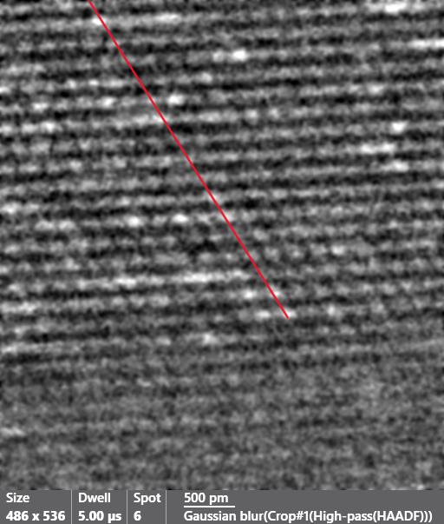
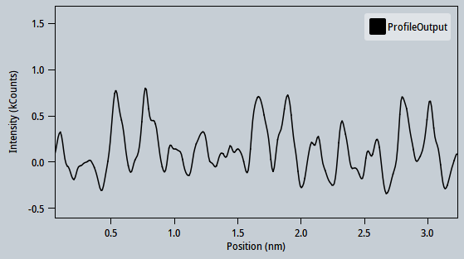
Pristine Th:CaF2 HRSTEM
Kjeld Beeks| Slide 14
Notes:
Add epfl logo

Slide 18
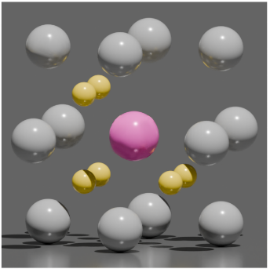
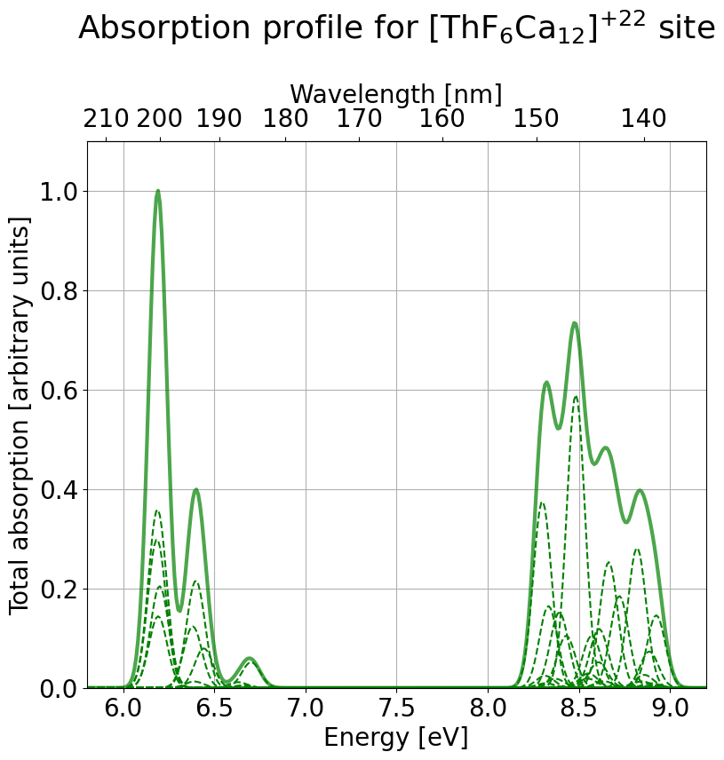
Bleaching of F vacancy
Excitation light source background
Excitation light source background
Kjeld Beeks| Slide 15
Notes:
Add calculations by marek

Slide 19
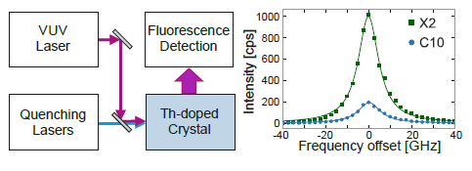
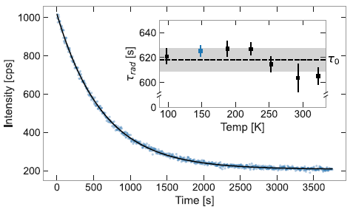
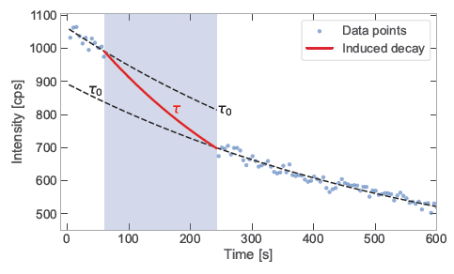
LIQing the crystals
Kjeld Beeks| Slide 16
Notes:
Add ptb logo

Slide 20
LIQing the crystals
F center absorbs around 420 nm, H center absorbs around 280 nm, STE is created by 148 nm.
Excitation increases spatial extent of electronic excitation, increasing nuclear quenching (and STE quenching*)
*Lindner, R., et al. "Femtosecond laser pulse excitation of electrons and excitons in CaF2 and SrF2." Journal of Physics: Condensed Matter 13.10 (2001): 2339.
Kjeld Beeks| Slide 17
Notes:
Go through the different options we are considering, just to have some frame of reference to talk about. Why is it important? All should be transparent. Add F and H absorption. Look at paper

Slide 21
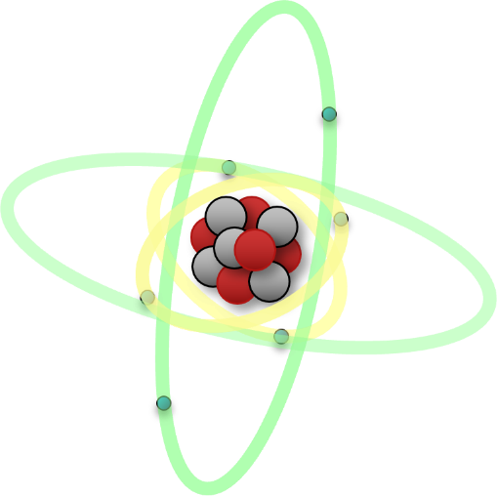
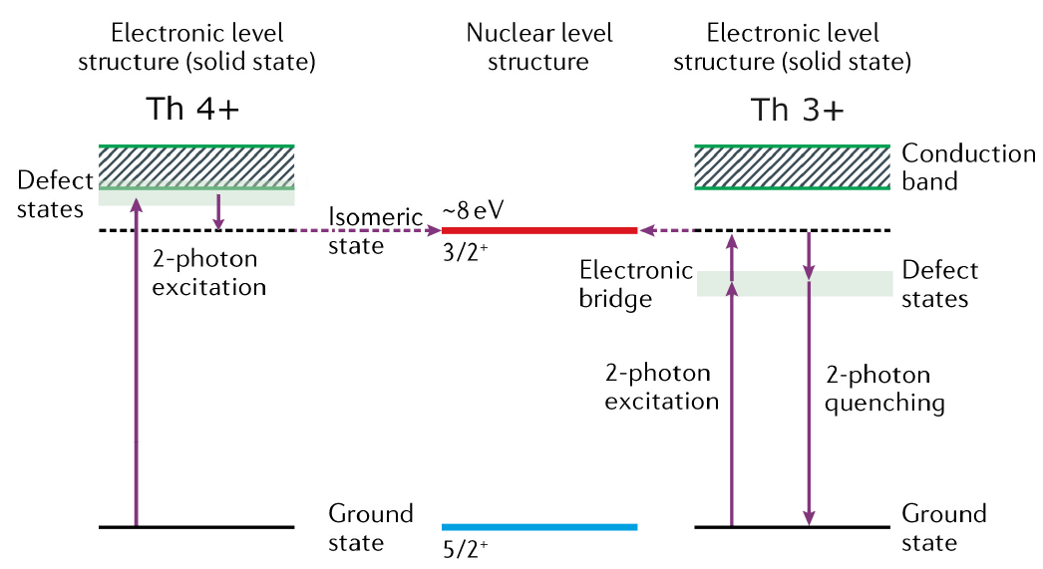
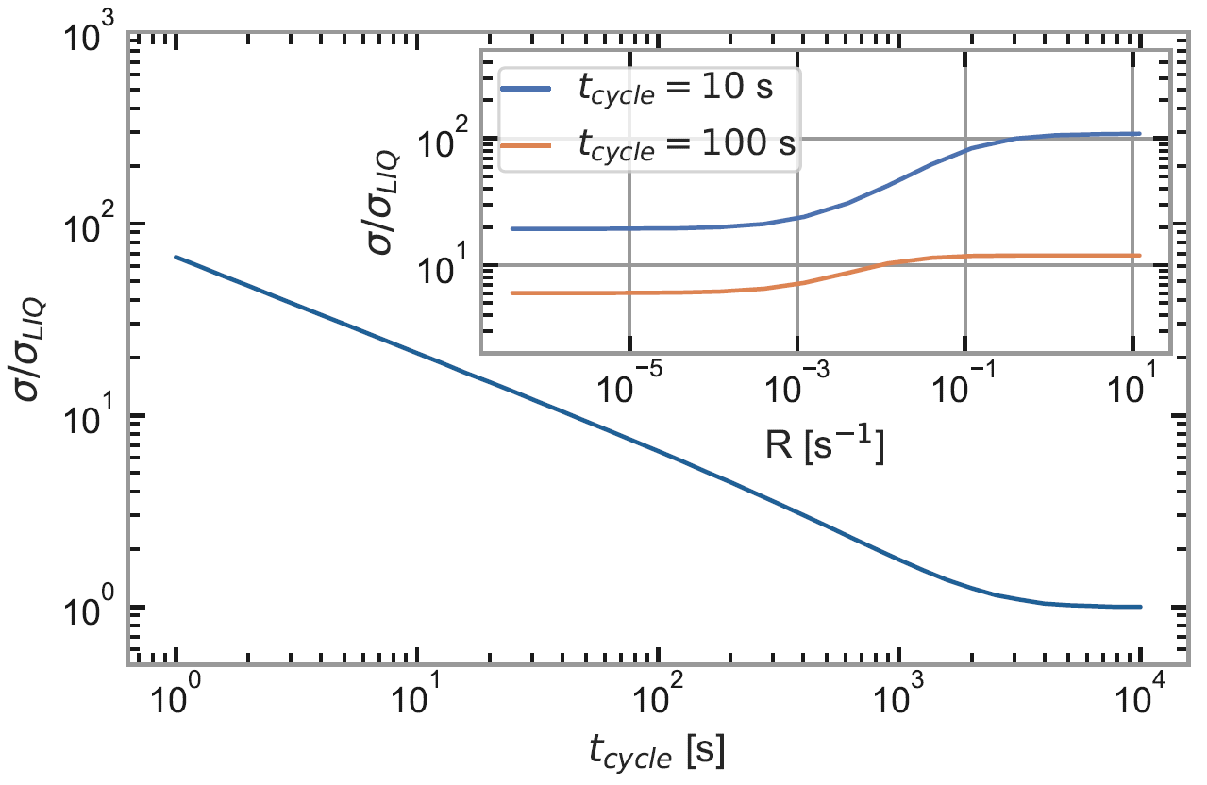
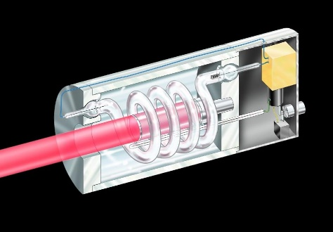
The Th-Defect centre
F⁻
e⁻
e⁻
h⁺
Th⁴⁺
Th⁴⁺
Notes:
Claim this hypothesis, make a cool image with Th-V center

Slide 22
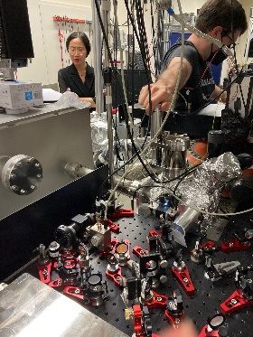
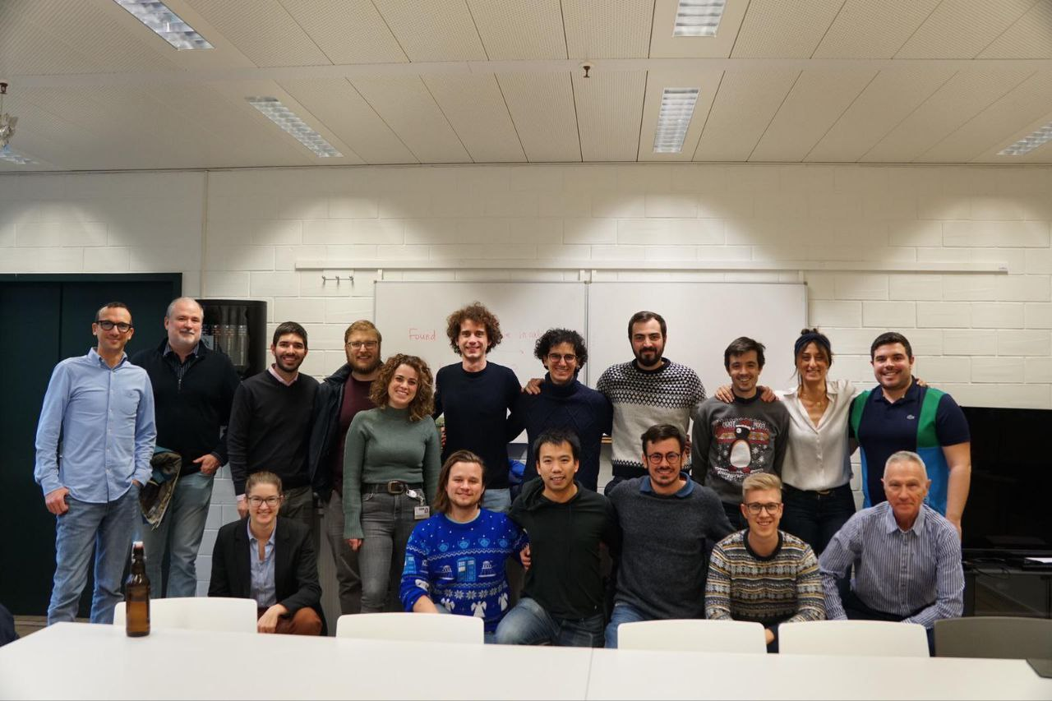
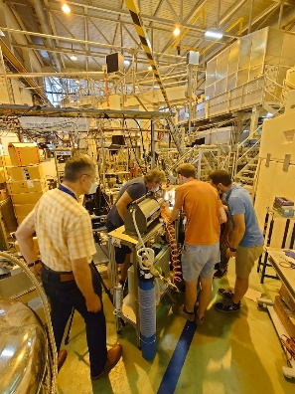
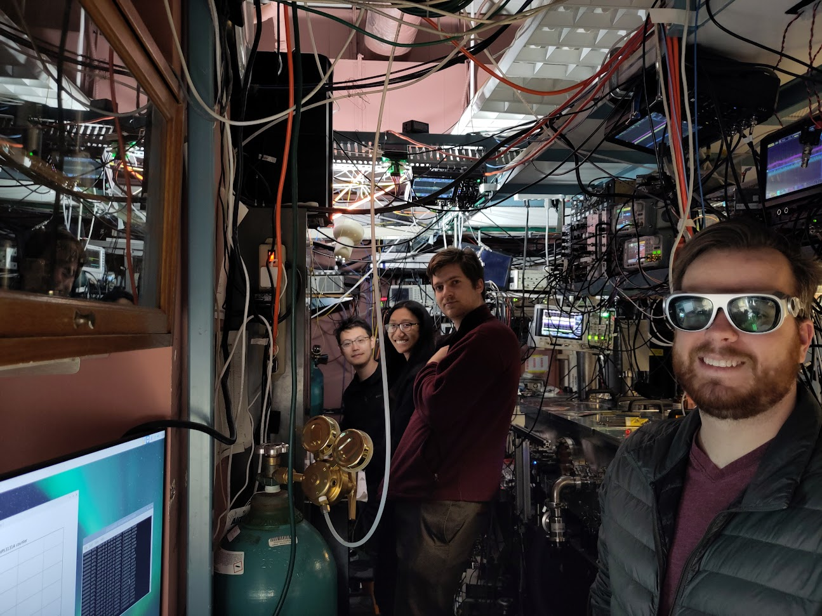
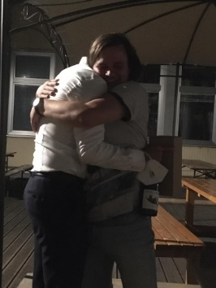
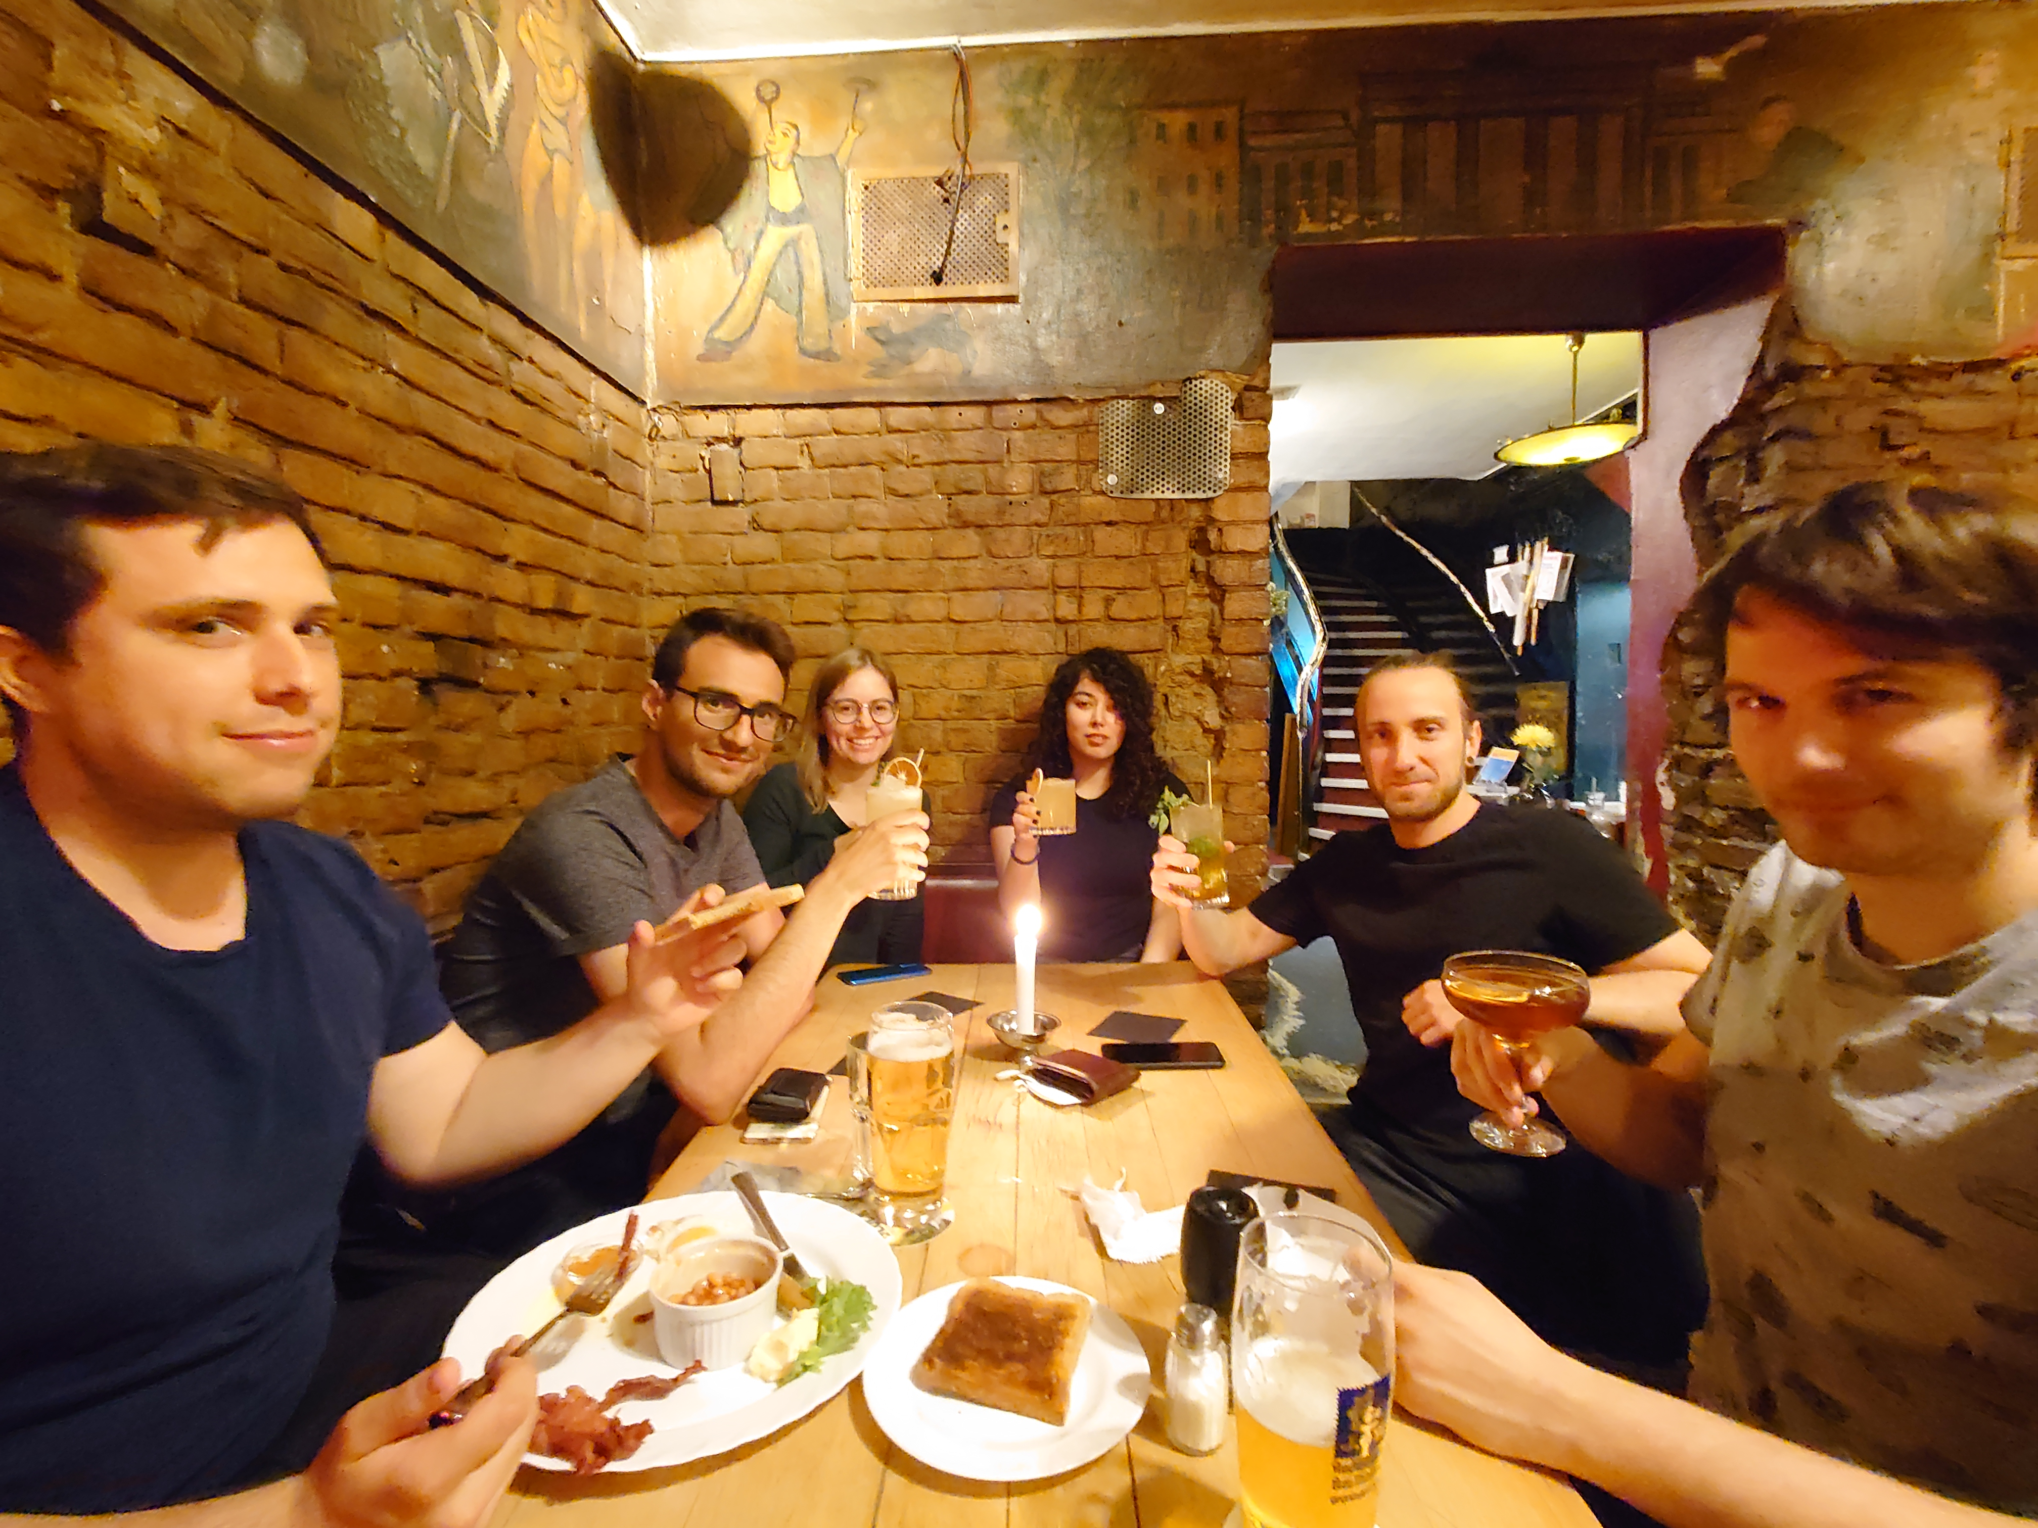
Thank you!
PTB Braunschweig
Okayama U
EPF Lausanne
Atominstitut
JILA Boulder
KU Leuven
PTB Berlin
Kjeld Beeks, Physics | Slide 9

Slide 23
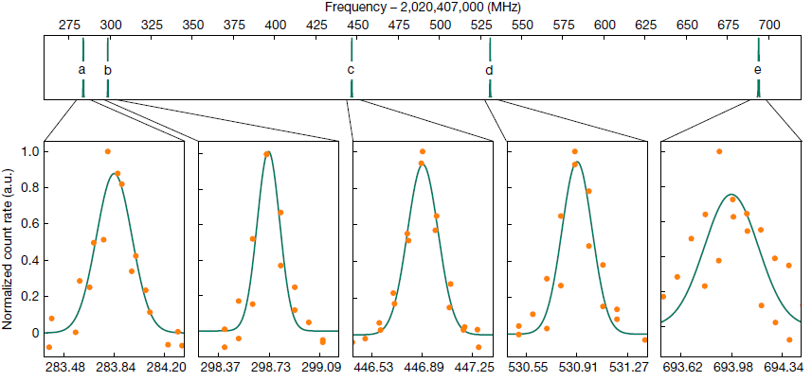
The EFG mystery
$$V_{zz}≈109 V/Å$$
(and stable!)
From XAFS, RBS/C & EPR:
Th is 4+ and 10 F (purple) is preferred
$$V_{zz}≈0 V/Å^{2}$$
$$V_{zz}≈150 V/Å^{2}$$
$$V_{zz}≈50 V/Å^{2}$$
$$V_{zz}≈30 V/Å^{2}$$
Notes:
These are all observations that are model dependent. Distance to fluorides is an important factor though, add Jila logo

