Slide 1
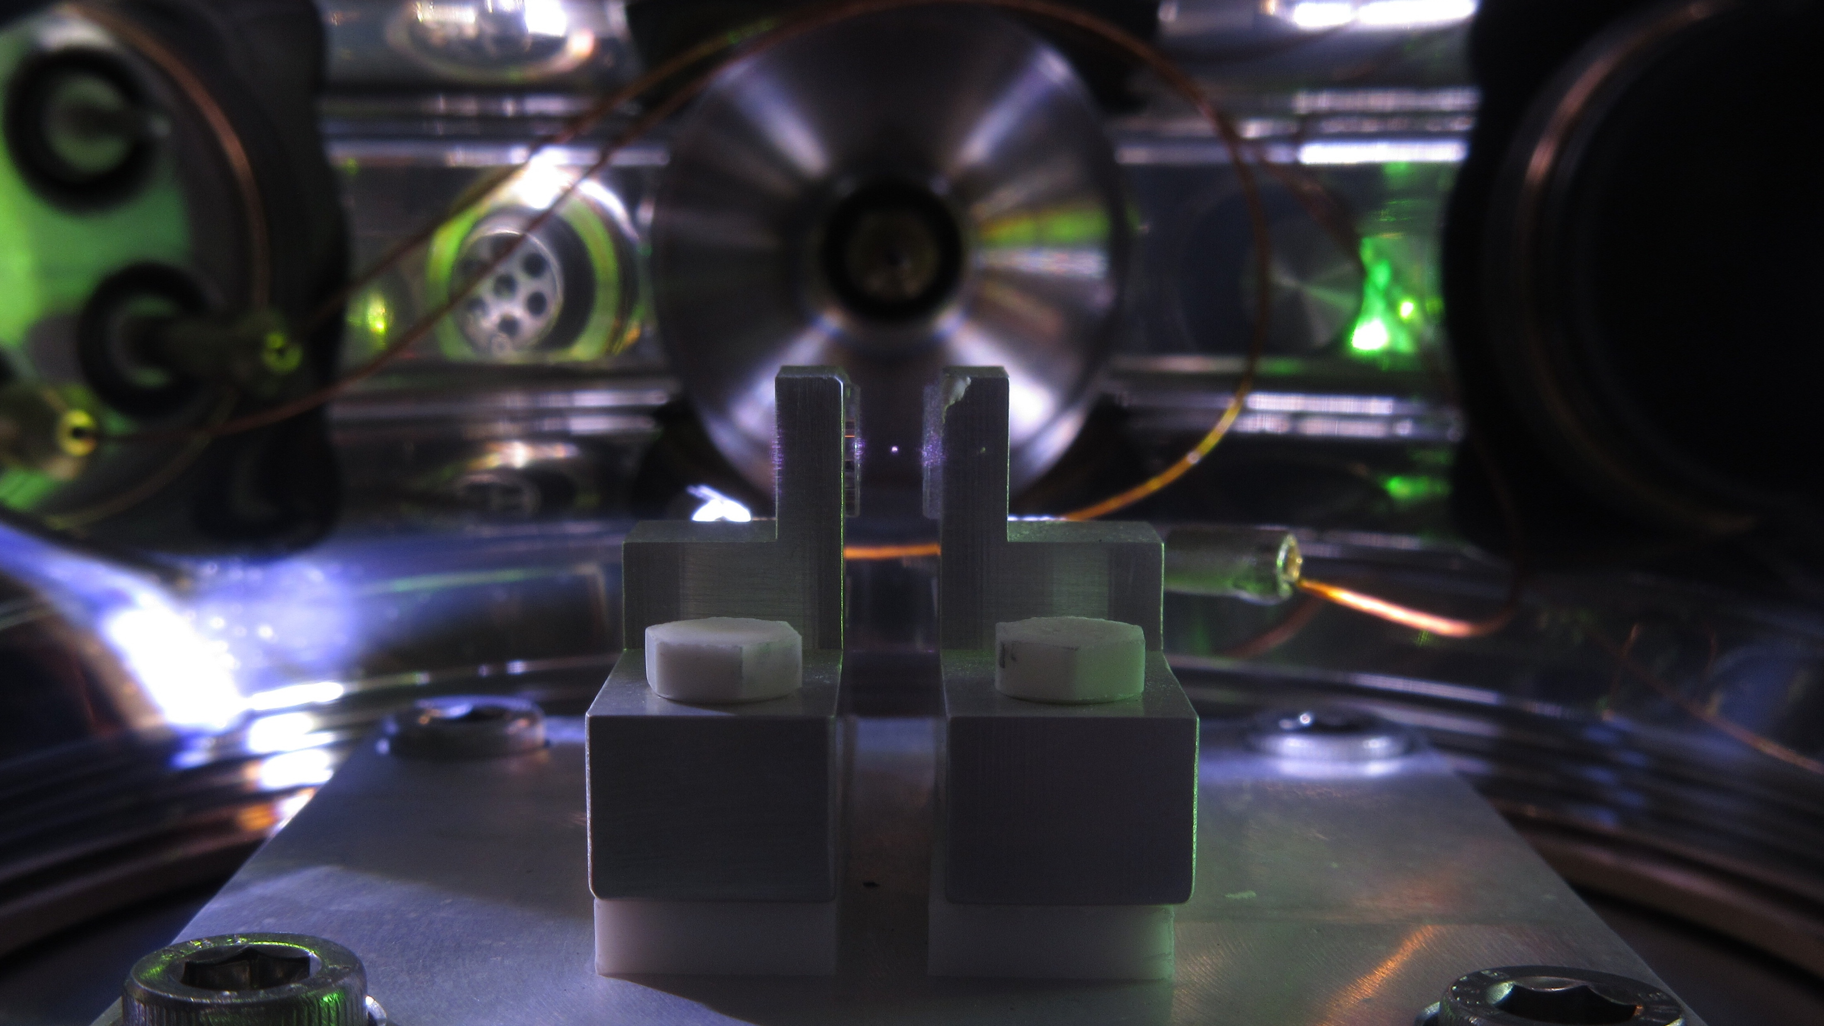


Detection of nuclear decays with levitated mechanical quantum sensors
David Moore, Yale
QIS in NP/AMO, UMass Boston
January 15, 2025

Slide 2
The precision frontier of nuclear and particle physics
The SM was largely developed through accelerator-based experiments at the energy frontier
The precision frontier provides complementary probes for many BSM questions (dark matter, neutrinos, gravity, …)
  New, ultra-precise sensors may be required to identify these weakly coupled phenomena
  Such sensors may also provide new capabilities in other areas (nuclear safeguards, inertial sensing, etc)
Cosmological constant
QCD scale
EW scale
GUT scale
Planck Mass
10⁻⁶
10⁻³
1
10³
10⁶
10⁹
10¹²
10¹⁵
10¹⁸
10²¹
10²⁴
10²⁷
Direct searches (accelerators)
u
s
c
t
Mass/Energy Scale (eV)
d
b
Energy frontier
SUSY
e
μ
τ
W
Interaction strength
Z
ν₂
ν₃
ν₁
WIMPs
H
Heavy ν_{R} (see-saw)
Precision frontier
Sterile ν DM
Sterile ν
Axions
Ultra-light DM
Hidden sector DM
D. Moore, Yale

Slide 3
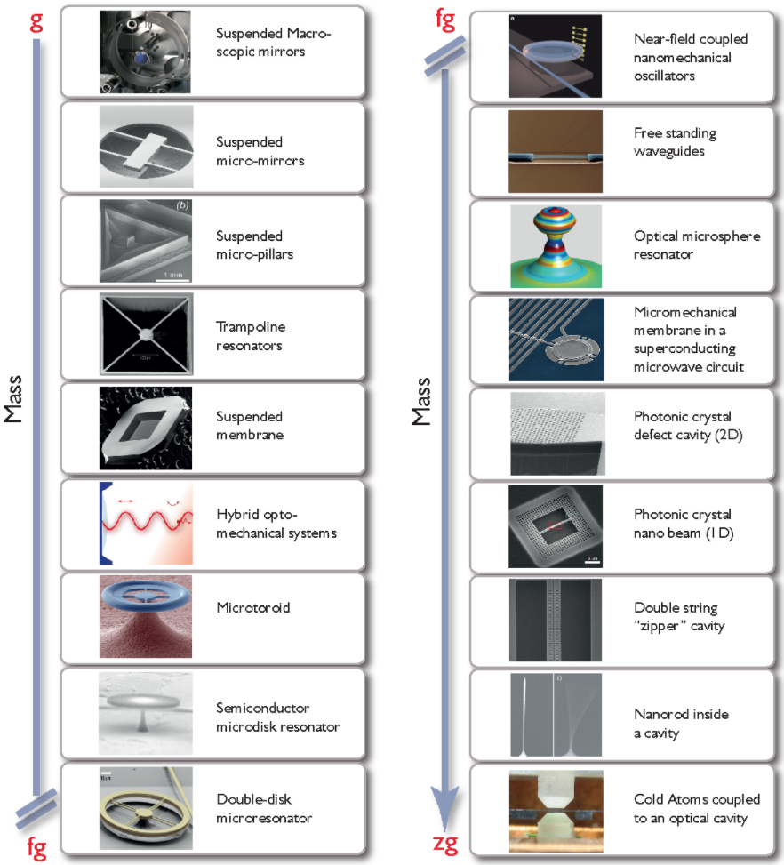
LIGO, VIRGO, KAGRA
Optomechanical systems
Quantum measurement constraints are increasingly important for sensors at the precision frontier
Existing examples:
  LIGO: squeezed light readout of interferometer for gravitational waves
  HAYSTAC: squeezed microwave readout of haloscope cavity for axions
A wide range of “optomechanical” sensors are now reaching quantum measurement limits
These sensors are extremely sensitive to tiny forces or accelerations
  In the <ng range, now reaching sensitivity to the forces imparted by single sub-atomic particles!
For more details see, e.g.:
  “Snowmass 2021: Quantum Sensors for HEP Science,” arXiv:2203.07250.
  "Mechanical Quantum Sensing in the Search for Dark Matter,” Quant. Sci. Tech. 6 024002 (2021), arXiv:2008.06074
  “Searching for new physics using optically levitated sensors,” Quant. Sci. Tech. 6 014008 (2021), arXiv:2008.13197
  …
Levitated objects ~fg to mg
Aspelmeyer et al., Rev. Mod. Phys. 86, 1391 (2014)
D. Moore, Yale

Slide 4
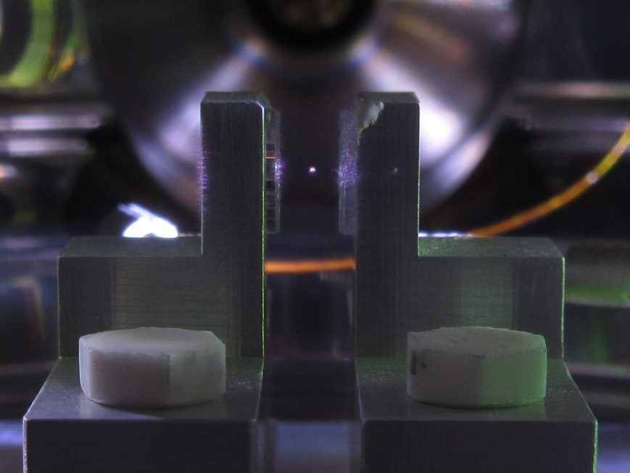
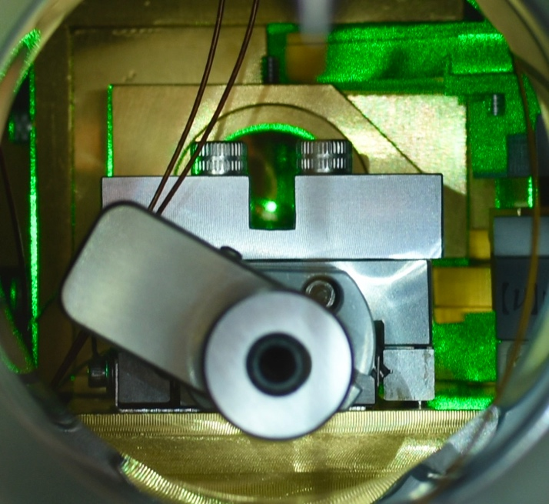
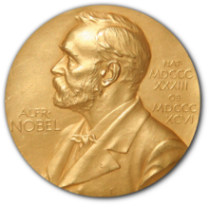

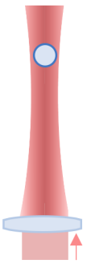
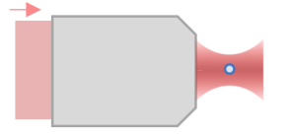
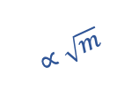

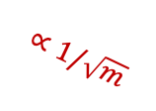


Photographs of trapped nano/micro particles at Yale:
Levitated optomechanics
Nano- to micro-sized dielectric masses can be optically trapped with ~100 mW of laser power
Optical tweezers are a common tool in biophysics to measure ~pN forces
Levitated masses are isolated both electrically and thermally
  Force sensitivities at the zN level and acceleration sensitivities near a nano-g
Levitation trap
(~1 – 30 𝜇m):
Highly focused tweezers (~0.1 – 1𝜇m):
~1 pg – 30 ng
~1 fg – 1 pg
Force and acceleration sensitivity vs particle mass:
10⁻¹⁹
$$∝\sqrt{m}$$
10⁻⁶
Force sensitivity [N/$\sqrt{Hz}$]
Accel. sensitivity [g/$\sqrt{Hz}$]
10⁻²⁰
10⁻⁷
$$∝1/\sqrt{m}$$
10⁻²¹
10⁻⁸
$$\vec{g}$$
fg
pg
ng
Particle mass
D. Moore, Yale

Slide 5
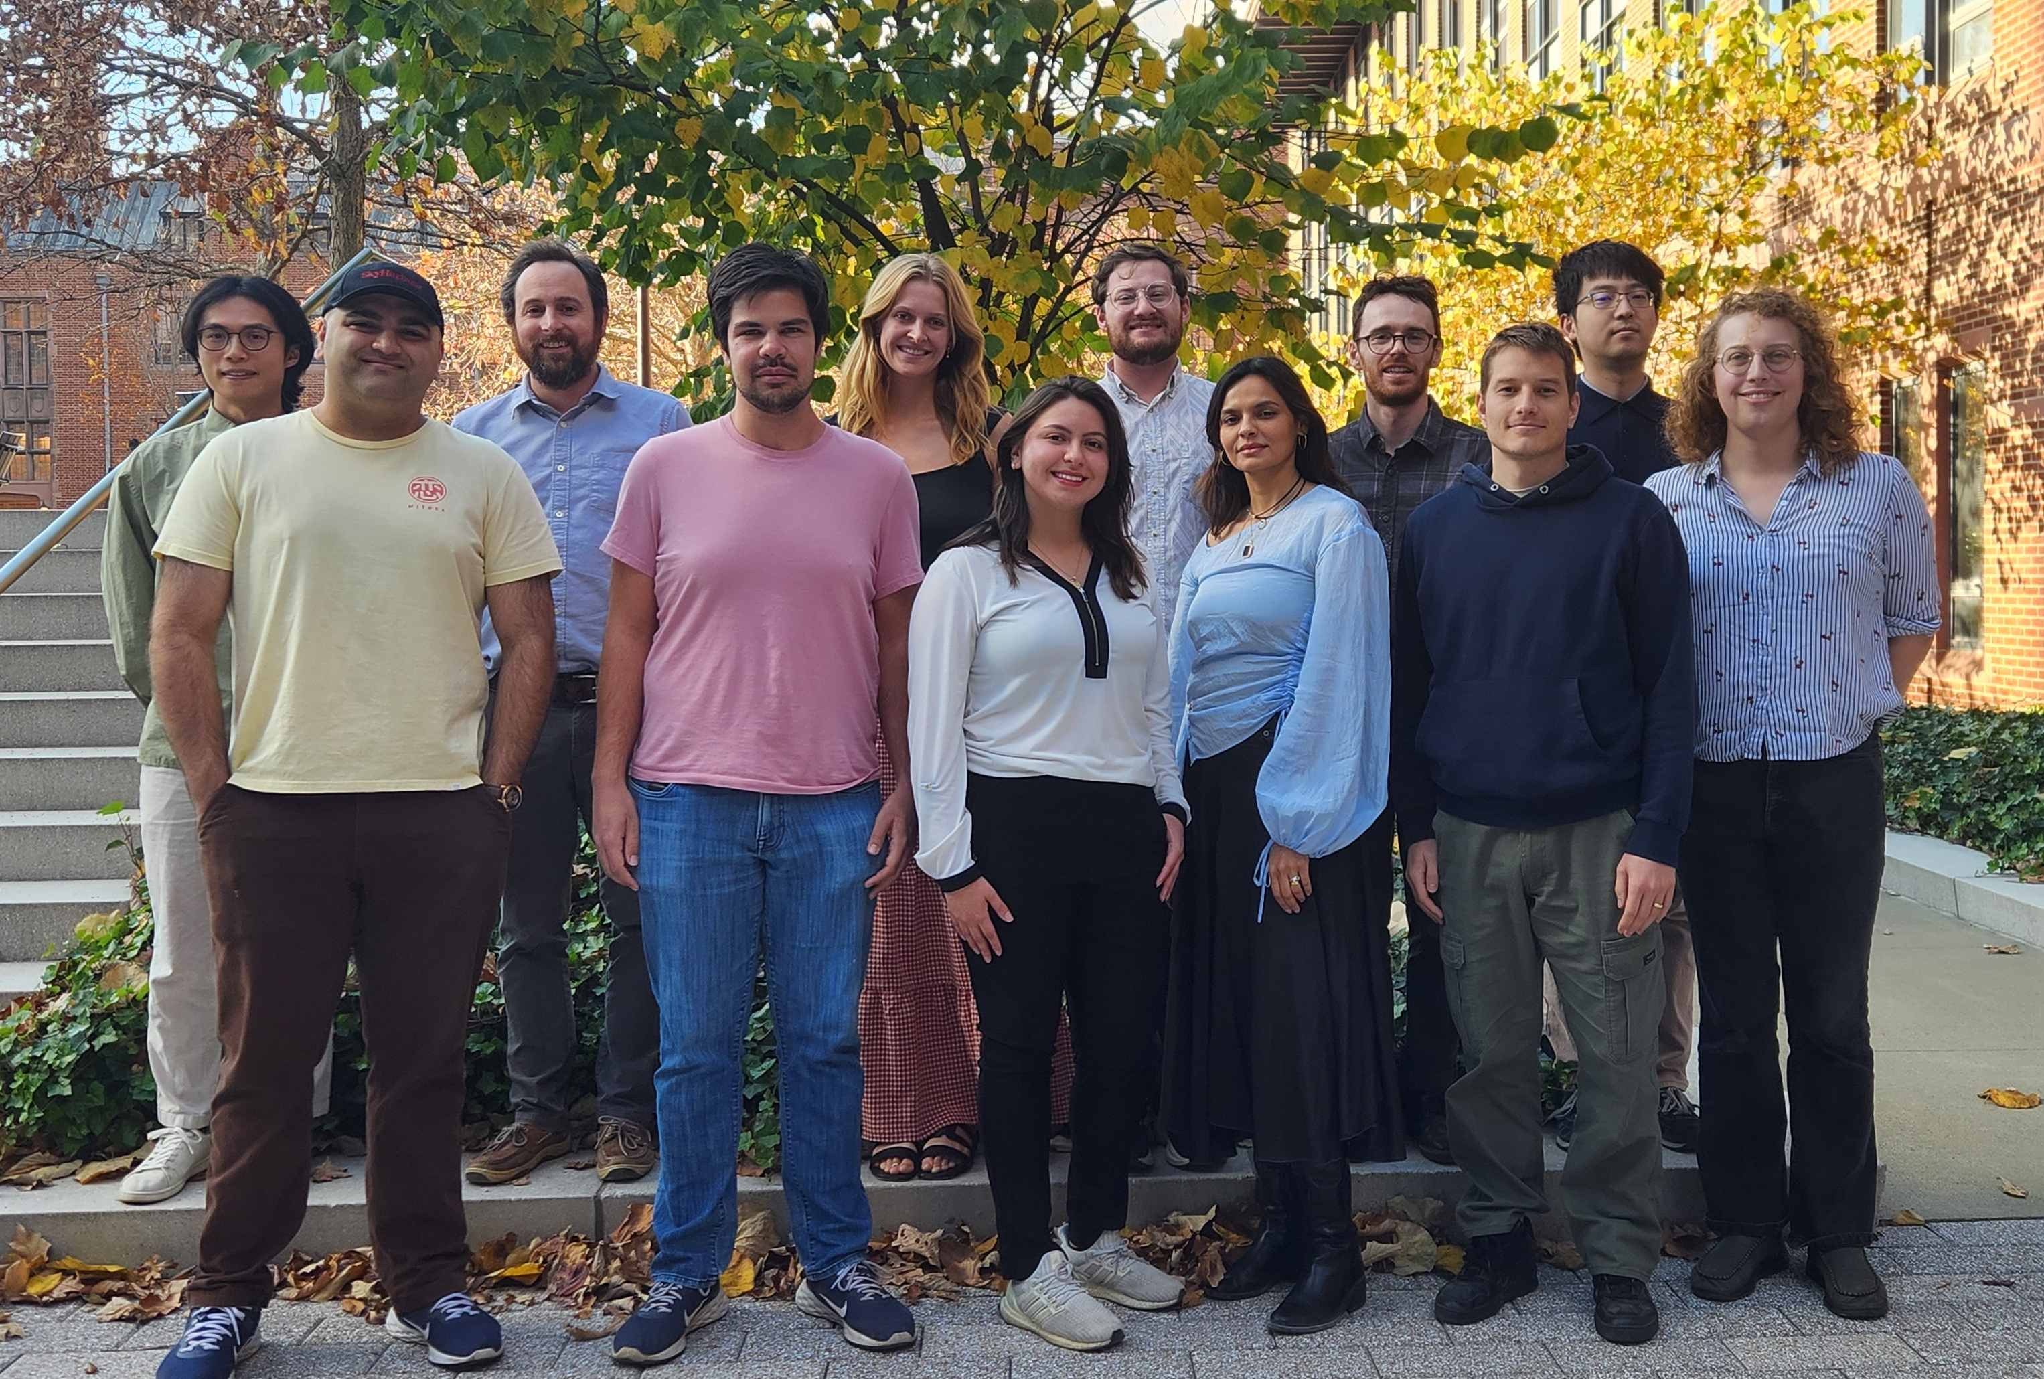












The SIMPLE team at Yale:
(Search for new Interactions in a Microsphere Precision Levitation Experiment)
Jackie Baeza-Rubio
Lucas Darroch
Cecily Lowe
Vasilisa Malenkiy
Aaron Markowitz
Siddhant Mehrotra
David Moore
Tom Penny
Ben Siegel
Yu-Han Tseng
Jiaxiang Wang
Molly Watts
With collaborators:
QuIPs:
MAST-QG:
(Quantum Invisible Particle Search)
(Macroscopic Superpositions Towards Witnessing the Quantum nature of Gravity)
D. Moore, Yale

Slide 6
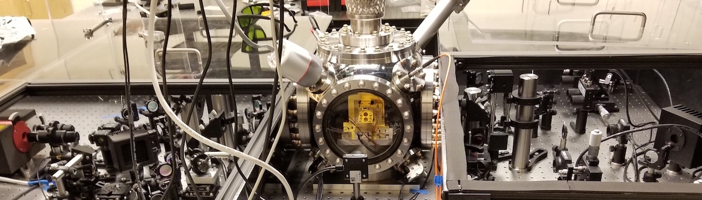
Experimental setup
Operate several optical traps at Yale capable of levitating spheres between 0.1 and 30 𝜇m
Microspheres are trapped with ~10-100 mW trapping laser power per particle
Trapping times longer than one month at pressure ~10⁻⁸ mbar
Photo of experimental microsphere trapping setup:
Input optics
Vacuum chamber
Output imaging optics
Imaging laser (532 nm)
Trapping laser (1064 nm)
D. Moore, Yale

Slide 7
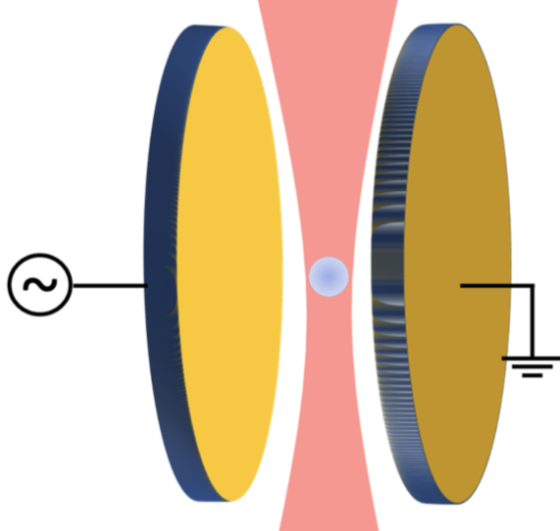
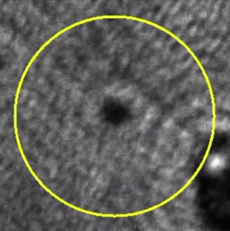
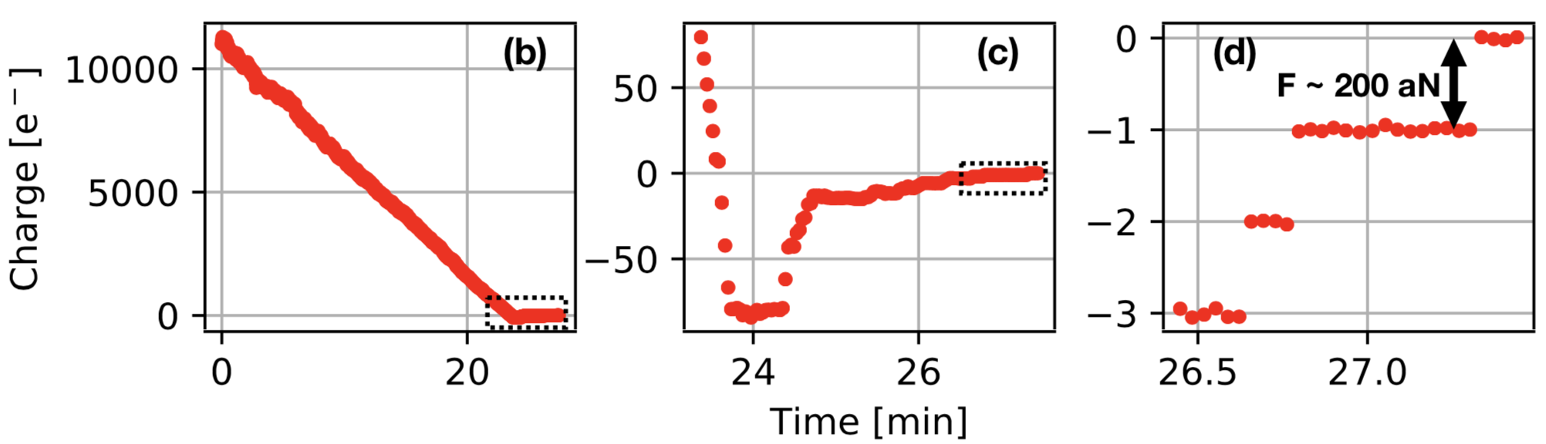
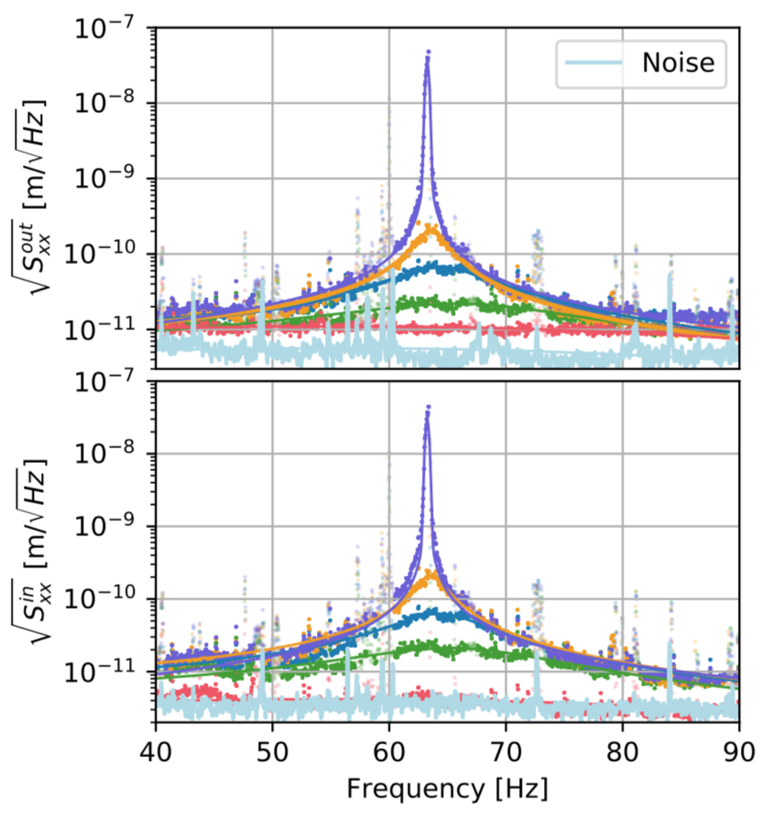
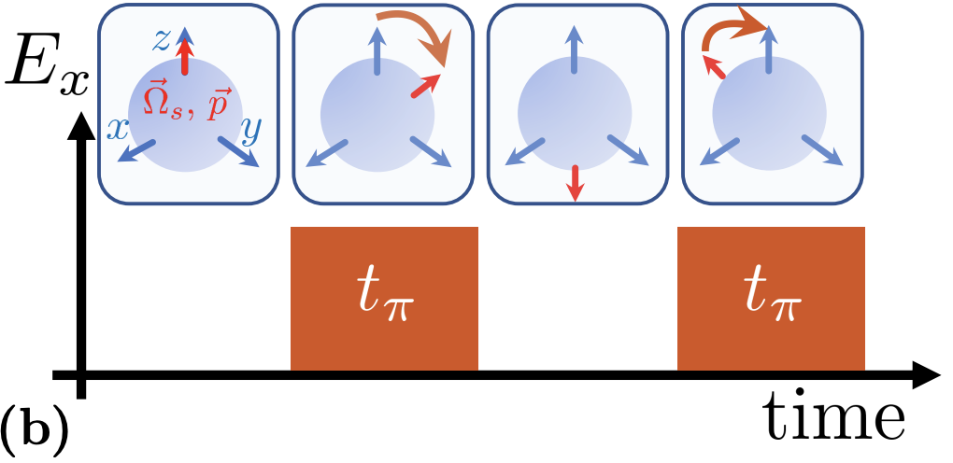

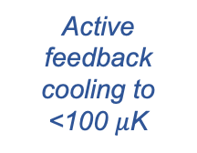


Experimental sequence (>ng spheres)
25 mm
Step 1: Trap sphere (~1 mbar)
Step 2: Electrically neutralize
q_{init} >10⁴ e⁻
~1-10 mm
Pump to $≲$10⁻⁷ mbar
E ~ 1 V/mm
Piezo stack
Monteiro et al., PRA 101, 053835, arXiv:2001.10931(2020)
Monteiro et al., PRA 101, 053835, arXiv:2001.10931(2020)
Step 4: Cool center-of-mass mode
Step 5: Orient electric dipole moment
Step 3: Stabilize spin
Optically spin to >MHz frequency
$$ω\sim MHz$$
Active feedback cooling to <100 $μ$K
Out-of-loop sensor
Apply electric field (if desired)
$50±22 μ$K
p₀
Afek et al., PRA 104, 053512, arXiv:2108.04406 (2021)
Monteiro et al., PRA 97, 051802(R), arXiv:1803.04297 (2018)
Monteiro et al., PRA 101, 053835, arXiv:2001.10931(2020)
Monteiro et al., PRA 96, 063841, arXiv:1711.04675 (2017)

Slide 8
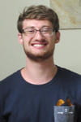
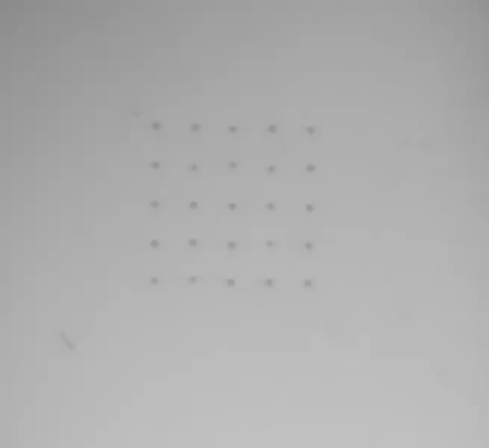
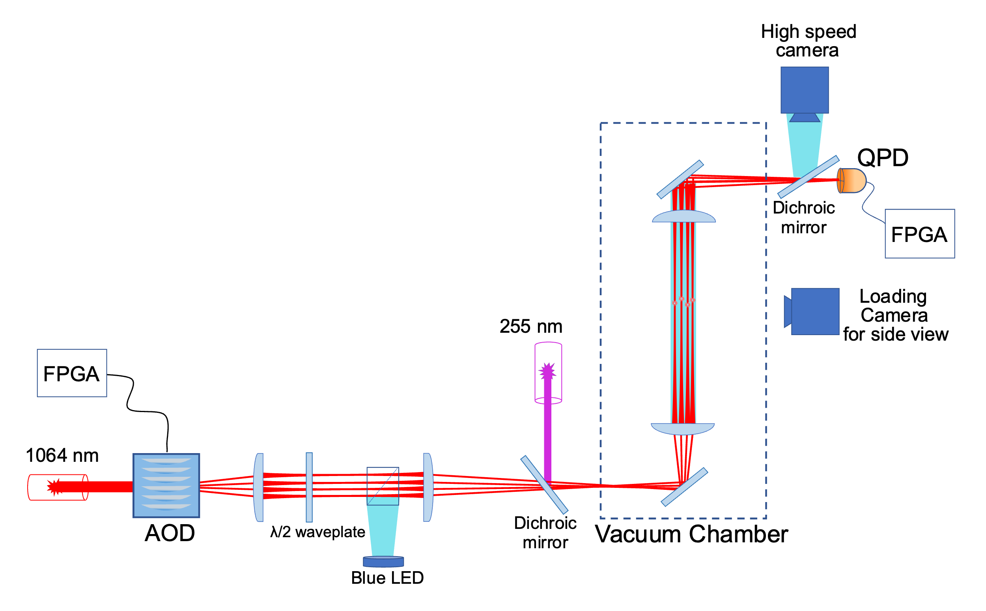
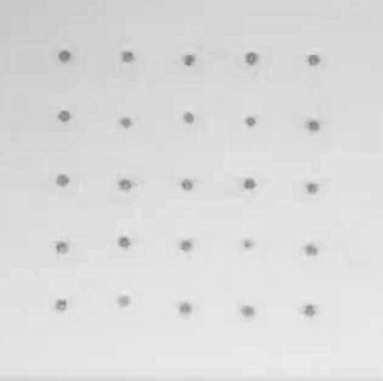

Rearrangement example (10 $μ$m spheres @ ~1 mbar):
Microsphere arrays
Microsphere trap has been upgraded with high power laser (100 W) to allow up to ~10 x 10 arrays
Similar technology to tweezer arrays for neutral atom quantum computing
  Real time control over trap positions
Ben Siegel
5x5 array of spheres (~1 mbar):
Simplified schematic:
~70 $μ$m
100 $μ$m
Played at 8x speed
D. Moore, Yale
arXiv:2412.07088

Slide 9
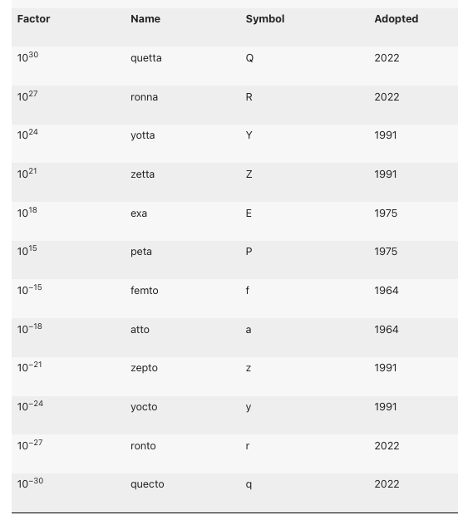
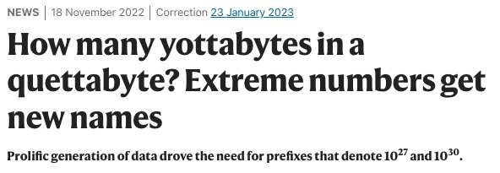
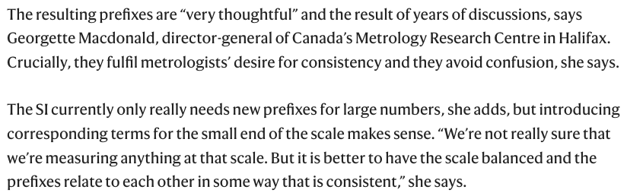
Aside on SI units
In 2022, new official SI prefixes were added for the first time in 3 decades
https://www.nature.com/articles/d41586-022-03747-9
<1 electron charge/(few weeks) ~ 100 rontoamps!

Slide 10
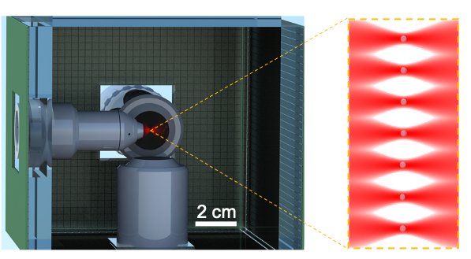







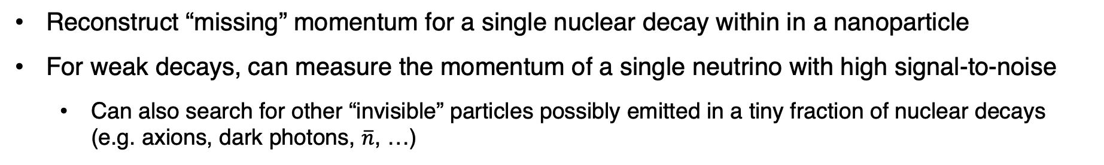

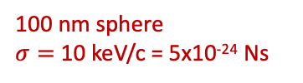


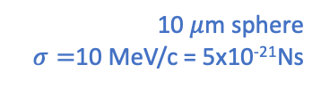
Nuclear decays in mechanical sensors
Reconstruct “missing” momentum for a single nuclear decay within in a nanoparticle
For weak decays, can measure the momentum of a single neutrino with high signal-to-noise
  Can also search for other “invisible” particles possibly emitted in a tiny fraction of nuclear decays (e.g. axions, dark photons, $\overline{n}$, …)
Detector concept:
Nanosphere array
$α$ decay
$β/$EC decay
$$α$$
$$\vec{p}α$$
$$\vec{p}sph$$
Auger e⁻
x-rays
$$\vec{p}ν$$
$$ν_{e}$$
$$\vec{p}sph$$
10 $μ$m sphere
$σ=$10 MeV/c = 5x10⁻²¹Ns
100 nm sphere
$σ=$10 keV/c = 5x10⁻²⁴ Ns
D. Carney, K. Leach, and DCM, “Searches for massive neutrinos with mechanical quantum sensors,” PRX Quantum 4, 010315 (2023) arXiv:2207.05883
J. Wang et al., “Mechanical detection of nuclear decays,” Phys. Rev. Lett. 133, 023602 (2024), arXiv:2402.13257
See also talk by Kyle Leach on Monday
Scintillator + SiPM arrays
D. Moore, Yale

Slide 11
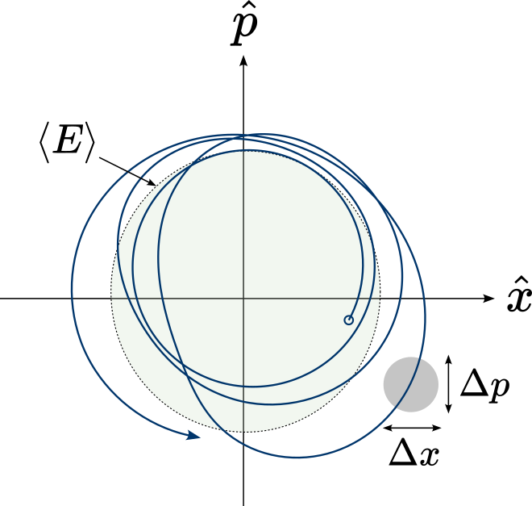
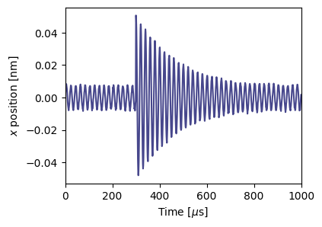








$$\vec{p}sph$$
Impulse detection (near SQL)
$β$⁻
$$\vec{p}β$$
For nuclear decays, signals of interest are momentum impulses:
For 100 nm diameter spheres, sensitivity now at the “standard quantum limit”
$Δp=FΔt$, for interaction time $Δt≪{1/ω}_{0}$
$$\vec{p}ν$$
$${\overline{ν}}_{e}$$
$$Δt ≲1 ps$$
Phase space trajectory:
Position vs time:
“Standard quantum limit” for an impulse:
See, e.g., A. Clerk, PRB 70, 245306 (2004)
0.5 MeV/c (1 ng @ 100 Hz)
10 $μ$m sphere
15 keV/c (1 fg @ 100 kHz)
100 nm sphere
For a non-unity detection efficiency, $η$:
See, e.g.:
Magrini et al., Nature 595, 373 (2021)
Tebbenjohanns et al., Nature 595, 378 (2021)

Slide 12
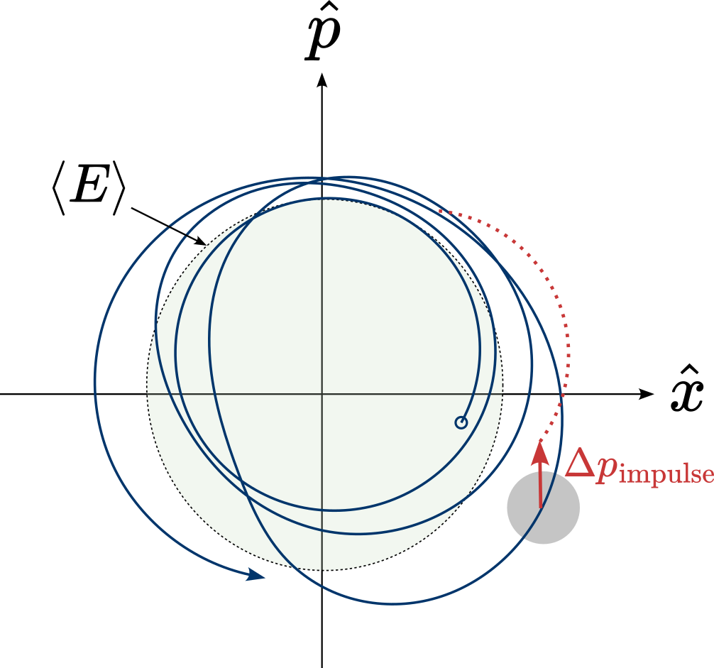
$$\vec{p}sph$$
Impulse detection (near SQL)
$β$⁻
$$\vec{p}β$$
For nuclear decays, signals of interest are momentum impulses:
For 100 nm diameter spheres, sensitivity now at the “standard quantum limit”
$Δp=FΔt$, for interaction time $Δt≪{1/ω}_{0}$
$$\vec{p}ν$$
$${\overline{ν}}_{e}$$
$$Δt ≲1 ps$$
Phase space trajectory:
Position vs time:
“Standard quantum limit” for an impulse:
See, e.g., A. Clerk, PRB 70, 245306 (2004)
0.5 MeV/c (1 ng @ 100 Hz)
10 $μ$m sphere
15 keV/c (1 fg @ 100 kHz)
100 nm sphere
For a non-unity detection efficiency, $η$:
See, e.g.:
Magrini et al., Nature 595, 373 (2021)
Tebbenjohanns et al., Nature 595, 378 (2021)

Slide 13
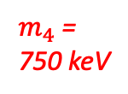
Projected sensitivity
If a keV – MeV mass sterile 𝜈 mixes with the light 𝜈, then expect small fraction of decays to emit a heavy 𝜈
Possibility to probe many orders of magnitude beyond best existing experiments with mechanical sensors
Example electron capture decay (³⁷Ar):
Projected sensitivity versus livetime:
100 nm sphere
1 month
$m_{4}$ = 750 keV
1 sphere month
10 sphere years
1000 sphere years
D. Moore, Yale
PRX Q 4, 010315 (2023) arXiv:2207.05883

Slide 14

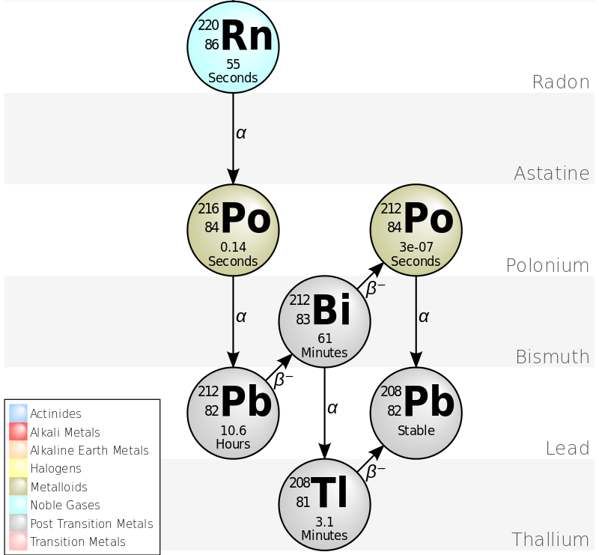

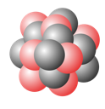
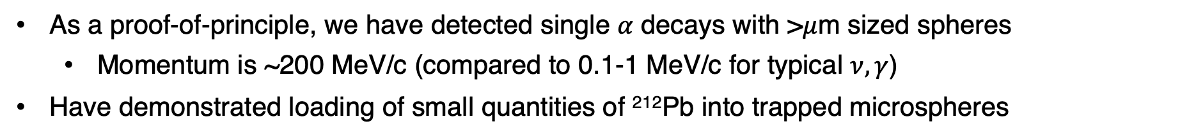

Proof of principle ($α$ decays)
As a proof-of-principle, we have detected single 𝛼 decays with >$μ$m sized spheres
  Momentum is ~200 MeV/c (compared to 0.1-1 MeV/c for typical $ν, γ$)
Have demonstrated loading of small quantities of ²¹²Pb into trapped microspheres
Jiaxiang Wang
Rn-220 decay chain:
Schematic of loading scheme:
²²⁰Rn
²¹⁶Po⁺
Drift in E-field
~100 nm
²¹²Pb
T_{1/2} = 56 s
T_{1/2} = 0.14 s
T_{1/2} = 10.6 h
3 $μ$m diameter SiO₂ sphere
J. Wang et al, PRL133, 023602 (2024), arXiv:2402.13257
D. Moore, Yale

Slide 15

Detection of single nuclear decays (charge)
Can detect single nuclear decays through the change in net charge of the particle
Example of measured charge changes vs. time:
Auto-discharge
$α/β$ decays
PRL133, 023602 (2024), arXiv:2402.13257

Slide 16
Distribution of measured charge changes
Single $α$ and $β$ decays nearly always kick out extra electrons, with changes >>1 e⁻ observed
Distribution of charge changes (6 spheres):
Counts
“Background free” tag of a decay within the particle!
PRL133, 023602 (2024), arXiv:2402.13257
Change in charge [e]

Slide 17
Detection of single nuclear decays (recoil)
Reconstruct recoil of the entire particle correlated with the decay time
Recoil coincident with charge change:
Zoom to decay time:
Signal to noise = 13
PRL133, 023602 (2024), arXiv:2402.13257

Slide 18
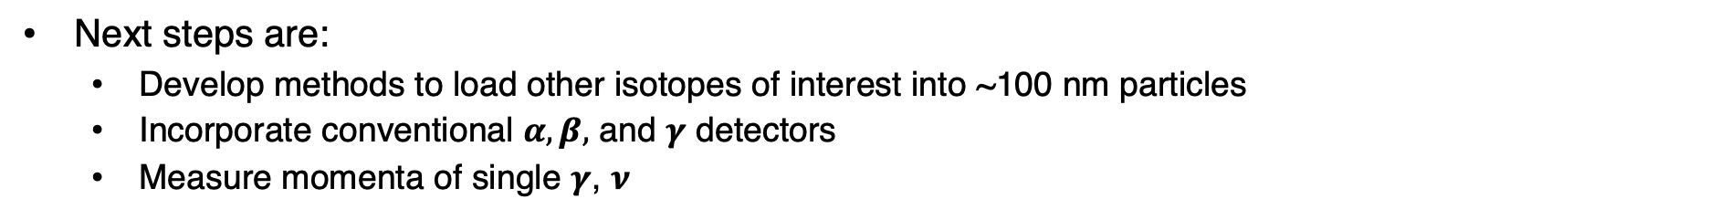
SiPM detector measured spectrum
Next steps
This first proof-of-principle result already may find applications in nuclear safeguards/forensics:
  E.g. 10 um diameter ²³⁵U₂O₅ particle -> 400 $μ$Bq activity (~1 decay/hr)
Next steps are:
  Develop methods to load other isotopes of interest into ~100 nm particles
  Incorporate conventional $α, β,$ and $γ$ detectors
  Measure momenta of single $γ$, $ν$
Particle detector surrounding trap:
Droplet on micropipette:
Microdroplet loading concept:
D. Moore, Yale

Slide 19
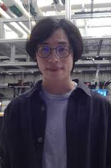

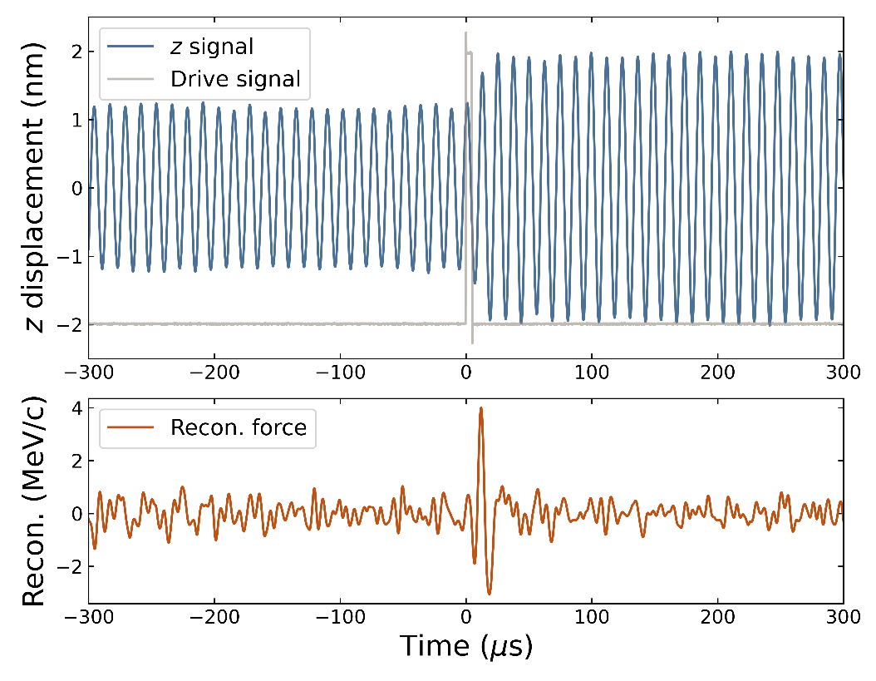
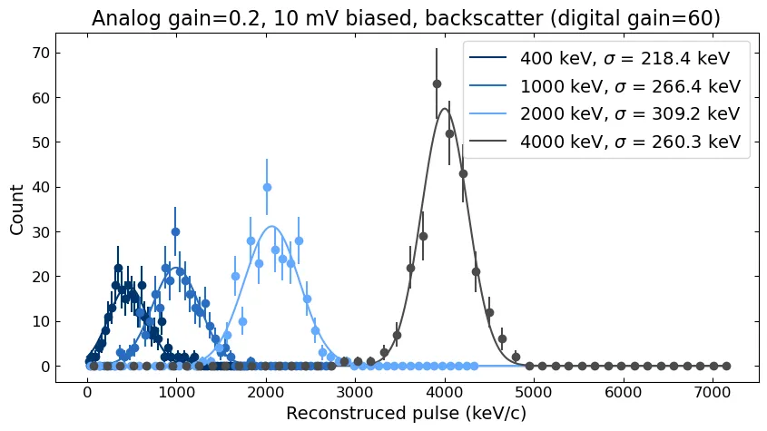
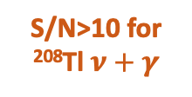
fg mass spheres
In parallel, have reached required sensitivity to detect neutrinos with high signal-to-noise with ~150 nm diameter spheres
Resolution now approaching the Standard Quantum Limit (SQL)
Yu-Han Tseng
Tom Penny
Calibrated response, 5 fg particle (4 MeV/c):
Resolution vs. pulse amplitude:
Rn-220 decay chain:
S/N>10 for ²⁰⁸Tl $ν+γ$
D. Moore, Yale

Slide 20
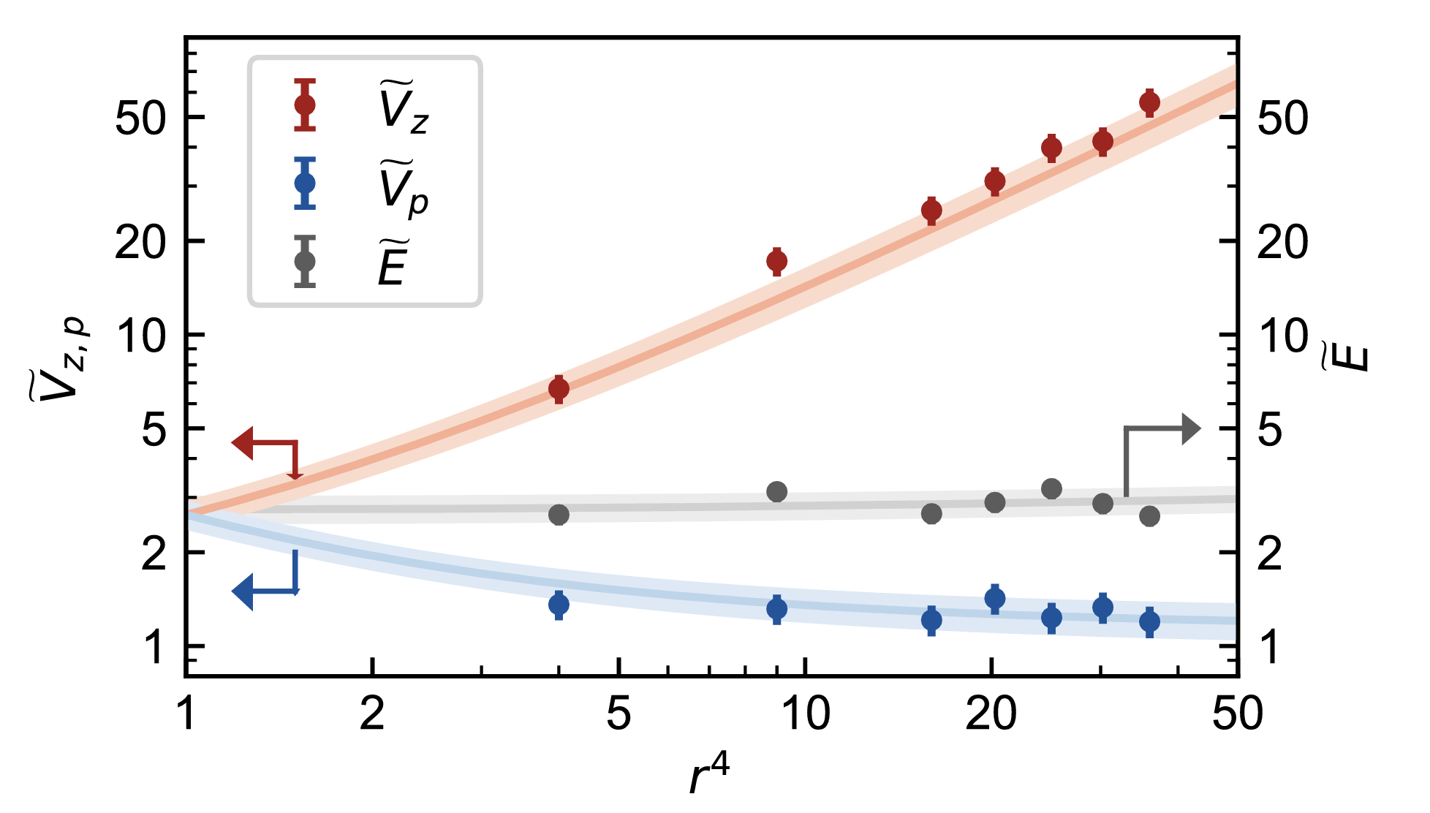
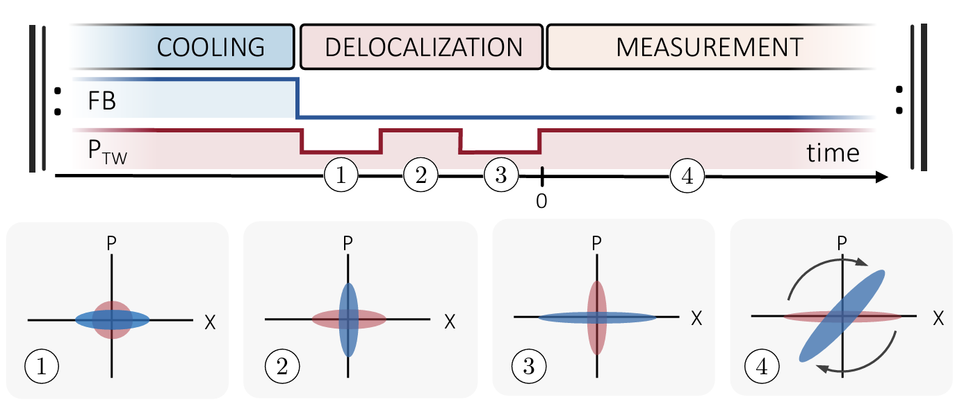
Beyond the SQL
While searches operating near the SQL are already possible, in the long term a substantial goal of the levitated optomechanics community is to go well beyond
  Levitated systems possibly unique in their ability to isolate the mass from the environment (minimize decoherence) and enable control of the potential
  Recent work (Novotny group, ETH) has demonstrated delocalization/squeezing of 100 nm diameter particle
Variance after potential modulation:
Delocalization/squeezing protocol:
7 dB of squeezing
Rossi et al, “Quantum Delocalization of a Levitated Nanoparticle,” arXiv:2408.01264 (2024)
D. Moore, Yale

Slide 21
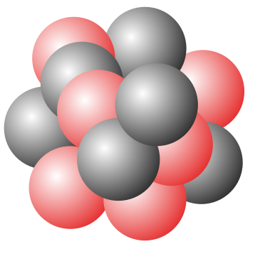

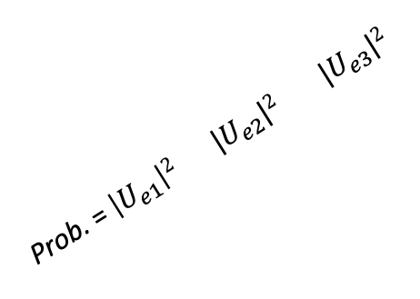
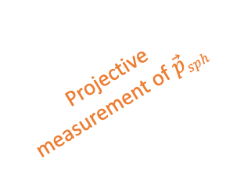
Projective measurement of sphere momentum:
Light 𝜈
$$\vec{p}sph$$
Reaching a projective measurement of light 𝜈 masses would require measurements deep in the quantum regime
A fixed solid source localizing nuclei at atomic distances cannot produce 𝜈 with sufficiently well defined momenta:
Prob. = $\left|U_{e1}\right|2$ $|U_{e2}|2$ $|U_{e3}|2$
Projective measurement of $\vec{p}sph$
Relevance of Heisenberg Uncertainty also recently pointed out for PTOLEMY (C𝜈B):
Example of requirements on state preparation and measurement:
5 nm graphene flake in ground state of 100 Hz trap
Flake COM
See, e.g., Cheipesh et al., PRD 104, 116004 (2021)
Apponi et al. (PTOLEMY), arXiv:2203.11228 (2022)
𝜈
Delocalizing COM of solid nanoparticle could allow required state-preparation
Substantially beyond current state-of-the-art in quantum optomechanics
Squeezed by 20 dB
D. Moore, Yale

Slide 22
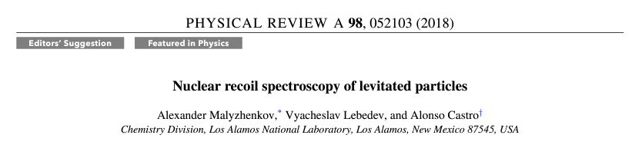
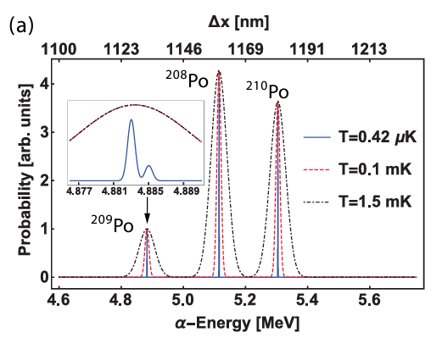
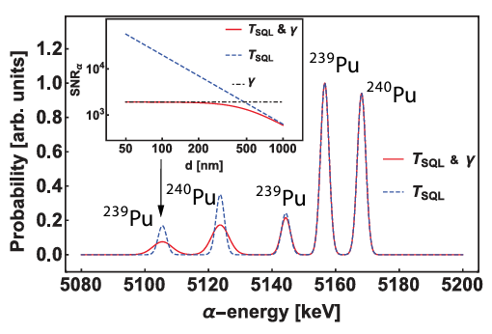
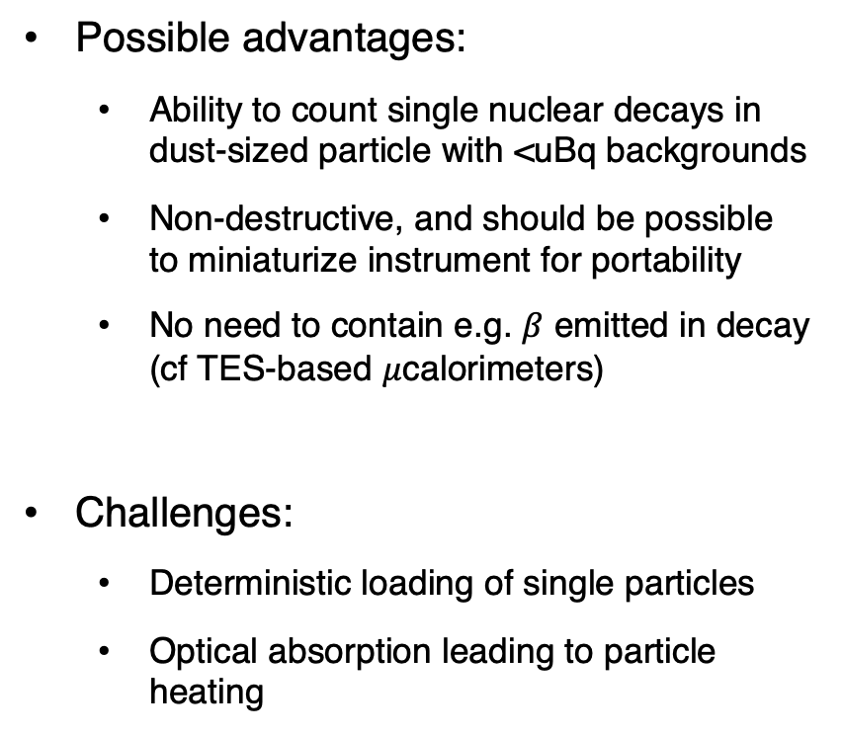
Recoil spectroscopy for nuclear materials
Original proposal for applying these systems to nuclear material characterization from Malyzhenkov et al (2018)
Possible advantages:
  Ability to count single nuclear decays in dust-sized particle with <uBq backgrounds
  Non-destructive, and should be possible to miniaturize instrument for portability
  No need to contain e.g. $β$ emitted in decay (cf TES-based $μ$calorimeters)
Challenges:
  Deterministic loading of single particles
  Optical absorption leading to particle heating
Estimated sensitivity for $α$ spectroscopy (nanoparticle at SQL):
https://journals.aps.org/pra/abstract/10.1103/PhysRevA.98.052103
D. Moore, Yale

Slide 23
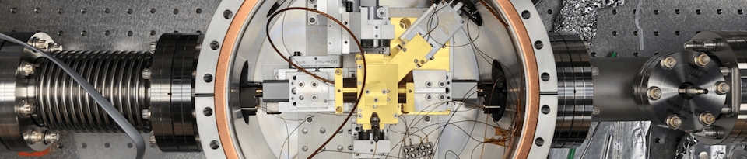

Summary
Levitated optomechanical systems provide extremely precise sensors for forces and accelerations, and are reaching quantum measurement regimes
We have recently detected single $α$ decays occurring in our particles and are developing techniques to search for sterile $ν$
Ambitious future extensions of these techniques are possible and may provide new tools at the precision frontier of nuclear physics!
D. Moore, Yale

Slide 24
D. Moore, Yale

Slide 25


Experimental signature
If a keV – MeV mass sterile 𝜈 mixes with the light 𝜈, then expect small fraction of decays to emit a heavy 𝜈
Momentum difference between heavy and light state is largest for non-relativistic neutrinos, i.e., $E_{ν}≈m_{ν}$
Example electron capture decay (³⁷Ar):
Example $β^{−}$ decay (³²P):
$m_{4}$ = 750 keV
D. Moore, Yale
PRX Quantum 4, 010315 (2023)

Slide 26

Projected sensitivity
A single nanosphere at existing sensitivity could search well beyond existing laboratory constraints on heavy sterile 𝜈 in ~1 month
Larger arrays and smaller particles could reach many orders of magnitude further sensitivity
Backgrounds can be mitigated through triple coincidence (sphere recoil, secondary particle, sphere charge change)
Example $β^{−}$ isotopes (1 sphere x 1 month):
Projected sensitivity versus livetime:
1 sphere month
10 sphere years
1000 sphere years
D. Moore, Yale
PRX Quantum 4, 010315 (2023)

