Slide 1
Enhancing Quantum Utility
simulating large-scale quantum spin chains on superconducting quantum computers
https://doi.org/10.1103/PhysRevResearch.6.033107
arXiv: 2312.12427
Kwangmin Yu
January 15th, 2025

Slide 2
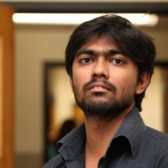
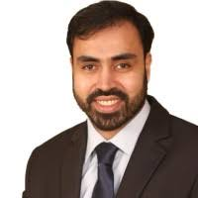
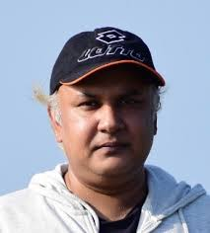
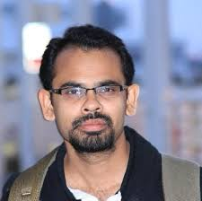
Contributors
Talal Ahmed Chowdhury
University of Kansas
University of Dhaka
Raza Sabbir Sufian
New Mexico State University
Brookhaven National Lab
Mahmud Ashraf Shamim
University of Alabama
Md Latiful Kabir
Brookhaven National Lab

Slide 3
Introduction

Slide 4
Supremacy, Advantage, and Utility
Quantum Supremacy:
Demonstrating that a programmable quantum computer can solve a problem that no classical computer can solve in any feasible amount of time, irrespective of the usefulness of the problem (Preskill, 2012).
Neill, Charles, et al., Science 360.6385 (2018): 195-199.
Arute, Frank, et al., Nature 574.7779 (2019): 505-510.
Quantum Advantage
The experimental demonstration of a quantum algorithm solving a real-world problem on a quantum computer faster than ANY classical algorithm running on any classical computer.
Quantum Utility
Emphasizes the practical usefulness of quantum computers in scientific and industrial applications.
https://www.ibm.com/quantum/blog/what-is-quantum-utlity
Kim, Youngseok, et al., Nature 618.7965 (2023): 500-505.
Timothy Proctor, et al., ArXiv 2407.08828 (2024)

Slide 5
Introduction
The landscape of quantum computing has experienced signiﬁcant evolution leading to the emergence of NISQ computers and beyond.
Can we utilize these contemporary noisy quantum computers to study fundamental physics?
There are challenges:
Error rates aﬀecting computational accuracy: Before FTQC
Constraints on qubit numbers limiting the study of complex physics.
Maintaining qubit stability over an extended period of time: Short decoherence time
Ongoing advancements in error-mitigation techniques and algorithms for noisy quantum computers are enhancing the capabilities of them.
Therefore, our modest aim is to explore a large-scale quantum simulation of a quantum many-body system on contemporary noisy quantum computers.

Slide 6
Our Contributions
Keywords: Gate-based quantum computer. TE of a Hamiltonian, Trotterization
Developed 2nd-order Trotterization algorithms for a Heisenberg spin chain models having nearest-neighbor interaction.
Developed 1st-order Trotterization algorithms for a Heisenberg spin chain models having both nearest-neighbor and next nearest-neighbor interaction.
Applied four QEM algorithms with optimal combinations.
Validated and tested the implementations on 96 (PBC) and 100 (OBC) qubits.
Hopefully, our work will be a stepping stone to achieving the quantum advantage over classical ones in simulating quantum systems (time-evolution of Hamiltonian) before the fault tolerant quantum computing (FTQC) era.

Slide 7
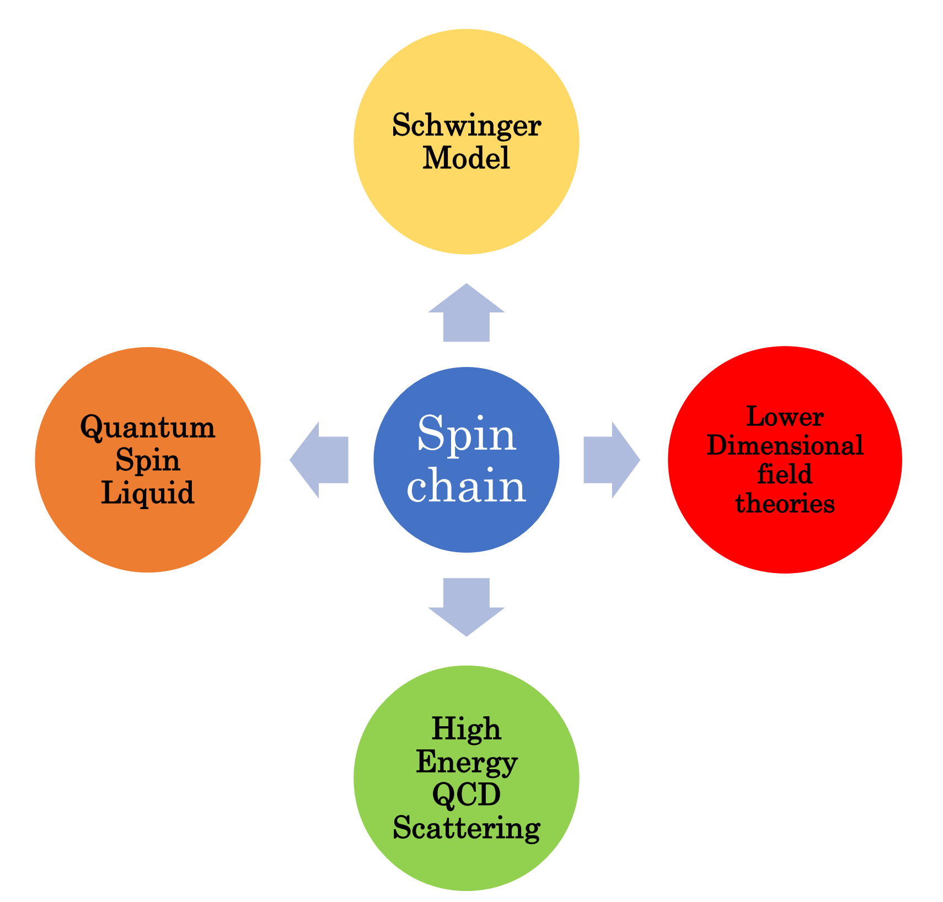
Quantum Spin Chain
The frustrated spin ½ antiferromagnetic model is a paradigmatic representation of a quantum many-body system.
The ground state of the frustrated systems becomes highly entangled, leading to exotic phases of quantum matters such as QSLs.
Relation to the Schwinger model (a toy model in (1+1) D) that captures the features of strongly coupled sector of QCD.

Slide 8
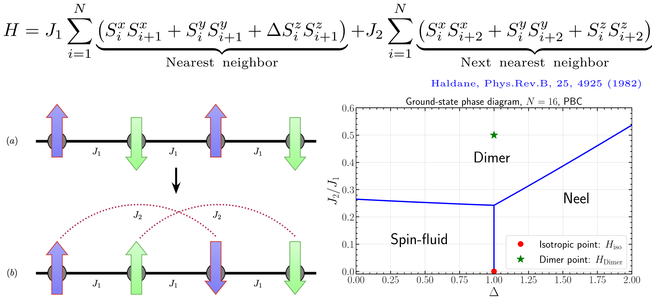
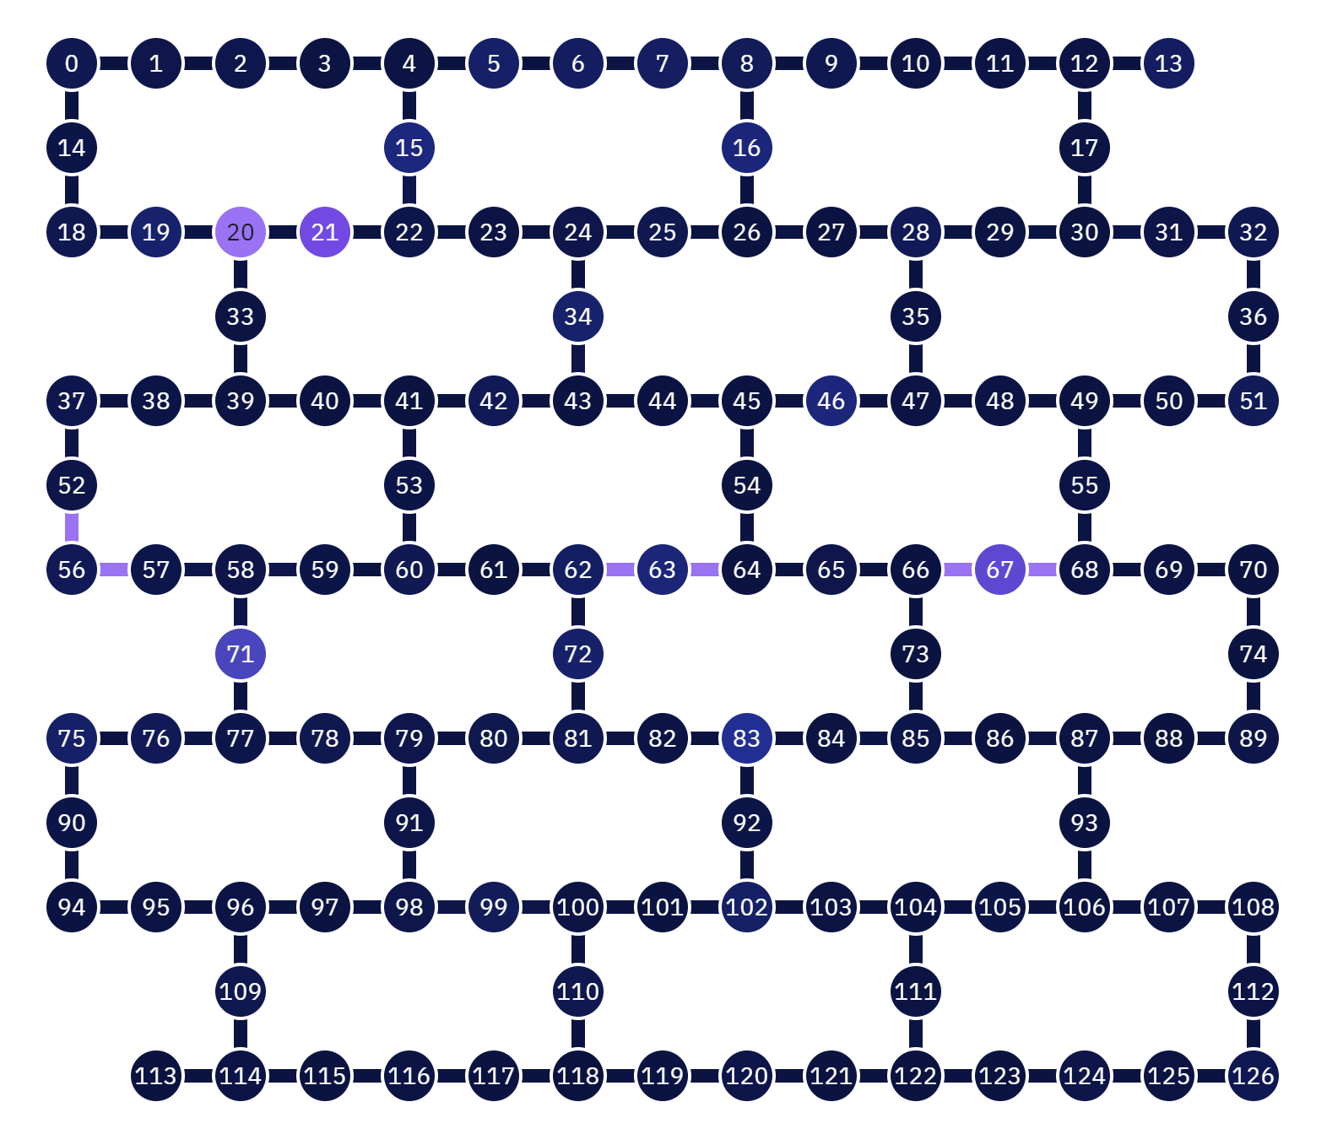
Quantum Spin Chain
The Hamiltonian of the frustrated spin ½ antiferromagnetic spin chain :
Isotropic Heisenberg Hamiltonian
Dimer Hamiltonian
Both Hamiltonians are SU(2) global symmetric.

Slide 9
Hamiltonian Simulation Trotterization

Slide 10
Time Evolution of Hamiltonian
Time evolution of Hamiltonian, H, is given by
We determine the time evolution of an observable $\hat{O}$, with respect to the time-evolved state $|\left.ψ\left(t\right)\right\rangle$ as $\left\langle ψ\left(t\right) | \hat{O} | ψ\left(t\right)\right\rangle$.
We consider Nèel’s initial state $|\left.ψ_{Neel}\left(t\right)\right\rangle =|\left.↑↓↑↓…↑↓\right\rangle =|\left.0101…01\right\rangle$.
For the observable, our choice is the staggered magnetization that capture the antiferromagnetic ordering as follows:
We determine the variation $\left\langle ψ_{Neel}\left(t\right) | {\hat{O}}_{M_{st}} | ψ_{Neel}\left(t\right)\right\rangle$ with time in the quantum computer.

Slide 11
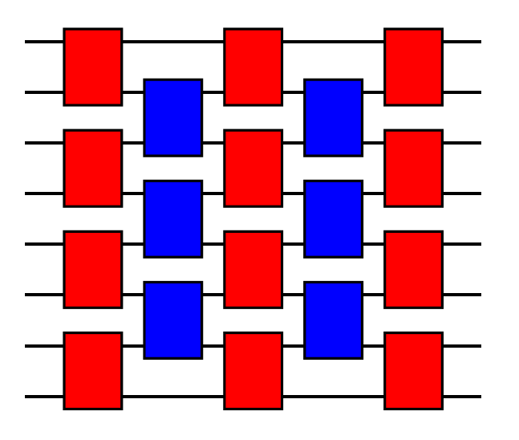
Trotterization
Also known as the product formulas or the splitting method.
Let the Hamiltonian of the system of N qubits be given by $H=\sum_{i=1}^{L}{H_{i}}$.
$U\left(t\right)=e^{−itH}= e^{−it\sum_{i=1}^{L}{H_{i}}}≈{(\prod_{i=1}^{L}{e^{−\frac{it}{r}H_{i}}})}^{r}$
Let $U_{1}\left(t\right)= {(\prod_{i=1}^{L}{e^{−\frac{it}{r}H_{i}}})}^{r}.$ Then $U\left(t\right)= U_{1}\left(t\right)+O(\frac{t^{2}}{r})$
When $U_{2}\left(t\right)= {(\prod_{i=1}^{L}{e^{−\frac{it}{2r}H_{i}}}\prod_{i=L}^{1}{e^{−\frac{it}{2r}H_{i}}})}^{r}$, then $U\left(t\right)= U_{2}\left(t\right)+O(\frac{t^{3}}{r^{2}})$
In general, $U\left(t\right)= U_{p}\left(t\right)+O(\frac{t^{p+1}}{r^{p}})$
p: Trotterization order, r: Trotter number
Trotterization can preserve locality of the system, which can reduce the simulation cost.
Brick structure

Slide 12
Trotterization of $H_{iso}$
For the isotropic Heisenberg Hamiltonian
our basic building block is the following unitary operator:
One Trotter step is defined in terms of the even layer, $U_{e}\left(\overset{⃑}{θ}\right)$, and the odd layer, $U_{o}\left(\overset{⃑}{θ}\right)$, as follows:

Slide 13
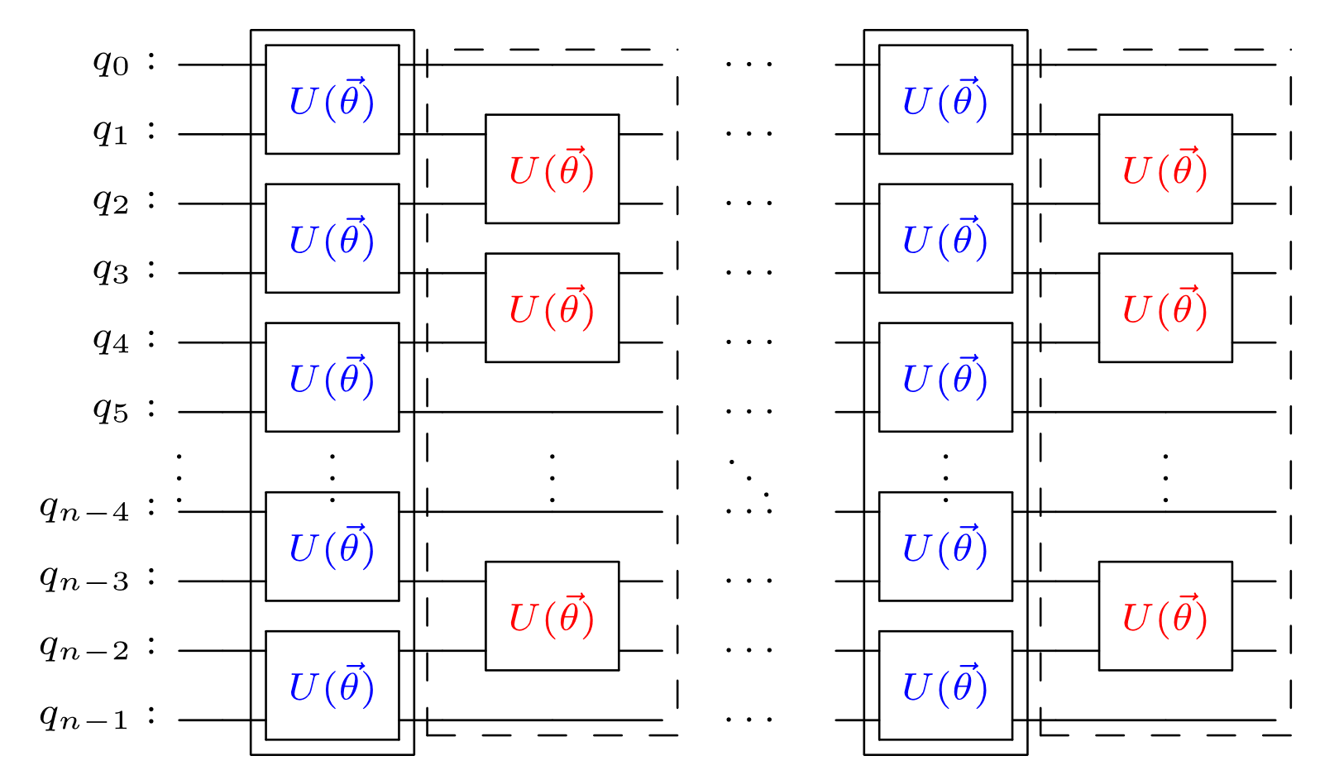
Trotterization of $H_{iso}$ (first-order)
The first-order Trotterization of the model with open boundary condition.
One Trotter step is composed of the even layer and the odd layer.
For a PBC, the odd layers have the two-qubit gates, $U_{0}\left(\overset{⃑}{θ}\right)$, between $q_{n−1}$ and $q_{0}$.

Slide 14
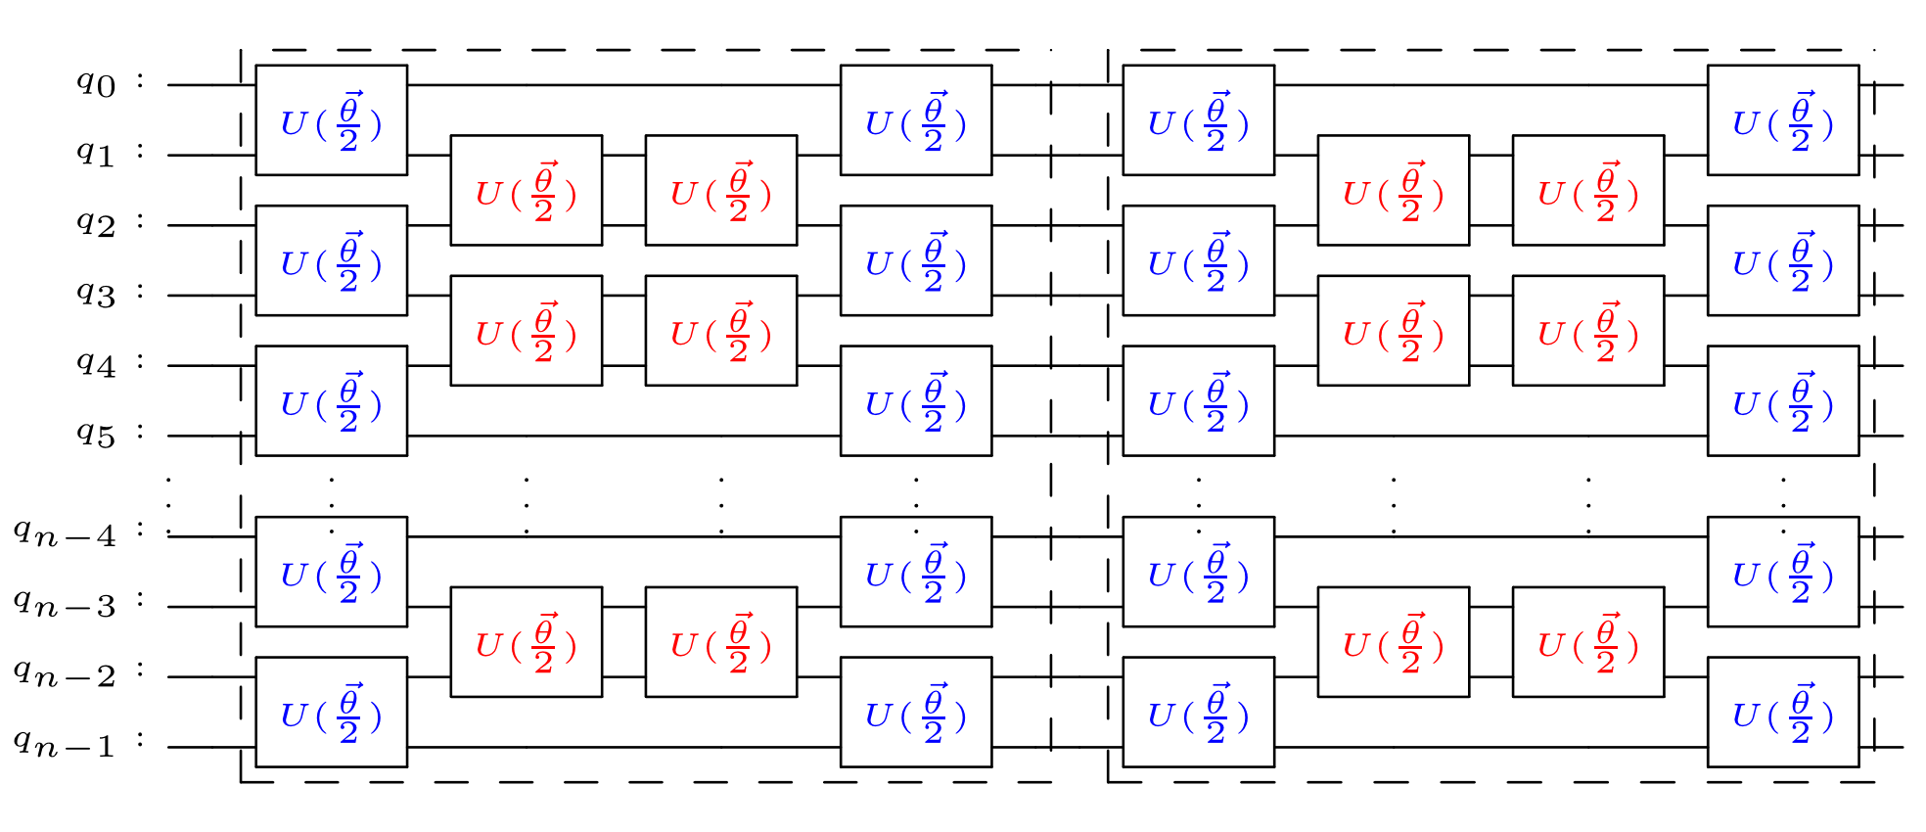
Trotterization of $H_{iso}$ (second-order)
The second-order Trotterization of the model with OBC.
One Trotter step is compared of the even layer and the odd layer with parameter $\overset{⃑}{\frac{θ}{2}}$.
For a PBC, the odd layers have the two-qubit gates, $U_{0}\left(\overset{⃑}{\frac{θ}{2}}\right)$, between $q_{n−1}$ and $q_{0}$.

Slide 15
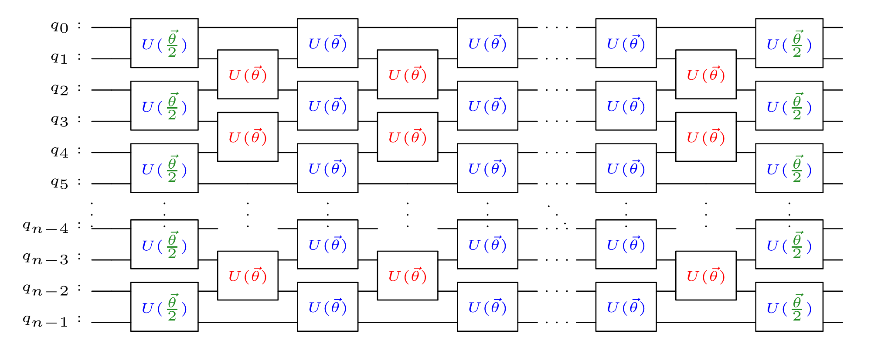
Trotterization of $H_{iso}$ (second-order) Opt.
The optimized second-order Trotterization of $H_{iso}$ is obtained by the following identities:
We merge the adjacent odd layers, and the last even layer can be merged with the first even layer of the next Trotter step.
2L (1st order) => 4L (2nd order) => 2L+1 (2nd order optimized) when we have L Trotter steps.

Slide 16
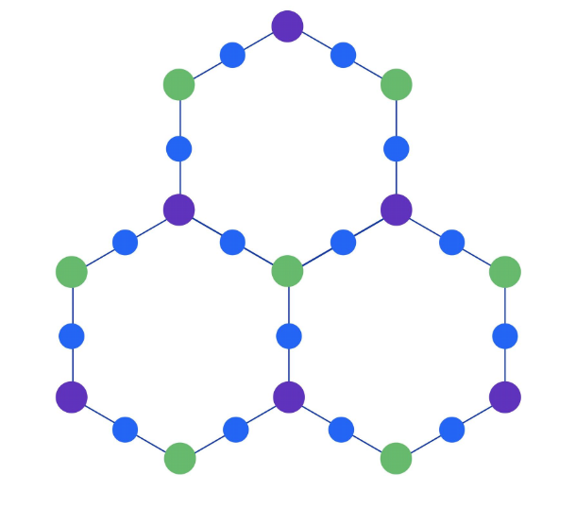
Trotterization of $H_{Dimer}$
The Dimer Hamiltonian, $H_{Dimer}$, is
IBM’s quantum computers have the heavy hex lattice structure.
We implemented the next-nearest neighbor interaction with the nearest neighbor interaction in IBM’s heavy hex lattice topology by interweaving SWAP gates.

Slide 17
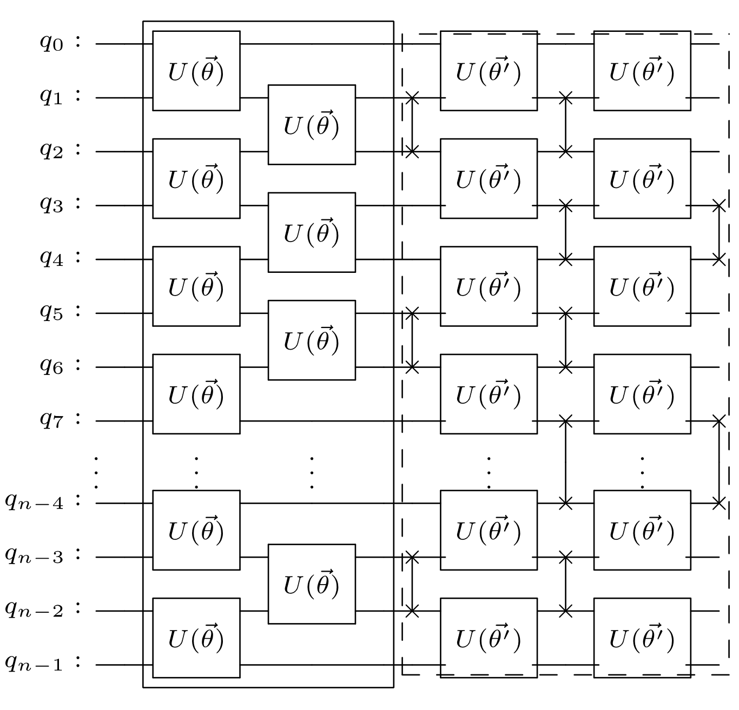
Trotterization of $H_{Dimer}$

Slide 18
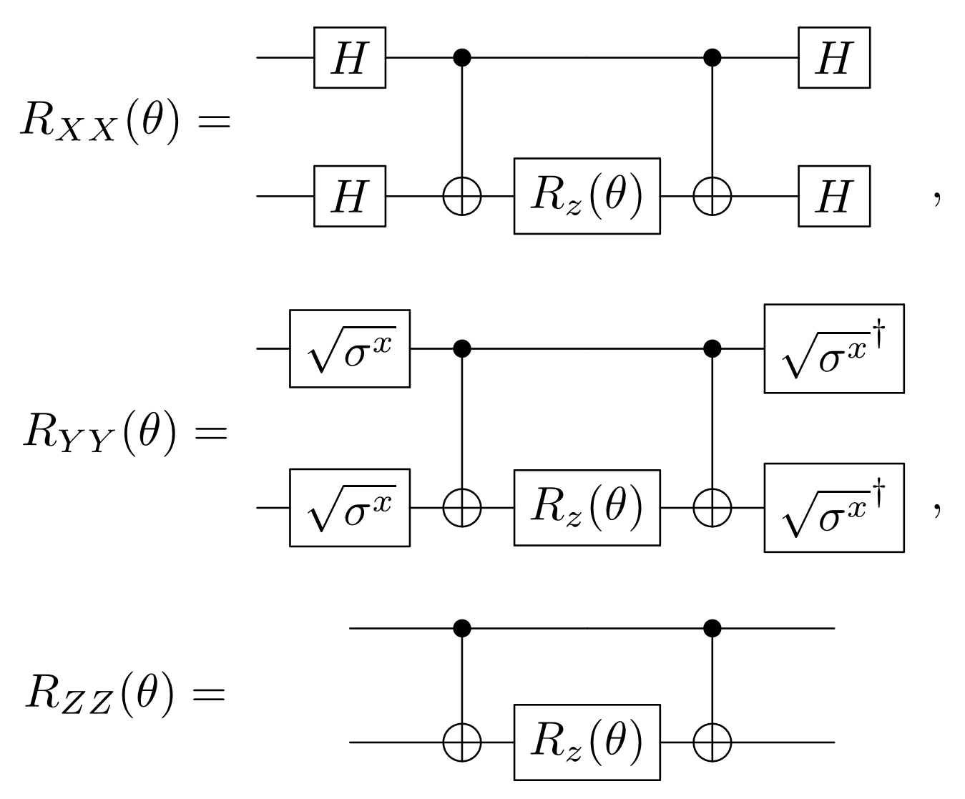
Circuit Implementation of U_{i} (one brick)
An efficient implementation of $U_{i}\left(\overset{⃑}{θ}\right)$ is crucial for the simulation.
We build up our Trotterization circuit using two-qubit rotation gates, $R_{XX}\left(θ\right)$, $R_{YY}\left(θ\right)$, and $R_{ZZ}\left(θ\right)$ as follows:

Slide 19
Circuit Implementation (Optimization)
The unitary operator $U_{i}\left(\overset{⃑}{θ}\right)$ is implemented as:
This implementation has 6 CNOT gates and 13 circuit depth.
This is optimized as:
The optimized circuit has 3 CNOT gates and 7 circuit depth.
Reducing the number of CNOT gates as well as the circuit depth is essential to reduce the overall noise of the simulation on noisy quantum computers.
$$R_{XX}\left(θ\right)$$
$$R_{YY}\left(θ\right)$$
$$R_{ZZ}\left(θ\right)$$
(Refer to Zhang et al., Adv. Quantum Technol. 7.4 (2024))

Slide 20
Error Mitigation/Suppression

Slide 21
Quantum Error Correction (QEC)
Quantum computers are prone to various errors that are unavoidable.
QEC is a set of techniques used in quantum computing to protect quantum information from errors due to decoherence and other quantum noise.
QEC is essential to achieve FTQC.
The 2D surface (qLDPC) codes are arguably most successful so far.
However, the 2D surface code has two challenging drawback.
The required number of physical qubits to encode one logical qubit is $O(d^{2})$.
It is difficult to implement a computationally universal set of logical gates.
A recently developed honeycomb code (by MS) has dynamically defined logical qubits.
In a follow-up benchmark, the honeycomb code would require 7,000 physical qubits to encode one logical qubit with ${10}^{−12}$ error rate.

Slide 22
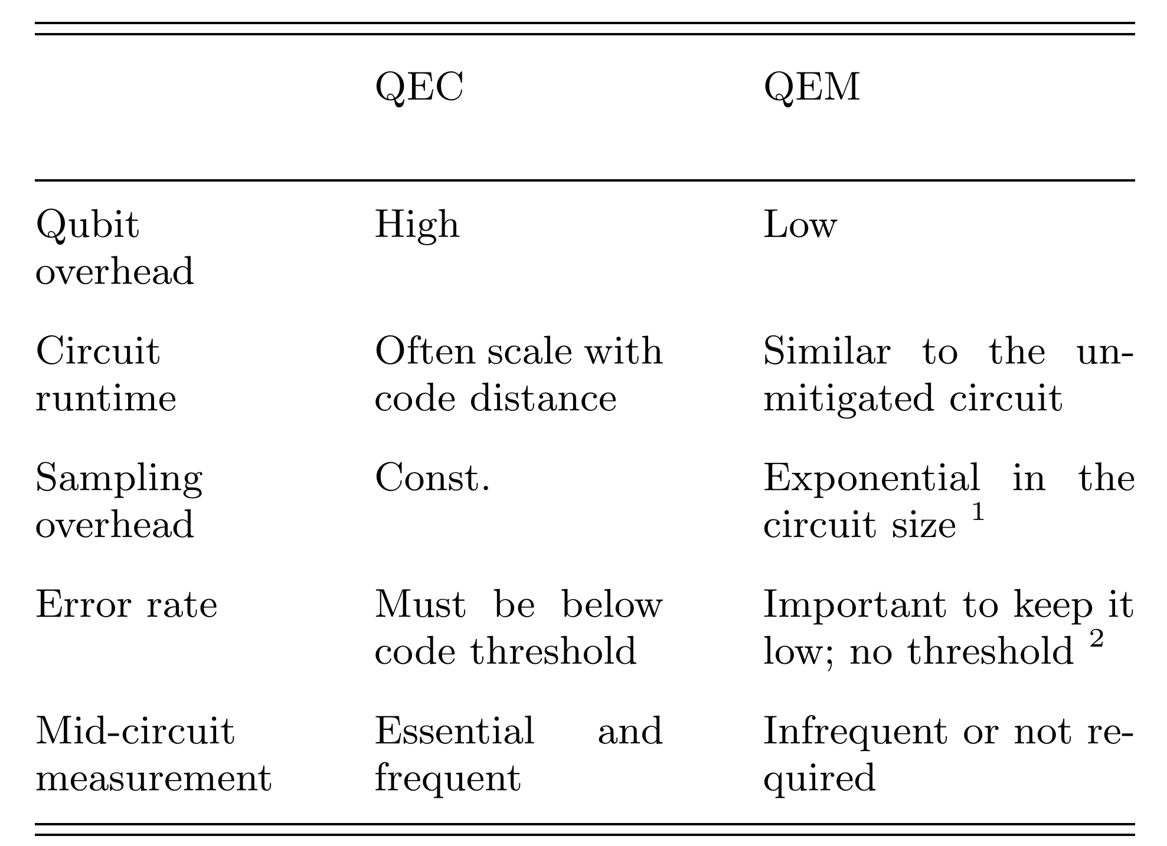
Quantum Error Mitigation (QEM)
Under the assumption that we try to construct an unbiased expectation value computation in QEC. => Some QEM such as ZNE is much efficient.
The lower error rate, the smaller sampling overheads.
No threshold for the gate noise in the unmitigated circuit. But additional gates or circuits are required.
In usual, the overhead of QEM can be handled in classical computers. => Hybrid quantum computing.
Cai, Z., Babbush, R., Benjamin, S. C., Endo, S., Huggins, W. J., Li, Y., ... & O’Brien, T. E. (2023). Quantum error mitigation. Reviews of Modern Physics, 95(4), 045005.

Slide 23
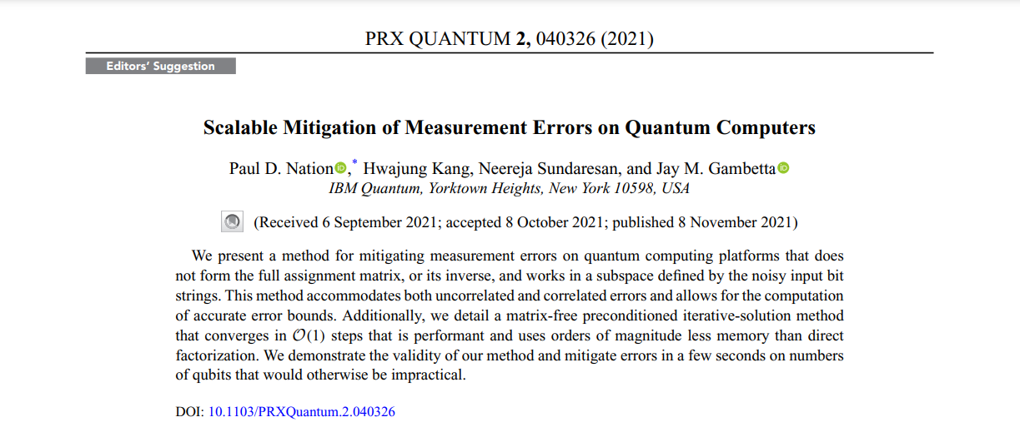
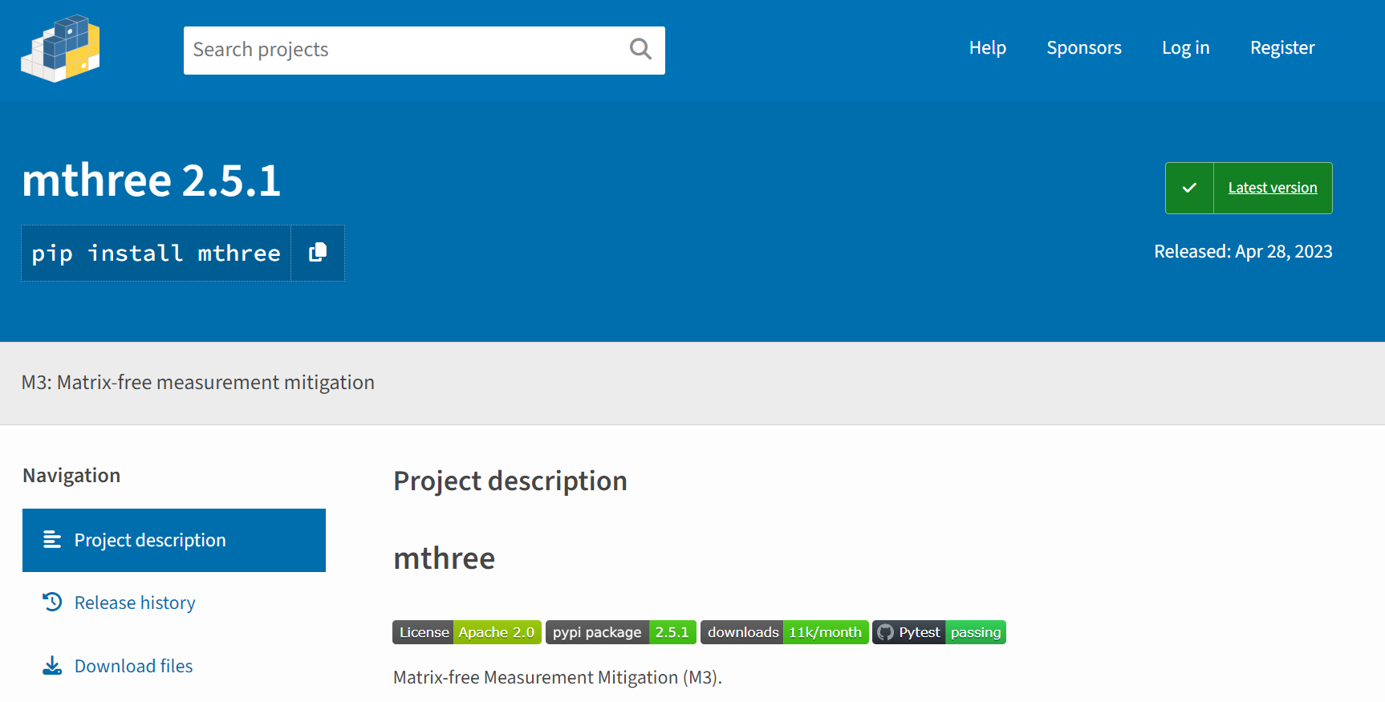
Matrix-free Measurement Mitigation (M3)
https://journals.aps.org/prxquantum/abstract/10.1103/PRXQuantum.2.040326

Slide 24
Dynamical Decoupling (DD)
Idle qubits may undergo damping and dephasing error due to T1-relaxation and T2-dephasing.
Dynamical Decoupling (DD) can suppress those errors.
Applying DD involves dressing the idle times between gates on a qubit with some choice of DD sequence.

Slide 25
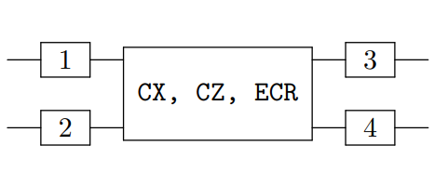
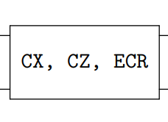
Pauli Twirling (PT)
Pauli twirling is a method averaging out the off-diagonal coherent errors of the circuits in the Pauli basis.
Pauli-twirling is a quantum error mitigation technique that uses randomization to noise-shape coherent error into stochastic errors, by combining the results from many random, but logically equivalent circuits, together.
Search all possible Pauli gate sets satisfying the above equality and duplicate a given circuit with the logically equivalent circuits added by the Pauli gates. After that averaging all the duplicated circuit results.
Kim, Y., Wood, C.J., Yoder, T.J. et al. Scalable error mitigation for noisy quantum circuits produces competitive expectation values. Nat. Phys. 19, 752–759 (2023). https://doi.org/10.1038/s41567-022-01914-3
In our experiments, we searched all the combinations of Pauli gates that are mathematically identical up the global phase with only the Clifford gate (ECR or CZ gate in our experiments) out of 256(=4⁴) cases. Finally, we obtained 16 combinations of {I, X, Y, Z}.
Duplicated 10 copies of the base quantum circuit.
In the 10 copies, we applied the 16 combination randomly to all ECR (or CZ) gates.

Slide 26
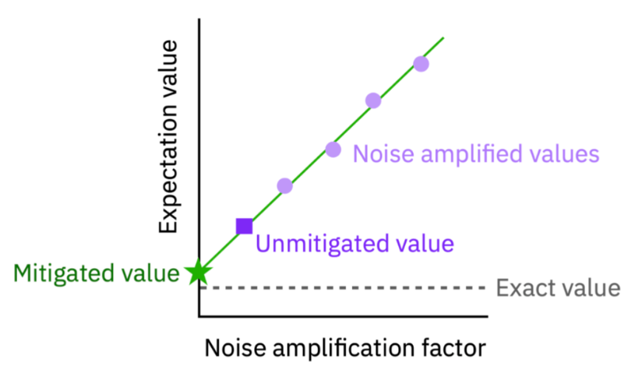
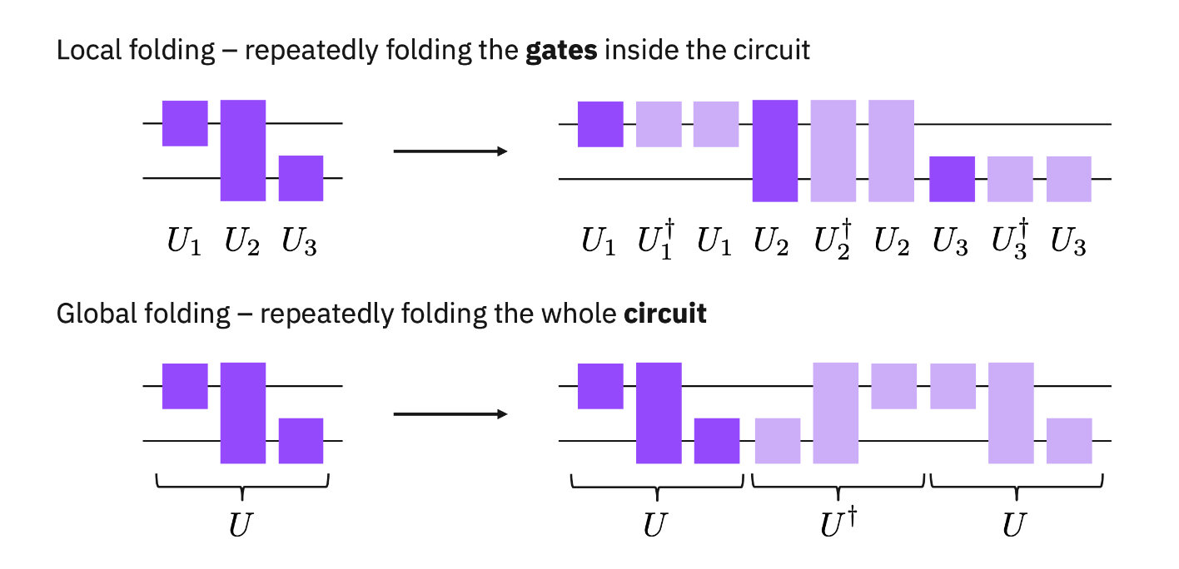
Zero Noise Extrapolation (ZNE)
In this experiment, the digital (gate-based) & local folding is applied to only on ECR and CZ gates.
Argument on the fitting functions.

Slide 27
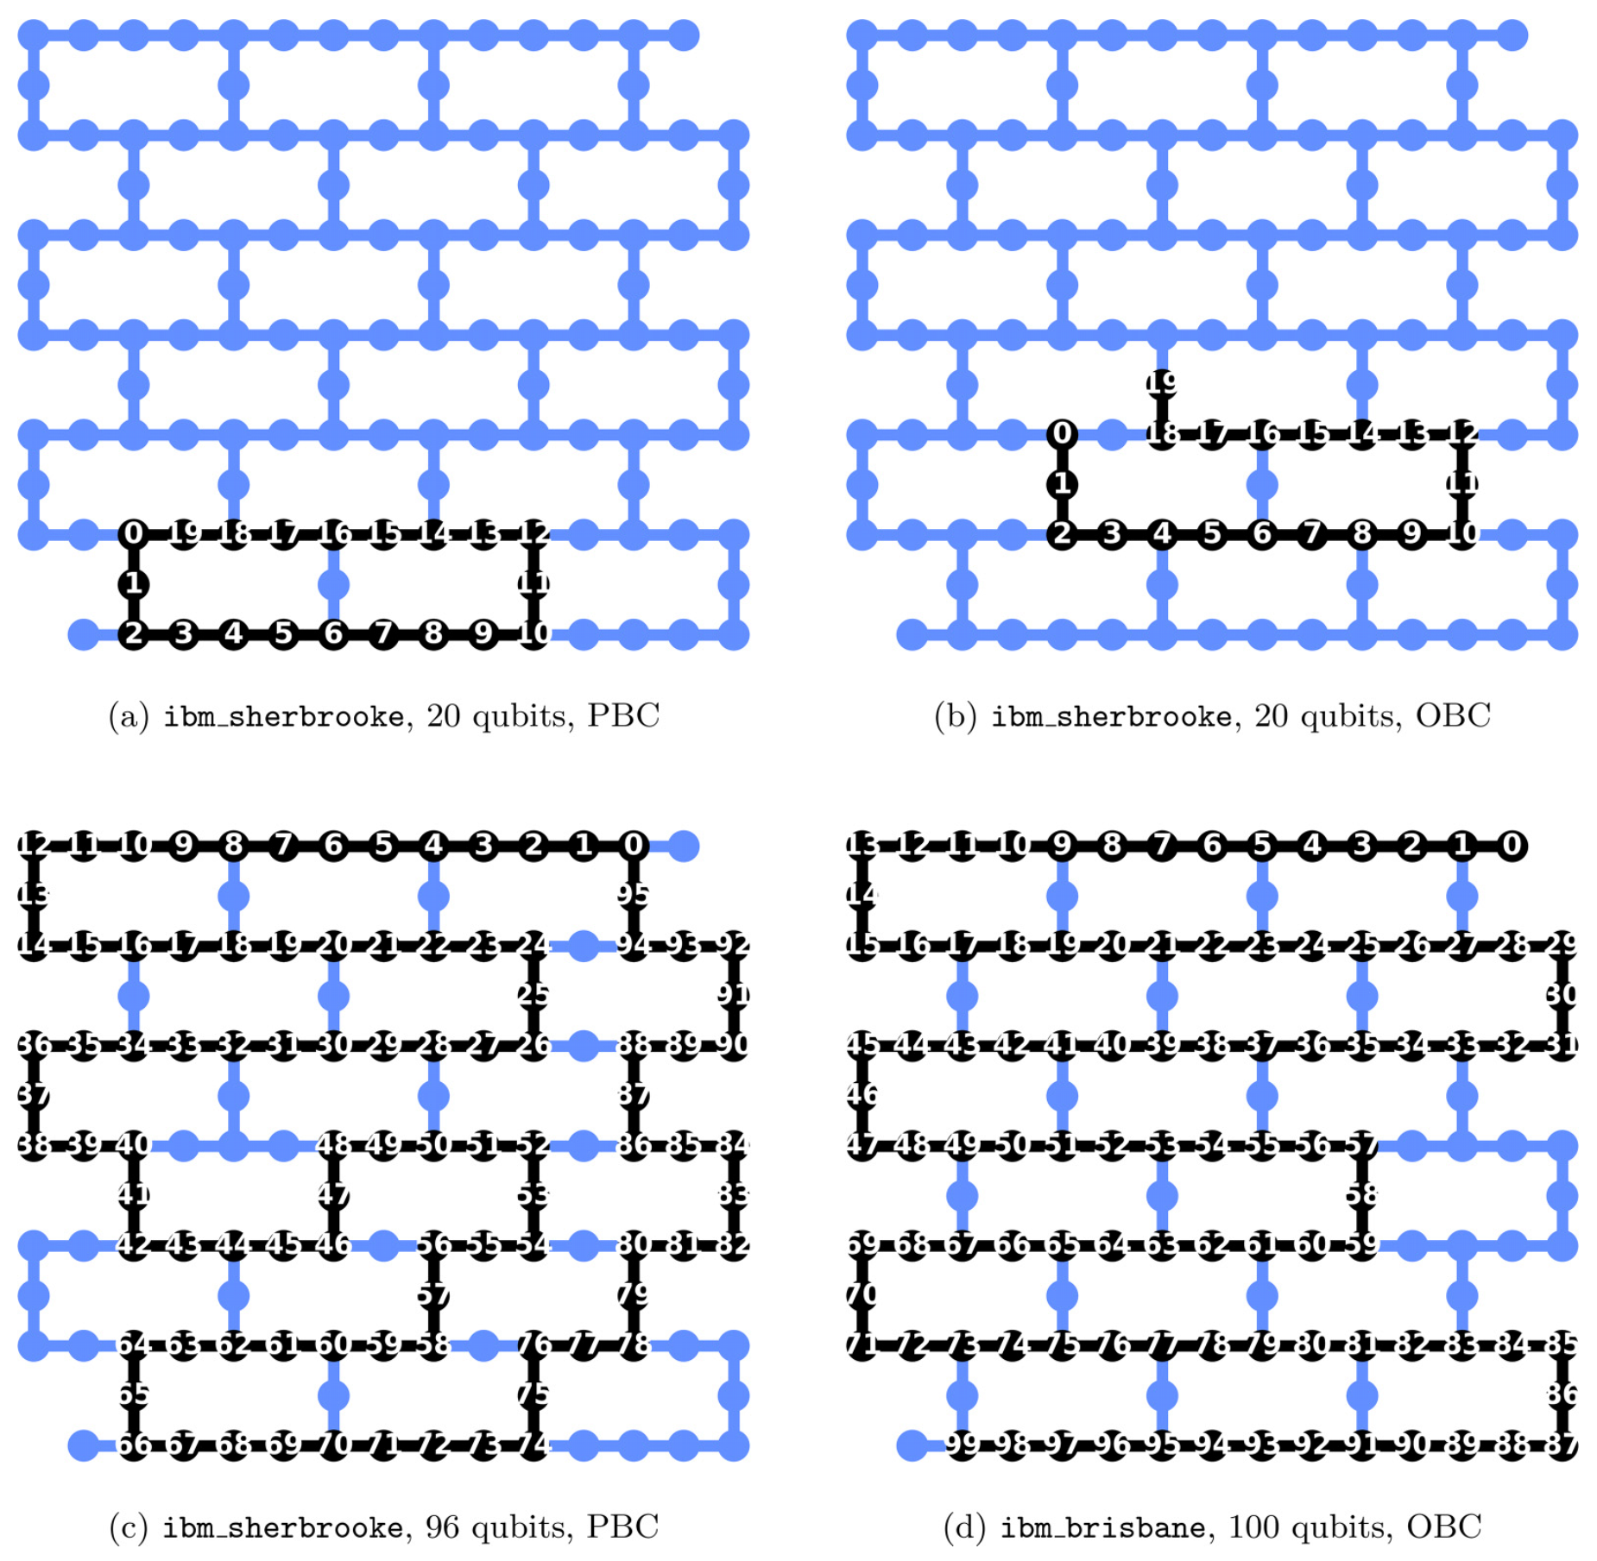
Qubit Mapping
Eagle r3: ECR, ID, RZ, SX, X
Heron: CZ, ID, RX, RZ, SX, X, RZZ

Slide 28
Results

Slide 29
Classical Methods
It is crucial to cross-check the results by the quantum computers.
We adopt two classical methods widely used to study the quantum many-body system: 1. Direct method (QuSpin), 2. Matrix Product States (MPS) based method.
Direct method (QuSpin): Direct computation of ${|\left.ψ\left(t\right)\right\rangle = e}^{−itH}|\left.ψ(0)\right\rangle$ where $|\left.ψ\left(0\right)\right\rangle ∈ ℂ^{2^{N}}$.
MPS based method: This method uses Matrix Product States which are one-dimensional arrays of tensor linked together, with each tensor corresponding to a site or particle of the many-body system
We use time dependent variational principle (TDVP) to calculate the time evolution of the expectation value in MPS-based method. We named it as MPS-TDVP method.

Slide 30
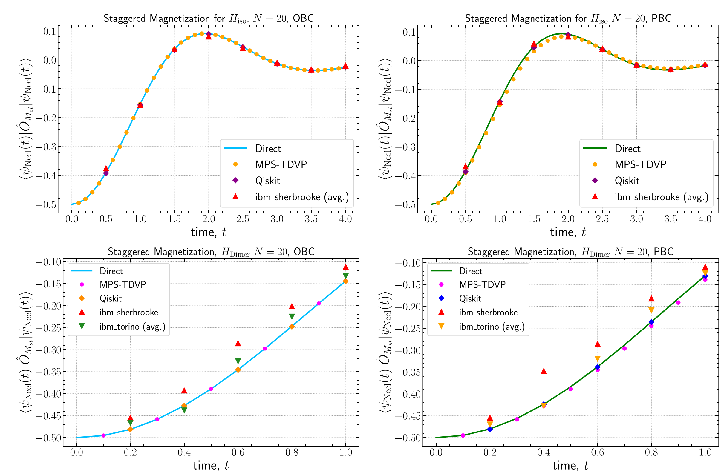
Results: N=20 sites (qubits)

Slide 31
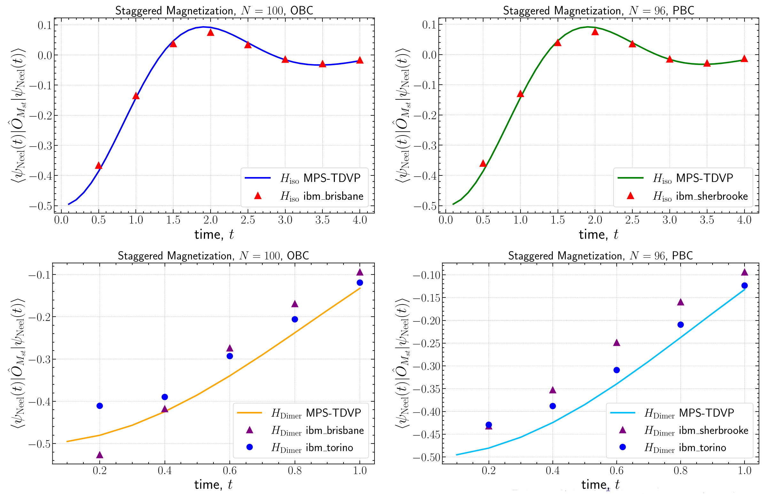
Results: N=96, 100 sites (qubits)

Slide 32
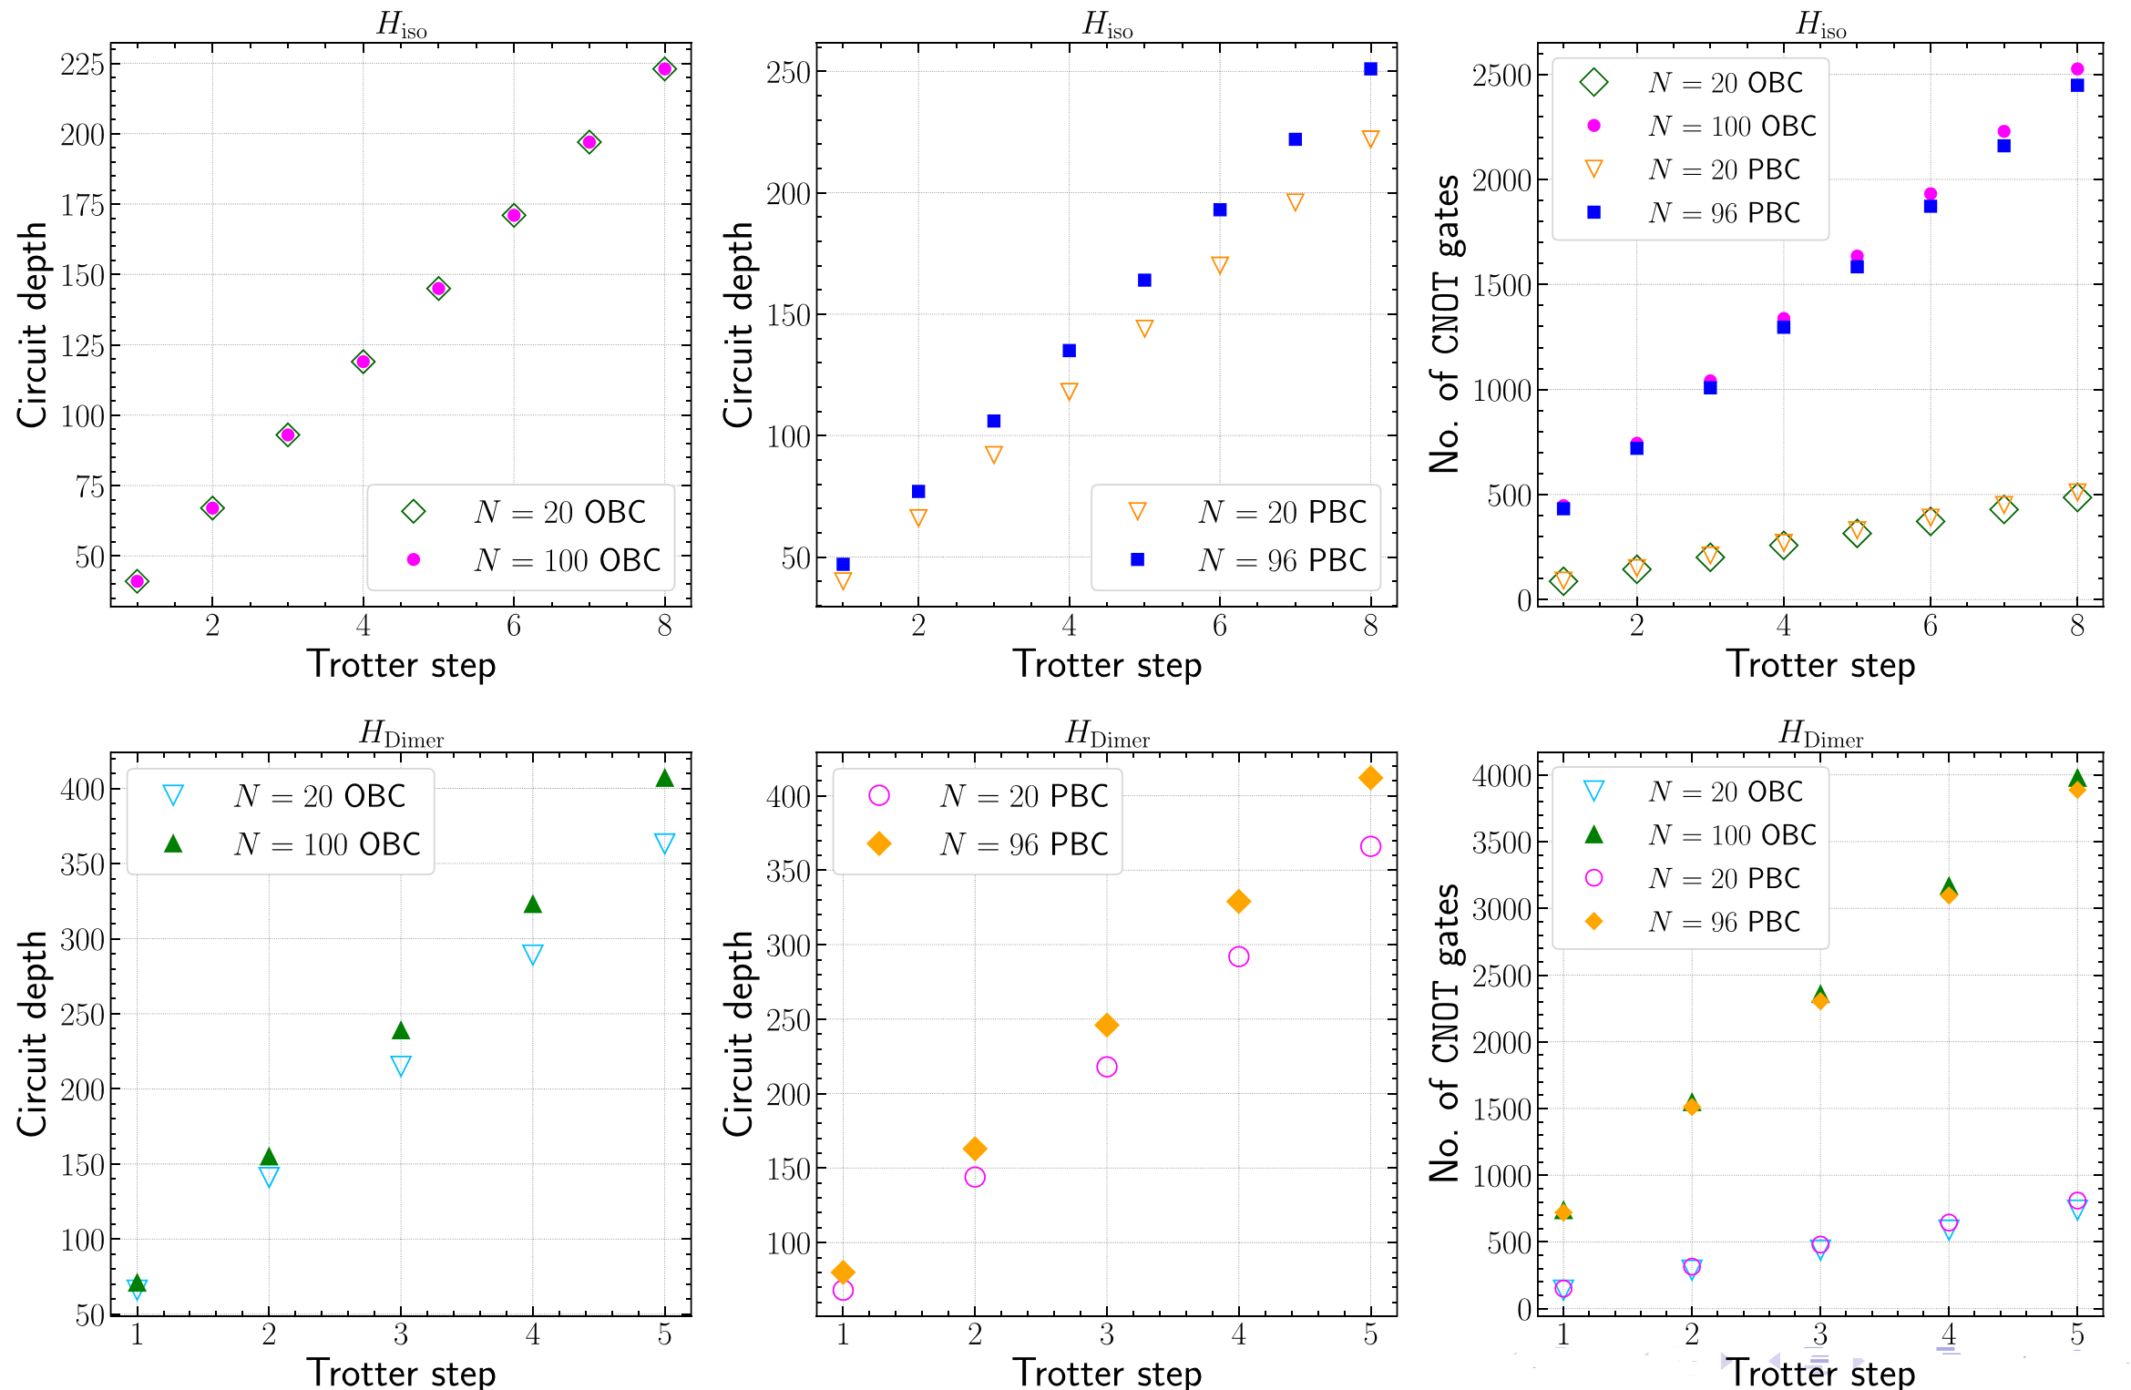
Results: Circuit Depths & CX Gate Counts

Slide 33
Results: Discussion
The $H_{Dimer}$ cases have larger discrepancy with classical results compared to the $H_{iso}$.
The sources of this discrepancy are the quantum errors and noises rather than numerical errors associated the ﬁrst-order Trotterization.
The EPGL (error per layered gate) for ibm sherbrooke: 1.7% and ibm_torino: 0.8%. Results from ibm_torino agrees better for N = 20, 96 and 100 qubit cases.
The nearest-neighbor interactions in the Dimer Hamiltonian is nothing but the isotropic Heisenberg Hamiltonian whose results agree well with classical results.
Therefore, the error mitigation implementations of the terms associated with the next-nearest-neighbor interactions in the Dimer Hamiltonian are the key sources of discrepancy.

Slide 34
Conclusion & Outlook
We are entering into the era of quantum utility.
Our large-scale quantum simulation on IBM’s superconducting quantum computers shows promising results.
The circuit depth staying almost the same at each Trotter step regardless of the number of qubits.
Moreover, the accurate measurement of expectations values for large-scale quantum system using superconducting quantum computers establishes their utility to probe the dynamics of quantum many-body system.

Slide 35
Future Work
Proper state preparation: We plan to extend our study to include state preparation before the time evolution, allowing us to tackle more realistic quantum simulation problems.
Highly entangled state: Studying the time evolution with highly entangle states.
New QEM methods: Developing new QEM methods and combining them with already know QEM methods efficiently.
Fine-Tunning: We will study how to ﬁne-tune the parameters of the QEM methods and combine diﬀerent methods to obtained more optimized results.
Other Applications: We are developing other applications at a large scale (> 100) on IBMQ.

Slide 36
Thank You! kyu@bnl.gov

