Slide 1
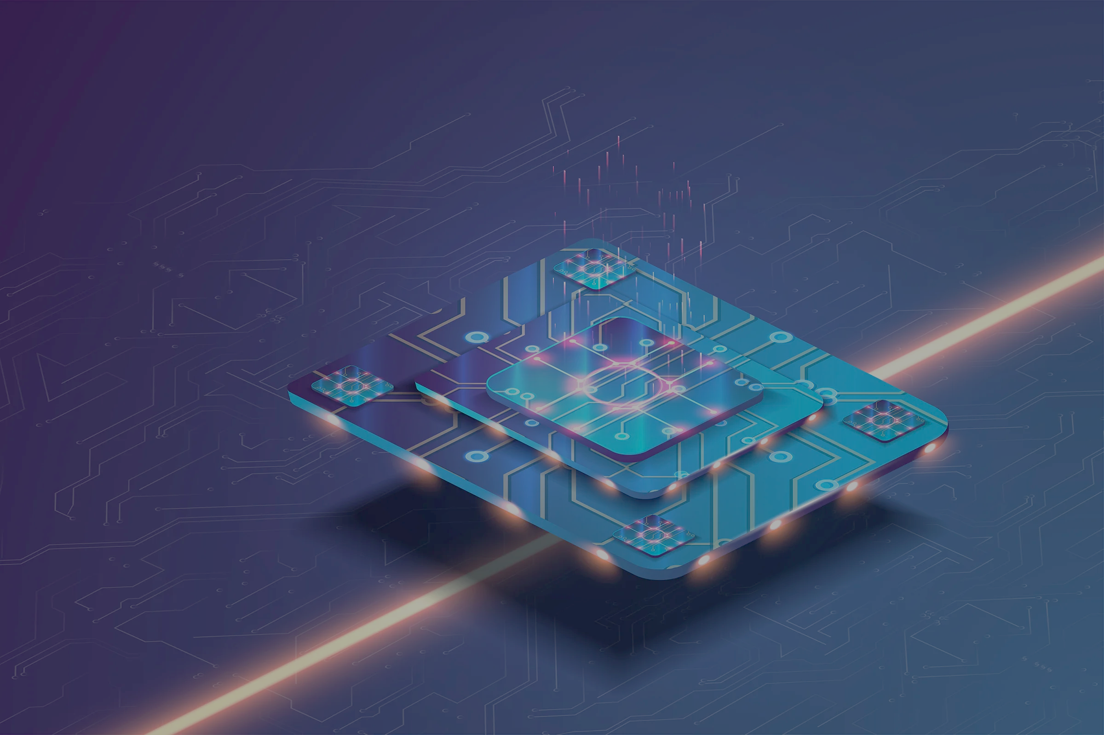
January 15th, 2025
NP-AMO-QIS Workshop at UMass Boston
Quantum sensing assisted by near-term quantum algorithms
LA-UR-21-20536
LA-UR-20-28328
LA-UR-20-27870
Akira Sone
University of Massachusetts, Boston, MA
AS, M. Cerezo, J. L. Beckey, and P. J. Coles, Phys. Rev. A 104, 062602 (2021)
M. Cerezo, AS, J. L. Beckey, and P. J. Coles, Quantum Sci. Technol. 6, 035008 (2021)
J. L. Beckey, M. Cerezo, AS, and P. J. Coles, Phys. Rev. Research 4, 013083 (2022)

Slide 2
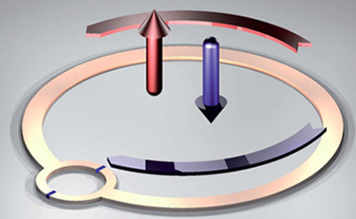

2
Progress in Hardware Fabrication and Quantum Control
Fabrication of good qubit systems
Electron spin in defects
(e.g. NV center in diamond)
Superconducting circuit
Quantum dot
Atom in optical lattice
Photons
Quantum control for noise decoupling
Control
Noise
Long coherence (life) time of superposition state
What has been achieved from these technological developments?

Slide 3
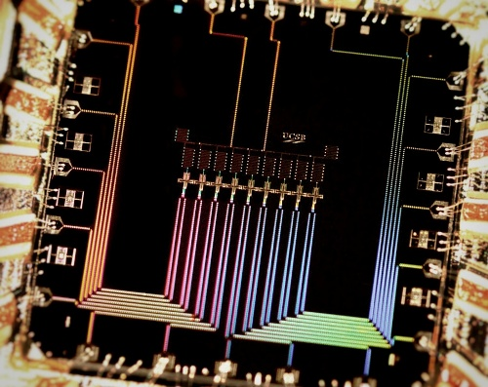
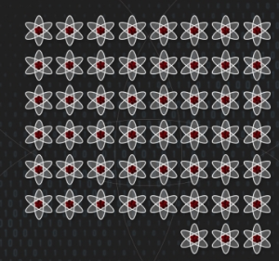
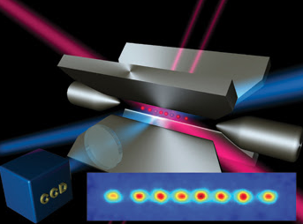
3
Near-term Quantum Computers
Noisy Intermediate-Scale Quantum (NISQ) Computers
Properties
Noisy
Limited connectivity
50 ~ a few hundreds qubits (no quantum error correction)
Candidates for NISQ computers
Superconducting circuit
Neutral atom
Trapped ion
Photons
Quantum dot
Can we do any quantum computing tasks by using currently existing NISQ device?
J. Preskill, Quantum 2, 79 (2018)

Slide 4
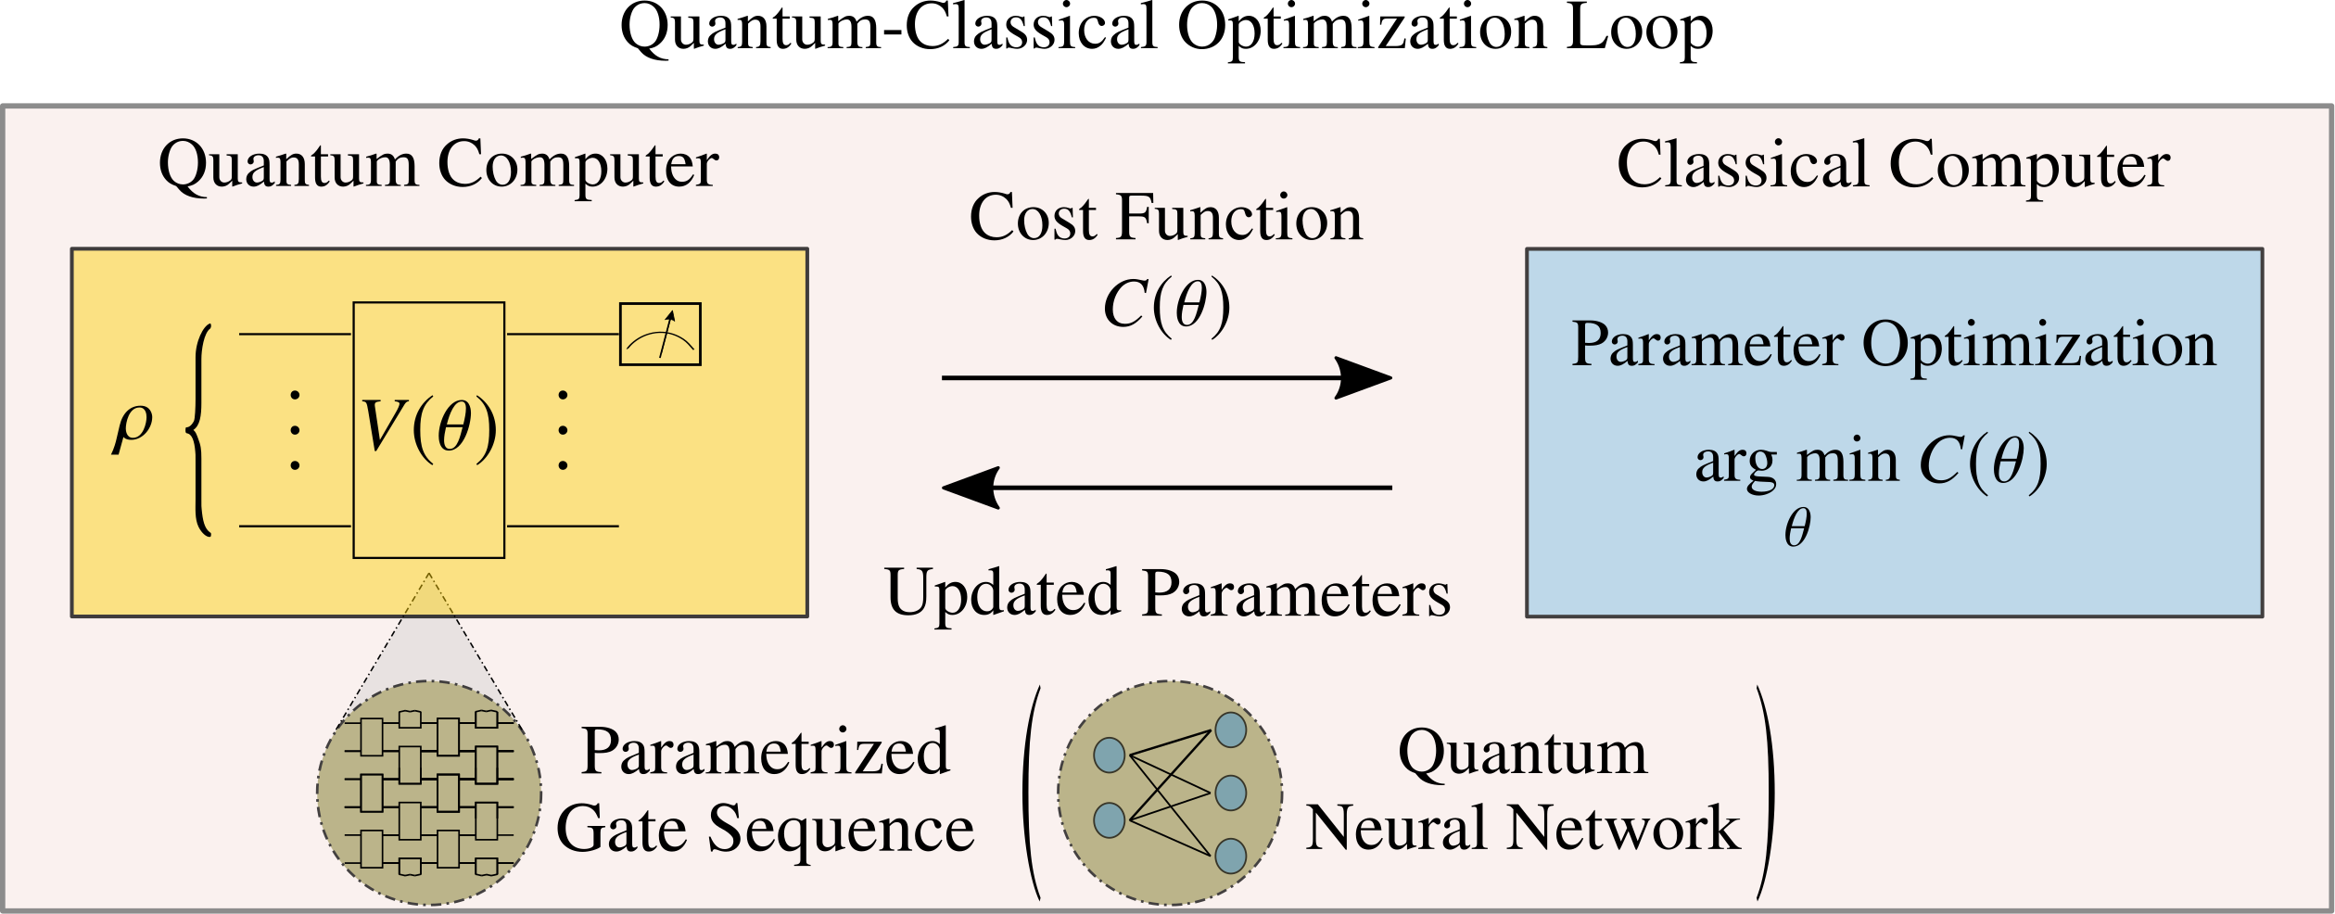
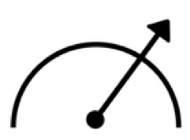
4
Variational Quantum Algorithms (VQAs) as Leading Strategies
Hybrid quantum-classical optimization loop
Quantum computer
Cost Function
(e.g. Energy)
Classical computer
Initial state:
Optimize parameters
…
…
Updating parameters
Quantum system
(e.g. Molecule)

Slide 5
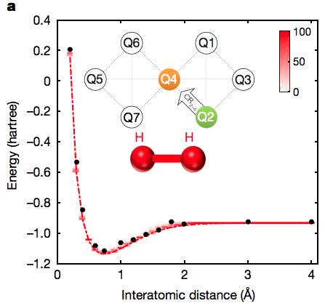
5
Envisioned Applications of NISQ Computers
Quantum chemistry
System of linear equations
Combinatorial optimization
Quantum networking
Quantum sensing

Slide 6
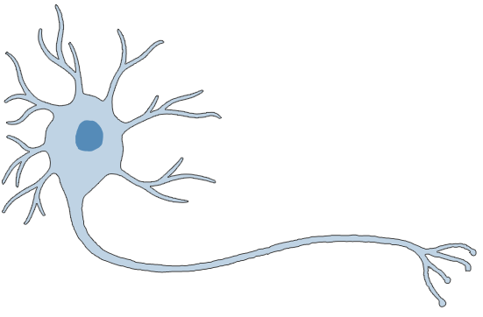
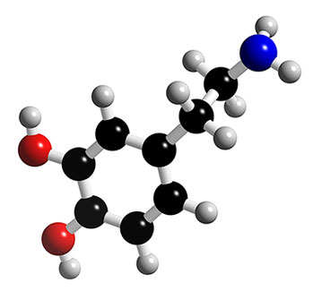
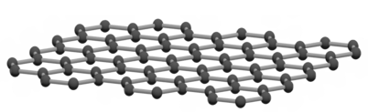
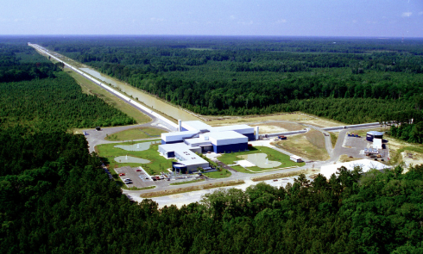
6
Quantum Sensing
Precision measurement beyond classical limit
Molecular structure determination
2D Magnetic material
Living system
Gravitational wave detection
Dark matter

Slide 7
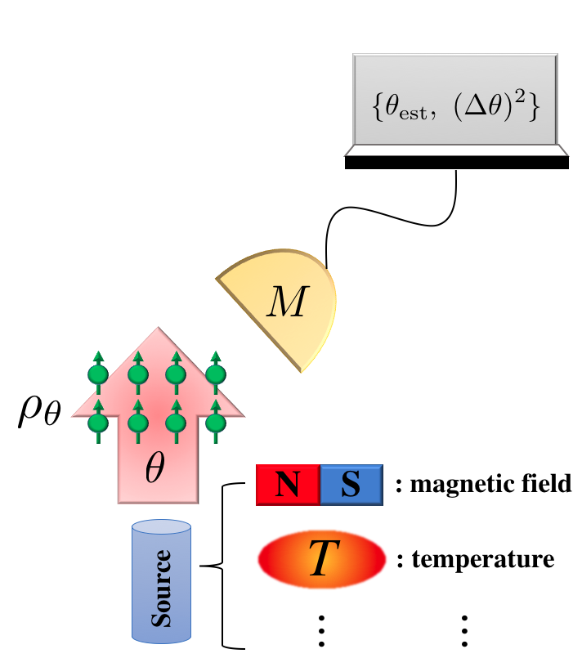
7
Quantum Fisher Information (QFI)
Quantum Cramer-Rao bound:
Quantum Fisher Information
(how good the quantum sensor is)
Quantum Fisher information (QFI):
error
quantum fidelity

Slide 8
8
Maximum QFI of Mixed State in Unitary Families
Input state:
optimization
L. Fiderer et al, Phys. Rev. Lett, 123, 250502 (2019)

Slide 9
Variational Quantum Fisher Information Estimation (VQFIE) Algorithms

Slide 10
10
Difficulties in Estimating QFI with Quantum Computers
In practice, for a general state…
Compute the fidelity via quantum computer
We need to identify all the
eigenvalues and eigenvectors
Exponential computational complexity
Can we use the bounds on QFI to estimate QFI via quantum computer?

Slide 11
11
We Expect to See….
QFI estimation
Optimal state preparation
QFI
QFI
Upper bound
max QFI
Exact QFI
Lower bound
Lower bound
Iteration of optimization loop
Iteration of optimization loop

Slide 12
12
Truncated Quantum States (Efficiently Computable)
Quantum state
m-truncated quantum state (sub-normalized)
We need to identify only $m$ eigenvalues and eigenvectors

Slide 13
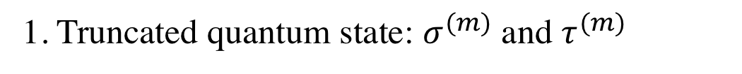
13
Truncated QFI (TQFI)
1. Truncated quantum state: $σ^{(m)}$ and $τ^{(m)}$
2. Generalized fidelity:
3. Fidelity inequality:
with
M. Cerezo et al, Quantum 4, 248 (2020)
4. QFI inequality: Defining
Lower TQFI
Upper TQFI
AS, M. Cerezo, J. L. Beckey, and P. J. Coles, Phys. Rev. A 104, 062602 (2021)
M. Cerezo, AS, J. L. Beckey, and P. J. Coles, Quantum Sci. Technol. 6, 035008 (2021)
J. L. Beckey, M. Cerezo, AS, and P. J. Coles, Phys. Rev. Research 4, 013083 (2022)

Slide 14
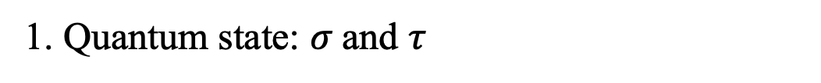
14
Super- and Sub-QFI
1. Quantum state: $σ$and $τ$
2. Sub- and Super- fidelity:
J. A. Miszczak, Z. Puchała, P. Horodecki, A. Uhlmann, K. Zyczkowski, Quantum Inf. Comput., 9, 103 (2009)
: sub-fidelity
: super-fidelity
3. Fidelity inequality:
4. QFI inequality:
: Sub-QFI
: Super-QFI
● Dynamics-agnostic QFI bounds
AS, M. Cerezo, J. L. Beckey, and P. J. Coles, Phys. Rev. A 104, 062602 (2021)
M. Cerezo, AS, J. L. Beckey, and P. J. Coles, Quantum Sci. Technol. 6, 035008 (2021)
J. L. Beckey, M. Cerezo, AS, and P. J. Coles, Phys. Rev. Research 4, 013083 (2022)

Slide 15
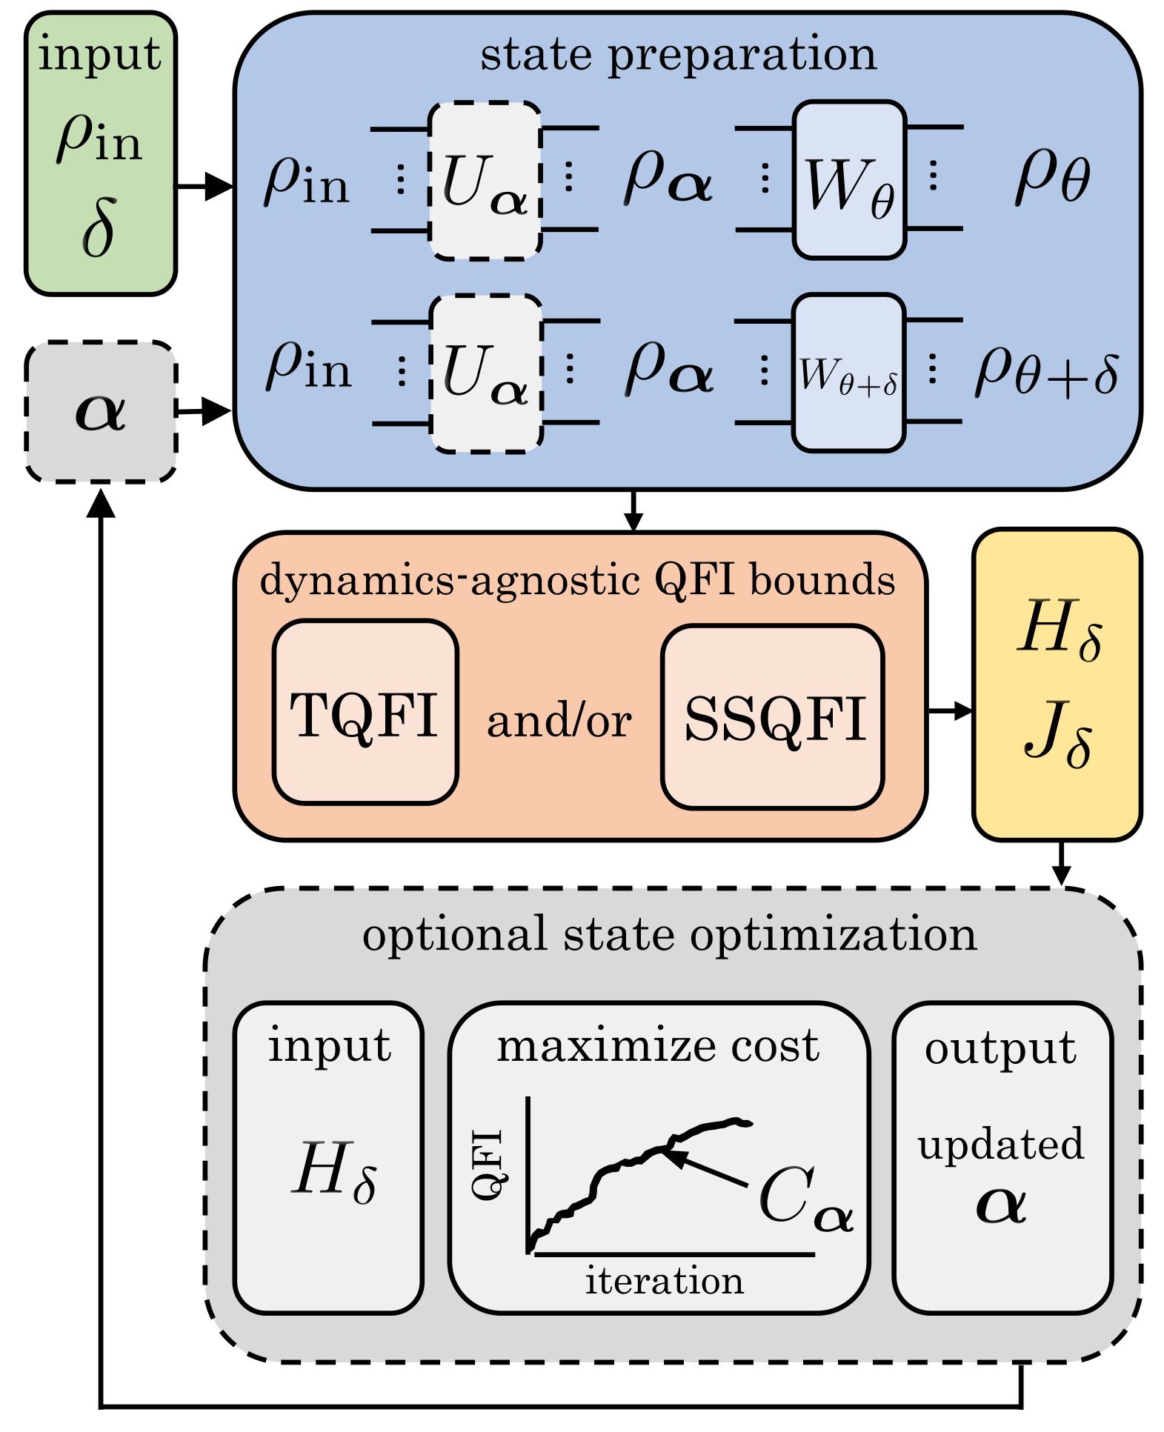
15
Variational Quantum Fisher Information Estimation (VQFIE) Algorithm
Computing TQFI
Step 1: Variational Quantum State Eigensolver (VQSE)
We need $m∈O(log⁡(d))$ eigenvalues/eigenvectors
Step 2: Variational Quantum Fidelity Estimation (VQFE)

Slide 16
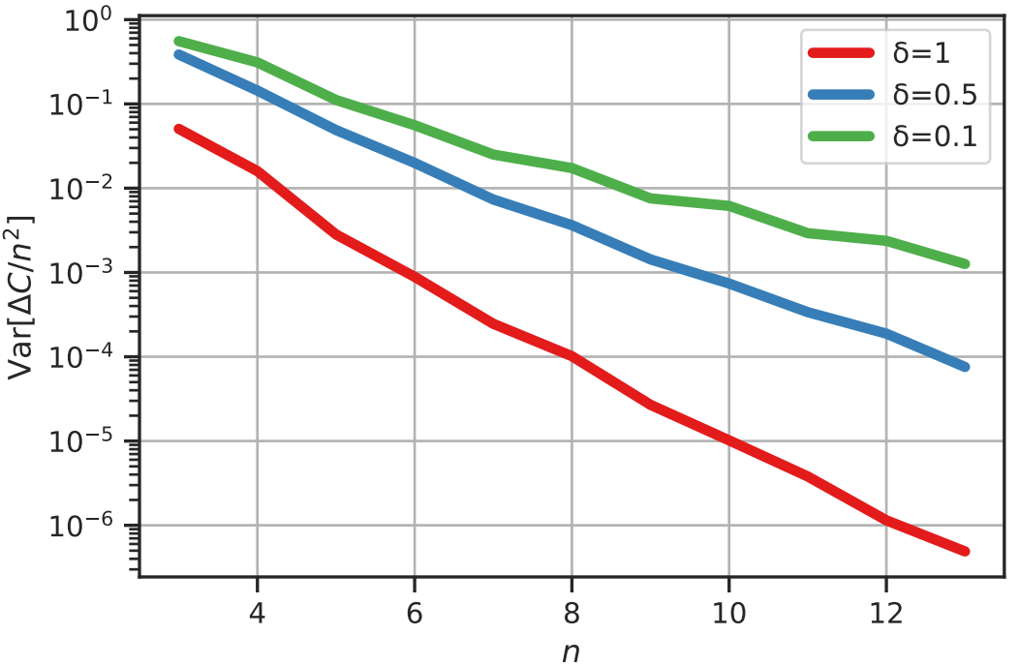
16
Variational Quantum Fisher Information Estimation (VQFIE) Algorithm
Trainability for computing TQFI
J. L. Beckey, M. Cerezo, AS, and P. J. Coles, Phys. Rev. Research 4, 013083 (2022)

Slide 17
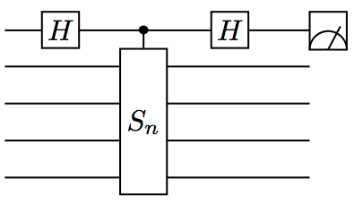
17
Variational Quantum Fisher Information Estimation (VQFIE) Algorithm
Computing Sub- and Super-QFI
SWAP
Sub:
Super:
J. L. Beckey, M. Cerezo, AS, and P. J. Coles, Phys. Rev. Research 4, 013083 (2022)

Slide 18
Example: Magnetometry
(TQFI outperforms)

Slide 19
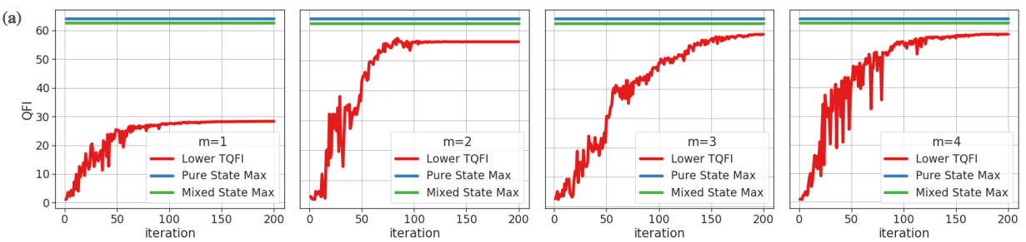
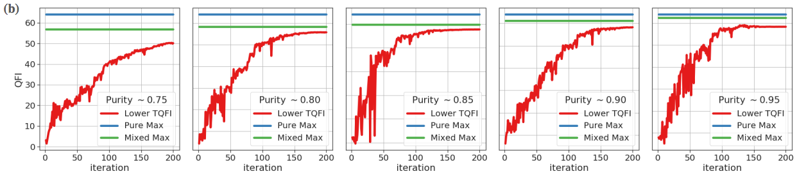
19
Optimal State Preparation via Lower TQFI (4-qubit, error $δ=0.1$)
purity 0.95
Better performance as m increases
m = 4
Better performance for high purity states
J. L. Beckey, M. Cerezo, AS, and P. J. Coles, Phys. Rev. Research 4, 013083 (2022)

Slide 20
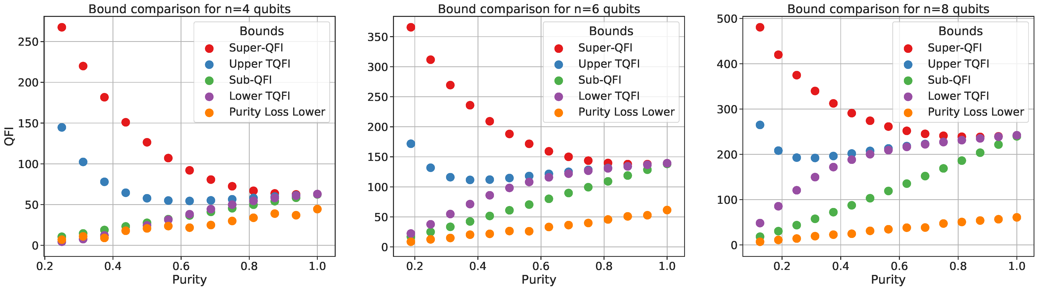
20
Bounds Comparison for Reaching Maximum QFI for Magnetometry
m = 4
m = 4
m = 4
1. Our derived lower bounds are always larger than the lower bound of previous studies (purity-loss bound)
2. The advantage of using our derived bounds becomes manifest in higher purity case
3. TQFI outperforms in these ranges
J. L. Beckey, M. Cerezo, AS, and P. J. Coles, Phys. Rev. Research 4, 013083 (2022)

Slide 21
Usefulness of sub-QFI

Slide 22
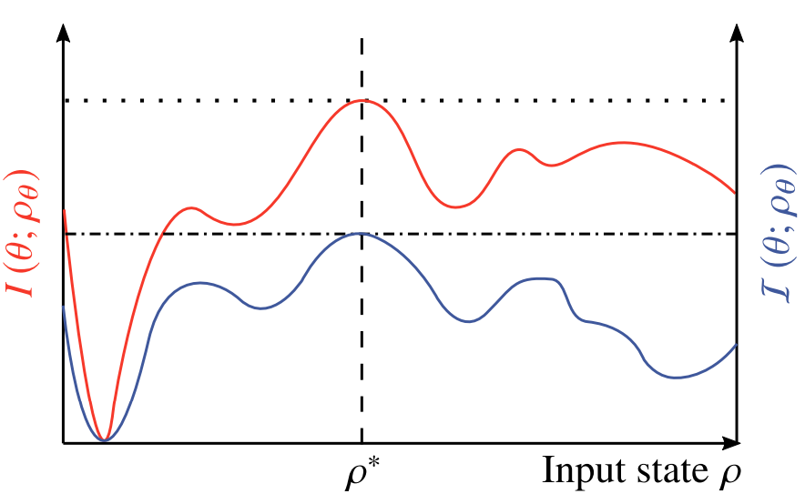
22
Optimal State of QFI and Sub-QFI
Achieving max QFI = Achieving max sub QFI
Exact QFI
optimization
Sub-QFI
M. Cerezo, AS, J. L. Beckey, and P. J. Coles, Quantum Sci. Technol. 6, 035008 (2021)

Slide 23
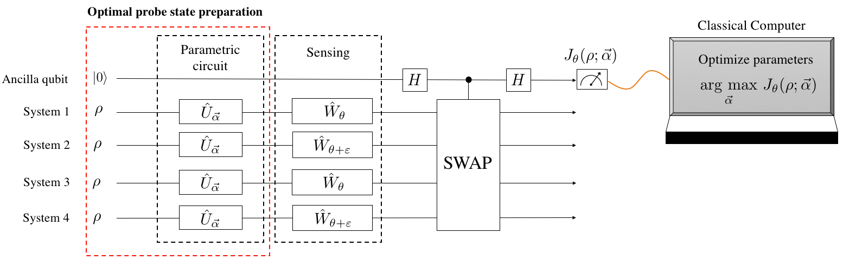


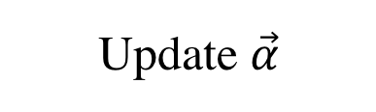
23
Optimal State of QFI and Sub-QFI
Sub-QFI
Update $\vec{α}$
Sub-QFI is computable with quantum computers.
Optimal probe state can be prepared through VQAs on NISQ computers.
J. L. Beckey, M. Cerezo, AS, and P. J. Coles, Phys. Rev. Research 4, 013083 (2022)
Classical Computer
Cost function
Parametric circuit
Sensing
Sub- and Super
fidelity
$$∙$$
Optimize parameters
SWAP
Update $\vec{α}$

Slide 24
24
Conclusion
We proposed a novel efficiently computable lower bounds on the QFI.
The developed VQFIE algorithm can be employed to estimate the QFI and prepare the state maximizing the QFI.
Next Steps:
Employ the state that maximizes the QFI for quantum sensing: determining the optimal measurement.
Multi-parameter estimation (distributed quantum sensing)

