Slide 1
Structured light for quantum information science
Andy Chong
Associate Professor
Physics Department
Pusan National University

Slide 2
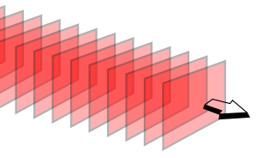
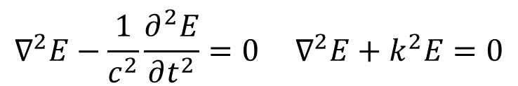

Maxwell wave equation
Beam propagation
  Maxwell’s wave equation (Helmholtz equation)
$$∇^{2}E−\frac{1}{c^{2}}\frac{∂^{2}E}{∂t^{2}}=0 ∇^{2}E+k^{2}E=0$$
Plane wave
$$\vec{E}\left(z\right)=\vec{E_{o}}e^{i(kz−ωt)}$$
Notes:
2

Slide 3

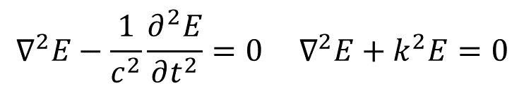
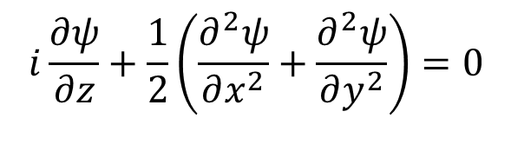
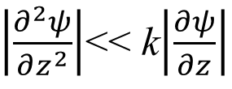
Maxwell wave equation
Beam propagation
  Maxwell’s wave equation (Helmholtz equation)
$$∇^{2}E−\frac{1}{c^{2}}\frac{∂^{2}E}{∂t^{2}}=0 ∇^{2}E+k^{2}E=0$$
Paraxial approximation
if
$\left|\frac{∂^{2}ψ}{∂z^{2}}\right|$<< k$\left|\frac{∂ψ}{∂z}\right|$
$$E\left(x,y,z\right)=ψ(x,y)e^{ikz}$$
  and normalized
$$i\frac{∂ψ}{∂z}+\frac{1}{2}\left(\frac{∂^{2}ψ}{∂x^{2}}+\frac{∂^{2}ψ}{∂y^{2}}\right)=0$$
  Paraxial equation
Notes:
3

Slide 4
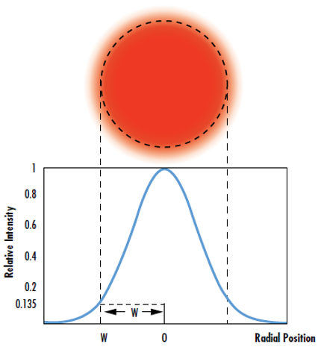
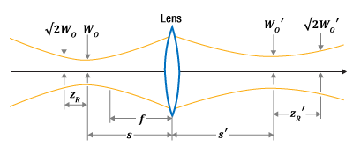
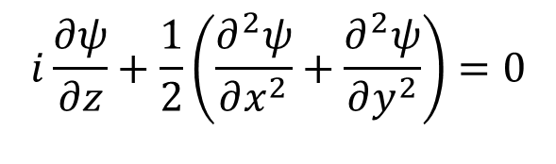
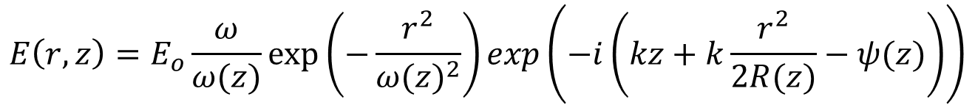
Paraxial wave equation
$$i\frac{∂ψ}{∂z}+\frac{1}{2}\left(\frac{∂^{2}ψ}{∂x^{2}}+\frac{∂^{2}ψ}{∂y^{2}}\right)=0$$
Paraxial equation
Gaussian beam
$$E\left(r,z\right)=E_{o}\frac{ω}{ω(z)}exp⁡\left(−\frac{r^{2}}{{ω(z)}^{2}}\right)exp\left(−i\left(kz+k\frac{r^{2}}{2R(z)}−ψ(z)\right)\right)$$
Notes:
4

Slide 5
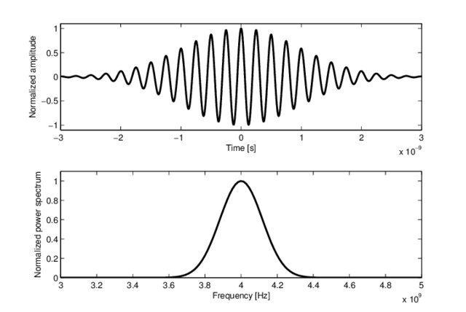
Ultrafast pulses
Notes:
5

Slide 6
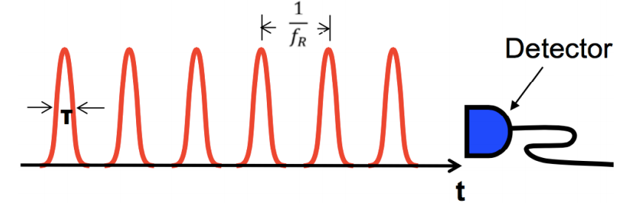
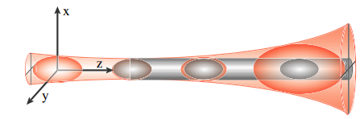

Ultrafast Optics
Ultrafast optics
Femtosecond ~${10}^{−15}$ s
Gaussian-Gaussian
Wave packet
Notes:
6

Slide 7
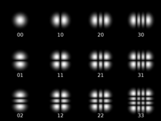
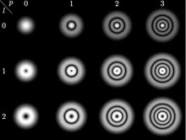

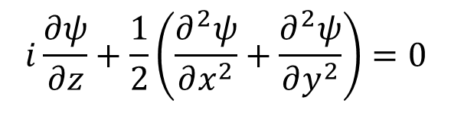
Paraxial wave equation
$$i\frac{∂ψ}{∂z}+\frac{1}{2}\left(\frac{∂^{2}ψ}{∂x^{2}}+\frac{∂^{2}ψ}{∂y^{2}}\right)=0$$
Paraxial equation
Hermite Gaussian beam
Laguerre Gaussian beam
Notes:
7

Slide 8
Structured light
Structured Light
(H. Rubinsztein-Dunlop et al., J. Opt., 2017)
Complicate structured light
(Structured in phase, amplitude, polarization, etc)
Can be structured in space and time
Notes:
8

Slide 9
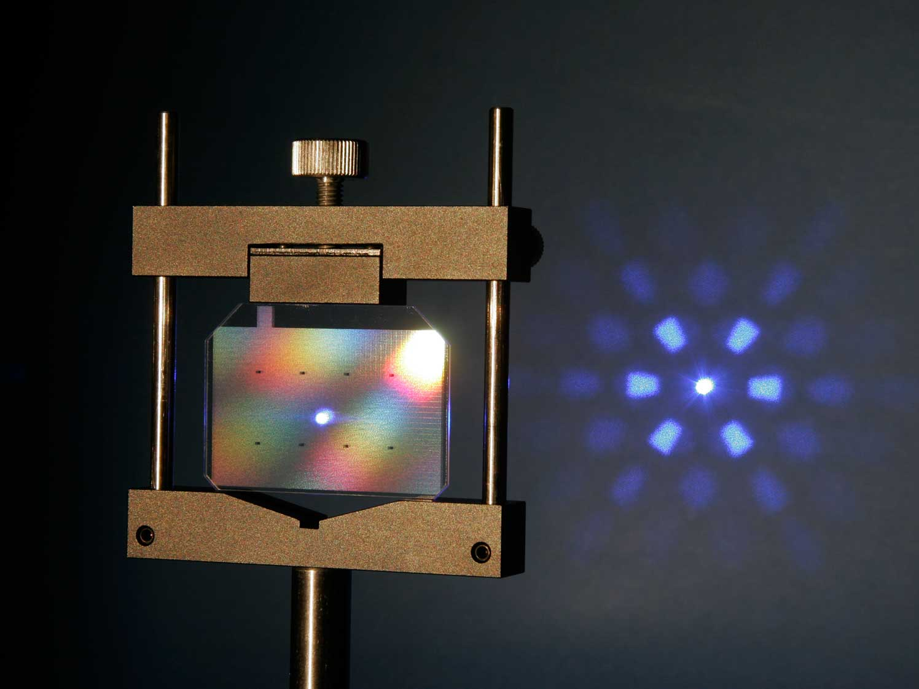
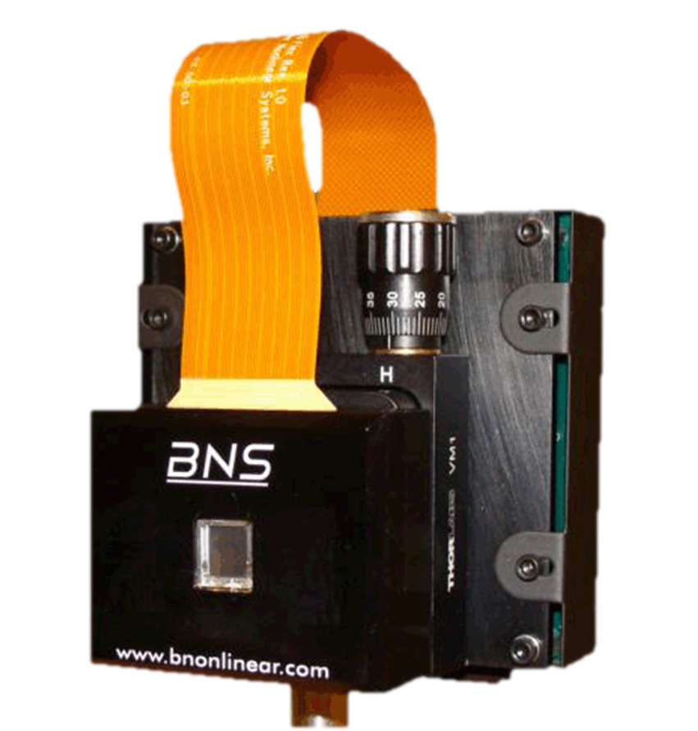
Structured light generation
(Beam shaping )
LCD based
Spatial light modulator (SLM)
Phase mask (diffractive optical element)
(from JENOPTIK)
Notes:
9

Slide 10
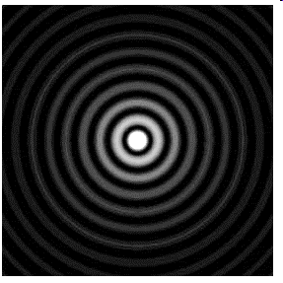

Localized waves (beams)
Beam propagation
  Maxwell’s wave equation (Helmholtz equation)
$$∇^{2}E−\frac{1}{c^{2}}\frac{∂^{2}E}{∂t^{2}}=0 ∇^{2}E+k^{2}E=0$$
Localized (non-diffractive) beam propagation
  Solutions of Helmholtz wave equation
  Ex) Plane wave (non-local), Bessel beam (localized)
  Non-square integrable – requires the infinite energy
$$ψ=J_{o}(α\sqrt{x^{2}+y^{2}})\exp{(}iβz)$$
$$α^{2}+β^{2}=k^{2}$$
Notes:
10

Slide 11
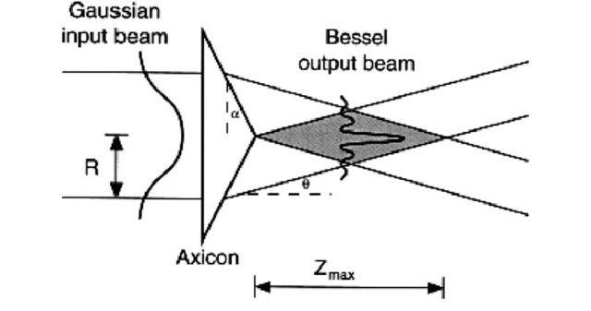
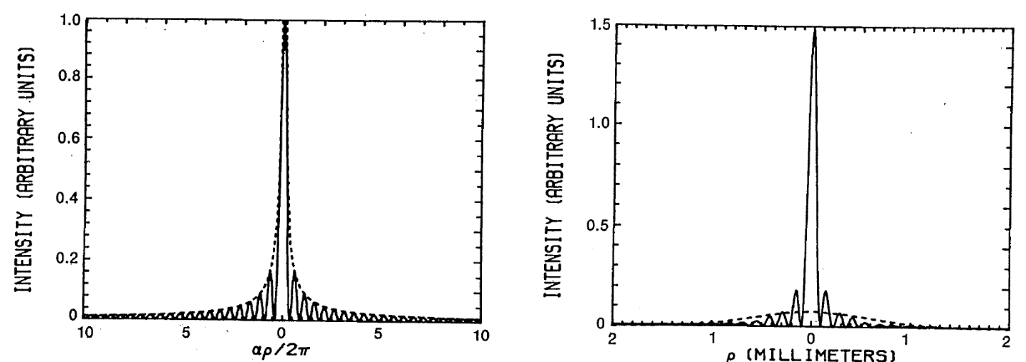
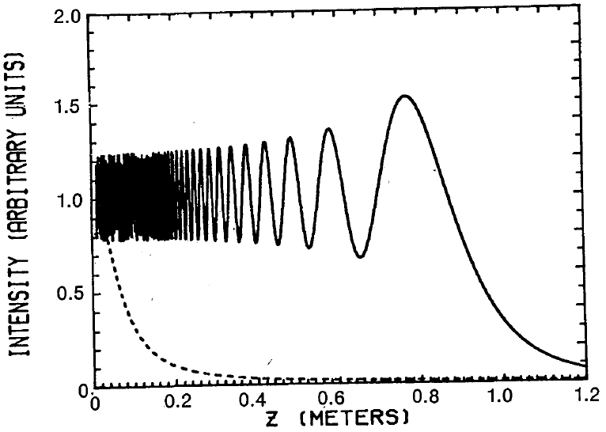
Bessel beam
Bessel beam propagation: Non-diffractive propagation
    (J. Durnin, JOSA A, 1987)
Notes:
11

Slide 12
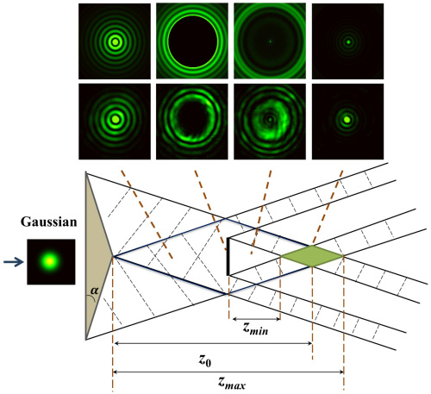
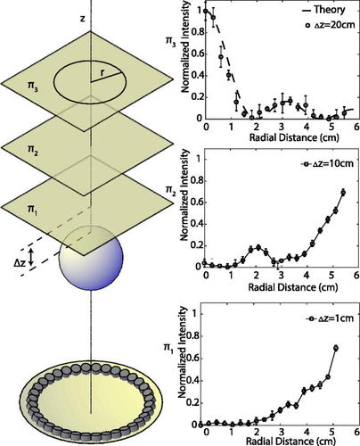
Bessel beam
Bessel beam propagation: self-healing Acoustic field
    (N. Mphuthi, et al. JOSA A, 2018)
    (G. Antonacci, et al., Appl. Phys. Lett., 2019)
Notes:
12

Slide 13
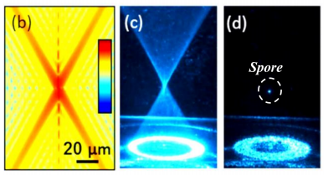
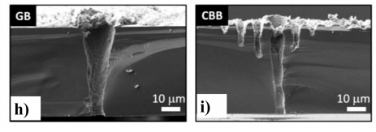
Bessel beam applications
Optical trapping
Material processing
    (B. Redding et al. Opt. Lett., 2015)
    Gaussian Bessel
    (F. He et al., Sci. Rep., 2017)
Notes:
13

Slide 14
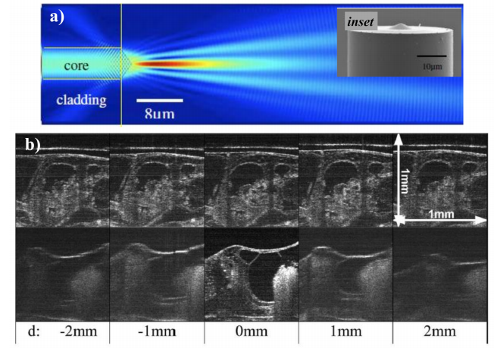
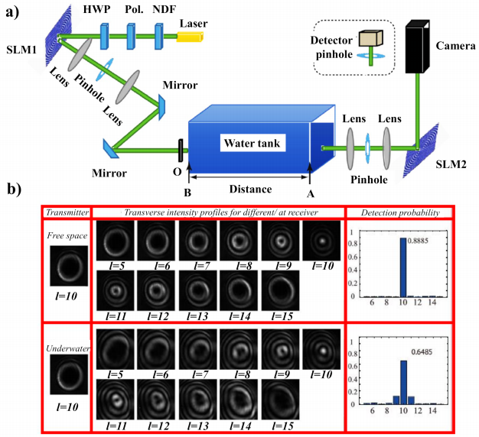
Bessel beam applications
Optical coherent tomography
Long distance self healing
    (K.-S. Lee et al. Opt. Lett., 2008)
    (S. Zhao et al., Sci. Rep., 2019)
Notes:
14

Slide 15
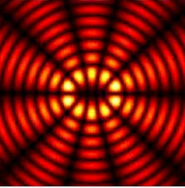
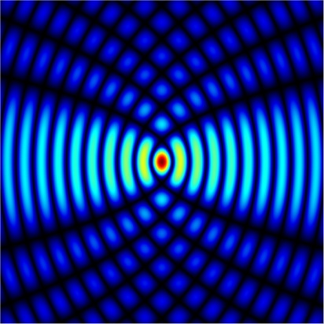
Other localized optical beams
Mathieu beam
Parabolic beam
Localized (non-diffractive) beam propagation
Self-Self healing
Notes:
15

Slide 16
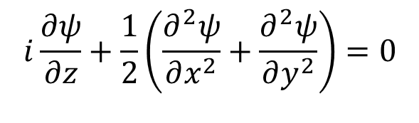
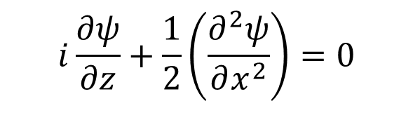
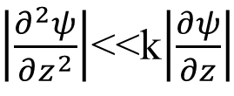
Paraxial wave equation
Beam propagation
  Maxwell’s wave equation (Helmholtz equation)
$$∇^{2}E−\frac{1}{c^{2}}\frac{∂^{2}E}{∂t^{2}}=0 ∇^{2}E+k^{2}E=0$$
Paraxial approximation
if
$\left|\frac{∂^{2}ψ}{∂z^{2}}\right|$<<k$\left|\frac{∂ψ}{∂z}\right|$
$$E\left(x,y,z\right)=ψ(x,y)e^{ikz}$$
  and normalized
$$i\frac{∂ψ}{∂z}+\frac{1}{2}\left(\frac{∂^{2}ψ}{∂x^{2}}+\frac{∂^{2}ψ}{∂y^{2}}\right)=0$$
  Paraxial equation
$$i\frac{∂ψ}{∂z}+\frac{1}{2}\left(\frac{∂^{2}ψ}{∂x^{2}}\right)=0$$
  1D Paraxial equation
Notes:
16

Slide 17
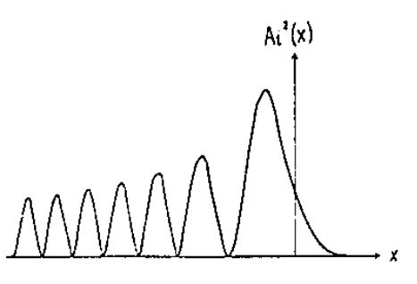



Airy wave packet in quantum mechanics
    1D potential free Schrodinger equation
    (M. V. Berry et al., Am. J. Phys, 1979)
$$−\frac{1}{2}\frac{∂^{2}ψ}{∂x^{2}}=i\frac{∂ψ}{∂z}$$
Airy wave packet
    1D eigenfunction
    1D Paraxial equation
Notes:
17

Slide 18
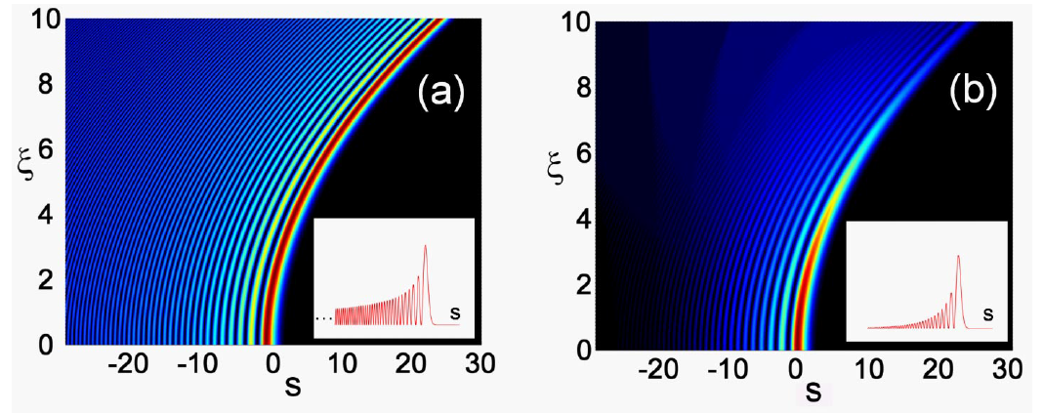
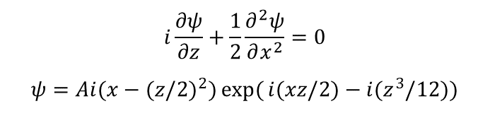
Non-diffractive accelerating Airy wave
    (G. Siviloglou et al., Phys. Rev. Lett., 2007)
Airy beam
  Airy wave is a solution of a 1D paraxial wave equation
  Generated by phase masks (i.e. SLM) or simple lens systems
  non-diffractive propagation
$$i\frac{∂ψ}{∂z}+\frac{1}{2}\frac{∂^{2}ψ}{∂x^{2}}=0$$
$$ψ=Ai(x−(z/2)^{2})\exp{(}i(xz/2)−i(z^{3}/12))$$
Notes:
18

Slide 19
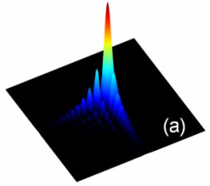
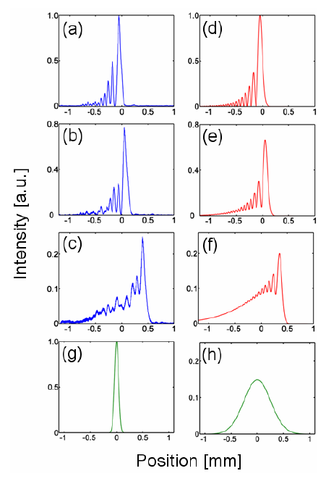
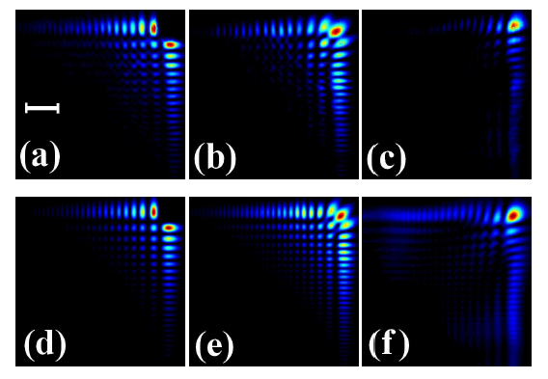
Airy beam self acceleration and healing
Non-diffractive propagation
Self acceleration
Self-healing
    (G. Siviloglou et al., Phys. Rev. Lett., 2007)
    (J.Broky et al., Opt. Express, 2008)
Notes:
19

Slide 20
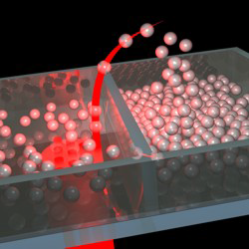
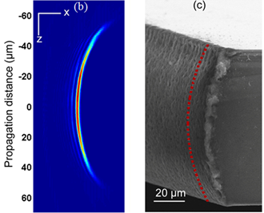
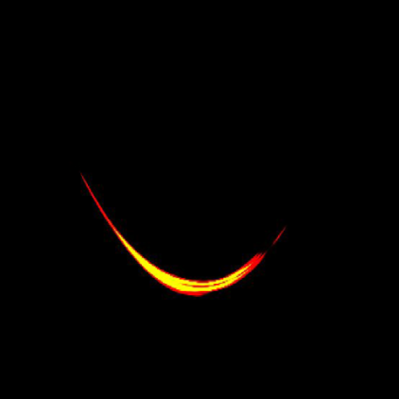
Airy beam applications
Optical tweezer
Curved plasma channel generation
  (J. Baumgartl et al., Nat. Photonics, 2008)
Micromachining
    (F. Courvoisier et al., Optics & Laser Tech., 2016)
  (P. Polynkin et al., Science, 2009)
Notes:
20

Slide 21
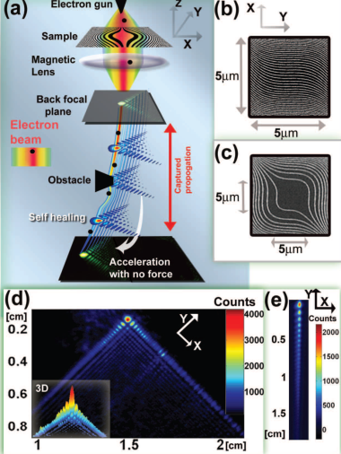
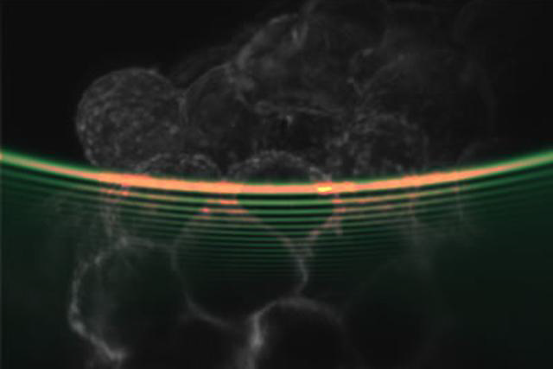
Airy beam applications
Light sheet microscopy
  (T Vettenburg et al., Nat. Method., 2014)
Airy electron beam
    (N. Voloch-Bloch et al., Nature, 2016)
Notes:
21

Slide 22
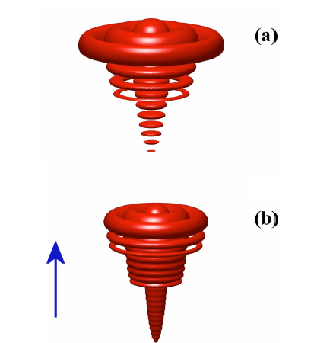
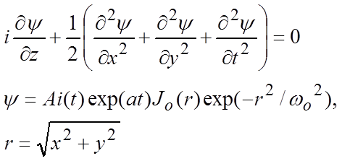
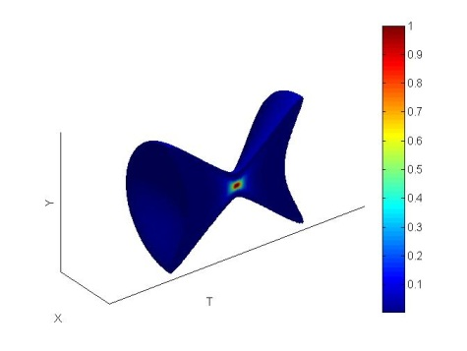
Airy waves in 3D optical wave packet
Airy-Bessel wave packet
  Airy pulse + Bessel beam is a solution of a 3D paraxial wave equation
  Versatile linear light bullet
    suggested in
    (G. Siviloglou et al., Opt. Lett., 2007)
    X-wave
Notes:
22

Slide 23
Pulse shaping
Pulse shaper with a SLM
  Phase / amplitude modulation for each frequency
    (A. M. Weiner., Rev. Sci. Instr., 2000)
Notes:
23

Slide 24
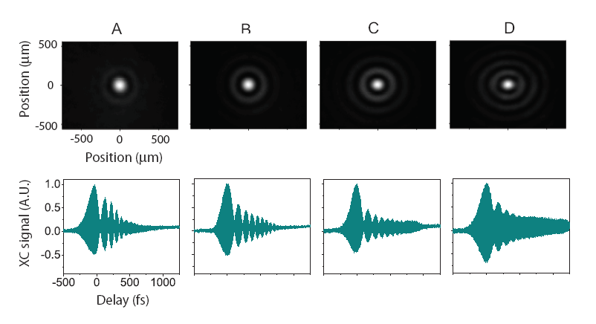
Airy-Bessel wave packet
Airy-Bessel wave packet
Ld 0 1.8 3.6 5.4
LR 0 3.3 5.4 7.5
Airy-Bessel wave packet: Non-varying propagation (linear light bullet)
    (A. Chong, W. H. Renninger,
    D. N. Christodoulides, F. W. Wise, Nat. Photonics, 2010)
Notes:
24

Slide 25
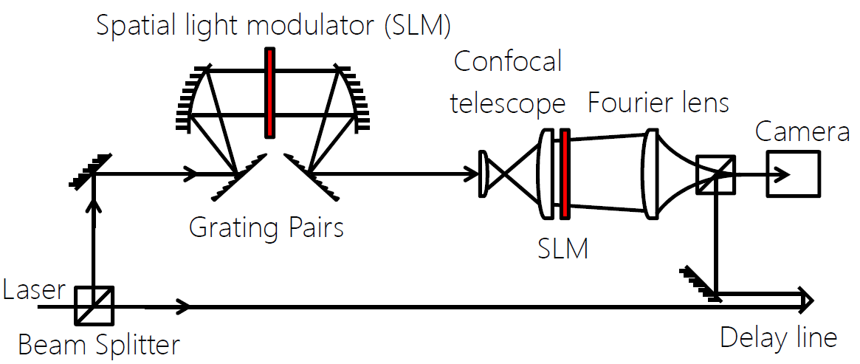


Airy waves in 3D optical wave packet
3D wave packet generation and measurement
Diagnostic method in
(Y. Li, S. et al., Phys. Rev. ST Accel. Beams , 2009)
Notes:
25

Slide 26


Vortex beam
Vortex beam
  Referred as twisted light
  Vortex beam contains phase singularities in the spatial domain
  Carries longitudinal orbital angular momentum (OAM)
  Generated by phase masks (fork grating, spiral phase plate, etc)
Poynting
vector (S)
k vector
OAM (l)
Laguerre Gaussian (LG) beam
$ℓ$-topological charge (integer)
Notes:
26

Slide 27

Spatiotemporal vortex
Spatiotemporal vortex (ST) vortex
  Vortex beam contains phase singularities in the ST domain
  Carries purely transverse OAM
Spatial vortex
Spatiotemporal vortex
    (A. Chong, C. Wan, J. Chen, Q. Zhan, Nat. Photonics, 2020)
Notes:
27

Slide 28





Spatiotemporal vortex
Spatiotemporal vortex (ST) vortex
  Applying a spiral phase in the spatial frequency – frequency domain
$$r=\sqrt{{k_{x}}^{2}+ω^{2}}$$
$$θ=\tan^{−1}\left(\frac{ω}{k_{x}}\right)$$
$$ρ=\sqrt{x^{2}{+t}^{2}}$$
$$φ=\tan^{−1}\left(\frac{x}{t}\right)$$
$G\left(ρ, φ\right)=F.T.\left\{g_{R}\left(r\right)e^{ilθ}\right\}={2π (−i)}^{l}e^{ilφ}H_{l}\left\{g_{R}(r)\right\}$.
    (A. Chong, C. Wan, J. Chen, Q. Zhan, Nat. Photonics, 2020)
Notes:
28

Slide 29

Spatiotemporal vortex
Spatiotemporal vortex (ST) vortex generation
  Applying a spiral phase in the spatial frequency – frequency domain
    (A. Chong, C. Wan, J. Chen, Q. Zhan, Nat. Photonics, 2020)
Notes:
29

Slide 30

Spatiotemporal vortex
ST vortex 3D iso-intensity profiles
    (A. Chong, C. Wan, J. Chen, Q. Zhan, Nat. Photonics, 2020)
Notes:
30

Slide 31



Toroidal vortex
Toroidal (ring) vortex in nature
Toroidal vortices in nature
Notes:
31

Slide 32


Optical toroidal vortex
Toroidal vortex generation
Notes:
32

Slide 33



Optical toroidal vortex
Toroidal vortex generation
    (C. Wan, Q. Cao, J. Chen, A. Chong, Q. Zhan, Nat. Photon. 2022)
Notes:
33

Slide 34



More spatiotermpoal wavepackets
    (X. Lin, Q. Cao, N. Zhang, A. Chong, Y. Cai, Q. Zhan, Nat. Commun. 2024)
Notes:
34

Slide 35



More spatiotermpoal wavepackets
    (Q. Cao, N. Zhang, A. Chong, Q. Zhan, Nat. Commun. 2024)
Notes:
35

Slide 36




Recent achievement in 3D wave packets
We like to add time as a DoF to optical wave packets (3D wave packet)
Hydrogen orbital like linear light bullets (spherical harmonic symmetric)
Suggested in
(M. Mills et al., Phys. Rev. A, 2012)
Notes:
36

Slide 37

Spatiotemporal Structuring of Light
Airy single-photon wave packet
(Jianmin Wang et al.,ArXiv, 2022)
Notes:
37

Slide 38
Spatiotemporal Structuring of Light
Program Overview
Optical fields are described in terms of their spatial, temporal, and polarization degrees of freedom (DoFs), which are usually modulated independently of each other. This is the foundation of the separate fields of optical beams, ultrafast pulses, and vector fields.
The past five years have witnessed a paradigm shift, whereby the insights developed in these fields are merging to lay the foundation for spatiotemporally structured light, in which the spatial, temporal, and polarization DoFs are modulated jointly. New optical field structures have rapidly emerged, unexpected propagation behaviors have been observed, and novel interactions of such optical fields with photonic devices have been investigated. A plethora of applications are anticipated as these concepts are further explored and their foundations established.
Notes:
38

Slide 39
Spatiotemporal Structuring of Light
Scope and Goals
Spatiotemporal synthesis and characterization techniques,
Interaction of spatiotemporally structured light with optical devices and systems, including optical fibers and waveguides,
Bridging the gap between ultrafast optics and resonant photonics,
Impact of spatiotemporally structured light on nonlinear and quantum optics, including filamentation, harmonic generation, pulsed fiber-laser mode-locking, and supercontinuum generation,
Spatiotemporally structured light in plasma physics and future laser accelerators,
Spatiotemporally structured light in turbulence, scattering, and turbid media and applications in free-space optical communication,
Space-time optical fields and relativity.
Notes:
39

Slide 40




Classical Entanglement
Bell states with classical light
$$\frac{1}{\sqrt{2}}\left(\left.\left|{HG}_{1},\right.H\right\rangle +\left.\left|{HG}_{2},\right.V\right\rangle \right)$$
$$\frac{1}{\sqrt{2}}\left(\left.\left|l,\right.RCP\right\rangle +\left.\left|−l,\right.LCP\right\rangle \right)$$
Notes:
40

Slide 41


Classical Entanglement
Notes:
41

Slide 42


Classical Entanglement
Notes:
42

Slide 43


Classical Entanglement
Notes:
43

Slide 44


Quantum structured light
Notes:
44

Slide 45


Quantum structured light
Notes:
45

Slide 46


Quantum structured light
Notes:
46

Slide 47


Quantum structured light
Notes:
47

Slide 48


Quantum structured light
Notes:
48

Slide 49


Quantum spatiotermpoal structured light
Notes:
49

Slide 50

Quantum spatiotermpoal structured light
Notes:
50

Slide 51
Conclusions and Future direction
Structured light with unique properties has been used in quantum optics
Spatiotemporal wavepackets can provide extra DoF (spatial and temporal) and unique properties for quantum optics
Future Goal: Generate a variety of quantum spatiotemporally structured light and study their properties for further applications
Notes:
51

