Slide 1

Quantum Computing Enhanced Sensing
Soonwon Choi
Collaborators:
Richard Allen (MIT)
Francisco Machado (Harvard-ITAMP)
Isaac Chuang (MIT)
Hsin-Yuan (Robert) Huang (Google, MIT, Caltech)
QIS Workshop @ UMass Boston
Jan 14, 2025
Notes:
Hsin-Yuan Huang

Slide 2
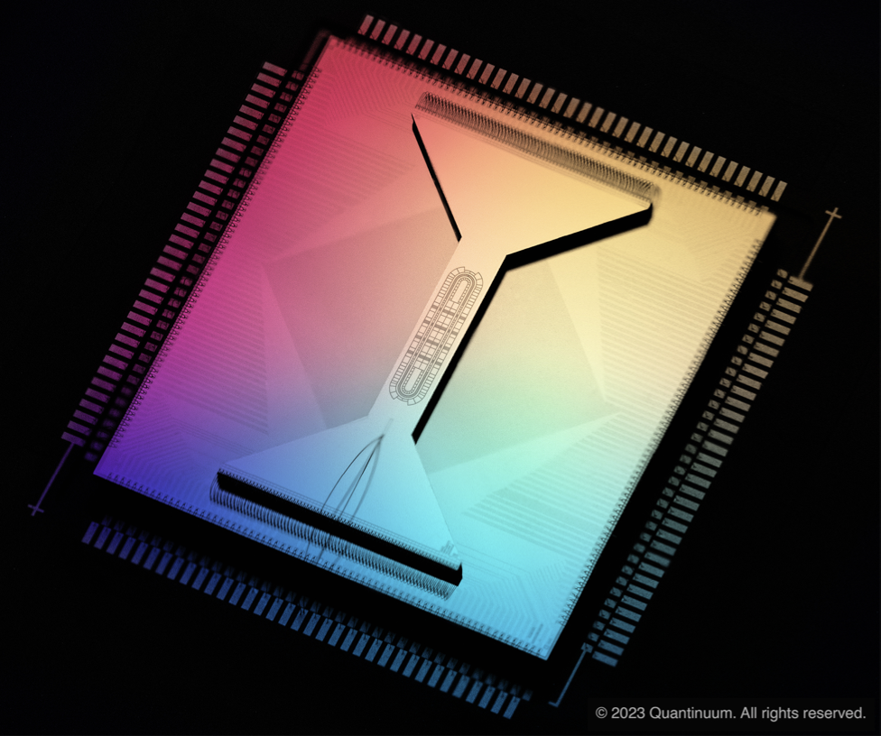
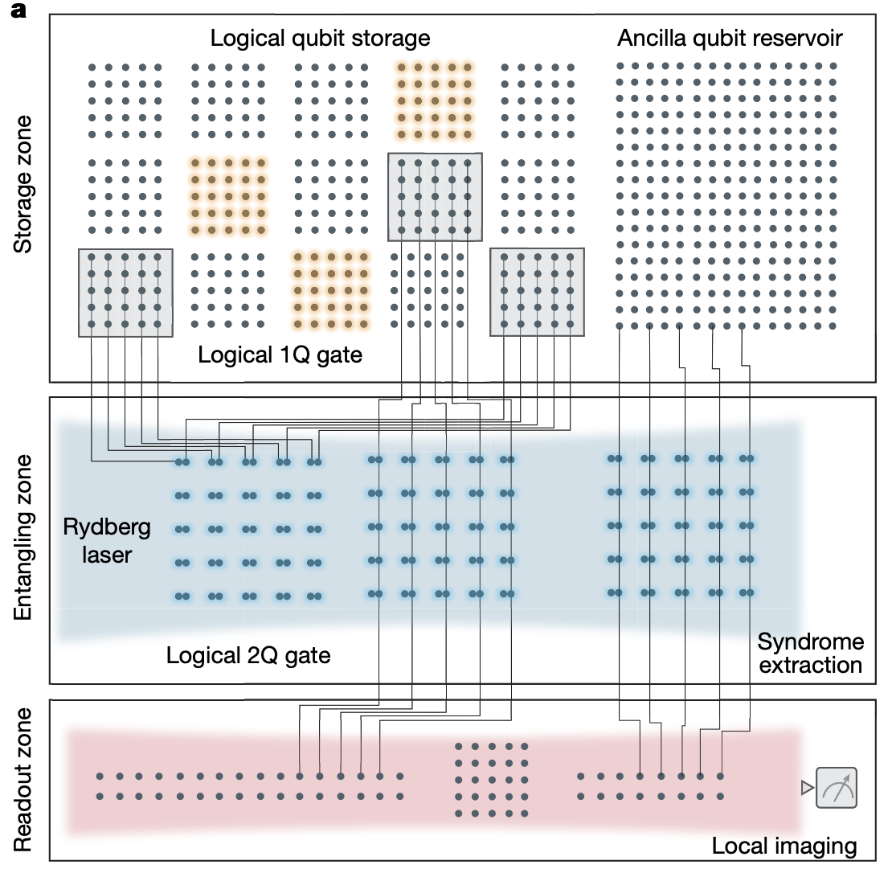
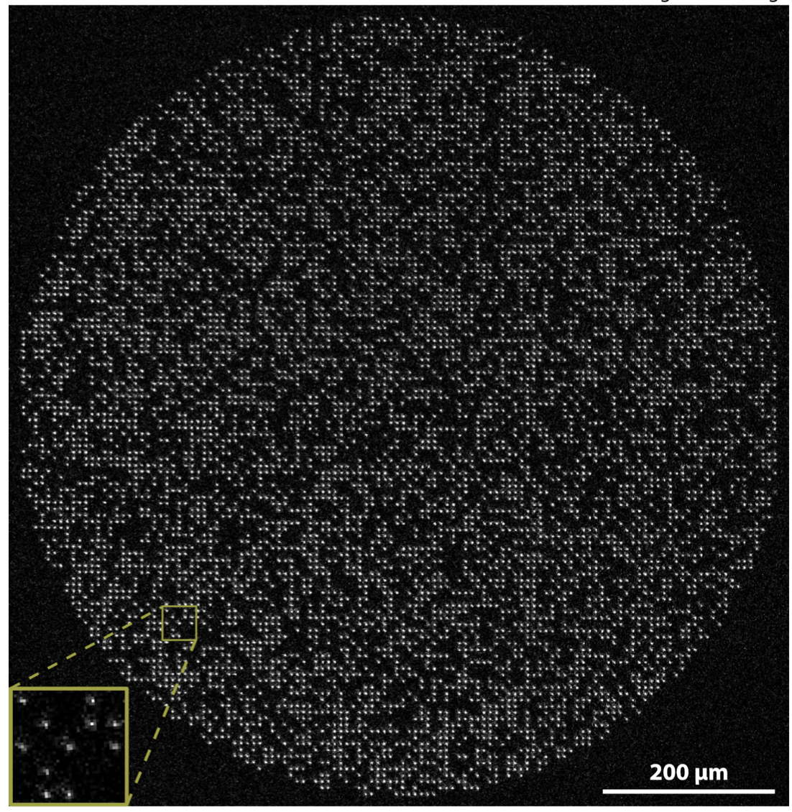
Exciting Time for Quantum Information Science
High fidelity operations
Logical quantum circuits
Large qubit arrays
6100 atoms
Quantinuum
Lukin group
Endres group
Quality
Control
Size

Slide 3
What should we do with quantum devices?
Notes:
Of course, the answer is that we should build practically useful applications

Slide 4
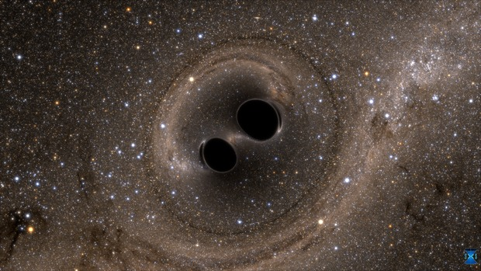
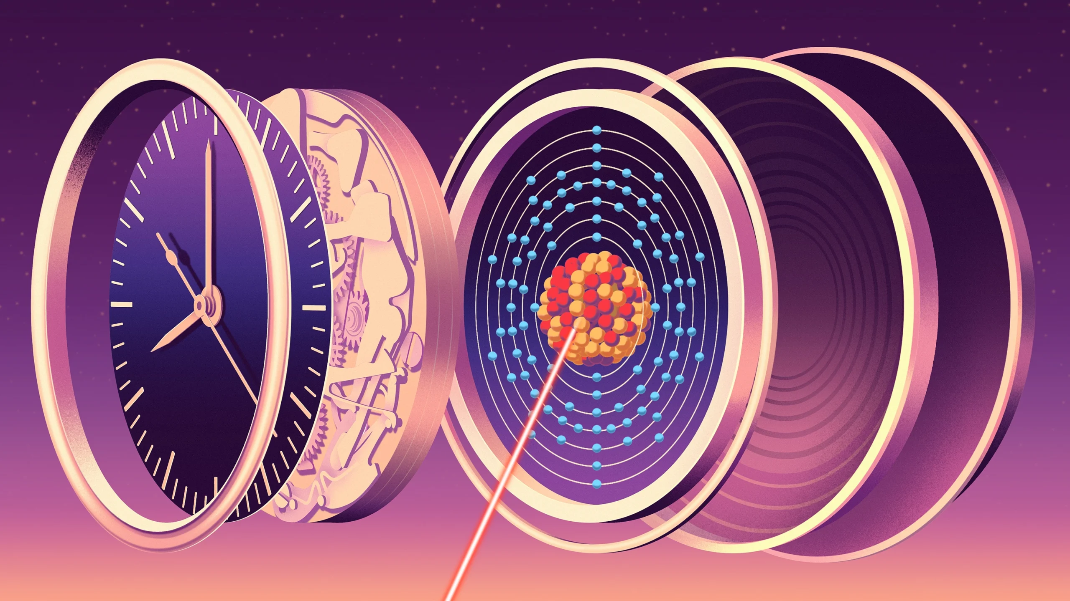
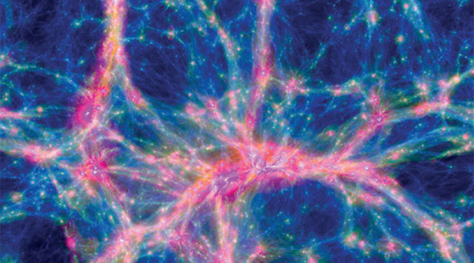
Quantum Sensing & Metrology
Driving force for new sciences and technologies
Gravitational Wave (2016)
Atomic Clock (2024)
Dark Matter Search (?)
Images taken from LIGO, Quanta Magazine, and cerncourier.com.
Notes:
The same principle – interference.

Slide 5
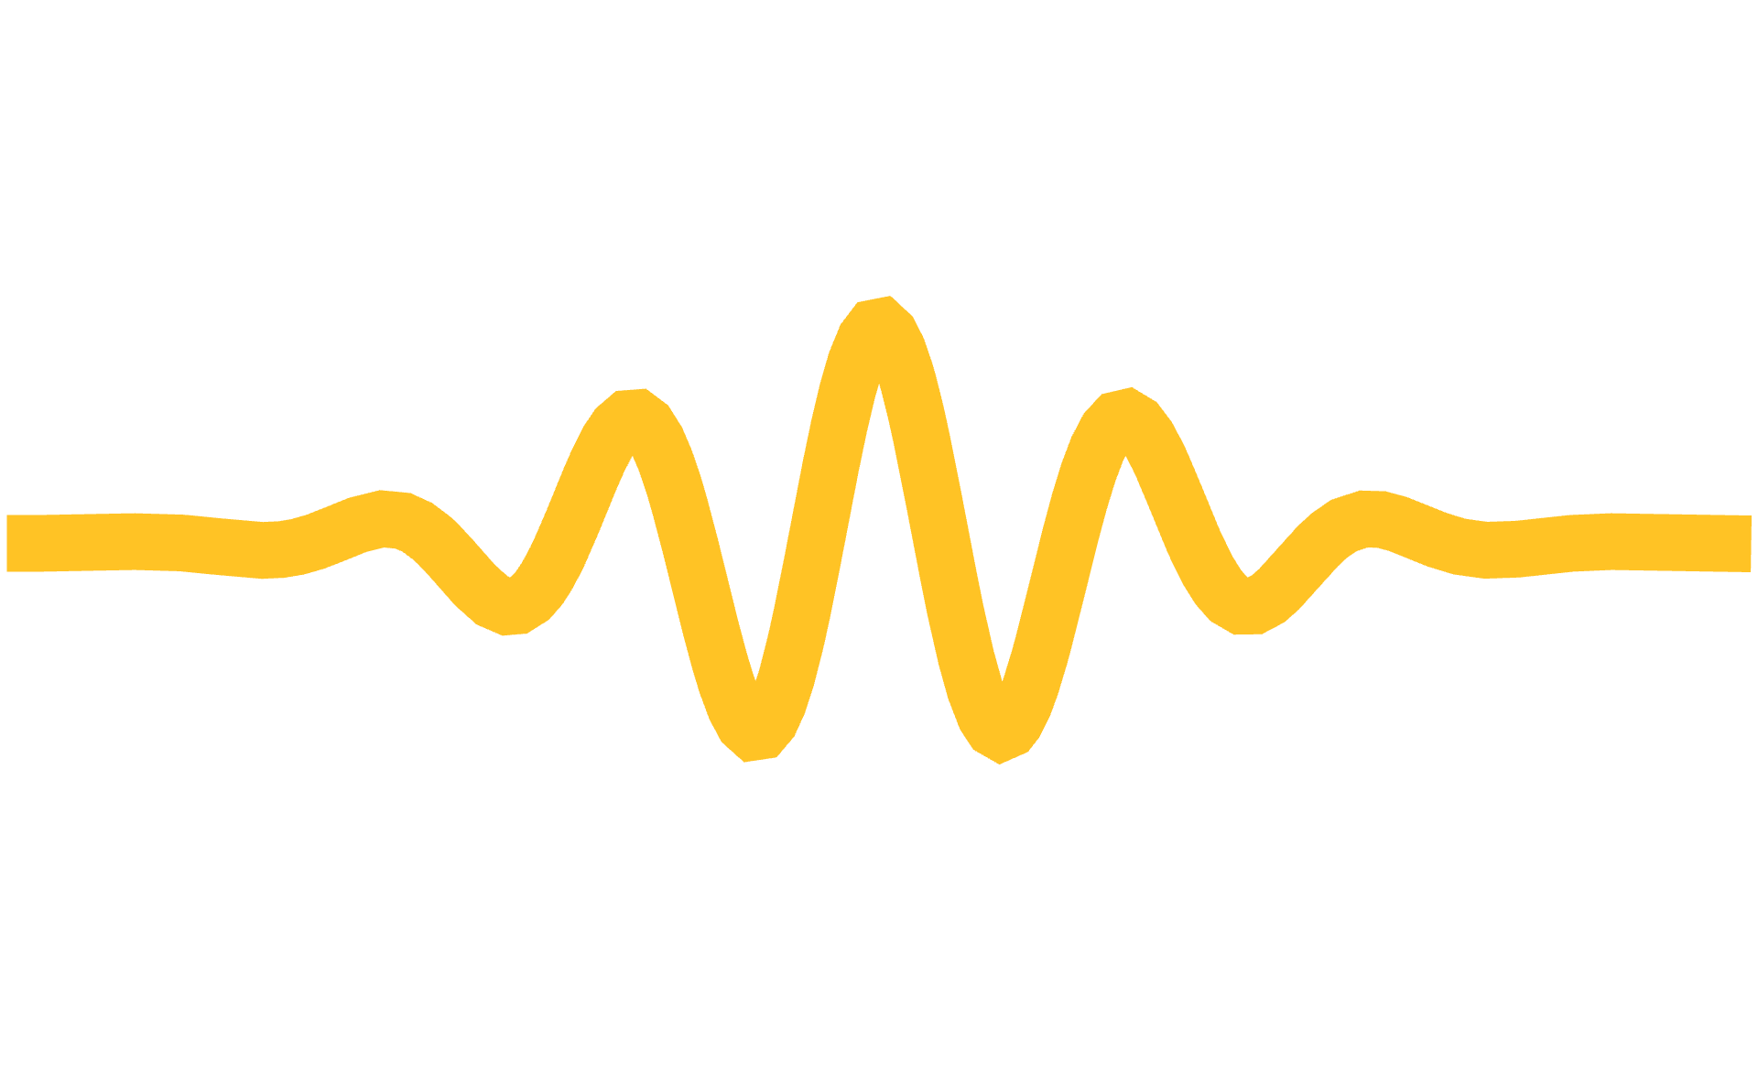
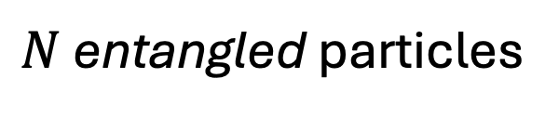
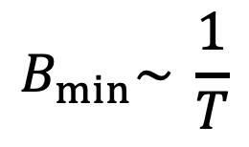

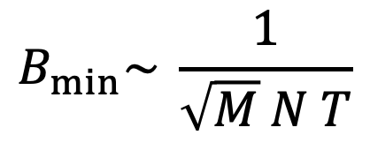
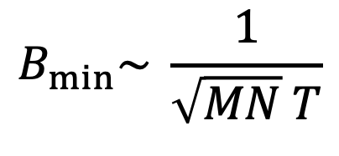
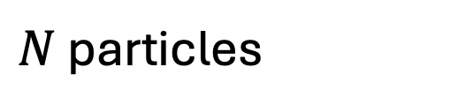

Sensitivity Limits in Quantum Sensing
One particle
$N$ particles
$N$ entangled particles
Repeat$M$ times
Repeat$M$ times
$$B_{min}\sim \frac{1}{T}$$
$$B_{min}\sim \frac{1}{\sqrt{MN} T}$$
$$B_{min}\sim \frac{1}{\sqrt{M} N T}$$
Standard Quantum Limit
(SQL)
Heisenberg Limit
(HL)

Slide 6


Metrological enhancements that are qualitatively different from these examples?
Conventional
New technology
Entangled sensors
Classical control
Entangled sensors
Quantum computer
Can we leverage quantum computational advantage for sensing?

Slide 7
Today’s talk
Task: Broadband AC Sensing
Optimal algorithm: Quantum Search Sensing
Computationally Enhanced Metrology
Near-term Experimental Realization
Summary, Discussion, Outlook

Slide 8
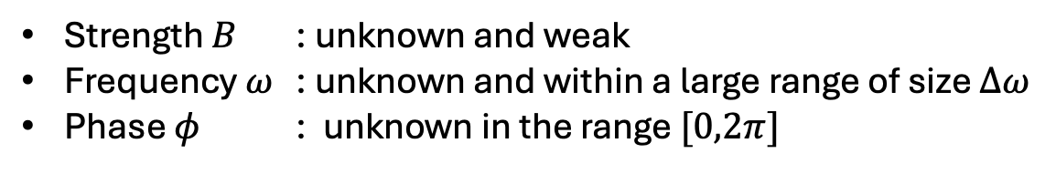
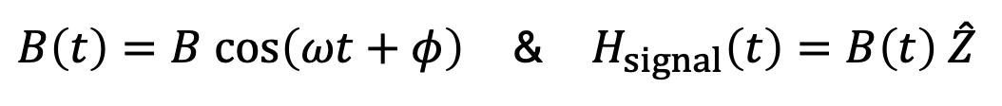
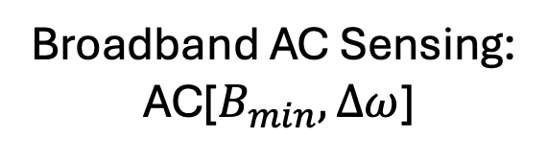

Task
Determine if a weak oscillating field exists, as quickly as possible
$B\left(t\right)=B cos\left(ωt+φ\right)$ & $H_{signal}\left(t\right)=B\left(t\right) \hat{Z}$
Strength $B$ : unknown and weak
Frequency $ω$ : unknown and within a large range of size $Δω$
Phase $φ$ : unknown in the range $[0,2π]$
Broadband AC Sensing:
AC[$B_{min},Δω$]
Sensitivity $B_{min}$
Bandwidth $Δω$

Slide 9
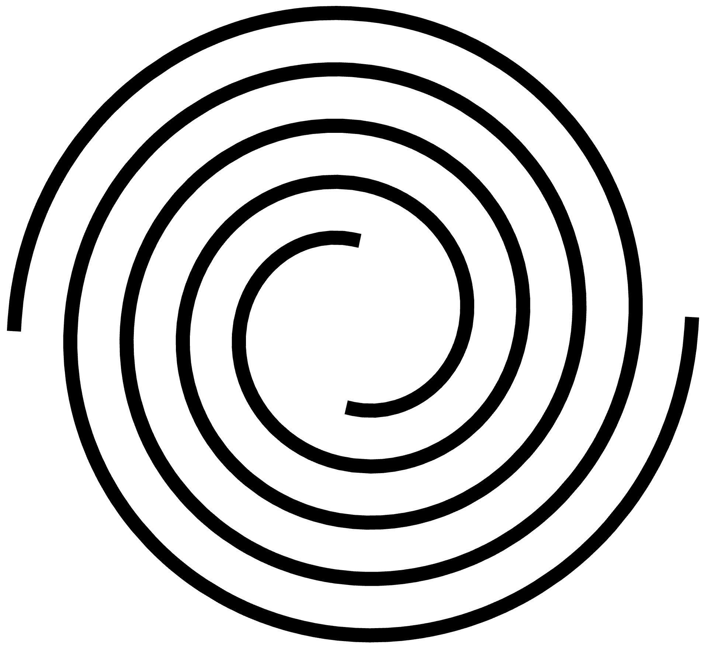



Broadband AC sensing
AC[$B_{min},Δω$] is practically useful.
…
Gravitational wave detection
Dark matter detection
NMR
Quantum clocks

Slide 10


Broadband AC sensing
AC[$B_{min},Δω$] is conceptually important.
Simplest time-dependent Hamiltonian learning
Formal hardness (complexity)?
Optimal algorithms?
How fast can we detect?
Total sensing time
$$τ=τ\left(B_{min},Δω\right)$$

Slide 11

Conventional approaches to solve AC[$B_{min}, Δω$]

Slide 12
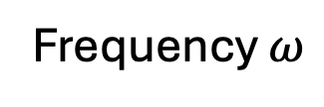
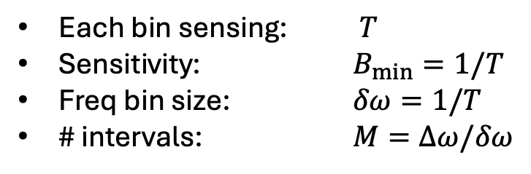
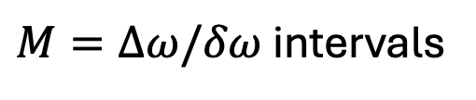

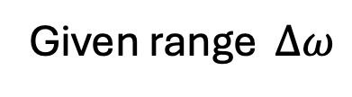
Conventional approach
$M=Δω/δω$ intervals
$$δω$$
Frequency $ω$
Given range $Δω$
Each bin sensing: $T$
Sensitivity: $B_{min}=1/T$
Freq bin size: $δω=1/T$
# intervals: $M=Δω/δω$
Sequentially perform
Optimal HL sensing strategies

Slide 13

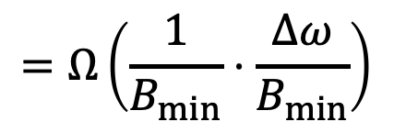
Conventional approach
For any conventional (sequential) approaches, the minimum time needed scales as
$$=Ω\left(\frac{1}{B_{min}}⋅\frac{Δω}{B_{min}}\right)$$
$$τ_{conv}=τ\left(B_{min},Δω\right)$$

Slide 14
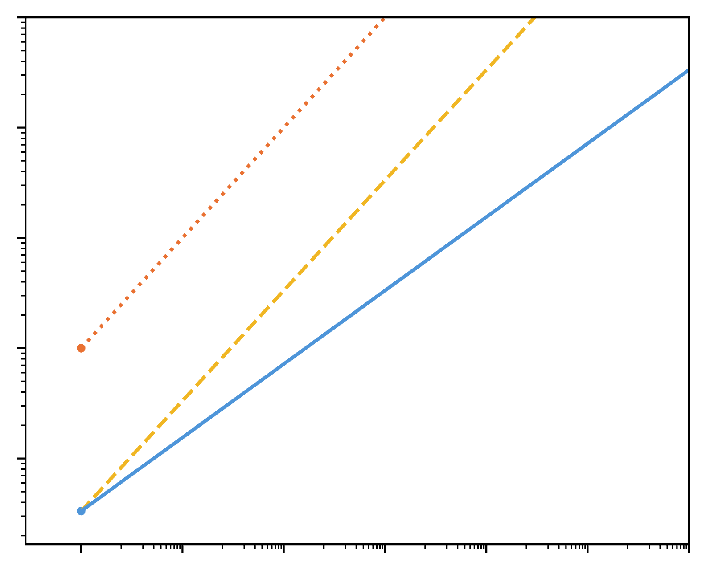

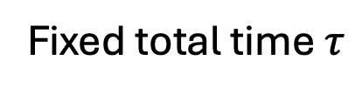
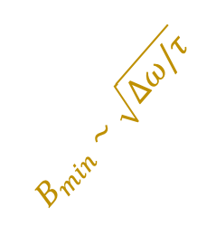
Conventional approach
Fixed total time $τ$
Slow-insensitive
$$B_{min}∼\sqrt{Δω/τ}$$
SQL
HL
Sensitivity (Log)
$$\sqrt{N}$$
Fast-Sensitivity
Bandwidth (Log)

Slide 15
Quantum Computing Enhanced Sensing

Slide 16
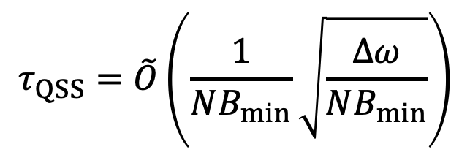
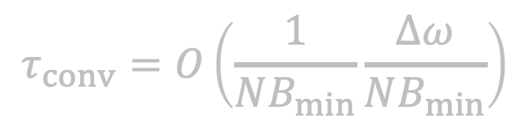
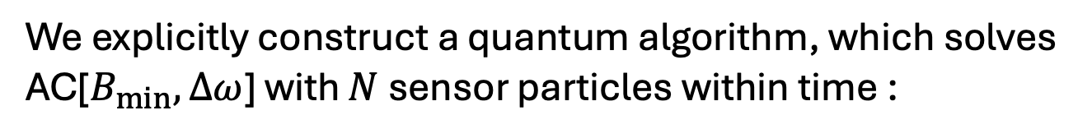
Result 1: Quantum Search Sensing
We explicitly construct a quantum algorithm, which solves AC[$B_{min},Δω$] with $N$ sensor particles within time :
$$τ_{QSS}=\tilde{O}\left(\frac{1}{NB_{min}}\sqrt{\frac{Δω}{NB_{min}}}\right)$$
$$τ_{conv}=O\left(\frac{1}{NB_{min}}\frac{Δω}{NB_{min}}\right)$$
Note:

Slide 17
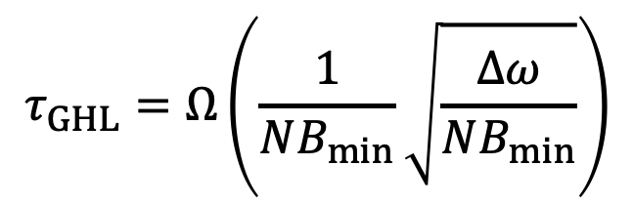
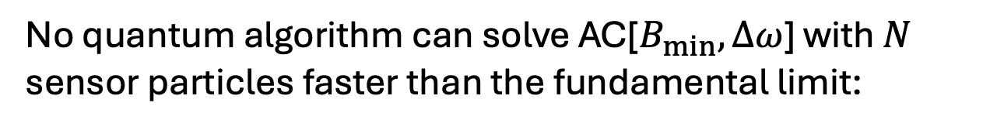
Result 2: Optimality
No quantum algorithm can solve AC[$B_{min},Δω$] with $N$ sensor particles faster than the fundamental limit:
$$τ_{GHL}=Ω\left(\frac{1}{NB_{min}}\sqrt{\frac{Δω}{NB_{min}}}\right)$$
Grover-Heisenberg Limit

Slide 18
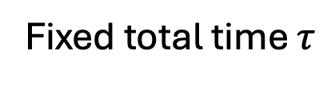
Quantum Search Sensing
Fixed total time $τ$
Our algorithm
Grover-HL
SQL
HL
Sensitivity (Log)
Impossible
Bandwidth (Log)

Slide 19
How do we construct the algorithm?

Slide 20
Computational approach
Computational problem
AC sensing
Design quantum algorithm

Slide 21


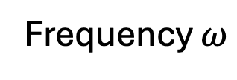
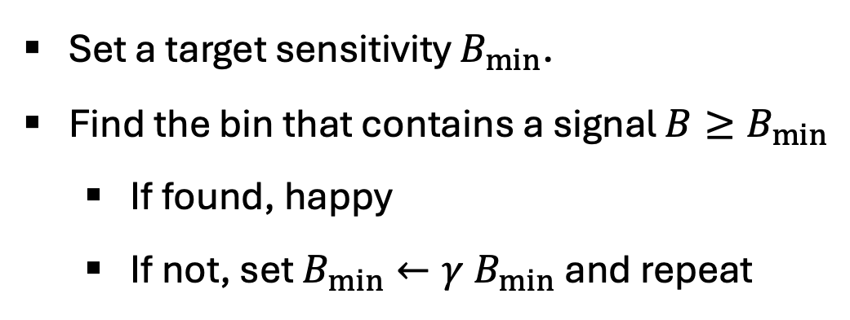
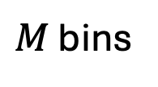

Broadband AC sensing as Search Problem
$M$ bins
$k$-th bin
$$δω$$
Frequency $ω$
$$Δω$$
Set a target sensitivity $B_{min}$.
Find the bin that contains a signal $B≥B_{min}$
  If found, happy
  If not, set $B_{min}←γ B_{min}$ and repeat
Quantum Search

Slide 22







Grover’s Search algorithm
$N≫1$ books in a library
Find one specially marked book
On average $N/2$ attempts
Only $\sqrt{N}$ attempts
Provable quantum advantage with quadratic speed-up.

Slide 23
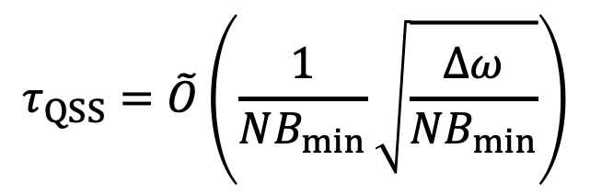
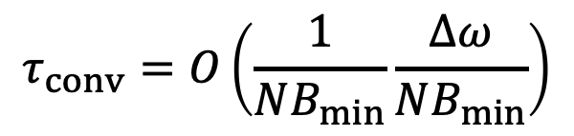
Quantum Search Sensing
$$τ_{QSS}=\tilde{O}\left(\frac{1}{NB_{min}}\sqrt{\frac{Δω}{NB_{min}}}\right)$$
$$τ_{conv}=O\left(\frac{1}{NB_{min}}\frac{Δω}{NB_{min}}\right)$$
Grover speed-up!
(we will come back to this point later)

Slide 24
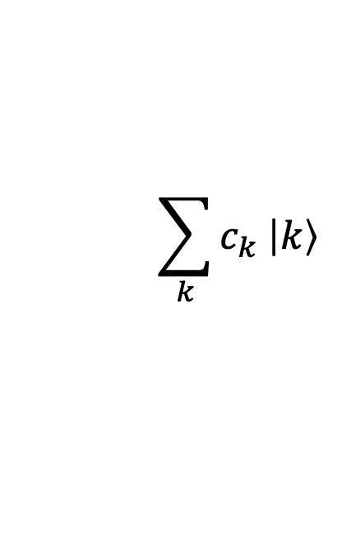
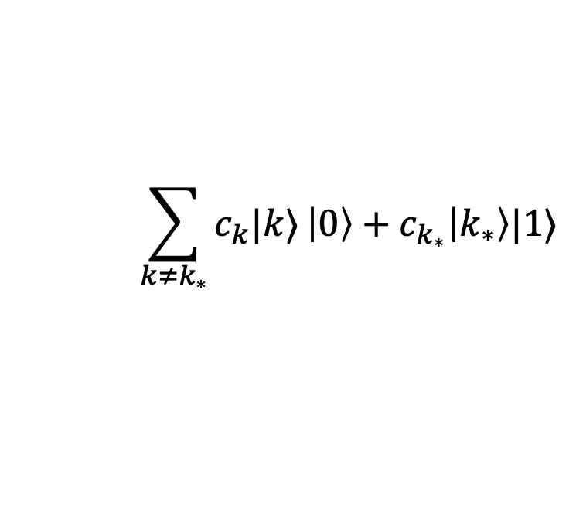

Grover Algorithm requires an Oracle
$$\sum_{k}{c_{k} \left|k\right\rangle }$$
$$\sum_{k≠k_{∗}}{c_{k}|k⟩}\left|0\right\rangle +c_{k_{∗}}\left|k_{∗}\right\rangle |1⟩$$
$$\left|0\right\rangle$$
Quickly verify the marked element while maintaining coherent superposition
Notes:
Who gives us the oracle?

Slide 25

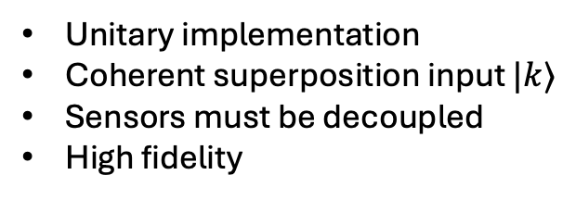








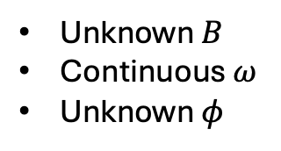


Building an Oracle from Quantum Sensing
$$|k⟩$$
$$|k⟩$$
$$\left|1\right\rangle$$
If signal exists in the $k$^{th} bin
$$\left|0\right\rangle$$
$$\left|ψ\right\rangle$$
$$\left|0\right\rangle$$
Otherwise
$$\left|GHZ\right\rangle$$
$$\left|GHZ\right\rangle$$
Challenges
More Challenges
Unitary implementation
Coherent superposition input $|k⟩$
Sensors must be decoupled
High fidelity
$$B\left(t\right)=B cos\left(ωt+φ\right)$$
$$H_{signal}\left(t\right)=B\left(t\right) \hat{Z}$$
Unknown $B$
Continuous $ω$
Unknown $φ$
Analog coupling to signal
Discrete Oracle output
Notes:
Who gives us the oracle?

Slide 26
Building an Oracle from Quantum Sensing
$$|k⟩$$
$$|k⟩$$
$$\left|1\right\rangle$$
If signal exists in the $k$^{th} bin
“Digitization”
Unitarily transform analog signals into
high-accuracy discrete operations
$$\left|0\right\rangle$$
$$\left|ψ\right\rangle$$
$$\left|0\right\rangle$$
Otherwise
$$\left|GHZ\right\rangle$$
$$\left|GHZ\right\rangle$$
Challenges
More Challenges
Unitary implementation
Coherent superposition input $|k⟩$
Sensors must be decoupled
High fidelity
$$B\left(t\right)=B cos\left(ωt+φ\right)$$
$$H_{signal}\left(t\right)=B\left(t\right) \hat{Z}$$
Unknown $B$
Continuous $ω$
Unknown $φ$
Analog coupling to signal
Discrete Oracle output
Notes:
Who gives us the oracle?

Slide 27
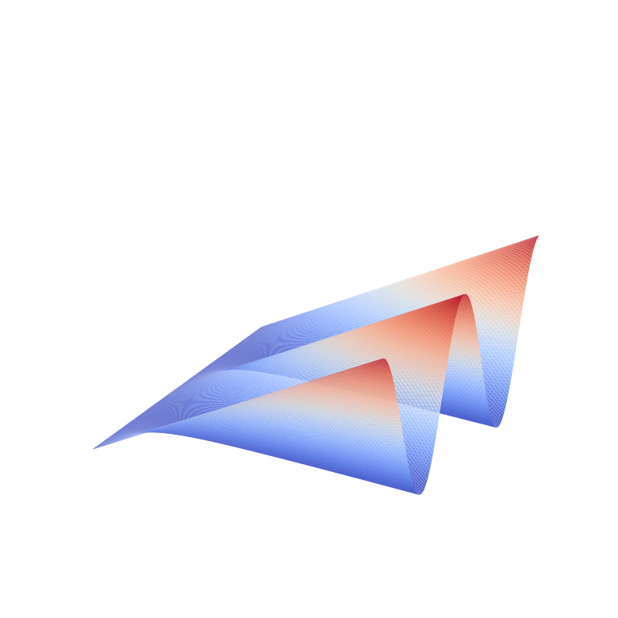
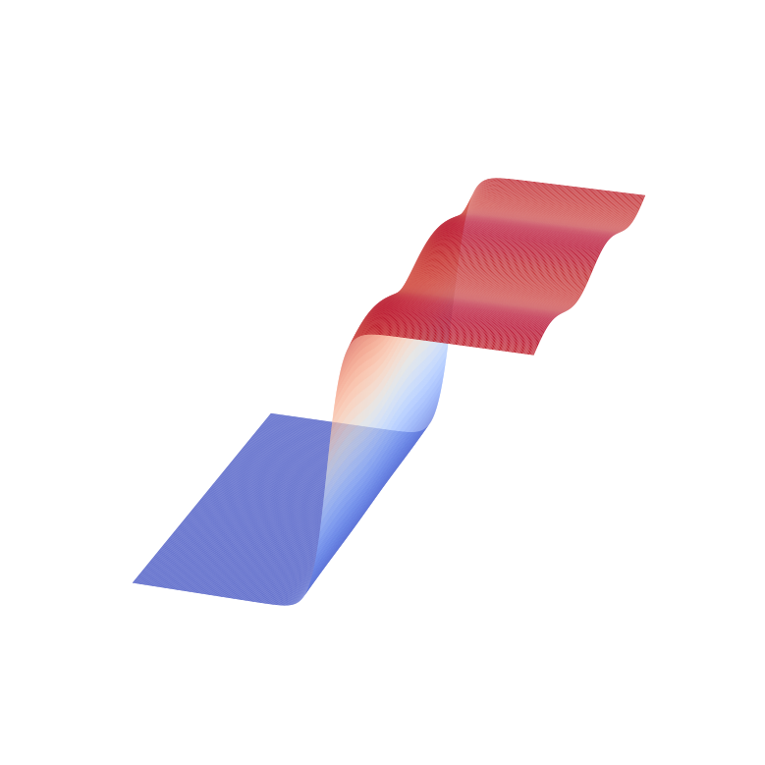
Parallel Digitized AC Sensing
Analog response
Digitized response
Undigitized Phase
Digitized Phase

Slide 28
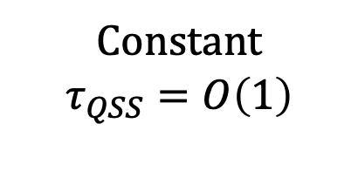
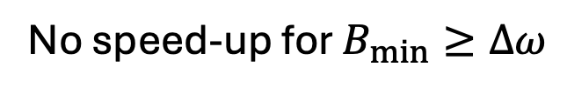

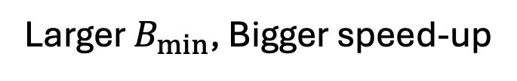
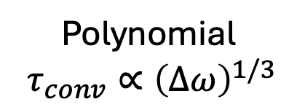
Grover advantage = quadratic speed up (?)
Computational Time
Physical (sensing) time
No speed-up for $B_{min}≥Δω$
Larger $B_{min}$, Bigger speed-up
Grover-HL
Structured signal
SQL
HL
Sensitivity (Log)
Impossible
Constant
$τ_{QSS}=O\left(1\right)$
Polynomial
$τ_{conv}∝{\left(Δω\right)}^{1/3}$
vs
Bandwidth (Log)
Coupling strength $g\left(ω\right)∝ω^{μ}$ & $\frac{1}{3}<μ<\frac{1}{2}$

Slide 29
Near-term Experimental Implementation

Slide 30

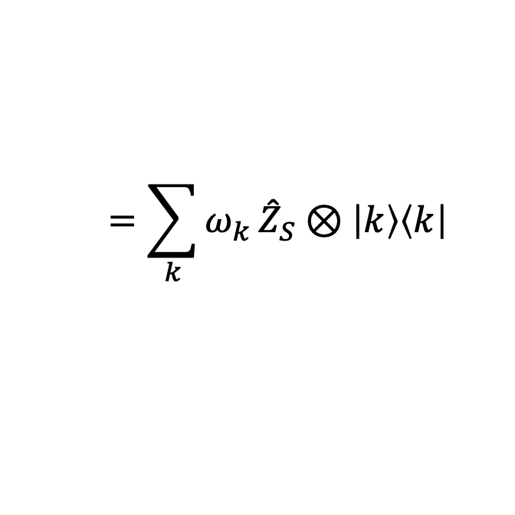

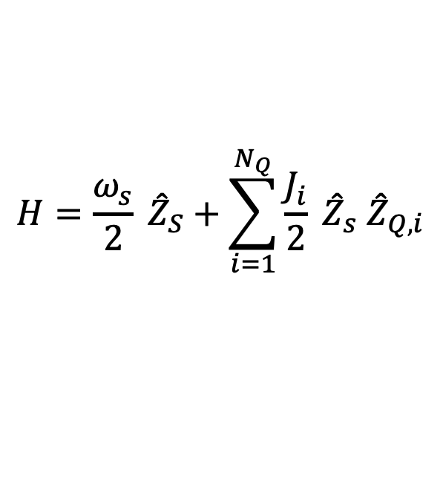





Near-term Experimental Implementation
$$H=\frac{ω_{s}}{2} {\hat{Z}}_{S}+\sum_{i=1}^{N_{Q}}{\frac{J_{i}}{2}} {\hat{Z}}_{s} {\hat{Z}}_{Q,i}$$
$$=\sum_{k}{ω_{k}}{\hat{Z}}_{S}⊗\left|k\right\rangle \left\langle k\right|$$
$${\left|1\right\rangle }_{S}$$
Superposition sensing
Grover reflection operation
Energy
$$ω≈ω_{1}$$
…
$${\left|0\right\rangle }_{S}$$
$${\left|000\right\rangle }_{Q}$$
$${\left|001\right\rangle }_{Q}$$
$${\left|010\right\rangle }_{Q}$$
…
$${\left|111\right\rangle }_{Q}$$

Slide 31
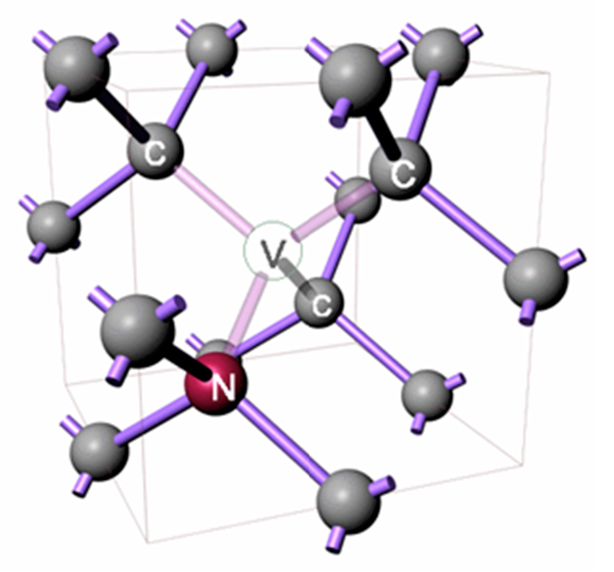
NV centers
Pulse-level implementation of a simplified model*
: NV center e-spin
Diamond
: ¹³C nuclear spin
Improvement
* If a signal exists, we assume $B=0$ is known and $ω∈\{ω_{k}\}$.

Slide 32






Discussion & Outlook
“Nature as Oracle”
“Robust Interface of Quantum Sensors and Computers”
“Hardware-efficient implementation for real-world applications”
Notes:
Who gives us the oracle?

Slide 33
Summary
Grover-HL
SQL
HL
Broadband AC sensing
  Algorithm: Quantum Search Sensing
  Optimality: Grover-Heisenberg Limit
Necessary ingredients for quantum computing enhanced sensing
  Non-perturbative
  Non-classical control
“Digitization”
“Nonlinear signal processing”
Notes:
Who gives us the oracle?

Slide 34
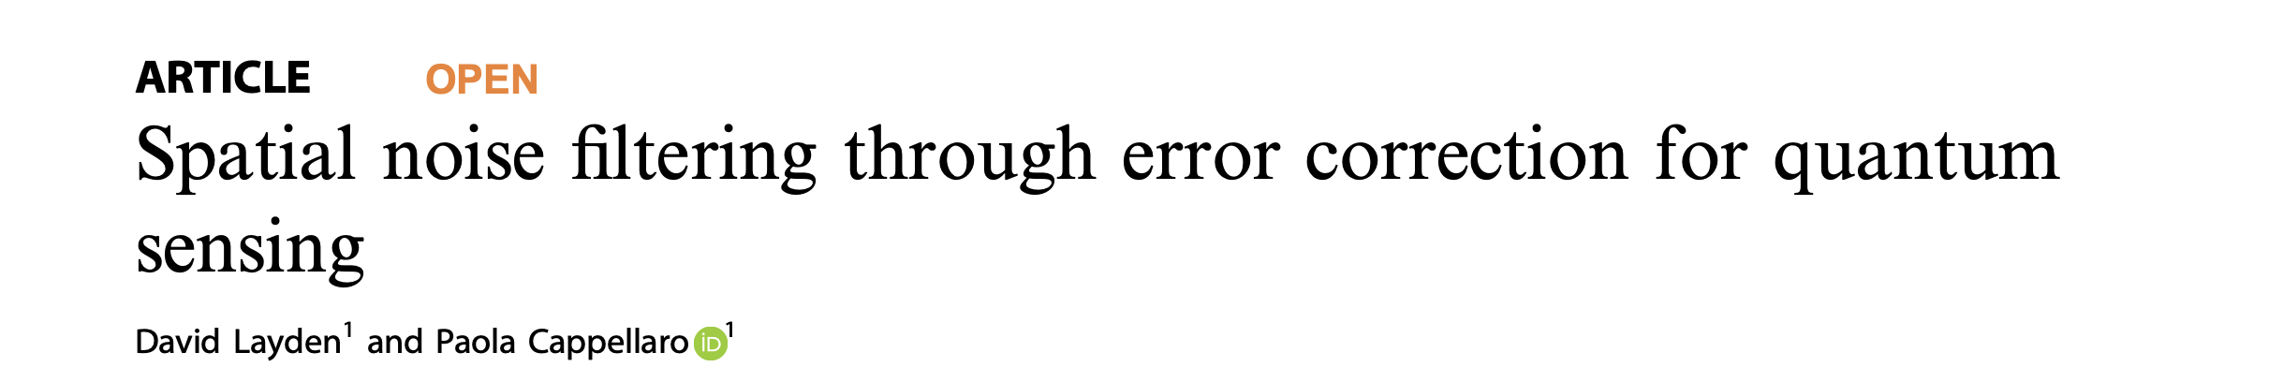
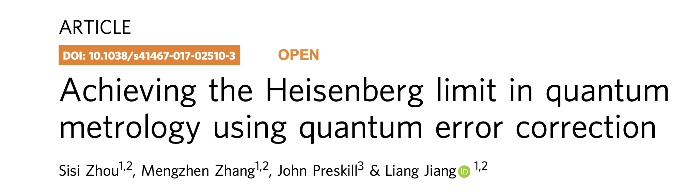



Efforts to achieve the Heisenberg Limit
Quantum Error Correction
Variational Optimization
Quantum Algorithm for Hamiltonian learning
many more…
Notes:
Quantum correlations

Slide 35


Efforts to achieve the Heisenberg Limit
Quantum Error Correction
Quantum Network
Variational Optimization
Quantum Algorithm for Hamiltonian learning
many more…
Notes:
Quantum correlations

Slide 36
Modern Sensors are Integrated with Computers

Slide 37





Broadband AC sensing as Decision Problem
AC[$B_{min},Δω$]:
For a weak oscillating field, $B\left(t\right)=B cos\left(ωt+φ\right)$ with unknown strength $B$, frequency $ω$, and phase $φ$ with promises $B>B_{min}$ & $ω∈\left[ω_{min},ω_{min}+Δω\right]$, distinguish between two cases:
$$H_{signal}\left(t\right)=B\left(t\right) \hat{Z}$$
vs
$$H_{signal}\left(t\right)=0$$
(yes, signal exists)
(no signal)
Sensitivity $B_{min}$
Bandwidth $Δω$
Q: How fast can we solve ?

Slide 38
Conventional approach
c
Grover-HL
SQL
HL
Sensitivity (Log)
Bandwidth (Log)

Slide 39



Task – Broadband AC sensing
Detect a weak oscillating signal field as quickly as possible
$$H_{signal}\left(t\right)=B\left(t\right) \hat{Z}$$
$$B\left(t\right)=B cos\left(ωt+φ\right)$$
Strength $B$ : unknown and small
Frequency $ω$ : unknown and within a large range $Δω$
Phase $φ$ : unknown and coherent

Slide 40

Broadband AC sensing
Definition: AC[$B_{min},Δω$]
For a weak oscillating field, $B\left(t\right)=B cos\left(ωt+φ\right)$ with unknown strength $B$, frequency $ω$, and phase $φ$ with promises $B>B_{min}$ & $ω∈\left[ω_{min},ω_{min}+Δω\right]$, distinguish between two cases:
$$H_{signal}\left(t\right)=B\left(t\right) \hat{Z}$$
vs
$$H_{signal}\left(t\right)=0$$
(yes, signal exists)
(no signal)
Practically useful
…
Gravitational wave detection
Dark matter detection
NMR
Quantum clocks

Slide 41
Broadband AC sensing
Definition: AC[$B_{min},Δω$]
For a weak oscillating field, $B\left(t\right)=B cos\left(ωt+φ\right)$ with unknown strength $B$, frequency $ω$, and phase $φ$ with promises $B>B_{min}$ & $ω∈\left[ω_{min},ω_{min}+Δω\right]$, distinguish between two cases:
$$H_{signal}\left(t\right)=B\left(t\right) \hat{Z}$$
vs
$$H_{signal}\left(t\right)=0$$
(yes, signal exists)
(no signal)
Conceptually important
Simplest time-dependent Hamiltonian learning problem
What is the formal hardness (complexity) of this task?
Optimal algorithms?

Slide 42
Intro (5 slides)
  Q Sensing (broad intro) – 1 slide
  Q Sensing basic (SQL) – 1 slide
  Entanglement enhanced sensing (HL) – 1 slide
  Various works (QEC, optimal control, VQE) to achieve HL– 1 slide
  Can we achieve drastically better improvements? – 1 slide
  QC + Sensing
Summary of results / outlines (1 slide)
Broadband AC detection (soft introduction) (3 slides)
  Practically important
  Theoretically interesting (ham learning)
Conventional approach (3 slides)
  CPMG (Classical computer controlling sensors)
  Scaling derivation
  Phase diagram
Our approach (3 slides)
  Result 1: we construct an algorithm Quantum Search Sensing with scaling..
  Result 2: Grover-Heisenberg Limit
  Phase diagram
15 slides

Slide 43
Quantum Search Sensing algorithm (5 slides)
  Sequential search -> Grover search (1 slide)
  Probability enhancement -> amplitude enhance ( 1 slide)
  A way to quantumly check, Yes/No Sensing oracle (1 slide)
  Challenge (Phase agnostic sensing, digitized output) -> Solution
  A slide on superadiabaticity (1 slide)
  A slide on QSP (1 slide)
Quantum Enhancement (metrological gain) - 6 slides
  Conventional -> entanglement (=correlations) (1 slide)
  Our approach -> computational advantage
    Digitization (nonlinear data processing) is needed: Absence of linear sensing (1 slide)
    Quantum control is needed: Classically controlled sensing (explain settings and no go theorem) (1 slide)
    Long coherent quantum memory is needed (1 slides)
  Larger separation (1 slide)
Experimental realization (NV centers) 2 slides
Summary & Discussion -1 slide
  Broadband AC detection
    Fundamental limit, optimal solution
  Nature as Oracle
  Digitization
  Quantum Computational Advantage -> Metrological gain
14 slides

Slide 44






Preliminary result: Quantum Search Sensing
Task:
Gravitational wave detections
Dark matter search
Spectroscopy…
Given a broad frequency range $Δω$, detect a very weak AC signal $B\left(t\right)=Bcos\left(ωt\right)$.
Single particle
$N$ entangled particle
Performance:
Sensitivity: Minimal detectable signal strength $B_{min}$
Bandwidth: Frequency range $Δω$
Our approach
Existing methods have trade-off between $B_{min}$ and $Δω$
Developed a quantum algorithm beyond existing approach
Better performance scaling
Proved a fundamental limit (optimality of our approach)
Robustness analysis in progress

Slide 45
NV centers
Dispersive couplings

Slide 46










Phase agnostic AC sensing
$$H_{signal}=B cos\left(ωt+φ\right)\hat{Z}$$
Quantum controlled AC sensing
$$H_{conv}^{\left(k\right)}=B cos\left(δ_{k} t+φ\right)\hat{Z}$$
$$|k⟩$$
$$H^{\left(k\right)}=δ \hat{Z}+χ\left(t\right)B\left(cos\left(φ\right) \hat{X}+\sin{(φ}) \hat{Y} \right)$$
$$H_{conv}^{\left(k\right)}=B cos\left(δ_{k} t+φ\right)\hat{Z}$$
$$H_{eff}\left(t\right)=\frac{δ}{2} \hat{Z}+χ\left(t\right)\frac{B}{2}\left(cos\left(φ\right) \hat{X}+\sin{(φ}) \hat{Y} \right)$$
$$H_{k}=B cos\left(δ_{k} t+φ\right)\hat{Z}$$
Notes:
Who gives us the oracle?

Slide 47
“Logical Quantum Sensors”
Modern computing devices have integrated sensors
Can we design a robust interface between sensors and logical quantum processors?

Slide 48




“Logical Quantum Sensors”
Proposed Research: Investigate the opportunities and limitations of logical sensors?
$N$ physical sensors
$k$ logical sensors
Continuous signal $B$
Decoherence rate $γ$
Imperfect control
Discrete signal $B_{eff}$
Error rate $γ_{eff}$
Robust control
Open questions:
Sensitivity enhancement?
“Coherent” sensing
Quantum signal source
No-go theorem (?)
  Zhou et al, Nature Comm (2018)
  Eastin-Knill theorem
Key Ideas:
Transversal gates
Digitization
Hypothesis test

