Slide 1
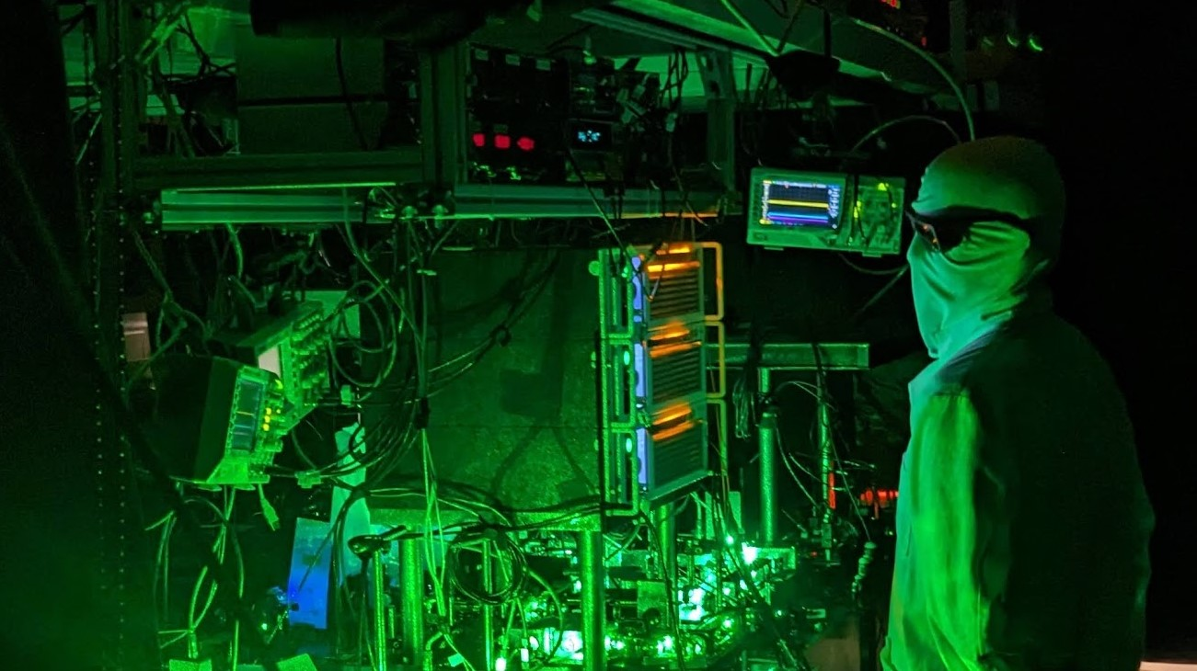
Laser cooled alkaline-earth like molecules
for quantum science
Dan McCarron
January 14th, 2025

Slide 2
Motivation – selecting a qubit (an idealized AMO physicist’s view)
→ real-time dynamics are key
Strong and weak optical transitions
e.g. Sr, Yb
Ground state dipole-dipole interactions
e.g. Er, Dy
$$\left.\text{|}\text{ψ}\right\rangle =\left.\text{|}\text{n}\text{, }\text{v}\text{, }\text{J}\text{, }\text{F}\text{, }\text{m}\text{F} \right\rangle$$
τ ~ ns
N
¹P₁
³P₂
³P₁
μs
S
³P₀
s
N
Quantum Control
Ferlaino, Greiner, Lev,
Pfau, Smith…
¹S₁
S
Blatt, Colombo, Covey, Endres, Jo, Jones, Katori, Kaufman, Killian, Ludlow, Takahashi, Thompson, Vuletic, Ye, Zelevinsky…
Similar structures leveraged w/
popular trapped ions e.g. Ba⁺, Yb⁺, Al⁺
E_{int} (1 μm) ~ 1 Hz
x10³
?
E_{int} (1 μm) ~ 1 kHz

Slide 3
Motivation – selecting a qubit (an idealized AMO physicist’s view)
→ real-time dynamics are key
Strong and weak optical transitions
e.g. Sr, Yb
Ground state dipole-dipole interactions
e.g. Er, Dy
$$\left.\text{|}\text{ψ}\right\rangle =\left.\text{|}\text{n}\text{, }\text{v}\text{, }\text{J}\text{, }\text{F}\text{, }\text{m}\text{F} \right\rangle$$
τ ~ ns
+
¹Π₁
³Π₂
-
³Π₁
ms
+
+
³Π₀
s
Quantum Control
-
¹Σ₁
Similar structures leveraged w/
popular trapped ions e.g. Ba⁺, Yb⁺, Al⁺
E_{int} (1 μm) ~ 1 Hz
x10³
²⁷Al
³⁵Cl
See also: DeMille, TlF
Hemmerling, AlCl
Truppe/Meijer, AlF
E_{int} (1 μm) ~ 1 kHz
5/2
3/2
Complementary approach w/ atoms & Rydberg dressing

Slide 4
Laser cooling molecules presents a challenge
Crucial requirement for laser cooling: a “closed” cycling transition
~10⁻⁷ eV
excess
Excitation
Ground
state
Excited
state
repump
light
cooling
light
Decay
Decay into a dark state?
➔ Cycling stops
➔ Solution = “repump” laser
Additional degrees of freedom: many potential dark states
problematic for laser cooling molecules
Vibration
First laser cooled:
ions
atoms
diatomics
triatomics
Wineland et al. PRL 40, 1639 (1978)
Mg⁺
Na
SrF
SrOH
Phillips et al. PRL 48, 596 (1982)
Shuman et al. Nature 467, 820 (2010)
Rotation
1978
1982
2010
2017
Kozyryev et al. PRL 118, 173201 (2017)

Slide 5
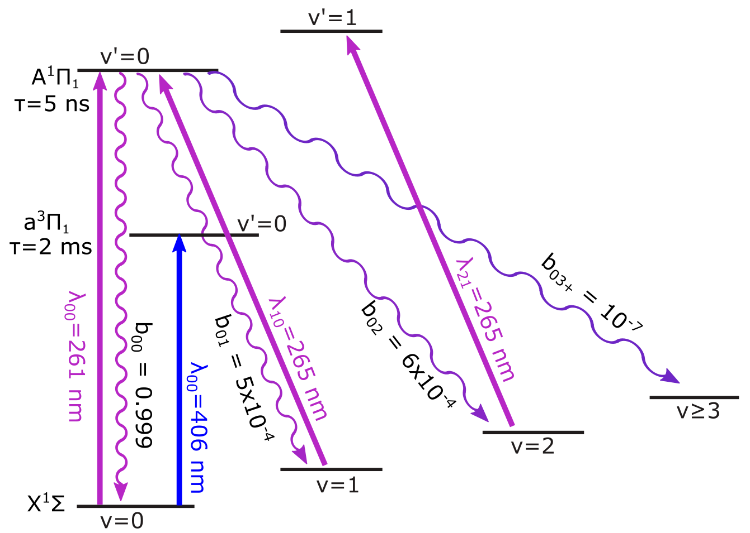
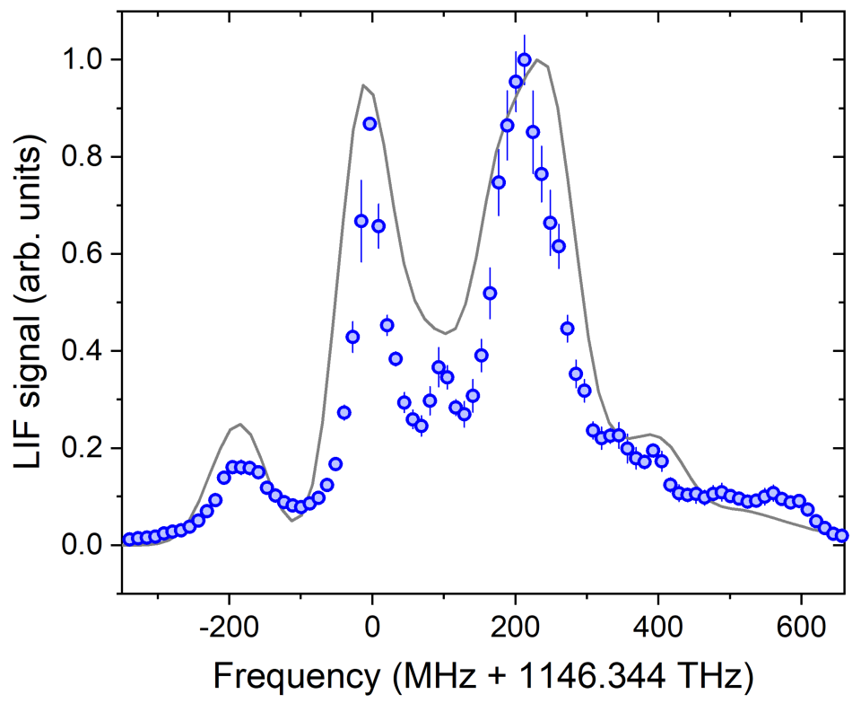
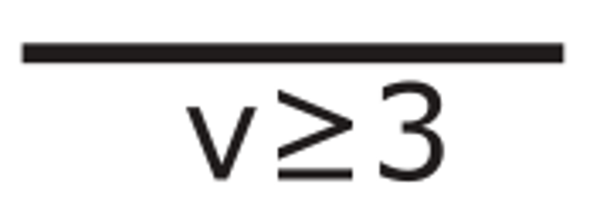
AlCl: Rovibrational and hyperfine structure
F’=2-5
F₁’=7/2
-
F₁’=5/2
F’=1-4
J’=1
+
~ 500 MHz
6
(partially
resolved)
Γ = 1/τ
= 2π(27 MHz)
F₁’=3/2
F’=0-3
Three UV lasers →
~ 10⁴ photons
F₁’=5/2
F₁’=7/2
5 x 10⁻⁴
λ₀₀ = 261 nm
6 x 10⁻⁴
10⁻⁷
0.999
Q-Branch
≲ 10⁻⁴
F₁’=3/2
1.7(7) x 10⁻³
4(1) x 10⁻³
0.9952(9)
J=1
-
~11 MHz
(unresolved)
Theory: J. Chem. Phys. 145 024309 (2016)
Chin. Phys. B 25 043101 (2016)
Experiment: Semco et al. - in preparation.
$Isat∝$ $\frac{1}{τ . λ3}$
Need ~500 mW/cm²
Z. Naturf. 28A, 1066 (1973)
J. Daniel et al., Phys. Rev. A 108, 062821 (2023)

Slide 6
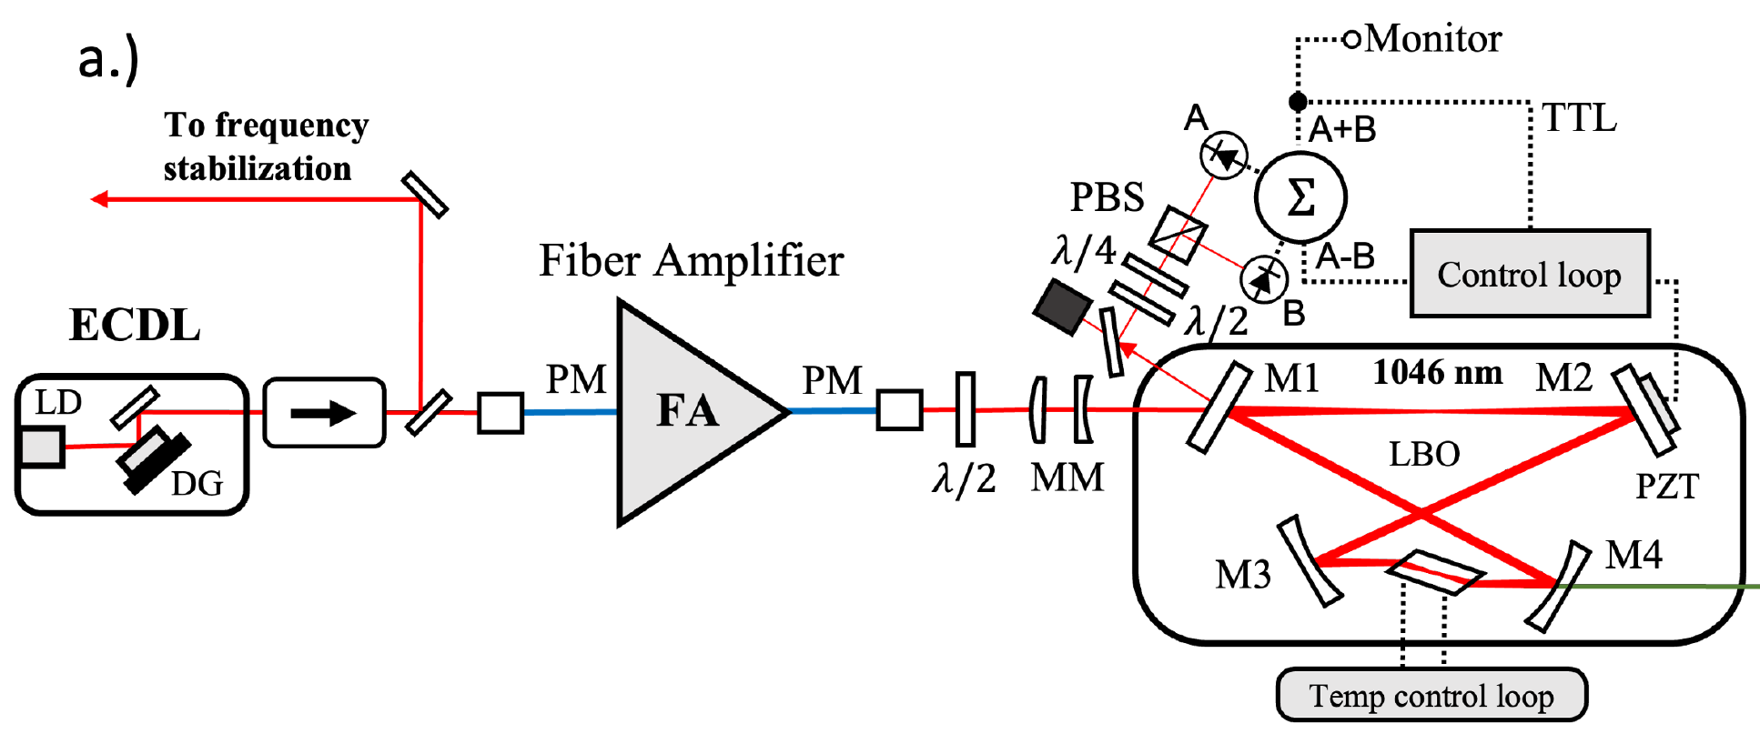
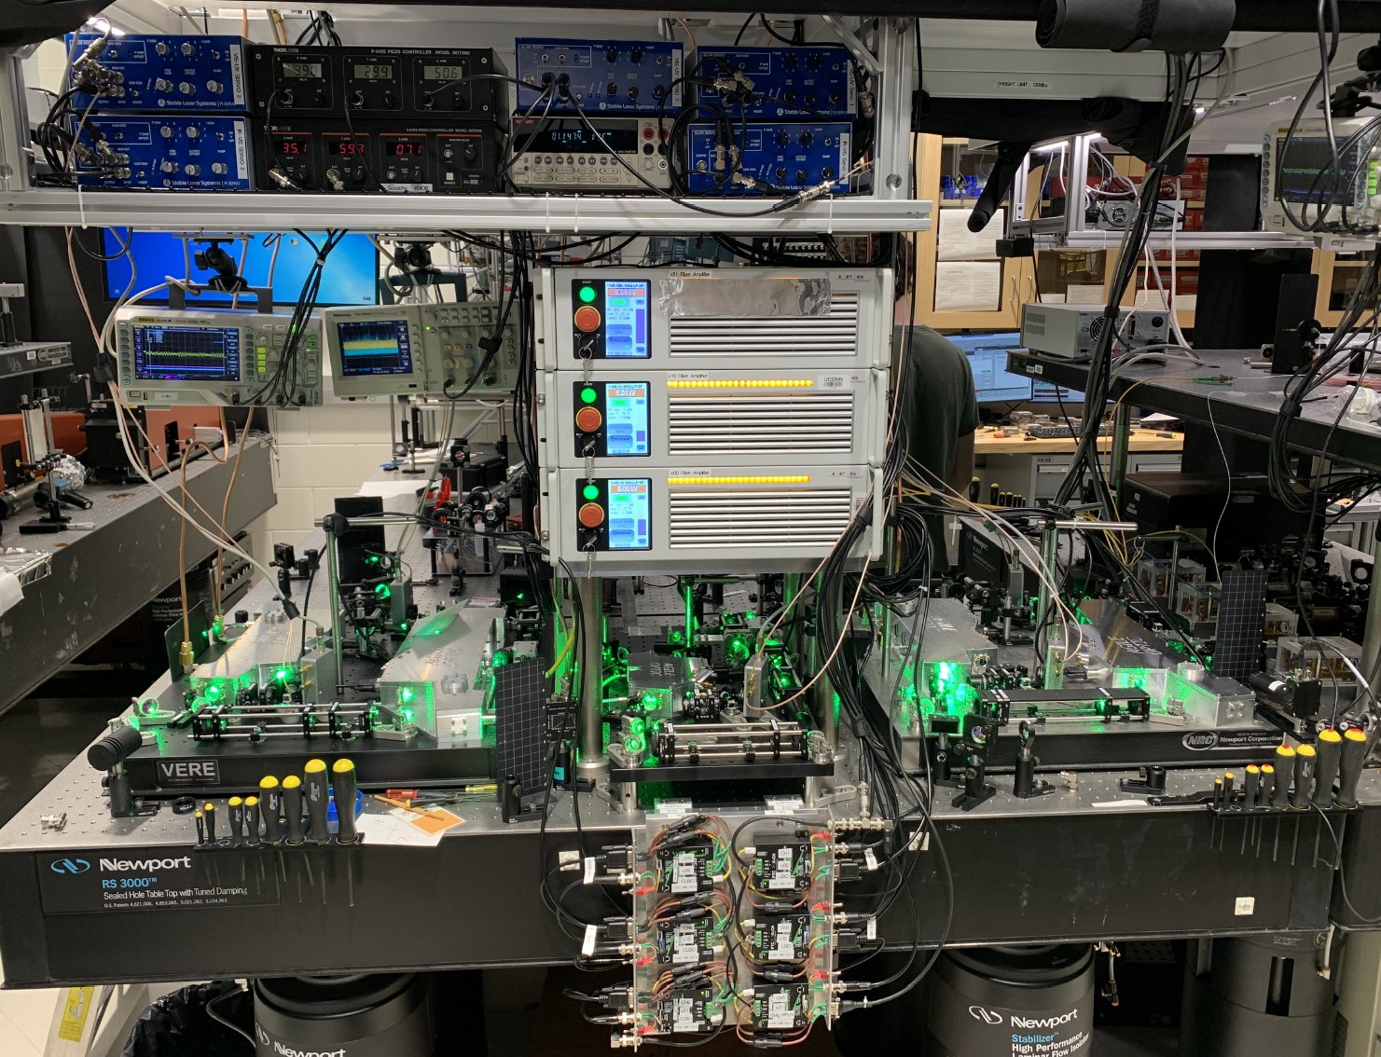
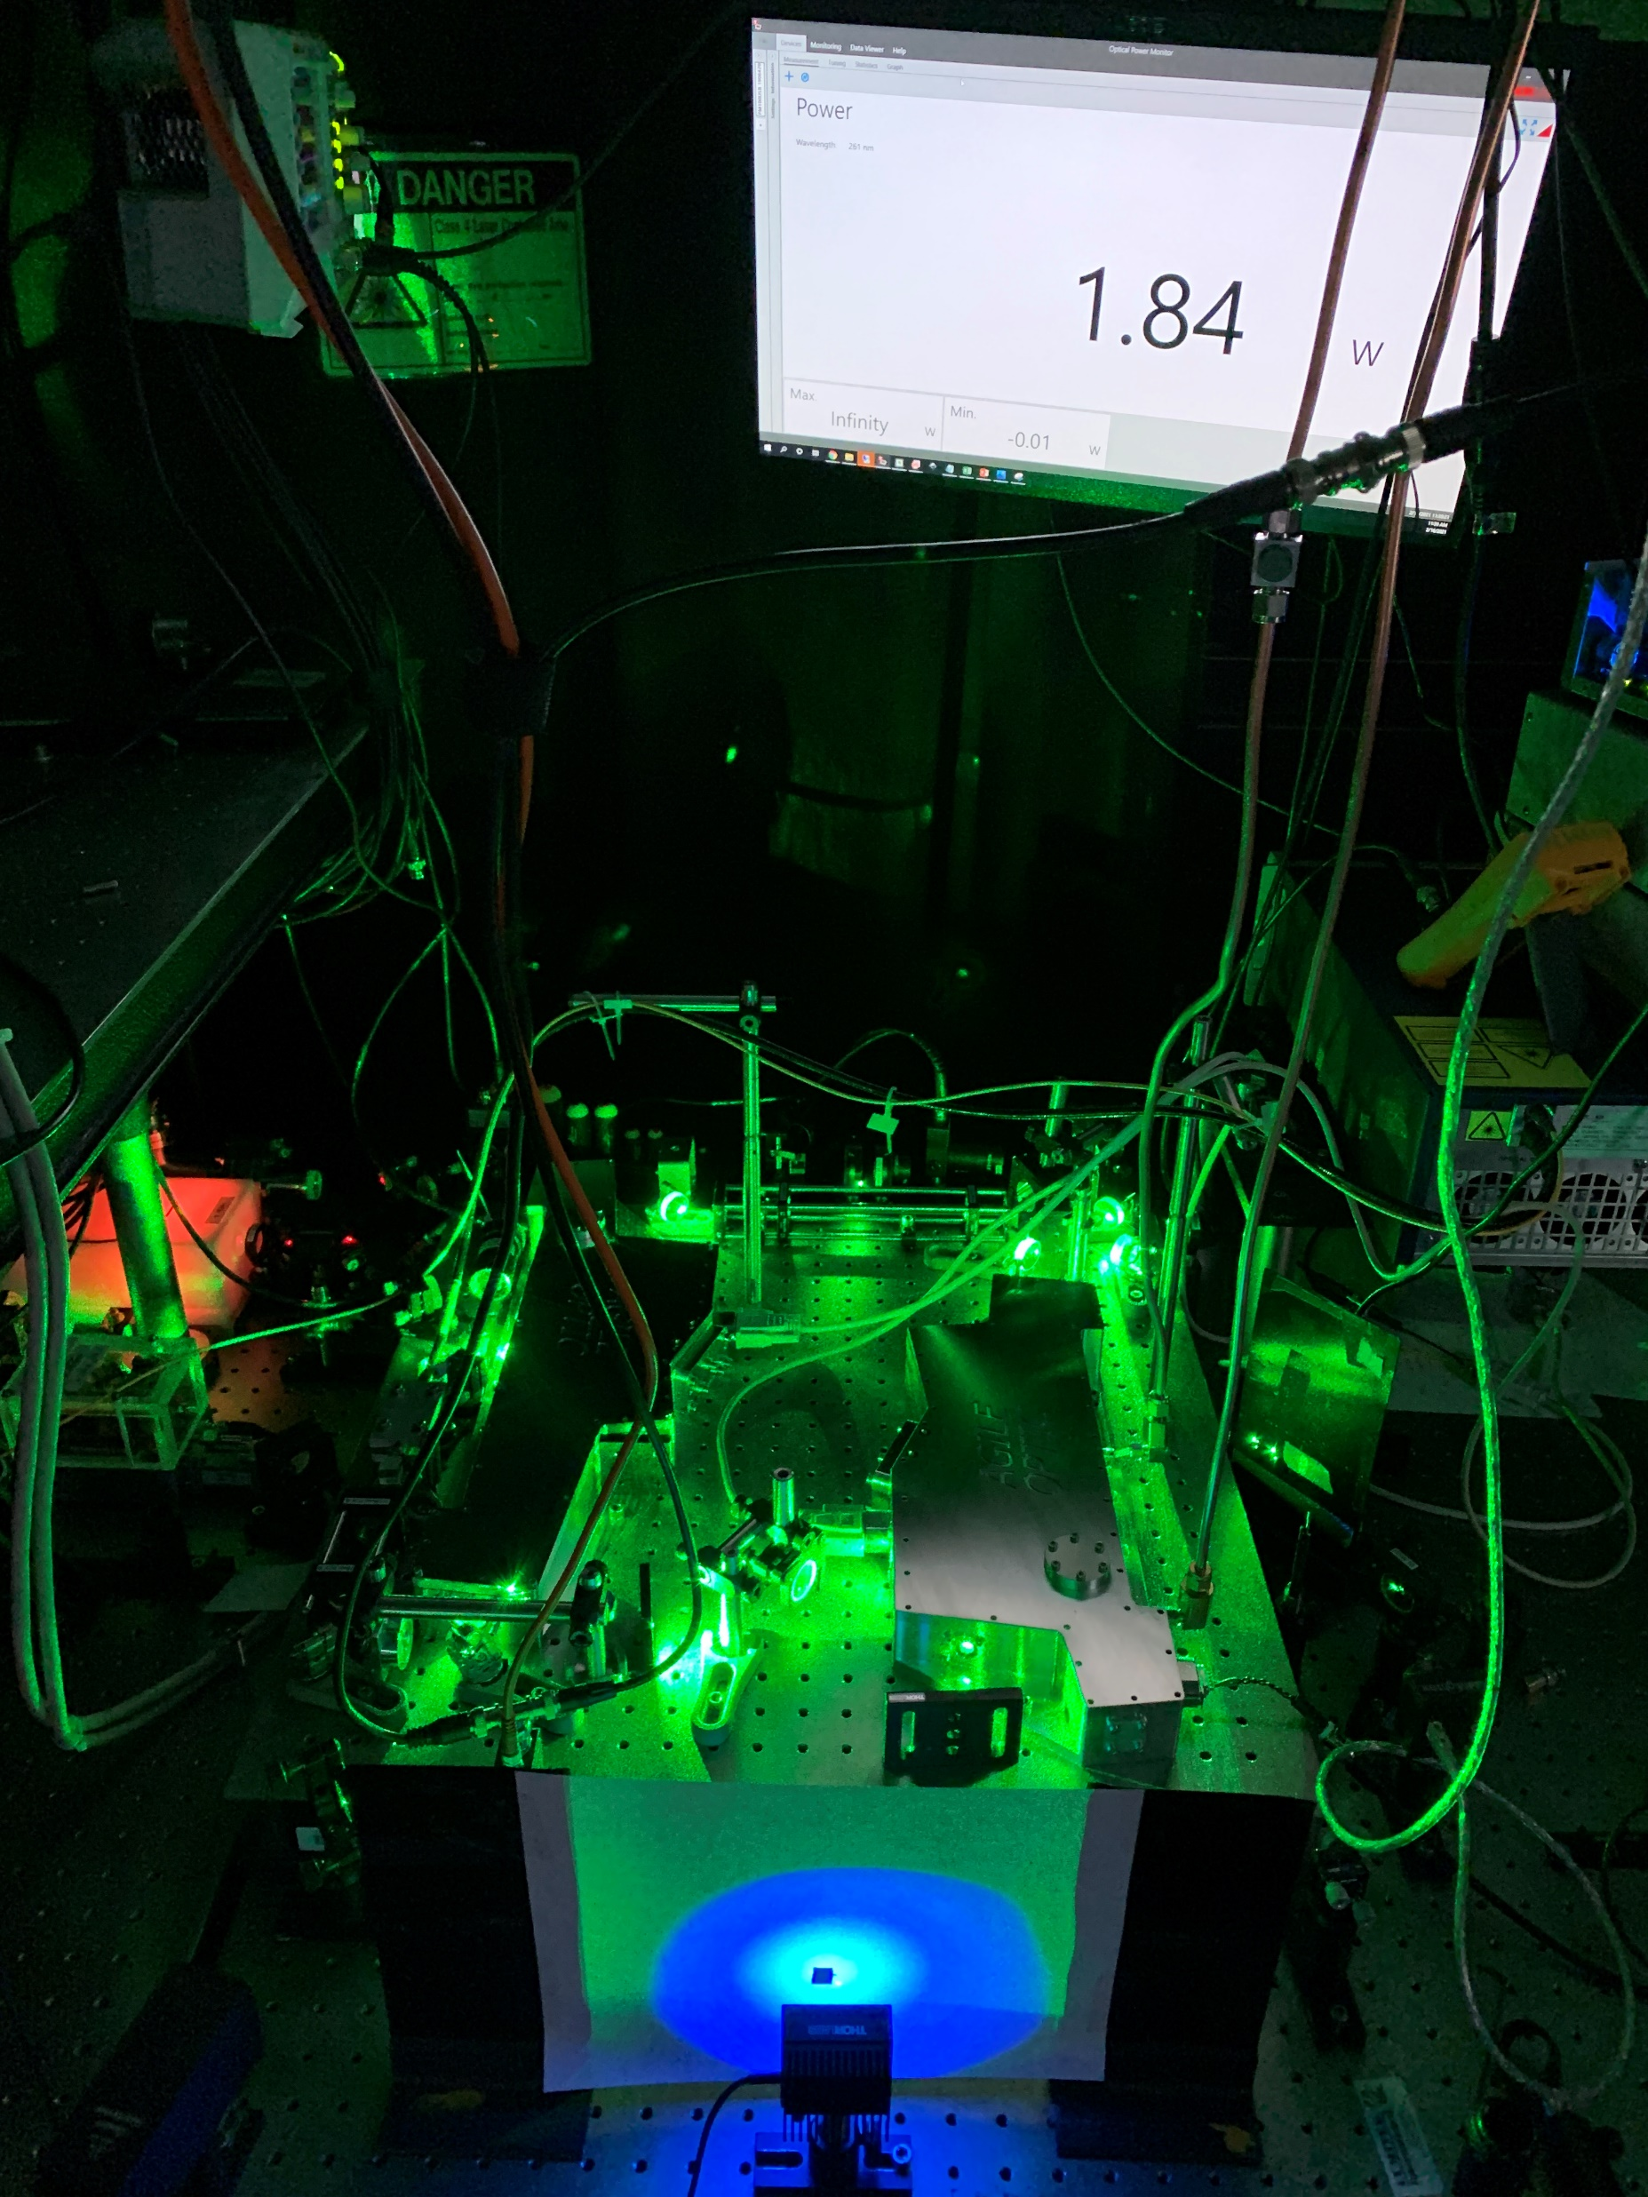
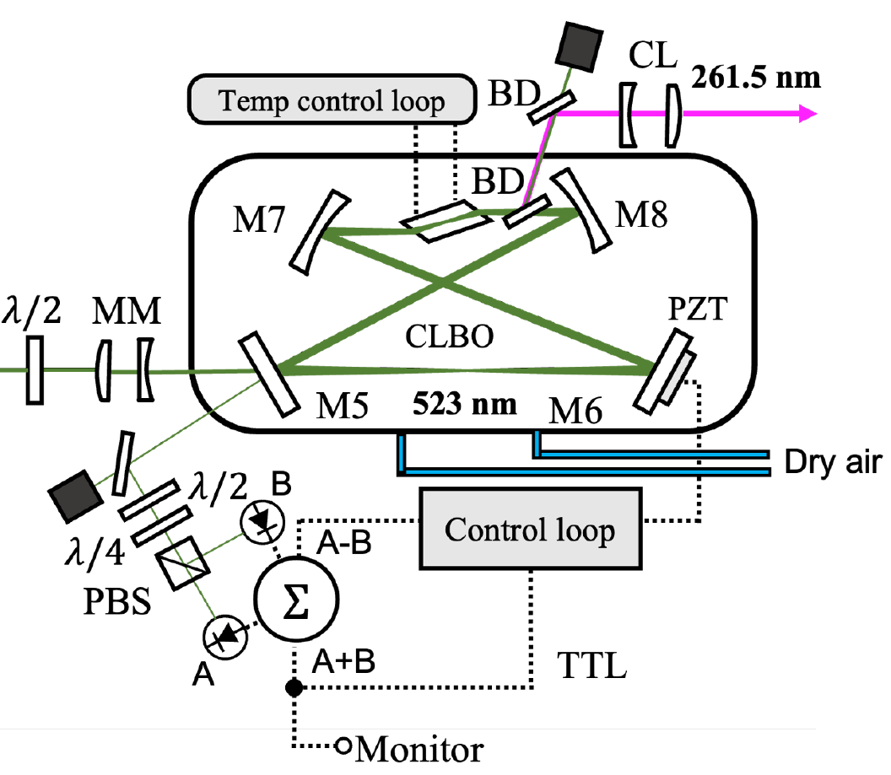
Tunable CW laser at 260-265 nm (4.8 eV)
Hybrid approach – cavity housings developed with Agile Optic GmbH
Approach looks feasible for 148 nm light – add one more cavity
Fiber amplifiers at 1184 nm possible
VUV production in e.g. BaMgF₄, BaZnF₄ established
Lasers measure 2’ x 2’ (need ~1 kW) – portable nuclear clock?
296 nm → 148 nm
J. Shaw et al. Opt. Exp. 29, 37140 (2021)
~4 years operation w/o UV degradation
Robust autolocking/relocking of cavities
Thanks to: D. DeMille, D. Hanneke, L. Hunter & D. Yost

Slide 7
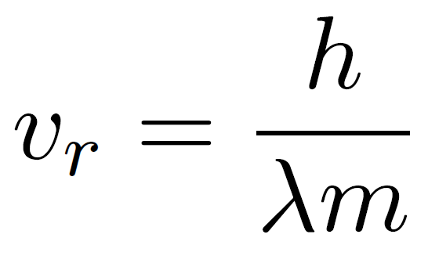
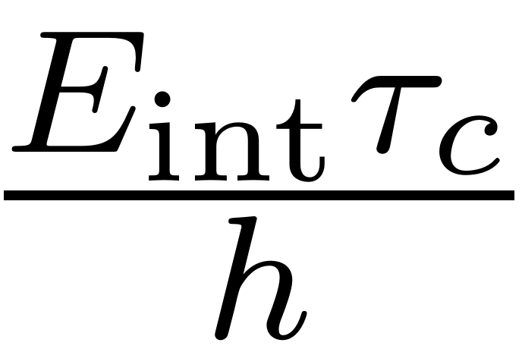
This looks challenging, why this polar molecule?
Small molecule with short-wavelength transition → large photon recoil velocity
Short-lived excited state → high photon scattering rate
large optical forces
Crucially, can also optically trap & image in the deep UV:
λ/2
E_{int} (1 μm) ~ 1 kHz
E_{int} (150 nm) ~ 100 kHz
Figure of merit:
~ 10⁵ operations per qubit
Deep-UV optical lattice
Gate fidelity also key! Dictates error correction overhead.
τ_{c} ~ 1 s already realized for RbCs molecules: Nat. Phys. 20, 415 (2024)

Slide 8
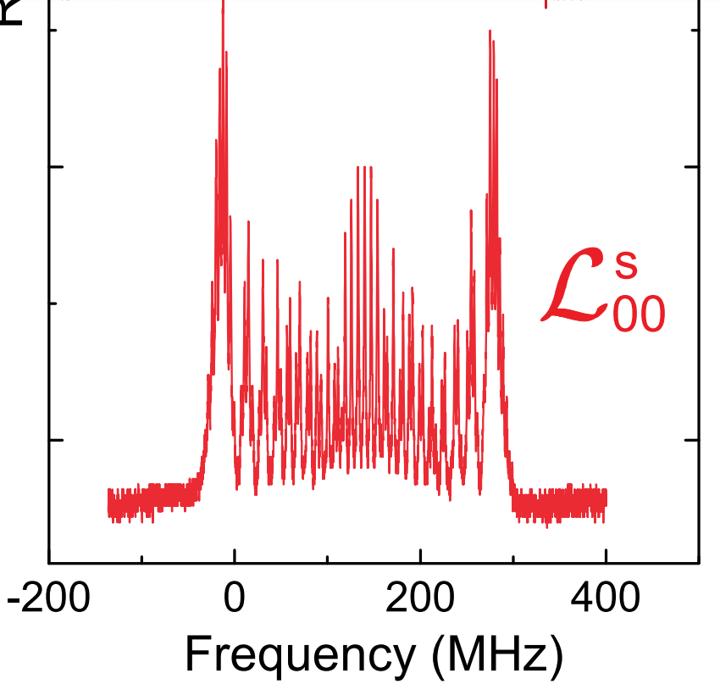
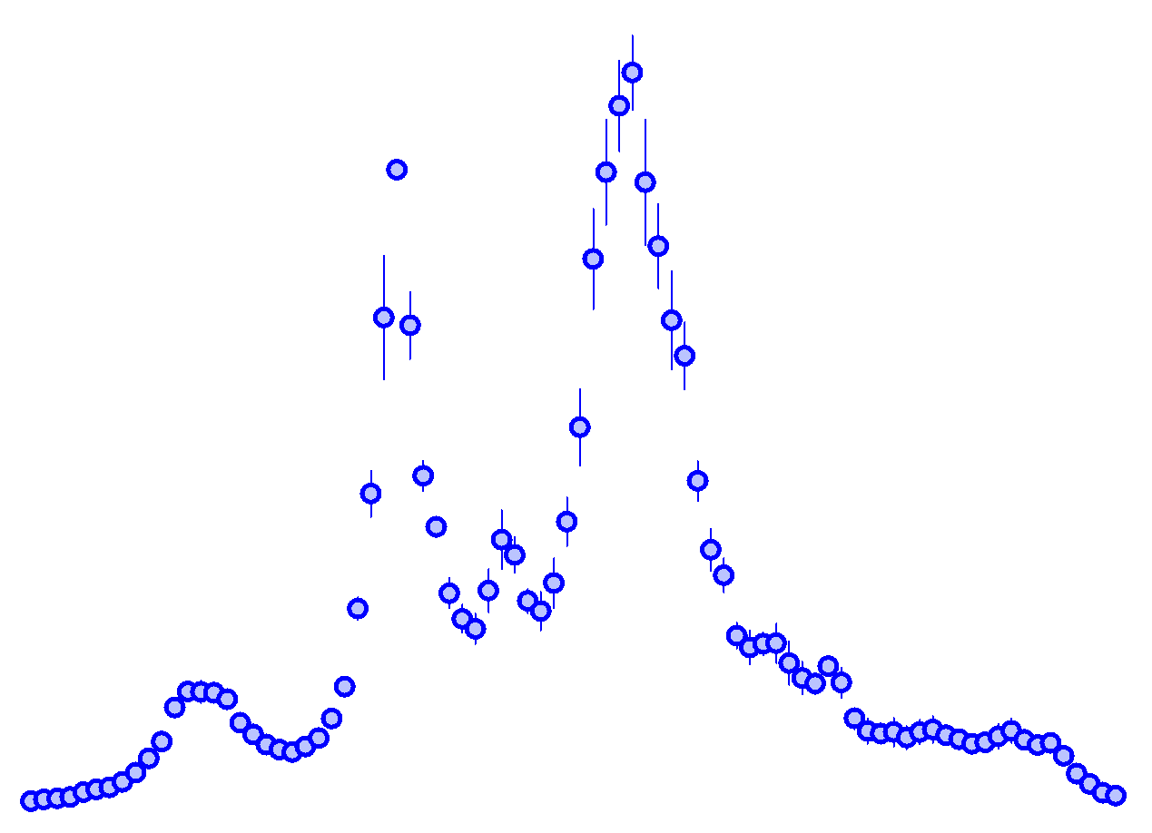
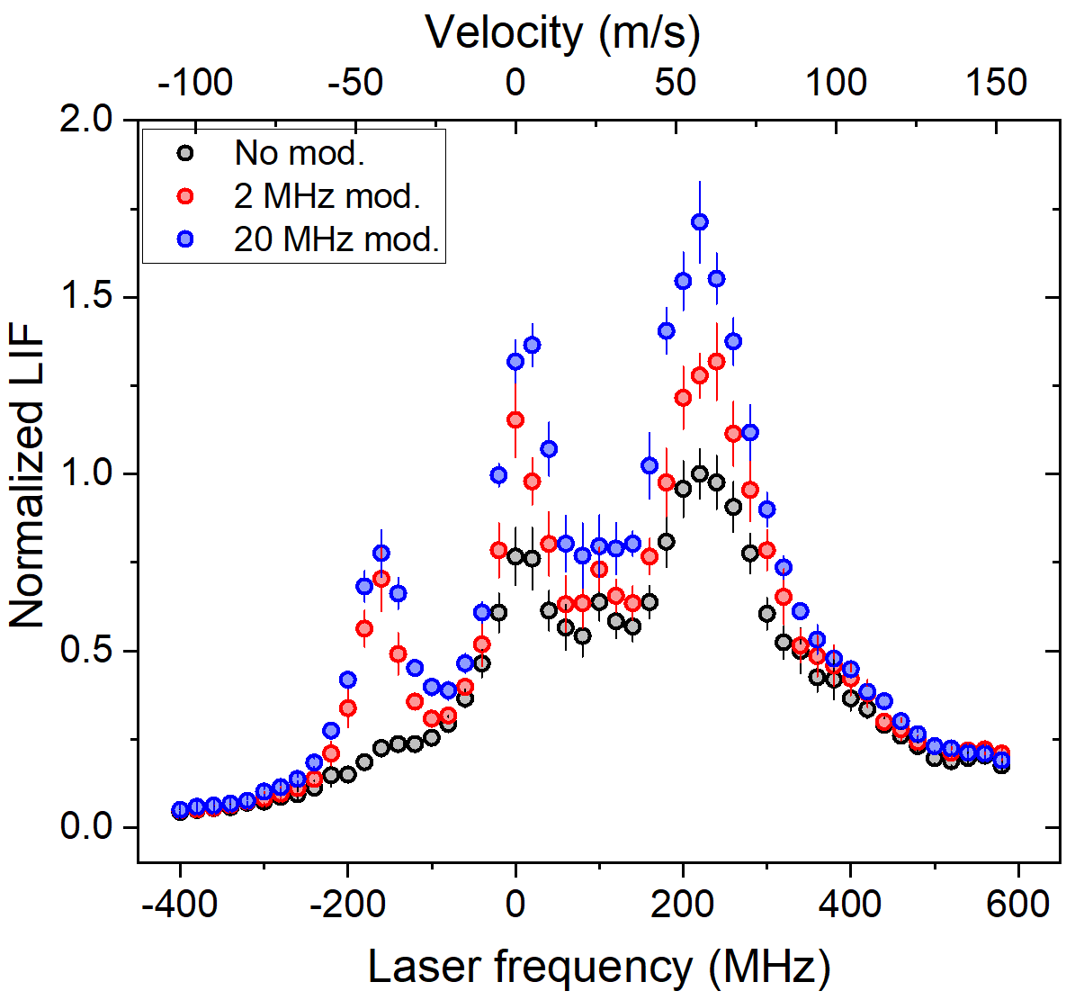
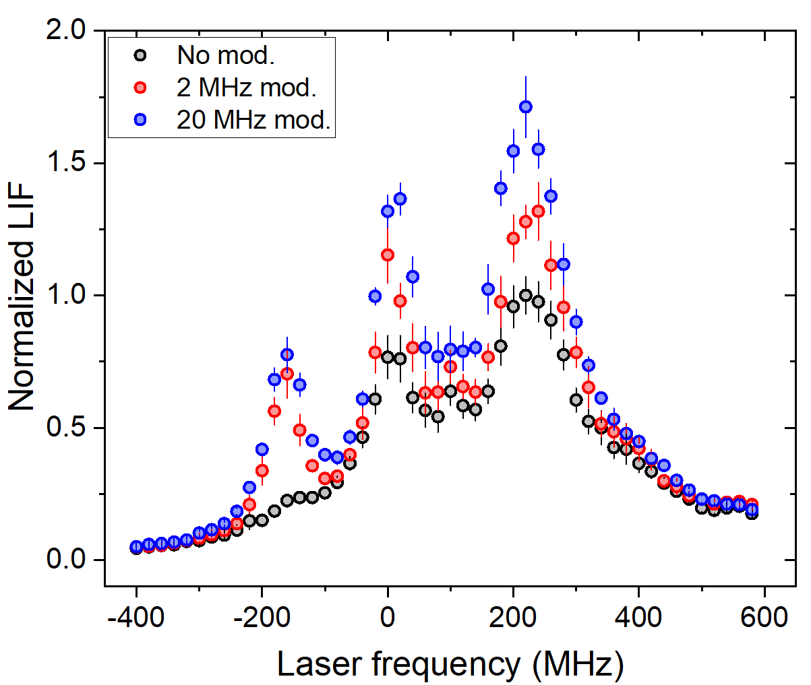
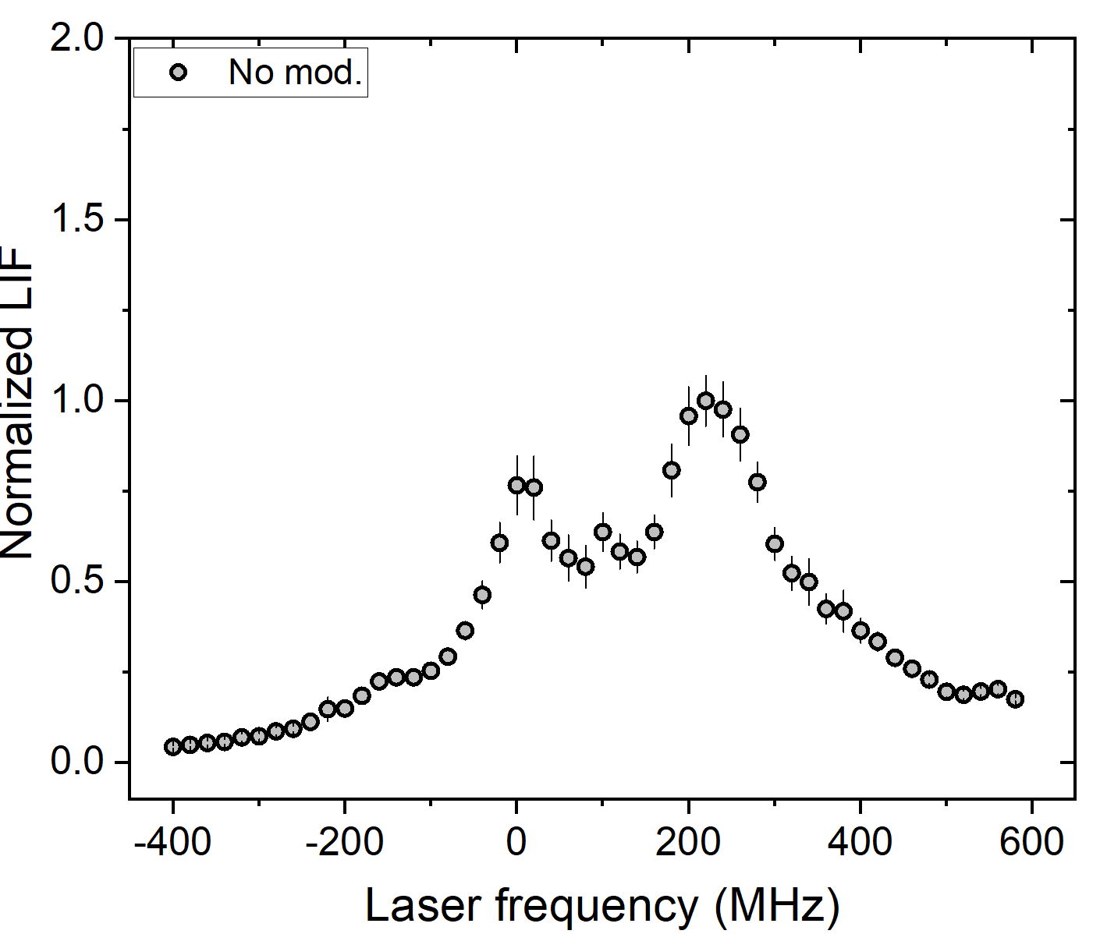
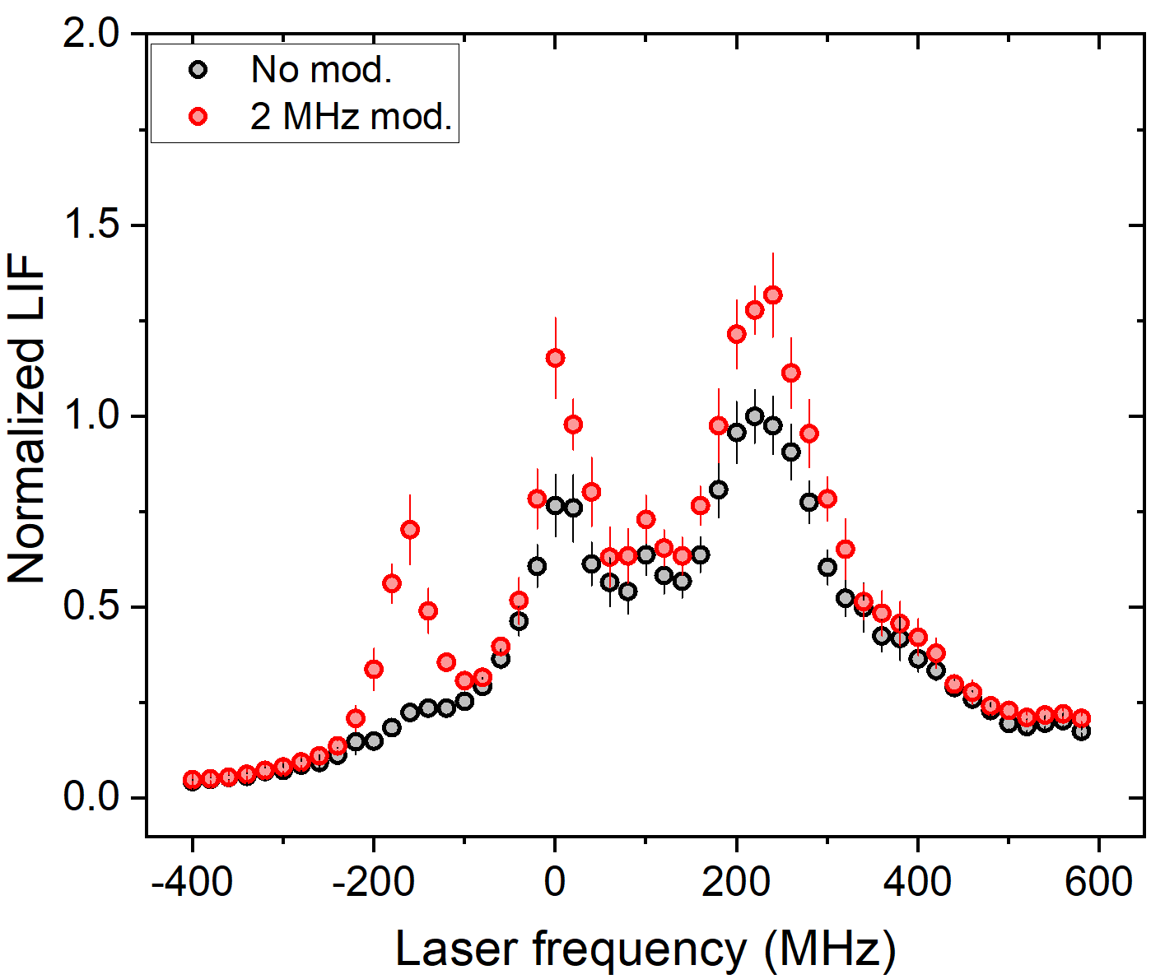
Destabilizing dark states
+pol. mod.
EOM
SrF, DeMille
EMCCD
Probe
F₁’=7/2
32 sublevels
7/2 32/104 Gamma = 0.31 1
5/2 24/96 Gamma = 0.25 0.8
3/2 16/88 Gamma =0.18 0.6
J’=1
+
F₁’=5/2
24 sublevels
I ≃ 4 W/cm²
A¹Π₁
F₁’=3/2
16 sublevels
τ = 6 ns
F₁’=5/2
n_{e}< n_{g}/3
Robust dark states
F₁’=7/2
Beware coherent dark states
F₁’=3/2
λ₀₀ = 261 nm
Max R_{sc} limited by dark-bright remixing rate
X¹Σ
J=1
-
72 sublevels
“Baked-in white light slowing”
|b⟩
ΔE
Single laser frequency addresses ~130 m/s
|d⟩
Notes:
Either stationary angular momentum eigenstates e.g. F=0 and F=5
Coherent superposition of these eigenstates that precess
State counting argument - any given polarization can only couple one superposition state to one excited state.
16 excited states – any three linearly independent polarizations can couple to 16x3 = superposition states, 24 left behind.
They are not stationary dark states, with exception of F=5, they do evolve…

Slide 9
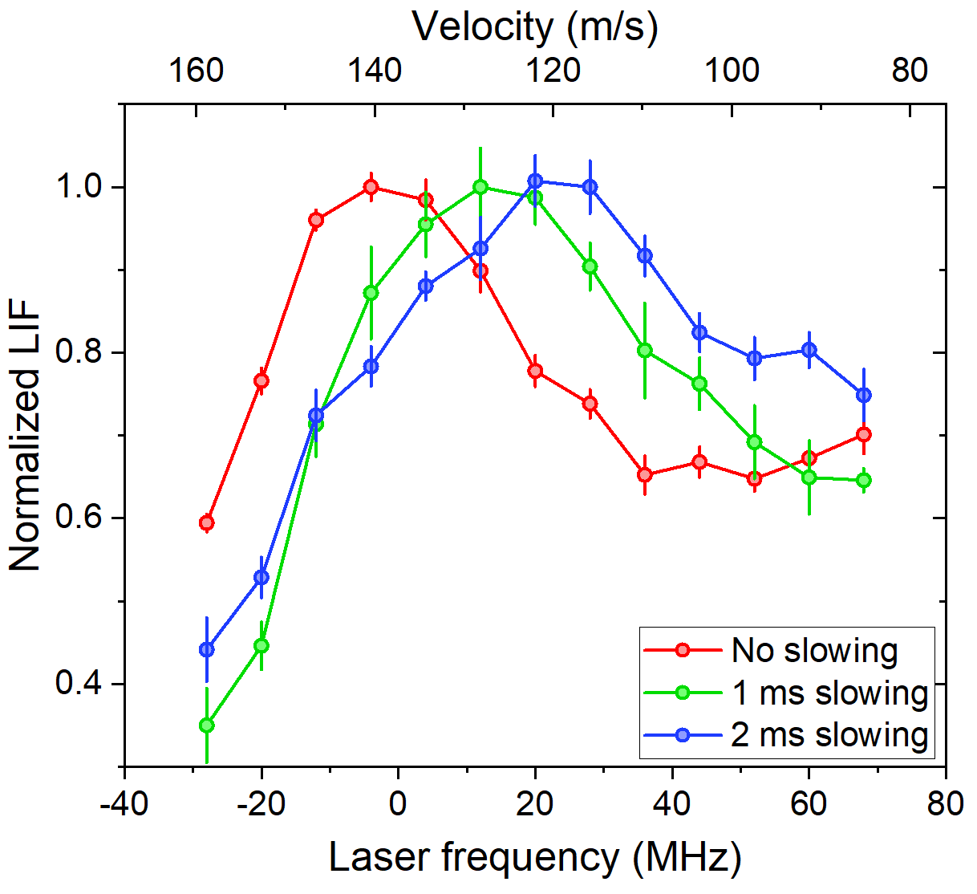
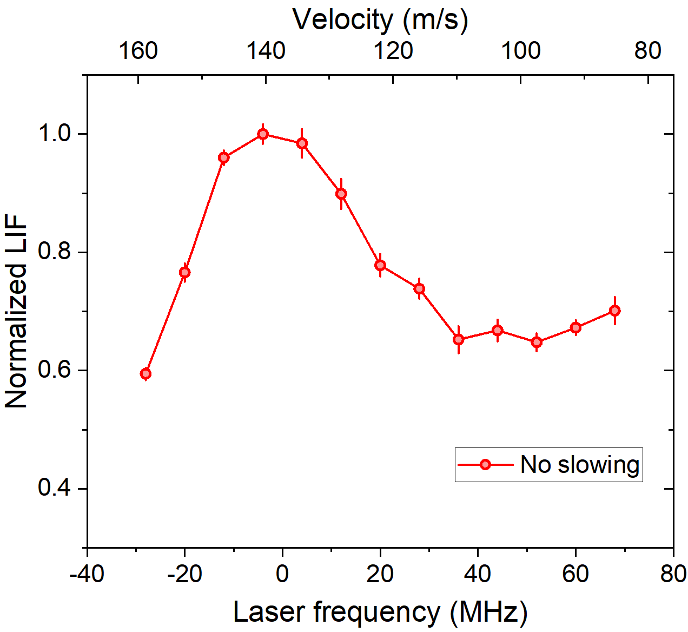
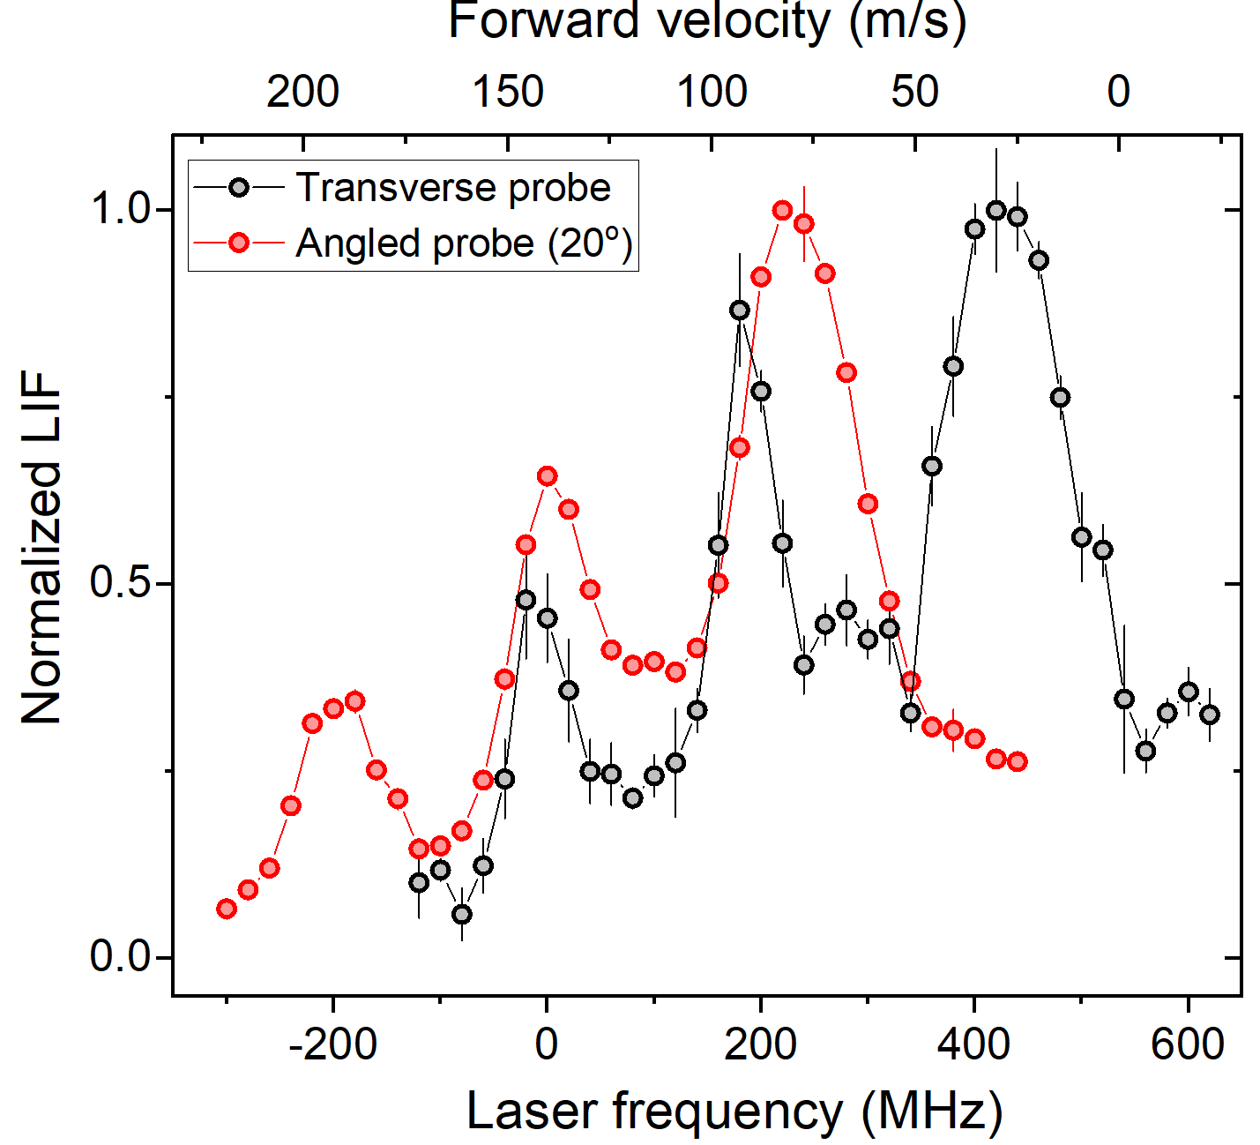
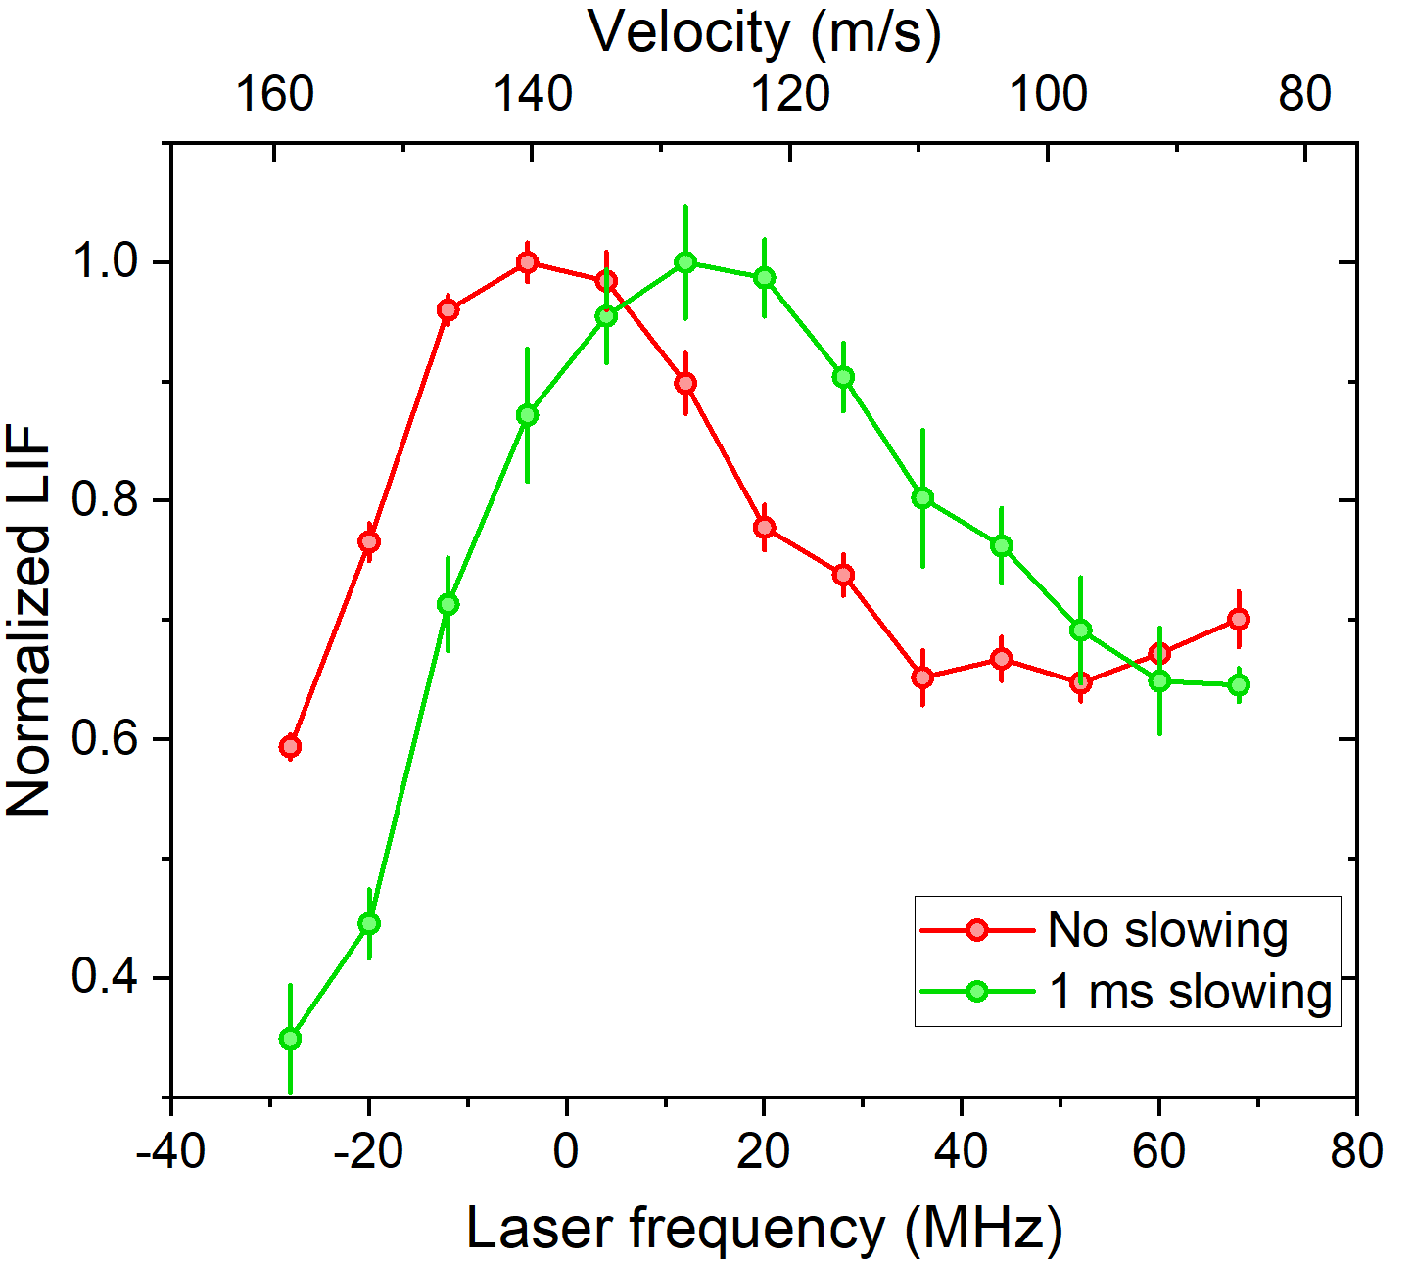
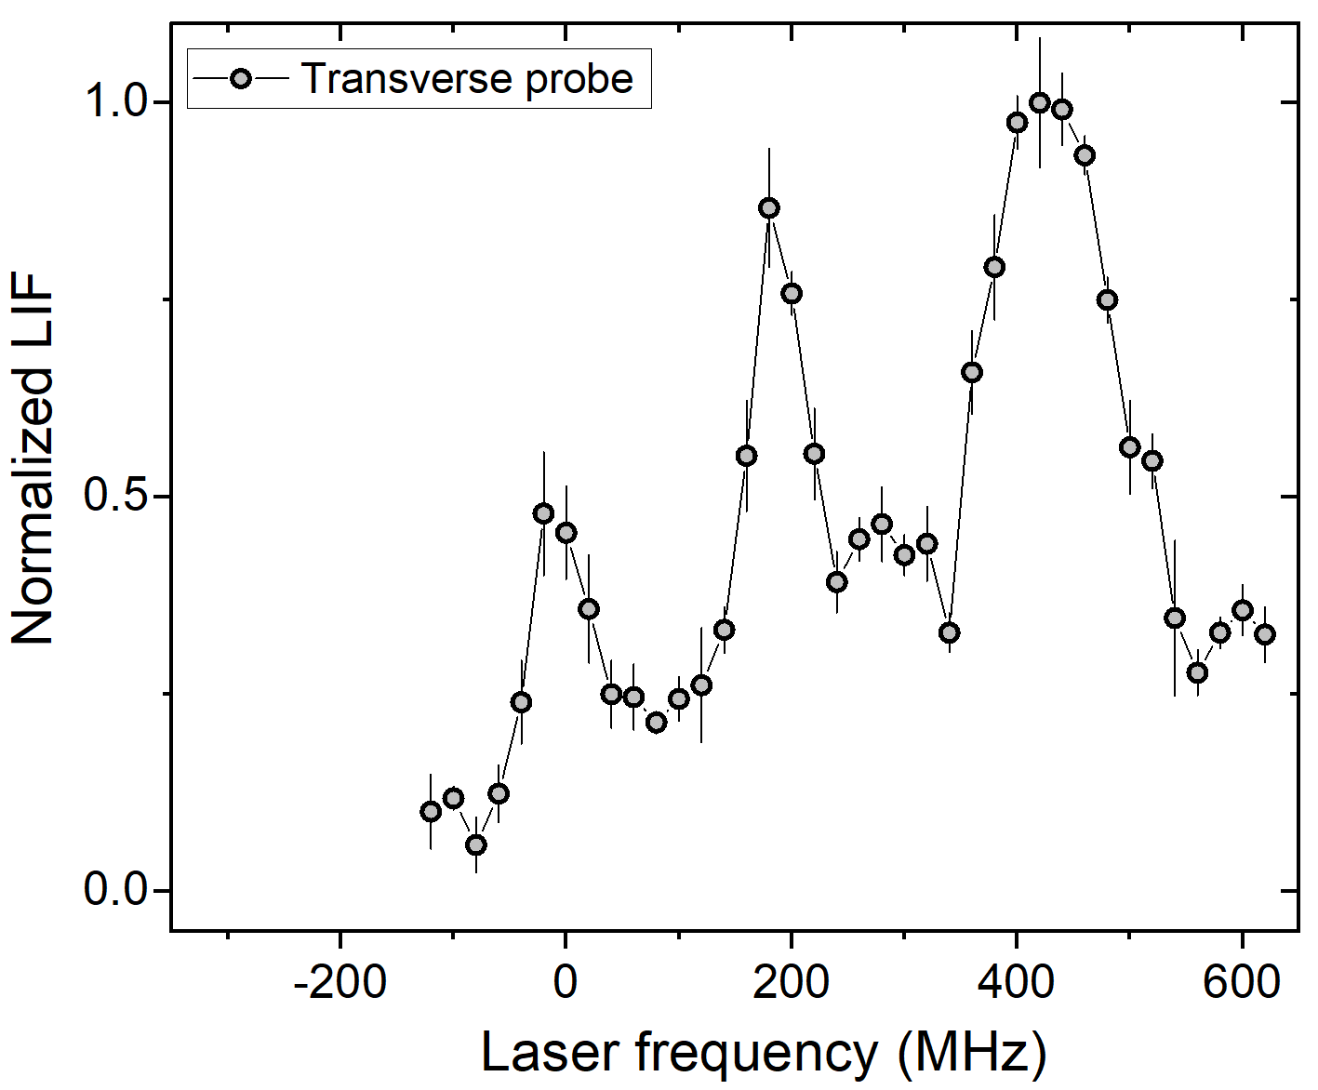
Laser slowing in AlCl
L₀₀, L₁₀,L₂₁
EMCCD
EOM
+pol. mod.
Probe
Δf ≈ 180 MHz → v_{fwd} ≈ 140 m/s

Slide 10
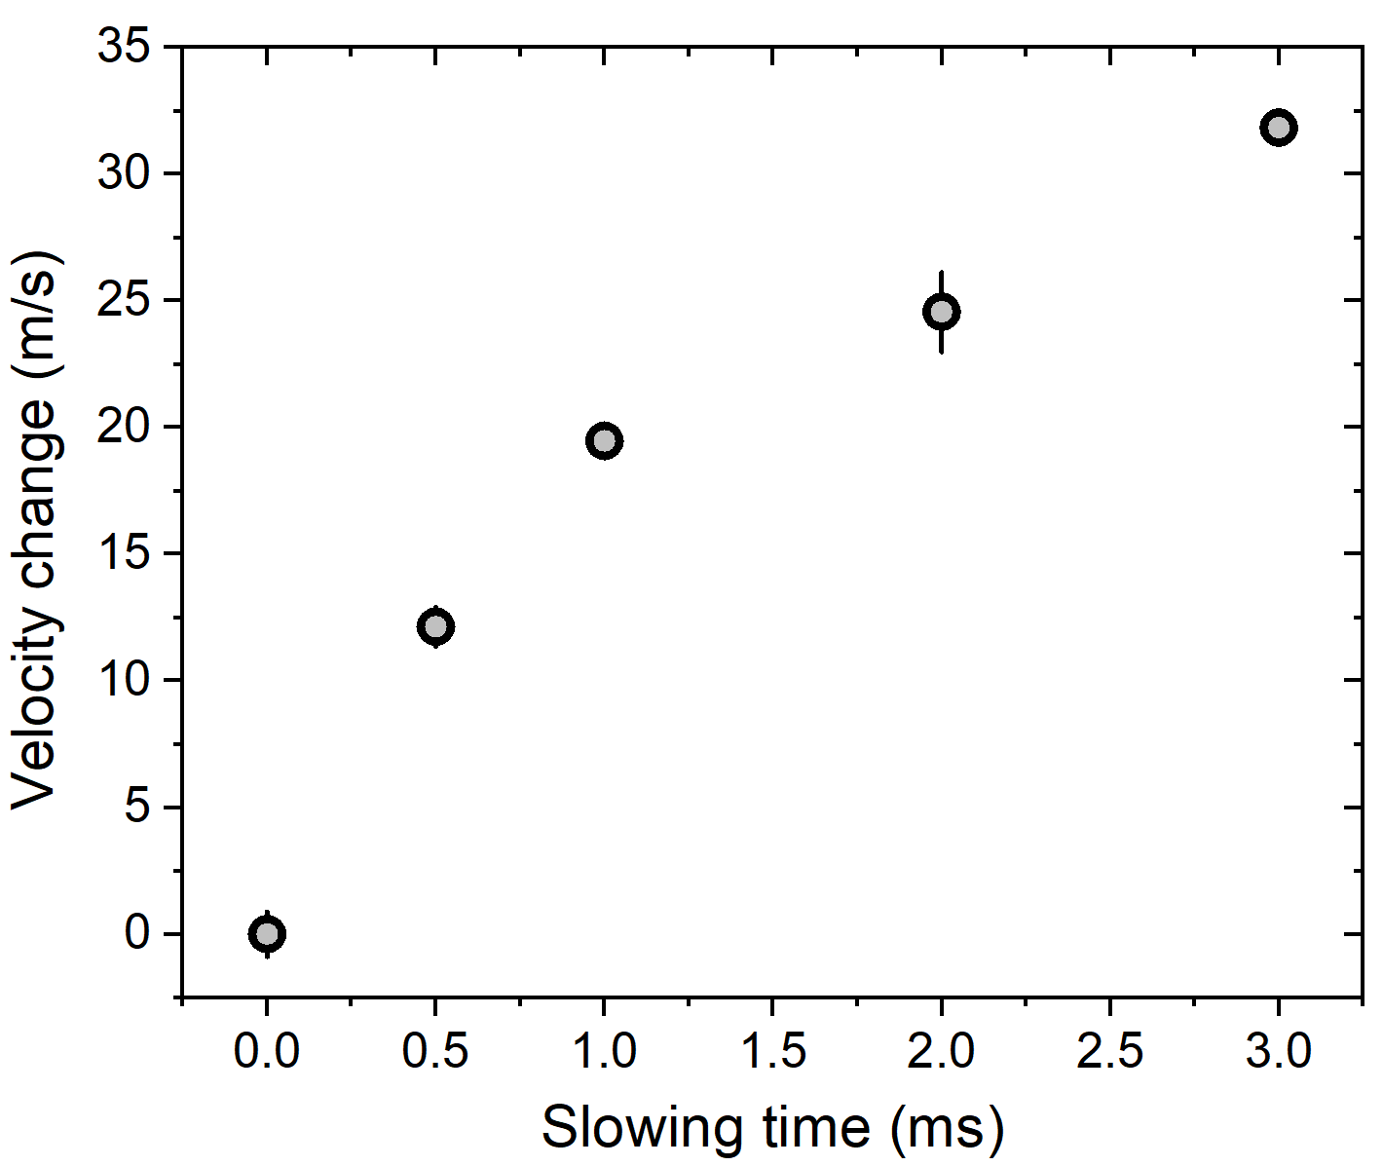
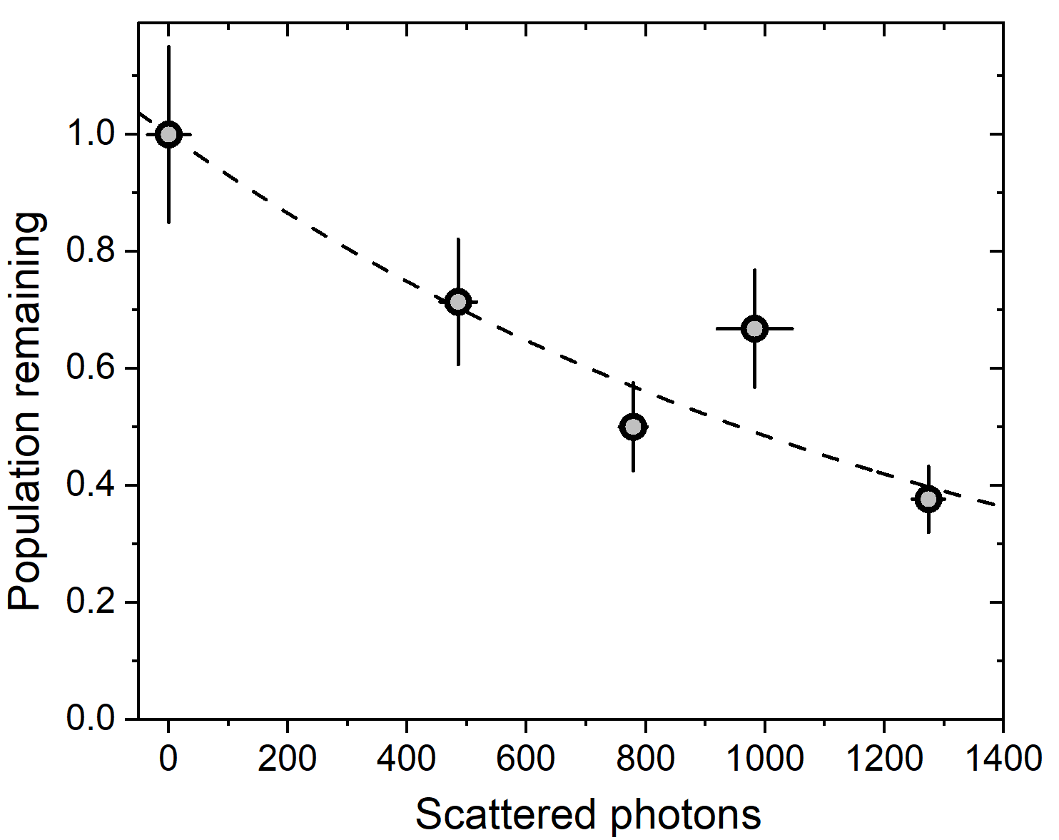
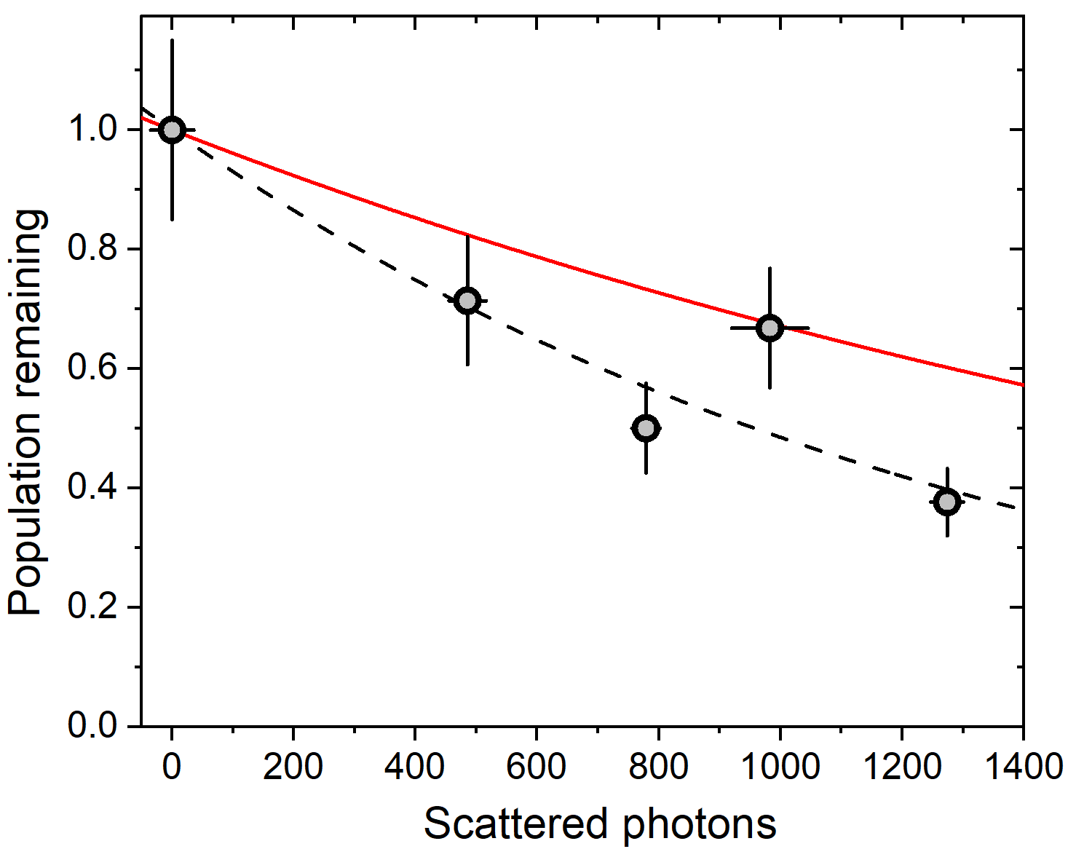
Laser slowing in AlCl
Beam Δv_{fwd} vs t_{slow}
Vibrational closure w/ 3 lasers
VBR ≥ 0.9996
Monte Carlo accounts for beam divergence

Slide 11
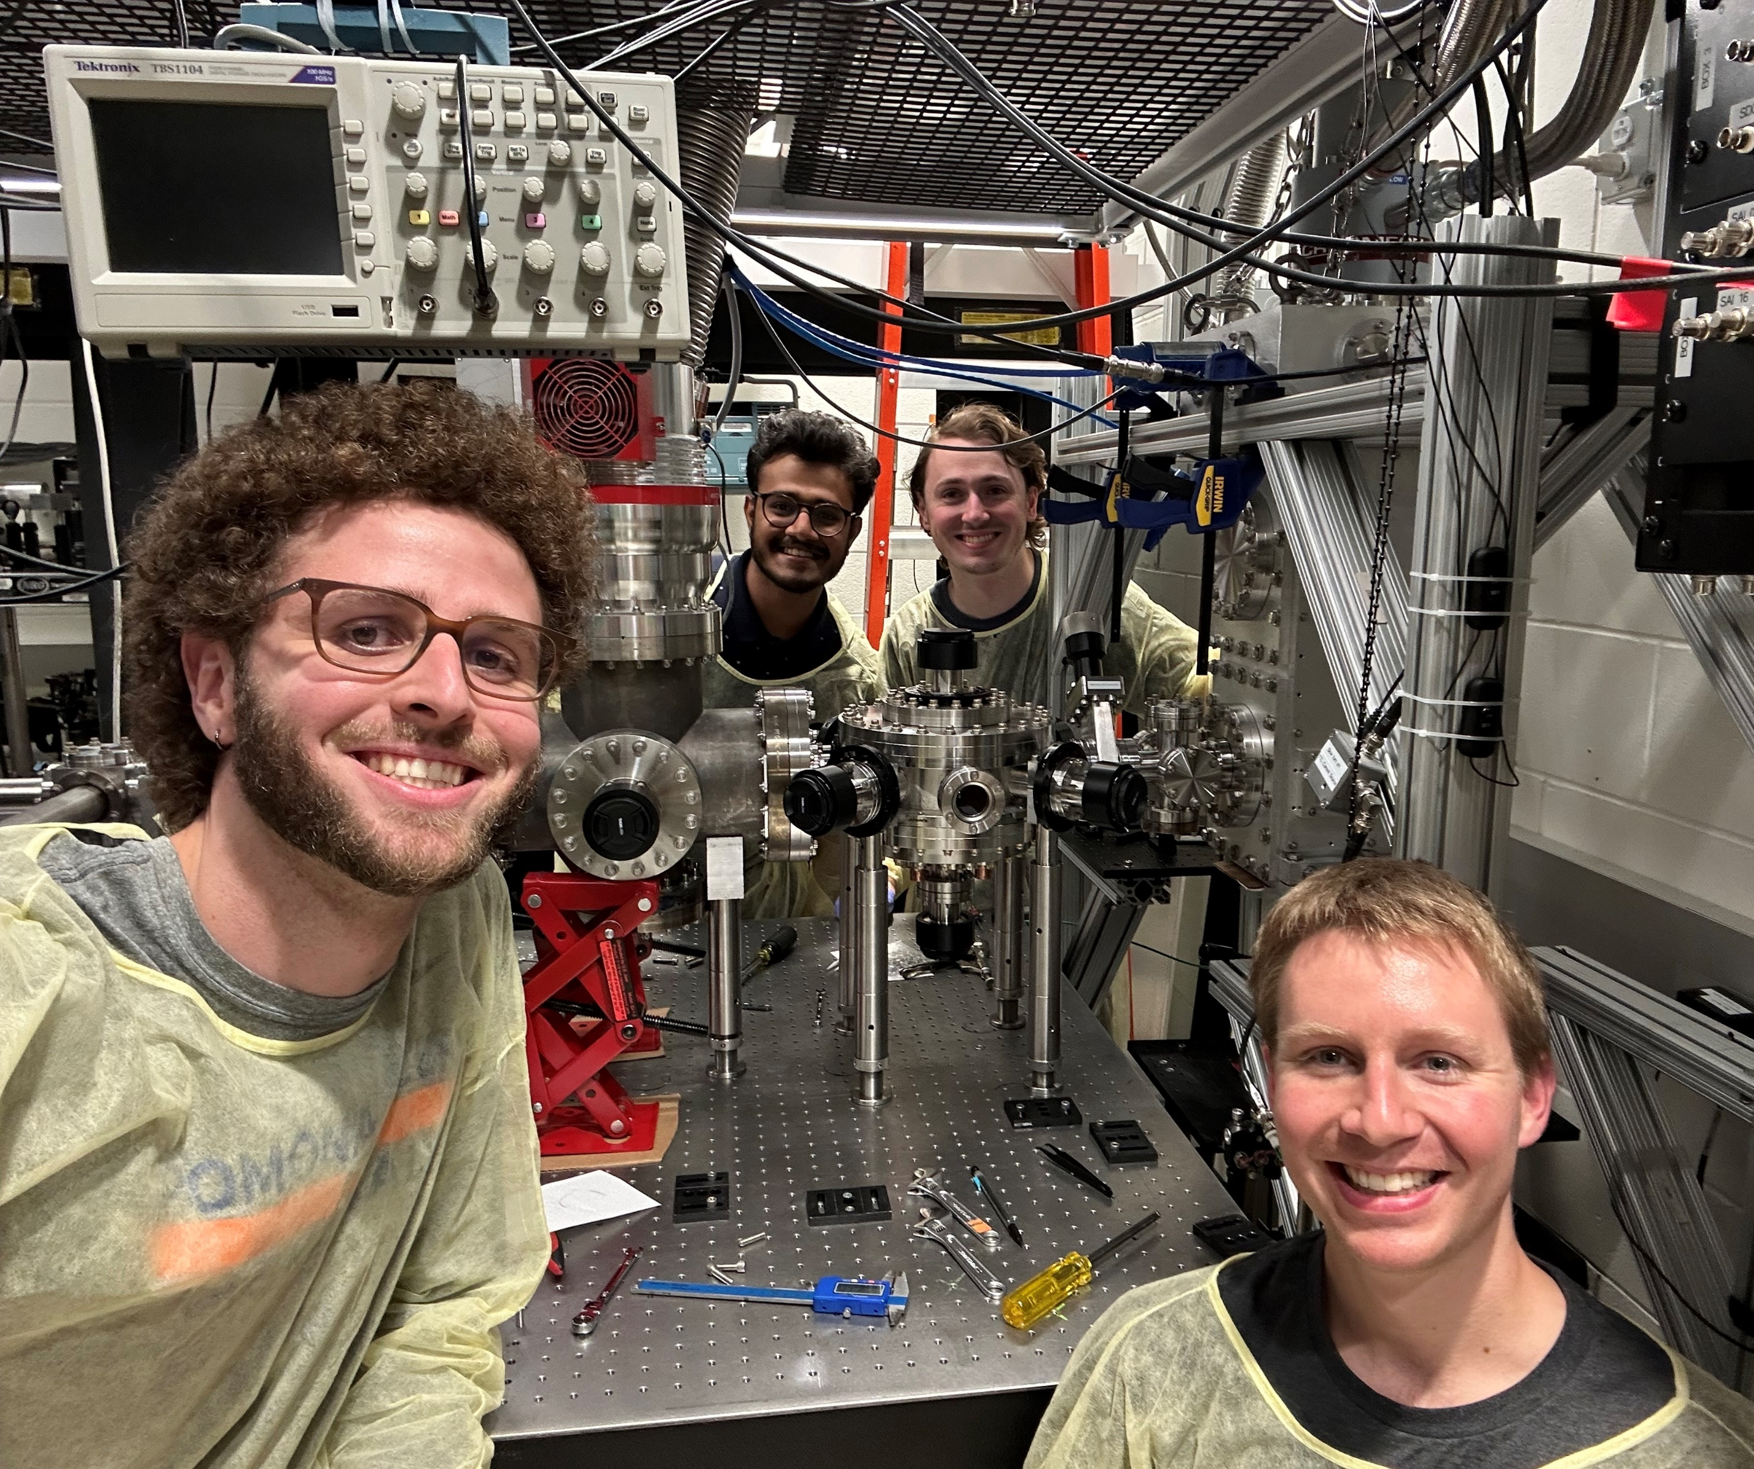
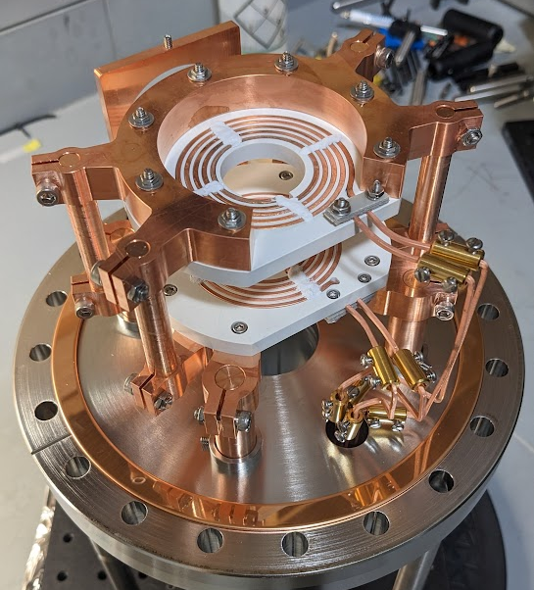
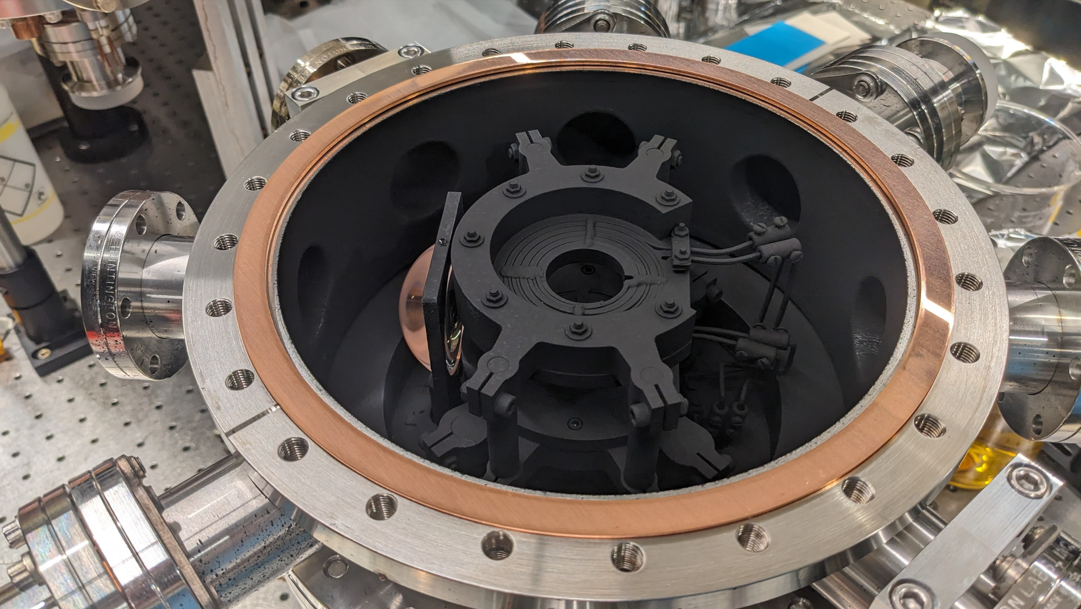
Towards laser cooled & trapped AlCl
Trapping region installed fall 2024
Trap
Source
40 cm
> 10⁸ mol./pulse
Axial gradients up to ~200 G/cm
Up to 1” diameter MOT beams

Slide 12
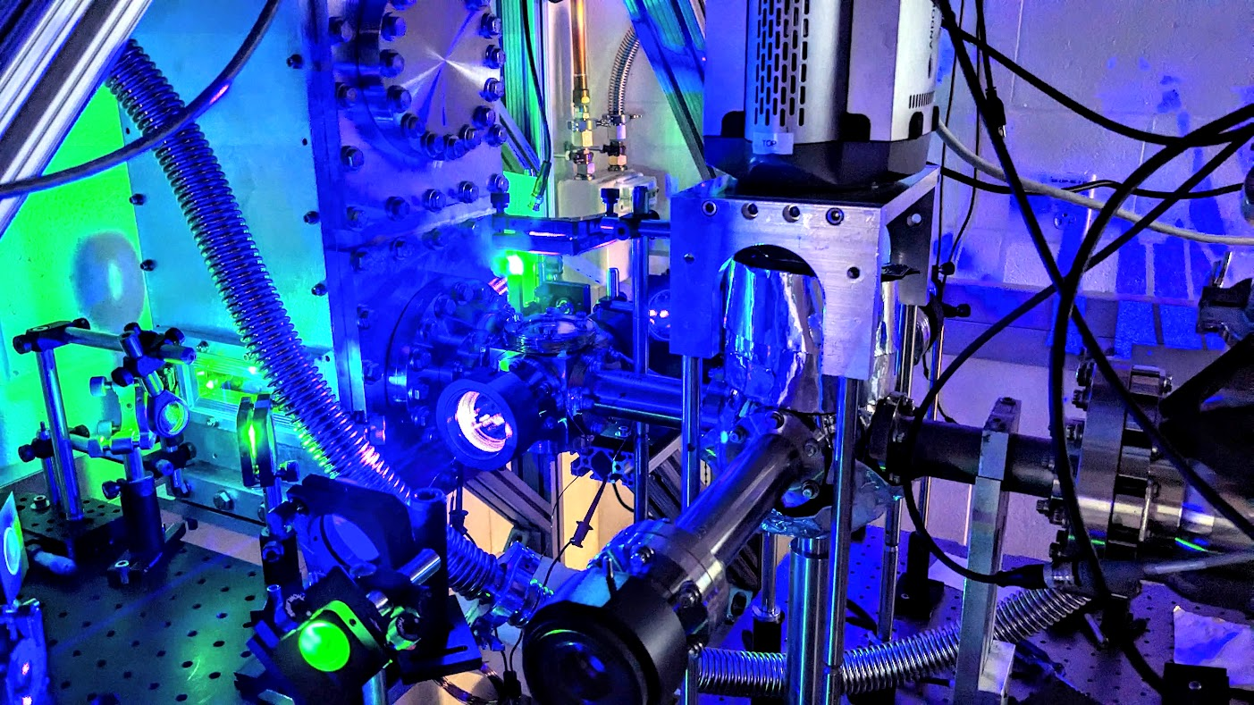
Now to short-range interactions with cold CH radicals

Slide 13
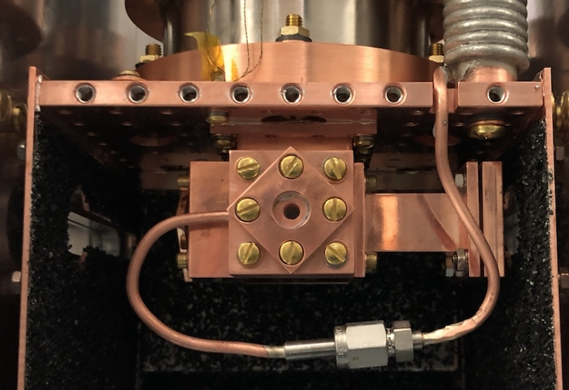
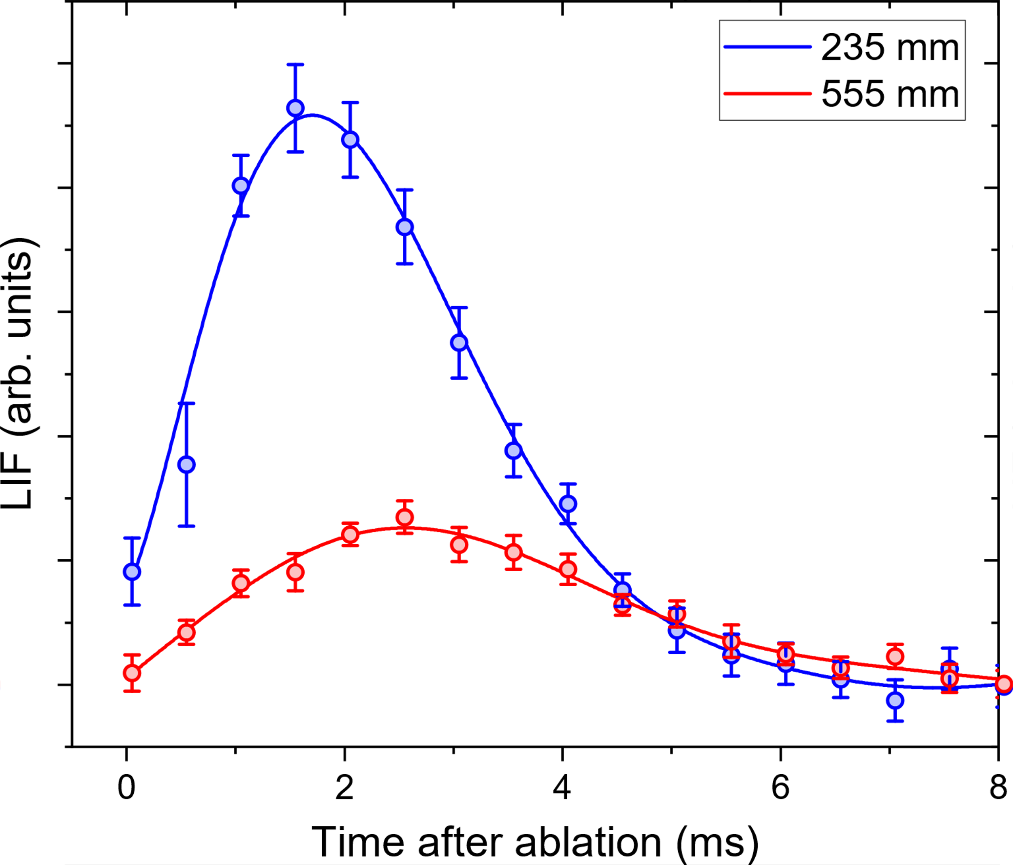
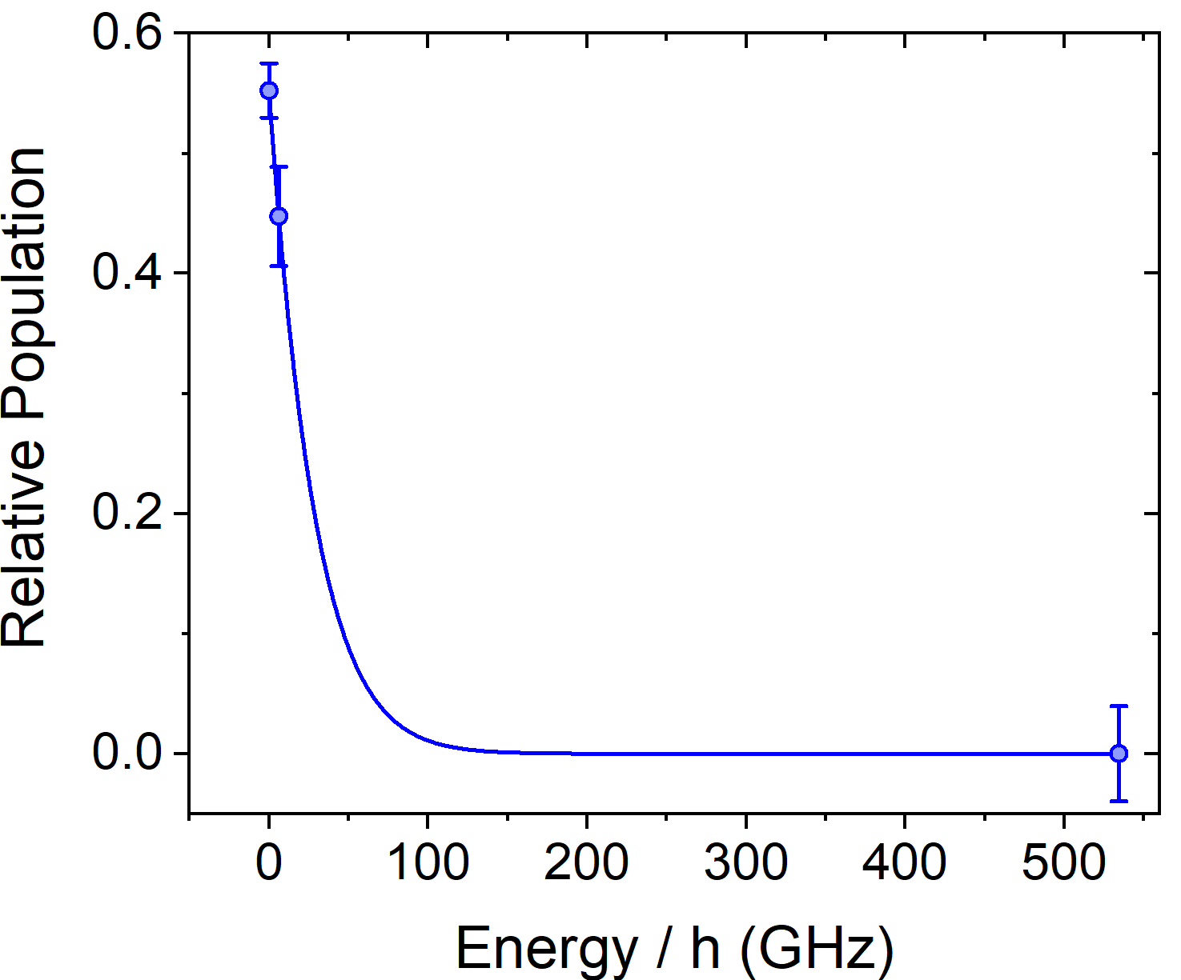
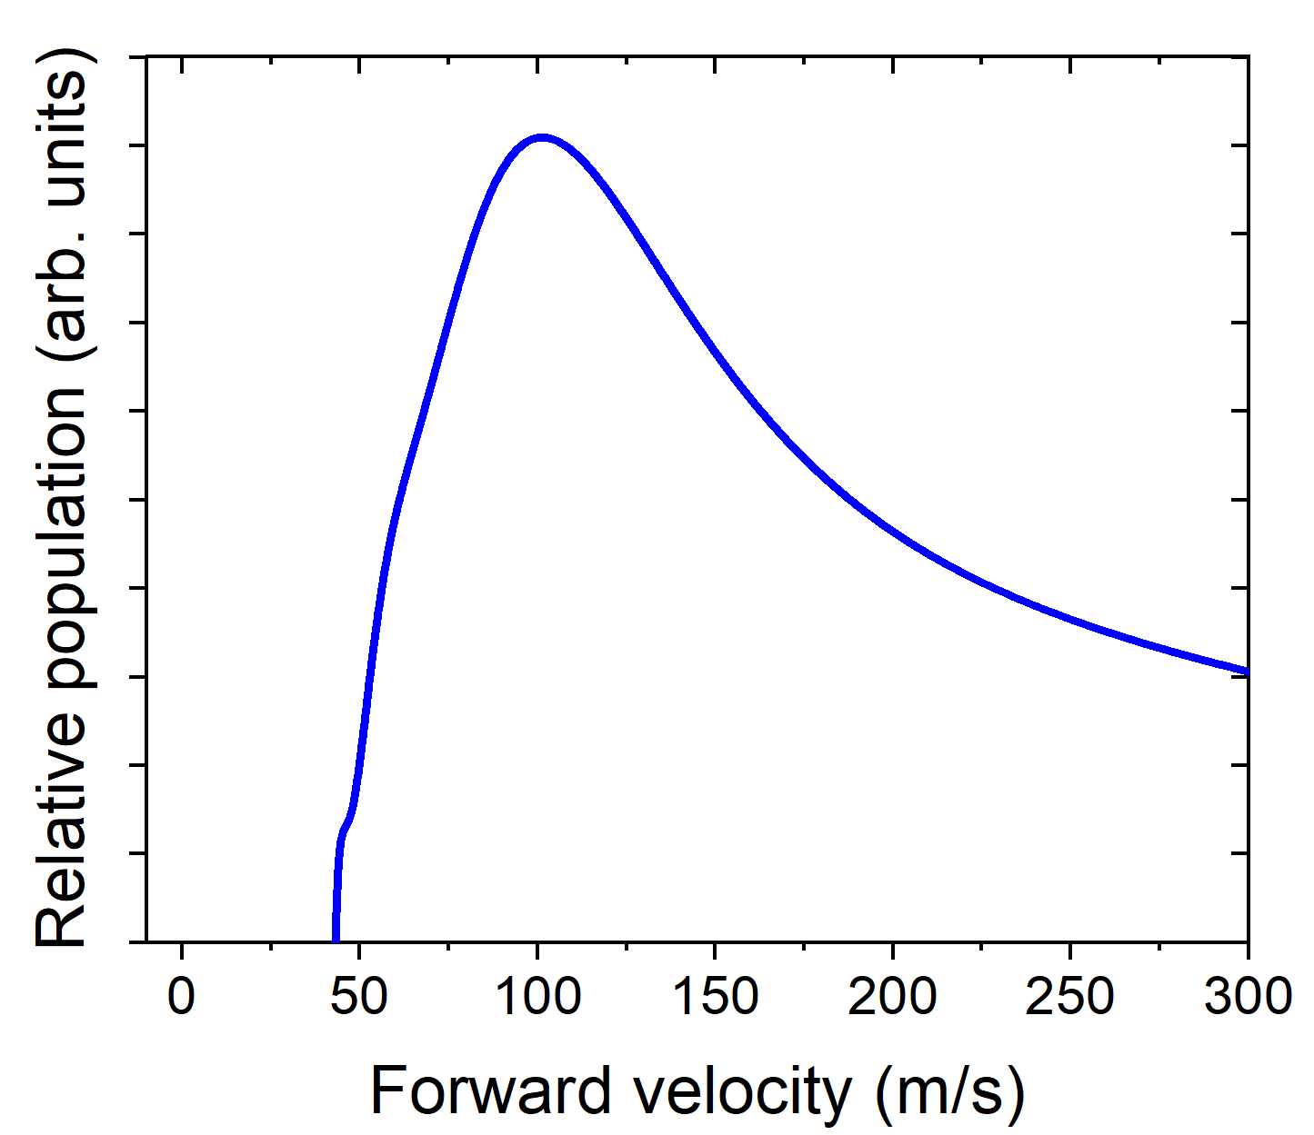
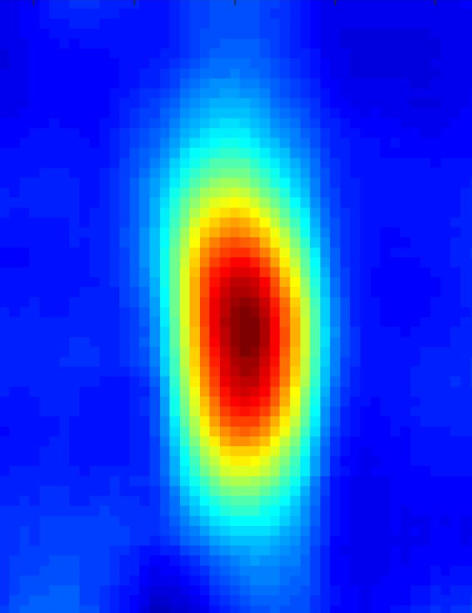
A cold, slow beam of CH
2 K
He
Cryogenic buffer gas beam source
→ sympathetic cooling of any* species
|N=1, J=1/2⟩
Λ-doublet
T_{rot} = 0.8(3) K
~ 10⁹ /sr
Peak ~ 100 m/s
~1400 photons

Slide 14
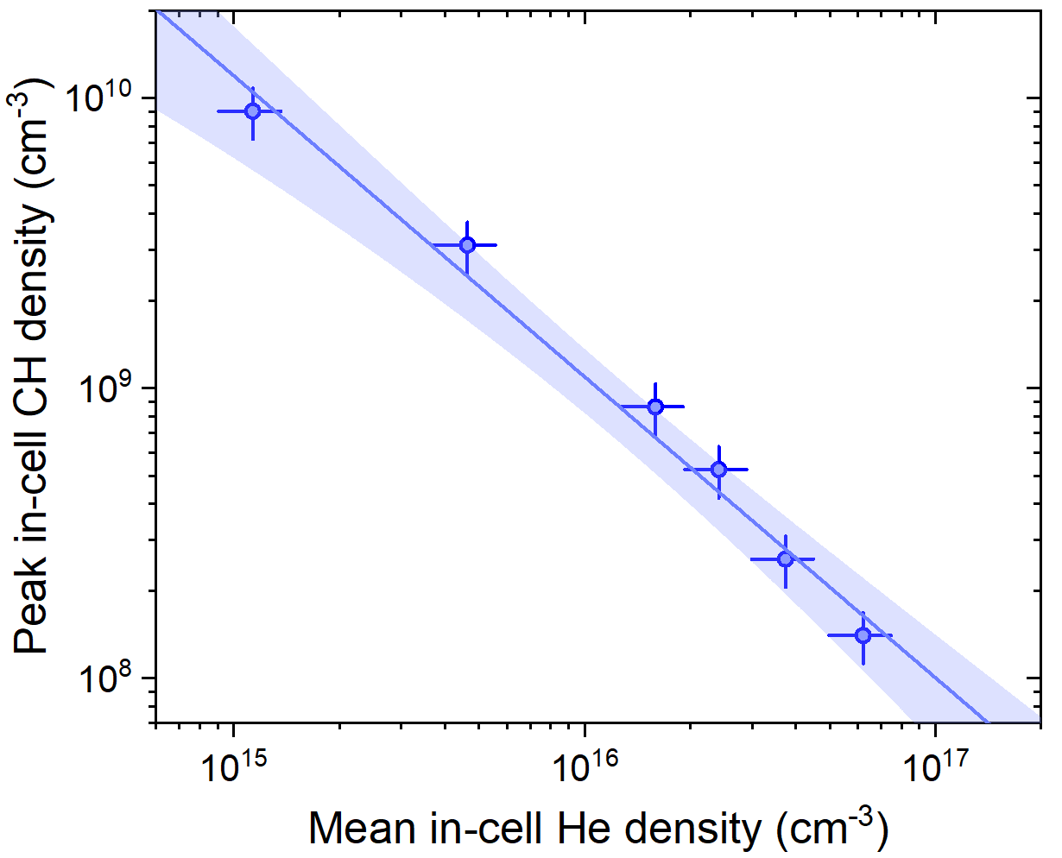
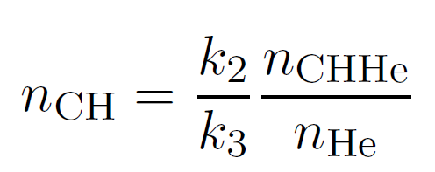
Controlled cold CH chemistry
Assuming steady state:
Predicted binding energy ~56 cm⁻¹ (!)
CH-HE PES: JCP 100, 1326 (1994)
Evidence of CHHe van der Waals
complex formation
Next: Spectroscopy to detect CHHe
AgHe (1.85 cm⁻¹): PRL 105, 033001 (2010)
LiHe (0.024 cm⁻¹): PRL 110, 153201 (2013)
TiHe (1.3 cm⁻¹): PRL 118, 213401 (2017)
we can control this!

Slide 15
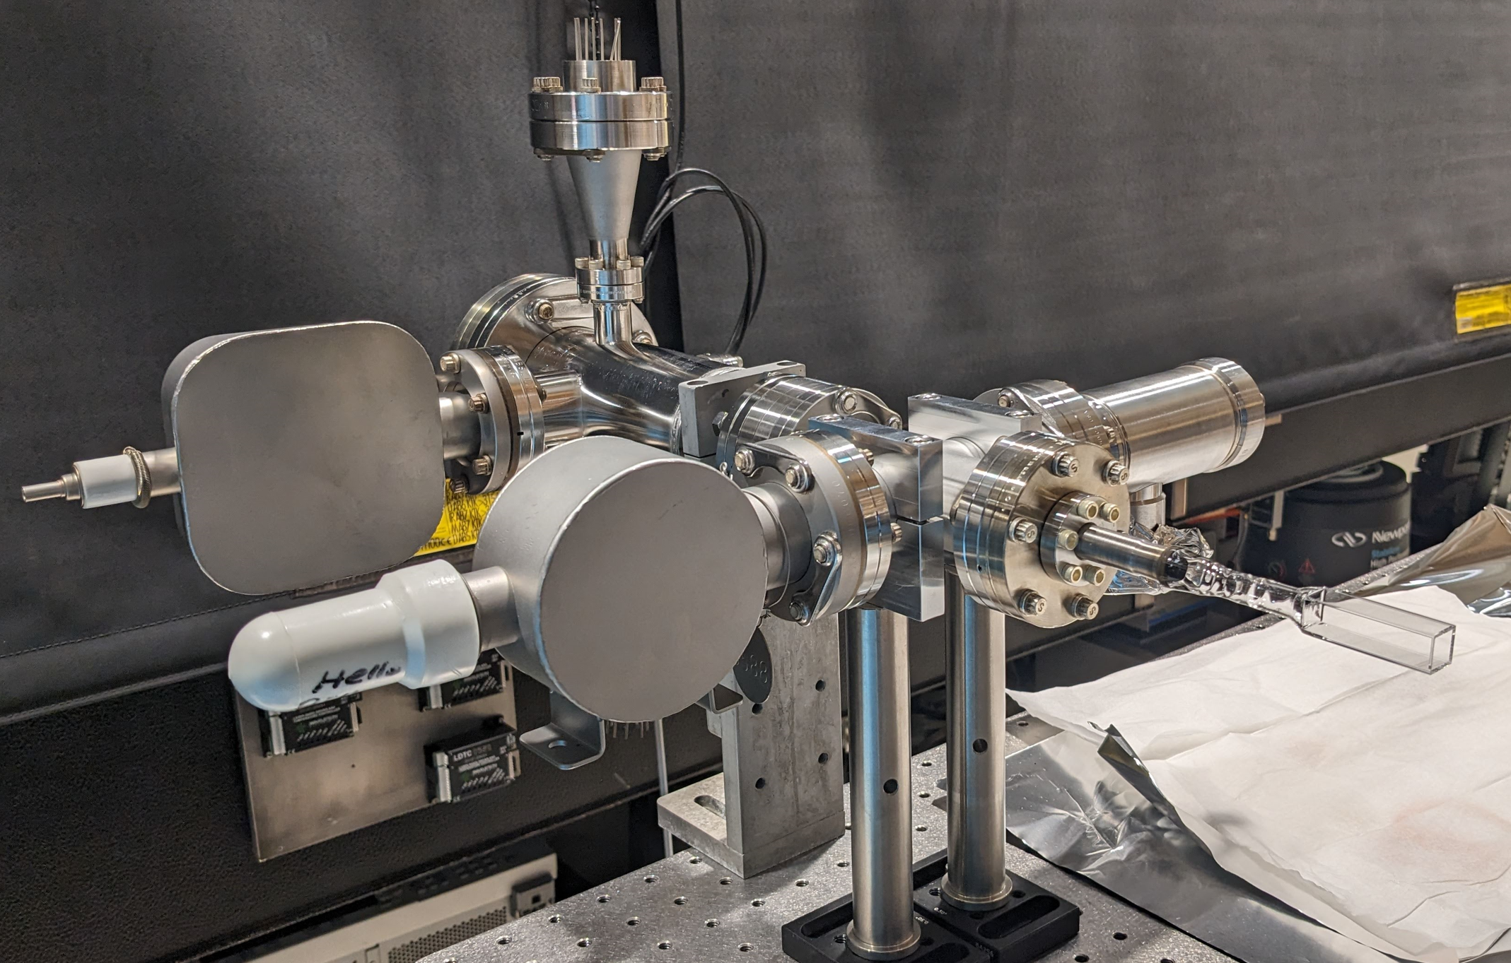
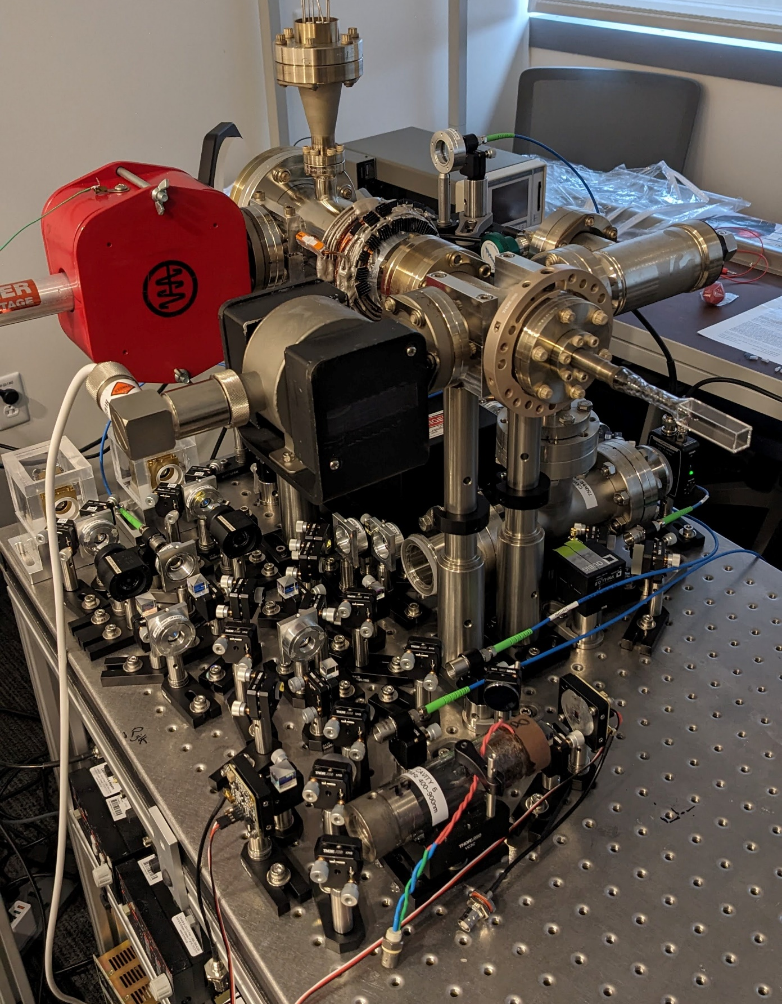
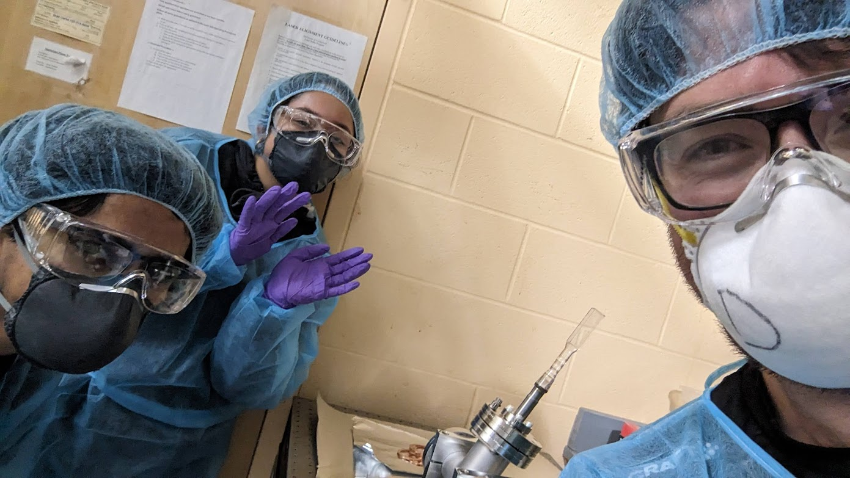
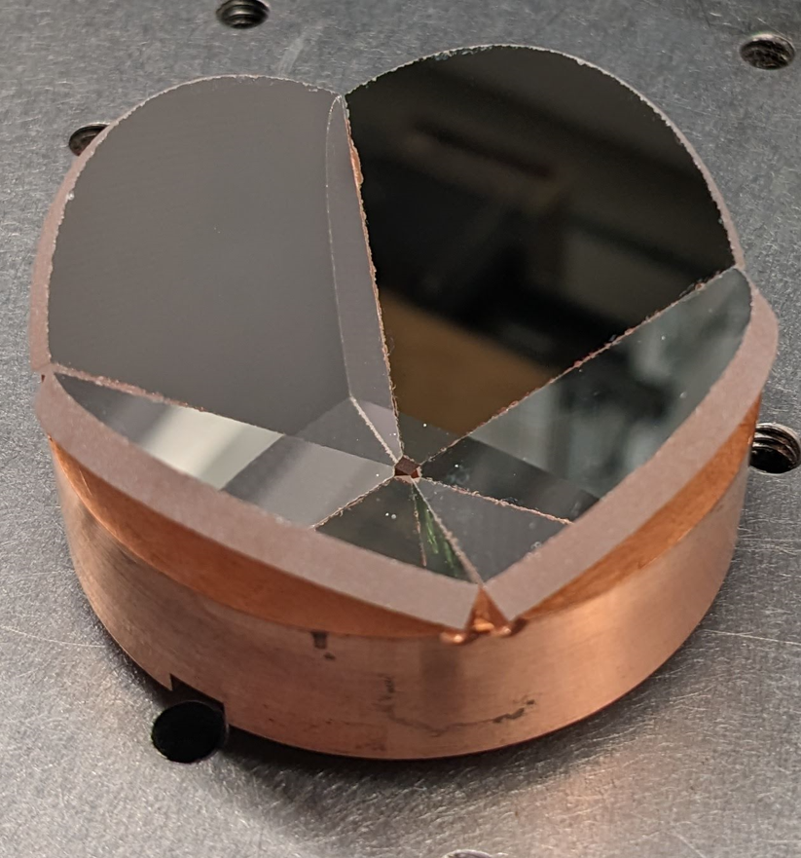
Aside: Quantum outreach (with Li atoms)
“Quantum Matters” – engaging local high school students in STEM
Laser-cooled lithium atoms
July 2023
Sept 2023
Jan 2024
Dec 2024

Slide 16
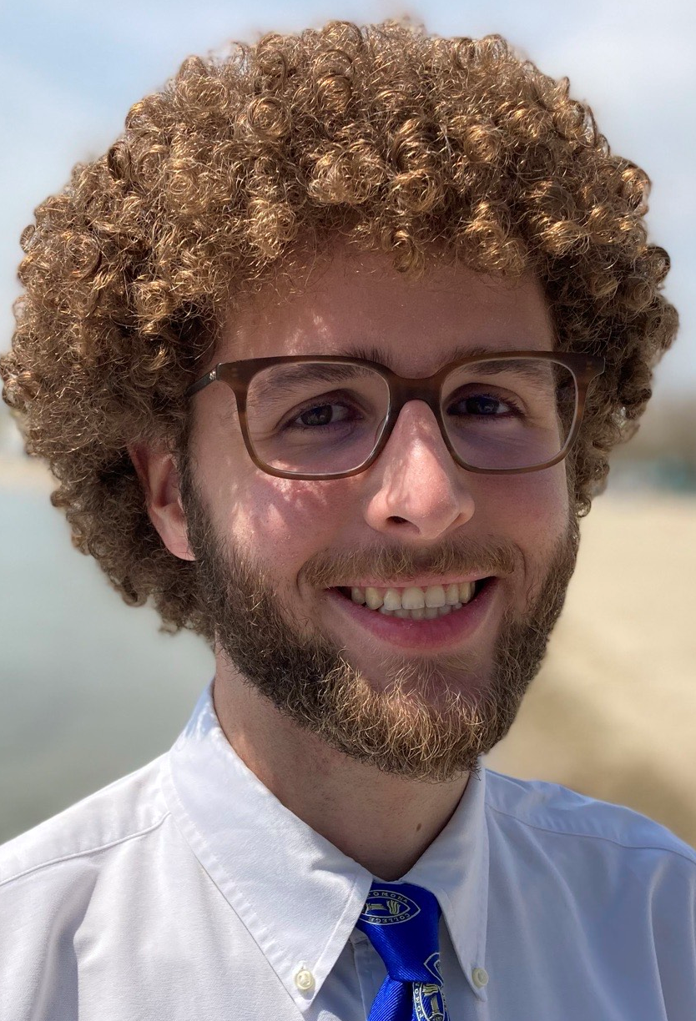
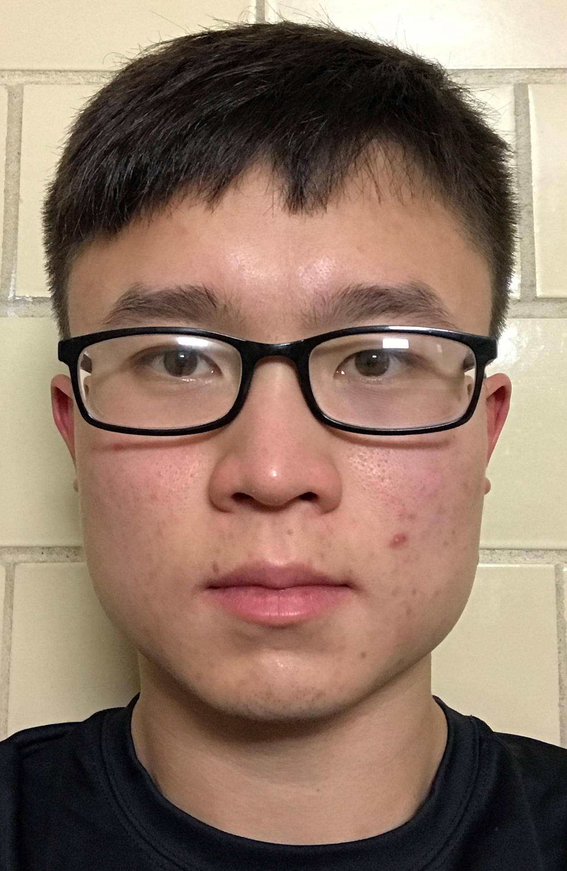
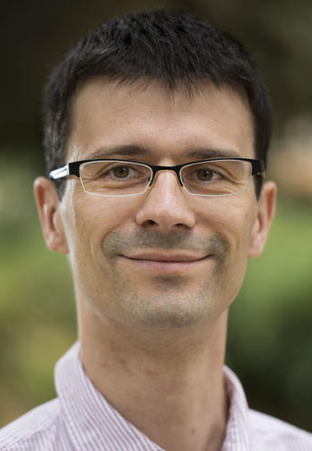
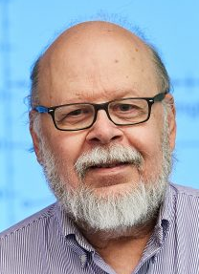
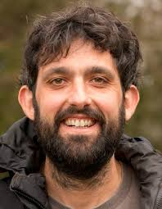
Our Group
Graduate Students
CH
AlCl
@mccarrongroup
themccarrongroup.com
Former Grad. Students
Jamie Shaw – MIT LL
Joseph Schnaubelt - UConn
Aritra Paul
Alex Preston
Mark Semco
William Wortley
Undergraduate Students
Collaborators
DURIP
Spencer Macri
Joseph Van Vlack
Jefferson Wang
Börge
Hemmerling
John
Montgomery
Jesus
Perez Rios

Slide 17
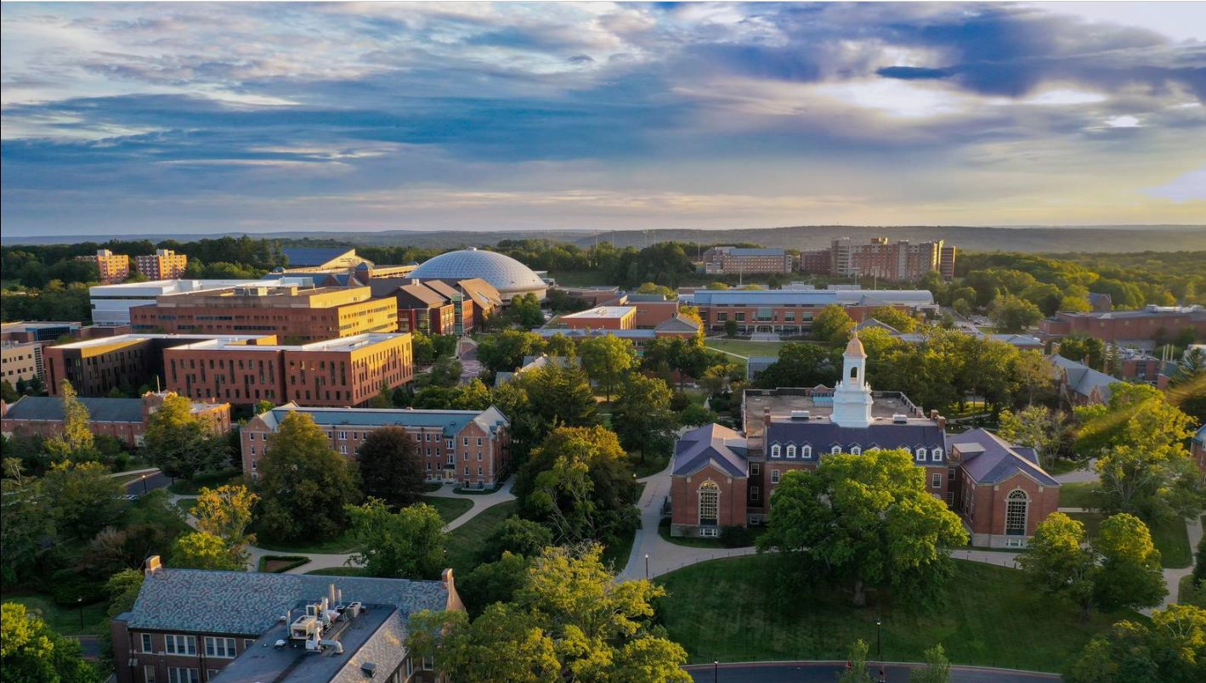
Please keep in touch! daniel.mccarron@uconn.edu

Slide 18
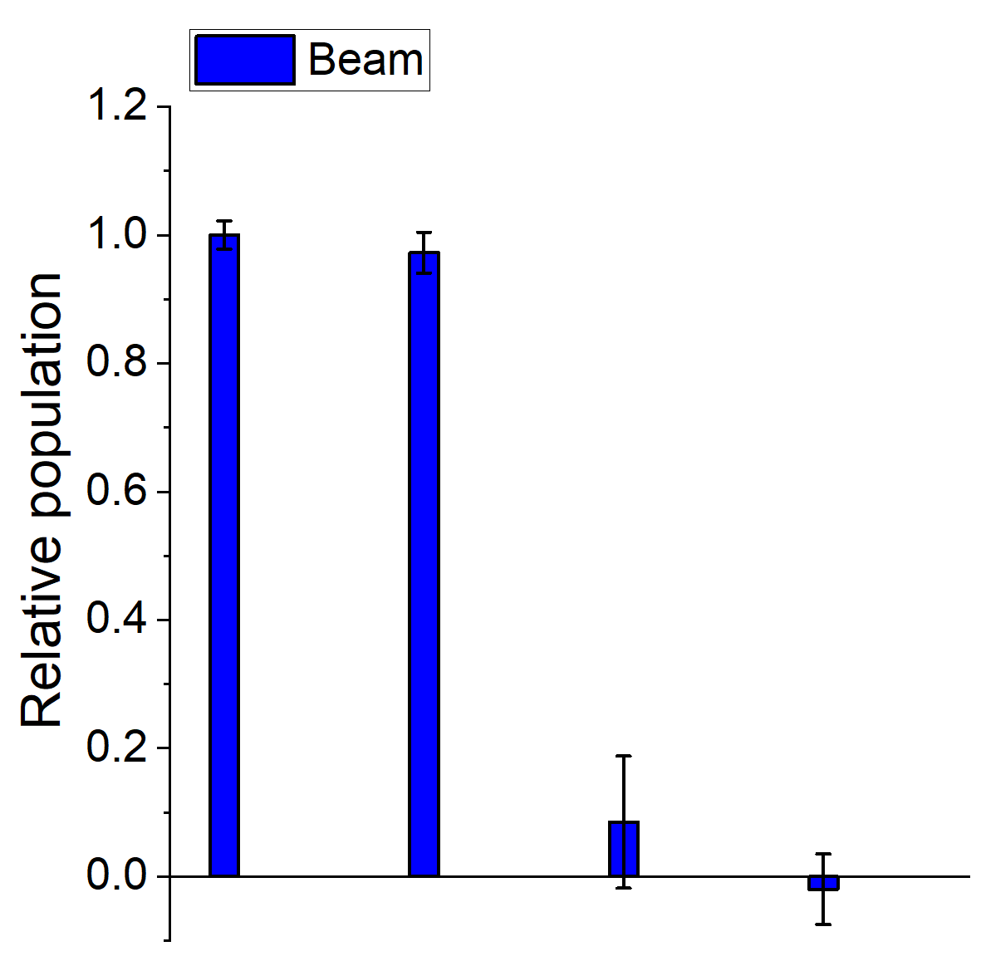
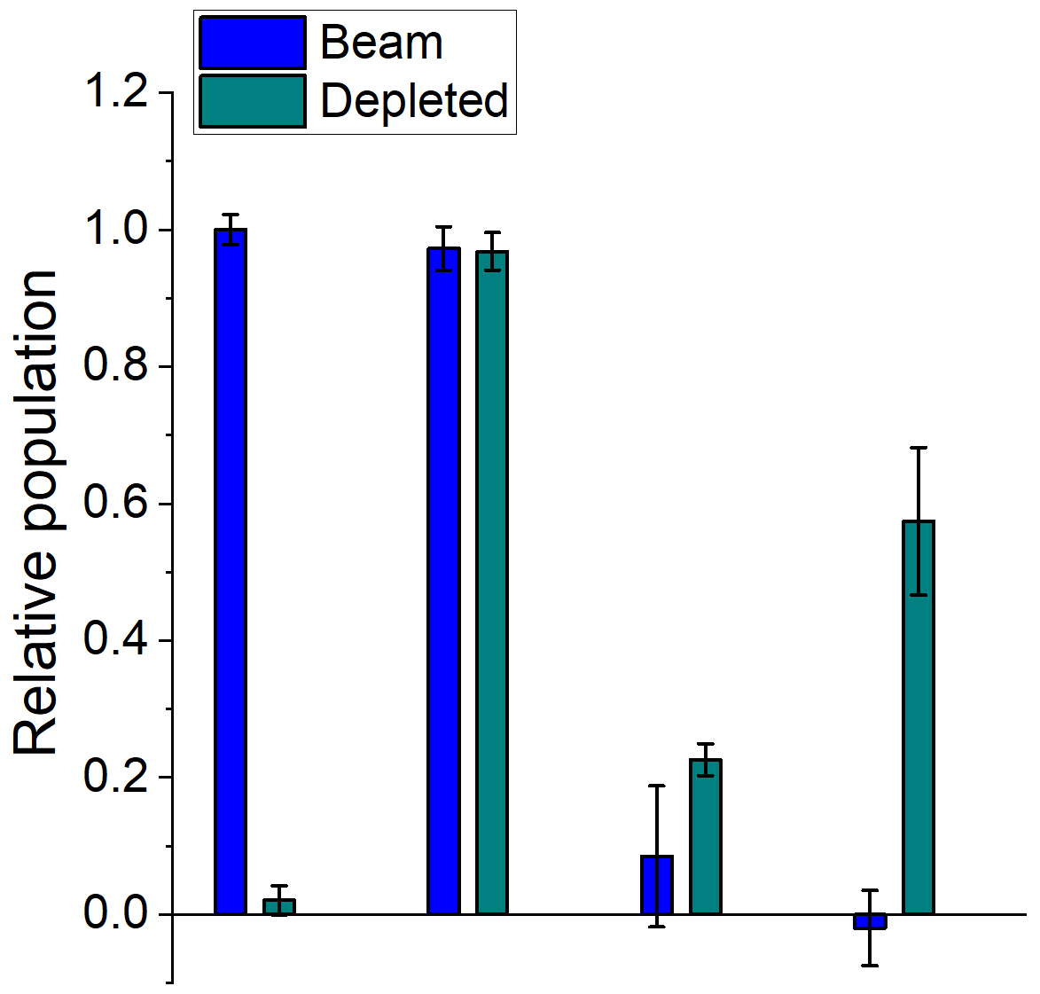
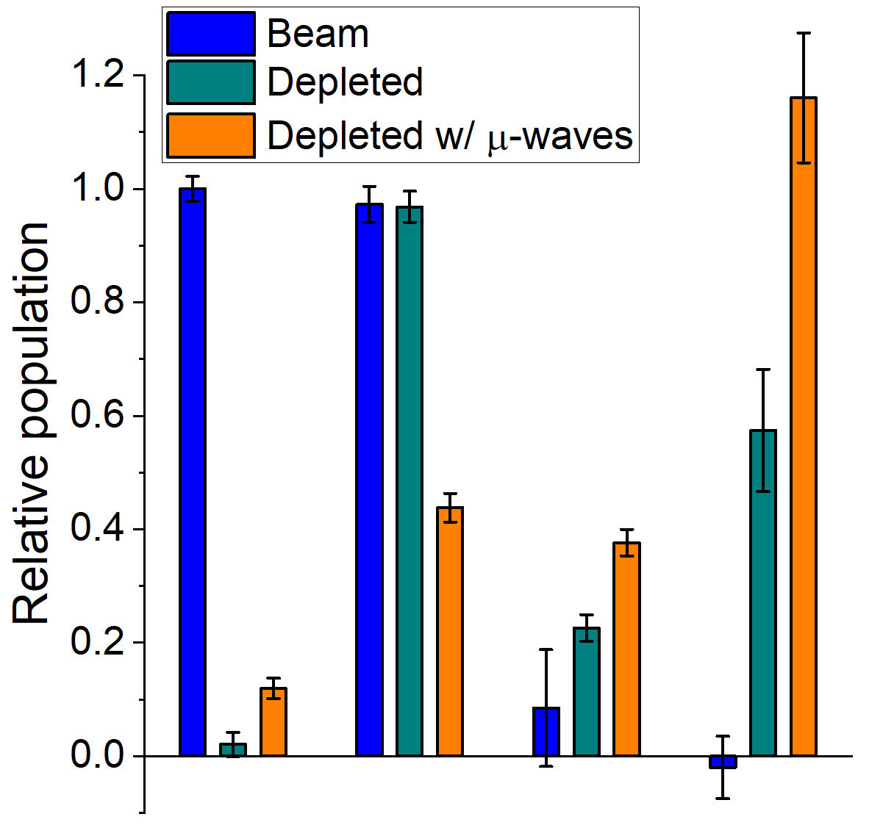
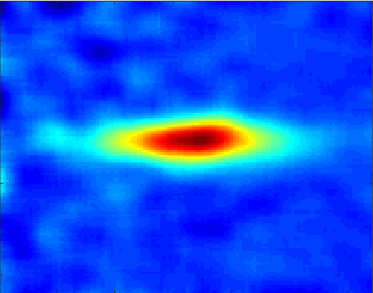
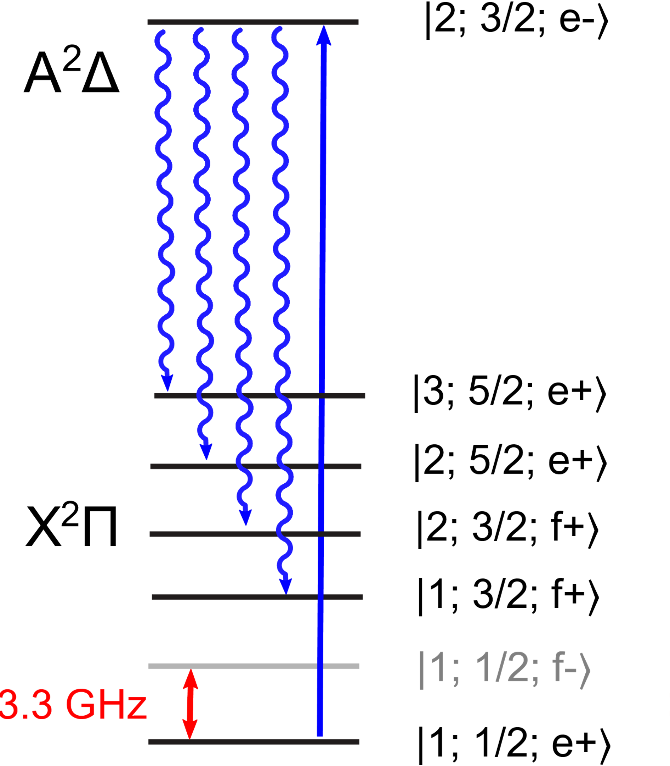
Navigating Parity Doublets in CH
Optical cycling
in CH
~4 photons/mol.
f₀
Probe
430 nm
|N=1, J=1/2⟩
Λ-doublet
Γ=2π(300 kHz)
5 mm
f₀ – 10 MHz
~ 10⁹ /sr
T_{rot} = 0.8(3) K
f₀ + 10 MHz
Detected
populations
f_{0,} f₀±10 MHz
EMCCD
Transfer ~60% of odd parity molecules into even states
Depl.
Probe

Slide 19
A radiative force in CH
equivalent to ~30 photons w/ CaF
or ~50 photons w/ SrF
or ~80 photons w/ YbF
0.76 rotational closure → 1/(1-0.76) = 4.2 photons max.
|1; 3/2; f+⟩ in beam (no cycling lasers) ~600 kHz detuned
Remixing:Type-I
Pol. Mod.
B-field
-0.98(8) mm def.
5(2) photons
(error from velocity spread)

Slide 20
Probing the CH-CH PES:
Short-range dipole-dipole interactions
Most pathways make HC≡CH
Can detect HC≡CH in IR @ 1.5 μm

Slide 21
How to make CH radicals?
J. D. Weinstein, H. J. Lewandowski, PRA 90, 033418 (2014)
J. D. Weinstein, EPJD 74, 132 (2020)
In-cell absorption
Probe Beam
(X-A @ 431 nm)
= 0
Reproducible
& durable
No density
dep. loss
N_{cell} ~ 10¹¹
Paraffin wax, C_{n}H_{2n+2}
Iodoform,
CHI₃
Ablation targets recently improved
Kapton

Slide 22
Uncontrolled cold CH chemistry I
Inelastic loss → Cold organic chemistry
β₀ changes by orders of magnitude…
NOT CH-CH
other undetected species

Slide 23
Next steps…
Slowing threshold
MOT?
Transverse cooling
Increasing uncertainty
Deflection
Dispersed-LIF measurements on CH? 430 nm, 488 nm, 559 nm, 649 nm, 767 nm…

Slide 24
Laser cooling CH
Opposite parity states & HFS not shown for clarity.
v_{recoil} = 7.1 cm/s
Optical Cycling
10 lasers → ~5x10³ photons
Load pre-slowed CH into MOT
T_{recoil} = 8 μK
Beam Slowing
Stark deceleration
~0.1 m
Bichromatic force
~0.01 m
SrOH – Doyle
CaF - Eyler, DMc, Gould
DURIP
PCCP 13, 19036 (2011)
Phys. Rev. A 90 033418 (2014)
Eur. Phys. J. D 74, 132 (2020)
Pioneering work by Doyle Group CaOH experiment
J. Schnaubelt et al. in prep

Slide 25
Optical cycling in CH
(towards the ultracold regime)
τ = 540 ns
162.1(3) MHz
A²Δ
v’=0
FWHM ≃ 13 MHz
T_{CH} ≃ 8 mK
λ = 430 nm
v_{recoil} = 7.1 cm/s
T_{recoil} = 8 μK
b₀₀ =0.9940(3)
X²Π
v=0
13.7(3) MHz

Slide 26
Are 10 lasers enough?
Dispersed fluorescence → Isolated fluorescence
Idea: Image CH beam through split interference filters
+
=
Preliminary
430 nm
fluorescence
488 nm
fluorescence
559 nm
488 nm
430 nm
To do: i) calibrate imaging system at 430, 488 and 559 nm
move from detected to emitted photon ratio
ii) collect data using 488/559 nm filter
Is this number accurate?
If larger, fewer scattered photons ☹
PCCP 13, 19036 (2011)

Slide 27
Resonance Raman optical cycling

Slide 28
Laser Cooling
Centred on three simple concepts:
Excited
Resonance
Photons carry momentum
The Doppler effect
ω₀
Ground

Slide 29
Laser Cooling I – Radiation Pressure
Photons carry momentum → absorbing a photon exerts a force on atom
photon
Excited
2. Momentum kick
Energy
Ground
1. Absorbs a photon
3. Emits photon in
random direction
SrF: m = 107 amu
4. Momentum kick
in random direction
λ = 663 nm
Δv ~ 5 mm/s
NET FORCE IN DIRECTION OF LASER BEAM

Slide 30
Laser Cooling II – The Doppler effect
Excited
Transition between states depends on frequency
ω_{B}
Too high, too low => no absorption
ω ~ ω₀ => light force
ω₀
ω_{R}
Ground
Doppler effect modifies frequency seen by moving atom
Deliberately tune laser to lower frequency (red) ω < ω₀
Stationary Atom
No Force
Atom Moving Toward Laser
Force opposing velocity =
Cooling Force!
v
v-Δv

Slide 31
Laser Cooling III – Optical Molasses
Use two lasers, in opposite directions, both tuned to same lower freq.
Laser 1
Laser 2
Absorb from Laser 1
Slow down
Atoms move right:
Absorb from Laser 2
Slow down
Atoms move left:
Opposes motion in either direction!
F = − α v
Like viscous fluid: “Optical Molasses”
Cooling Force in 1-D (compresses velocity distribution)
T = 10-100 μK routine
Trapping & evaporative
cooling: 10-100 nK
NOT A TRAP

