Slide 1
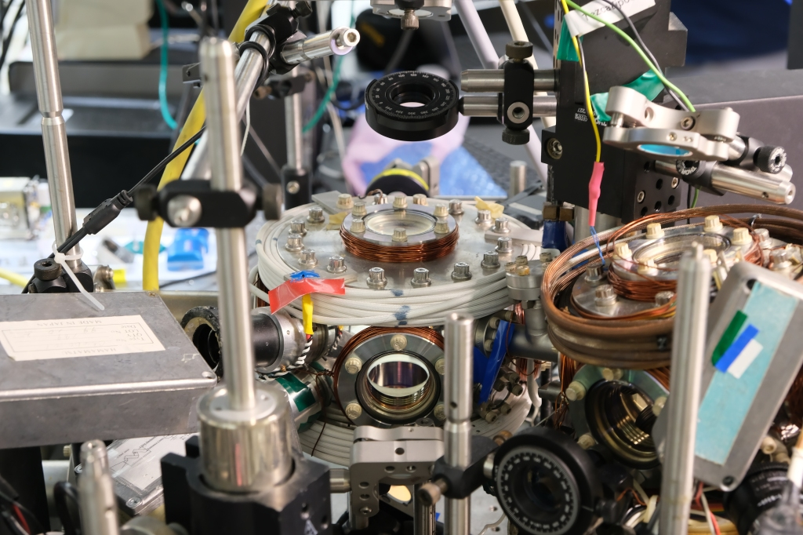
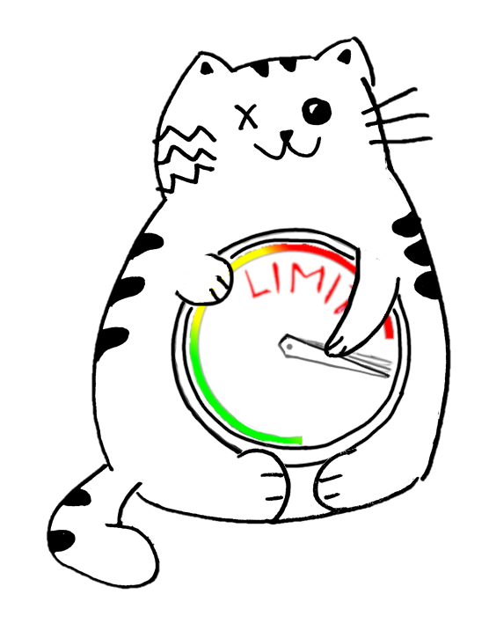
Simone Colombo
Cavity QED Quantum Simulator
Assistant Professor, Physics, UCONN
The Colombo Lab
QIS workshop, UMass Boston, 13th to 15th of January, 2025

Slide 2
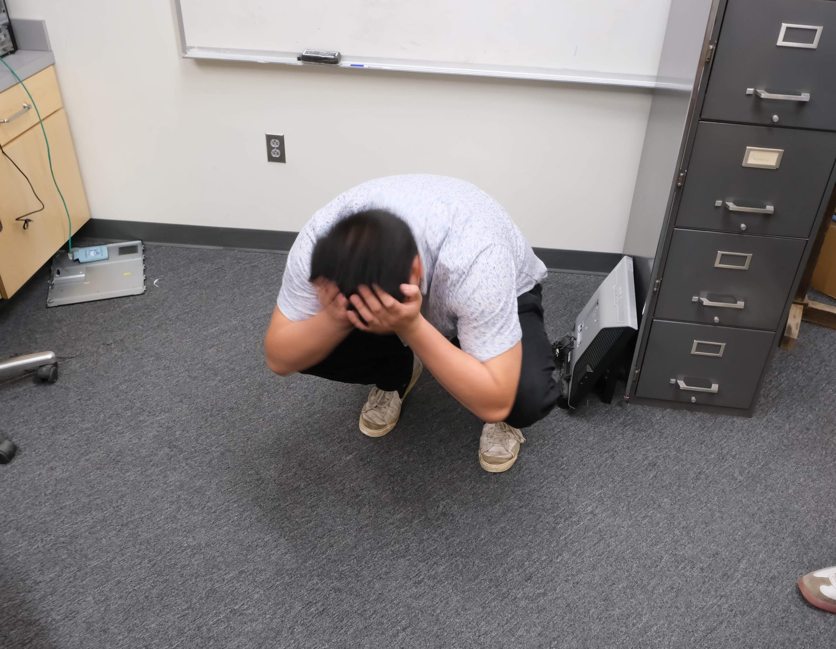
The Colombo Lab

Slide 3
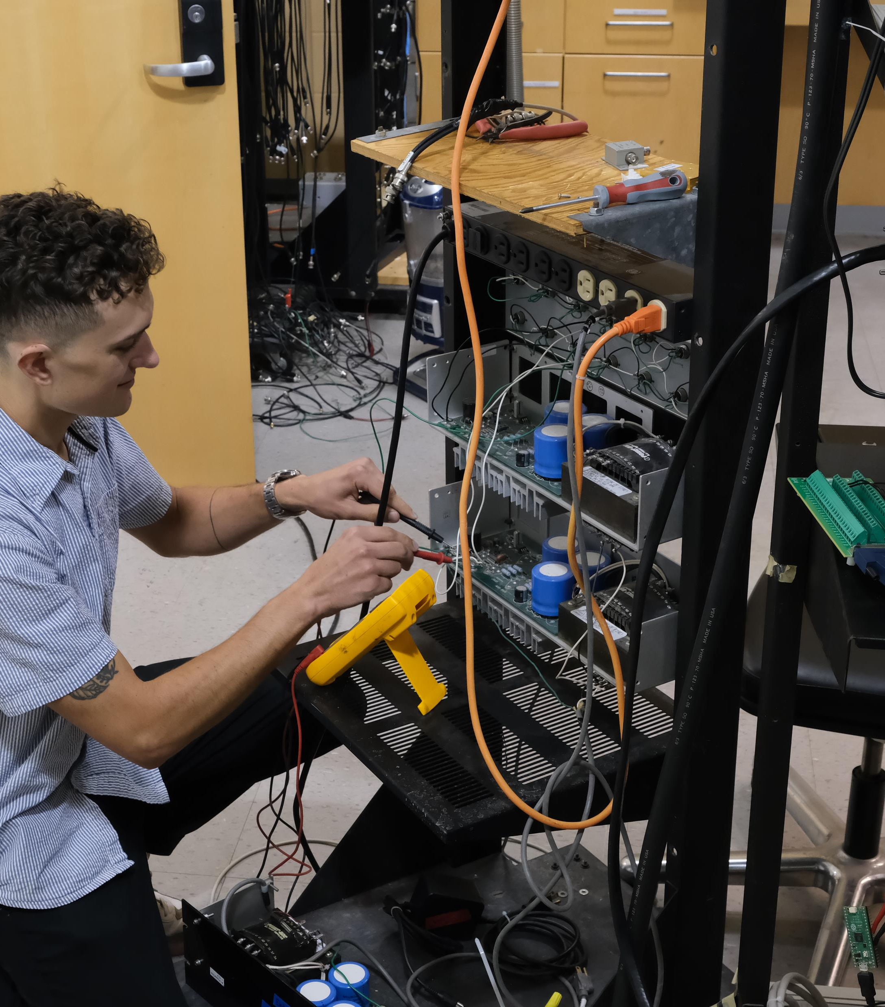
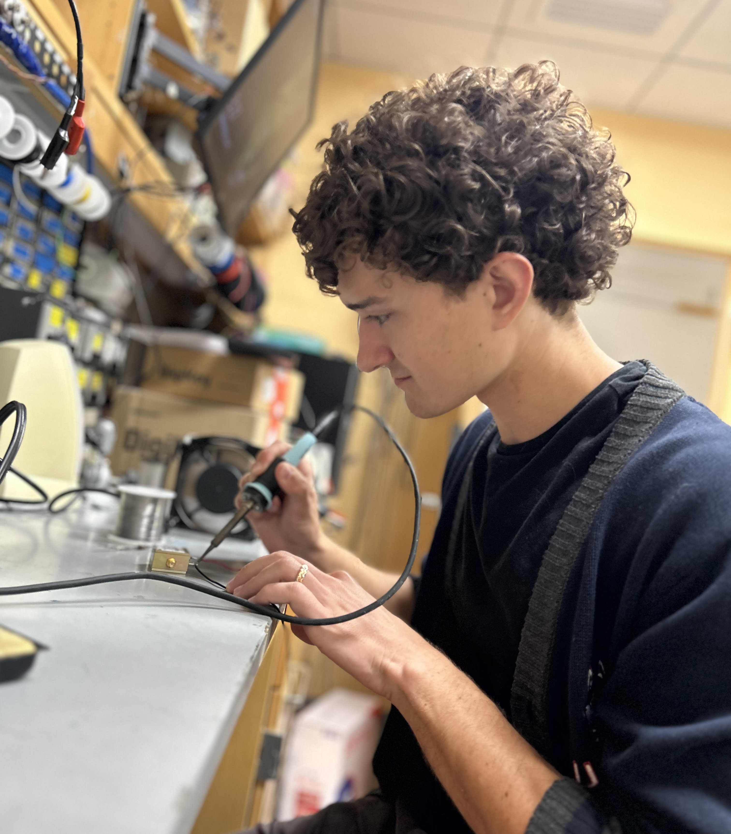
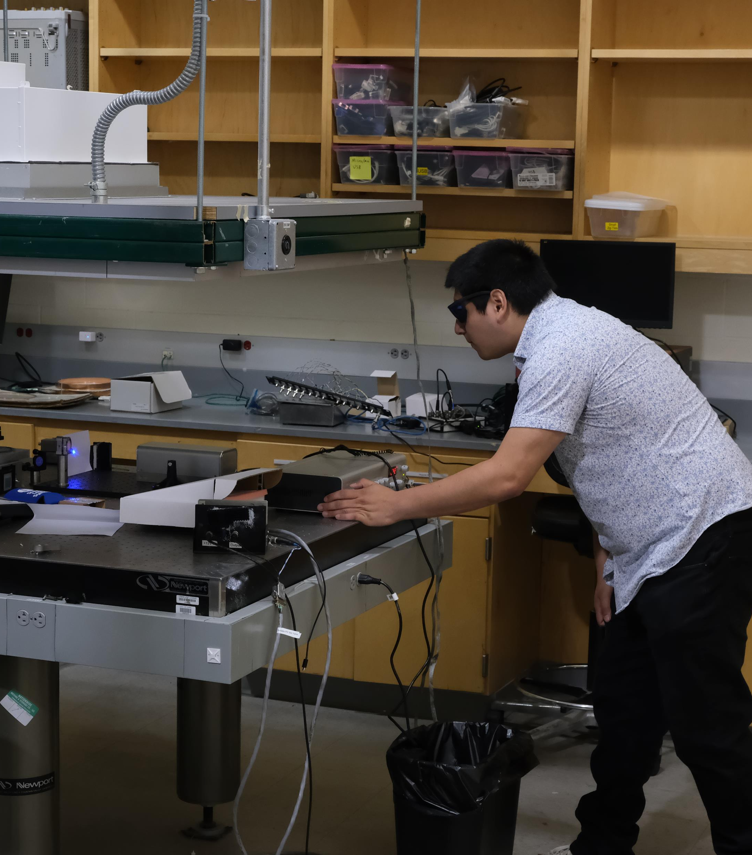
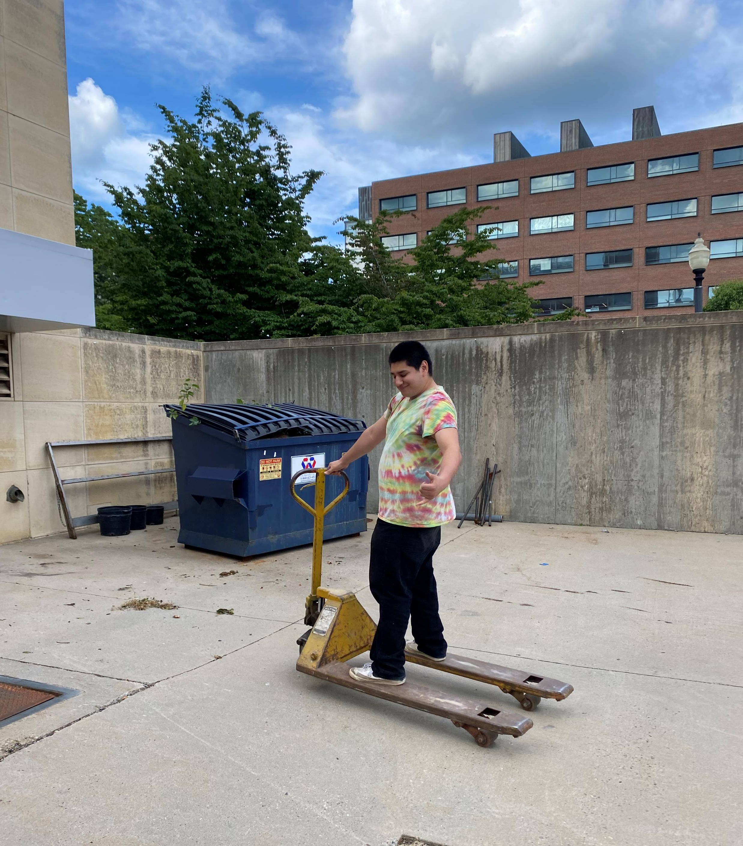
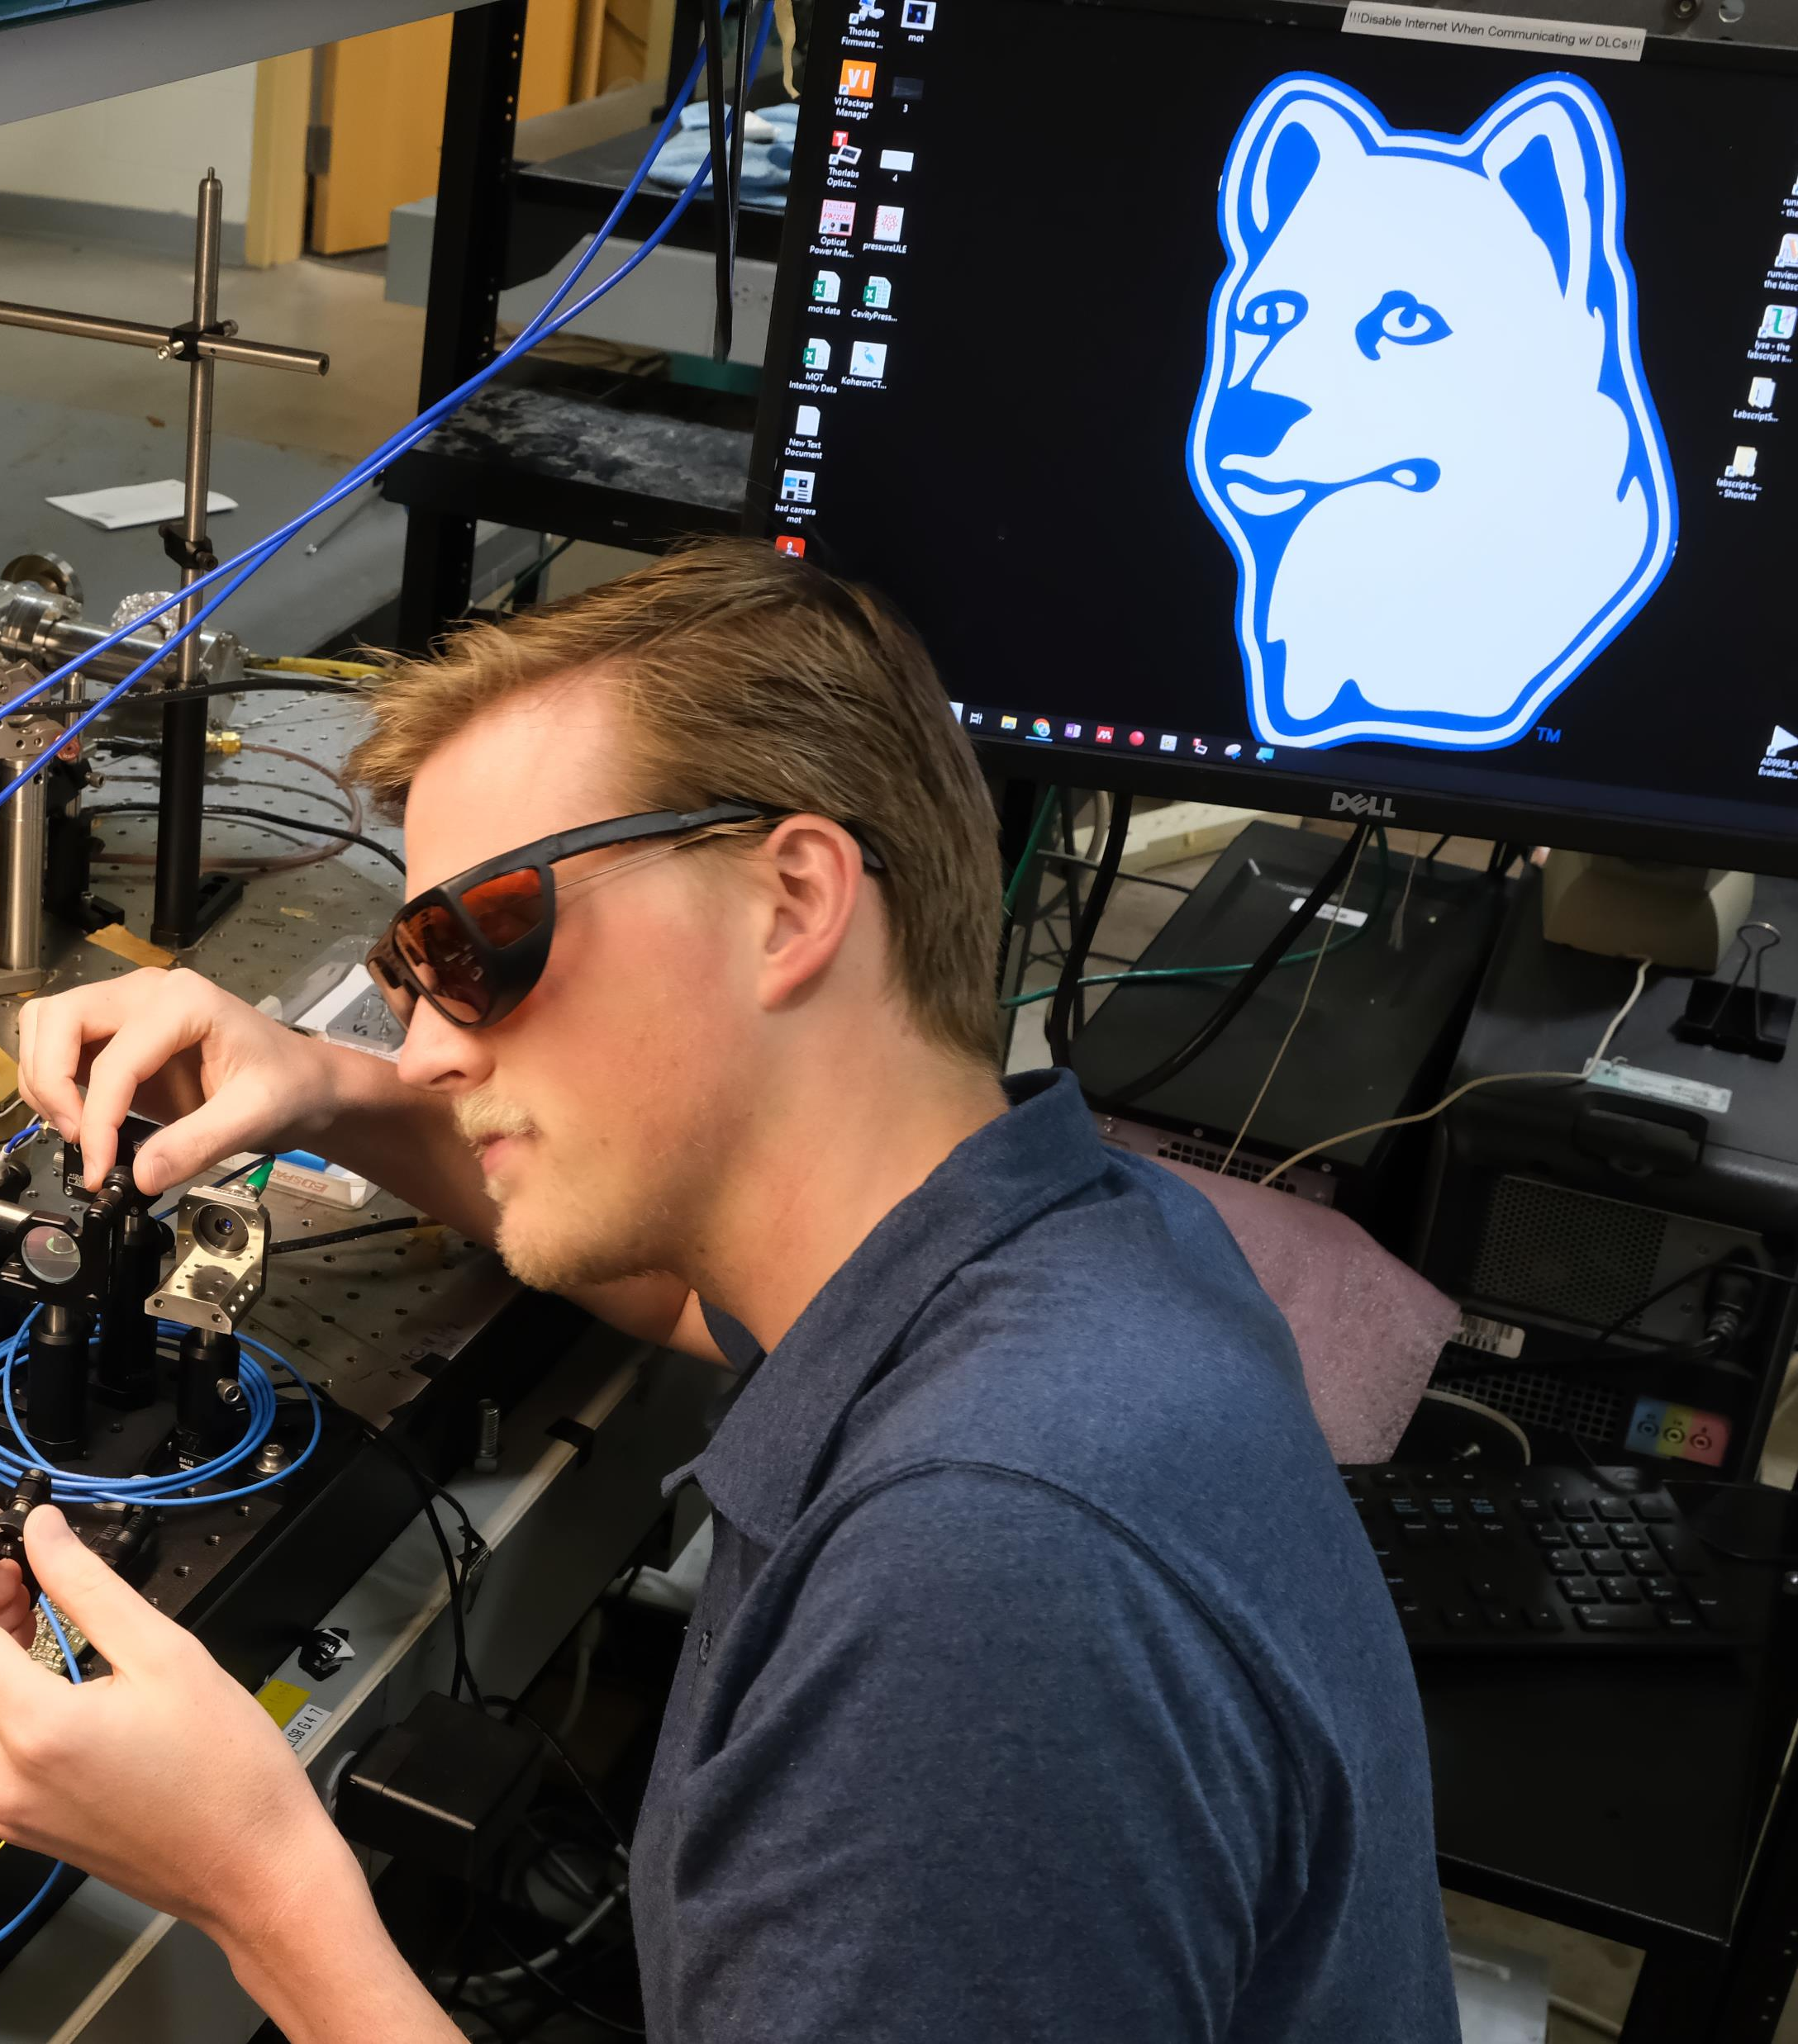
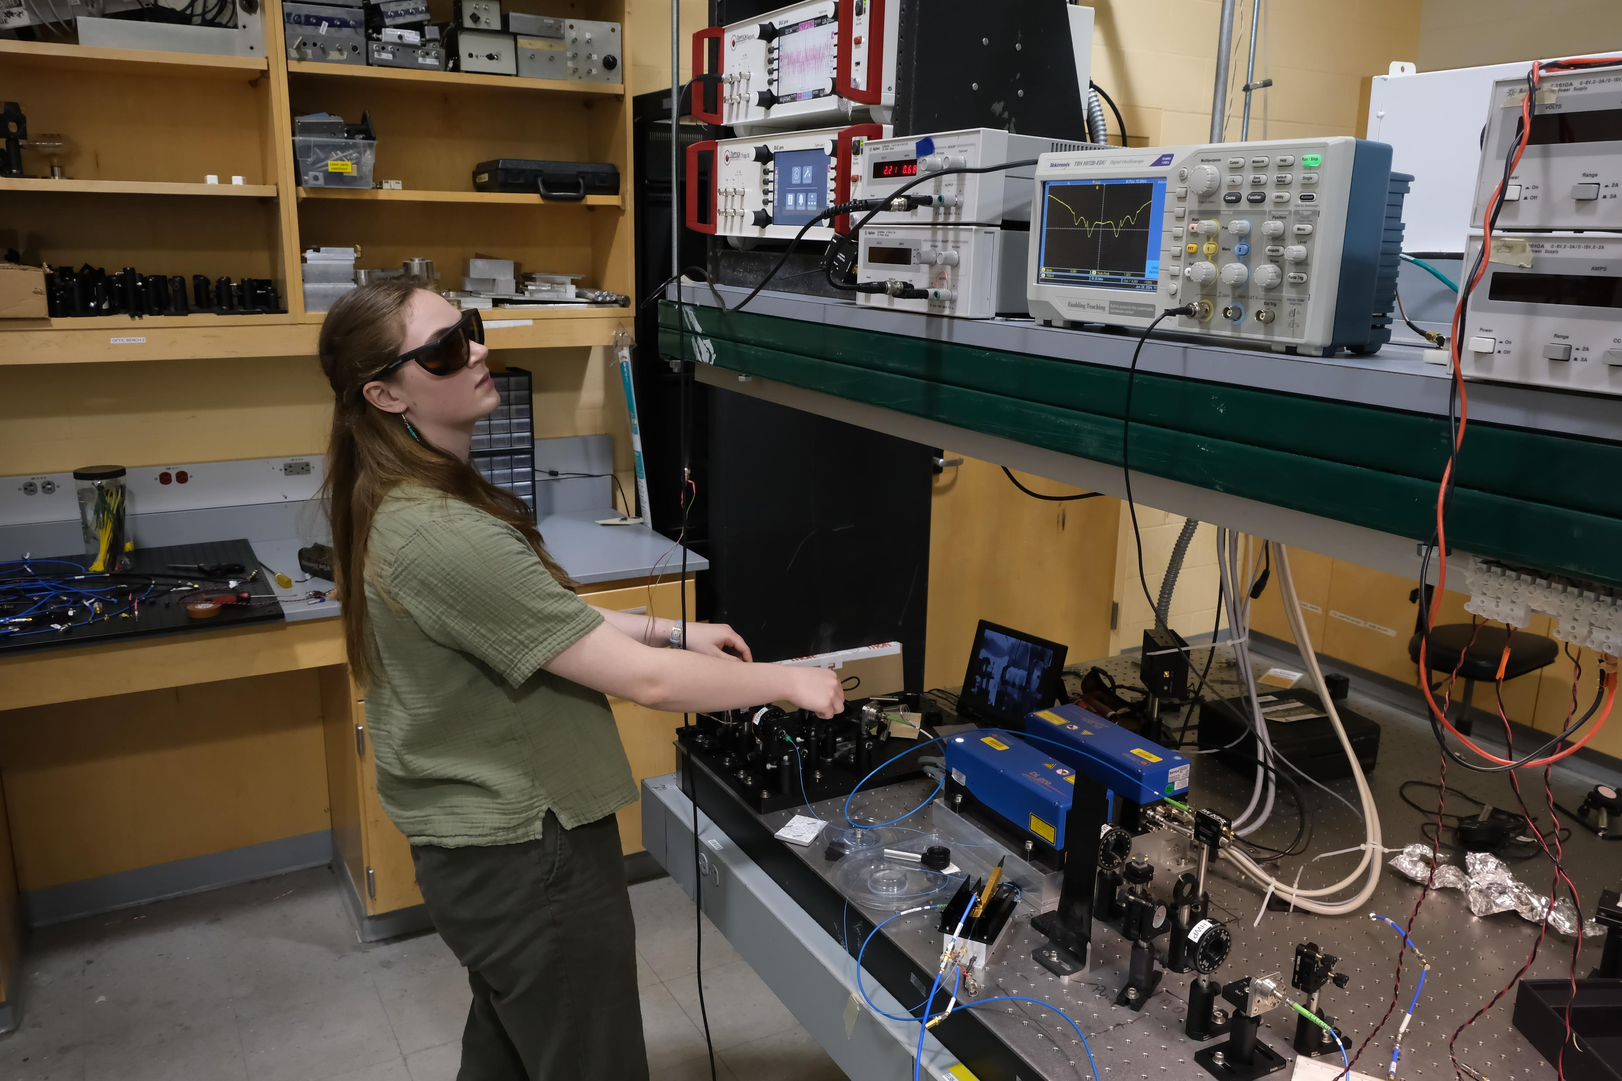
Summer Work

Slide 4
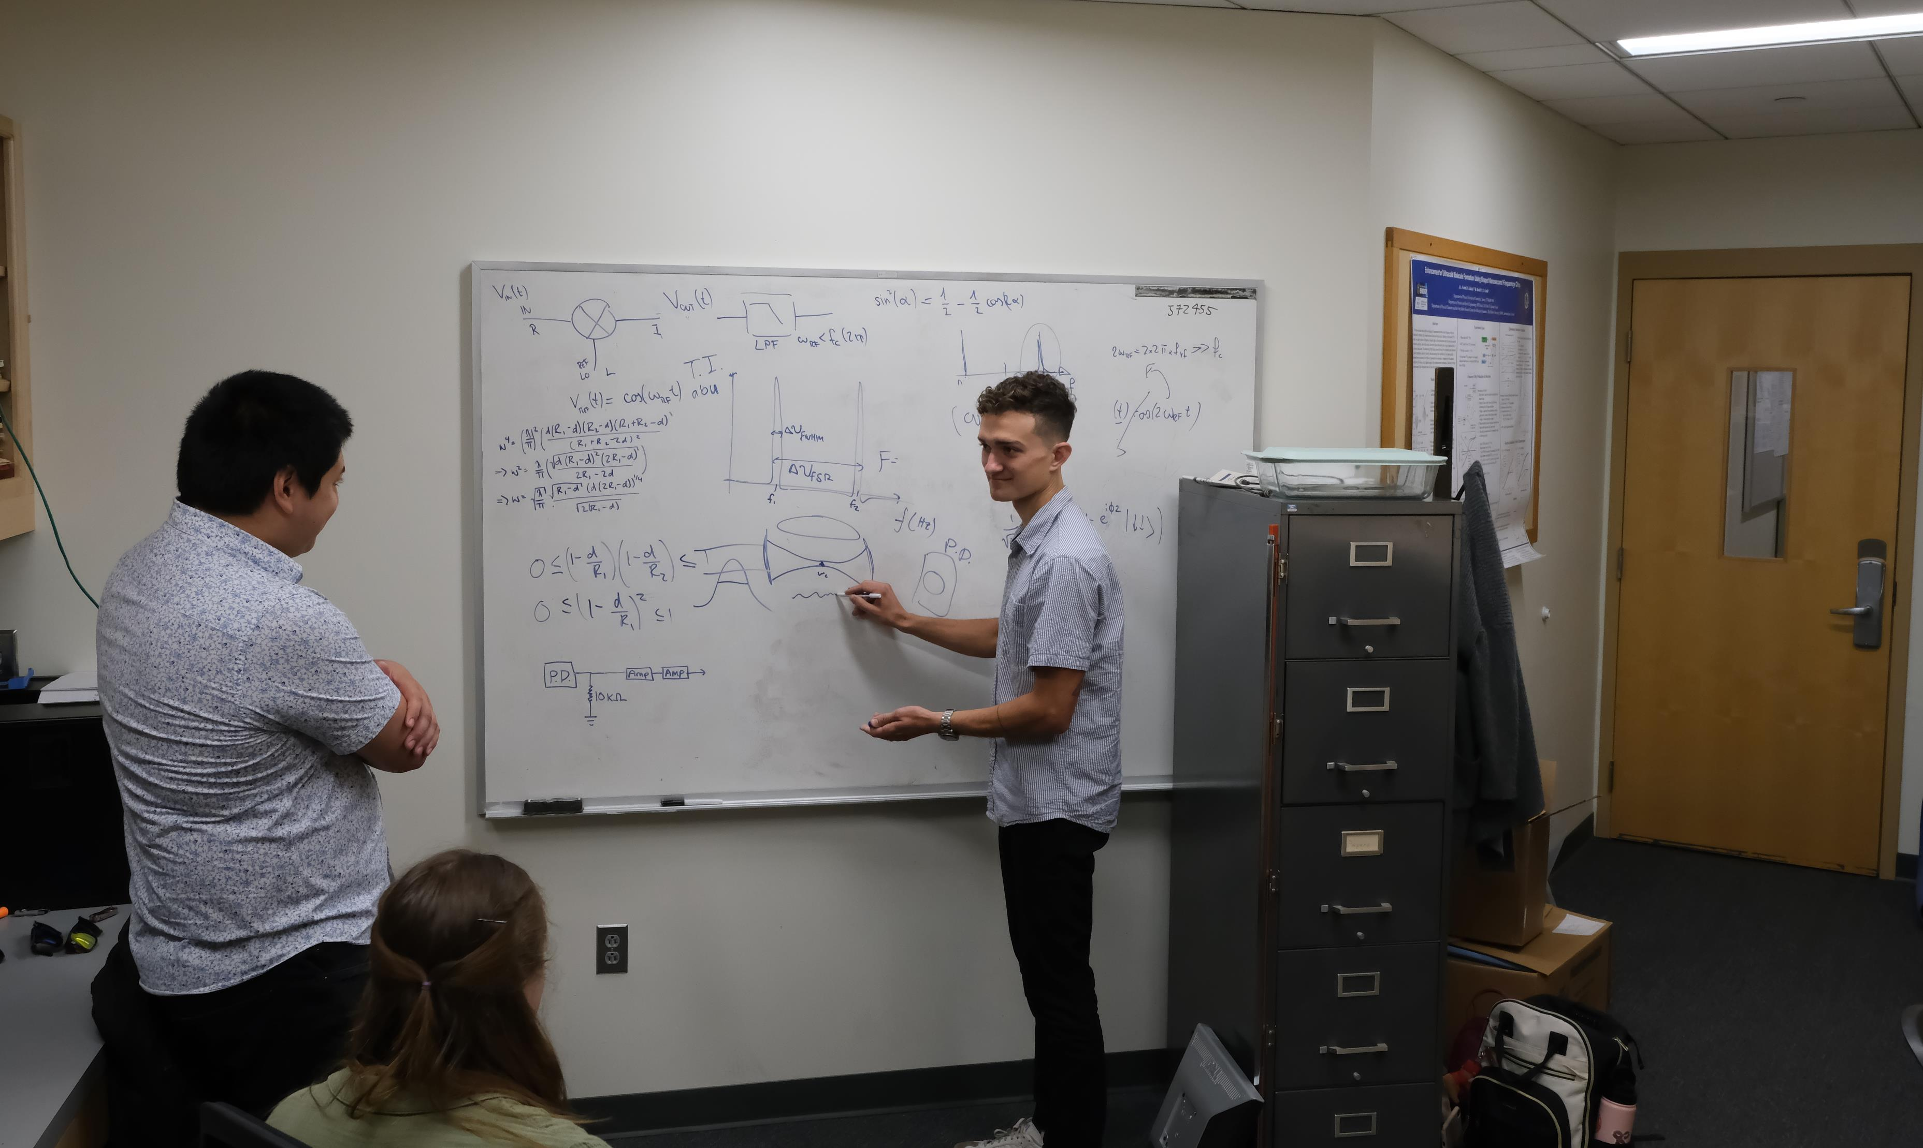
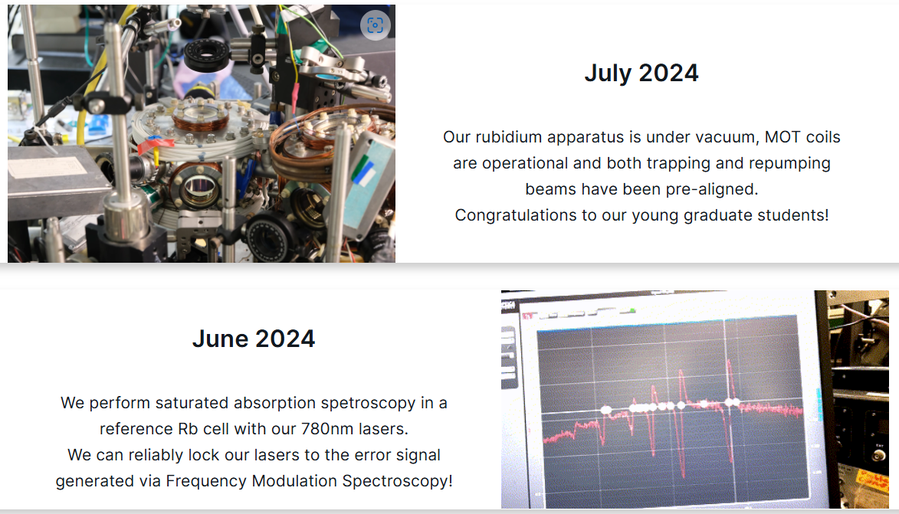
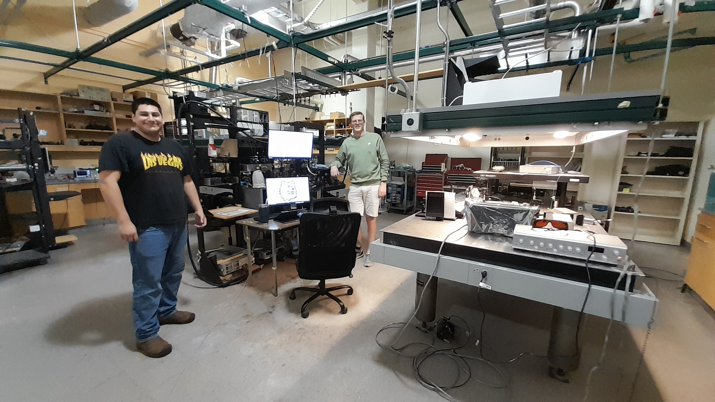
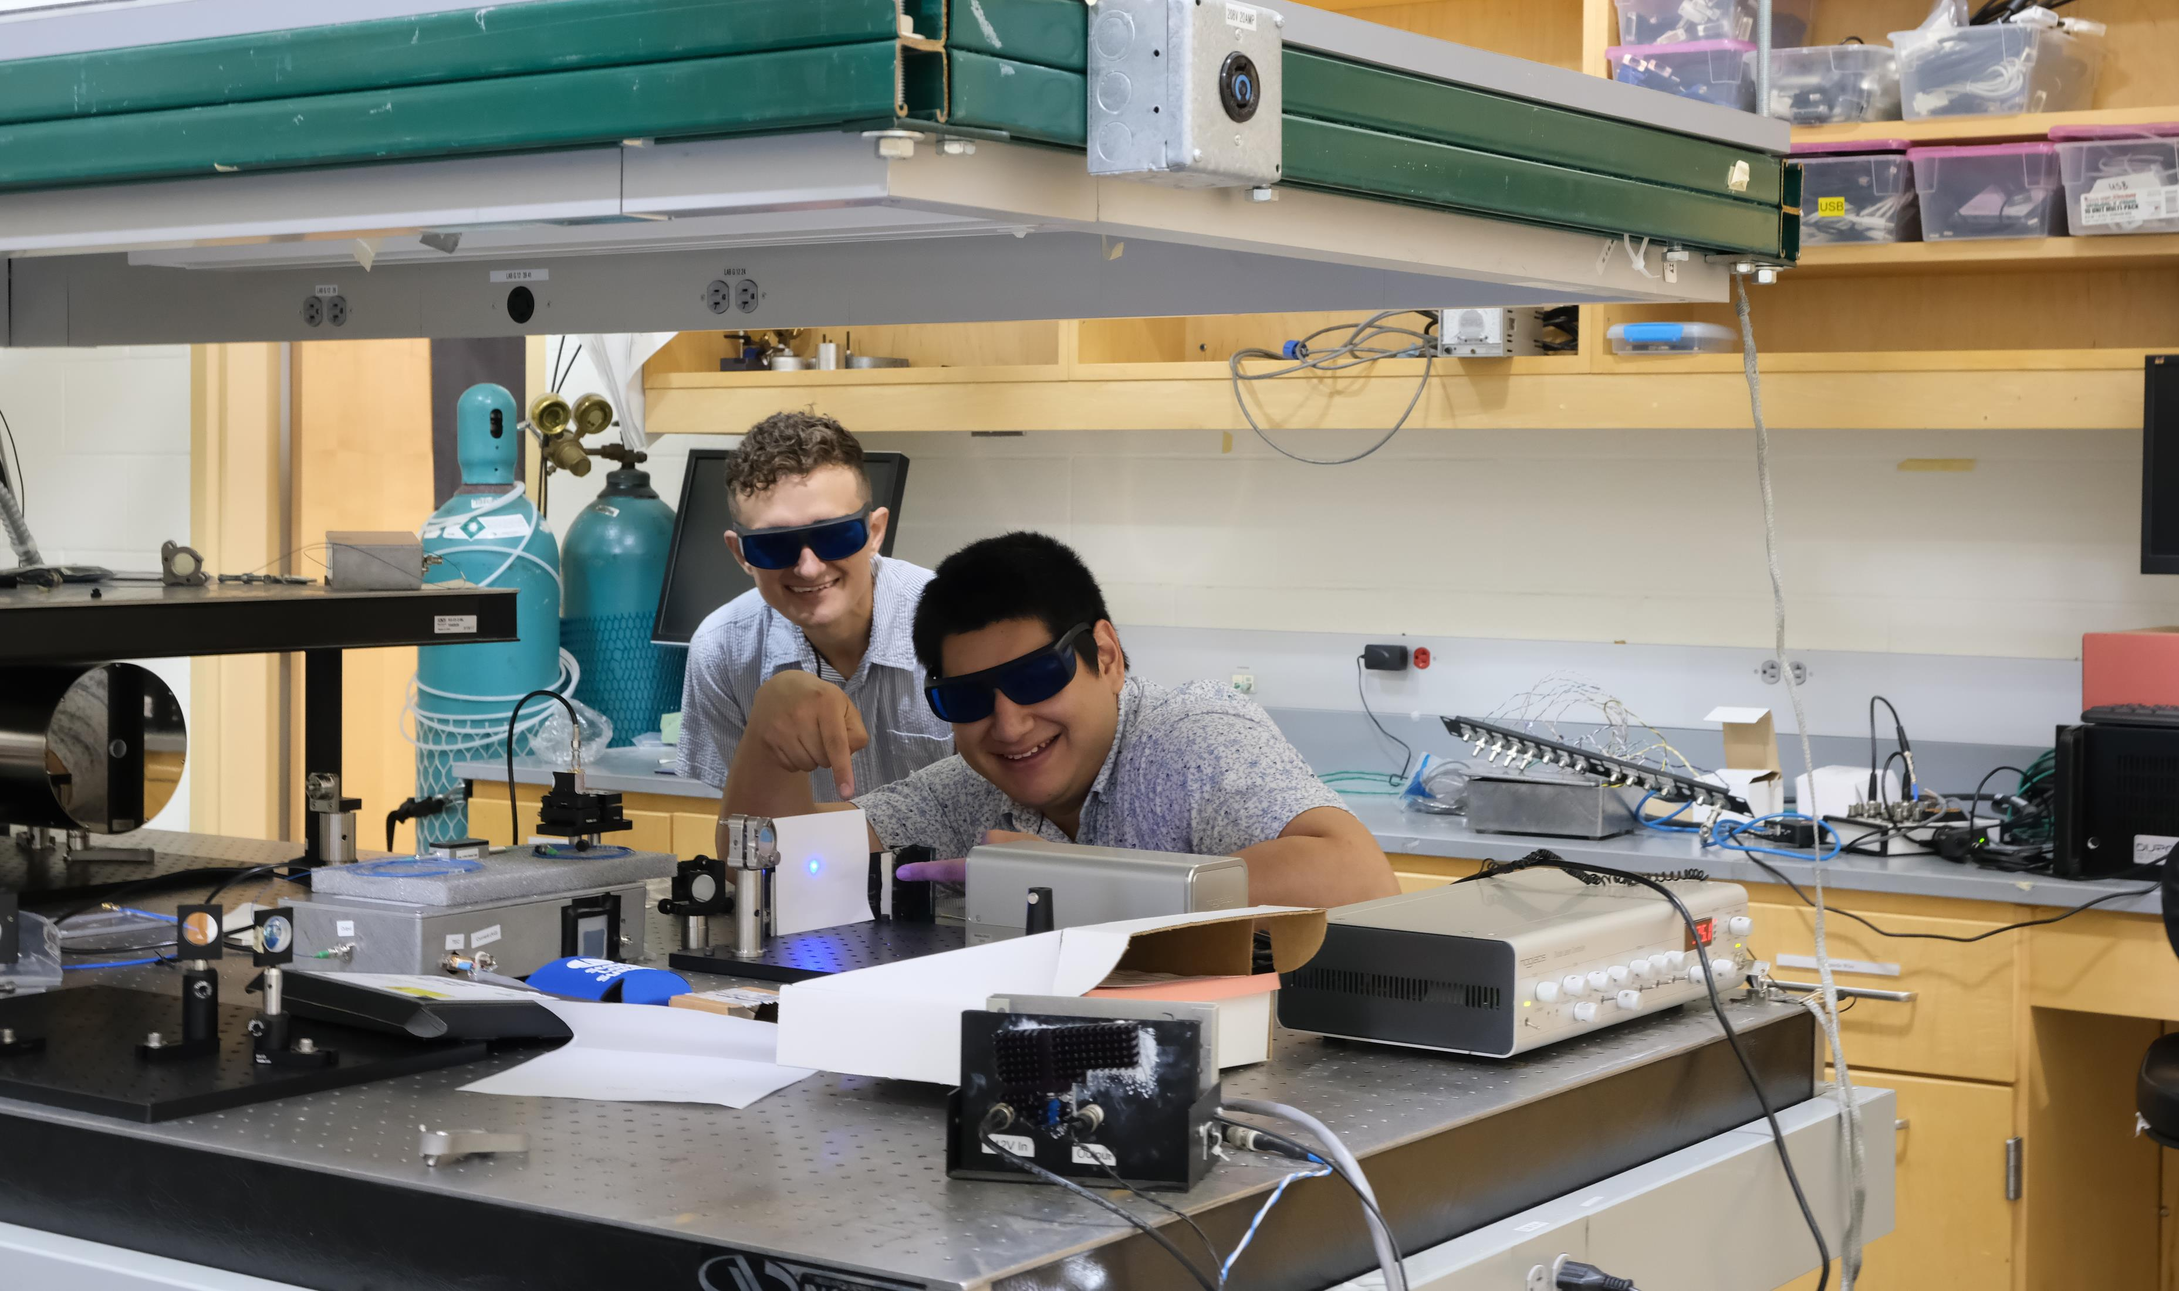
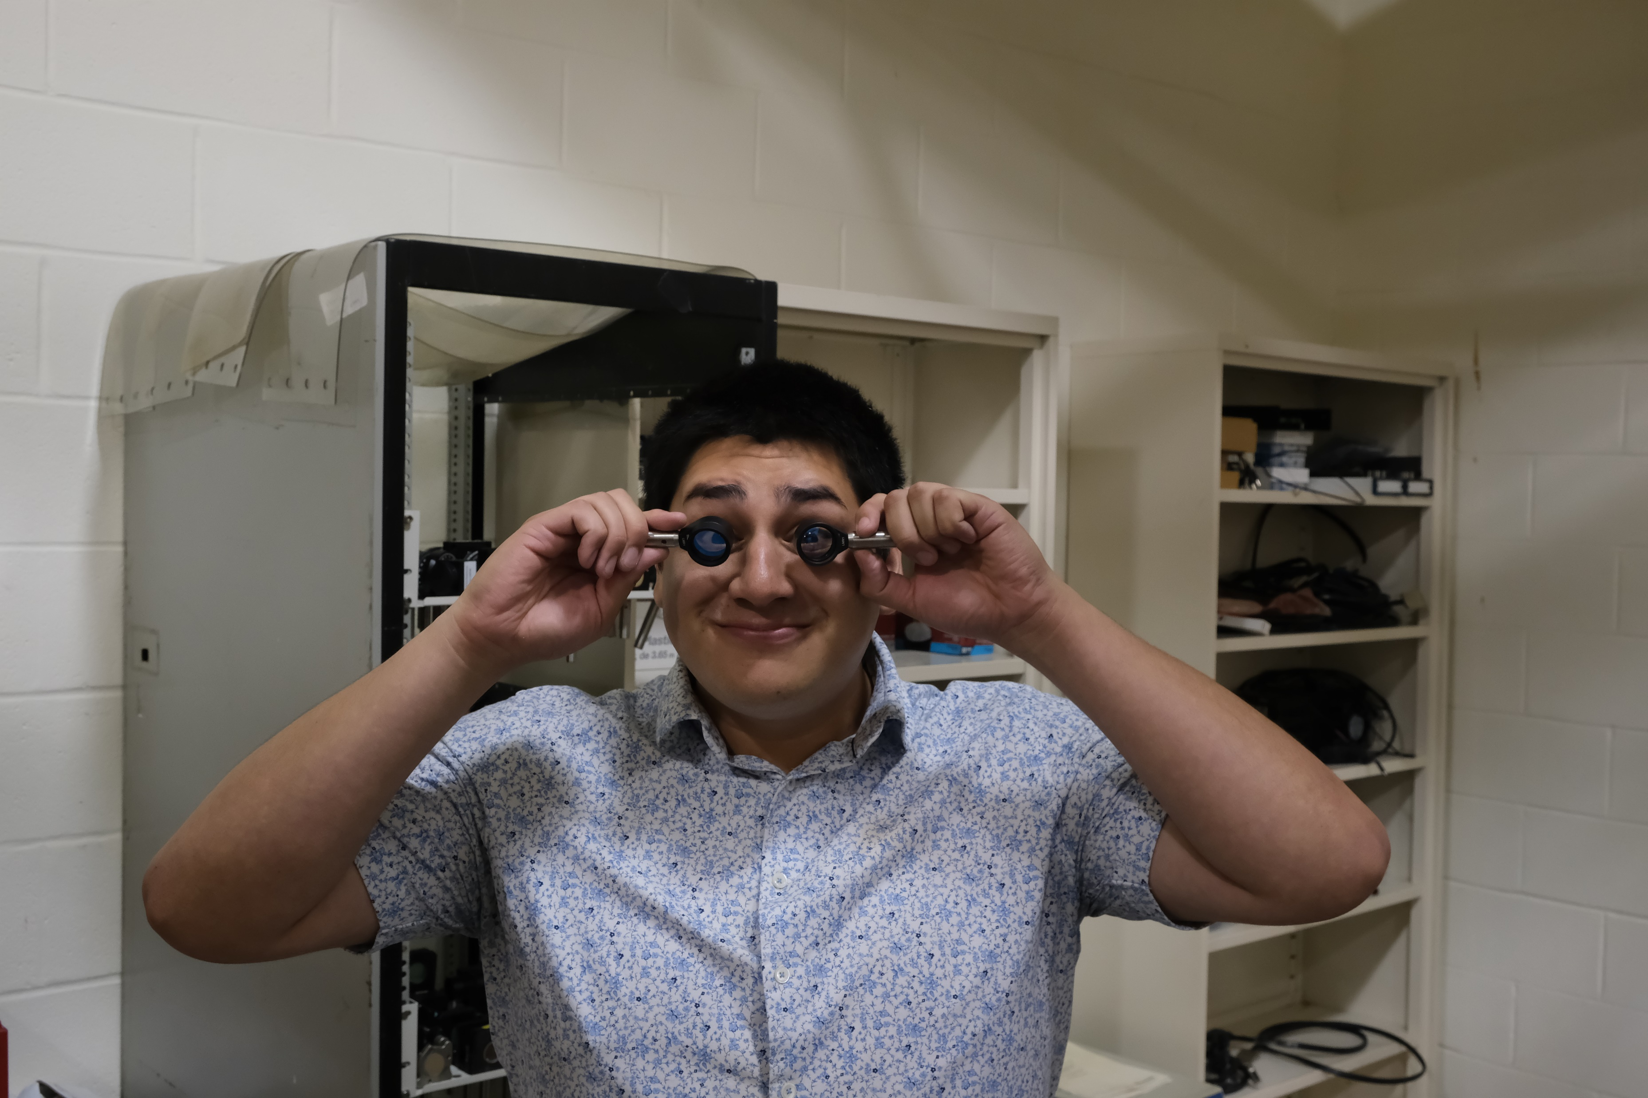
Fall Status

Slide 5
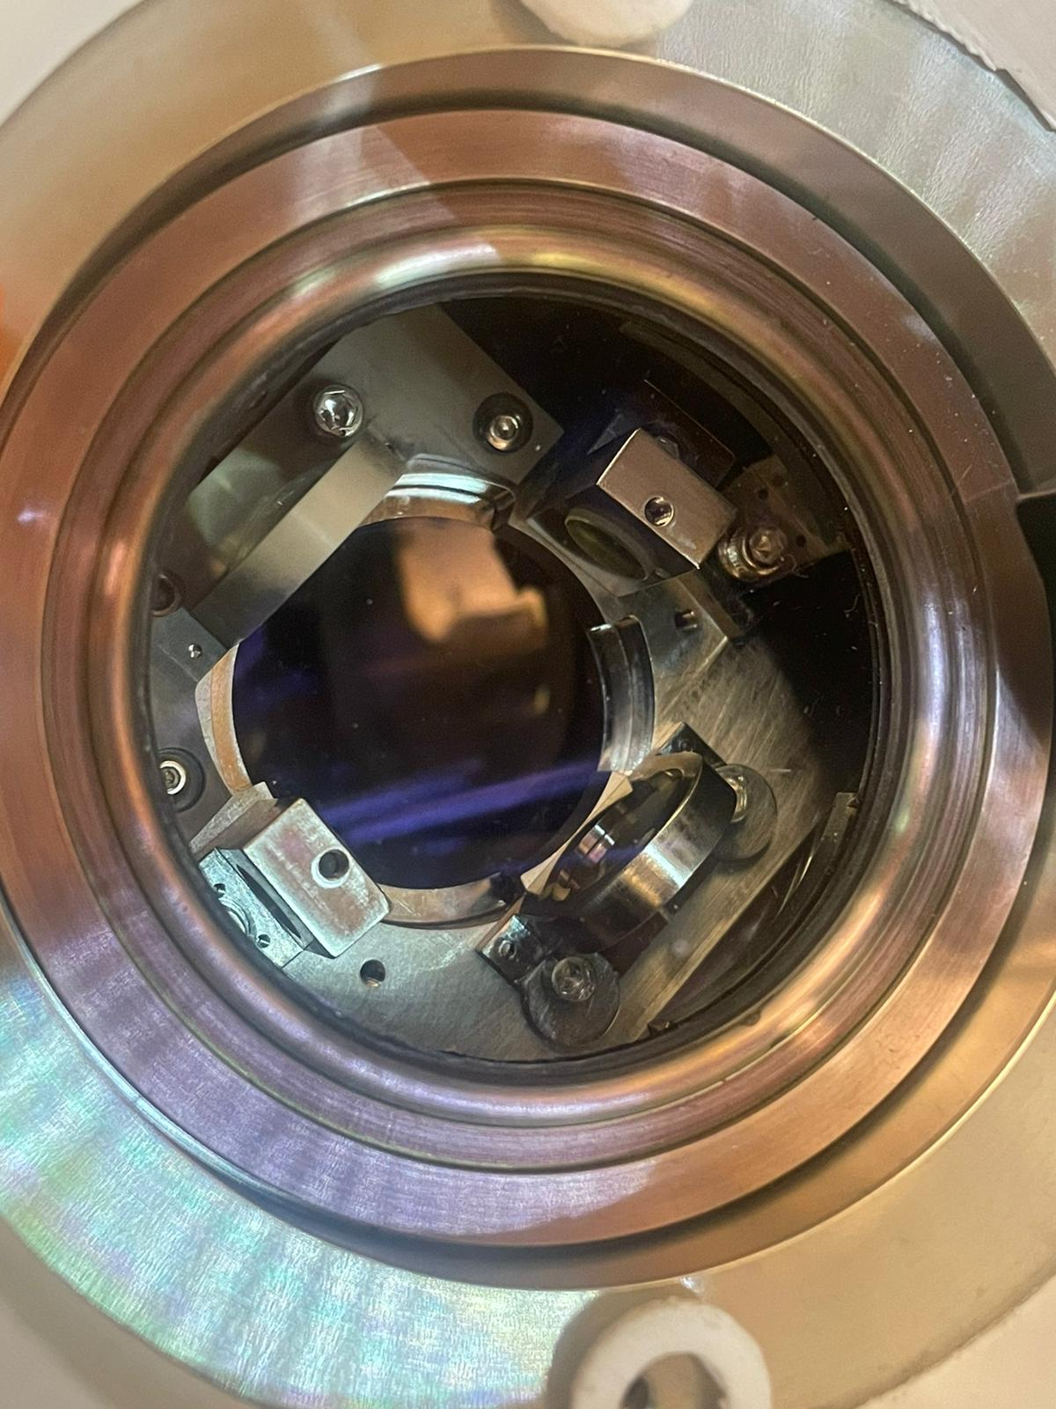
Rationale
Why: Understanding how our universe works
How: By sensing it with the highest precision
What: Quantum-Enhanced Sensors and Simulators

Slide 6
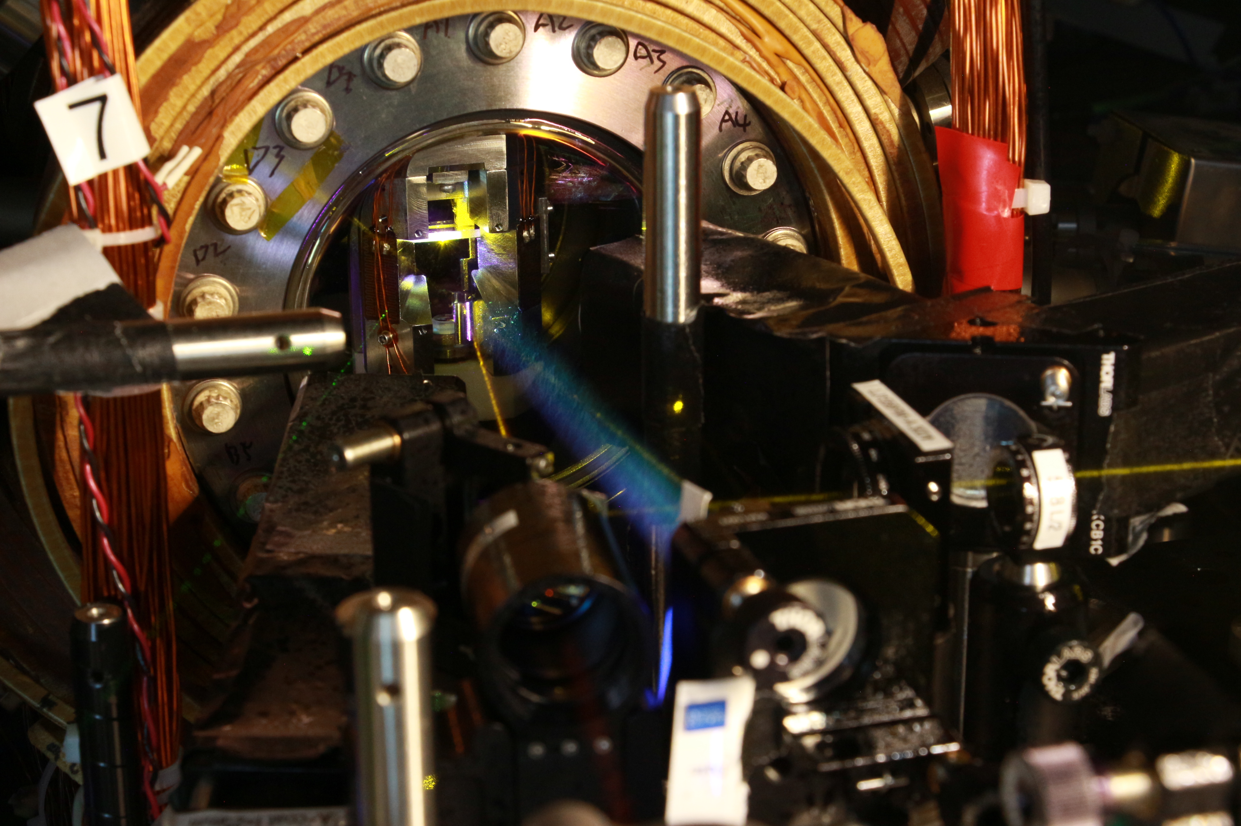
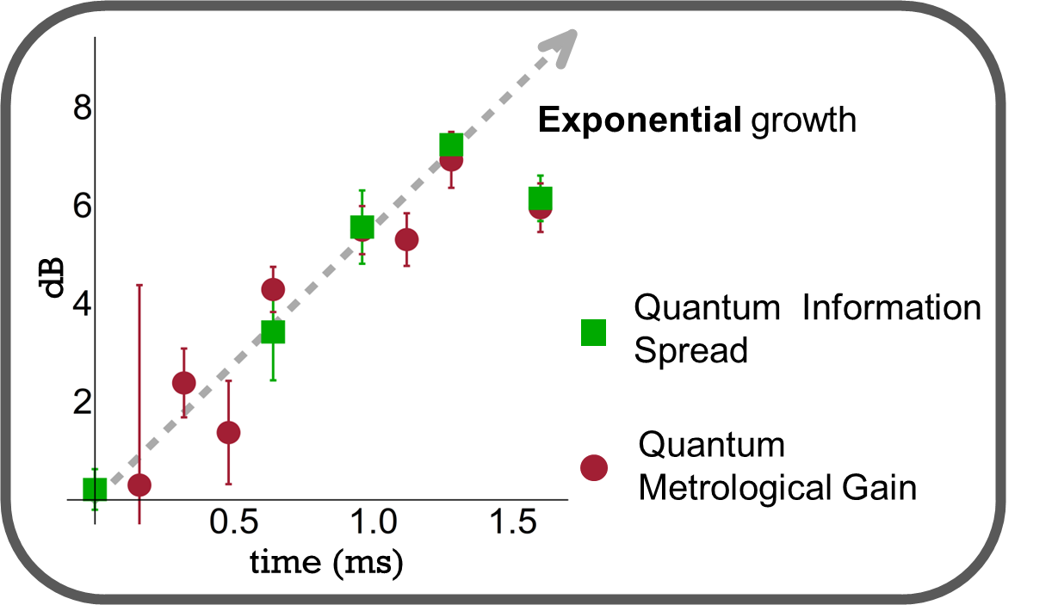
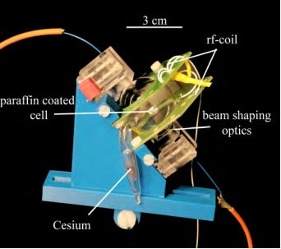
What Excites me about Quantum Stuff
Quantum Superposition and Entanglement
Gaining control of “quantum objects”
Use Quantum effects to our advantage
Fundamentals of Quantum Mechanics
Sensors Quantum Metrology
Quantum Simulators
Colombo, S. (2017)
A magnetic particle imaging scanner based on atomic magnetometry
Li, Z., Colombo, S., et al. Science 380 (6652), 1381-1384
Scientific Vision : harnessing quantum systems for applications spanning from quantum sensing to quantum simulation and information

Slide 7
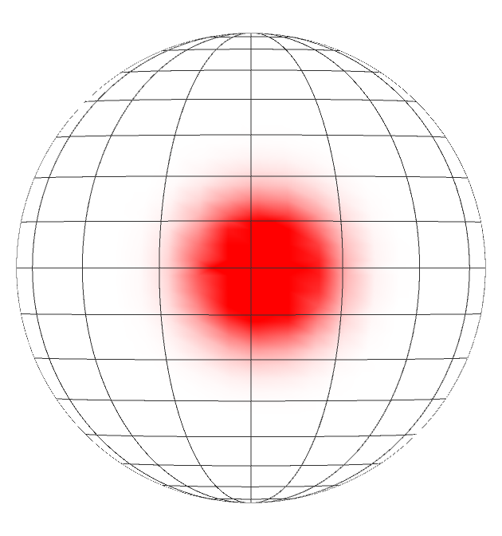
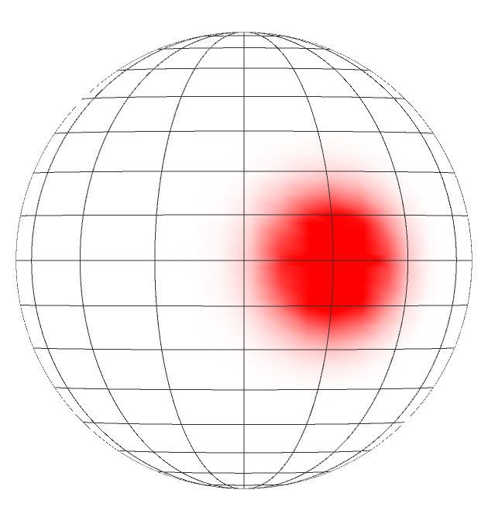
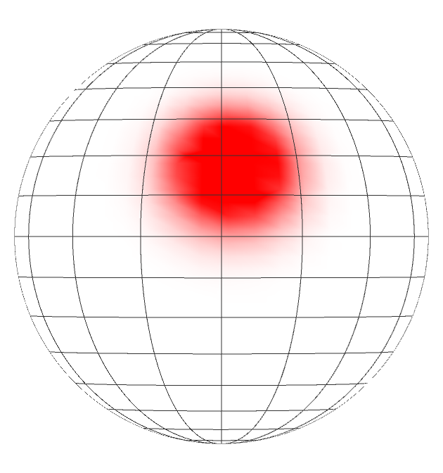
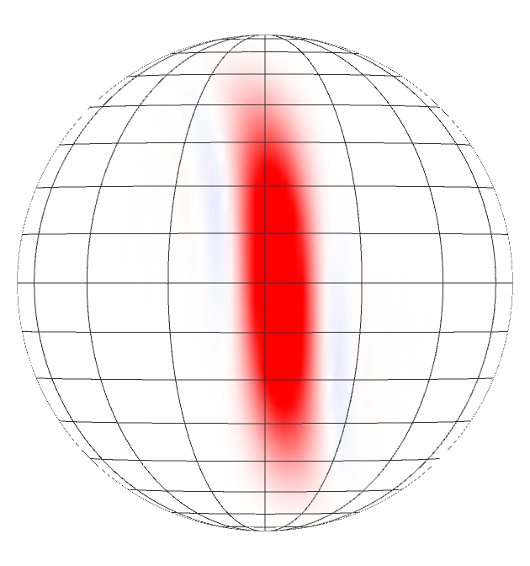
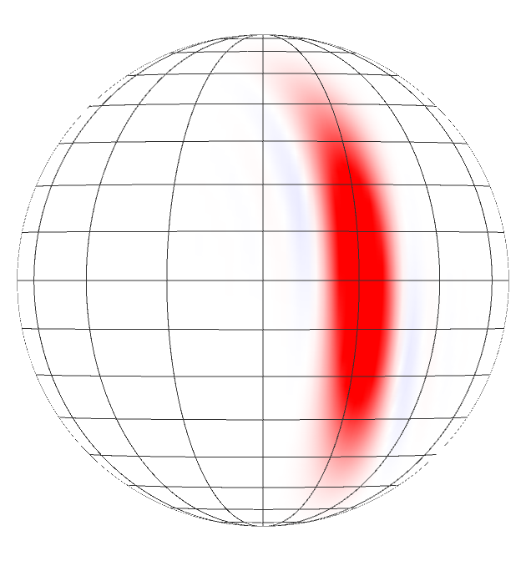
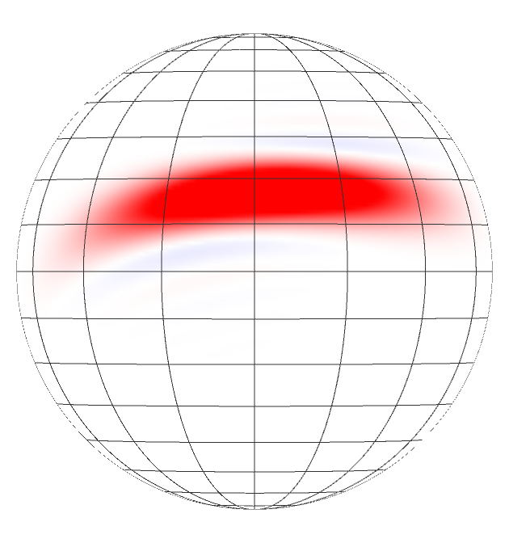
Quantum Metrology
$${Δφ}_{SQL}=\frac{1}{\sqrt{N}}$$
$$z$$
$$y$$
$$x$$
atomic state preparation
state evolves in the field
measure
final state
Sensing time $τ$
Evolve under a
nonlinear Hamiltonian$H$
$$Δφ<\frac{1}{\sqrt{N}}$$
$$z$$
$$y$$
$$x$$
state evolves in the field
measure
final state
Entangled atomic state preparation

Slide 8
Quantum Metrology
Atom-atom interaction
Atom-atom interaction
Sensing time $τ$
Evolve under a
nonlinear Hamiltonian$H$
$$Δφ<\frac{1}{\sqrt{N}}$$
$$z$$
$$y$$
$$x$$
state evolves in the field
measure
final state
Entangled atomic state preparation

Slide 9
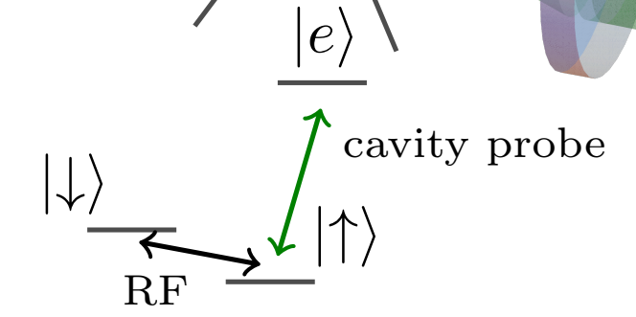
System: N atoms coupled to a cavity mode
Q: What non-linear Hamiltonians can be engineered in the $|↑⟩$, $|↓⟩$ manifold?
$$κ$$
¹⁷¹Yb, ¹⁷³Yb, ⁸⁷Sr,… ⁸⁵Rb, ⁸⁷Rb, ¹³³Cs,…
…
$$Γ$$
Drive
Drive
nonlinear Hamiltonian$H$
Quantum Metrology
Quantum Simulation

Slide 10
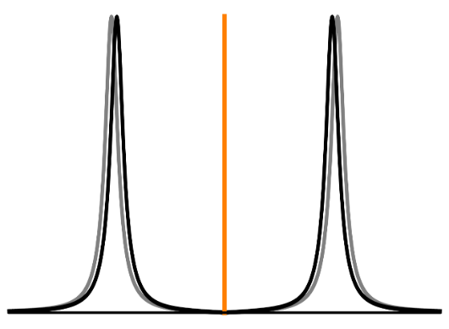
System: N atoms coupled to a cavity mode
Q: What non-linear Hamiltonians can be engineered in the $|↑⟩$, $|↓⟩$ manifold?
We work in the weak drive regime -> At most 1 excitation in the cavity at any time
$${\hat{H}}_{TCM}$$
$$κ$$
$$Γ$$
Drive
$${\hat{n}}_{c}({\hat{S}}_{z})$$
Drive
$$⟨{\hat{n}}_{c}⟩$$
Drive
$${\hat{S}}_{k}=\frac{1}{2}\sum_{j}{σ_{j}^{k}}$$
$${\hat{S}}_{z}={\hat{N}}_{↑}−\hat{S}$$
$$ω_{l}$$

Slide 11
System: N atoms coupled to a cavity mode
Q: What non-linear Hamiltonians can be engineered in the $|↑⟩$, $|↓⟩$ manifold?
$$κ$$
The effective Hamiltonian in the $|↑⟩$, $|↓⟩$ manifold:
$$\hat{H}=χ_{1}\left(δl\right){ \hat{n}}_{c}\left({\hat{S}}_{z}\right)⋅{\hat{S}}_{z}+Ω{\hat{S}}_{x}$$
where$χ_{1}\left(δl\right)=\frac{1}{2}η κ ℒ_{d}\left(δl\right).$
$$Γ$$
Drive
We expand the Hamiltonian as
$$\hat{H}=n_{c}\left[χ_{1}\left(δl\right){\hat{S}}_{z}+χ_{2}\left(δl\right){\hat{S}}_{z}^{2}+χ_{3}\left(δl\right){\hat{S}}_{z}^{3}+χ_{4}\left(δl\right){\hat{S}}_{z}^{4}+…\right]+Ω{\hat{S}}_{x}$$

Slide 12
System: N atoms coupled to a cavity mode
Q: What non-linear Hamiltonians can be engineered in the $|↑⟩$, $|↓⟩$ manifold?
$$\hat{H}=n_{c}\left[χ_{1}\left(δl\right){\hat{S}}_{z}+χ_{2}\left(δl\right){\hat{S}}_{z}^{2}+χ_{3}\left(δl\right){\hat{S}}_{z}^{3}+χ_{4}\left(δl\right){\hat{S}}_{z}^{4}+…\right]+Ω{\hat{S}}_{x}$$
$$𝒯_{0}\left({\hat{S}}_{z}\right)={\left({\left[1+\left(\frac{N}{2}+{\hat{S}}_{z}\right)ηℒ_{a}\left(x_{a}\right)\right]}^{2}+{\left[x_{c}+\left(\frac{N}{2}+{\hat{S}}_{z}\right)ηℒ_{d}\left(x_{a}\right)\right]}^{2}\right)}^{−1}$$
$χ_{2}\left(δl\right)=−χ_{1}\left(δl\right)×n_{c}×𝒯_{0}\left(0\right)×2 ηℒ_{a}\left(x_{a}\right)\left(1−x_{a}x_{c}+\frac{ηN}{2}\right)$
$χ_{3}\left(δl\right)=χ_{1}\left(δl\right)×n_{c}×𝒯_{0}(0)×η^{2}ℒ_{a}\left(x_{a}\right)\left[{4 𝒯_{0}\left(0\right)ℒ_{a}\left(x_{a}\right)\left(1−x_{a}x_{c}+\frac{ηN}{2}\right)}^{2}−1\right]$
$χ_{4}\left(δl\right)=χ_{1}\left(δl\right)×n_{c}×𝒯_{0}{\left(0\right)}^{2}×4 η^{3}ℒ_{a}^{2}\left(x_{a}\right)\left(1−x_{a}x_{c}+\frac{ηN}{2}\right)\left[1−𝒯_{0}\left(0\right)×2ηℒ_{a}\left(x_{a}\right){\left(1−x_{a}x_{c}+\frac{ηN}{2}\right)}^{2}\right]$

Slide 13
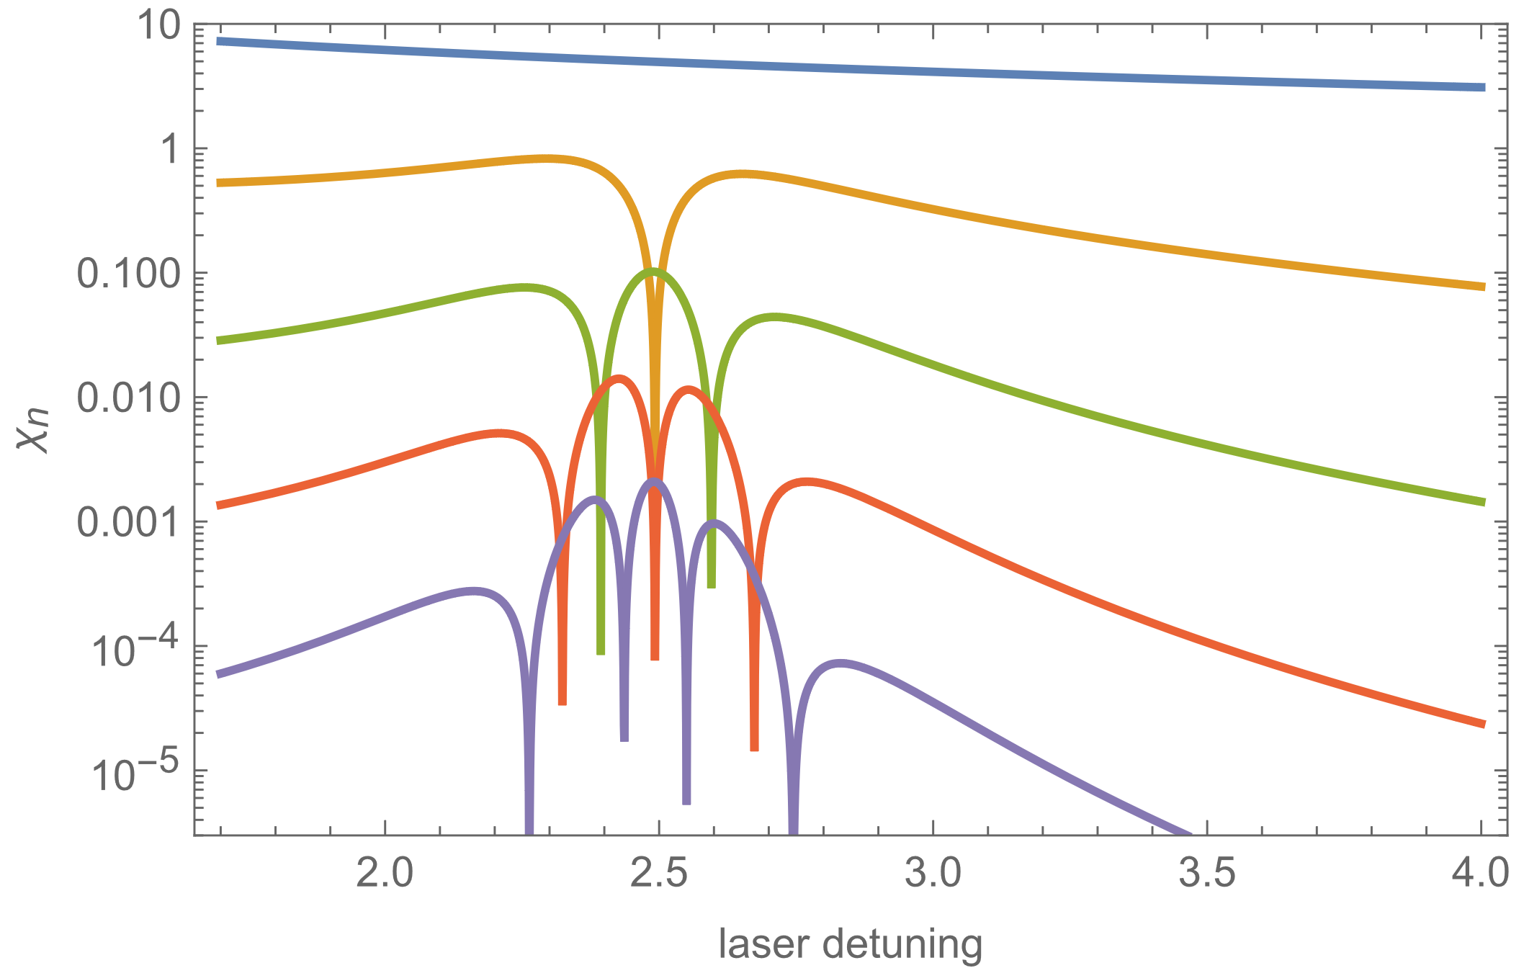
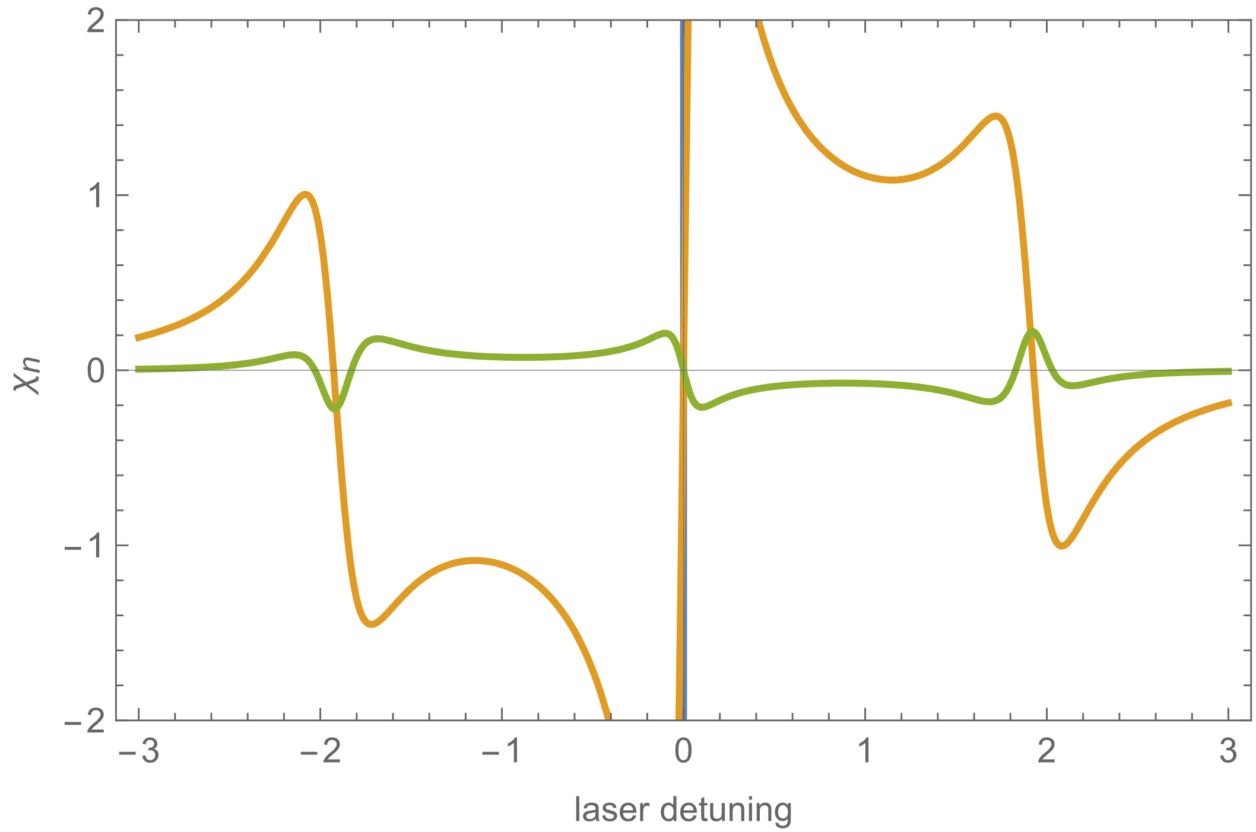
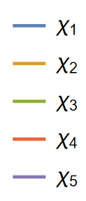
System: N atoms coupled to a cavity mode
Q: What non-linear Hamiltonians can be engineered in the $|↑⟩$, $|↓⟩$ manifold?
$$\hat{H}=n_{c}\left[χ_{1}\left(δl\right){\hat{S}}_{z}+χ_{2}\left(δl\right){\hat{S}}_{z}^{2}+χ_{3}\left(δl\right){\hat{S}}_{z}^{3}+χ_{4}\left(δl\right){\hat{S}}_{z}^{4}+…\right]+Ω{\hat{S}}_{x}$$
$n_{c}$ and $Ω$ allow us to control, independently, the strengths of the light part and of the rf-part.
The laser detuning $δl$ controls the ratio between various terms in the expansion and their sign.
The phase of the rf-field controls the sign of $Ω$.
$η=4\frac{g^{2}}{κΓ}=5$, N=100, $κ$=500kHz, $Γ=200$kHz

Slide 14
System: N atoms coupled to a cavity mode
Q: What non-linear Hamiltonians can be engineered in the $|↑⟩$, $|↓⟩$ manifold?
$$\hat{H}=n_{c}\left[χ_{1}\left(δl\right){\hat{S}}_{z}+χ_{2}\left(δl\right){\hat{S}}_{z}^{2}+χ_{3}\left(δl\right){\hat{S}}_{z}^{3}+χ_{4}\left(δl\right){\hat{S}}_{z}^{4}+…\right]+Ω{\hat{S}}_{x}$$
$η=4\frac{g^{2}}{κΓ}=5$, N=100, $κ$=500kHz, $Γ=200$kHz

Slide 15
System: N atoms coupled to a cavity mode
Q: What non-linear Hamiltonians can be engineered in the $|↑⟩$, $|↓⟩$ manifold?
Adding multiple (k) drives to the cavity field. The effective Hamiltonian is then
$${\hat{H}=n}_{c1}\left[F\left(δl_{1}\right){\hat{S}}_{z}+χ\left(δl_{1}\right){\hat{S}}_{z}^{2}+…\right]+n_{c2}\left[F\left(δl_{2}\right){\hat{S}}_{z}+χ\left(δl_{2}\right){\hat{S}}_{z}^{2}+…\right]+…+n_{ck}\left[F\left(δl_{k}\right){\hat{S}}_{z}+χ\left(δl_{k}\right){\hat{S}}_{z}^{2}+…\right]+Ω{\hat{S}}_{x}$$
With k tones in the driving laser, one can tune up to k(+1) terms independently!
$η=4\frac{g^{2}}{κΓ}=5$, N=100, $κ$=500kHz, $Γ=200$kHz

Slide 16
System: N atoms coupled to a cavity mode
Q: What non-linear Hamiltonians can be engineered in the $|↑⟩$, $|↓⟩$ manifold?
$$\hat{H}=n_{c}\left[χ_{1}\left(δl\right){\hat{S}}_{z}+χ_{2}\left(δl\right){\hat{S}}_{z}^{2}+χ_{3}\left(δl\right){\hat{S}}_{z}^{3}+χ_{4}\left(δl\right){\hat{S}}_{z}^{4}+…\right]+Ω{\hat{S}}_{x}$$
$n_{c}$ and $Ω$ allow us to control, independently, the strengths of the light part and of the rf-part.
The laser detuning $δl$ controls the ratio between various terms in the expansion and their sign.
The phase of the rf-field controls the sign of $Ω$.
$$𝒯_{0}\left({\hat{S}}_{z}\right)={\left({\left[1+\left(\frac{N}{2}+{\hat{S}}_{z}\right)ηℒ_{a}\left(x_{a}\right)\right]}^{2}+{\left[x_{c}+\left(\frac{N}{2}+{\hat{S}}_{z}\right)ηℒ_{d}\left(x_{a}\right)\right]}^{2}\right)}^{−1}$$
$χ_{2}\left(δl\right)=−χ_{1}\left(δl\right)×n_{c}×𝒯_{0}\left(0\right)×2 ηℒ_{a}\left(x_{a}\right)\left(1−x_{a}x_{c}+\frac{ηN}{2}\right)$
$χ_{3}\left(δl\right)=χ_{1}\left(δl\right)×n_{c}×𝒯_{0}(0)×η^{2}ℒ_{a}\left(x_{a}\right)\left[{4 𝒯_{0}\left(0\right)ℒ_{a}\left(x_{a}\right)\left(1−x_{a}x_{c}+\frac{ηN}{2}\right)}^{2}−1\right]$
$χ_{4}\left(δl\right)=χ_{1}\left(δl\right)×n_{c}×𝒯_{0}{\left(0\right)}^{2}×4 η^{3}ℒ_{a}^{2}\left(x_{a}\right)\left(1−x_{a}x_{c}+\frac{ηN}{2}\right)\left[1−𝒯_{0}\left(0\right)×2ηℒ_{a}\left(x_{a}\right){\left(1−x_{a}x_{c}+\frac{ηN}{2}\right)}^{2}\right]$

Slide 17
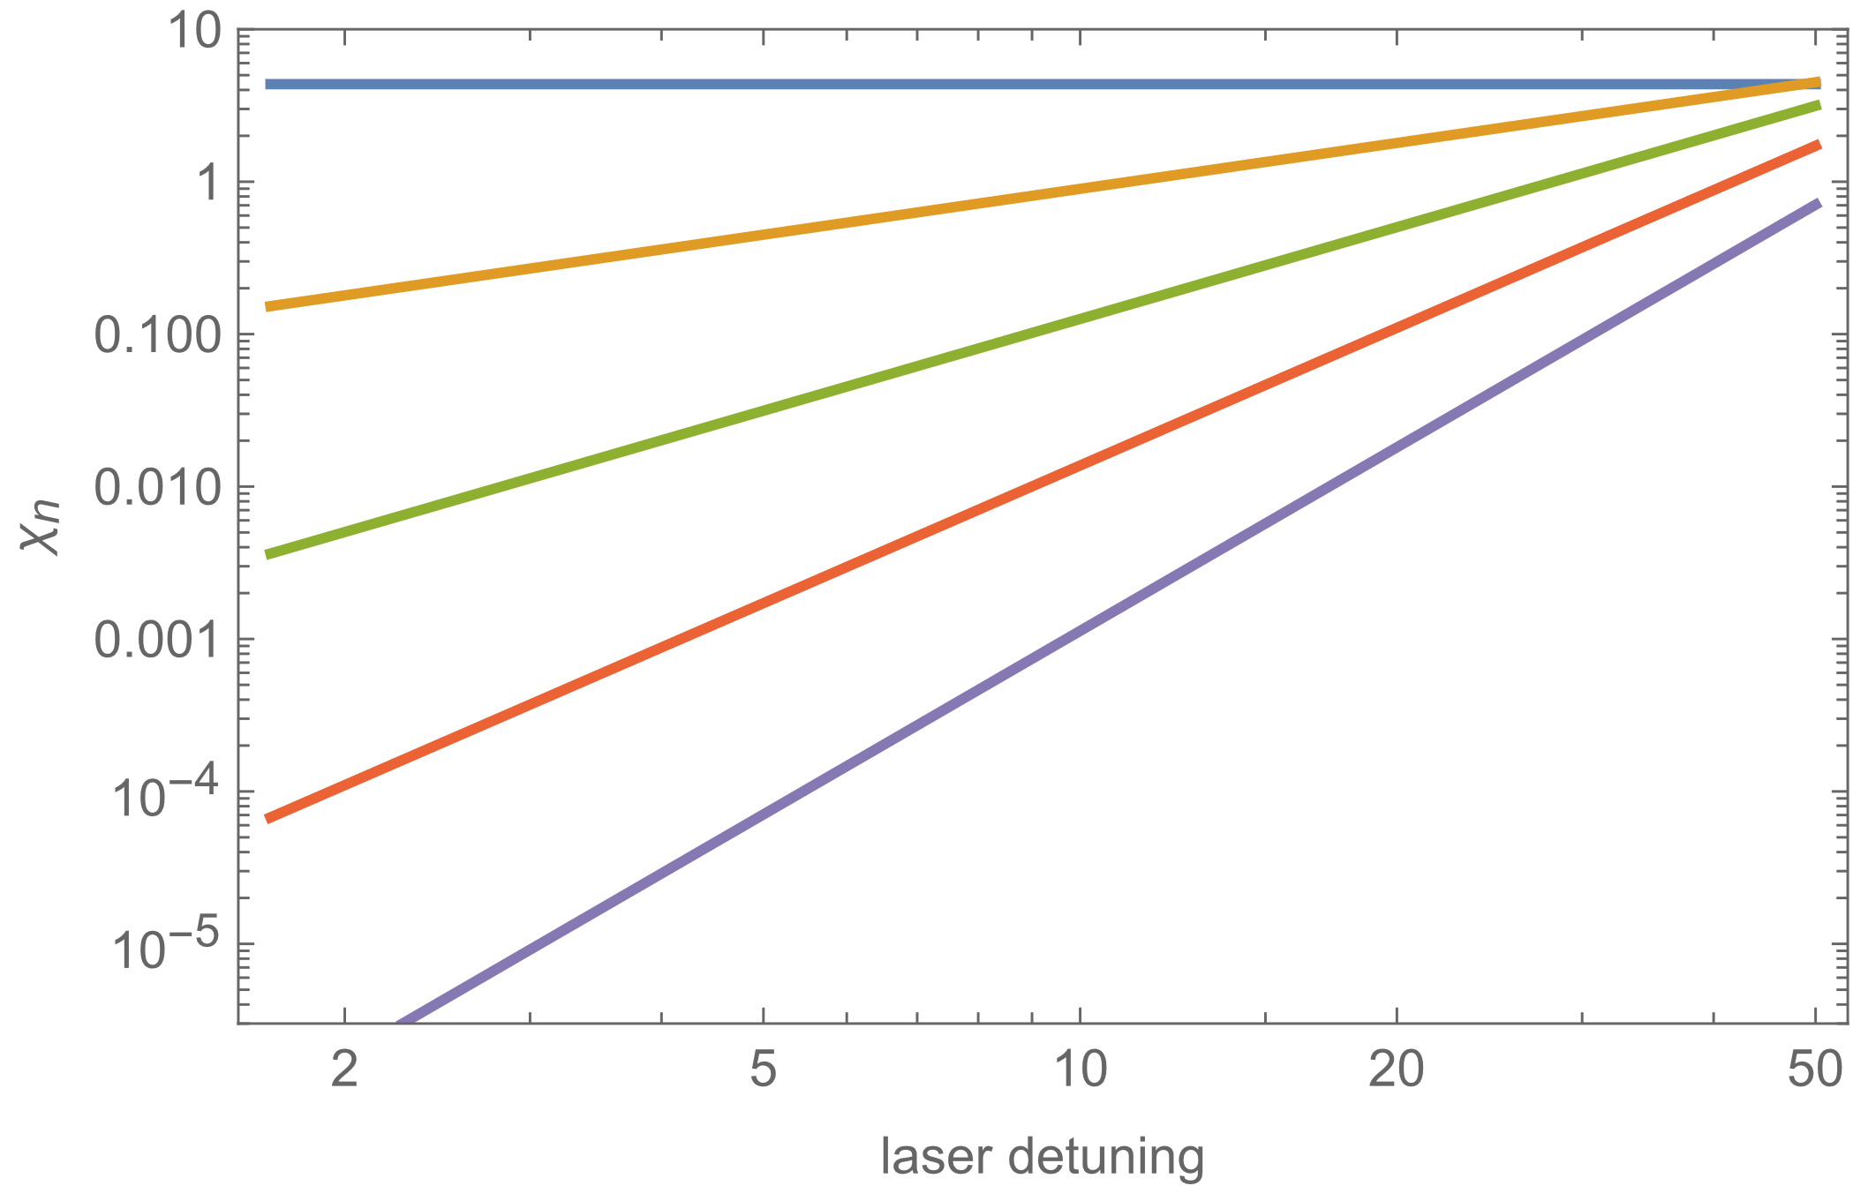
System: N atoms coupled to a cavity mode
Q: What non-linear Hamiltonians can be engineered in the $|↑⟩$, $|↓⟩$ manifold?
$$\hat{H}=n_{c}\left[χ_{1}\left(δl\right){\hat{S}}_{z}+χ_{2}\left(δl\right){\hat{S}}_{z}^{2}+χ_{3}\left(δl\right){\hat{S}}_{z}^{3}+χ_{4}\left(δl\right){\hat{S}}_{z}^{4}+…\right]+Ω{\hat{S}}_{x}$$
$n_{c}$ and $Ω$ allow us to control, independently, the strengths of the light part and of the rf-part.
The laser detuning $δl$ controls the ratio between various terms in the expansion and their sign.
The phase of the rf-field controls the sign of $Ω$.
Fixed collective cooperativity and laser detuning
$$η$$

Slide 18
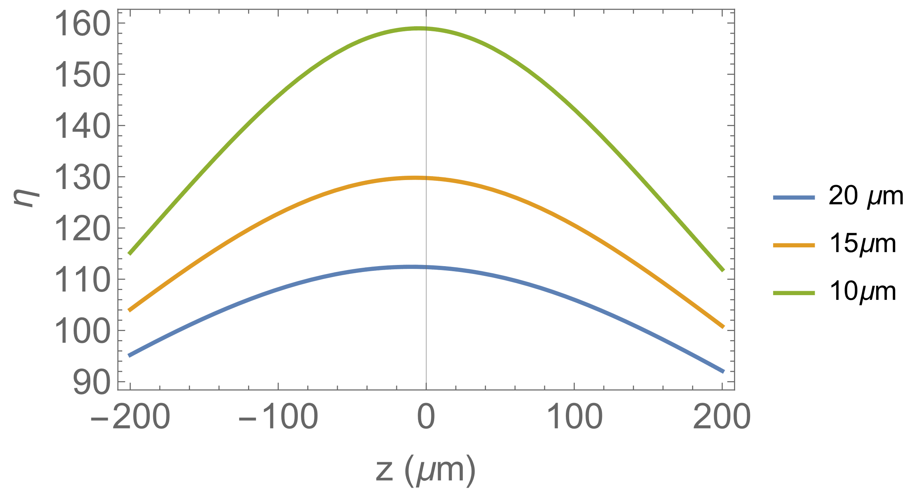
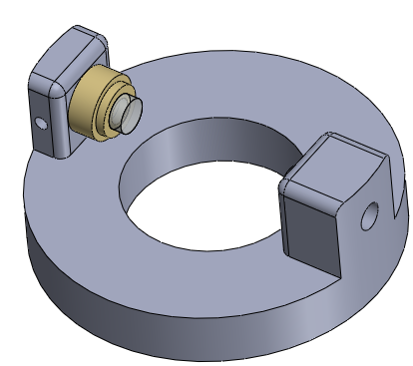
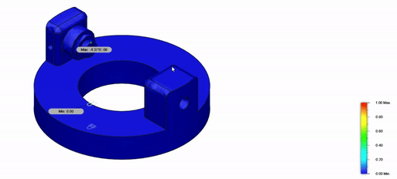
What can be achieved with current/future cavity design?
State-of-art cooperativities $η>10$
Near future: $η>100$
High Cooperativity
Ample Optical Access
Accommodates ~ 100 atoms
Notes:
Designing with atomic control in mind i.e. make atoms emit in the cavity mode, and hopefully an easy implementation
High optical access
High Finesse
Sturdy

Slide 19
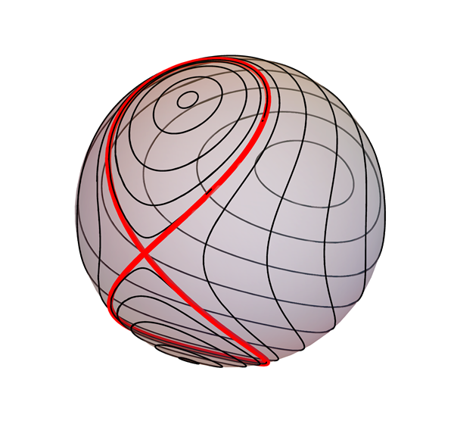
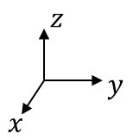
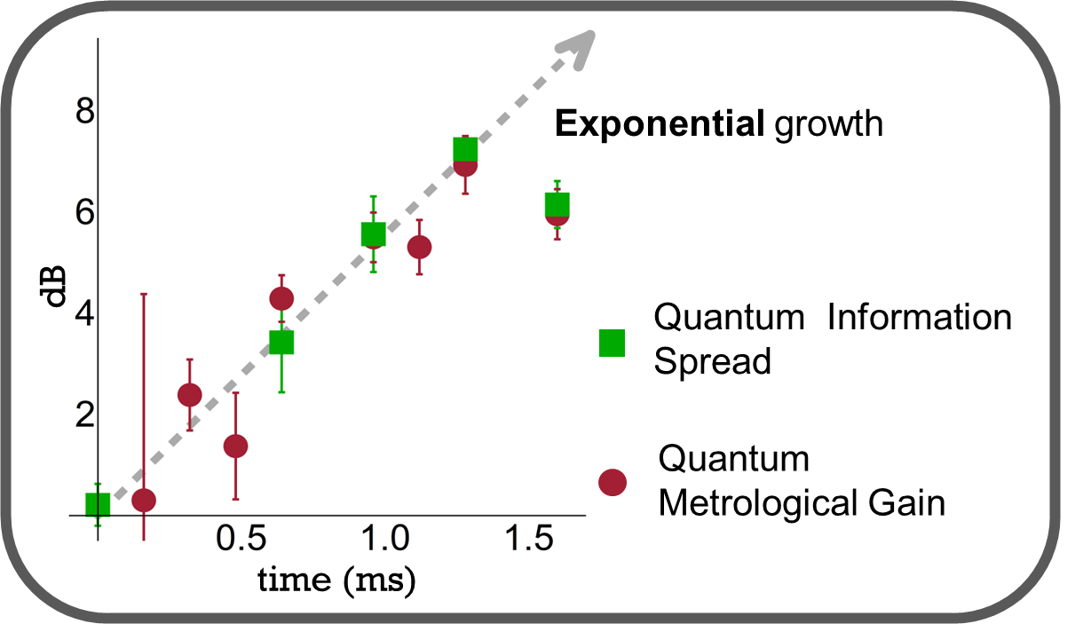
Application 1: The Lipkin-Meshkov-Glick Hamiltonian
With a bicolored drive, we can generate the LMG Hamiltonian
$${\hat{H}}_{LMG}=χ_{1}{\hat{S}}_{z}−χ_{2}{\hat{S}}_{z}^{2}+Ω{\hat{S}}_{x}$$
$$κ$$
$$Γ$$
Li, Z., Colombo, ... & Vuletić, V. (2023). Improving metrology with quantum scrambling. Science, 380(6652), 1381-1384.
Drive

Slide 20
Application 2: Asymmetric Double Well
With a three-colored drive, one can generate the following Hamiltonian
$${\hat{H}}_{DB}=χ_{1}{\hat{S}}_{z}−χ_{2}{\hat{S}}_{z}^{2}+χ_{4}{\hat{S}}_{z}^{4}+Ω{\hat{S}}_{x}$$
$$κ$$
In the Holstein-Primakoff approximation we have the following mapping
${\hat{S}}_{x}→\frac{N}{2}−b^{+}b$ ${\hat{S}}_{z}→\frac{\sqrt{N}}{2} \left(b^{+}+b\right)\sim \hat{x}$ ${\hat{S}}_{y}→\frac{\sqrt{N}}{2 i} \left(b^{+}−b\right)\sim −\hat{p}$
with $\left[b,b^{+}\right]=1$
$$Γ$$
${\hat{H}}_{DB}$ $≈{A_{1} \hat{S}}_{z}+A_{2}{\hat{S}}_{z}^{2}−B_{2}{\hat{S}}_{y}^{2}+A_{4}{\hat{S}}_{z}^{4}\sim$ $${{ B}_{2}{\hat{p}}^{2}+A}_{1}\hat{x}+A_{2}{\hat{x}}^{2}+A_{4}{\hat{x}}^{4}$$
The asymmetric double-well Hamiltonian (can model tunneling of protons in DNA, for example)
Drive

Slide 21
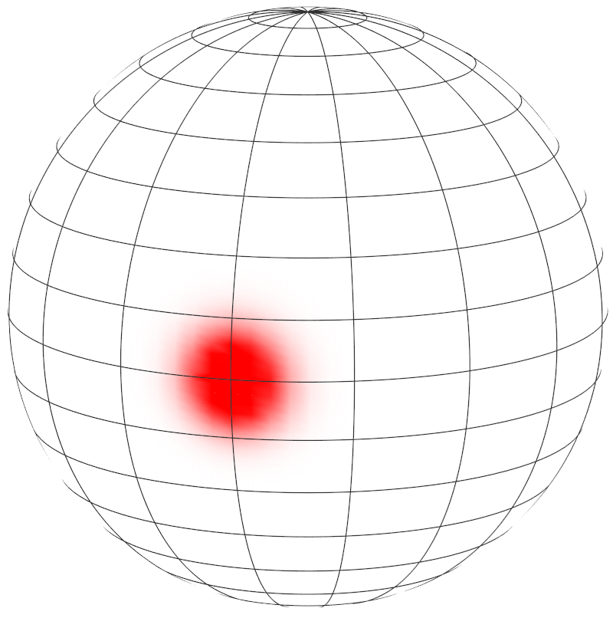
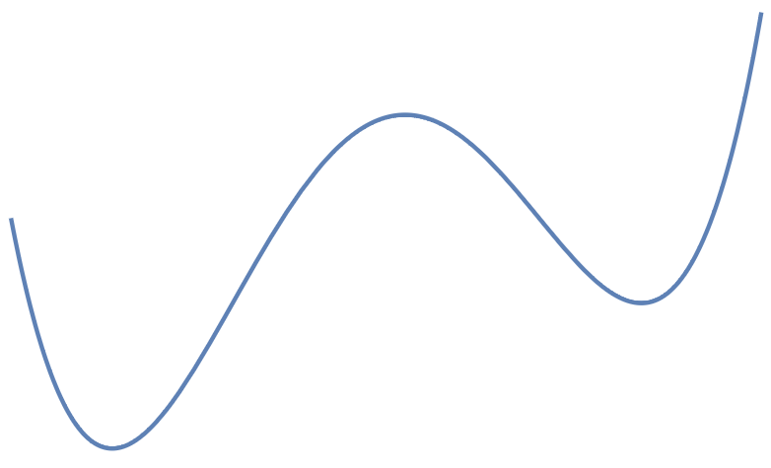
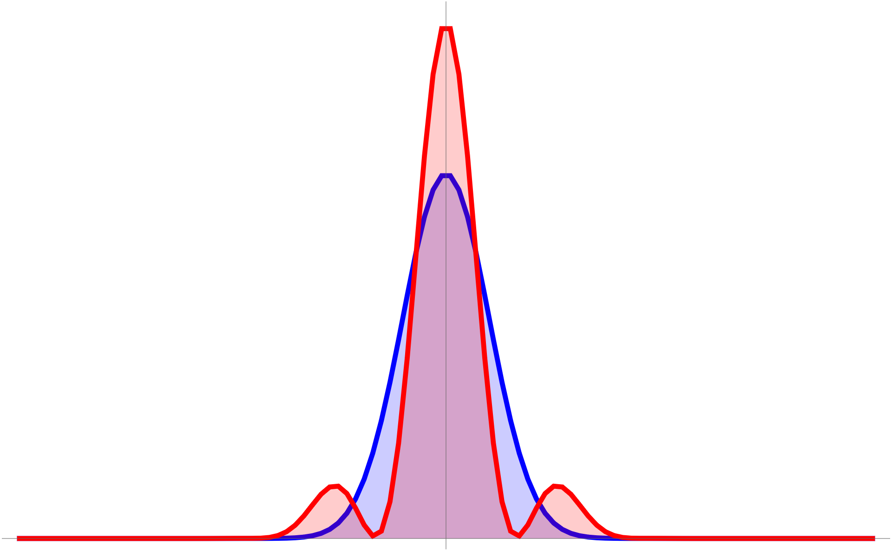
Application 2: Asymmetric Double Well
${\hat{H}}_{DB}$ $≈{A_{1} \hat{S}}_{z}+A_{2}{\hat{S}}_{z}^{2}−B_{2}{\hat{S}}_{y}^{2}+A_{4}{\hat{S}}_{z}^{4}\sim {{ B}_{2}{\hat{p}}^{2}+A}_{1}\hat{x}+A_{2}{\hat{x}}^{2}+A_{4}{\hat{x}}^{4}$
${\hat{S}}_{z}→\frac{\sqrt{N}}{2} \left(b^{+}+b\right)\sim \hat{x}$ ${\hat{S}}_{y}→\frac{\sqrt{N}}{2 i} \left(b^{+}−b\right)\sim −\hat{p}$
$$κ$$
$\hat{x}$
$\hat{x}$
$$Γ$$
$\hat{p}$
Drive

Slide 22
General Polynomial Hamiltonian (Kerr- Hamiltonians)
With a k-colored drive, one can generate the following Hamiltonian
$$κ$$
$${\hat{H}}_{eff}={A_{1} \hat{S}}_{z}+A_{2}{\hat{S}}_{z}^{2}+A_{3}{\hat{S}}_{z}^{3}…+Ω_{x}{\hat{S}}_{x}$$
$$Γ$$
${\hat{S}}_{x}→\frac{N}{2}−b^{+}b$ ${\hat{S}}_{z}→\frac{\sqrt{N}}{2} \left(b^{+}+b\right)\sim \hat{x}$ ${\hat{S}}_{y}→\frac{\sqrt{N}}{2 i} \left(b^{+}−b\right)\sim −\hat{p}$
with $\left[b,b^{+}\right]=1$
Drive

Slide 23
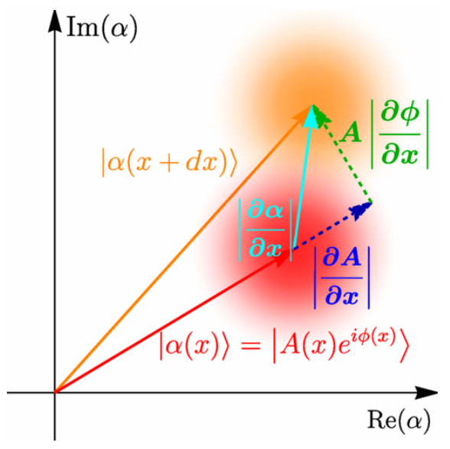
Limitation: Dissipation
Dissipation: we have 2 mechanisms
Collective decoherence $γ_{coll}$ resulting from entanglement between cavity-field and the collective atomic state
Single atom decoherence $γ_{s}$ is the result of a non-coherent scattering of a photon.
$$γ_{coll}$$
$$γ_{coll}$$
$$γ_{s}$$

Slide 24
Limitation… or extra degree of freedom?
Dissipation: we have 2 mechanisms
Both ratios $\frac{χ_{k}}{γ_{coll}}$ and $\frac{χ_{k}}{γ_{s}}$ grow with single atom cooperativity $η$ (coupling strength between atom and cavity field).
$\frac{χ_{k}}{γ_{s}}\sim η^{k−1}$
When the ${\hat{S}}_{z}$ is a (near) conserved quantity: $\frac{γ_{coll}}{γ_{s}}\sim \sqrt{η}$and $\frac{χ_{k}}{γ_{coll}}\sim η^{(k−1)/2}$

Slide 25
Conclusion
$$κ$$
Method to engineer and simulate universal collective polynomial Hamiltonians of the form:
$$Γ$$
$${\hat{H}}_{eff}={A_{1} \hat{S}}_{z}+A_{2}{\hat{S}}_{z}^{2}+A_{3}{\hat{S}}_{z}^{3}…+Ω_{x}{\hat{S}}_{x}$$
This allows the study of dynamics of those Hamiltonians
Outlook
Full dissipation analysis.
Protocols to find eigenstates of these Hamiltonian?
Individual atom control?
….
Drive

