Slide 1
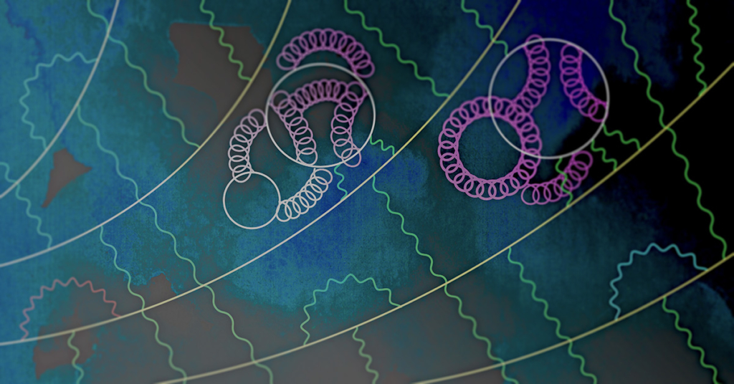
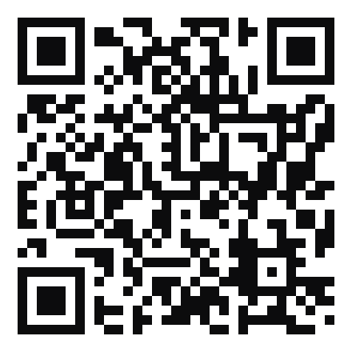



9th Plenary Workshop of the
Muon g-2 Theory Initiative
University of Connecticut
August 3-7, 2026
https://indico.phys.uconn.edu/event/3/
Background credit: Mark Rayner, CERN

